Slide 1

SMART INDIA HACKATHON 2026
TITLE PAGE
Problem Statement ID – SIH26055
Problem Statement Title- Smart Scan strategy for Electronic Warfare
Theme- Robotics and Drones
PS Category- Software
Team ID- SIH26-A0H-T359
Team Name – Half Squadron

Slide 2
IDEA TITLE
Half
Squadron
The Problem
Monitoring 0.5-18.0 GHz spectrum via 500 MHz IBW across 35 discrete channels against agile radars
Literature ignores LO settling blind time (15-50 us), dropping pulses during hops
Standard AI models suffer catastrophic forgetting under chaotic adversarial agility
Our Solution
Dual-engine scan strategy dynamically allocates 500 MHz receiver dwells across 35 sub-bands
Engine A (DQN with PER) predicts structured radar patterns to maximize intercept in 2-10 ms dwells
Engine B (Exp3 Bandit) bounds worst-case regret to catch chaotic pseudo-random frequency hops
Hysteresis dispatcher transitions between DQN and Exp3 without decision thrashing
Our Uniqueness
Hardware-aware loss directly penalizes LO slew latency (15 us + 2 us/GHz) in the control loop
Threat-weighted utility prioritizes low-duty lethal missile locks over dense civil radar signals
Edge-optimized design (<15k params) projected for sub-10 us inference on embedded FPGA SoCs
Convex starvation barrier forces unvisited channel revisits before threat deadlines expire

Slide 3
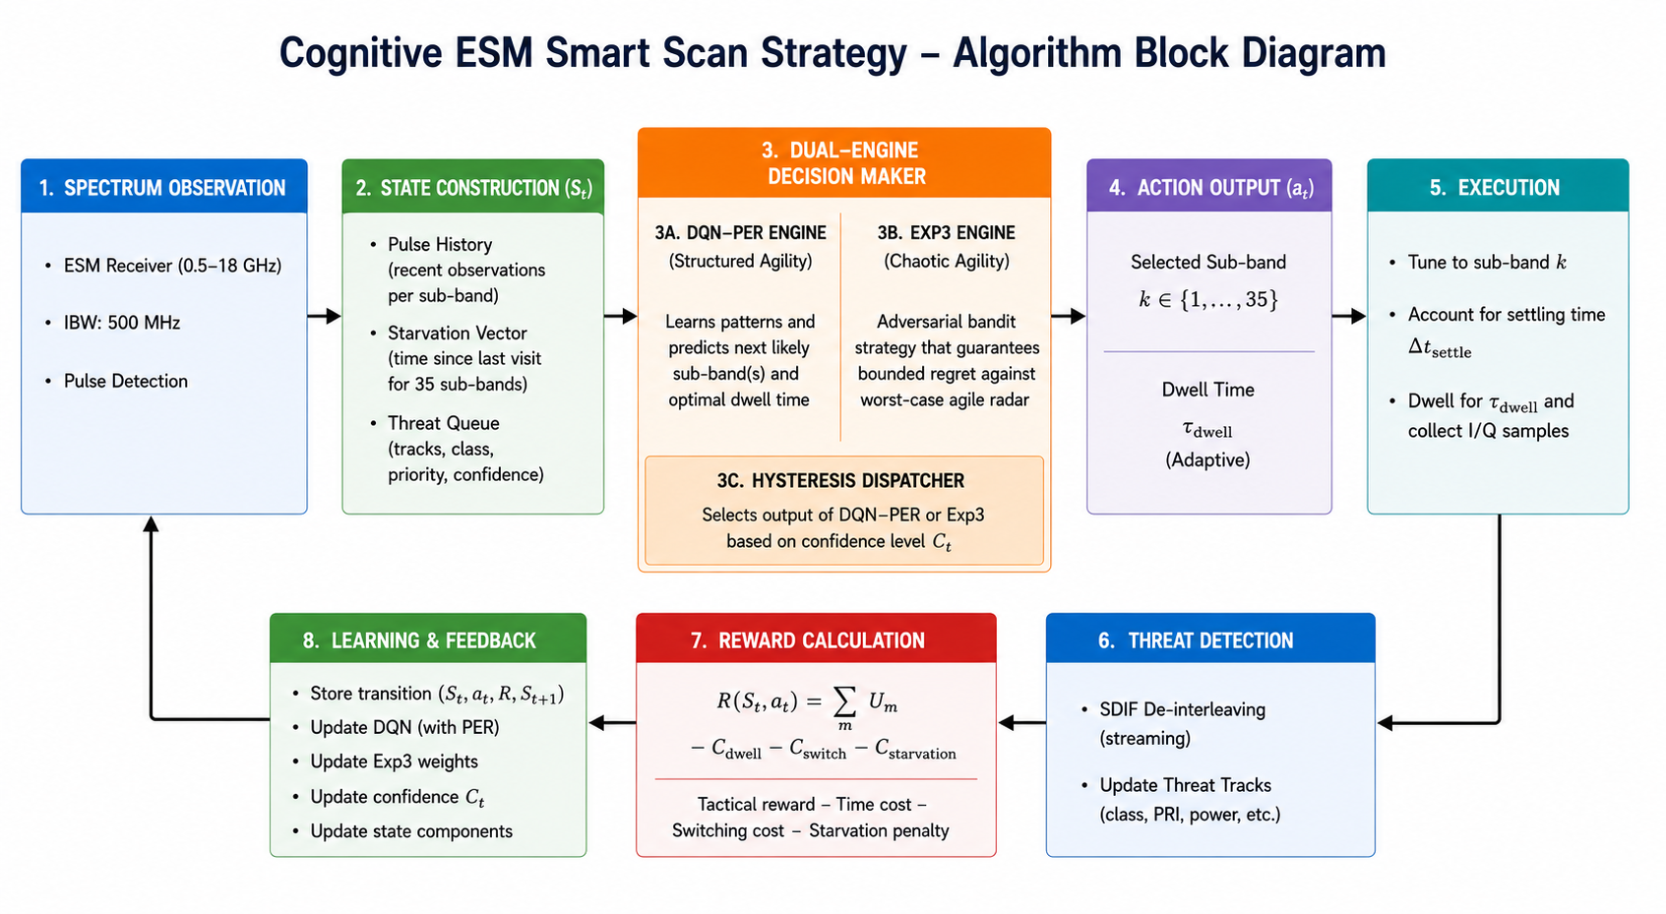
TECHNICAL APPROACH
Half
Squadron
Target Embedded Hardware: AMD/Xilinx Zynq UltraScale+ RFSoC / NVIDIA Jetson Orin Nano
Core Language: Python 3.12 (100% Native, Air-Gapped, Zero Cloud Dependencies)
Deep Reinforcement Learning: PyTorch (DQN with Prioritized Experience Replay & INT8 Quantization)
Adversarial Bandit Framework: NumPy & SciPy (Vectorized Exp3 Regret-Minimization Engine)
Environment & Simulation: Gymnasium (Discrete-Event RF Dwell & Blind-Time Simulation)
PDW Ingestion & Parsing: H5py & Pandas (TSRD 5D Radar Stream I/O)
De-Interleaving Algorithm: Streaming Sequential Difference Histogramming (SDIF Lineage)
Synthesizer Latency Models: Analog Devices ADF4371 & Texas Instruments LMX2594 PLL Specifications

Slide 4
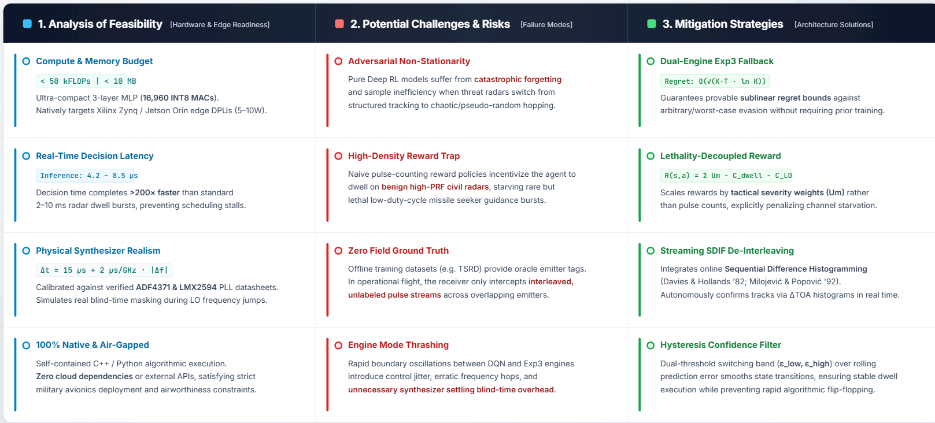
FEASIBILITY AND VIABILITY
Half
Squadron

Slide 5
IMPACT AND BENEFITS
Half
Squadron
Potential Impact on the Target Audience
Directly improves survivability for aircrew and ship crews operating under RWR/ESM cover — faster, more reliable threat detection in the critical seconds before missile lock
Reduces cognitive load on human operators by automating scan prioritization, letting crews focus on tactical response rather than manual threat triage
Strengthens India's indigenous EW capability, reducing reliance on imported ESM receiver systems for frontline defense platforms
Applicable across multiple platform classes (airborne, naval) without redesign, since the controller is software-defined on top of standard receiver hardware
Economic
Lowers dependency on costly foreign-sourced ESM technology, supporting indigenous defense manufacturing (Atmanirbhar Bharat in defense electronics)
Software-defined intelligence layered on existing hardware reduces the need for expensive receiver redesigns or additional RF front-end hardware
Environmental / Operational Efficiency
SWaP-C-aware design (Size, Weight, Power, Cost) avoids the extra power draw and thermal load of full-spectrum simultaneous digitization
Social
Builds domestic expertise in cognitive EW systems, contributing to India's defense R&D talent base
Protects military personnel by closing the detection gap against modern agile-hopping threat radars
Efficient sub-band scanning reduces unnecessary continuous wideband processing, lowering onboard power consumption during extended patrol/mission durations

Slide 6
RESEARCH AND REFERENCES
Half
Squadron
Radar Dataset Turing Synthetic Radar Dataset (TSRD) — https://arxiv.org/abs/2602.03856 Dataset repository — https://huggingface.co/datasets/alan-turing-institute/turing-synthetic-radar-dataset
De-Interleaving Foundations
Davies & Hollands (1982), "Automatic processing for ESM" — https://doi.org/10.1049/ip-f-1.1982.0025
Mardia (1989), "New techniques for the deinterleaving of repetitive sequences" https://doi.org/10.1049/ip-f-2.1989.0025
Milojević & Popović (1992), "Improved algorithm for the deinterleaving of radar pulses" https://doi.org/10.1049/ip-f-2.1992.0012
Cognitive Algorithms
Mnih et al. (2015), "Human-level control through deep reinforcement learning" https://doi.org/10.1038/nature14236
Schaul et al. (2016), "Prioritized Experience Replay" — https://arxiv.org/abs/1511.05952
Auer et al. (2002), "The Nonstochastic Multiarmed Bandit Problem" https://doi.org/10.1137/S0097539701398375
Synthesizer Hardware Baselines
Analog Devices, ADF4371 Datasheet https://www.analog.com/media/en/technical-documentation/data-sheets/adf4371.pdf
Texas Instruments, LMX2594 Datasheet — https://www.ti.com/lit/ds/symlink/lmx2594.pdf

