Slide 1


ML Hackathon 2023

Slide 2
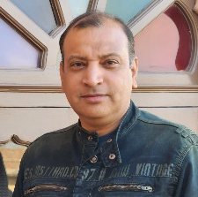

Team Details
Team Name : AI-Chauffeurs
Team Members : Sourabh Dogra, Sumit Jha
Add any Team/ Individual pictures

Slide 3
Idea
Problem Statement :
Right now, in the current system, there is no way to inform the customers about the order ready time. Even, we feel like there should be an attribute in the existing system, to mention the preparation time for each item. In long run, it would help to calculate more precise order preparation time.
Solution:
As of now with the information we have in hands, there could be two possible solutions. One would be to write a “Rule Engine”, that can calculate the order preparation time (though highly believe, it would need individual item preparation time). The second possible solution would be to use power of Artificial Intelligence with deep learning to calculate the same. This is our proposed solution.

Slide 4
Idea
Say Total Records = 100 million
Train Date ( 80%) = 80 million
Test Date (20%) = 20 million

Slide 5
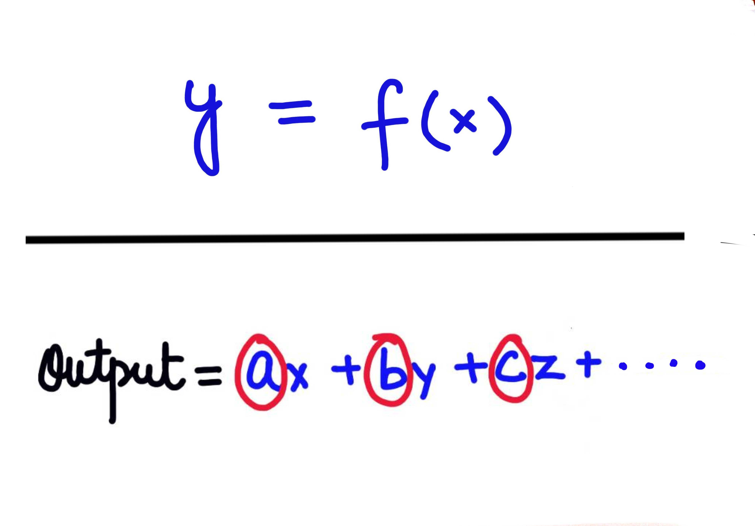
Idea

Slide 6
Demo
Features considered in the proposed solution:
Store Id ( This would be beneficial to identify the kitchen capacity)
Order day and time
Order size (in terms of amount)
Order size (in terms of # of items ordered)
Pending Orders count in kitchen (at time when current order is placed)
Pending Orders size (in terms of amount)
Pending Orders size (in terms of # of items ordered)
Order preparation time
Demo: to follow

Slide 7
Next Steps
What will it take to productionize it ? :
As of now the AI/ML models have been prepared using the Dev/QA data and we all understand that in order to get more actual and accurate results, we need millions of records of actual production data. If the idea, is to be materialize, need production data to train the models even further. Also, depending upon the actual data, we definitely have to consider more features and compare more AI algorithms. With our limited knowledge we strongly believe like Recurrent Neural Network Tutorial (RNN) might be helpful, but again need more and more data to get precise results.

Slide 8
Deliverables
Link to git repo/ wireframes/ video etc.:
https://github.com/sourabh-dogra-par/par-hackathon-2023.git

