Slide 1

Data Mining
Week 4: K-Nearest Neighbor, Classifier Evaluation
Pabitra Mitra
Computer Science and Engineering, IIT Kharagpur

Slide 2
Bayes Classifier: Recap
P( TUNA | L)
P( SHARK | L)
P( HILSA | L)
L
Maximum Aposteriori (MAP) Rule
Distributions assumed to be of particular family (e.g., Gaussian), and
parameters estimated from training data.

Slide 3
Bayes Classifier: Recap
P( TUNA | L)
P( SHARK | L)
P( HILSA | L)
L +- δ
Approximate Maximum Aposteriori (MAP) Rule
Non-parametric (data driven) approach: consider a small window around L,
Find which class is most populous in that window.

Slide 4
Nearest Neighbor Classifiers
Basic idea: If it walks like a duck, quacks like a duck, then it’s probably a duck
Compute Distance
Test Record
Training Records
Choose k of the “nearest” records

Slide 5
Basic Idea
k-NN classification rule is to assign to a test sample the majority category label of its k nearest training samples
In practice, k is usually chosen to be odd, so as to avoid ties
The k = 1 rule is generally called the nearest-neighbor classification rule

Slide 6
Definition of Nearest Neighbor
K-nearest neighbors of a record x - data points that have the k smallest distance to x

Slide 7
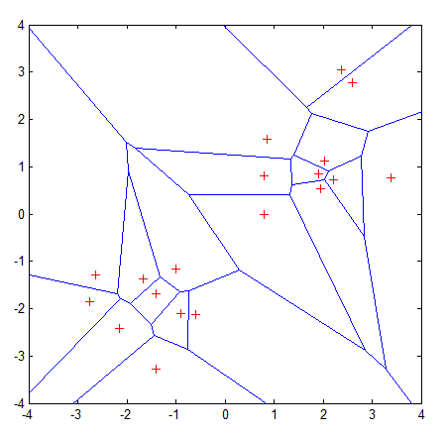
Nearest Neighbor: Voronoi Diagram
Properties:
All possible points within a sample's Voronoi cell are the nearest neighboring points for that sample
For any sample, the nearest sample is determined by the closest Voronoi cell edge

Slide 8
Distance-weighted k-NN
Replace by:
General Kernel functions like Parzen Windows may be considered
Instead of inverse distance.

Slide 9
Predicting Continuous Values
Replace by:
Note: unweighted corresponds to w_{i}=1 for all i

Slide 10
Nearest-Neighbor Classifiers: Issues
The value of k, the number of nearest neighbors to retrieve
Choice of Distance Metric to compute distance between records
Computational complexity
Size of training set
Dimension of data

Slide 11
Value of K
Choosing the value of k:
If k is too small, sensitive to noise points
If k is too large, neighborhood may include points from other classes
Rule of thumb:
K = sqrt(N)
N: number of training points

Slide 12
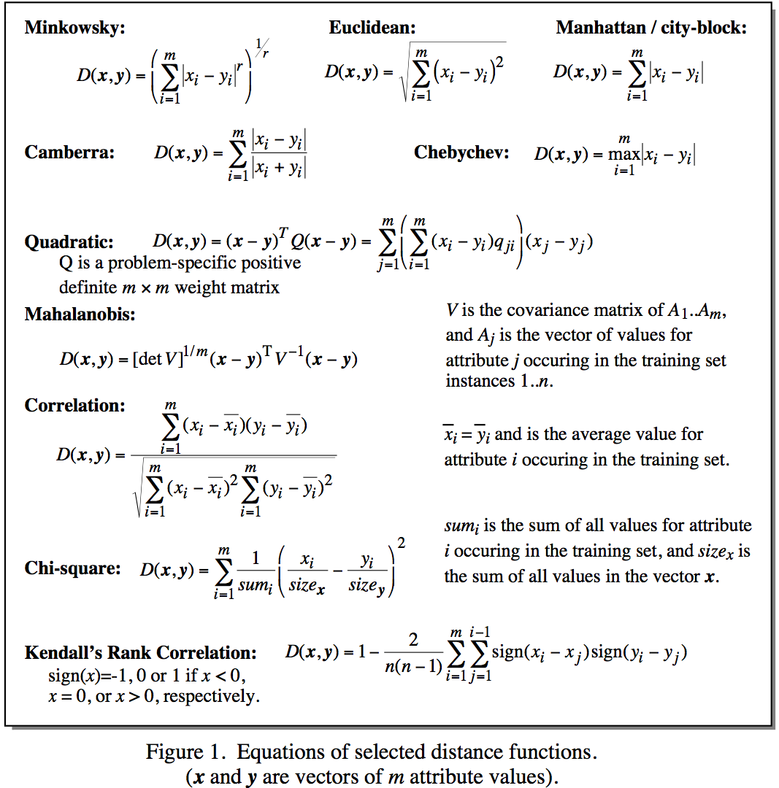
Distance Metrics
Notes:
Minkowsky = l-norm

Slide 13
Distance Measure: Scale Effects
Different features may have different measurement scales
E.g., patient weight in kg (range [50,200]) vs. blood protein values in ng/dL (range [-3,3])
Consequences
Patient weight will have a much greater influence on the distance between samples
May bias the performance of the classifier

Slide 14
Standardization
Transform raw feature values into z-scores
is the value for the i^{th} sample and j^{th} feature
is the average of all for feature j
is the standard deviation of all over all input samples
Range and scale of z-scores should be similar (providing distributions of raw feature values are alike)

Slide 15
Nearest Neighbor : Dimensionality
Problem with Euclidean measure:
High dimensional data
curse of dimensionality
Can produce counter-intuitive results
Shrinking density – sparsification effect
1 1 1 1 1 1 1 1 1 1 1 0
1 0 0 0 0 0 0 0 0 0 0 0
vs
0 1 1 1 1 1 1 1 1 1 1 1
0 0 0 0 0 0 0 0 0 0 0 1
d = 1.4142
d = 1.4142

Slide 16
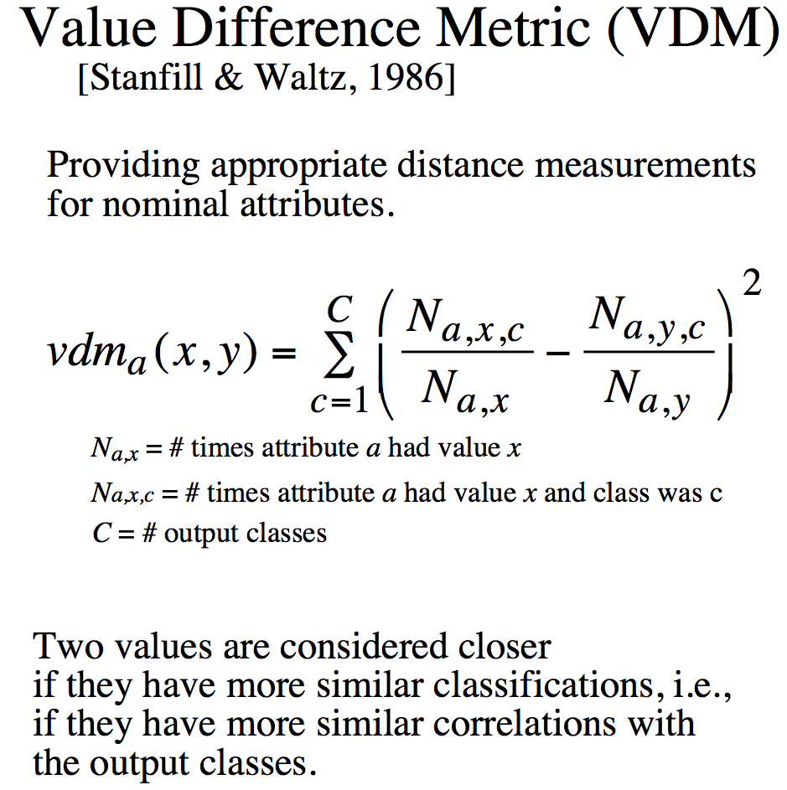
Distance for Nominal Attributes
Notes:
Do a single example here. Shape (Round, Square) 6/10 and 3/5

Slide 17
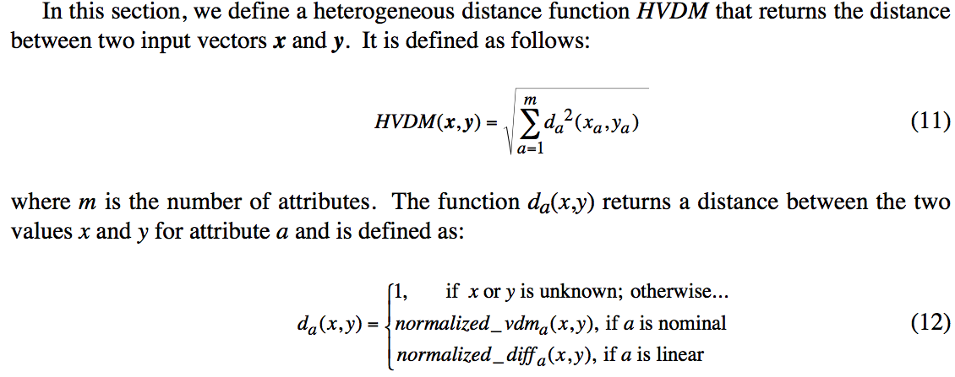
Distance for Heterogeneous Data

Slide 18
Nearest Neighbour : Computational Complexity
Expensive
To determine the nearest neighbour of a query point q, must compute the distance to all N training examples
Pre-sort training examples into fast data structures (kd-trees)
Compute only an approximate distance (LSH)
Remove redundant data (condensing)
Storage Requirements
Must store all training data P
Remove redundant data (condensing)
Pre-sorting often increases the storage requirements
High Dimensional Data
“Curse of Dimensionality”
Required amount of training data increases exponentially with dimension
Computational cost also increases dramatically
Partitioning techniques degrade to linear search in high dimension

Slide 19
Reduction in Computational Complexity
Reduce size of training set
Condensation, editing
Use geometric data structure for high dimensional search

Slide 20
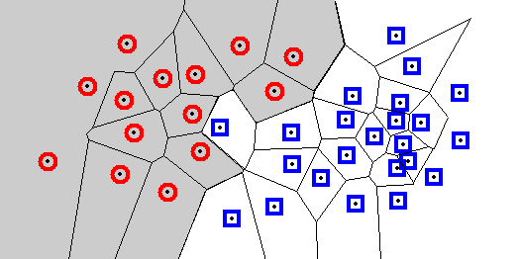
Condensation: Decision Regions
Each cell contains one sample, and every location within the cell is closer to that sample than to any other sample.
A Voronoi diagram divides the space into such cells.
Every query point will be assigned the classification of the sample within that cell. The decision boundary separates the class regions based on the 1-NN decision rule.
Knowledge of this boundary is sufficient to classify new points.
The boundary itself is rarely computed; many algorithms seek to retain only those points necessary to generate an identical boundary.

Slide 21
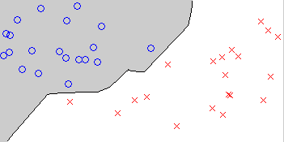
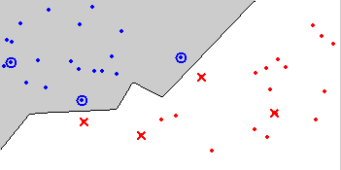
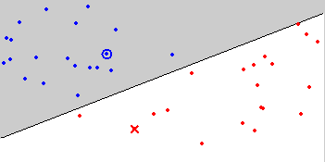
Condensing
Aim is to reduce the number of training samples
Retain only the samples that are needed to define the decision boundary
Decision Boundary Consistent – a subset whose nearest neighbour decision boundary is identical to the boundary of the entire training set
Minimum Consistent Set – the smallest subset of the training data that correctly classifies all of the original training data
Original data
Condensed data
Minimum Consistent Set

Slide 22
Condensed Nearest Neighbor
Condensed Nearest Neighbour (CNN)
Incremental
Order dependent
Neither minimal nor decision boundary consistent
O(n³) for brute-force method
Initialize subset with a single (or K) training example
Classify all remaining samples using the subset, and transfer any incorrectly classified samples to the subset
Return to 2 until no transfers occurred or the subset is full

Slide 23
High dimensional search
Given a point set and a nearest neighbor query point
Find the points enclosed in a rectangle (range) around the query
Perform linear search for nearest neighbor only in the rectangle
Query

Slide 24
kd-tree: data structure for range search
Index data into a tree
Search on the tree
Tree construction: At each level we use a different dimension to split
x=5
x<5
x>=5
C
B
y=3
y=6
A
E
D
x=6

Slide 25
KNN: Alternate Terminologies
Instance Based Learning
Lazy Learning
Case Based Reasoning
Exemplar Based Learning

Slide 26
Text Search: Documents as vectors
We have a |V|-dimensional vector space
Terms are axes of the space
Documents are points or vectors in this space
Very high-dimensional: tens of millions of dimensions when you apply this to a web search engine
These are very sparse vectors - most entries are zero.

Slide 27
Queries as vectors
Key idea 1: Do the same for queries: represent them as vectors in the space
Key idea 2: Rank documents according to their proximity to the query in this space
proximity = similarity of vectors
proximity ≈ inverse of distance
Recall: We do this because we want to get away from the you’re-either-in-or-out Boolean model.
Instead: rank more relevant documents higher than less relevant documents

Slide 28
Formalizing vector space proximity
First cut: distance between two points
( = distance between the end points of the two vectors)
Euclidean distance?
Euclidean distance is a bad idea . . .
. . . because Euclidean distance is large for vectors of different lengths.

Slide 29
Use angle instead of distance
Thought experiment: take a document d and append it to itself. Call this document d′.
“Semantically” d and d′ have the same content
The Euclidean distance between the two documents can be quite large
The angle between the two documents is 0, corresponding to maximal similarity.
Key idea: Rank documents according to angle with query.

Slide 30
From angles to cosines
Sec. 6.3
The following two notions are equivalent.
Rank documents in decreasing order of the angle between query and document
Rank documents in increasing order of cosine(query,document)
Cosine is a monotonically decreasing function for the interval [0º, 180º]

Slide 31
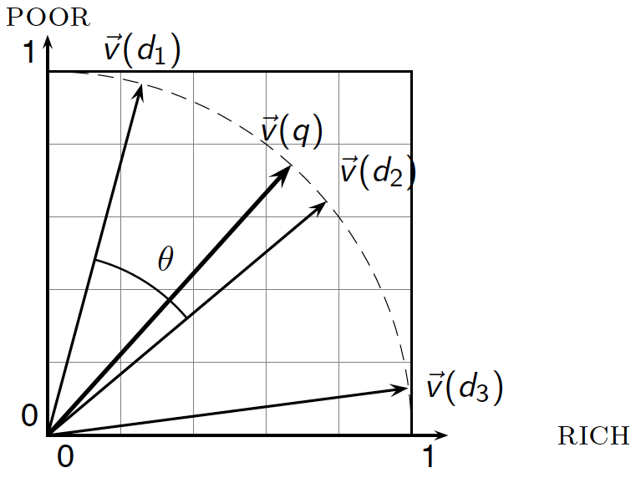
Cosine similarity illustrated

Slide 32
End of K-Nearest Neighbor

Slide 33
Classifier Evaluation

Slide 34
Classifier Evaluation
Metrics for Performance Evaluation
How to evaluate the performance of a model
Methods for Performance Evaluation
How to obtain reliable estimates?
Methods for Model Comparison
How to compare the relative performance among competing models?

Slide 35
Metrics for Performance Evaluation
Focus on the predictive capability of a model
Rather than how fast it takes to classify or build models, scalability, etc.
Confusion Matrix:
 | PREDICTED CLASS
ACTUAL CLASS |  | Class=Yes | Class=No
 | Class=Yes | a | b
 | Class=No | c | d
a: TP (true positive)
b: FN (false negative)
c: FP (false positive)
d: TN (true negative)

Slide 36
Accuracy
 | PREDICTED CLASS
ACTUAL CLASS |  | Class=Yes | Class=No
 | Class=Yes | a (TP) | b (FN)
 | Class=No | c (FP) | d (TN)

Slide 37
Limitation of Accuracy
Consider a 2-class problem
Number of Class 0 examples = 9990
Number of Class 1 examples = 10
If model predicts everything to be class 0, accuracy is 9990/10000 = 99.9 %
Accuracy is misleading because model does not detect any class 1 example

Slide 38
Cost Matrix
 | PREDICTED CLASS
ACTUAL CLASS | C(i|j) | Class=Yes | Class=No
 | Class=Yes | C(Yes|Yes) | C(No|Yes)
 | Class=No | C(Yes|No) | C(No|No)
C(i|j): Cost of misclassifying class j example as class i

Slide 39
Cost-Sensitive Measures
Precision is biased towards C(Yes|Yes) & C(Yes|No)
Recall is biased towards C(Yes|Yes) & C(No|Yes)
F-measure is biased towards all except C(No|No)

Slide 40
Model Evaluation
Metrics for Performance Evaluation
How to evaluate the performance of a model
Methods for Performance Evaluation
How to obtain reliable estimates?
Methods for Model Comparison
How to compare the relative performance among competing models?

Slide 41
Methods for Performance Evaluation
How to obtain a reliable estimate of performance?
Performance of a model may depend on other factors besides the learning algorithm:
Class distribution
Cost of misclassification
Size of training and test sets

Slide 42
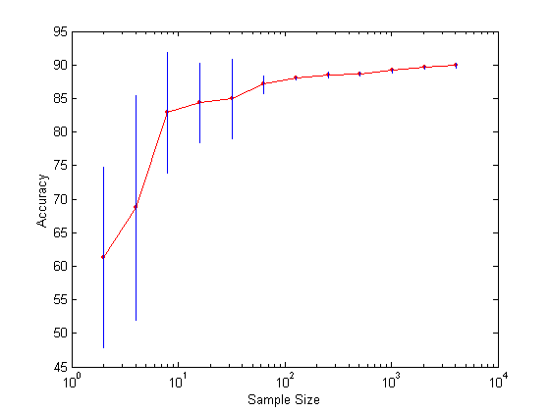
Learning Curve
Learning curve shows how accuracy changes with varying sample size
Effect of small sample size:
Bias in the estimate
Variance of estimate

Slide 43
Methods of Estimation
Holdout
Reserve 2/3 for training and 1/3 for testing
Random subsampling
Repeated holdout
Cross validation
Partition data into k disjoint subsets
k-fold: train on k-1 partitions, test on the remaining one
Leave-one-out: k=n
Stratified sampling
oversampling vs undersampling
Bootstrap
Sampling with replacement

Slide 44
Model Evaluation
Metrics for Performance Evaluation
How to evaluate the performance of a model?
Methods for Performance Evaluation
How to obtain reliable estimates?
Methods for Model Comparison
How to compare the relative performance among competing models?

Slide 45
ROC (Receiver Operating Characteristic)
Developed in 1950s for signal detection theory to analyze noisy signals
Characterize the trade-off between positive hits and false alarms
ROC curve plots TP (on the y-axis) against FP (on the x-axis)
Performance of each classifier represented as a point on the ROC curve
changing the threshold of algorithm, sample distribution or cost matrix changes the location of the point

Slide 46
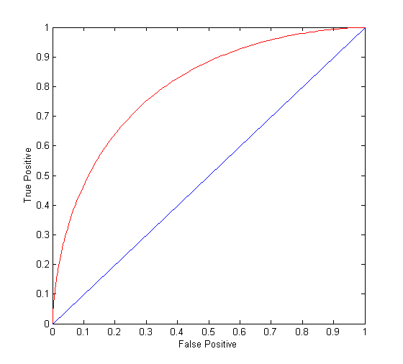
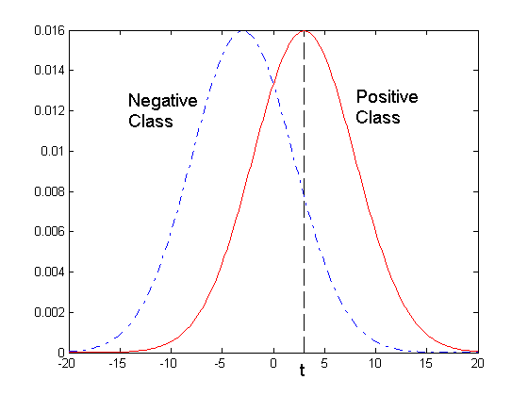
ROC Curve
- 1-dimensional data set containing 2 classes (positive and negative)
- any points located at x > t is classified as positive
At threshold t:
TP=0.5, FN=0.5, FP=0.12, FN=0.88

Slide 47
ROC Curve
(TP,FP):
(0,0): declare everything to be negative class
(1,1): declare everything to be positive class
(1,0): ideal
Diagonal line:
Random guessing
Below diagonal line:
prediction is opposite of the true class

Slide 48
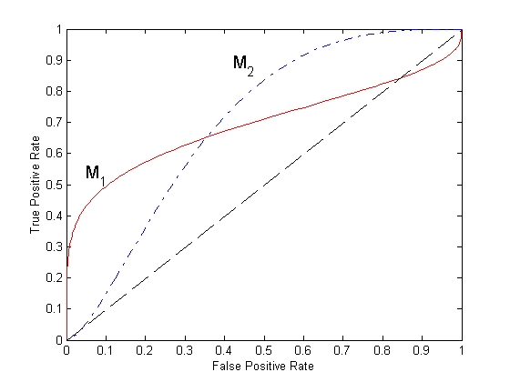
Using ROC for Model Comparison
No model consistently outperform the other
M₁ is better for small FPR
M₂ is better for large FPR
Area Under the ROC curve
Ideal:
Area = 1
Random guess:
Area = 0.5

Slide 49
Test of Significance
Given two models:
Model M1: accuracy = 85%, tested on 30 instances
Model M2: accuracy = 75%, tested on 5000 instances
Can we say M1 is better than M2?
How much confidence can we place on accuracy of M1 and M2?
Can the difference in performance measure be explained as a result of random fluctuations in the test set?

Slide 50
Comparing Performance of 2 Models
Given two models, say M1 and M2, which is better?
M1 is tested on D1 (size=n1), found error rate = e₁
M2 is tested on D2 (size=n2), found error rate = e₂
Assume D1 and D2 are independent
If n1 and n2 are sufficiently large, then
Approximate:

Slide 51
Comparing Performance of 2 Models
To test if performance difference is statistically significant: d = e1 – e2
d ~ N(d_{t},σ_{t}) where d_{t} is the true difference
Since D1 and D2 are independent, their variance adds up:
At (1-α) confidence level,

Slide 52
End of Classifier Evaluation

