Slide 1

Data Mining
Week 7: Clustering
Pabitra Mitra
Computer Science and Engineering, IIT Kharagpur

Slide 2
Clustering
Unsupervised method
Exploratory Data Analysis
Useful in many applications like market segment analysis

Slide 3
What is clustering?
Organizing data into classes such that there is
high intra-class similarity
low inter-class similarity
Finding the class labels and the number of classes directly from the data (in contrast to classification).
More informally, finding natural groupings among objects.

Slide 4





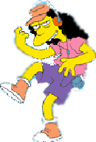



What is a natural grouping among these objects?

Slide 5




What is a natural grouping among these objects?
Clustering is subjective
Simpson's Family
School Employees
Females
Males

Slide 6
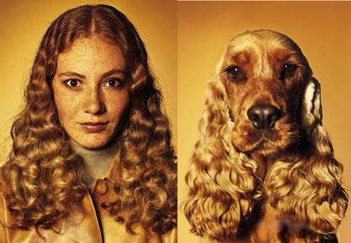
What is similarity?
The quality or state of being similar; likeness; resemblance; as, a similarity of features.
Similarity is hard to define.

Slide 7
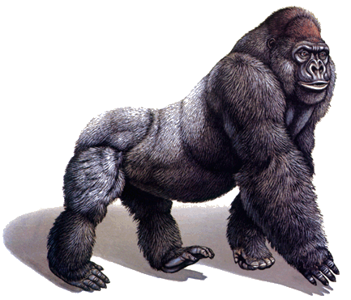
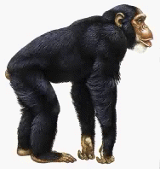
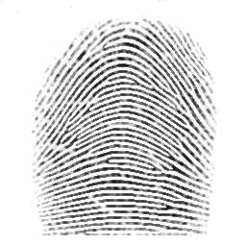
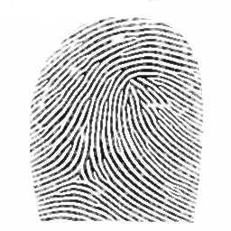
Defining distance measures
Definition: Let O₁ and O₂ be two objects from the universe of possible objects. The distance (dissimilarity) between O₁ and O₂ is a real number denoted by D(O₁,O₂)
Peter
Piotr
0.23
3
342.7

Slide 8
What properties should a distance measure have?
D(A,B) = D(B,A) Symmetry
D(A,B) = 0 iff A= B Reflexive
D(A,B) ≤ D(A,C) + D(B,C) Triangle Inequality
Peter
Piotr
d('', '') = 0 d(s, '') = d('', s) = |s| -- i.e. length of s d(s1+ch1, s2+ch2) = min( d(s1, s2) + if ch1=ch2 then 0 else 1 fi, d(s1+ch1, s2) + 1, d(s1, s2+ch2) + 1 )
3

Slide 9


Two types of clustering
Partitional algorithms: Construct various partitions and then evaluate them by some criterion
Hierarchical algorithms: Create a hierarchical decomposition of the set of objects using some criterion
Hierarchical
Partitional

Slide 10
Desirable Properties of clustering algorithm
Scalability (in terms of both time and space)
Ability to deal with different data types
Minimal requirements for domain knowledge to determine input parameters
Able to deal with noise and outliers
Insensitive to order of input records
Incorporation of user-specified constraints
Interpretability and usability

Slide 11
Summarizing similarity measurements
Dendrogram.
The similarity between two objects in a dendrogram is represented as the height of the lowest internal node they share.

Slide 12
Hierarchical clustering using string edit distance
Pedro (Portuguese)
Petros (Greek), Peter (English), Piotr (Polish), Peadar (Irish), Pierre (French), Peder (Danish), Peka (Hawaiian), Pietro (Italian), Piero (Italian Alternative), Petr (Czech), Pyotr (Russian)
Cristovao (Portuguese)
Christoph (German), Christophe (French), Cristobal (Spanish), Cristoforo (Italian), Kristoffer (Scandinavian), Krystof (Czech), Christopher (English)
Miguel (Portuguese)
Michalis (Greek), Michael (English), Mick (Irish!)
Piotr
Pyotr
Pedro
Piero
Peter
Peder
Miguel
Petros
Pietro
Pierre
Peadar
Michael
Krystof
Michalis
Mick
Crisdean
Peka
Cristovao
Christoph
Cristobal
Kristoffer
Christophe
Cristoforo
Christopher

Slide 13
Hierarchical clustering
Bottom-Up (agglomerative): Starting with each item in its own cluster, find the best pair to merge into a new cluster. Repeat until all clusters are fused together.
Top-Down (divisive): Starting with all the data in a single cluster, consider every possible way to divide the cluster into two. Choose the best division and recursively operate on both sides.
The number of dendrograms with n leafs = (2n -3)!/[(2^{(n -2)}) (n -2)!]

Slide 14


Distance matrix
We begin with a distance matrix which contains the distances between every pair of objects in our database.
D( , ) = 8
D( , ) = 1
0
8
8
7
7
0
2
4
4
0
3
3
0
1
0

Slide 15
Bottom-Up (agglomerative)
Starting with each item in its own cluster, find the best pair to merge into a new cluster. Repeat until all clusters are fused together.
Consider all possible merges…
Choose the best
…

Slide 16
Bottom-Up (agglomerative)
Starting with each item in its own cluster, find the best pair to merge into a new cluster. Repeat until all clusters are fused together.
Consider all possible merges…
Choose the best
…
Consider all possible merges…
Choose the best
…

Slide 17
Bottom-Up (agglomerative)
Starting with each item in its own cluster, find the best pair to merge into a new cluster. Repeat until all clusters are fused together.
Consider all possible merges…
Choose the best
…
Consider all possible merges…
Choose the best
…
Consider all possible merges…
Choose the best
…

Slide 18
Bottom-Up (agglomerative)
Starting with each item in its own cluster, find the best pair to merge into a new cluster. Repeat until all clusters are fused together.
Consider all possible merges…
Choose the best
…
Consider all possible merges…
Choose the best
…
Consider all possible merges…
Choose the best
…

Slide 19
Extending distance measure to clusters
We the distance between two objects, defining the distance between an object and a cluster, or defining the distance between two clusters:
Single linkage (nearest neighbor): In this method the distance between two clusters is determined by the distance of the two closest objects (nearest neighbors) in the different clusters.
Complete linkage (farthest neighbor): In this method, the distances between clusters are determined by the greatest distance between any two objects in the different clusters (i.e., by the "furthest neighbors").
Group average linkage: In this method, the distance between two clusters is calculated as the average distance between all pairs of objects in the two different clusters.

Slide 20
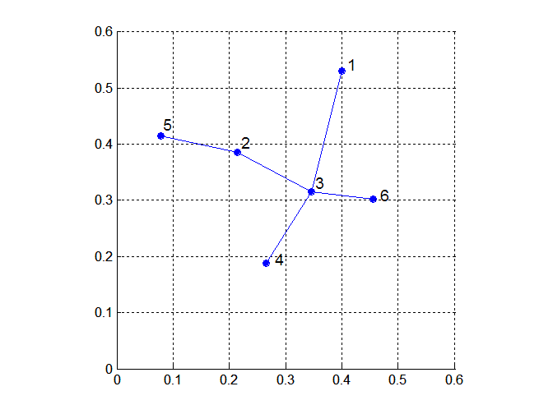
Minimal Spanning Tree – Single Linkage
Build MST (Minimum Spanning Tree)
Start with a tree that consists of any point
In successive steps, look for the closest pair of points (p, q) such that one point (p) is in the current tree but the other (q) is not
Add q to the tree and put an edge between p and q

Slide 21
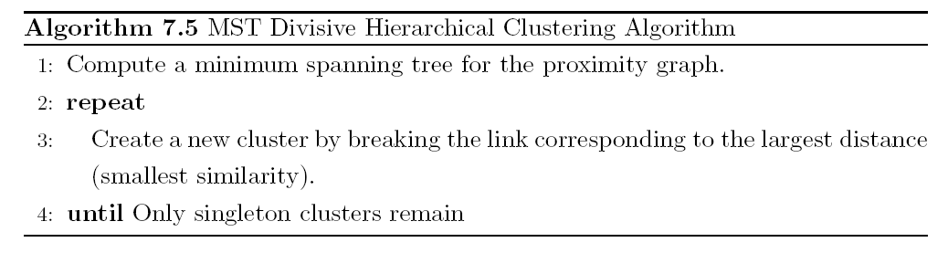
MST: Divisive Hierarchical Clustering
Use MST for constructing hierarchy of clusters

Slide 22
Summary of hierarchal clustering
No need to specify the number of clusters in advance.
Hierarchal nature maps nicely onto human intuition for some domains
They do not scale well: time complexity of at least O(n²), where n is the number of total objects.

Slide 23







Partitional clustering
Nonhierarchical, each instance is placed in exactly one of K nonoverlapping clusters.
Since only one set of clusters is output, the user normally has to input the desired number of clusters K.

Slide 24
k-means
1. Decide on a value for k.
2. Initialize the k cluster centers (randomly, if necessary).
3. Decide the class memberships of the N objects by assigning them to the nearest cluster center.
4. Re-estimate the k cluster centers, by assuming the memberships found above are correct.
5. If none of the N objects changed membership in the last iteration, exit. Otherwise goto 3.

Slide 25
K-means clustering: step 1
Algorithm: k-means, Distance Metric: Euclidean Distance
5
4
k₁
3
k₂
2
1
k₃
0
0
1
2
3
4
5

Slide 26
K-means clustering: step 2
Algorithm: k-means, Distance Metric: Euclidean Distance
5
4
k₁
3
k₂
2
1
k₃
0
0
1
2
3
4
5

Slide 27
K-means clustering: step 3
Algorithm: k-means, Distance Metric: Euclidean Distance
5
4
k₁
3
2
k₃
k₂
1
0
0
1
2
3
4
5

Slide 28
K-means clustering: step 4
Algorithm: k-means, Distance Metric: Euclidean Distance
5
4
k₁
3
2
k₃
k₂
1
0
0
1
2
3
4
5

Slide 29
K-means clustering: step 5
Algorithm: k-means, Distance Metric: Euclidean Distance
k₁
k₂
k₃

Slide 30
Evaluation of K-means
Strength
Relatively efficient: O(tkn), where n is # objects, k is # clusters, and t is # iterations. Normally, k, t << n.
Often terminates at a local optimum. The global optimum may be found using techniques such as: deterministic annealing and genetic algorithms
Weakness
Applicable only when mean is defined, then what about categorical data?
Need to specify k, the number of clusters, in advance
Unable to handle noisy data and outliers
Not suitable for clusters with non-convex shapes

Slide 31
DBSCAN
DBSCAN is a density-based algorithm.
Density = number of points within a specified radius (Eps)
A point is a core point if it has more than a specified number of points (MinPts) within Eps
These are points that are at the interior of a cluster
A border point has fewer than MinPts within Eps, but is in the neighborhood of a core point
A noise point is any point that is not a core point or a border point.

Slide 32
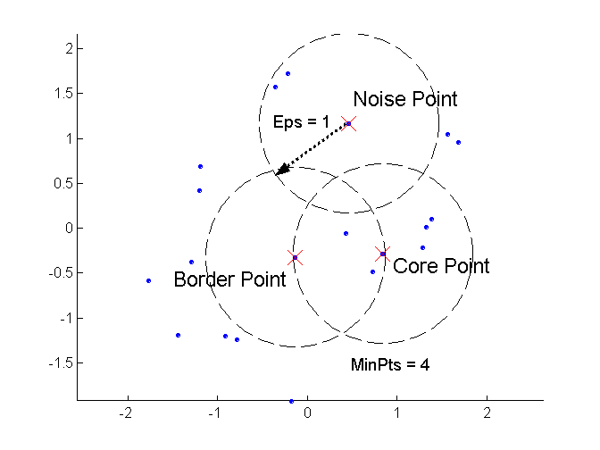
DBSCAN: Core, Border, and Noise Points

Slide 33
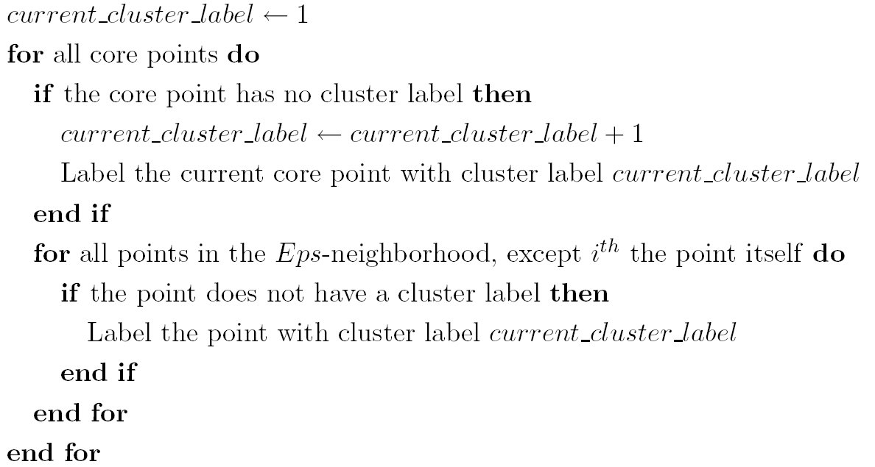
DBSCAN Algorithm
Eliminate noise points
Perform clustering on the remaining points

Slide 34
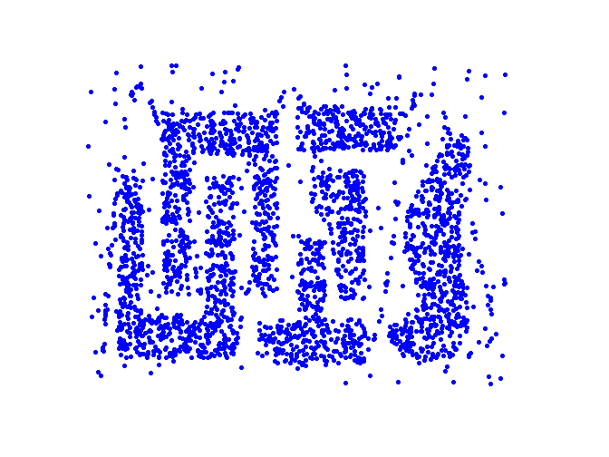
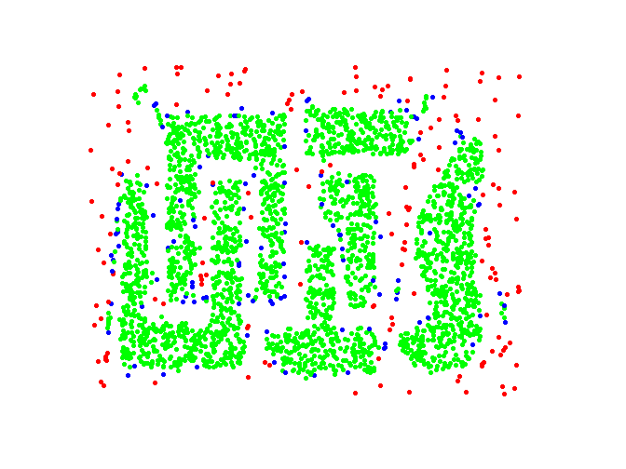
DBSCAN: Core, Border and Noise Points
Original Points
Point types: core, border and noise
Eps = 10, MinPts = 4

Slide 35
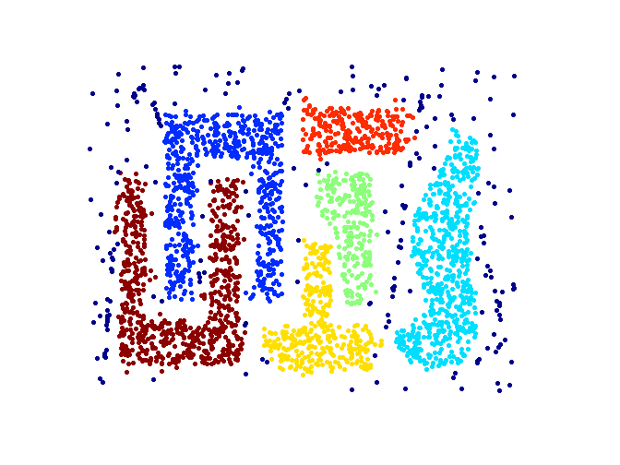
When DBSCAN Works Well
Original Points
Clusters
Resistant to Noise
Can handle clusters of different shapes and sizes

Slide 36
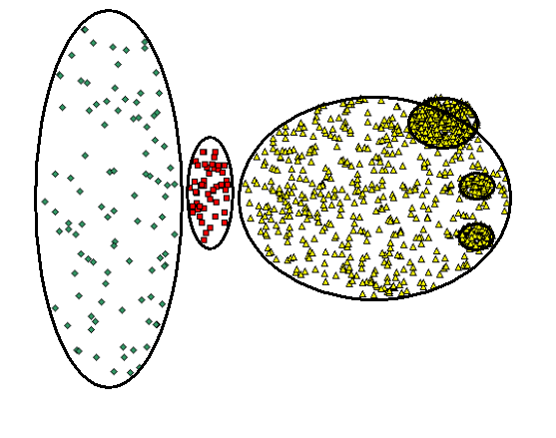
When DBSCAN Does NOT Work Well
(MinPts=4, Eps=9.75).
Original Points
Varying densities
High-dimensional data
(MinPts=4, Eps=9.92)

Slide 37
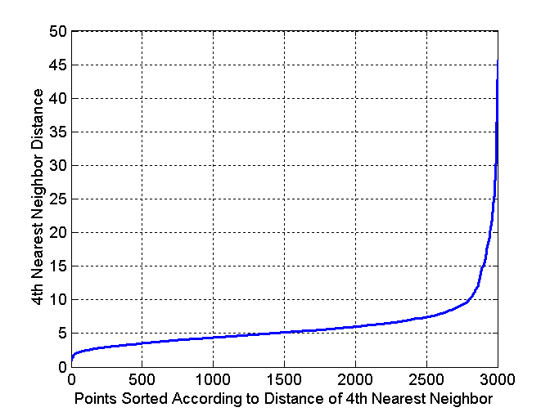
DBSCAN: Determining EPS and MinPts
Idea is that for points in a cluster, their k^{th} nearest neighbors are at roughly the same distance
Noise points have the k^{th} nearest neighbor at farther distance
So, plot sorted distance of every point to its k^{th} nearest neighbor

Slide 38
Summary of Clustering Algorithms
K-Means – fast, works only for data where mean can be defined, generates spherical clusters, robust to noise
Single linkage – produces non-convex clusters, slow for large data sets, sensitive to noise
Complete linkage – produces non-convex clusters, very sensitive to noise, very slow for large data sets
DBSCAN – produces arbitrary shaped clusters – works only for low dimensional data

Slide 39
Cluster Validity
For supervised classification we have a variety of measures to evaluate how good our model is
Accuracy, precision, recall
For cluster analysis, the analogous question is how to evaluate the “goodness” of the resulting clusters?
But “clusters are in the eye of the beholder”!
Then why do we want to evaluate them?
To avoid finding patterns in noise
To compare clustering algorithms
To compare two sets of clusters
To compare two clusters

Slide 40
Different Aspects of Cluster Validation
Determining the clustering tendency of a set of data, i.e., distinguishing whether non-random structure actually exists in the data.
Comparing the results of a cluster analysis to externally known results, e.g., to externally given class labels.
Evaluating how well the results of a cluster analysis fit the data without reference to external information.
- Use only the data
Comparing the results of two different sets of cluster analyses to determine which is better.
Determining the ‘correct’ number of clusters.

Slide 41
Measures of Cluster Validity
Numerical measures that are applied to judge various aspects of cluster validity, are classified into the following three types.
External Index: Used to measure the extent to which cluster labels match externally supplied class labels.
Entropy
Internal Index: Used to measure the goodness of a clustering structure without respect to external information.
Sum of Squared Error (SSE)
Relative Index: Used to compare two different clusterings or clusters.
Often an external or internal index is used for this function, e.g., SSE or entropy

Slide 42
Scatter Coefficient
Cluster evaluation index
Ratio of average intra-cluster distances to intra-cluster distances (Sum Squared Error)

Slide 43
Internal Measures: Cohesion and Separation
Cluster Cohesion: Measures how closely related are objects in a cluster
Example: SSE
Cluster Separation: Measure how distinct or well-separated a cluster is from other clusters
Example: Squared Error
Cohesion is measured by the within cluster sum of squares (SSE)
Separation is measured by the between cluster sum of squares
Where |C_{i}| is the size of cluster i

Slide 44
Internal Measures: Cohesion and Separation
Example: SSE
BSS + WSS = constant
m
×
×
×
1
m₁
2
3
4
m₂
5
K=1 cluster:
K=2 clusters:

Slide 45
Internal Measures: Cohesion and Separation
A proximity graph based approach can also be used for cohesion and separation.
Cluster cohesion is the sum of the weight of all links within a cluster.
Cluster separation is the sum of the weights between nodes in the cluster and nodes outside the cluster.
cohesion
separation

Slide 46
Internal Measures: Silhouette Coefficient
Silhouette Coefficient combine ideas of both cohesion and separation, but for individual points, as well as clusters and clusterings
For an individual point, i
Calculate a = average distance of i to the points in its cluster
Calculate b = min (average distance of i to points in another cluster)
The silhouette coefficient for a point is then given by s = 1 – a/b if a < b, (or s = b/a - 1 if a ≥ b, not the usual case)
Typically between 0 and 1.
The closer to 1 the better.
Can calculate the Average Silhouette width for a cluster or a clustering

Slide 47
External Measures of Cluster Validity: Entropy and Purity

Slide 48
Outliers Detection
Important in many applications like anomaly detection
Outliers are points not belonging to any cluster
Many outlier detection algorithms available

Slide 49
End of Clustering

