Slide 1

Data Mining
Week 8: Regression, Dimensionality Reduction
Pabitra Mitra
Computer Science and Engineering, IIT Kharagpur

Slide 2
Regression
Predict real-valued output for given input – given a training set
Examples:
Predict rainfall in cm for month
Predict stock prices in next day
Predict number of users who will click on an internet advertisement

Slide 3
Linear Regression
Task: predict real-valued Y, given real-valued vector X using a regression model f
Error function, e.g., least squares is often used
S(θ) = Σ_{i} [y(i) – f(X(i) ; θ) ]²
Model structure: e.g., linear f(X ; θ) = α₀ + Σ α_{j} x_{j}
Model parameters = θ = {α₀, α_{1,} …… α_{p} }
target value
predicted value

Slide 4
Estimating θ (having least error): we can write-
S(θ) = Σ_{i} [y(i) – Σ α_{j} x_{j}]²
= Σ_{i} e_{i}²
= e’ e where e = y – X θ
= (y – X θ)’ (y – X θ)
(p+1) x 1 vector
of parameter values
y = N x 1 vector
of target values
N x (p+1) vector
of input values

Slide 5
S(θ) = Σ e² = e’ e = (y – X θ)’ (y – X θ)
= y’ y – θ’ X’ y – y’ X θ + θ’ X’ X θ
= y’ y – 2 θ’ X’ y + θ’ X’ X θ
Taking derivative of S(θ) with respect to the components of θ gives -
dS/d θ = -2 X’ y + 2 X’ X θ
Set this to 0 to find the minimum of S as a function of θ.

Slide 6
Set to 0 to find the minimum of S as a function of θ …
- 2 X’ y + 2 X’ X θ = 0
X’ X θ = X’ y (known in statistics as the Normal Equations)
Letting X’ X = C, and X’ y = b,
we have C θ = b, i.e., a set of linear equations
We could solve this directly, e.g., by matrix inversion
θ = C⁻¹ b = ( X’ X )⁻¹ X’ y

Slide 7
Solving for the θ’s
Problem is equivalent to inverting X’ X matrix
Inverse does not exist if matrix is not of full rank
E.g., if 1 column is a linear combination of another (collinearity)
Note that X’X is closely related to the covariance of the X data
So we are in trouble if 2 or more variables are perfectly correlated
Numerical problems can also occur if variables are almost collinear
Equivalent to solving a system of p linear equations
Many good numerical methods for doing this, e.g.,
Gaussian elimination, LU decomposition, etc
These are numerically more stable than direct inversion
Alternative: gradient descent
Compute gradient and move downhill

Slide 8
Multivariate Linear Regression
Prediction model is a linear function of the parameters
Score function: quadratic in predictions and parameters
Derivative of score is linear in the parameters
Leads to a linear algebra optimization problem, i.e., C θ = b
Model structure is simple….
p-1 dimensional hyperplane in p-dimensions
Linear weights => interpretability
Often useful as a baseline model
e.g., to compare more complex models to
Note: even if it’s the wrong model for the data (e.g., a poor fit) it can still be useful for prediction

Slide 9
Limitations of Linear Regression
True relationship of X and Y might be non-linear
Suggests generalizations to non-linear models
Complexity:
O(N p² + p³) - problematic for large p
Correlation/Collinearity among the X variables
Can cause numerical instability (C may be ill-conditioned)
Problems in interpretability (identifiability)
Includes all variables in the model…
But what if p=1000 and only 3 variables are actually related to Y?

Slide 10
Non-linear Regression
We can generalize further to models that are nonlinear:
f(x ; θ) = α₀ + Σ α_{k} g_{k}(β_{k0} +Σ β_{kj} x_{j} )
where the g’s are non-linear functions.
- In statistics this is referred to as a generalized linear regression
- Closed form (analytical) solutions are rare.
- We have a multivariate non-linear optimization problem
(which may be quite difficult!)

Slide 11
Optimization in the Non-Linear Case
We seek the minimum of a function in d dimensions, where d is the number of parameters (d could be large!)
There are a multitude of heuristic search techniques
Steepest descent (follow the gradient)
Newton methods (use 2nd derivative information)
Conjugate gradient
Line search
Stochastic search
Genetic algorithms
Two cases:
Convex (nice -> means a single global optimum)
Non-convex (multiple local optima => need multiple starts)

Slide 12
Other non-linear models
Splines
“patch” together different low-order polynomials over different parts of the x-space
Works well in 1 dimension, less well in higher dimensions
Memory-based models y’ = Σ w_{(x’,x)} y, where y’s are from the training data w_{(x’,x)} = function of distance of x from x’
Local linear regression y’ = α₀ + Σ α_{j} x_{j ,} where the alpha’s are fit at prediction time just to the (y,x) pairs that are close to x’

Slide 13
Overfitting
Squared Error score (as an example: we could use other scores) S(θ) = Σ_{i} [y(i) – f(x(i) ; θ) ]²
where S(θ) is defined on the training data D
We are really interested in finding the f(x; θ) that best predicts y on future data, i.e., minimizing E [S] = E [y – f(x ; θ) ]² (where the expectation is over future data)
Empirical learning
Minimize S(θ) on the training data D_{train}
If D_{train} is large and model is simple we are assuming that the best f on training data is also the best predictor f on future test data D_{test}

Slide 14
Complexity versus Goodness of Fit
Training data
y
x

Slide 15
Complexity versus Goodness of Fit
Training data
Too simple?
y
y
x
x

Slide 16
Complexity versus Goodness of Fit
Training data
Too simple?
y
y
x
x
Too complex ?
y
x

Slide 17
Complexity versus Goodness of Fit
Training data
Too simple?
y
y
x
x
Too complex ?
About right ?
y
y
x
x

Slide 18
Model Complexity and Generalization
Error Function
e.g., squared
error
S_{test}(θ)
S_{train}(θ)
Complexity = degrees
of freedom in the model
(e.g., number of variables)
Optimal model
complexity

Slide 19
Complexity and Generalization
Score Function
e.g., squared
error
S_{test}(θ)
S_{train}(θ)
High bias
Low variance
Low bias
High variance

Slide 20
Training Data
Use this data to find the best θ for each model f_{k}(x ; θ)
Training Data

Slide 21
Validation Data
Use this data to find the best θ for each model f_{k}(x ; θ)
Training Data
Use this data to
calculate an estimate of S_{k}(θ) for each f_{k}(x ; θ) and
select k* = arg min_{k} S_{k}(θ)
Validation Data

Slide 22
Validation Data
can generalize to cross-validation….
Use this data to find the best θ for each model f_{k}(x ; θ)
Training Data
Use this data to
calculate an estimate of S_{k}(θ) for each f_{k}(x ; θ) and
select k* = arg min_{k} S_{k}(θ)
Validation Data

Slide 23
Test Data
Use this data to find the best θ for each model f_{k}(x ; θ)
Training Data
Use this data to
calculate an estimate of S_{k}(θ) for each f_{k}(x ; θ) and
select k* = arg min_{k} S_{k}(θ)
Validation Data
Use this data to calculate an unbiased estimate of S_{k*}(θ) for the selected model
Test Data

Slide 24
Time-series prediction as regression
Measurements over time x₁,…… x_{t}
We want to predict x_{t+1} given x₁,…… x_{t}
Autoregressive model x_{t+1} = f( x₁,…… x_{t} ; θ ) = Σ α_{k} x_{t-k}
Number of coefficients K = memory of the model
Can take advantage of regression techniques in general to solve this problem (e.g., linear in parameters, score function = squared error, etc)
Generalizations
Vector x
Non-linear function instead of linear
Add in terms for time-trend (linear, seasonal), for “jumps”, etc

Slide 25
Generalized Linear Models (GLMs)
g(y) = u(x) = α₀ + Σ α_{j} x_{j}
Where g [ ] is a “link” function
u(x) is a linear function of the vector x
Examples:
g = identity function -> linear regression
Logistic regression: g(y) = log(y / 1-y) = α₀ + Σ α_{j} x_{j}
Logarithmic link: g(y) = log(y) = α₀ + Σ α_{j} x_{j}
GLMs are widely used in statistics
Details of learning/fitting algorithm depend on the specifics of the link function

Slide 26
Tree-Structured Regression
Functional form of model is a “regression tree”
Univariate thresholds at internal nodes
Constant or linear surfaces at the leaf nodes
Yields piecewise constant (or linear) surface
(like classification tree, but for regression)
Very crude functional form…. but
Can be very useful in high-dimensional problems
Can useful for interpretation
Can handle combinations of real and categorical variables
Search problem
Finding the optimal tree is intractable
Practice: greedy algorithms

Slide 27
Simple example of Tree Model
Income > t1
Debt > t2
E[y] = 5.3
Income > t3
E[y] = 2.1
E[y] = -1.0
E[y] = 10.8

Slide 28
Greedy Search for Learning Regression Trees
Binary_node_splitting, real-valued variables
For each variable x_{j}
For each possible threshold t_{jk} , compute
Select t_{jk} with the lowest MSE for that variable
Select variable x_{j} and t_{jk} with the lowest MSE
Split the training data into the 2 branches
For each branch
If leaf-node: prediction at this leaf node = mean value of y data points
If not: call binary_node_splitting recursively
Time complexity?
MSE in left branch
MSE in right branch

Slide 29
Model Averaging/Ensembles
Can average over parameters and models
E.g., weighted linear combination of predictions from multiple models
y = Σ w_{k} y_{k}
Why? Any predictions from a point estimate of parameters or a single model has only a small chance of the being the best
Averaging makes our predictions more stable and less sensitive to random variations in a particular data set (good for less stable models like trees)

Slide 30
Components of Data Mining Algorithms
Model Representation:
Determining the nature and structure of the representation to be used
Score function
Measuring how well different representations fit the data
Search/Optimization method
An algorithm to optimize the score function
Data Management
Deciding what principles of data management are required to implement the algorithms efficiently.

Slide 31
Steps of Data Mining Algorithm
Task
Representation
Score Function
Search/Optimization
Data Management
Models, Parameters

Slide 32
Dimensionality Reduction
Purpose:
Avoid curse of dimensionality
Reduce amount of time and memory required by data mining algorithms
Allow data to be more easily visualized
May help to eliminate irrelevant features or reduce noise
Techniques
Principle Component Analysis
Singular Value Decomposition
Others: supervised and non-linear techniques

Slide 33
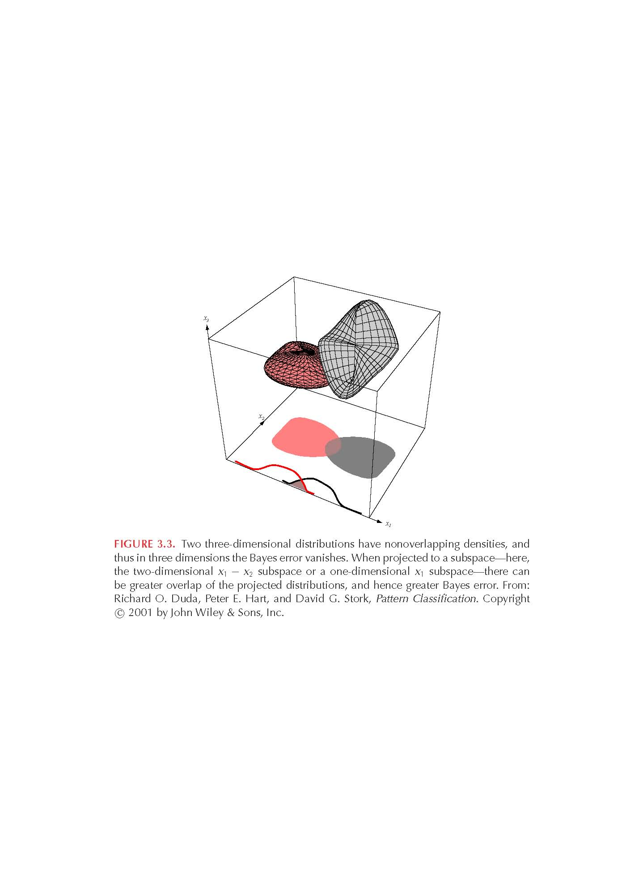
Data Dimensionality
From a theoretical point of view, increasing the number of features should lead to better performance.
In practice, the inclusion
of more features leads to
worse performance (i.e., curse
of dimensionality).
The number of training examples required increases
exponentially with dimensionality.

Slide 34
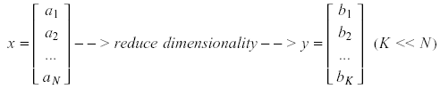
Dimensionality Reduction
Significant improvements can be achieved by first mapping the data into a lower-dimensional space.
Dimensionality can be reduced by:
Combining features using a linear or non-linear
Selecting a subset of features (i.e., feature selection).

Slide 35
Dimensionality Reduction (cont’d)
Linear combinations are particularly attractive because they are simple to compute and analytically tractable.
Given x ϵ R^{N}, the goal is to find an N x K matrix U such that:
y = U^{T}x ϵ R^{K} where K<<N
U^{T}

Slide 36


Dimensionality Reduction (cont’d)
Idea: represent data in terms of basis vectors in a lower dimensional space (embedded within the original space).
(1) Higher-dimensional space representation:
(2) Lower-dimensional sub-space representation:

Slide 37
Dimensionality Reduction (cont’d)
Classical approaches for finding an optimal linear transformation:
Principal Components Analysis (PCA): Seeks a projection that preserves as much information in the data as possible (in a least-squares sense).
Linear Discriminant Analysis (LDA): Seeks a projection that best separates the data (in a least-squares sense).

Slide 38
Principal Component Analysis (PCA)
Dimensionality reduction implies information loss; PCA preserves as much information as possible by minimizing the reconstruction error:
How should we determine the “best” lower dimensional space?
The “best” low-dimensional space can be determined by the “best” eigenvectors of the covariance matrix of the data (i.e., the eigenvectors corresponding to the “largest” eigenvalues – also called “principal components”).

Slide 39
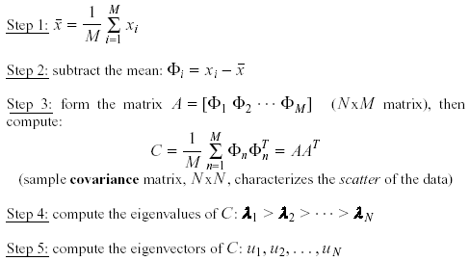
PCA - Steps
Suppose x₁, x₂, ..., x_{M} are N x 1 vectors
(i.e., center at zero)

Slide 40
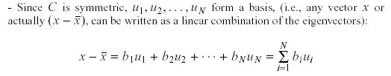

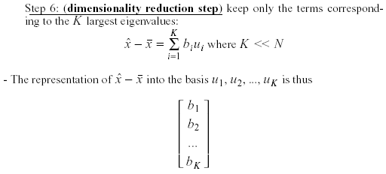
PCA – Steps (cont’d)
where

Slide 41
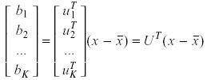
PCA – Linear Transformation
If u_{i} has unit length:
The linear transformation R^{N} → R^{K} that performs the dimensionality reduction is:

Slide 42
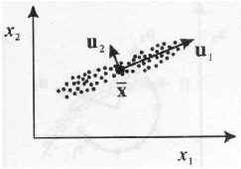
Geometric interpretation
PCA projects the data along the directions where the data varies most.
These directions are determined by the eigenvectors of the covariance matrix corresponding to the largest eigenvalues.
The magnitude of the eigenvalues corresponds to the variance of the data along the eigenvector directions.

Slide 43


Error due to dimensionality reduction
The original vector x can be reconstructed using its principal components:
PCA minimizes the reconstruction error:
It can be shown that the reconstruction error is:

Slide 44
Feature Subset Selection
Another way to reduce dimensionality of data
Redundant features
duplicate much or all of the information contained in one or more other attributes
Example: purchase price of a product and the amount of sales tax paid
Irrelevant features
contain no information that is useful for the data mining task at hand
Example: students' ID is often irrelevant to the task of predicting students' GPA

Slide 45
Feature Subset Selection
Evaluate a subset of feature
Search for the best subset

Slide 46
Feature Subset Selection
Techniques:
Brute-force approch:
Try all possible feature subsets as input to data mining algorithm
Embedded approaches:
Feature selection occurs naturally as part of the data mining algorithm
Filter approaches:
Features are selected before data mining algorithm is run
Wrapper approaches:
Use the data mining algorithm as a black box to find best subset of attributes

Slide 47
Software
MATLAB
Many free “toolboxes” on the Web for regression and prediction
e.g., see http://lib.stat.cmu.edu/matlab/ and in particular the CompStats toolbox
R
General purpose statistical computing environment (successor to S)
Free (!)
Widely used by statisticians, has a huge library of functions and visualization tools
Commercial tools
SAS, Salford Systems, other statistical packages
Various data mining packages
Often are not progammable: offer a fixed menu of items

Slide 48
Useful References
T. Hastie, R. Tibshirani, and J. Friedman,
Elements of Statistical Learning, 2nd edition,
Springer Verlag, 2009

