Slide 1

Data Mining
Week 1: Introduction, Association Rules
Pabitra Mitra
Computer Science and Engineering, IIT Kharagpur
Email: pabitra@gmail.com

Slide 2
Course Outline:
Introduction: KDD Process
Data Preprocessing
Association Rule Mining
Classification
Clustering and Anomaly Detection
Regression
Case Studies

Slide 3
Data Mining
Introduction
Pabitra Mitra
Computer Science and Engineering, IIT Kharagpur

Slide 4
Why Data Mining?
The Explosive Growth of Data: from terabytes to petabytes
Data collection and data availability
Automated data collection tools, database systems, Web, computerized society
Major sources of abundant data
Business: Web, e-commerce, transactions, stocks, …
Science: Remote sensing, bioinformatics, scientific simulation, …
Society and everyone: news, digital cameras, YouTube
We are drowning in data, but starving for knowledge!
“Necessity is the mother of invention”—Data mining—Automated analysis of massive data

Slide 5
What Is Data Mining?
Data mining (knowledge discovery from data)
Extraction of interesting (non-trivial, implicit, previously unknown and potentially useful) patterns or knowledge from huge amount of data
Alternative names
Knowledge discovery (mining) in databases (KDD), knowledge extraction, data/pattern analysis, data archeology, data dredging, information harvesting, business intelligence, etc.
Watch out: Is everything “data mining”?
Simple search and query processing
(Deductive) expert systems

Slide 6
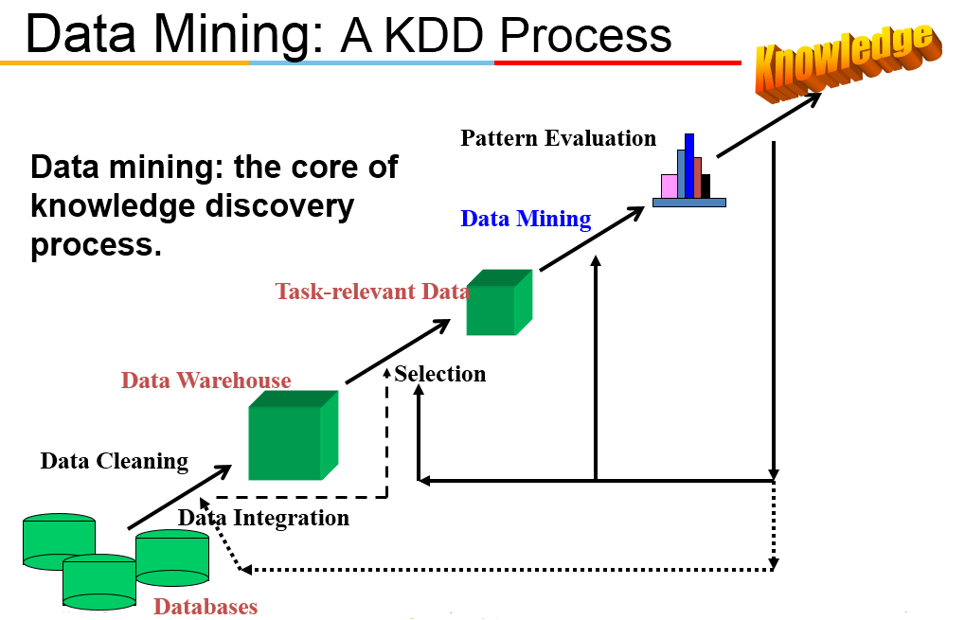

Slide 7
Data Mining: Confluence of Multiple Disciplines
Database
Technology
Statistics
Machine
Learning
Data Mining
Visualization
Pattern
Recognition
Other
Disciplines
Algorithm

Slide 8
Why Not Traditional Data Analysis?
Tremendous amount of data
Algorithms must be highly scalable to handle such as tera-bytes of data
High-dimensionality of data
Micro-array may have tens of thousands of dimensions
High complexity of data
Data streams and sensor data
Time-series data, temporal data, sequence data
Structure data, graphs, social networks and multi-linked data
Heterogeneous databases and legacy databases
Spatial, spatiotemporal, multimedia, text and Web data

Slide 9
Data Mining: On What Kinds of Data?
Database-oriented data sets and applications
Relational database, data warehouse, transactional database
Advanced data sets and advanced applications
Data streams and sensor data
Time-series data, temporal data, sequence data (incl. bio-sequences)
Structure data, graphs, social networks and multi-linked data
Object-relational databases
Heterogeneous databases and legacy databases
Spatial data and spatiotemporal data
Multimedia database
Text databases
The World-Wide Web

Slide 10
Data Mining Functionalities
Multidimensional concept description: Characterization and discrimination
Generalize, summarize, and contrast data characteristics, e.g., dry vs. wet regions
Frequent patterns, association, correlation vs. causality
Tea → Sugar [0.5%, 75%] (Correlation or causality?)
Classification and prediction
Construct models (functions) that describe and distinguish classes or concepts for future prediction
E.g., classify countries based on (climate), or classify cars based on (gas mileage)
Predict some unknown or missing numerical values

Slide 11
Data Mining Functionalities
Cluster analysis
Class label is unknown: Group data to form new classes, e.g., cluster houses to find distribution patterns
Maximizing intra-class similarity & minimizing interclass similarity
Outlier analysis
Outlier: Data object that does not comply with the general behavior of the data
Noise or exception? Useful in fraud detection, rare events analysis
Trend and evolution analysis
Trend and deviation: e.g., regression analysis
Sequential pattern mining: e.g., digital camera → large SD memory
Periodicity analysis
Similarity-based analysis
Other pattern-directed or statistical analyses

Slide 12
Major Issues in Data Mining
Mining methodology
Mining different kinds of knowledge from diverse data types, e.g., bio, stream, Web
Performance: efficiency, effectiveness, and scalability
Pattern evaluation: the interestingness problem
Incorporation of background knowledge
Handling noise and incomplete data
Parallel, distributed and incremental mining methods
Integration of the discovered knowledge with existing one: knowledge fusion
User interaction
Data mining query languages and ad-hoc mining
Expression and visualization of data mining results
Interactive mining of knowledge at multiple levels of abstraction
Applications and social impacts
Domain-specific data mining & invisible data mining
Protection of data security, integrity, and privacy

Slide 13
Architecture: Typical Data Mining System
Graphical User Interface
Pattern Evaluation
Knowledge-Base
Data Mining Engine
Database or Data Warehouse Server
data cleaning, integration, and selection
Data
Warehouse
World-Wide
Web
Other Info
Repositories
Database

Slide 14
KDD Process: Summary
Learning the application domain
relevant prior knowledge and goals of application
Creating a target data set: data selection
Data cleaning and preprocessing: (may take 60% of effort!)
Data reduction and transformation
Find useful features, dimensionality/variable reduction, invariant representation
Choosing functions of data mining
summarization, classification, regression, association, clustering
Choosing the mining algorithm(s)
Data mining: search for patterns of interest
Pattern evaluation and knowledge presentation
visualization, transformation, removing redundant patterns, etc.
Use of discovered knowledge

Slide 15
End of Introduction

Slide 16
Data Mining
Data Preprocessing
Pabitra Mitra
Computer Science and Engineering, IIT Kharagpur

Slide 17
What is Data?
Collection of data objects and their attributes
An attribute is a property or characteristic of an object
Examples: eye color of a person, temperature, etc.
Attribute is also known as variable, field, characteristic, or feature
A collection of attributes describe an object
Object is also known as record, point, case, sample, entity, or instance
Attributes
Objects

Slide 18
Types of Attributes
There are different types of attributes
Nominal
Examples: ID numbers, eye color, zip codes
Ordinal
Examples: rankings (e.g., taste of potato chips on a scale from 1-10), grades, height in {tall, medium, short}
Interval
Examples: calendar dates, temperatures in Celsius or Fahrenheit.
Ratio
Examples: temperature in Kelvin, length, time, counts

Slide 19
Properties of Attribute Values
The type of an attribute depends on which of the following properties it possesses:
Distinctness: = ≠
Order: < >
Addition: + -
Multiplication: * /
Nominal attribute: distinctness
Ordinal attribute: distinctness & order
Interval attribute: distinctness, order & addition
Ratio attribute: all 4 properties

Slide 20
Attribute Type
Description
Examples
Operations
Nominal
The values of a nominal attribute are just different names, i.e., nominal attributes provide only enough information to distinguish one object from another. (=, ≠)
zip codes, employee ID numbers, eye color, sex: {male, female}
mode, entropy, contingency correlation, χ² test
Ordinal
The values of an ordinal attribute provide enough information to order objects (< >).
hardness of minerals, {good, better, best}, grades, street numbers
median, percentiles, rank correlation, run tests, sign tests
Interval
For interval attributes, the differences between values are meaningful, i.e., a unit of measurement exists. (+, - )
calendar dates, temperature in Celsius or Fahrenheit
mean, standard deviation, Pearson's correlation, t and F tests
Ratio
For ratio variables, both differences and ratios are meaningful. (*, /)
temperature in Kelvin, monetary quantities, counts, age, mass, length, electrical current
geometric mean, harmonic mean, percent variation

Slide 21
Discrete and Continuous Attributes
Discrete Attribute
Has only a finite or countably infinite set of values
Examples: zip codes, counts, or the set of words in a collection of documents
Often represented as integer variables.
Note: binary attributes are a special case of discrete attributes
Continuous Attribute
Has real numbers as attribute values
Examples: temperature, height, or weight.
Practically, real values can only be measured and represented using a finite number of digits.
Continuous attributes are typically represented as floating-point variables.

Slide 22
Types of data sets
Record
Data Matrix
Document Data
Transaction Data
Graph
World Wide Web
Molecular Structures
Ordered
Spatial Data
Temporal Data
Sequential Data
Genetic Sequence Data

Slide 23
Record Data
Data that consists of a collection of records, each of which consists of a fixed set of attributes

Slide 24
Data Matrix
If data objects have the same fixed set of numeric attributes, then the data objects can be thought of as points in a multi-dimensional space, where each dimension represents a distinct attribute
Such data set can be represented by an m by n matrix, where there are m rows, one for each object, and n columns, one for each attribute

Slide 25
Text Data
Each document becomes a `term' vector,
each term is a component (attribute) of the vector,
the value of each component is the number of times the corresponding term occurs in the document.

Slide 26
Transaction Data
A special type of record data, where
each record (transaction) involves a set of items.
For example, consider a grocery store. The set of products purchased by a customer during one shopping trip constitute a transaction, while the individual products that were purchased are the items.

Slide 27
Graph Data
Examples: Facebook graph and HTML Links

Slide 28
Ordered Data
Genomic sequence data

Slide 29
Data Quality
What kinds of data quality problems?
How can we detect problems with the data?
What can we do about these problems?
Examples of data quality problems:
Noise and outliers
missing values
duplicate data

Slide 30
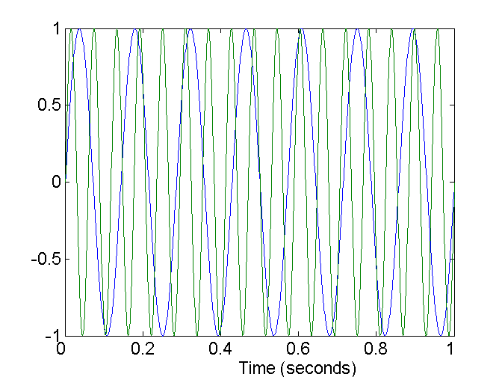
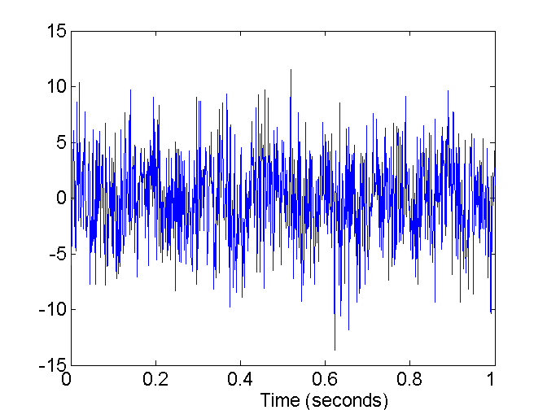
Noise
Noise refers to modification of original values
Examples: distortion of a person’s voice when talking on a poor phone and “snow” on television screen
Two Sine Waves
Two Sine Waves + Noise

Slide 31
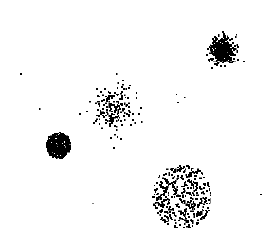
Outliers
Outliers are data objects with characteristics that are considerably different than most of the other data objects in the data set

Slide 32
Missing Values
Reasons for missing values
Information is not collected (e.g., people decline to give their age and weight)
Attributes may not be applicable to all cases (e.g., annual income is not applicable to children)
Handling missing values
Eliminate Data Objects
Estimate Missing Values
Ignore the Missing Value During Analysis
Replace with all possible values (weighted by their probabilities)

Slide 33
Duplicate Data
Data set may include data objects that are duplicates, or almost duplicates of one another
Major issue when merging data from heterogenous sources
Examples:
Same person with multiple email addresses
Data cleaning
Process of dealing with duplicate data issues

Slide 34
Data Preprocessing
Aggregation
Sampling
Dimensionality Reduction
Feature subset selection
Feature creation
Discretization and Binarization
Attribute Transformation

Slide 35
Aggregation
Combining two or more attributes (or objects) into a single attribute (or object)
Purpose
Data reduction
Reduce the number of attributes or objects
Change of scale
Cities aggregated into regions, states, countries, etc
More “stable” data
Aggregated data tends to have less variability

Slide 36
Sampling
Sampling is the main technique employed for data selection.
It is often used for both the preliminary investigation of the data and the final data analysis.
Statisticians sample because obtaining the entire set of data of interest is too expensive or time consuming.
Sampling is used in data mining because processing the entire set of data of interest is too expensive or time consuming.

Slide 37

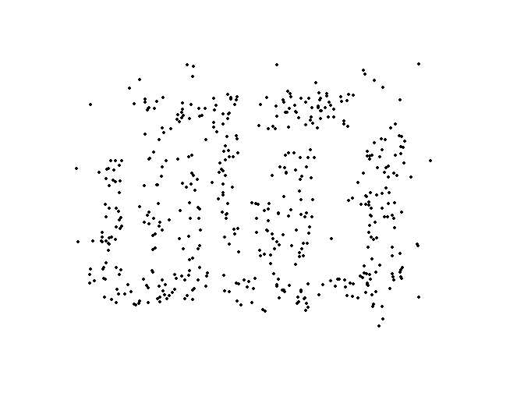
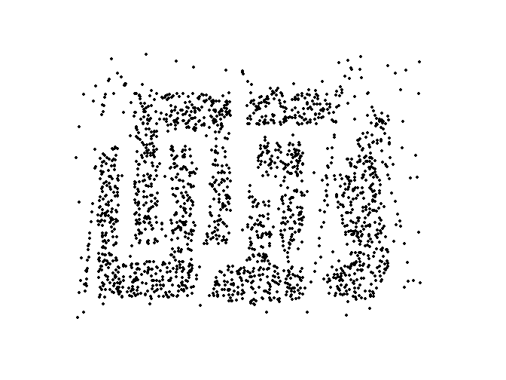
Sample Size
8000 points 2000 Points 500 Points

Slide 38
Sampling …
The key principle for effective sampling is the following:
using a sample will work almost as well as using the entire data sets, if the sample is representative
A sample is representative if it has approximately the same property (of interest) as the original set of data

Slide 39
Types of Sampling
Simple Random Sampling
There is an equal probability of selecting any particular item
Sampling without replacement
As each item is selected, it is removed from the population
Sampling with replacement
Objects are not removed from the population as they are selected for the sample.
In sampling with replacement, the same object can be picked up more than once
Stratified sampling
Split the data into several partitions; then draw random samples from each partition

Slide 40
Curse of Dimensionality
When dimensionality increases, data becomes increasingly sparse in the space that it occupies
Definitions of density and distance between points, which is critical for clustering and outlier detection, become less meaningful

Slide 41
Dimensionality Reduction
Purpose:
Avoid curse of dimensionality
Reduce amount of time and memory required by data mining algorithms
Allow data to be more easily visualized
May help to eliminate irrelevant features or reduce noise
Techniques
Principle Component Analysis
Singular Value Decomposition
Others: supervised and non-linear techniques

Slide 42
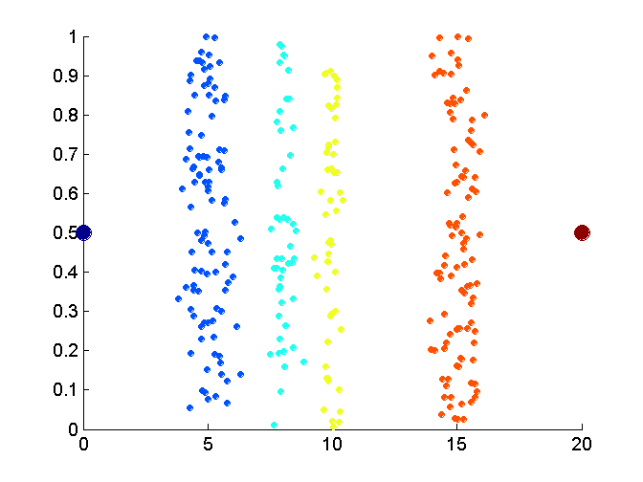
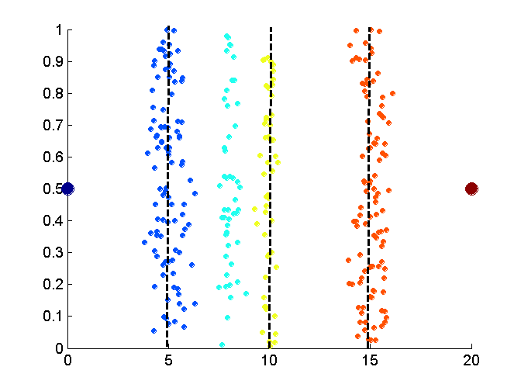
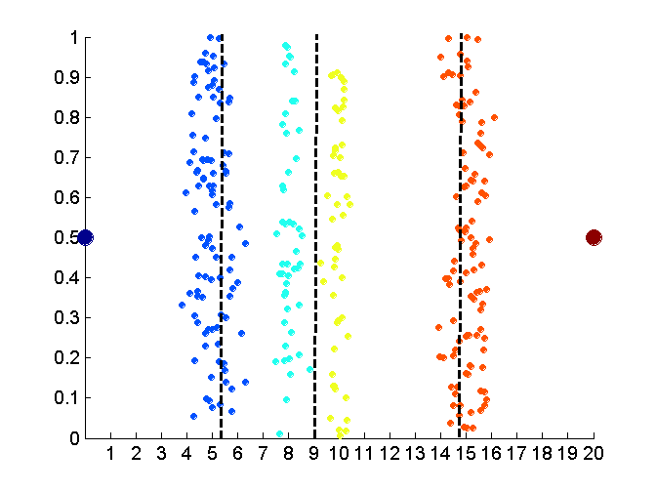
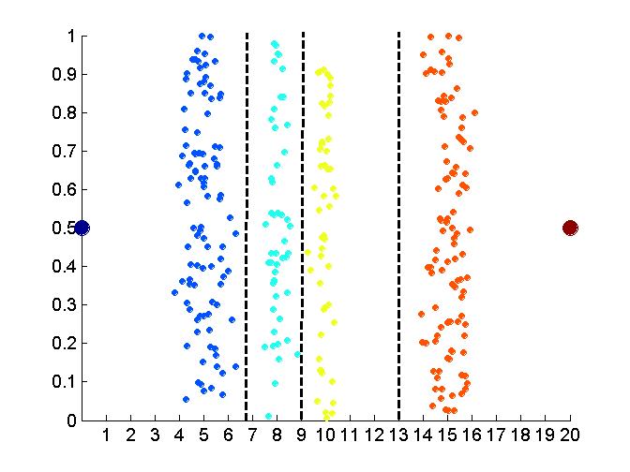
Discretization
Data
Equal interval width
Equal frequency
K-means

Slide 43
Attribute Transformation
A function that maps the entire set of values of a given attribute to a new set of replacement values such that each old value can be identified with one of the new values
Simple functions: x^{k}, log(x), e^{x}, |x|
Standardization and Normalization

Slide 44
Similarity and Dissimilarity
Similarity
Numerical measure of how alike two data objects are.
Is higher when objects are more alike.
Often falls in the range [0,1]
Dissimilarity
Numerical measure of how different are two data objects
Lower when objects are more alike
Minimum dissimilarity is often 0
Upper limit varies
Proximity refers to a similarity or dissimilarity

Slide 45
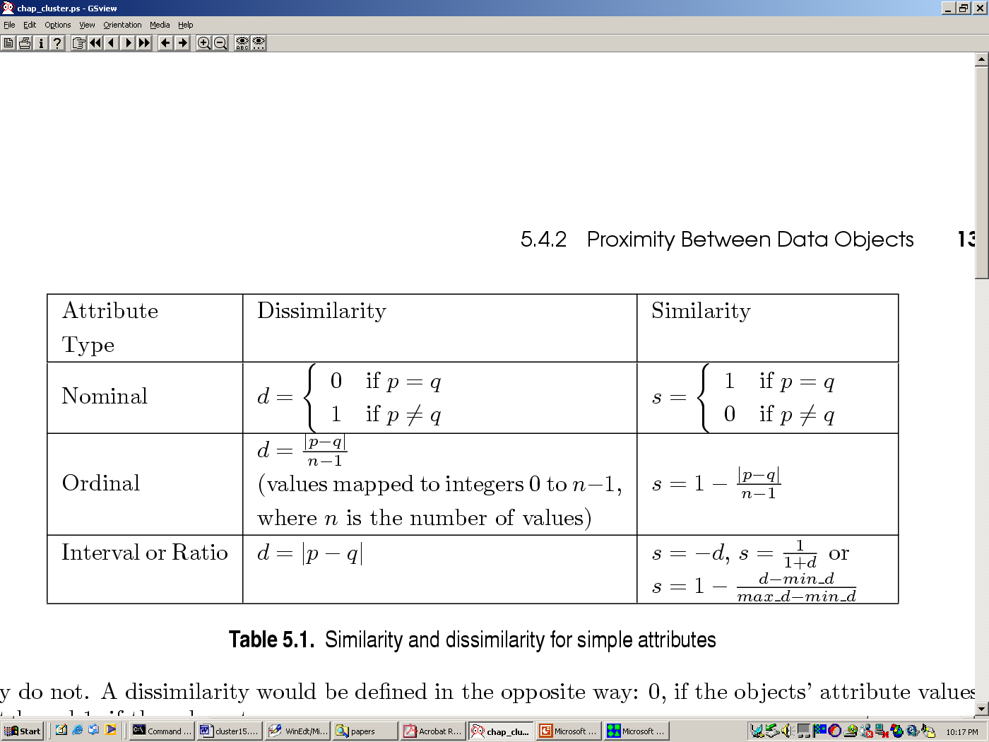
Similarity/Dissimilarity for Simple Attributes
p and q are the attribute values for two data objects.

Slide 46
Euclidean Distance
Euclidean Distance
Where n is the number of dimensions (attributes) and p_{k} and q_{k} are, respectively, the k^{th} attributes (components) or data objects p and q.
Standardization is necessary, if scales differ.

Slide 47
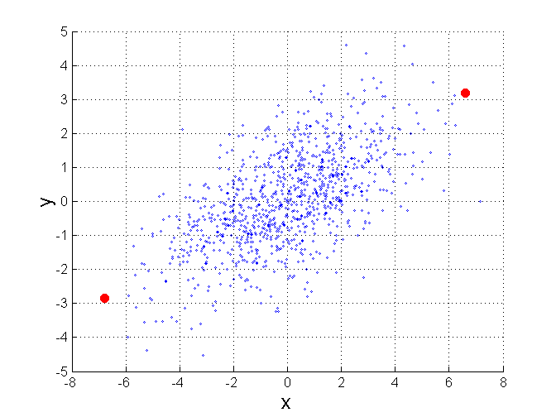
Mahalanobis Distance
Σ is the covariance matrix of the input data X
For red points, the Euclidean distance is 14.7, Mahalanobis distance is 6.

Slide 48
Cosine Similarity
If d₁ and d₂ are two document vectors, then
cos( d₁, d₂ ) = (d₁ • d₂) / ||d₁|| ||d₂|| ,
where • indicates vector dot product and || d || is the length of vector d.
Example:
d₁ = 3 2 0 5 0 0 0 2 0 0
d₂ = 1 0 0 0 0 0 0 1 0 2
d₁ • d₂= 3*1 + 2*0 + 0*0 + 5*0 + 0*0 + 0*0 + 0*0 + 2*1 + 0*0 + 0*2 = 5
||d₁|| = (3*3+2*2+0*0+5*5+0*0+0*0+0*0+2*2+0*0+0*0)^{0.5} = (42) ^{0.5} = 6.481
||d₂|| = (1*1+0*0+0*0+0*0+0*0+0*0+0*0+1*1+0*0+2*2) ^{0.5} = (6) ^{0.5} = 2.245
cos( d₁, d₂ ) = .3150

Slide 49
Similarity Between Binary Vectors
Common situation is that objects, p and q, have only binary attributes
Compute similarities using the following quantities
M₀₁ = the number of attributes where p was 0 and q was 1
M₁₀ = the number of attributes where p was 1 and q was 0
M₀₀ = the number of attributes where p was 0 and q was 0
M₁₁ = the number of attributes where p was 1 and q was 1
Simple Matching and Jaccard Coefficients
SMC = number of matches / number of attributes
= (M₁₁ + M₀₀) / (M₀₁ + M₁₀ + M₁₁ + M₀₀)
J = number of 11 matches / number of not-both-zero attributes values
= (M₁₁) / (M₀₁ + M₁₀ + M₁₁)

Slide 50
Correlation
Correlation measures the linear relationship between objects
To compute correlation, we standardize data objects, p and q, and then take their dot product

Slide 51
Visually Evaluating Correlation
Scatter plots showing the similarity from –1 to 1.

Slide 52
End of Data Preprocessing

Slide 53
Data Mining
Association Rules
Pabitra Mitra
Computer Science and Engineering

Slide 54
Association Rule Mining
Given a set of transactions, find rules that will predict the occurrence of an item based on the occurrences of other items in the transaction
Market-Basket transactions
Example of Association Rules
{Diaper} → {Beer}, {Milk, Bread} → {Eggs,Coke}, {Beer, Bread} → {Milk},
Implication means co-occurrence, not causality!

Slide 55
Definition: Frequent Itemset
Itemset
A collection of one or more items
Example: {Milk, Bread, Diaper}
k-itemset
An itemset that contains k items
Support count (σ)
Frequency of occurrence of an itemset
E.g. σ({Milk, Bread,Diaper}) = 2
Support
Fraction of transactions that contain an itemset
E.g. s({Milk, Bread, Diaper}) = 2/5
Frequent Itemset
An itemset whose support is greater than or equal to a minsup threshold

Slide 56
Association Rule
An implication expression of the form X → Y, where X and Y are itemsets
Example: {Milk, Diaper} → {Beer}
Rule Evaluation Metrics
Support (s)
Fraction of transactions that contain both X and Y
Confidence (c)
Measures how often items in Y appear in transactions that contain X
Example:

Slide 57
Association Rule Mining Task
Given a set of transactions T, the goal of association rule mining is to find all rules having
support ≥ minsup threshold
confidence ≥ minconf threshold
Brute-force approach:
List all possible association rules
Compute the support and confidence for each rule
Prune rules that fail the minsup and minconf thresholds
⇒ Computationally prohibitive!

Slide 58
Mining Association Rules
Two-step approach:
Frequent Itemset Generation
Generate all itemsets whose support ≥ minsup
Rule Generation
Generate high confidence rules from each frequent itemset, where each rule is a binary partitioning of a frequent itemset
Frequent itemset generation is still computationally expensive

Slide 59
Frequent Itemset Generation
Given d items, there are 2^{d} possible candidate itemsets

Slide 60
Frequent Itemset Generation
Brute-force approach:
Each itemset in the lattice is a candidate frequent itemset
Count the support of each candidate by scanning the database
Match each transaction against every candidate
Complexity ~ O(NMw) => Expensive since M = 2^{d} !!!

Slide 61
Frequent Itemset Generation Strategies
Reduce the number of candidates (M)
Complete search: M=2^{d}
Use pruning techniques to reduce M
Reduce the number of transactions (N)
Reduce size of N as the size of itemset increases
Used by DHP and vertical-based mining algorithms
Reduce the number of comparisons (NM)
Use efficient data structures to store the candidates or transactions
No need to match every candidate against every transaction

Slide 62
Reducing Number of Candidates
Apriori principle:
If an itemset is frequent, then all of its subsets must also be frequent
Apriori principle holds due to the following property of the support measure:
Support of an itemset never exceeds the support of its subsets
This is known as the anti-monotone property of support

Slide 63
Illustrating Apriori Principle
Found to be Infrequent
Pruned supersets

Slide 64
Illustrating Apriori Principle
Items (1-itemsets)
Pairs (2-itemsets)
(No need to generate candidates involving Coke or Eggs)
Minimum Support = 3
Triplets (3-itemsets)
If every subset is considered,
⁶C₁ + ⁶C₂ + ⁶C₃ = 41
With support-based pruning,
6 + 6 + 1 = 13

Slide 65
Apriori Algorithm
Method:
Let k=1
Generate frequent itemsets of length 1
Repeat until no new frequent itemsets are identified
Generate length (k+1) candidate itemsets from length k frequent itemsets
Prune candidate itemsets containing subsets of length k that are infrequent
Count the support of each candidate by scanning the DB
Eliminate candidates that are infrequent, leaving only those that are frequent

Slide 66
Factors Affecting Complexity
Choice of minimum support threshold
lowering support threshold results in more frequent itemsets
this may increase number of candidates and max length of frequent itemsets
Dimensionality (number of items) of the data set
more space is needed to store support count of each item
if number of frequent items also increases, both computation and I/O costs may also increase
Size of database
Apriori makes multiple passes, run time of algorithm increase with number of transactions
Average transaction width
This may increase max length of frequent itemsets and traversals of hash tree (number of subsets in a transaction increases with its width)

Slide 67
Rule Generation
How to efficiently generate rules from frequent itemsets?
In general, confidence does not have an anti-monotone property
c(ABC →D) can be larger or smaller than c(AB →D)
But confidence of rules generated from the same itemset has an anti-monotone property
e.g., L = {A,B,C,D}: c(ABC → D) ≥ c(AB → CD) ≥ c(A → BCD)
Confidence is anti-monotone w.r.t. number of items on the RHS of the rule

Slide 68
Rule Generation for Apriori Algorithm
Lattice of rules
Low Confidence Rule
Pruned Rules

Slide 69
Rule Generation for Apriori Algorithm
Candidate rule is generated by merging two rules that share the same prefix in the rule consequent
join(CD=>AB,BD=>AC) would produce the candidate rule D => ABC
Prune rule D=>ABC if its subset AD=>BC does not have high confidence

Slide 70
Pattern Evaluation
Association rule algorithms tend to produce too many rules
many of them are uninteresting or redundant
Redundant if {A,B,C} → {D} and {A,B} → {D} have same support & confidence
Interestingness measures can be used to prune/rank the derived patterns
In the original formulation of association rules, support & confidence are the only measures used

Slide 71
Application of Interestingness Measure
Interestingness Measures

Slide 72
Computing Interestingness Measure
Given a rule X → Y, information needed to compute rule interestingness can be obtained from a contingency table
Contingency table for supports X → Y
 | Y | Y
X | f₁₁ | f₁₀ | f₁₊
X | f₀₁ | f₀₀ | f_{o+}
 | f₊₁ | f₊₀ | |T|
Used to define various measures
support, confidence, lift, Gini, J-measure, etc.

Slide 73
Statistical Independence
Population of 1000 students
600 students know how to swim (S)
700 students know how to bike (B)
420 students know how to swim and bike (S,B)
P(S∧B) = 420/1000 = 0.42
P(S) × P(B) = 0.6 × 0.7 = 0.42
P(S∧B) = P(S) × P(B) => Statistical independence
P(S∧B) > P(S) × P(B) => Positively correlated
P(S∧B) < P(S) × P(B) => Negatively correlated

Slide 74
Statistical-based Measures
take into account statistical dependence

Slide 75
Example: Lift/Interest
 | Coffee | Coffee
Tea | 15 | 5 | 20
Tea | 75 | 5 | 80
 | 90 | 10 | 100
Association Rule: Tea → Coffee
Confidence= P(Coffee|Tea) = 0.75
but P(Coffee) = 0.9
Lift = 0.75/0.9= 0.8333 (< 1, therefore is negatively associated)

Slide 76
There are lots of measures proposed in the literature
Some measures are good for certain applications, but not for others
What criteria should we use to determine whether a measure is good or bad?
What about Apriori-style support based pruning? How does it affect these measures?

Slide 77
Subjective Interestingness Measure
Objective measure:
Rank patterns based on statistics computed from data
e.g., 21 measures of association (support, confidence, Laplace, Gini, mutual information, Jaccard, etc).
Subjective measure:
Rank patterns according to user’s interpretation
A pattern is subjectively interesting if it contradicts the expectation of a user (Silberschatz & Tuzhilin)
A pattern is subjectively interesting if it is actionable (Silberschatz & Tuzhilin)

Slide 78
Interestingness via Unexpectedness
Need to model expectation of users (domain knowledge)
Need to combine expectation of users with evidence from data (i.e., extracted patterns)
+
Pattern expected to be frequent
-
Pattern expected to be infrequent
Pattern found to be frequent
Pattern found to be infrequent
+
-
Expected Patterns
-
+
Unexpected Patterns

Slide 79
End of Association Rule

