Slide 1
CloverLeaf application with SYCL and Celerity
Project by Sourabh Kulkarni
Guided by Prof. Dr. Sohan Lal

Slide 2
SYCL
High level programming model for heterogenous computing
Based on OpenCL
Can target any device and any number of devices

Slide 3
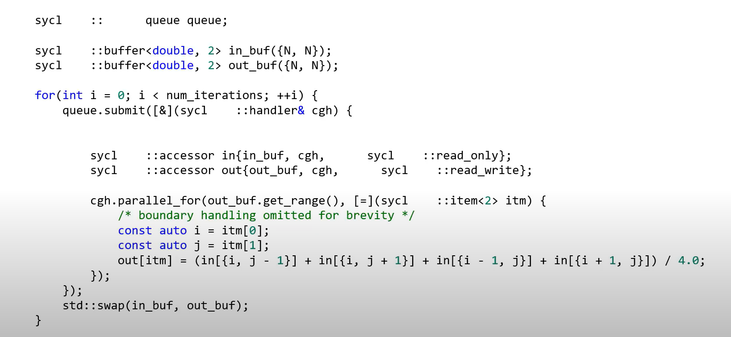
SYCL code example – Jacobi stencil

Slide 4
Celerity
Celerity is a high-level C++17 API and runtime environment that aims to bring the power and ease of use of SYCL to distributed-memory accelerator clusters.
Targets super computers and accelerator clusters.
Single distributed queue
Range mappers to specify the locality of the data access from the buffers
Host task support for asynchronous program handling

Slide 5
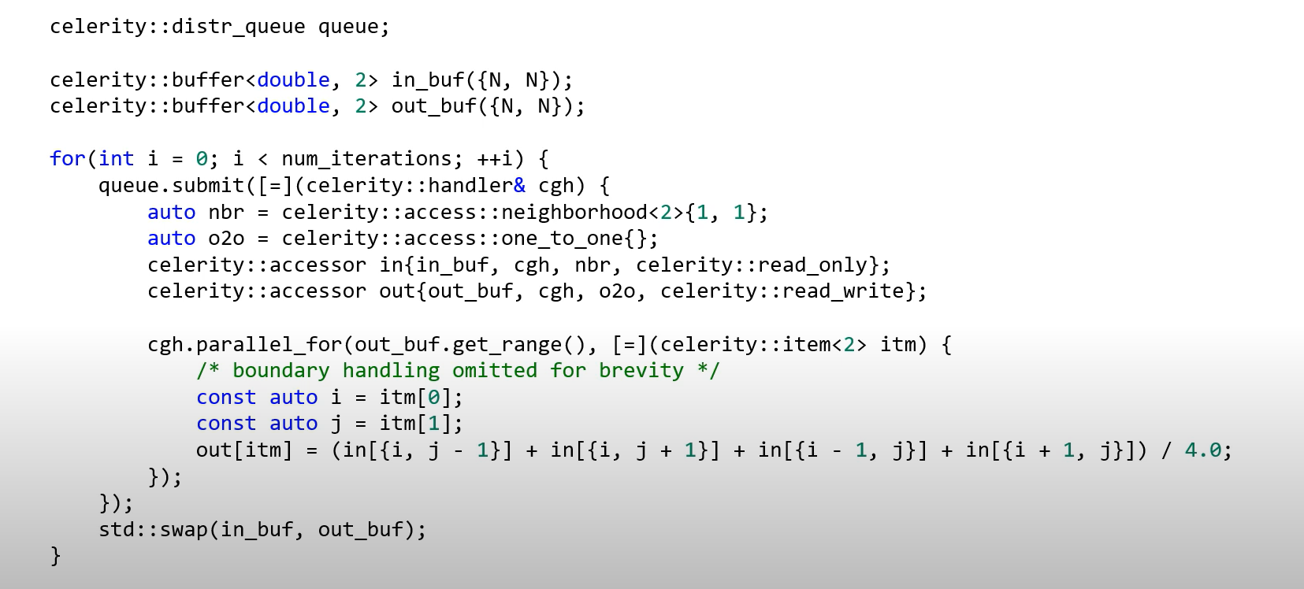
SYCL + Celerity code example – Jacobi stencil

Slide 6
CloverLeaf application
Simulates the behavior of a simple fluid dynamics system
Solves the compressible Euler equations on a Cartesian grid
Each cell stores three values: energy, density, and pressure
Each kernels looks over the entire grid and updates one (or some) mesh variables, based on a kernel-dependent computational stencil
It produces a second-order accurate solution using explicit finite volume methods.
Documentation - https://github.com/UK-MAC/CloverLeaf/blob/master/documentation.txt

Slide 7
Physics jargon
Lagrangian step -> advance the fluid by a delta time step
Second order Van Leer scheme -> for advection
Ideal gas equation -> to calculate the pressure and sound speed in a cell when energy and density are given
Navier-Stokes equations -> to simulate the fluid dynamics system

Slide 8
CloverLeaf implementations available
Serial
Performance - https://github.com/UK-MAC/CloverLeaf_Serial
OpenMP
Performance - https://github.com/UK-MAC/CloverLeaf_OpenMP
OpenACC
Performance - https://github.com/UK-MAC/CloverLeaf_OpenACC
CUDA
OpenCL
SYCL

Slide 9
SW Architecture
Kernels and Algorithm
Control Logic
Library

Slide 10
Kernel and Algorithm
Accelerate
Advec_cell
Advec_mom
Build_field
Calc_dt
Field_summary
Flux_calc
Ideal_gas
Pack_kernel
Initialise_chunk -> dispatches jobs on the queue

Slide 11
Kernel and Algorithm
PdV
Reset_field -> resets the field of interest
Revert
Timestep
Update_halo -> manages chunk and field boundary data
Update_tile_halo_kernel -> manages tile boundary data
Update_tile_halo -> invokes the appropriate tile boundary managing kernel
Viscosity -> calculate artificial viscosity

Slide 12
Control Logic
Clover_leaf -> runs the application (main)
Advection
Comms -> Mesh chunking and handling
Generate_chunk -> creates chunks of data for processing
Hydro -> cloverleaf complete logic (function/kernel calls) and profiling
Initialise -> initializes the application
Read_input -> read command line arguments as input for the application
Start -> invokes the application to build the field and to create chunks

Slide 13
Library
Comms -> tile handling and basic functions
Definitions -> all definitions of data types, functions and templates
Report -> error reporting
Sycl_reduction -> wrapper class to support reductions in SYCL
Sycl_utils -> wrapper class delegating SYCL code underneath
Timer -> real time measurement
Visit -> generates vtk files

Slide 14
SYCL wrapper structures
Accessor -> creates accessors for global buffer and host
Buffer -> creates buffers for global access and host access
Range1d -> creates 1d range object
Range2d -> creates 2d range object

Slide 15
SYCL wrapper functions
Offset -> accepts IDs and offsets them as per the required arguments
Par_ranged -> abstracts ‘sycl::parallel_for’ for 1d and 2d ranges and invokes a functor
Execute -> abstracts ‘sycl::queue::submit’ operation and handles exceptions

Slide 16
SYCL reduction wrappers
Local_reducer -> creates a reducer object to drain the result into a single local node
Par_reduce_nd_impl -> abstracts parallel_for reduction by accepting several functions for operation, combining and finalizing the result
Par_reduce_1d -> wraps par_reduce_nd_impl
Par_reduce_2d -> wraps par_reduce_nd_impl

Slide 17
Application Flow (1)
Clover_leaf
Initialise
Read_input
Start
Build_field
Initialize_chunk
Generate_chunk
Ideal_gas
Update_halo
Update_tile_halo
Update_tile_halo_kernel
Field_summary
…..

Slide 18
Application Flow (2)
Hydro
Timestep
Ideal_gas
Update_halo (…..)
Viscosity
Update_halo(…..)
Calc_dt
PdV
Ideal_gas
Update_halo(…..)
Revert
….

Slide 19
Application Flow (3)
Hydro
Accelerate
PdV(…..)
Flux_calc
Advection
Update_halo(…..)
Advec_cell
Update_halo(…..)
Advec_mom
Advec_cell
Udpate_halo(.....)
Advec_mom
Reset_field
….

Slide 20
Application Flow (4)
Hydro
Field_summary
Visit
Ideal_gas
Udpate_halo(…..)
Viscosity
Exit

Slide 21
Potential file updates
Sycl_reduction
Sycl_utils
All buffer and accessor creation calls
All kernel files

