Slide 1

Alumni Management System

Slide 2






Why Alumni Management System?
Notes:
Alumni are a truly asset
Potential recruiters for your new graduates
Brand ambassadors for your school
A significant source of revenue through donations and memberships
A large pool of expertise across different industries and roles
A precious help for the organization of your alumni events

Slide 3
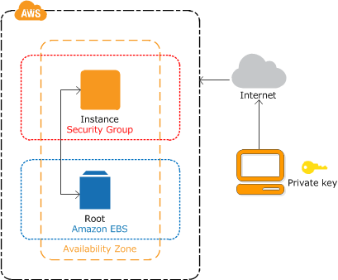


Migrate into the Cloud
Challenges
Collation Issues
Super rights for creating stored procedures
and views
Public & Private database – Security Groups
Notes:
We learnt to create a cloud MySQL database and migrate the local database to AWS RDS instance using a script generated on local database. Some of the issues we faced were:
Collation issues – We required to change the MySQL version of our cloud database to 8.0.15 to resolve this error.
The Super admin rights were required to execute the script generated for the stored procedures. On browsing through the AWS documentation, we learnt about creating and assigning a new parameter group with the value for log_bin_trust_function_creators=1 and then rebooting the database instance. This also did not resolve the error in our case. Finally, we resolved it by replacing `root`@`localhost` with CURRENT_USER to grant the creation rights to the default user.
For being able to access the cloud database from anywhere, we learnt about the security groups. The inbound rule had to be modified to accept connections from all IP addresses.

Slide 4
Advanced SQL SP 1 Definition
DROP PROCEDURE IF EXISTS spInviteProgramAlumniToEvent;
DELIMITER $$
CREATE PROCEDURE spInviteProgramAlumniToEvent( event_name VARCHAR(50), event_start_DT DATETIME, event_end_DT DATETIME, event_location VARCHAR(50), event_department_id INT, event_city_id INT, my_program_name VARCHAR(50) )
COMMENT 'This stored procedure allows the user to create an event and invite all alumni from a program.'
BEGIN
INSERT INTO `segr5300`.`all_events` (`all_events_name`, `all_events_start_time`, `all_events_end_time`, `all_events_address`, `department_id`, `city_id`)
VALUES
(event_name, event_start_DT, event_end_DT, event_location, event_department_id, event_city_id);
SET @event_id = (SELECT LAST_INSERT_ID());
INSERT INTO `segr5300`.`alum_events` (`all_events_id`,`alumni_id`,`attended`)
SELECT @event_id, a.alumni_id, 0 FROM alum_program ap LEFT JOIN alumni a
ON ap.alumni_id = a.alumni_id WHERE program_id IN (SELECT program_id FROM program
WHERE program_name = my_program_name);
END$$
DELIMITER ;
Notes:
Stored Procedures – Parameterized queries
Insert – One query to create an event and invite alumni from a department
SELECT LAST_INSERT_ID()
Select – Find the latest information on alumni by department, company, contact
Multiple table join
Using subquery in the where clause
Views
Aggregates - donations by Campaigns (this would help to understand different campaigns to market and strategize better),
Joins - the catalogue of all events organized
Subquery - top 5 donations from the alumni to send them appreciation letters.

Slide 5
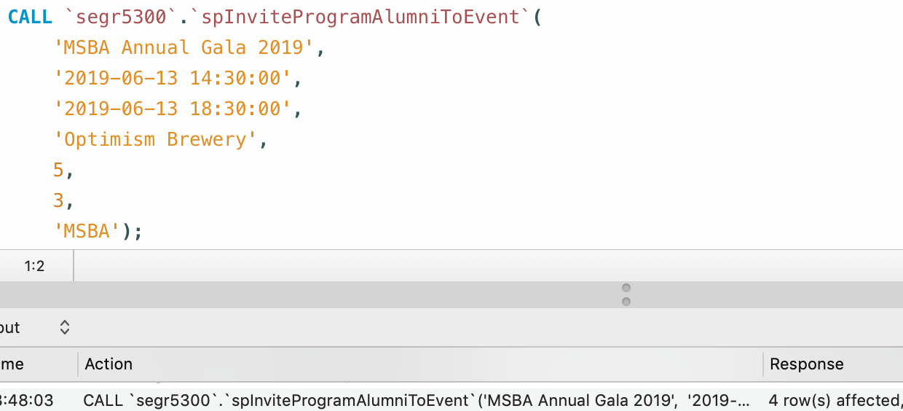
Advanced SQL SP 1 Call
Notes:
Stored Procedures – Parameterized queries
Insert – One query to create an event and invite alumni from a department
SELECT LAST_INSERT_ID()
Select – Find the latest information on alumni by department, company, contact
Multiple table join
Using subquery in the where clause
Views
Aggregates - donations by Campaigns (this would help to understand different campaigns to market and strategize better),
Joins - the catalogue of all events organized
Subquery - top 5 donations from the alumni to send them appreciation letters.

Slide 6
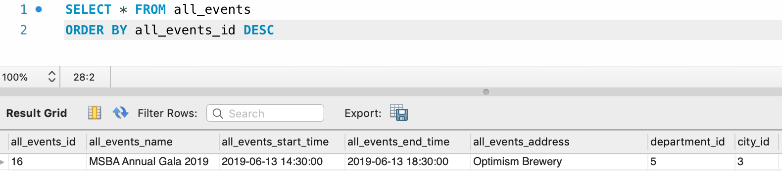
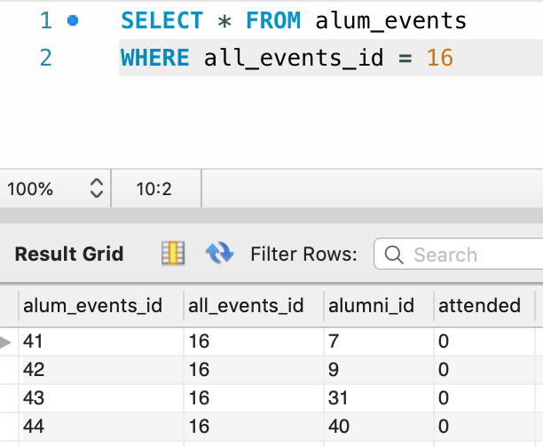
Advanced SQL SP 1 Call
Notes:
Stored Procedures – Parameterized queries
Insert – One query to create an event and invite alumni from a department
SELECT LAST_INSERT_ID()
Select – Find the latest information on alumni by department, company, contact
Multiple table join
Using subquery in the where clause
Views
Aggregates - donations by Campaigns (this would help to understand different campaigns to market and strategize better),
Joins - the catalogue of all events organized
Subquery - top 5 donations from the alumni to send them appreciation letters.

Slide 7
Advanced SQL SP 2 Definition
DROP PROCEDURE IF EXISTS spFindAlumniByDepartment;
DELIMITER $$
CREATE PROCEDURE spFindAlumniByDepartment(dept_id INT)
COMMENT 'This stored procedure allows the user to retrieve all alumni from a department.'
COMMENT 'EXAMPLE CALL -> CALL spFindAlumniByDepartment(5)'
BEGIN
SET @dept_name = (SELECT department_name from department where department_id = dept_id);
SELECT alumni_name, alumni_emailID, alumni_designation,
c.company_name, @dept_name as department
FROM alumni a
LEFT JOIN alum_program ap
ON a.alumni_id = ap.alumni_id
LEFT JOIN company c
ON a.company_id = c.company_id
WHERE ap.program_id IN (SELECT program_id FROM program WHERE department_id = dept_id);
END$$
DELIMITER ;
Notes:
Stored Procedures – Parameterized queries
Insert – One query to create an event and invite alumni from a department
SELECT LAST_INSERT_ID()
Select – Find the latest information on alumni by department, company, contact
Multiple table join
Using subquery in the where clause
Views
Aggregates - donations by Campaigns (this would help to understand different campaigns to market and strategize better),
Joins - the catalogue of all events organized
Subquery - top 5 donations from the alumni to send them appreciation letters.

Slide 8
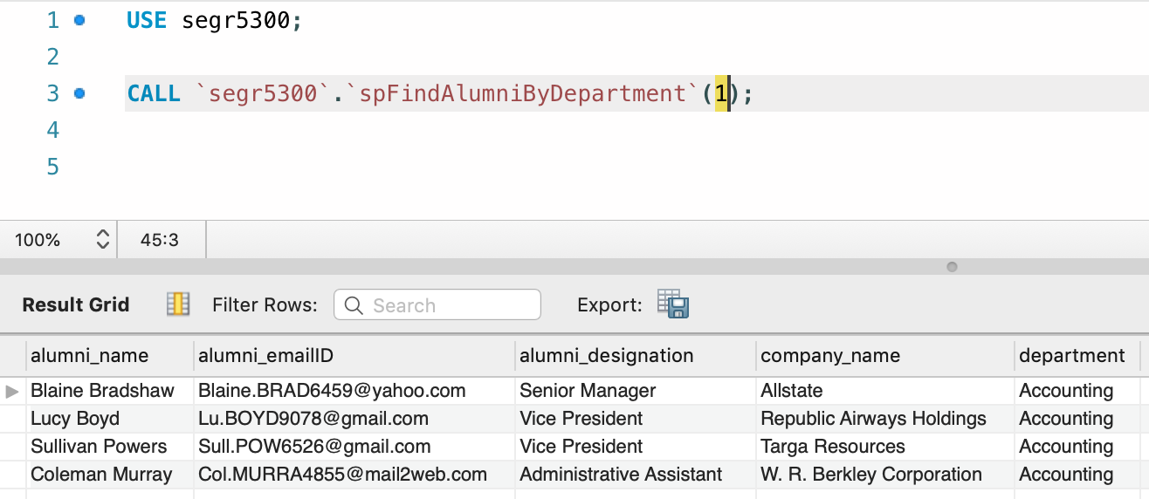
Advanced SQL SP 2 Call
Notes:
Stored Procedures – Parameterized queries
Insert – One query to create an event and invite alumni from a department
SELECT LAST_INSERT_ID()
Select – Find the latest information on alumni by department, company, contact
Multiple table join
Using subquery in the where clause
Views
Aggregates - donations by Campaigns (this would help to understand different campaigns to market and strategize better),
Joins - the catalogue of all events organized
Subquery - top 5 donations from the alumni to send them appreciation letters.

Slide 9
Advanced SQL View 1 Definition
DROP VIEW IF EXISTS viewAlumniProfileSnapshot;
CREATE VIEW viewAlumniProfileSnapshot AS
SELECT a.alumni_id, a.alumni_student_id, a.alumni_name, a.alumni_emailID,
alumni_contact_no as contact_no, alumni_postal_street_address as address,
alumni_postal_zip as zip_code, city_name as city, company_name as company,
COALESCE(donations.total_donation,0) as total_donations,
COALESCE(evnts.events_attended,0) as events_attended,
COALESCE(prgms.programs_attended,0) as programs_attended
FROM alumni a
LEFT JOIN (SELECT alumni_id, SUM(alumni_donation_amount) as total_donation
FROM alumni_donation GROUP BY alumni_id) as donations ON a.alumni_id = donations.alumni_id
LEFT JOIN (SELECT alumni_id, COUNT(alum_events_id) as events_attended
FROM alum_events WHERE attended=1 GROUP BY alumni_id) as evnts ON a.alumni_id = evnts.alumni_id
LEFT JOIN (SELECT alumni_id, COUNT(program_id) as programs_attended FROM alum_program
GROUP BY alumni_id) as prgms
ON a.alumni_id = prgms.alumni_id
LEFT JOIN city ON a.city_id = city.city_id
LEFT JOIN company cmp ON a.company_id = cmp.company_id;
Notes:
Stored Procedures – Parameterized queries
Insert – One query to create an event and invite alumni from a department
SELECT LAST_INSERT_ID()
Select – Find the latest information on alumni by department, company, contact
Multiple table join
Using subquery in the where clause
Views
Aggregates - donations by Campaigns (this would help to understand different campaigns to market and strategize better),
Joins - the catalogue of all events organized
Subquery - top 5 donations from the alumni to send them appreciation letters.

Slide 10
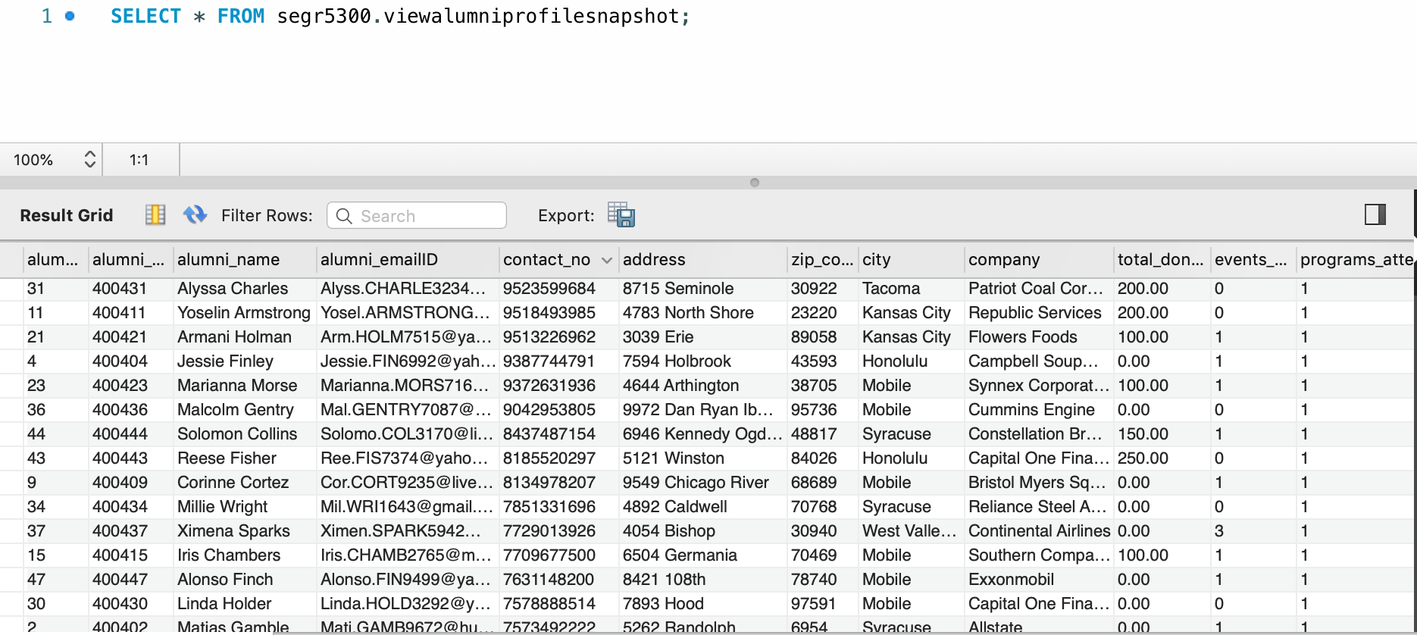
Advanced SQL View 1 Call
Notes:
Stored Procedures – Parameterized queries
Insert – One query to create an event and invite alumni from a department
SELECT LAST_INSERT_ID()
Select – Find the latest information on alumni by department, company, contact
Multiple table join
Using subquery in the where clause
Views
Aggregates - donations by Campaigns (this would help to understand different campaigns to market and strategize better),
Joins - the catalogue of all events organized
Subquery - top 5 donations from the alumni to send them appreciation letters.

Slide 11
Advanced SQL View 2 Definition
DROP VIEW IF EXISTS viewAllEventsCatalogue;
CREATE VIEW viewAllEventsCatalogue AS
SELECT e.all_events_name, DATE_FORMAT(e.all_events_start_time, '%e %b %Y') as event_date,
DATE_FORMAT(e.all_events_start_time, '%r') as event_start_time,
DATE_FORMAT(e.all_events_end_time, '%r') as event_end_time,
department_name as host_department,
all_events_address as location, city_name, country_name
FROM all_events e
LEFT JOIN department d
ON e.department_id = d.department_id
LEFT JOIN city c
ON e.city_id = c.city_id
LEFT JOIN country cn
ON c.country_id = cn.country_id;
Notes:
Stored Procedures – Parameterized queries
Insert – One query to create an event and invite alumni from a department
SELECT LAST_INSERT_ID()
Select – Find the latest information on alumni by department, company, contact
Multiple table join
Using subquery in the where clause
Views
Aggregates - donations by Campaigns (this would help to understand different campaigns to market and strategize better),
Joins - the catalogue of all events organized
Subquery - top 5 donations from the alumni to send them appreciation letters.

Slide 12
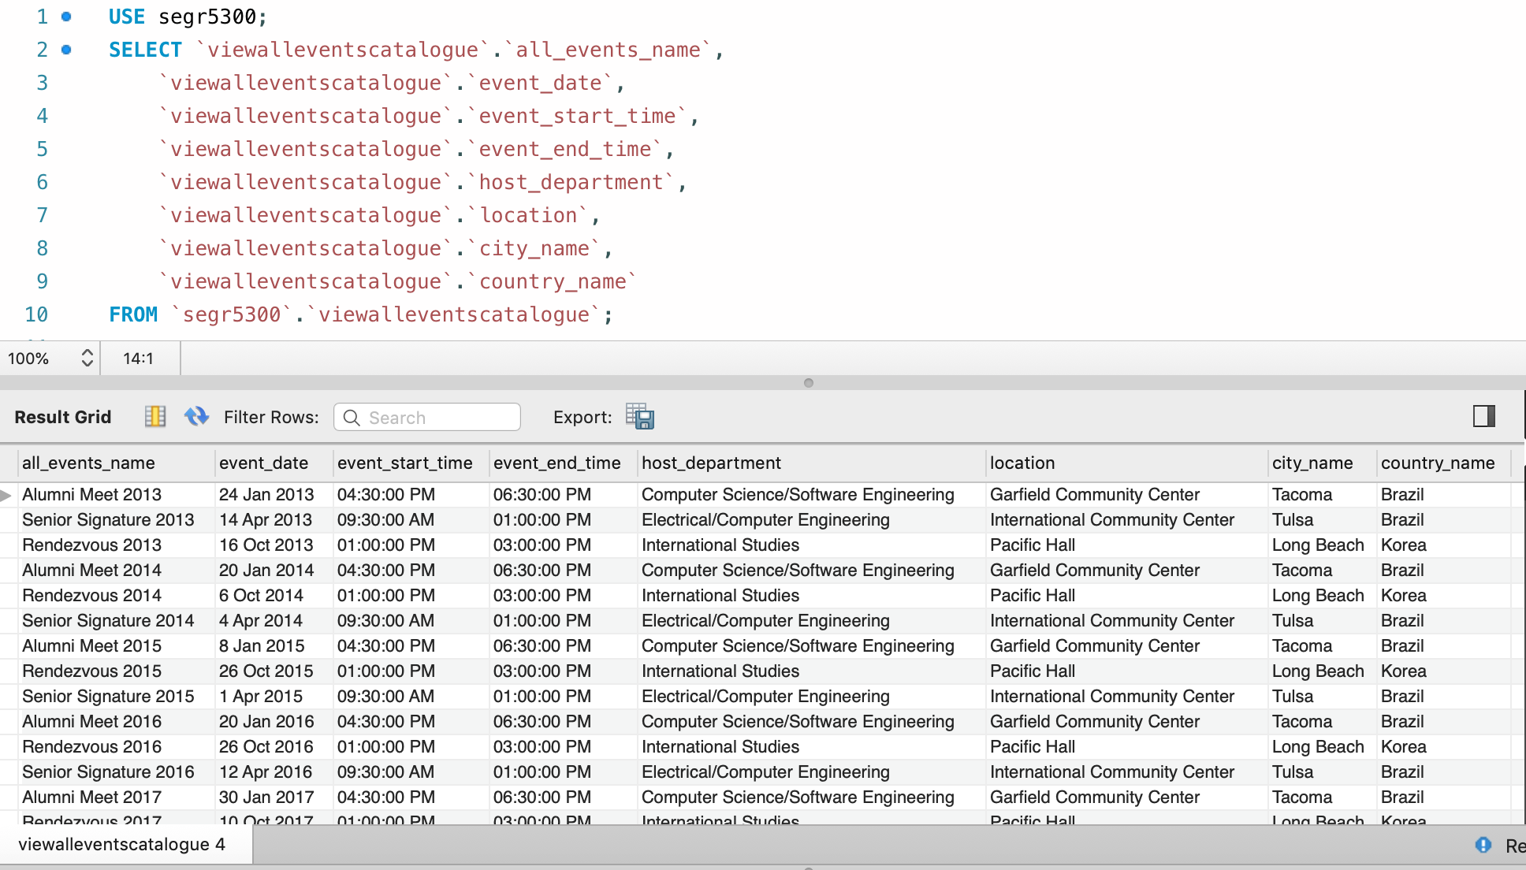
Advanced SQL View 2 Call
Notes:
Stored Procedures – Parameterized queries
Insert – One query to create an event and invite alumni from a department
SELECT LAST_INSERT_ID()
Select – Find the latest information on alumni by department, company, contact
Multiple table join
Using subquery in the where clause
Views
Aggregates - donations by Campaigns (this would help to understand different campaigns to market and strategize better),
Joins - the catalogue of all events organized
Subquery - top 5 donations from the alumni to send them appreciation letters.

Slide 13
Advanced SQL View 3 Definition
DROP VIEW IF EXISTS viewTop5Donation;
CREATE VIEW viewTop5Donation AS
SELECT a.alumni_name, Total_Donation
FROM alumni a
RIGHT JOIN (SELECT alumni_id,
SUM(alumni_donation_amount) AS Total_Donation
FROM alumni_donation d
GROUP BY alumni_id
ORDER BY Total_Donation DESC
LIMIT 5) AS d
ON a.alumni_id = d.alumni_id
Notes:
Stored Procedures – Parameterized queries
Insert – One query to create an event and invite alumni from a department
SELECT LAST_INSERT_ID()
Select – Find the latest information on alumni by department, company, contact
Multiple table join
Using subquery in the where clause
Views
Aggregates - donations by Campaigns (this would help to understand different campaigns to market and strategize better),
Joins - the catalogue of all events organized
Subquery - top 5 donations from the alumni to send them appreciation letters.

Slide 14
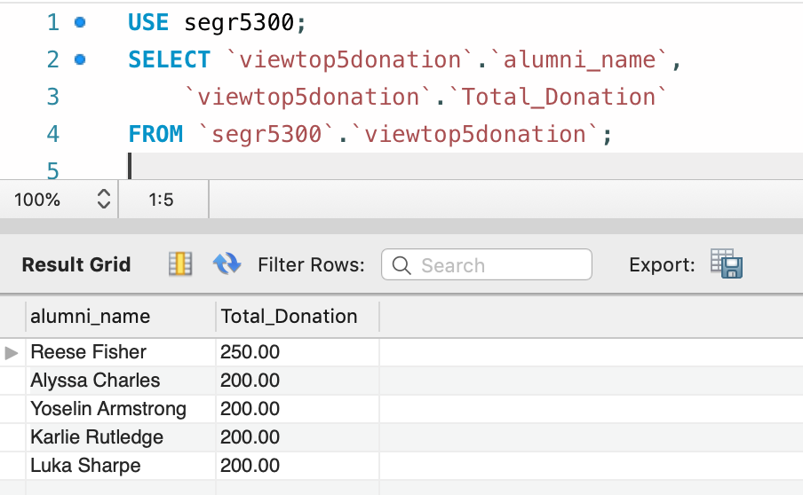
Advanced SQL View 3 Call
Notes:
Stored Procedures – Parameterized queries
Insert – One query to create an event and invite alumni from a department
SELECT LAST_INSERT_ID()
Select – Find the latest information on alumni by department, company, contact
Multiple table join
Using subquery in the where clause
Views
Aggregates - donations by Campaigns (this would help to understand different campaigns to market and strategize better),
Joins - the catalogue of all events organized
Subquery - top 5 donations from the alumni to send them appreciation letters.

Slide 15

Analytic Queries – Use Case 1
Our University event management put lots of efforts to organize an event. Not only efforts but money as well. But sometimes it turns out that after putting so much money and efforts, very less people attend it.
So, university wants to know what those events are so that they can either take some necessary actions like more publicity, communication, or cancel/merge them with other events.

Slide 16
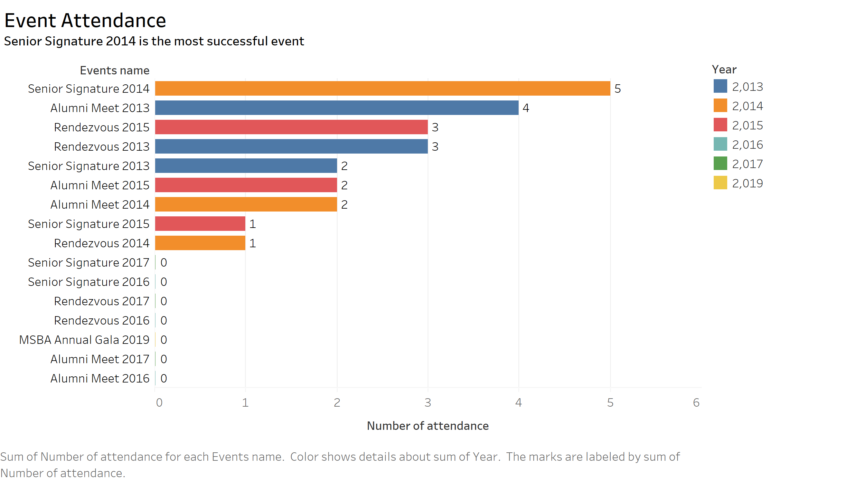
Use Case 1 – Graphs

Slide 17
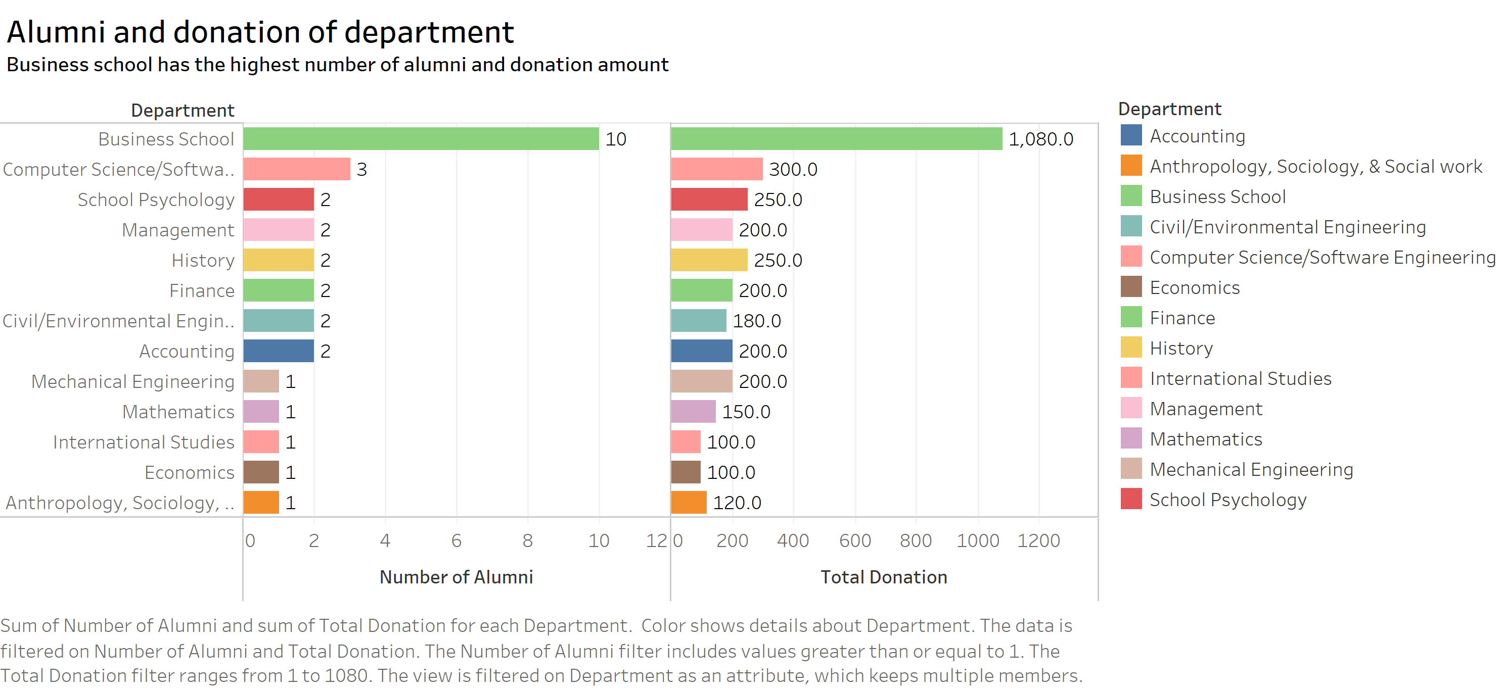
Use Case 1 – Graphs

Slide 18

Analytic Queries – Use Case 2
Expansion
Dean is planning to organize one fund raiser event and he wants us to shortlist 3 cities and also he wants to know which city he should go first. For this project we are deciding the cities based on these parameters:
Number of contacts in that city
Total donations received from that city
Number of companies our alumni(s) are associated with
After deciding the city, he will need detailed list of those alumni(s) :-
Alumni Name - Email id - Alumni Prog - All events attended by each alumnus - Donations given by each alumnus- companies they are associated with
Fund Raising
Networking

Slide 19
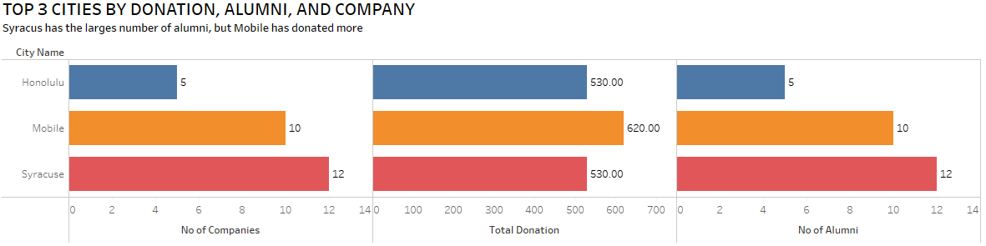
Use Case 2 – Visuals

Slide 20
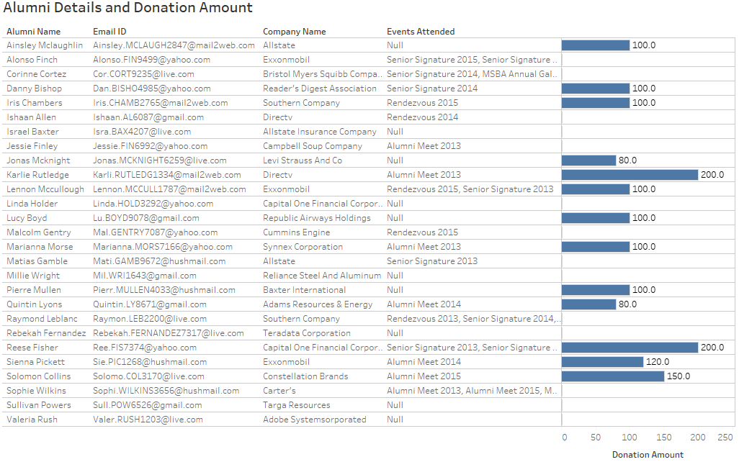
Use Case 2 – Visual

Slide 21
Scope for future improvements
We would like to resolve the error while restoring database on the AWS RDS instance from a backup programmatically.
For dashboard reporting, we can enhance the report by adding time series data for each event by year.
Add more visuals: Geographical, Text cloud visuals but were constrained by the amount of sample data.
Extend this database to create an online social network to increase alumni participation.
Add more data or use real data to arrive at actionable insights

Slide 22
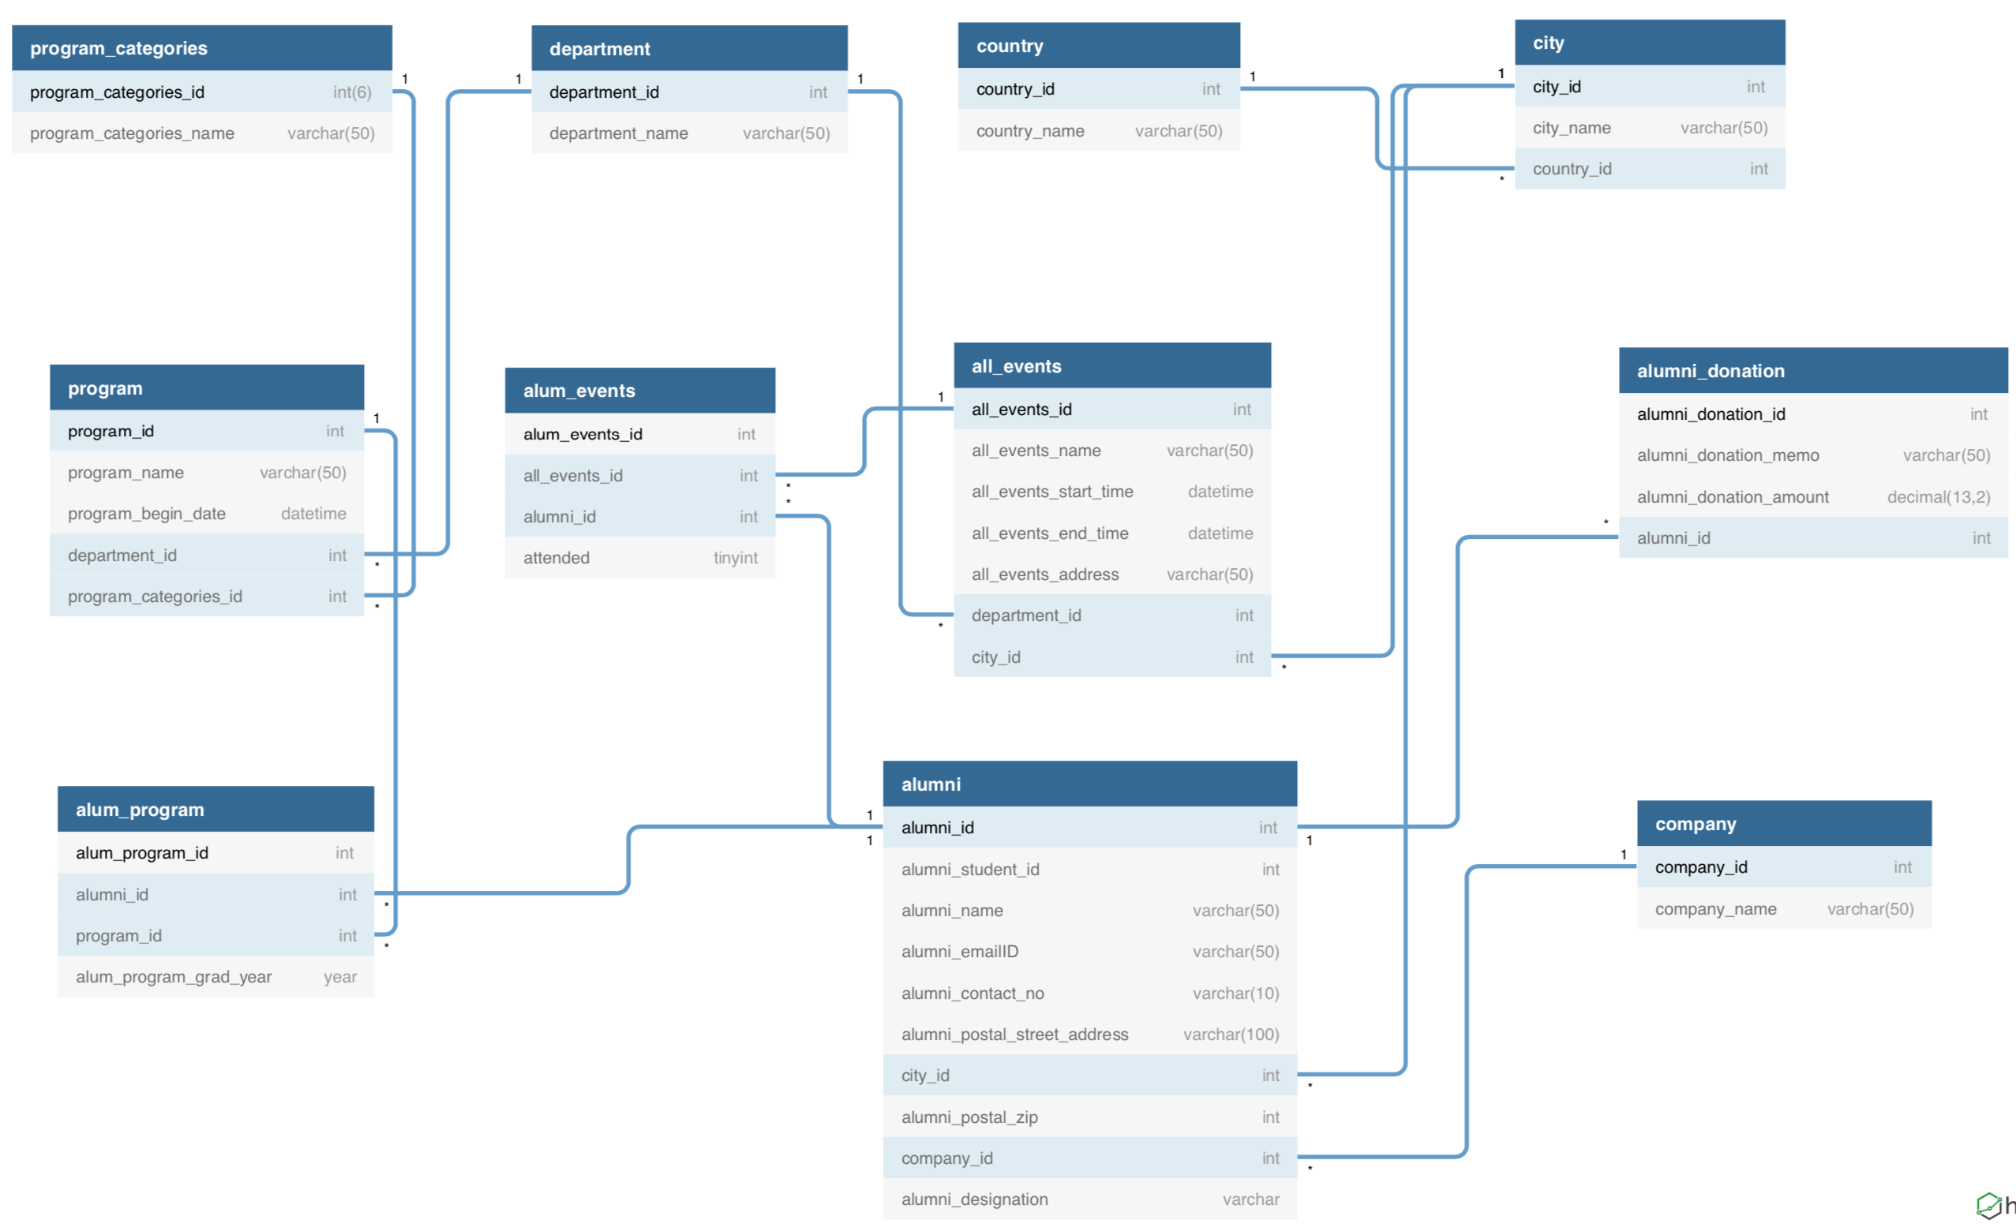
Data Modelling – ER diagram for reference
Notes:
translate business requirements to our database.
Add value through data
generate backup using MySQL workbench Data Export feature to generate a script that could restore the complete existing database locally or on the cloud.

