Slide 1
Health Care AI: Prompting Solutions on GenAI endpoints
Suman Roy, Ph.D.
OCI AI Science, Bangalore, India
Email: roy.suman@oracle.com
Adjunct Professor,
Dept. of Computer Science and Engg
IIIT-Delhi
Email: suman.roy68@gmail.com

Slide 2
Contents
IR Problems in Healthcare
Description of few tasks in IR: NER, RE, ASD, MEL, Summarization
Sketch of Deep Learning-bases solutions
Brief introduction to GenAI and LLM
In-context Learning and Inferencing
Prompting IR problems on ChatGPT UI
A Programmatic Approach of prompting using API keys

Slide 3
In-context Learning and inferencing

Slide 4
What are IR problems in Healthcare?
​Information retrieval (IR) in healthcare refers to the process of accessing
and extracting relevant medical information from vast and complex data
sources.
This encompasses retrieving patient records, clinical notes, medical literature,
imaging data, and other health-related documents.
The goal is to provide healthcare professionals with timely and pertinent
information to support clinical decision-making, research, and patient care.​

Slide 5
Key Applications of Information Retrieval in Healthcare
Clinical Decision Support: IR systems assist clinicians by providing access to patient histories, lab results, and relevant medical literature, enabling informed decision-making.​
Research and Evidence-Based Medicine: Researchers utilize IR to gather data from clinical trials, studies, and journals to support evidence-based practices.
Electronic Health Records (EHRs)/Clinical narratives: Efficient retrieval of patient information from EHRs ensures continuity of care and accurate treatment plans, and billing and insurance claims settlement.
Medical Imaging: IR facilitates the retrieval of imaging data, aiding in diagnostics and treatment planning.​
Public Health Monitoring: Aggregated data retrieval supports monitoring of disease outbreaks and public health trends.

Slide 6
Challenges in Healthcare Information Retrieval
Data Heterogeneity: Healthcare data comes in various formats (text, images, structured data),
making standardized retrieval complex.​
Privacy and Security: Ensuring patient confidentiality while accessing and sharing medical
information is paramount.​
Information Overload: Clinicians may face overwhelming amounts of data, necessitating efficient IR systems to filter and present relevant information.​
Advancements in IR Technologies:
Modern IR systems in healthcare leverage artificial intelligence and machine learning to enhance accuracy and efficiency.
For instance, tools like MedKnowts integrate documentation and information retrieval, providing clinicians with synthesized patient data to streamline workflows.

Slide 7
Description of few tasks in IR

Slide 8
Few tasks in IR
Entity extraction:
  Locate and classify named entities mentioned in unstructured text into pre-defined categories such as person names, organizations, locations, medical codes, time expressions, quantities, monetary values, percentages, etc
  Relationship Extraction:
  Identify the several semantic relations that can occur between the entities e.g., disease and treatment in bioscience text
Assertion Detection:
  Identify the assertion class (present, possible, absent) of an entity based on textual cues in unstructured text.
Entity Linking:
  Identify if a name that appears in text refers to a known entity in a reference set of named entities, such as a relational database or the set of articles in Wikipedia.

Slide 9
What is NER ?
NER involves identification of proper names in texts, and classification into a set of predefined categories of interest.
Three universally accepted categories:
  Person, location, organisation, medical codes
Other common tasks: recognition of date/time expressions, measures (percent, money, weight etc), email addresses etc.
Other domain-specific entities: names of Drugs, Genes, medical conditions, names of ships, bibliographic references etc.

Slide 10
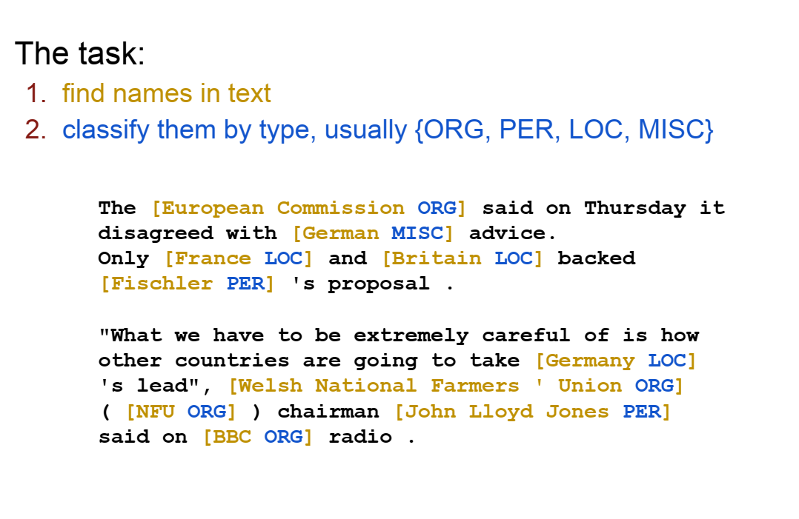
NER Task
3. rest of them are null entities

Slide 11
Examples of NER in medical domain
Entity types: SIGN_SYMPTOM, COURSE, DATETIME, ANATOMICAL_SITE
Pt reports cough (SIGN_SYMPTOM) is persisting (COURSE).
Rash on face (SIGN_SYMPTOM) is persisting (COURSE) without change.
has had soft loose stools (SIGN_SYMPTOM) 2-4 episodes in the mornings (DATETIME).
CARDIOVASCULAR (ANATOMICAL_SITE) Symptoms:
Denies chest pain (SIGN_SYMPTOM). Denies lightheadedness. Denies palpitations (SIGN_SYMPTOM). Denies swelling.
CARDIOVASCULAR (ANATOMICAL_SITE) Symptoms:
Denies chest pain (SIGN_SYMPTOM). Denies lightheadedness. Denies palpitations (SIGN_SYMPTOM). Denies swelling.
Bone marrow from 9/30/09 (DATETIME) showed 1.7% abnormal myeloid blasts (SIGN_SYMPTOM) consistent with persistent disease.

Slide 12
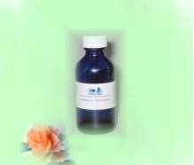

The task of Relation Extraction
Cure?
Prevent?
Treatment
Side Effect?
Disease

Slide 13
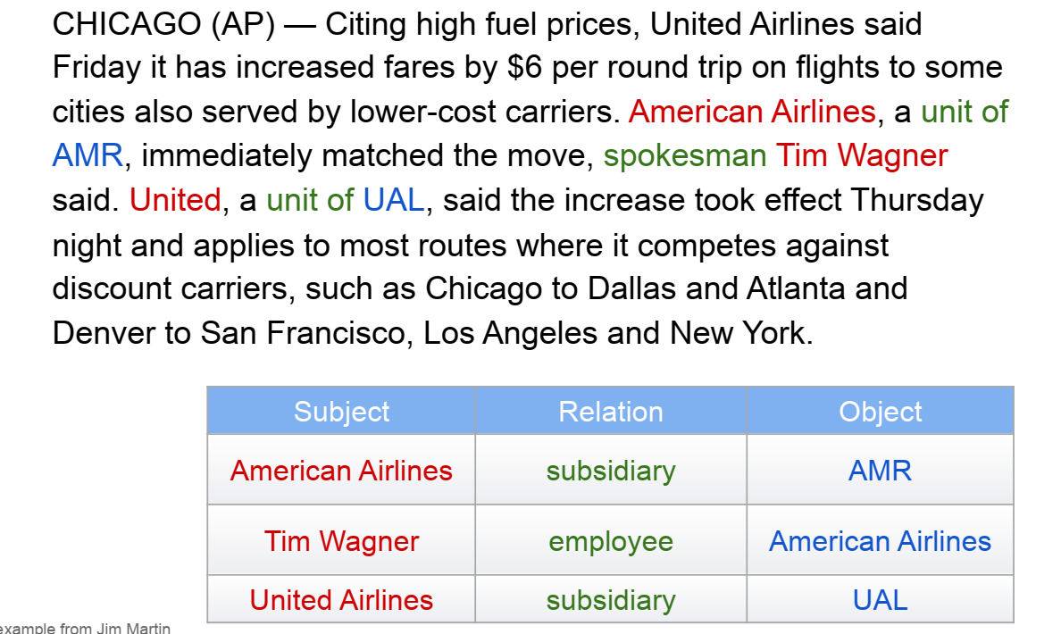
Relation Extraction Example
Entity types
Airliner
Organization
Person
American Airlines (Airliner), United Airlines (Airliner), AMR (Organization),
UAL (Organization), Tim Wagner (Person)

Slide 14
Examples of Relations from real life EHRs
LCOURSE_OF_SIGN_SYMPTOM
Pt reports cough (SIGN_SYMPTOM) is persisting (COURSE)
TIME_OF_SIGN_SYMPTOM
has had soft loose stools (SIGN_SYMPTOM) 2-4 episodes in the mornings (DATETIME),
ANATOMICAL_SITE_OF_SIGN_SYMPTOM
CARDIOVASCULAR (ANATOMICAL_SITE) Symptoms: Denies chest pain (SIGN_SYMPTOM). Denies lightheadedness. Denies palpitations (SIGN_SYMPTOM). Denies swelling.
ANATOMICAL_SITE_OF_DIAGNOSIS
GENITOURINARY (ANATOMICAL_SITE) Symptoms: denies blood in urine/hematuria, denies dysuria (DIAGNOSIS)

Slide 15
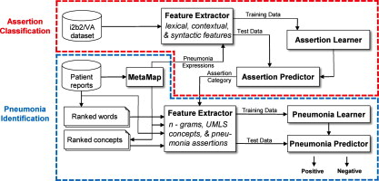
The task of Assertion Detection
Given a piece of text, we
need to identify two pieces
of information – a span which is mapped to named entity and textual cues indicating the presence or absence of that entity.

Slide 16
Assertion Detection: Practical Examples
SI | Text | Span with Entity type | Modality/ Dimension | Qualifier
1 | Prescribing sick days due to diagnosis of influenza | Influenza (disease) | Detection | Positive
2 | Jane Complains about flu-like symptoms | Flu-like symptoms (sign_symptom) | Presence | Speculative
3 | Jame’s RTDT came back clean | Jame’s RIDT (Background check) | Status | Negative
4 | Jim is at for flu if she is not vaccinated | Risk for flu (Exposure) | Risk | Conditional
5 | His kidneys are deteriorating | kidneys (Organ) | Condition | Worsening
6 | He has acute pain in left leg | Pain in left leg (sign_symptom) | Severity | acute

Slide 17
Entity Linking (Medical Entity Linking)
Task: recognizing entity mentions in text and linking the to the corresponding entries in a knowledge Base (KB)
  Limited to recognizing entities for which a target entity exists in the reference KB; each KB entity Is a candidate
  It is assumed that the document provides sufficient context for disambiguating entities
Knowledge base (KB)
  A catalog of entities, each with one or more names (surface forms), links to other entities, and optionally, a textual description
  Wikipedia, Dbpedia, Freebase, YAGO etc

Slide 18
Example of Entity Linking
Indication: Acute hypoxia, Relapsed AML, GVHD, and renal failure with new hypoxia with clear chest X-ray.
Diagnosis | ICD 10 CM code (ontology)
Acute hypoxia | J96.01
Relapsed AML | C92.02
GVHD | D89.813
Renal failure with new hypoxia | N17.1
Procedure | ICD 10 PC code (Ontology)
Clear Chest X-ray | BW03ZZZ

Slide 19
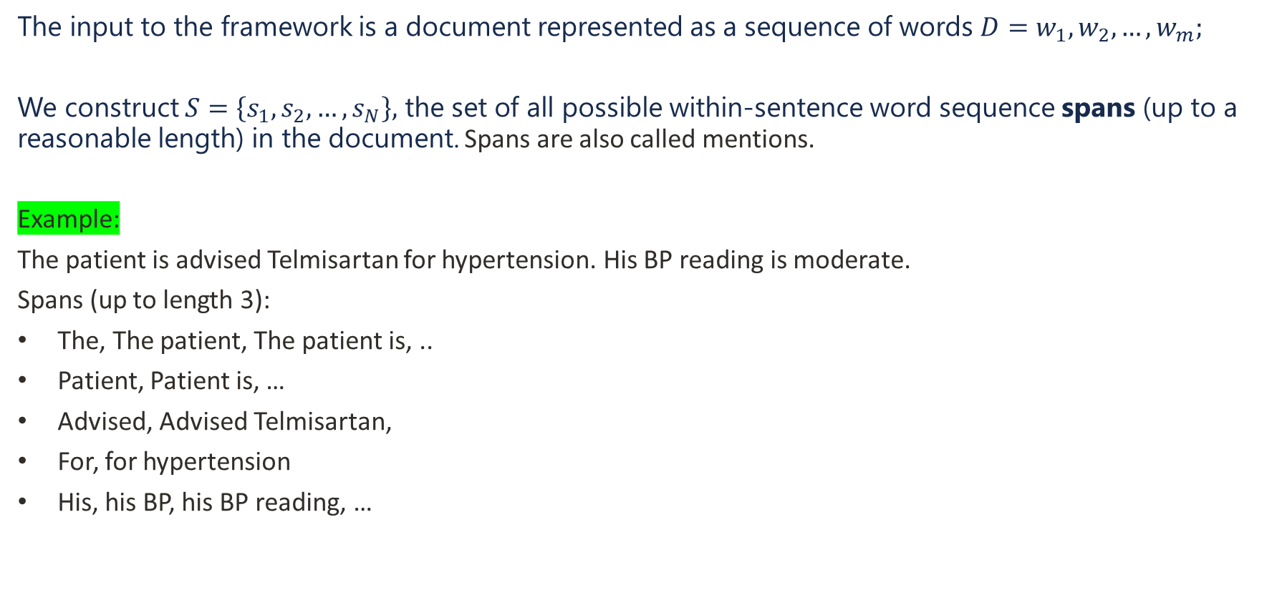
Input Corpus
Formulations of the problems
The input to the framework is a document represented as a sequence of words $D=w_{1},w_{2},…, w_{m};$
We construct $S=\left\{s_{1},s_{2},…, s_{N}\right\},$ the set of all possible within-sentence word sequence spans (up to a reasonable length) in the document. Spans are also called mentions.
Example:
The patient is advised Telmisartan for hypertension. His BP reading is moderate.
Spans (up to length 3):
The, The patient, The patient is, ..
Patient, Patient is, …
Advised, Advised Telmisartan,
For, for hypertension
His, his BP, his BP reading, …

Slide 20
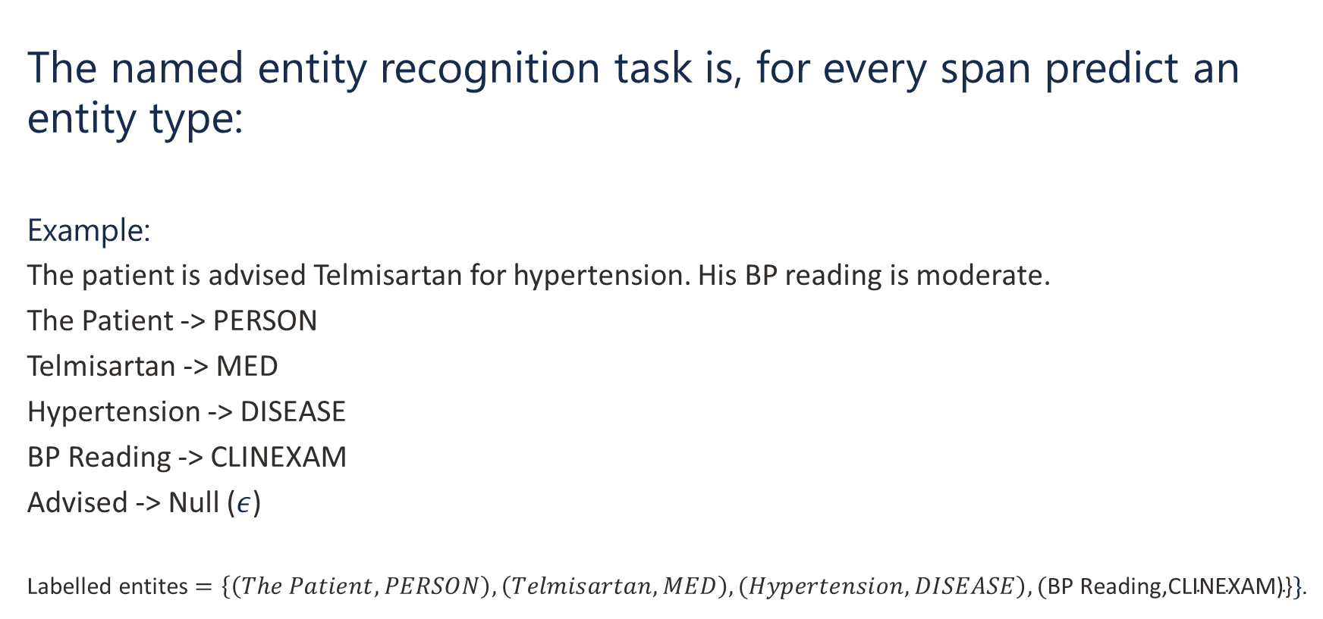
Named Entity Recognition Problem on Spans
The named entity recognition task is, for every span predict an entity type:
Example:
The patient is advised Telmisartan for hypertension. His BP reading is moderate.
The Patient -> PERSON
Telmisartan -> MED
Hypertension -> DISEASE
BP Reading -> CLINEXAM
Advised -> Null ($ε$)
Labelled entites $=\left\{\left(The Patient, PERSON\right), \left(Telmisartan, MED\right), (Hypertension, DISEASE\right), (\text{BP} \text{Reading}\text{,}\text{CLINEXAM}\text{)\}}\}$.

Slide 21
Relation Extraction Problem on Spans
The goal is, for every of labelled spans predict a relation between them. If there is no possible relation predict null (empty) relation.
The output will be a triple: (subject entity span, relation, object entity span)/
relation(: (subject entity span, object entity span).
Examples:
Rash on face (SIGN_SYMPTOM) is persisting (COURSE) without change, throat pain (SIGN_SYMPTOM)
COURSE_OF_SIGN_SYMPTOM(Rash on face, persisting)); NULL(throat pain, persisting).
2. SKIN (ANATOMICAL_SITE) Symptoms: rash (SIGN_SYMPTOM) (Face), denies itching (SIGN_SYMPTOM).
ANATOMICAL_SIGN_OF_SIGN_SYMPTOM(rash, SKIN)
3. Tacrolimus (MEDICINE_NAME) taper (COURSE), now at 2.5mg BID.
COURSE_OF_MEDICINE_NAME(Tacrolimus, taper).

Slide 22
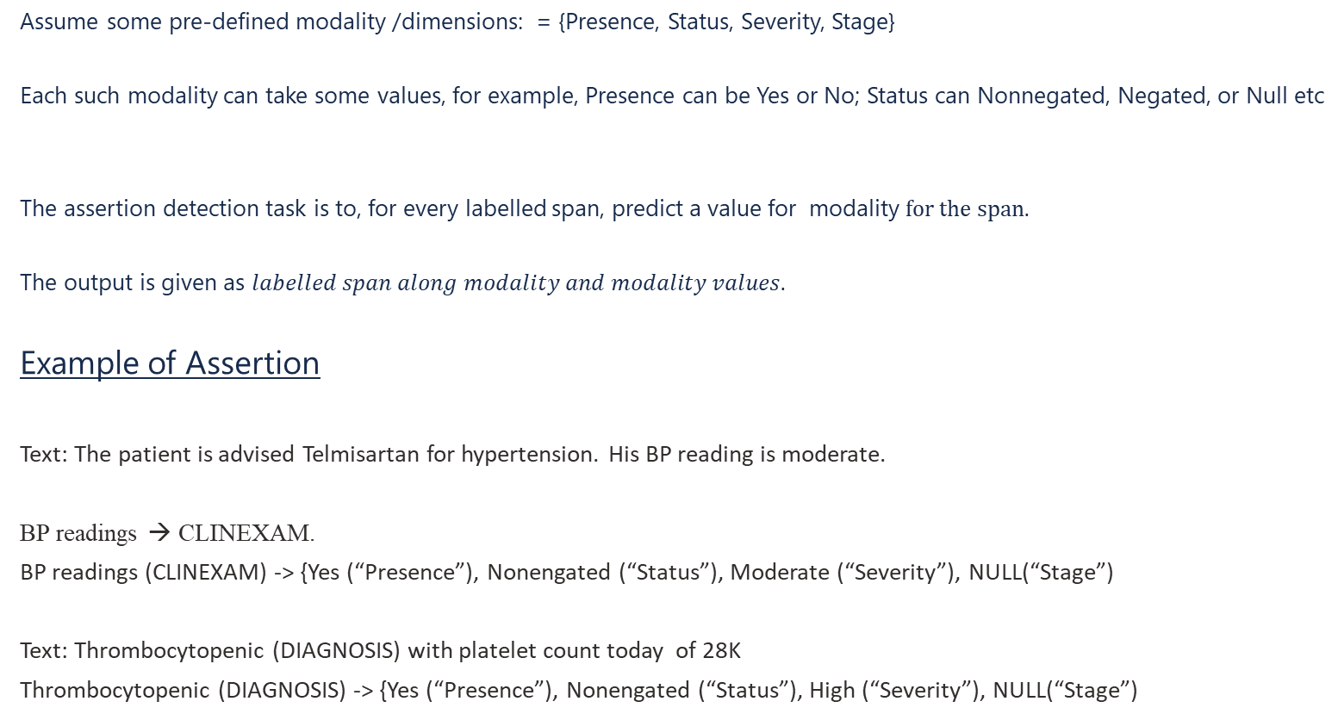
Assertion Detection
Assume some pre-defined modality /dimensions: = {Presence, Status, Severity, Stage}
Each such modality can take some values, for example, Presence can be Yes or No; Status can Nonnegated, Negated, or Null etc
The assertion detection task is to, for every labelled span, predict a value for modality $for the span.$
The output is given as $labelled span along modality and modality values.$
Example of Assertion
Text: The patient is advised Telmisartan for hypertension. His BP reading is moderate.
BP readings → CLINEXAM.
BP readings (CLINEXAM) -> {Yes (“Presence”), Nonengated (“Status”), Moderate (“Severity”), NULL(“Stage”)
Text: Thrombocytopenic (DIAGNOSIS) with platelet count today of 28K
Thrombocytopenic (DIAGNOSIS) -> {Yes (“Presence”), Nonengated (“Status”), High (“Severity”), NULL(“Stage”)

Slide 23
Entity Linking
The Entity Linking task is to, for a labelled span find a concept in the ontology O that is closest to labelled span in the context of the input text based on a similarity score between the span in question and the concept.
Example:
Text: Home to Empire State building, New York City is a fast-spaced globally influential center of art, culture, fashion and finance.
Spans: New York City → Location; Empire State Building → Building
Linking:
(New York City, Location, “Text”) → New York City: Wikipedia
https://en.wikipedia.org/wiki/New_York_City
(Empire State Building, Building, “Text”) → Empire State Building, Building: Wikipedia –
https://en.wikipedia.org/wiki/Empire_State_Building
Text: Acute hypoxia (Diagnosis), Relapsed AML, GVHD, and renal failure with new hypoxia with clear chest X-ray.
Linking:
(Acute, hypoxia, Diagnosis, “Text”) → J96.01 (ICD-10CM ontology)

Slide 24

Pipeline with specific inputs and outputs
Continue Abraxane. John is not taking Tyleno 325 mg and John is advised calcium carbonate. Patient also stopped taking cholecalciferol 1,000 units PO.
John (Patient)
Advised
Calcium carbonate (Med_namr)
Relations
RE
Abraxane (Med_name)
Tyleno (Med_name)
Tyleno 325 mg (Med_dosage)
John (Patient)
Spans (entities)
T
O
K
E
n
S
p
A
n layer
NER
pair of spans
Text Body
Spans with Text
Abraxane (Positive)
Tyleno (Negative)
Cholecalciferol (Negative)
Assertions
AD
Uniform Format (json) adopted for entity representation
Alignment of output of NER with input of RE,AD and MEL modules
NER does not produce any embedding, RE/AD use their own pre-train context token embed

Slide 25
Medical Summarization
The process of automatically generating a concise and coherent summary of medical documents while preserving the essential information.
It helps healthcare professionals quickly understand the key points in clinical notes, research articles, discharge summaries, radiology reports, etc., saving time and reducing cognitive load.
Original Text:
The patient is a 56-year-old male with a history of hypertension and type 2 diabetes mellitus. He presented to the emergency department with chest pain radiating to the left arm and shortness of breath. ECG showed ST-elevation in the anterior leads. Troponin levels were elevated. The patient was diagnosed with an acute anterior myocardial infarction and underwent percutaneous coronary intervention with stent placement in the LAD artery. He was started on dual antiplatelet therapy, statins, and beta-blockers. He is stable and recovering well.
Summary:
A 56-year-old male with hypertension and type 2 diabetes presented with chest pain and shortness of breath. He was diagnosed with an acute anterior myocardial infarction based on ECG and elevated troponin levels, and underwent PCI with stent placement in the LAD artery. He is now stable and receiving dual antiplatelet therapy, statins, and beta-blockers.

Slide 26
Deep Learning-based solution

Slide 27

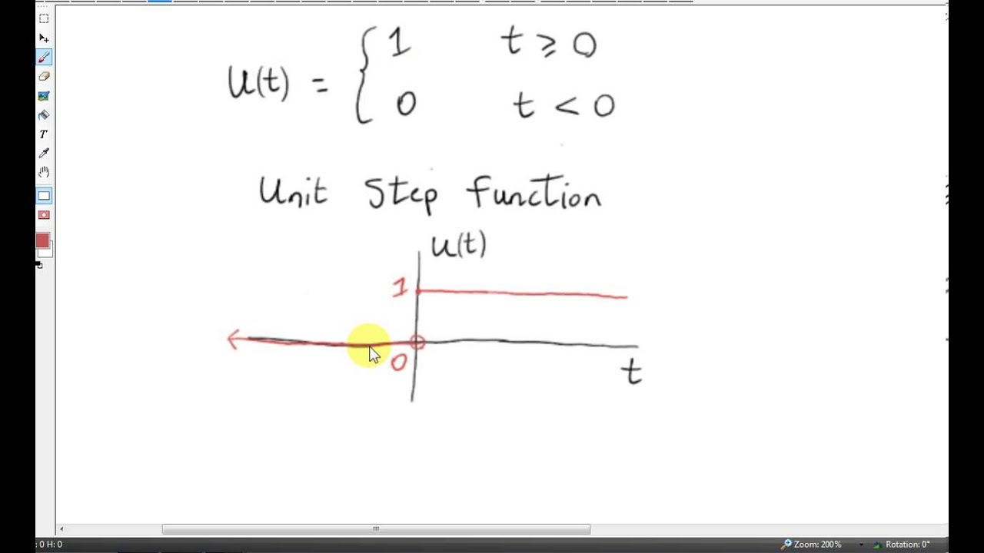
Neural Network
Scalar
output
Binary output
Feed Forward
Network
Logistic
Regression
Network
Activation layer
a
a
Activation layer (sigmoid/softmax function)
Encoder
Encoder
Encoder
Input Feature Vector
Input Feature Vector

Slide 28
Encoder/Decoder functionality
Think of the decoder like a box
that rebuilds the original from the code
Think of the encoder like a box
that shrinks and hides the original
message
##z14x%
I like pizza
Encoder
Decoder
I like pizza
##z14x%

Slide 29
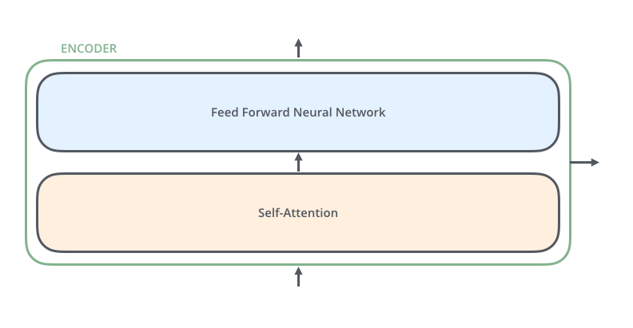
Encoder Block
All identical in structure (yet they do not share weights).
Each one is broken down into two sub-layers
Word → Embedding → Positional Embedding → Final Vector, framed as Context.

Slide 30
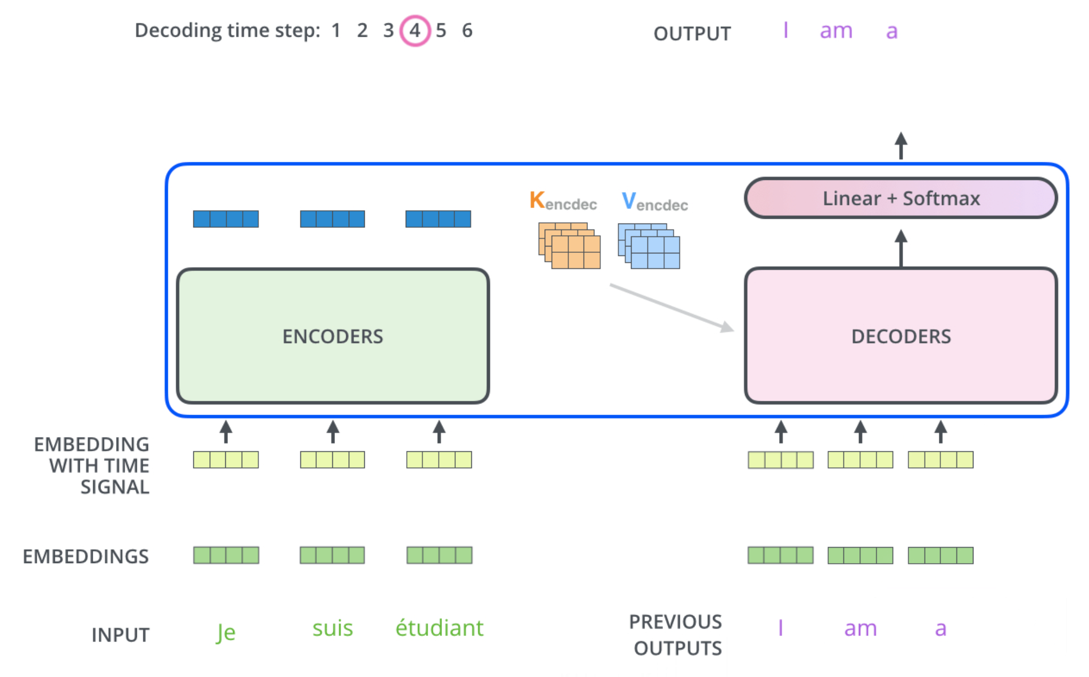
Decoder Block
Decoder Block
I am a student

Slide 31
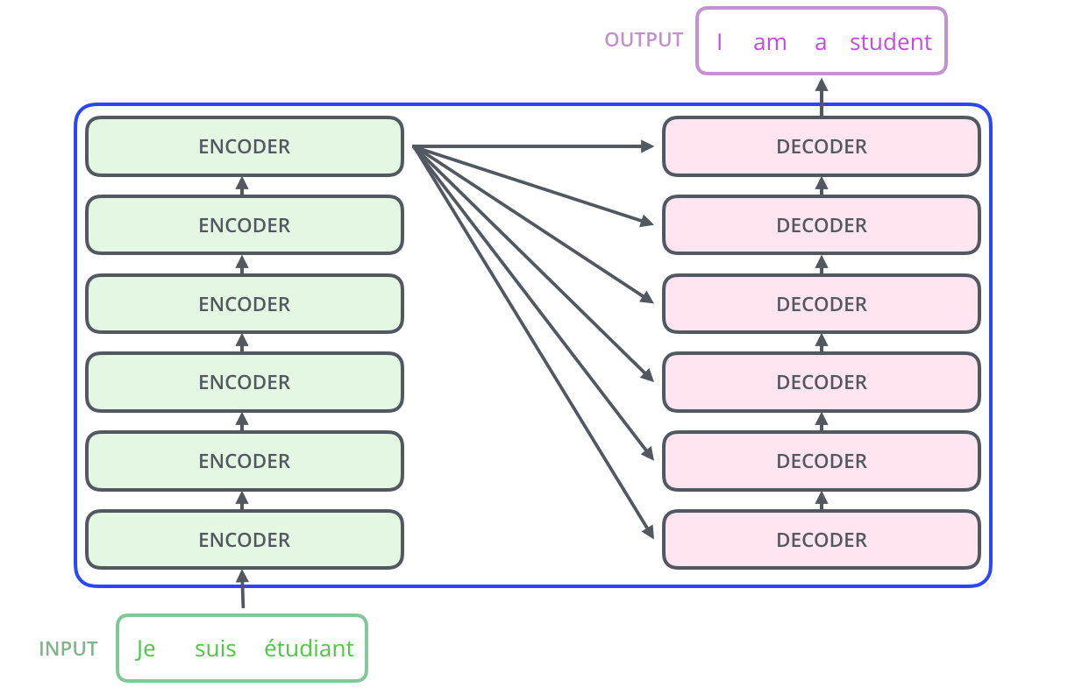
High-level architecture
Transformer architecture

Slide 32
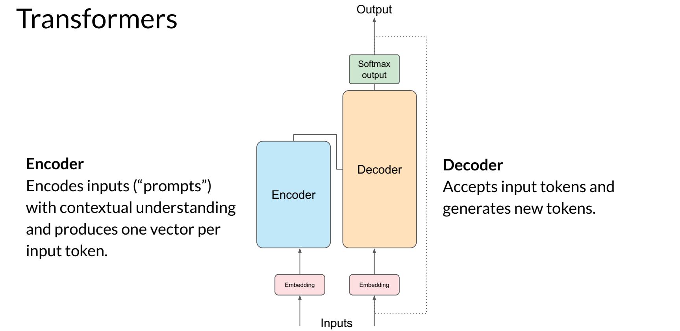
Transformer model – inner view

Slide 33
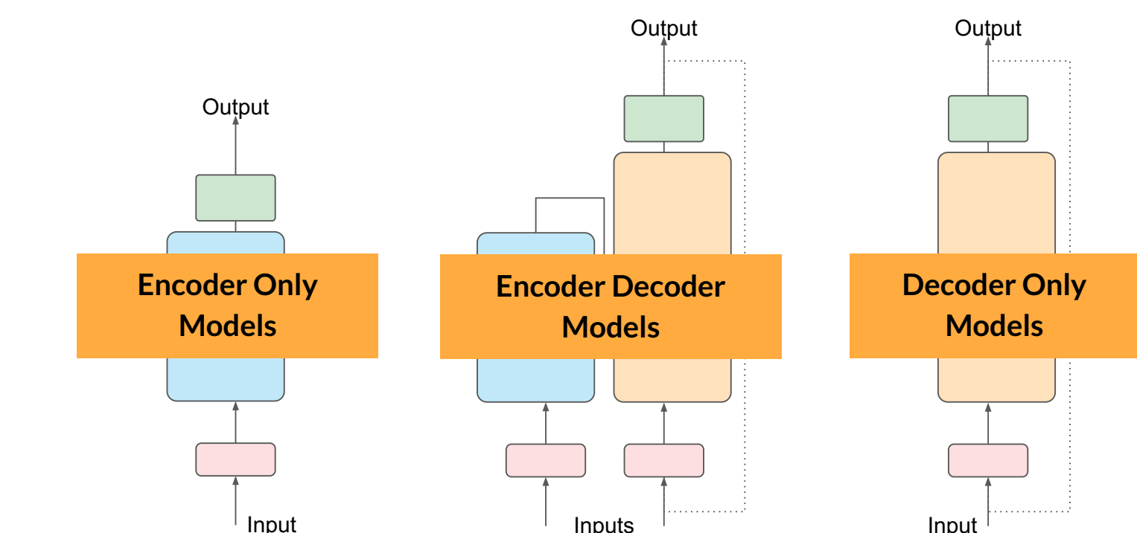
Transformers – different kinds of models

Slide 34
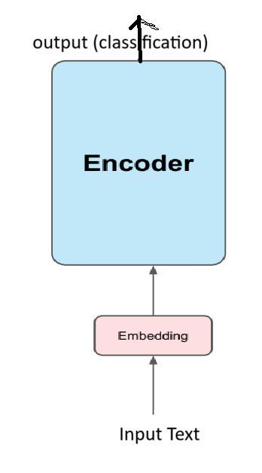
Encoder model used for Information retrieval task
NER, RE, ASD and MEL are modelled as classification tasks

Slide 35
Brief introduction to GenAI and LLM

Slide 36
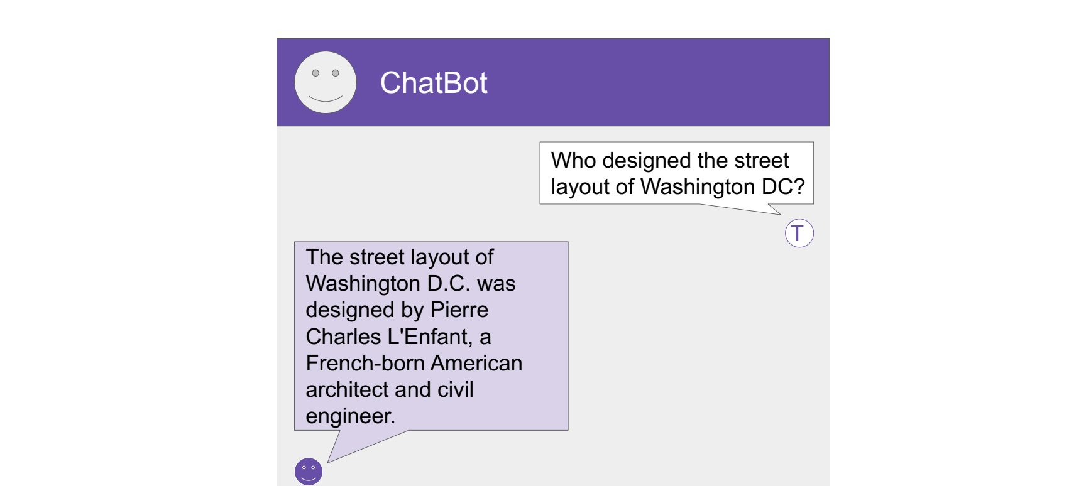
What is GenAI
Generative AI *GenAI) is a type of artificial intelligence that can create new content, like text, images, music, code, or even video,
often based on patterns it has learned from existing data.
Instead of just analyzing or categorizing data like traditional AI, generative AI can generate something new.

Slide 37
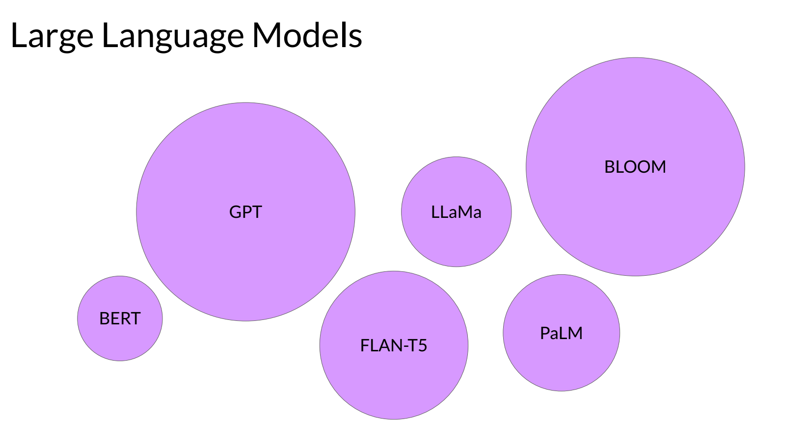
LLMs: Vehicles of GenAI
LLMs are mostly Transformer Models

Slide 38
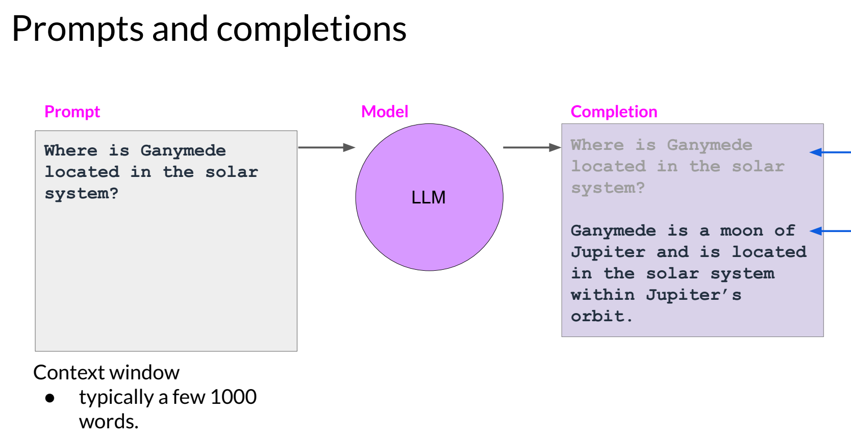
How to use LLM: write prompts at the interface

Slide 39


A simple prompt on ChatGPT
Freely available at https://chatgpt.com/?ref=dotcom
Who was the person who first showed that plants have life?
The person who first showed that plants have life in a scientific and demonstrable way was
Jagadish Chandra Bose (J.C. Bose), an Indian physicist, biologist, and inventor …

Slide 40
IR Problems in Healthcare

Slide 41
In-context Learning (ICL)
What is it?
In-context learning (ICL) is a technique where a Large Language Model (LLM) learns a new task without retraining by providing examples or instructions within the prompt itself. Instead of fine-tuning the model on a new dataset, ICL uses the pre-trained knowledge of the LLM and guides it to perform the desired task by providing context through the prompt.
How it works:
Prompt Engineering:
The core of ICL is crafting a well-designed prompt that includes examples of the desired input-output relationship or instructions for the task.
Task Demonstration:
These examples, often referred to as "few-shot learning" or "zero-shot learning" depending on the number of examples provided, demonstrate the task the LLM is expected to perform.
Model Adaptation:
The LLM leverages its pre-trained knowledge and the provided context to understand and execute the new task.

Slide 42
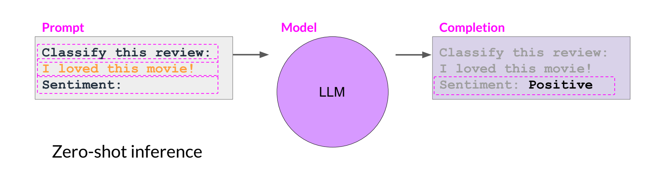
In-context Learning (ICL) – Zero shot inference

Slide 43
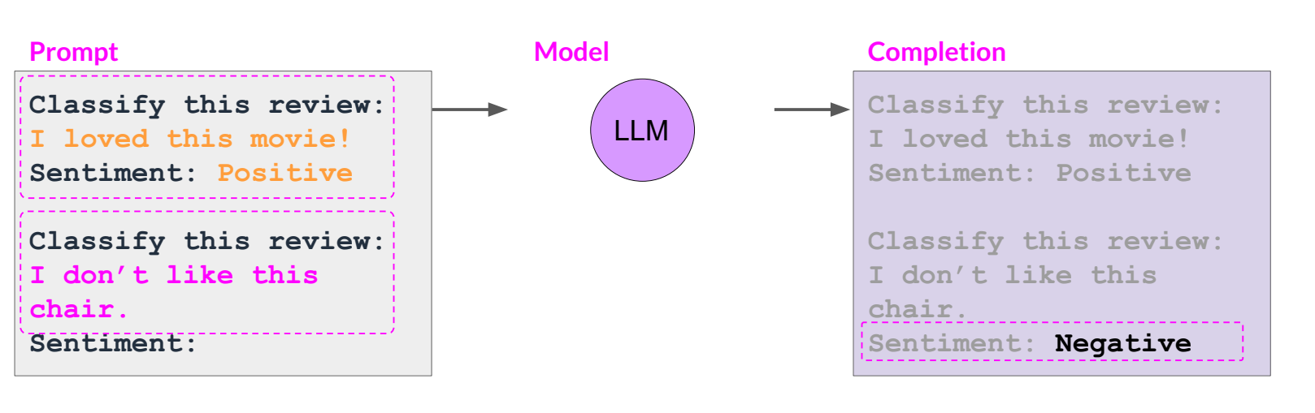
In-context Learning (ICL) – One shot inference

Slide 44
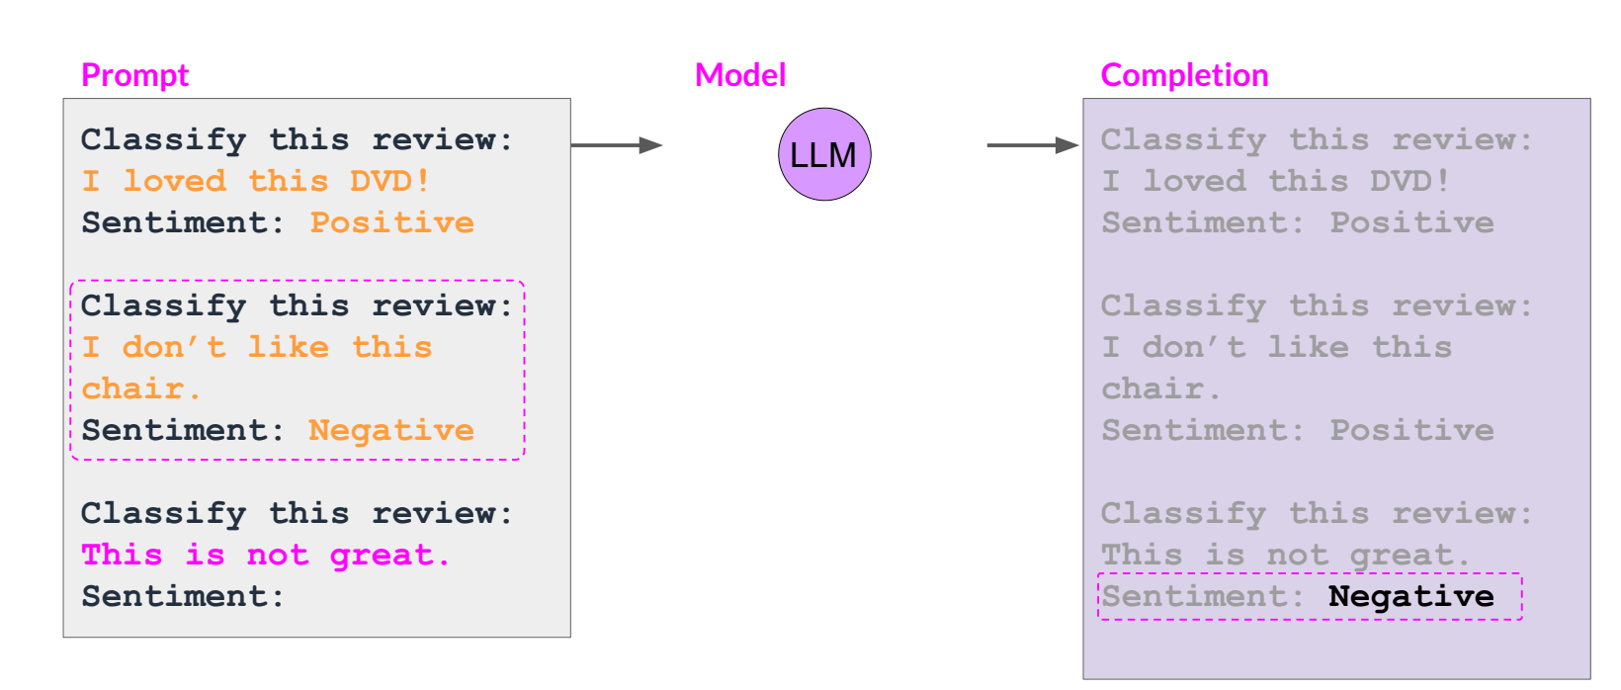
In-context Learning (ICL) – Few shot inference

Slide 45
Prompting IR problems on ChatGPT UI

Slide 46
Named Entity Recognition using LLM
Zero shot Inferencing:
Your task is recognize entity types in an input text and assign them to appropriate spans in the text. Please consider entity types from {Sign and Symptom, Course, Datetime, Anatomical Site}.
Input text: “Patient reports cough is persisting”.
Few Shot inferencing:
Your task is recognize entity types in an input text and assign them to appropriate spans in the text. Please consider entity types from {Sign and Symptom, Course, Datetime, Anatomical Site}.
{Input text: “Patient reports cough is persisting”. Entity assignment: cough (Sign and Symptom), persisting (Course).}
{Input text: “patient has had soft loose stools 2-4 episodes in the mornings.” Entity assignment: loose stools (Sign and Symptom), morning (Datetime).}
{Input text: “CARDIOVASCULAR Symptoms: Denies chest pain. Denies lightheaded-ness. Denies palpitations. Denies swelling.” Entity assignment: CARDIOVASCULAR (Anatomical Site), chest pain (Sign and Symptom), lightheaded-ness ((Sign and Symptom), palpitations (Sign and Symptom), swelling (Sign and Symptom).”}
{Input text: “GASTROINTESTINAL Symptoms: nausea (If she eats too much), diarrhea, denies abdominal pain, denies vomiting , denies constipation, hematochezia negative, denies melena”.
Entity assignment: }

Slide 47
Relation extraction using LLM (zero shot inferencing)
Your task is to predict relations between appropriate pairs of spans, each of these spans are mapped to suitable entity types. recognize entity types in an input text and assign them to appropriate spans in the text. Please consider entity types from {Sign and Symptom, Course, Datetime, Anatomical Site}. Also assume the set of relations as {Course of Sign and Symptom, Time of Sign and Symptom, Anatomical Site of Sign and Symptom}. The relations are defined between two entity types as ordered pairs: Course of Sign and Symptom(Sign and Symptom, Course); Time of Sign and Symptom(Sign and Symptom, Datetime); Anatomical Site of Sign and Symptom(Sign and Symptom, Anatomical Site). With this information please predict all possible relations between labelled spans in the Input text.
Input text: “Pt reports cough is persisting”.

Slide 48
Relation extraction using LLM (few shot inferencing)
Your task is to predict relations between appropriate pairs of spans, each of these spans are mapped to suitable entity types. recognize entity types in an input text and assign them to appropriate spans in the text. Please consider entity types from {Sign and Symptom, Course, Datetime, Anatomical Site}. Also assume the set of relations as {Course of Sign and Symptom, Time of Sign and Symptom, Anatomical Site of Sign and Symptom}. The relations are defined between two entity types as ordered pairs: Course of Sign and Symptom(Sign and Symptom, Course); Time of Sign and Symptom(Sign and Symptom, Datetime); Anatomical Site of Sign and Symptom(Sign and Symptom, Anatomical Site). With this information please predict all possible relations between labelled spans in the Input text.
{Input text: “Patient reports cough is persisting”. Relations extracted: Course of Sign and Symptom(cough, persisting).}
{Input text: “patient has had soft loose stools 2-4 episodes in the mornings ”. Relations extracted: Time of Sign and Symptom (loose stools, morning (Date).}
{Input text: “CARDIOVASCULAR Symptoms: Denies chest pain. Denies lightheadedness. Denies palpitations. Denies swelling.” Relations extracted: Anatomical Site of Sign and Symptom(chest pain, CARDIOVASCULAR); Anatomical Site of Sign and Symptom(palpitations, CARDIOVASCULAR)}.
{Input text: “GASTROINTESTINAL Symptoms: nausea (If she eats too much), diarrhea, denies abdominal pain, denies vomiting , denies constipation (SIGN_SYMPTOM), hematochezia negative, denies melena”.
Relations extracted: }

Slide 49
Summarization using LLM
Zero shot Inferencing
Your task is to summarize the Input text using at most 3 sentences
Input text: “The patient is a 56-year-old male with a history of hypertension and type 2 diabetes mellitus. He presented to the emergency department with chest pain radiating to the left arm and shortness of breath. ECG showed ST-elevation in the anterior leads. Troponin levels were elevated. The patient was diagnosed with an acute anterior myocardial infarction and underwent percutaneous coronary intervention with stent placement in the LAD artery. He was started on dual antiplatelet therapy, statins, and beta-blockers. He is stable and recovering well.”
Summary generated:
A 56-year-old male with hypertension and type 2 diabetes presented with chest pain and shortness of breath. He was diagnosed with an acute anterior myocardial infarction based on ECG and elevated troponin levels, and underwent PCI with stent placement in the LAD artery. He is now stable and receiving dual antiplatelet therapy, statins, and beta-blockers.

Slide 50
Summarization using LLM
Few shot inferencing
Your task is to generate summary of Input Text appropriately by preserving the proper medical information. Please use the following examples for your task.
{Input Text:
“The patient is a 67-year-old male with a history of type 2 diabetes and hypertension. He presented to the emergency department with complaints of chest pain and shortness of breath. ECG showed ST elevation, and troponin levels were elevated.”
Summary:
“67-year-old male with diabetes and hypertension presented with chest pain; diagnosed with ST-elevation myocardial infarction (STEMI).”
{Input Text:
“A 45-year-old woman with no significant past medical history came in for evaluation of fatigue and weight loss. Laboratory results showed elevated liver enzymes. Imaging revealed a mass in the right hepatic lobe.”
Summary:
“45-year-old woman with fatigue and weight loss found to have a hepatic mass and elevated liver enzymes.”}
{Input Text:
I“The patient is a 56-year-old male with a history of hypertension and type 2 diabetes mellitus. He presented to the emergency department with chest pain radiating to the left arm and shortness of breath. ECG showed ST-elevation in the anterior leads. Troponin levels were elevated. The patient was diagnosed with an acute anterior myocardial infarction and underwent percutaneous coronary intervention with stent placement in the LAD artery. He was started on dual antiplatelet therapy, statins, and beta-blockers. He is stable and recovering well.”
Summary:}

Slide 51
A Programmatic Approach of prompting using API keys

Slide 52
Principles of prompting
Write clear and specific instruction
  Write clear and specific instruction (clear NOT always short and vice-versa)
  Use delimiter to clearly indicate distinct parts of the input, Delimiters can be anything like ‘’’, <>, `` ’’, { } <tag> </tag>.
  Ask for a structured output - Json, html
  Ask the model to check whether certain conditions are satisfied
  Few shot prompting
Give the model time to think
  Specify the steps required to complete a task
  Ask for output in a specified format
  Instruct the model to work out its own solution before rushing to a conclusion

Slide 53
Programmatic approach of prompting LLM
Use openAI API keys for chat completions endpoint
Demo
Why do we NEED THIS?

