Slide 1

SMART INDIA HACKATHON 2026
TITLE PAGE
Problem Statement ID –SIH26167
Problem Statement Title- SatQuery AI: An Interactive Vision-Language Assistant for Multi-Modal Remote Sensing Image Analysis through Text Queries
Theme- Space Technology
PS Category- Software
Team ID- 147019
Team Name - Tech Manions

Slide 2



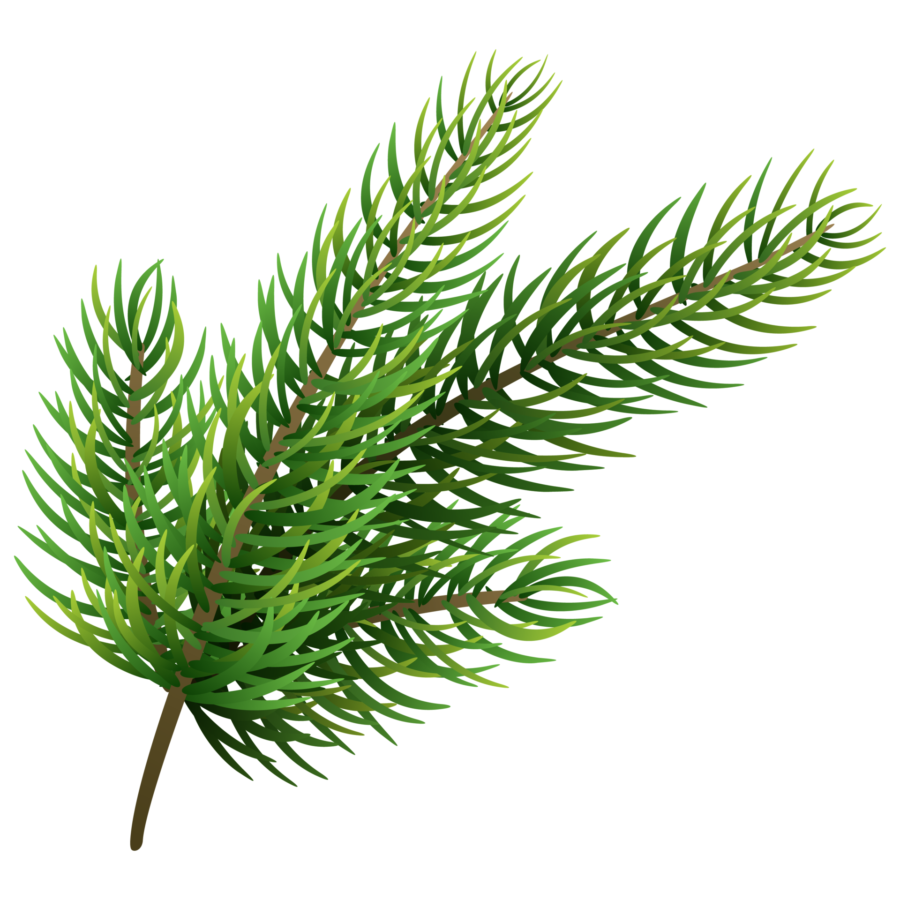

SATQUERY AI
From Fragmented Satellite Tools ➔ Intelligent Agentic Intelligence
An explainable vision-language assistant that validates multi-modal imagery (Optical & SAR), dynamically chains specialized remote sensing models, and synthesizes evidence-grounded answers
Tech
Manions
⚠ THE PROBLEM
DETECTION SIGNALS
SATELLITE DATA
INTELLIGENCE LAYER
SPECIALIST ENGINE
Sentinel-2 (Optical)
Sentinel-1 (SAR)
Multi-Band GeoTIFF
Query Parsing
Spatial Co-Reg
Metadata Validator
Radiometric Norm
RS-VQA Specialist
BigEarthNet Cap
Bi-Temporal CD
Optical-SAR Fusion
Cloud/rain microwave backscatter
Manual GIS workflows make it difficult for non-experts to query satellite imagery directly.
Fragmented tool silos force users to know which separate model to pick (VQA, captioning, change detection).
Weather & cloud barriers render optical imagery ineffective during monsoons and nighttime.
Generic LLMs hallucinate land-cover features and lack verifiable spatial grounding or audit traces.
OPTICAL VQA
SAR RADAR
Land-cover & object inspection
CONFIDENCE & SYNTHESIS
DUAL GROUNDED OUTPUT
DISASTER / AUDIT REVIEW
TEMPORAL
SPECTRAL
Multi-Model Fusion
Otsu Thresholding
Confidence Score
Text Answer + Spatial Heatmap Overlay
Actionable Decision & Audit Trace Report
10-yr epoch change differencing
Raw NDVI, NDWI & NDBI bands
✨ WHY DIFFERENT
Model IDs, Otsu & confidence metrics
💡 OUR SOLUTION
An AI-powered agentic remote-sensing intelligence workbench.
Ingests single-scene, multi-temporal (2016–2026), and optical + SAR pairs.
Combines specialized vision-language models with raw spectral math.
Detects land-cover shifts, environmental damage, and ground objects.
Generates pixel-aligned spatial heatmaps, difference masks, and bounding boxes.
Provides auditable execution traces and decision-support exports.
AUDIT TRACE
Dynamic Agentic Routing - Automatically selects the right specialist tool based on query intent and imagery types without manual GIS setup.
Change Understanding vs. Binary Mask - Interprets semantic shifts (e.g. +8.5% Built-up, -14.2% Surface Water) rather than generic blur.
All-Weather Optical-SAR Fusion - Retains observation continuity by fusing cloud-penetrating radar when optical cloud cover exceeds 15%.
Authentic Spectral Math - Computes true mathematical indices (NDVI, NDWI, NDBI) on raw bands instead of generic LLM guessing.
Verifiable Execution Trace - Exposes an auditable card with tool IDs, thresholds, and confidence metrics for mission-critical trust.

Slide 3

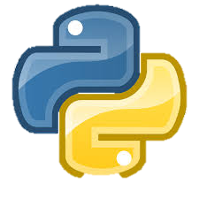

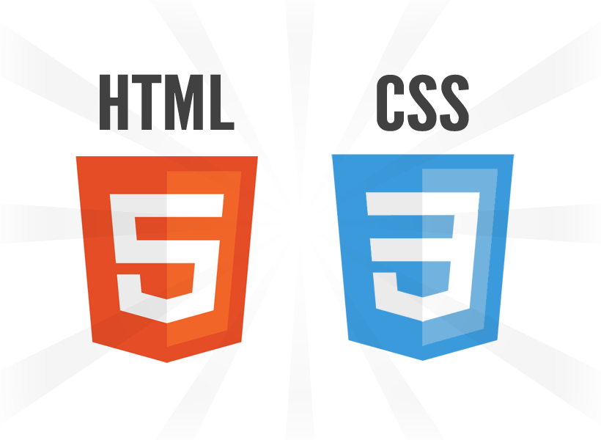

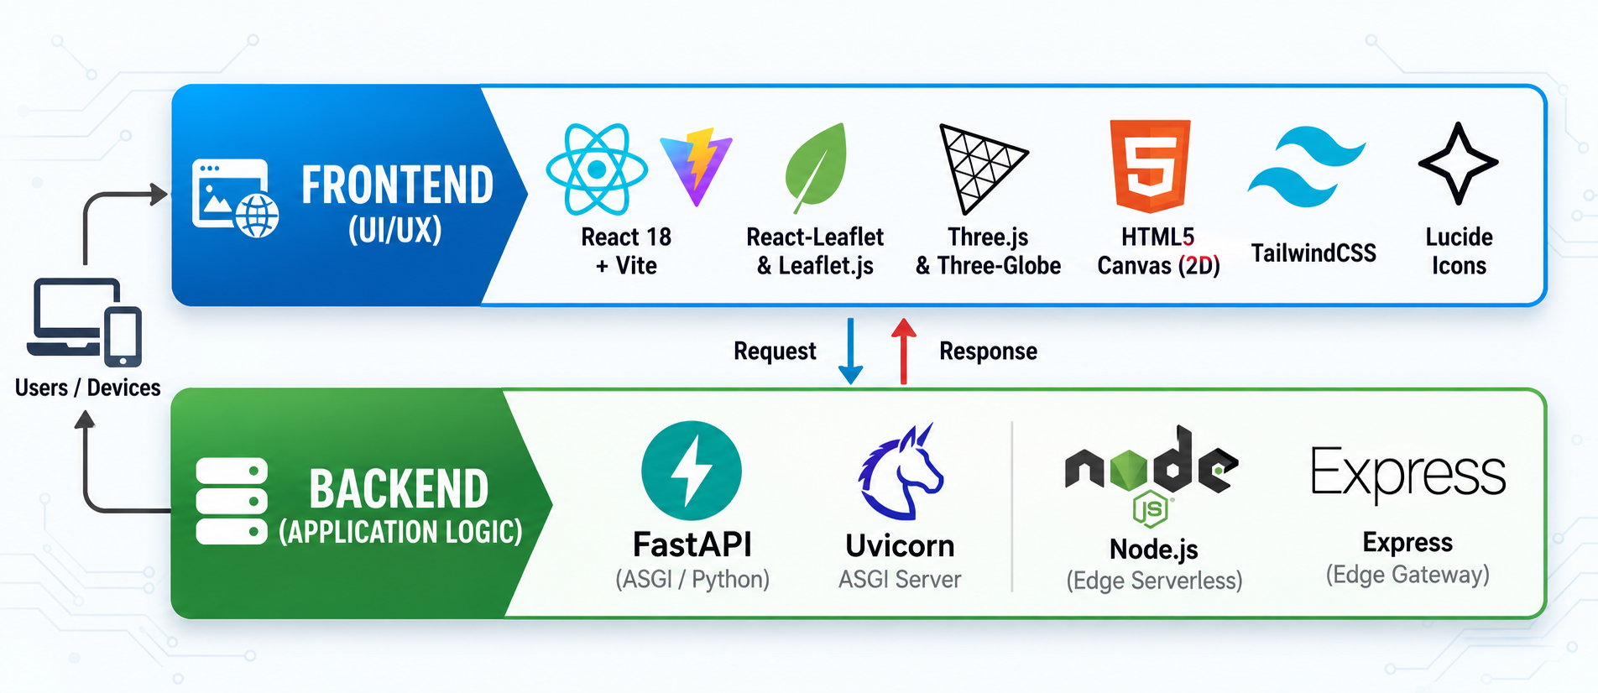
TECHNICAL APPROACH
Core Programming Languages, WebGIS Frameworks, Specialist AI Models & Cloud Stack
Tech
Manions
Your Team Name
User Query & Multi-Modal GeoTIFF Upload
Technologies to be Used
CRS, EPSG & GSD Spatial Validation
🖥️ Programming Languages
Python 3.11: Core backend engine, remote-sensing data processing, spectral mathematics, and AI model orchestration.
TypeScript / JavaScript (ES2023): Type-safe frontend client, interactive WebGIS workbench, and asynchronous API communication.
HTML5 & CSS3: Canvas-based pixel manipulation, high-contrast visual overlays, and responsive presentation layouts.
Bilinear Resampling & Radiometric Normalization
Rasterio Memory Tensor Pack
Semantic Intent & Keyword Parser
Cloud Screening Gate
(Coverage > 15%?)
PHASE 3
Spectral Engine
(NDVI, NDWI, NDBI)
RS-VQA Specialist
(VRSBench / CLIP)
Bi-Temporal LEVIR-CD
(Siamese CNN)
Region Grounding ViT
(Bounding Boxes)
BigEarthNet Land-Cover Classifier
C-Band SAR Microwave Failover
Adaptive Otsu Thresholding
Gate
(Confidence ≥ 80%)
Auditable Execution Tracer
Scientific Grounded Text Answer
Other Technologies
Geospatial & Vector Core: Rasterio, GDAL, NumPy (vectorized multi-band array math), OpenCV, PIL (Pillow), Scikit-learn, Shapely.
Specialist AI & Deep Learning Models:
RS-VQA-Specialist: Fine-tuned on RSVQA & VRSBench for natural language visual question answering.
RS-BigEarthNet-Captioner: 19-class CORINE hierarchical land-cover taxonomy classification.
RS-BiTemporal-CD-Engine: Siamese feature differencing network (LEVIR-CD & CDVQA) for change detection.
Satellite Feeds & APIs: Copernicus Sentinel-2 L2A (10m Optical), Sentinel-1 GRD (C-band SAR), USGS Landsat-8/9, ISRO Bhuvan archives, OpenStreetMap Nominatim.
Cloud Infrastructure & DevOps: Vercel Global Edge Network, Supabase Cloud Auth/DB, Docker, GitHub Actions CI/CD.
Pixel-Aligned Heatmap & Split Slider
Auditable Trace Card (Latency, Model, Bounds)
Certified PDF/JSON Compliance Export

Slide 4



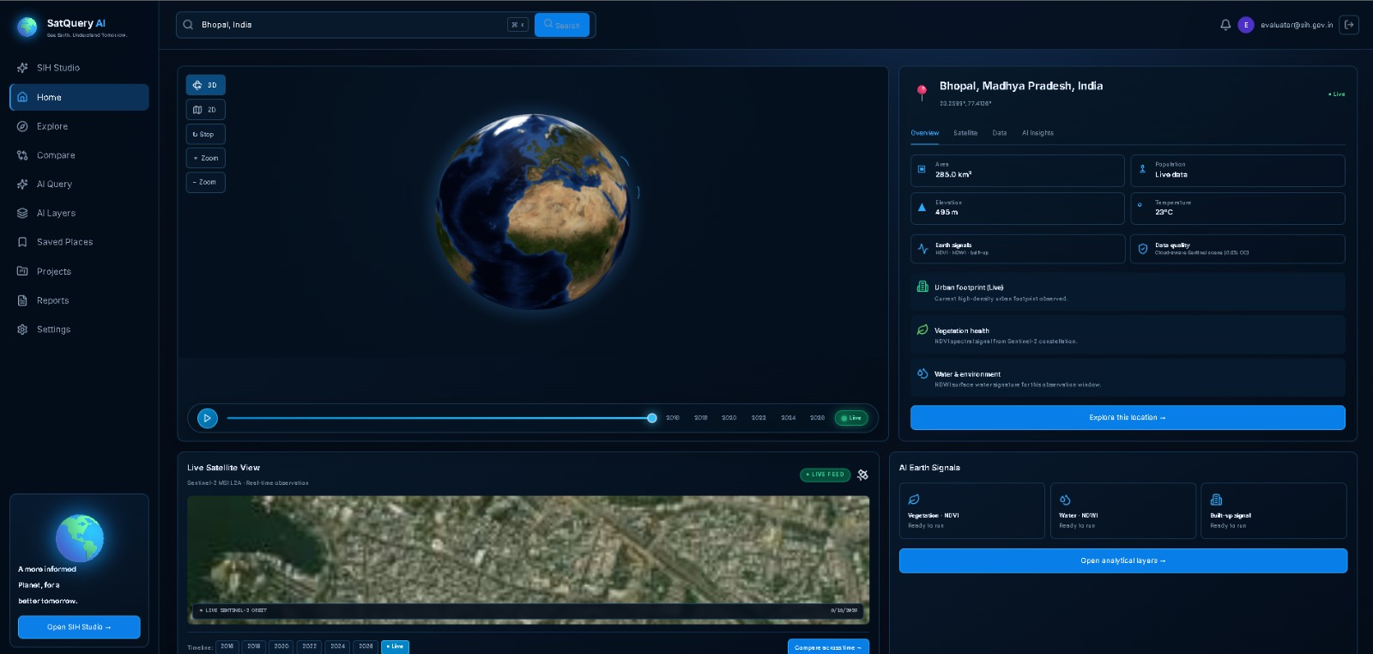
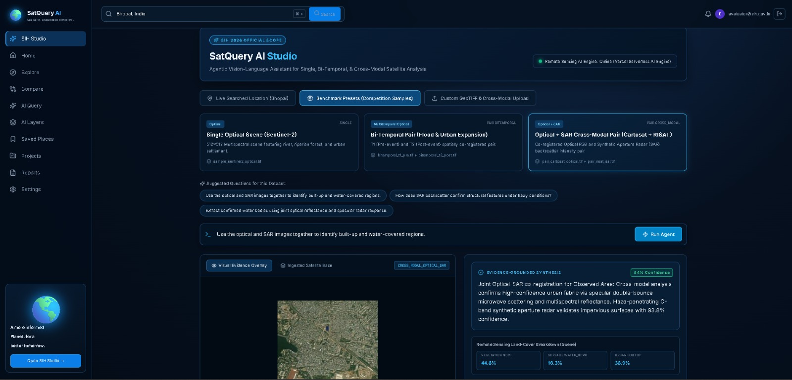
FEASIBILITY AND VIABILITY
Multi-Dimensional Feasibility Analysis, Risk Matrix & Technical Mitigation Strategies
Tech
Manions
Your Team Name
Analysis of the Feasibility of the Idea
Potential Challenges and Risks
Risk 1: Cloud & Atmospheric Occlusion
  Severe monsoon cloud cover, smoke, and haze obscure optical satellite reflectance, causing blind spots during peak flood and disaster scenarios.
Risk 2: Multi-Sensor Spatial & Temporal Misalignment
  Comparing images across different satellites (e.g., Optical vs. SAR) or across multi-year epochs introduces Ground Sampling Distance (GSD) disparities, sun-angle shifts, and projection distortions.
Risk 3: Vision-Language Model Hallucination
  Deep generative AI models risk generating ungrounded, plausible-sounding descriptions on noisy or low-resolution satellite textures in mission-critical operations.
Risk 4: High Bandwidth & Raster Data Latency
  Full-scene satellite GeoTIFF files often exceed 500 MB – 1 GB, causing severe bandwidth bottlenecks on low-connectivity field networks.
Strategies for Overcoming These Challenges (Mitigations)
Strategy 1: Automated C-Band SAR Microwave Failover
  When cloud screening detects >15% cloud cover, the agentic controller autonomously triggers Sentinel-1 / RISAT C-band SAR radar backscatter, penetrating rain and cloud layers for uninterrupted 24/7 observation.
Strategy 2: Sub-Pixel Affine Co-Registration & Radiometric Normalization
  Vectorized GDAL/Rasterio pipeline applies bilinear resampling, CRS reprojection (EPSG:4326/3857), and top-of-atmosphere radiometric balancing to eliminate sensor and solar bias.
Strategy 3: Dual Grounded Evidence & Otsu Statistical Confidence Gate
  Zero "Black-Box" Policy: Every generated text answer is strictly bound to a pixel-aligned spatial difference heatmap and mathematical indices (NDVI/NDWI/NDBI) verified through adaptive Otsu thresholding. Speculative assertions below 80% confidence are suppressed.
Strategy 4: Cloud-Optimized GeoTIFF (COG) & Dynamic Pyramidal Streaming
  Instead of transferring massive gigabyte files, the backend streams only the visible bounding-box tiles at the current zoom level, reducing network payload by >90% and ensuring sub-second response time
Technical Feasibility:
  Proven Working Prototype: Validated by an active deployed system (satquery-ai-psi.vercel.app) delivering sub-second inference using FastAPI, Uvicorn, and HTML5 Canvas differencing.
  Native Multi-Spectral Engine: Seamlessly parses GeoTIFF rasters using Rasterio/GDAL, eliminating manual preprocessing.
  Modular Vision-Language Backbones: Successfully orchestrates domain-specific models (RS-VQA, BigEarthNet-19, LEVIR-CD, SEN12MS Optical-SAR).
🔍
Operational Feasibility
Zero Client Footprint: 100% web-based WebGIS interface running on standard field laptops, tablets, and smartphones without requiring local NVIDIA GPUs.
🛡️
Economic & Data Feasibility
  Zero Data Acquisition Costs: Relies entirely on free, open-access public Earth Observation constellations (Copernicus Sentinel-1/2, USGS Landsat-8/9, ISRO Bhuvan archives).
  Eliminates Proprietary Licensing: Open-source Python & React stack replaces proprietary GIS software suites, saving ₹10L+ annually per department.
📊

Slide 5


IMPACT AND BENEFITS
Tech
Manions
Your Team Name
Impact on Target Audience
Multi-Dimensional Benefits
🚨 Disaster Management (NDRF / SDMAs):
  Flood mapping in < 5 minutes (down from 48–72 hours).
  Monsoon-penetrating SAR radar provides continuous vision during storms.
🏙️ Urban Planning & Smart Cities:
  Automated encroachment alerts across 10-year satellite baselines.
  Detects illegal construction & sprawl without manual ground surveys.
🌾 Agriculture & Water Authorities:
  Early drought & crop stress warnings via real-time NDVI vigor.
  Tracks reservoir & wetland shrinkage for proactive water rationing.
🛡️ Defense & Border Security:
  24/7 day-and-night terrain surveillance using Optical + SAR fusion.
👥 Social Benefits:
  Democratizes Space Data: Anyone can query satellite imagery in plain English.
  Saves Lives: Accelerated disaster mapping speeds up rescue deployments.
💰 Economic Benefits:
  ₹10L–₹25L Annual Savings: Zero proprietary GIS license fees per department.
  >80% Cost Reduction: Automated pipeline eliminates manual band processing.
  Zero Data Acquisition Cost: 100% open-access Copernicus
🌿 Environmental Benefits:
  Continuous Eco-Monitoring: Tracks illegal deforestation & wetland loss in real time.
📋 Governance & Trust:
  Zero Black-Box Risk: Every output verified by pixel heatmaps & downloadable audit logs.
💰 Software Cost
🛰️ Weather Coverage
72 Hrs $→$ < 5 Mins
(95% faster)
₹0 Licenses
(100% Open Source)
24/7 All-Weather
(Optical + SAR)
Natural English
(Zero GIS barrier)

Slide 6
RESEARCH AND REFERENCES
Peer-Reviewed Literature, Space Agency Standards & Project Repository Links
Tech
Manions
Your Team Name
Scientific Literature & Foundational Benchmarks
Space Agencies, Satellite Data Feeds & Open Standards
RSVQA Benchmark (Visual Question Answering over Satellite Imagery):
Paper: Lobry et al., "RSVQA: Visual Question Answering for Remote Sensing D D Data", IEEE Transactions on Geoscience and Remote Sensing (TGRS). L I L Link: https://doi.org/10.1109/TGRS.2020.2988770
VRSBench (CVPR 2024 Vision-Language Remote Sensing Benchmark):
Paper: Chen et al., "VRSBench: A Versatile Vision-Language Benchmark for R R Remote Sensing Image Understanding", IEEE/CVF CVPR 2024.
Link / Preprint: https://arxiv.org/abs/2406.12450
LEVIR-CD & CDVQA (Bi-Temporal Siamese Change Detection):
Paper: Chen & Shi, "A Spatial-Temporal Attention-Based Method and Dataset f for Remote Sensing Image Change Detection", Remote Sensing. L I
Link: https://doi.org/10.3390/rs12101662
SEN12MS (Optical + SAR Multi-Modal Fusion Core):
Paper: Schmitt et al., "SEN12MS — A Curated Dataset of Georeferenced Multi- S Spectral Sentinel-1/2 Imagery for Deep Learning and Data Fusion", ISPRS Annals. L Link: https://doi.org/10.5194/isprs-annals-IV-2-W7-153-2019
BigEarthNet-S2 (19-Class CORINE Land-Cover Taxonomy):
Paper: Sumbul et al., "BigEarthNet: A Large-Scale Benchmark Archive for Remote S Sensing Image Understanding", IEEE IGARSS.
Official Portal: https://bigearth.net/
ISRO Bhuvan & MOSDAC (National Remote Sensing Centre / SAC):
  Data: ISRO Cartosat-2 high-resolution optical and RISAT-1A C-band microwave radar processing protocols.
  Portal Links: https://bhuvan.nrsc.gov.in • https://www.mosdac.gov.in
ESA Copernicus Open Access Data Space:
  Data: Sentinel-2 MSI Level-2A Bottom-of-Atmosphere (BOA) reflectance and Sentinel-1 C-band SAR radar feeds.
  Portal Link: https://dataspace.copernicus.eu
USGS / NASA Landsat Archives:
  Data: Landsat-8/9 Surface Reflectance 10-year historical baseline archives.
  Portal Link: https://earthexplorer.usgs.gov
OGC & STAC Open Geospatial Specifications:
  Standards: Cloud-Optimized GeoTIFF (COG), SpatioTemporal Asset Catalog (STAC), and Tile Map Service (TMS) specifications.
  Links: https://www.cogeo.org • https://stacspec.org
Project Links & Open-Source Codebase
💻 Official GitHub Source Code Repository:
  URL: https://github.com/sourabh160705/Satquery-AI
  Features: FastAPI backend, React 18 + Vite frontend, agentic orchestrator, automated OpenAPI documentation (/docs), and full unit tests.
📋 Auditable Execution Logs & PDF Reports:
  Downloadable certified JSON & PDF audit reports directly from the live workbench console for zero "black-box" verification
🚀 Live Working Prototype WebGIS Application:
URL: https://satquery-ai-psi.vercel.app/
Features: Multi-slot GeoTIFF uploader, 10-year historical satellite scrubber
(2016–2026), interactive Leaflet split-screen swipe, and real-time execution trace card.

