Slide 1
Python & Pandas Analytics Report
Diwali Sales, Customer & Revenue Analytics
Customer segments
• Regional performance
• Product demand
• Commercial opportunities

Slide 2
Executive Sales Summary
Core performance metrics from 11,251 dataset transaction records
₹10.62 Cr
3,755
28,007
35.4 yrs
Total Revenue Generated
Unique Customers
Total Order Quantity
Average Customer Age

Slide 3
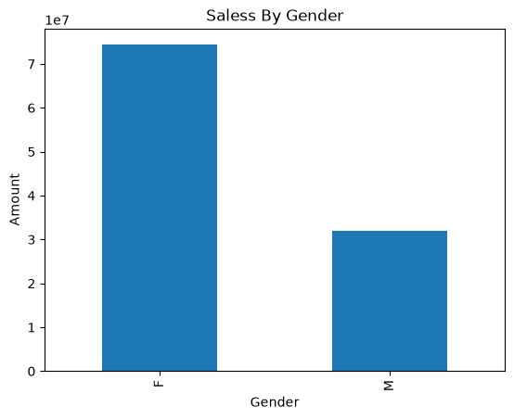
gender contribuites to sales
Female customers account for 70% of total revenue and order volume
Female Dominance
₹7.43 Cr revenue share with 19,568 orders.
Male Contribution
₹3.19 Cr revenue share across remaining order volume.

Slide 4
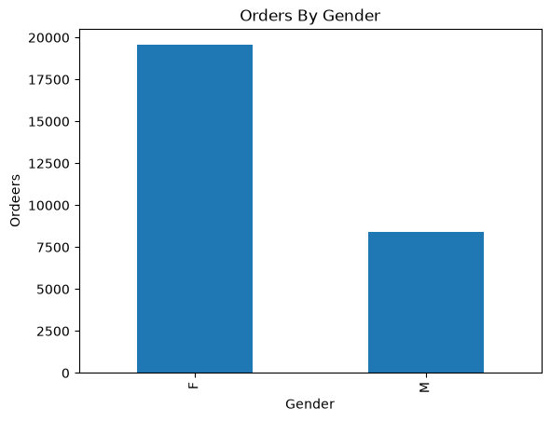
Female (F): 19,548 orders (accounting for roughly 69.8% of the total order volume)
Order Volume Breakdown
Female Buyers Place the Most Orders (70% of Total Volume)
Male (M): 8,433 orders (accounting for roughly 30.2% of the total order volume)

Slide 5
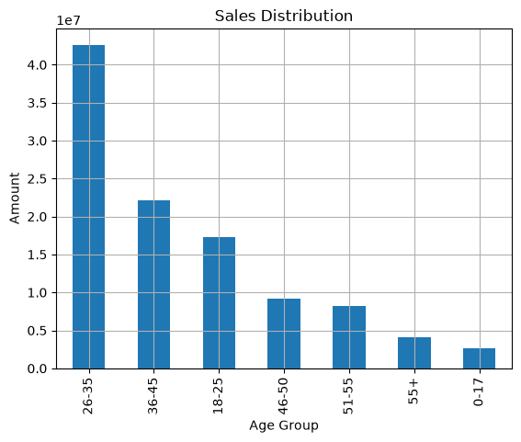
Diwali Sales Analysis & Customer Insights
The 26–35 age group represents the core purchasing Demographic
.
Gender Breakdown: Female customers contribute significantly more to total sales more than double the amount spent by male buyers. Women serve as the primary decision-makers for festive shopping.
Age Group: The 26–35 age group generates the highest revenue, driven primarily by working professionals and young earners with disposable income. The next highest-spending groups are ages 36–45 and 18–25.

Slide 6
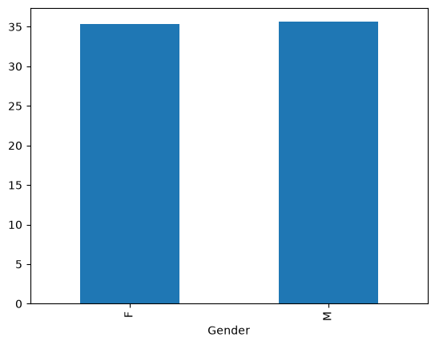
Customer Age Insights
Age Segmentation and Revenue Generation in Festive Sales Analysis
In the Diwali Sales , the exact average(mean) customer age is approximately 35.4 years (specifically 35.41 years).
Female Buyers: Women represent the largest share of the customer base (contributing over double the total revenue of male buyers). The majority of these female shoppers fall within the 26–35 age bracket, which serves as the primary revenue-driving segment for the entire dataset.
Male Buyers: While men account for a smaller volume of orders compared to women, their spending patterns also peak prominently within the 26–35 age group, followed closely by the 36–45 demographic.

Slide 7
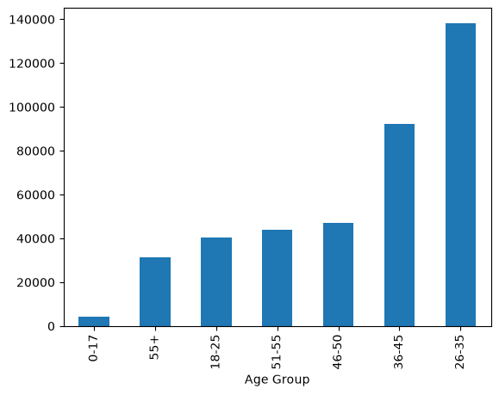
Peak Customer Age Group
26–35: Age Group with Most Customers
Largest Customer Segment: The 26–35 bracket has the highest frequency and count of buyers compared to any other age group (such as 18–25, 36–45, etc.).
Primary Revenue Driver: Because it houses the largest number of active shoppers, this age group also generates the highest overall revenue for the festive season.
Demographic Context: This group primarily consists of young working professionals and earners who drive the bulk of festive purchasing power across both male and female buyers.

Slide 8
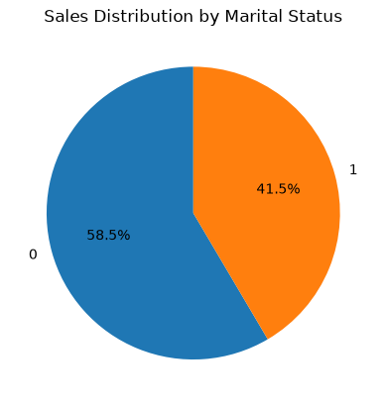
Marital Status Analysis
Unmarried buyers constitute the majority share of transactions
Unmarried Segment
₹58.5 Cr
Higher propensity for self-use gadgets &
lifestyle goods.
Married Segment
₹41 .5Cr
Strong focus on home appliances and family gifting.

Slide 9
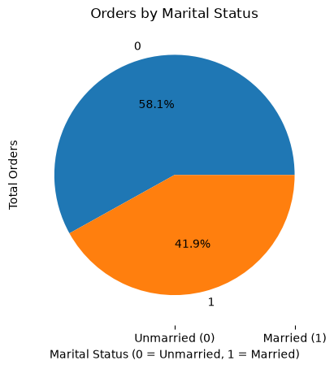
Order Distribution by Marital Status
Unmarried Customers Lead Order Volume with a 58% Market Share
Leading Segment: Unmarried (Single) customers generate higher total order volume and sales revenue.
Breakdown: 58% Unmarried vs 41% Married.
Target Insight: Unmarried individuals, particularly in the 26–35 age group, represent the largest portion of active buyers.

Slide 10
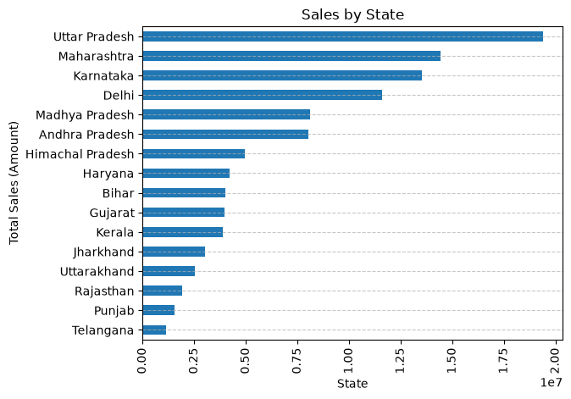
Regional performance | State revenue
Uttar Pradesh leads the state-level revenue ranking
Interpretation
Top state: Uttar Pradesh.
Revenue from Uttar Pradesh: ₹1.94 Cr.
The top 10 states chart helps prioritize regional campaign planning.
Business implication: compare revenue with order volume, population / reach and marketing investment before allocating budget.
DIWALI SALES ANALYTICS • PYTHON / PANDAS
07

Slide 11
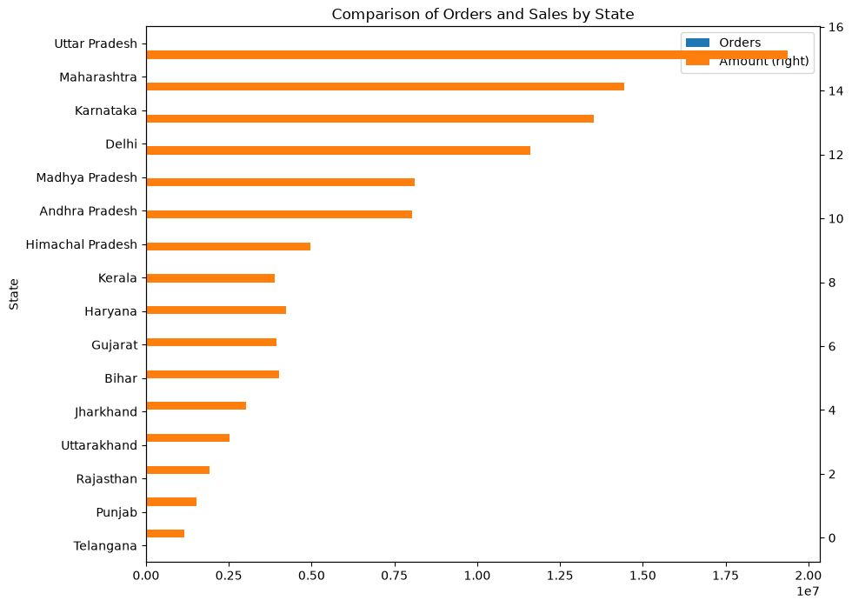
Regional opportunity | Orders vs revenue
Look for states with strong order volume but comparatively lower revenue
Interpretation
Each point represents a state; points farther right have more orders and points higher up have more revenue.
A large order count with lower-than-expected revenue can signal lower average order value.
States flagged by the rank comparison: Kerala
Follow-up: investigate category mix, discounts, product mix and order value in flagged states.
DIWALI SALES ANALYTICS • PYTHON / PANDAS
08

Slide 12
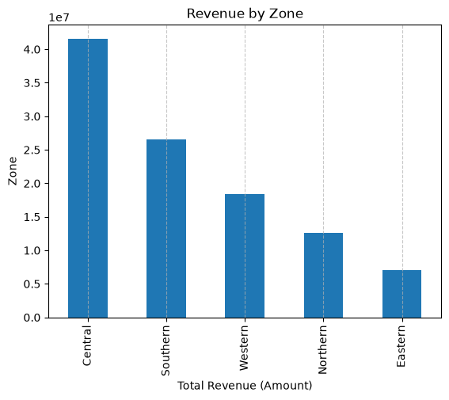
Regional Sales Comparison
Central and Southern zones lead in overall revenue generated
Top Performing State
Uttar Pradesh leads national totals with ₹1.94 Cr revenue.
Highest Order Value
Southern Zone exhibits highest average spending per basket.

Slide 13
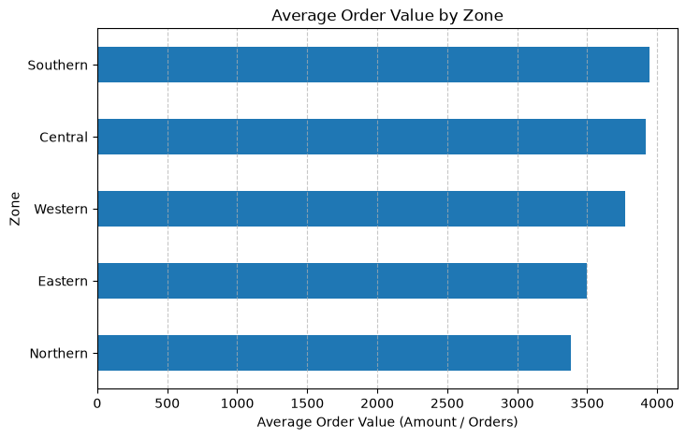
Average Order Value (AOV) Analysis by Regional Zone
Central Zone Leads Overall SaleRevenues with Strong Average Basket Sizes
Overall Benchmark: The dataset average transaction value sits around ₹9,453 (with a median of ₹8,109).
Top Revenue Zone: The Central Zone leads in total aggregate sales volume and order count.
Regional Variations: While high-volume zones like Central and Southern drive maximum transactions, average order values (basket sizes) vary across zones depending on preferred product categories (e.g., higher-ticket items versus everyday essentials).

Slide 14
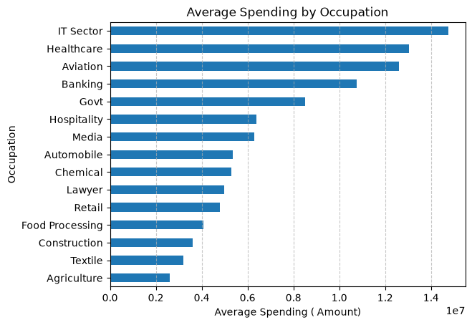
Occupation Sector Spending Chart
IT Sector and Healthcare professionals drive highest total spend

Slide 15
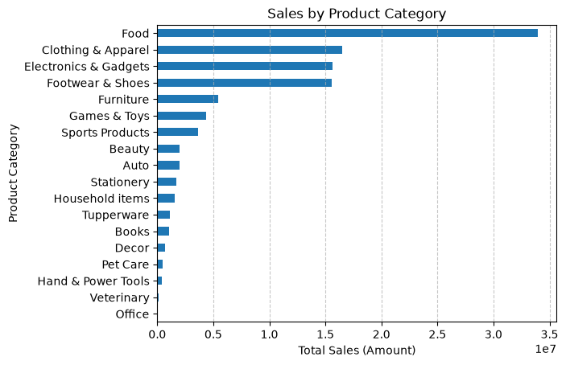
Top-Performing Product Categories by Revenue
Clothing & Apparel and Food Dominate Total Festive Sales Revenue
Top Revenue Drivers: Clothing & Apparel, Food, and Electronics & Gadgets account for the largest share of total sales.
Lower Contributing Categories: Categories such as Beauty and Stationery generate comparatively lower revenue volumes during the festive cycle.

Slide 16
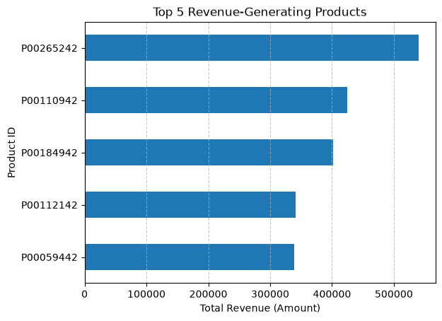
Top Product Revenue Leaders
Comparison graph of top 5 highest grossing SKUs

Slide 17
THANK YOU
Key takeaway
Revenue is concentrated among Female customers, the 26-35 age group, the Central zone and the Food category.
Dataset notes: 11,251 rows • 3,755 distinct User_IDs • 12 missing Amount values excluded from revenue totals.
Prepared using the provided notebook and CSV. The notebook's local MySQL connection credentials were not included in this report.
TURNING DATA INTO DECISIONS
A Diwali Sales Analytics Report · sourabh gawade

