Slide 1

Smart Pill Box
By
Sourabh Sarkar,
Srijita Gayen,
Prena Singh

Slide 2
Presentation Outline
Introduction
Block Diagram
Components Used
Working and Prototype
Advantage and application

Slide 3
Introduction
This pill box encourages the client to stay healthy by reminding the patient’s pill dose. Its motivation is to educate the client about: -
    Whether the patient has taken out the pill from the pill box at the correct time or not.
    Informs when the pill box gets vacant.
    Checks the blood pressure and creates a graph in the android application.
    Shows all the hospital, medical stores and blood donation centres.
    A person can set timer alerts by pre-setting.

Slide 4

Components
IR- Infra-Red.
Pulse sensor- measures the pulse and creates a graph on the android application.
Android Application
Firebase

Slide 5
    Functional Requirement
    Pill Intake:
      Android Application: It takes the schedule from the user and gives alert to the user about which pill is to be taken and on the user defined time and checks whether the pill is taken on time.
      IR Sensor: It will check the status of the pill. Checks if the pill slot is empty or not.
    Blood pressure:
      Android Application: Blood pressure graph is created to showcase the overall record of the patient
      Pulse Sensor: It takes in reading and sends it to the database.
      Pulse History in Database: It saves the pulse reading to show the rate in graph.
      Firebase Functions: It is written in the JavaScript. When there is an abnormal reading in the database, the firebase function would create a notification and send it to our device using Firebase Messaging Service.

Slide 6
    Functional Requirement
    Nearby:
      Android Application: This UI will show nearby hospitals, pharmacy and blood banks.
    RELIABILITY: Easy to use. It is reliable and cost effective. But the only weakness is slow networks.

Slide 7
  Non-Functional Requirement
    Usability
      Patient condition can be monitored
      They can be administered medication remotely.
    Reliability: Easy to use. It is reliable and cost effective.
    Performance
      Throughput is fast and reliable.
      May crash in case of high traffic or slow network speed.

Slide 8
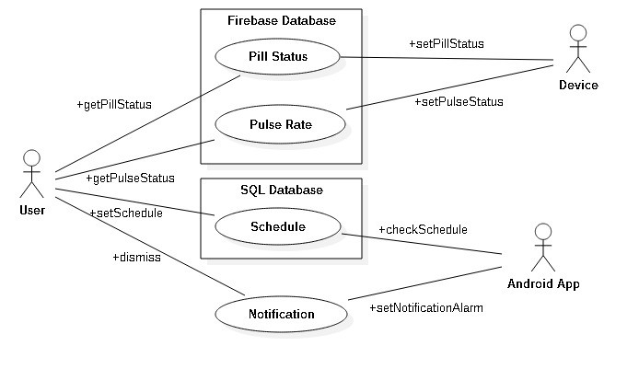
  Use Case Diagram

Slide 9
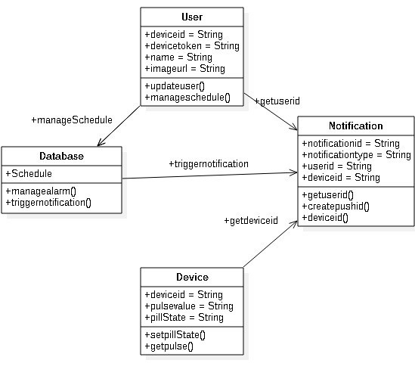
  Class Diagram

Slide 10
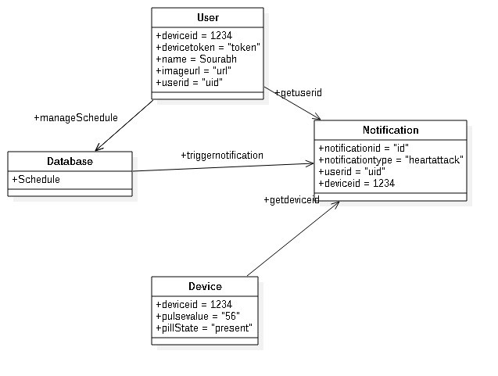
Object Diagram

Slide 11
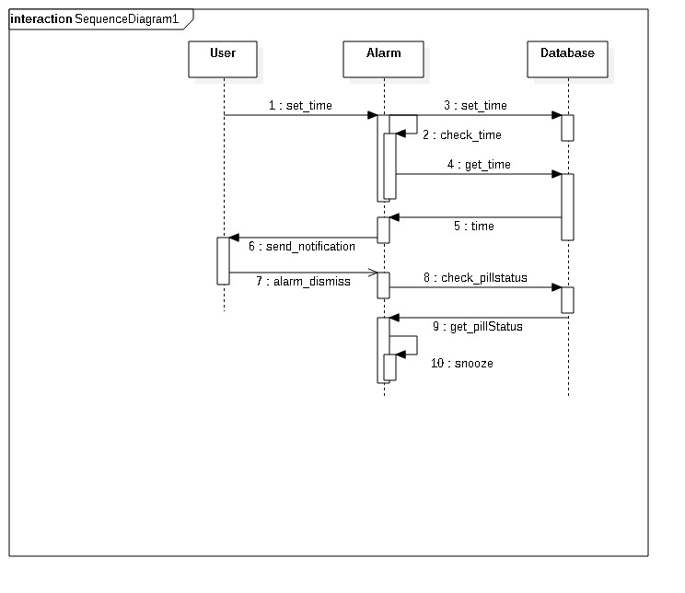
Sequence Diagram

Slide 12
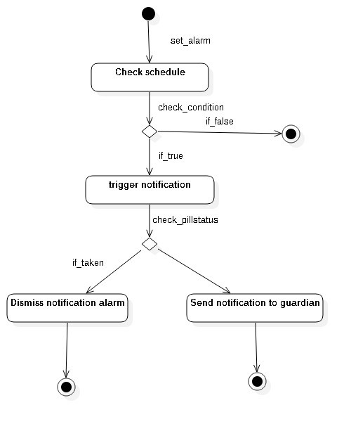
Activity Diagram

Slide 13
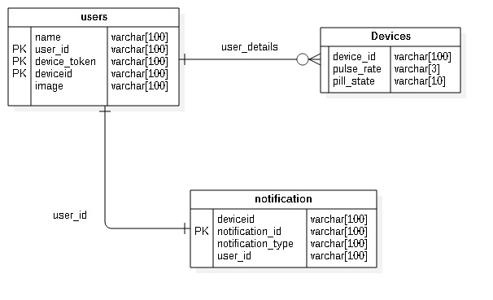
ER Diagram

Slide 14
Conclusion and Future Scope
Conclusion
This task has concentrated on the issues looked by senior natives concerning ad- hence to their recommended medicine. It helps the older who live freely as well as the guardians of the old by helping perfect add up to remember drug at the opportune time. The brilliant medication box utilizing install stage has just been tentatively demonstrated to work agreeably. This medication box alongside the android application is a kind of self-loader can demonstrate helpful and an easy to understand instrument for us all. It encourages it to be cost proficient too. The other favorable position of this crate is that it is anything but difficult to utilize and the intricacy is less. This guarantees the old patient expends the correct dose of drug at the ideal time, gave the person acknowledges this new, irregular technique for prescription. The portable application constructed additionally screens the heart beat rate and in- forms of any irregularity., adjacent drug store, medical clinics and Blood banks.
Future Scope
In the future, we chose to include the element of checking the quantity of pills. That will be useful for the client to get continuous prescription since it will almost certainly alert the client or patient on coming to the pre-set limit through notification.

Slide 15
References
    Wandless I, Mucklow JC, Smith A, and Prudham D Improving oral medication compliance with an electronic aid Engineering in Medicine and Biology Magazine, IEEE
    https://www.youtube.com/user/akshayejh
    https://www.tutorialspoint.com/android/index.htm
    https://github.com/ioxhop/IOXhop_FirebaseESP32
    http://www.instructables.com/howto/Pill-Box/

Slide 16

Thank You

