Slide 1
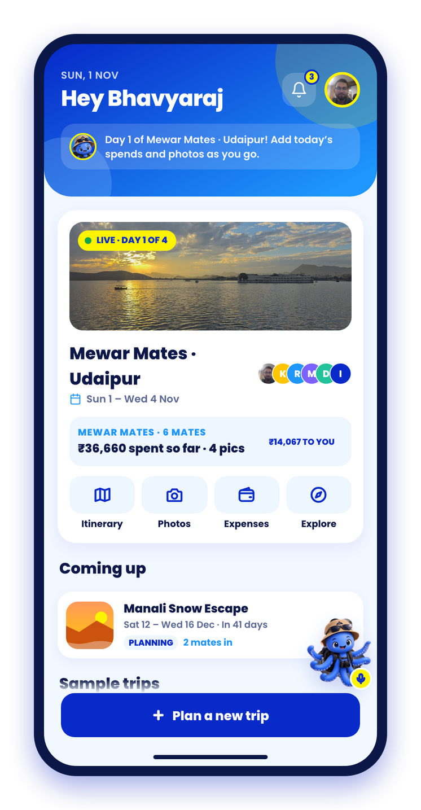

Ghoommates
Trips with your squad, sorted.
Plan together, split every rupee and find every pic. Now built for Udaipur’s heritage: calmer sites, stories at every stop, makers to meet and a greener trip.
Heritage-first group travel
Notes:
Ghoommates is a group-travel app for a squad of friends, with GhoomMate, a voice-first AI buddy.
For this track we rebuilt it around Udaipur: every heritage feature works for a whole squad at once.

Slide 2



Group trips are fun. Organising them isn’t
Three things break every squad trip we’ve been on:
Planning chaos in the group chat
Splitting money is awkward
Photos end up scattered
Where, when, what to do: every decision turns into an endless thread, and the loudest voice wins over everyone’s vibe.
Dozens of small spends across five people and a spreadsheet nobody trusts. Chasing dues strains friendships.
Every pic lives on someone else’s phone. Finding the ones you’re in, or making a reel, takes hours.
“So… who’s booking?”
“Bro, you still owe me ₹450”
“Send me the pics!”
Notes:
Lead with relatable pain: planning debates, money awkwardness, scattered photos.

Slide 3
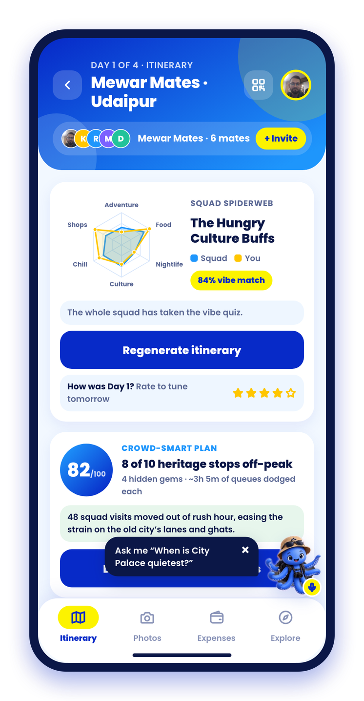



Meet Ghoommates: one app for the whole trip
Before
Vibe quiz · AI-drafted plan · Festivals
During
Crowd-smart plan · Kaavad Tales · Makers
After
Squad Miniature · Impact card · AI reel · Settle up
GhoomMate, your AI buddy on every screen
Just say it: “I paid 800 for the cab”, “What’s on this week?”, “Make a reel of Kabir”.
Notes:
Ghoommates covers the full trip: before, during and after. The heritage features sit inside that flow, not in a separate app.

Slide 4




Udaipur’s heritage deserves better than a rush
Four gaps the Heritage, Tourism & Sustainable Hospitality track asks us to close:
Everyone arrives at 11 AM
The stories get lost
Makers stay invisible
Kitchens guess and waste
City Palace, the Pichola boats and the ghats all peak at the same hours.
A rushed guide or a plaque. Visitors leave without the legends.
Middlemen set tourist prices; the craft family sees a fraction.
Produce travels far, demand is a guess, leftovers pile up.
Our lever is the squad. One nudge moves 4–10 people at once, and squads plan days ahead, so Ghoommates can forecast crowds before they form and send spend to local hands.
Notes:
The track names storytelling, artisans, crowds, eco hospitality and farm-to-table. We saw each of these gaps in Udaipur.
The insight: a squad is a unit. One nudge moves 4–10 people, and squads plan ahead, which turns their itineraries into a crowd forecast.

Slide 5




Every track goal has a feature
Domain 1 · Heritage, Tourism & Sustainable Hospitality · Udaipur
INTERACTIVE STORYTELLING
ARTISAN DISCOVERABILITY
SMART CROWD MANAGEMENT
Kaavad Tales
Maker Trail
Crowd Pulse + Ops
Painted, narrated site stories in English and हिन्दी; quizzes stamp a Heritage Passport.
14 Udaipur crafts, makers near each stop, a fair-price checker and squad workshops.
Squads’ plans become a crowd forecast; nudges and Heritage Ops advisories spread the load.
LIVING HERITAGE
FARM-TO-TABLE · ECO HOSPITALITY
SUSTAINABLE TOURISM
Mewar Utsav
Mewar Thali Table
Green Trip
A verified festival calendar, and a crowd model that rises on festival days.
Squad thalis from partner farms; hosts get demand, farm orders and a waste log.
Footprint per leg, crowd-hours avoided and rupees kept local, for the whole squad.
Plus Squad Miniature: an AI keepsake that sends squads to Udaipur’s real miniature painters.
Notes:
One slide that maps every hint in the track description to a working feature. Each one also works for a squad, which is our multiplier.

Slide 6
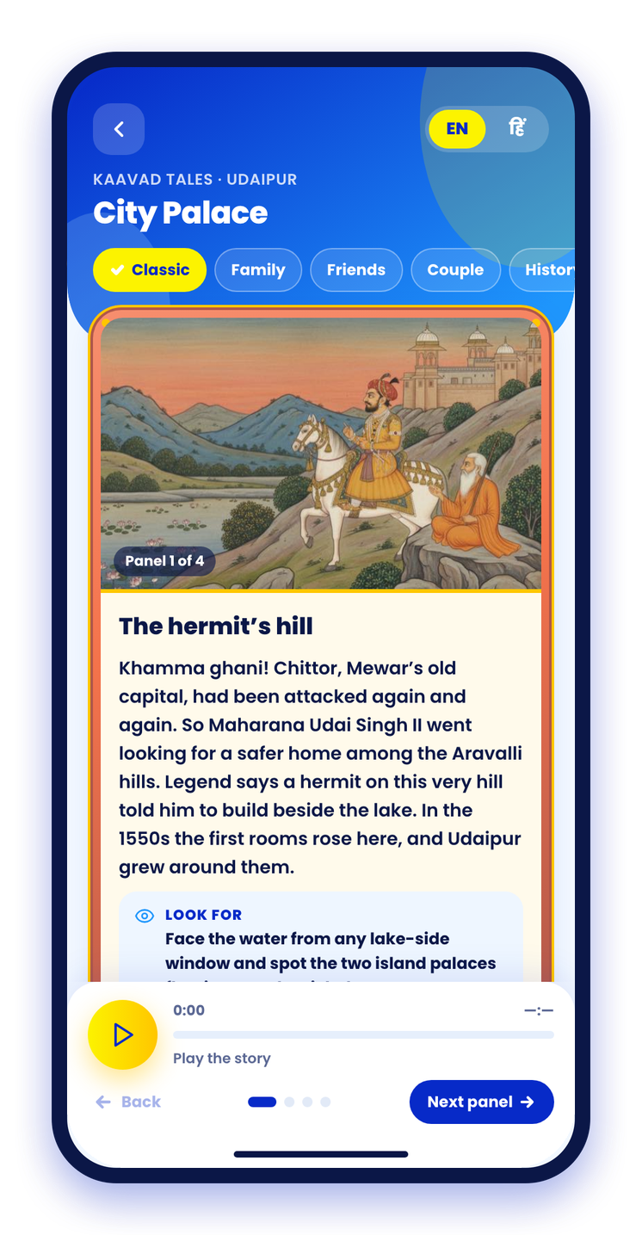
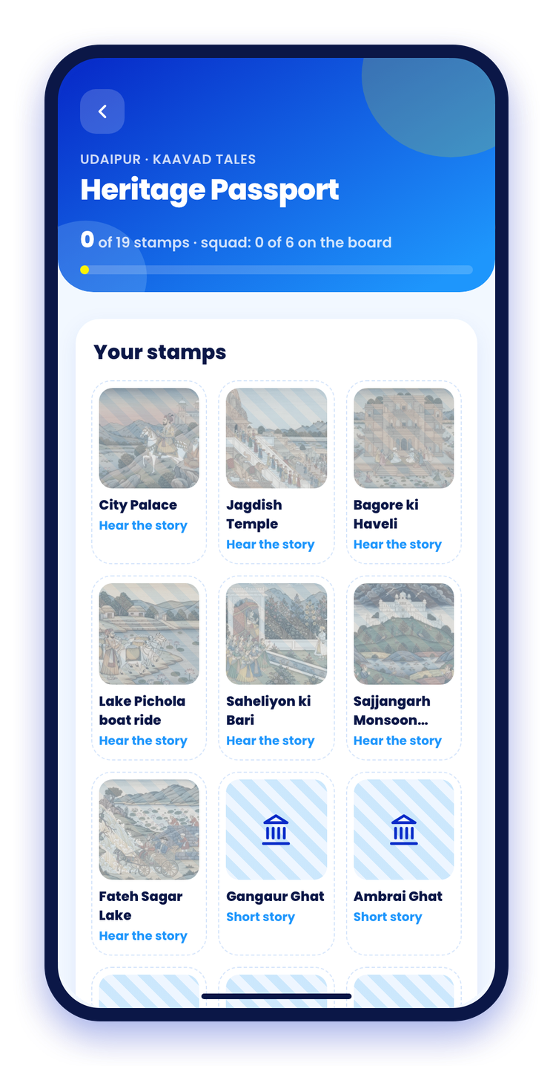



Kaavad Tales: every stop tells its story
A story that unfolds like a kaavad
Panel by panel, in Mewar miniature-style art, at the stop you’re standing in.
Narrated in English and हिन्दी
Retold for families, friends, couples or history buffs; Gemini keeps to the facts.
Quiz, stamp, compare
Three questions earn a stamp in each mate’s Heritage Passport; the squad sees the board.
7 sites · 28 painted panels · 2 languages
Hand-written, fact-checked stories; Gemini retells them for other audiences and Gemini TTS narrates.
Notes:
Interactive storytelling. Kaavad is the Mewari portable shrine whose doors open panel by panel; the story screen works the same way.
Demo: open City Palace, switch to हिन्दी, play narration, answer the quiz and show the stamp.

Slide 7
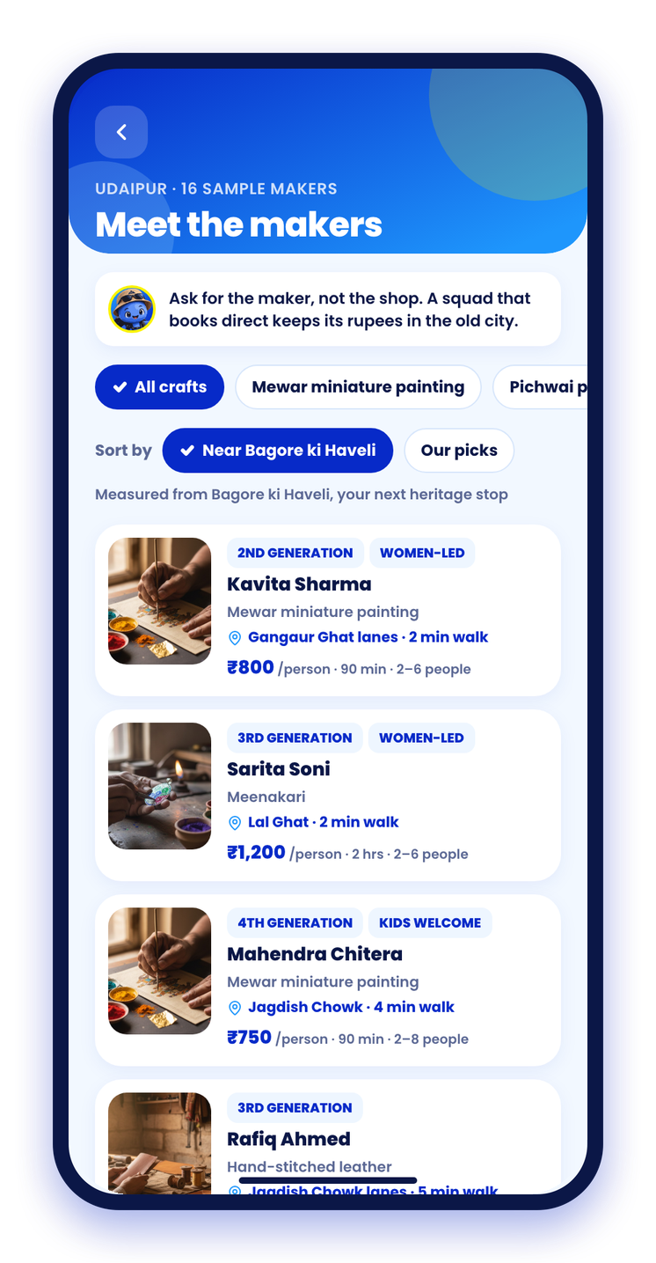
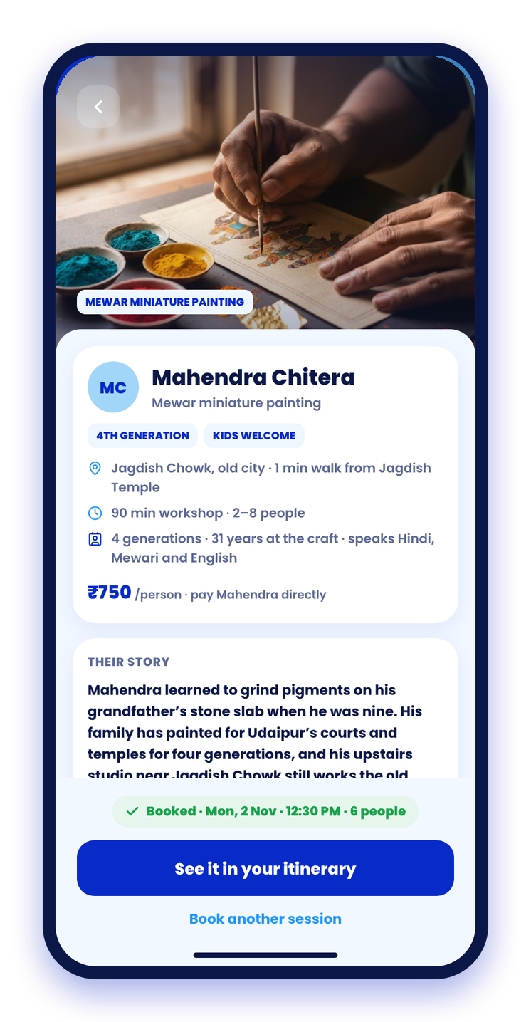


Maker Trail: meet the hands behind the craft
14 Udaipur crafts, explained
History, how it’s made, how to spot the real thing; GI tags only where verified.
A fair-price checker
Type the quote: fair, a bit high or a tourist price, with a counter-offer to make.
Book a squad workshop
Paint a miniature with a fourth-generation chitera; it lands in the itinerary.
Ask the maker
Gemini answers from that maker’s own facts only.
“Ask for the maker, not the shop. A squad that books direct keeps its rupees in the old city.”
Notes:
Artisan discoverability. Makers are sample partners with fictional names in real neighbourhoods; crafts and GI tags are real.
Demo: Explore, Makers of Udaipur, fair-price checker, then the booked miniature workshop on day 2.

Slide 8
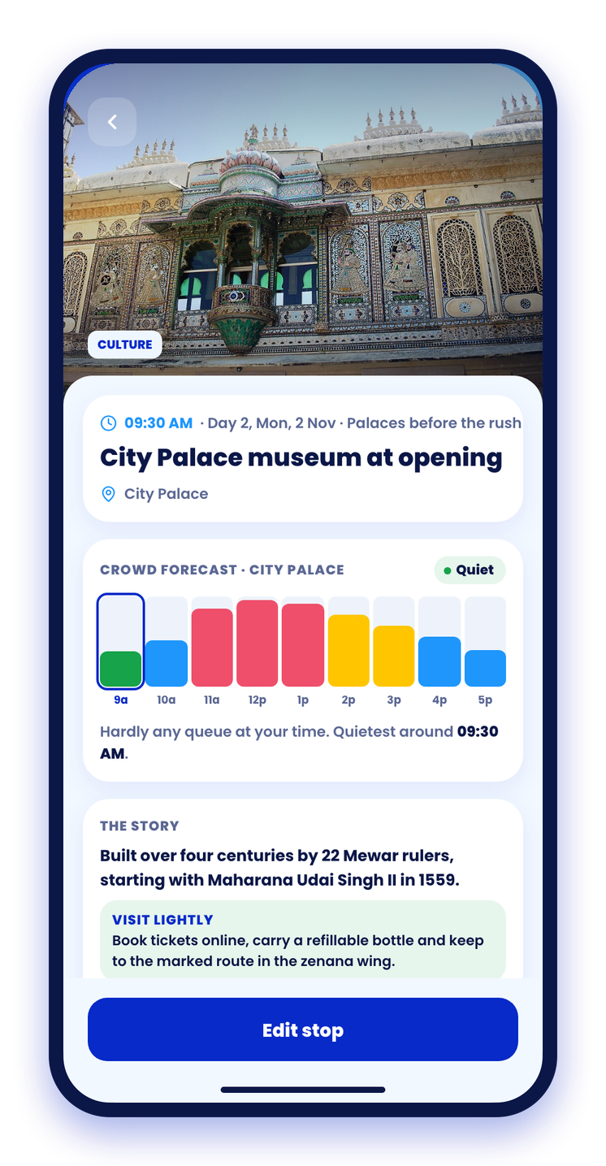
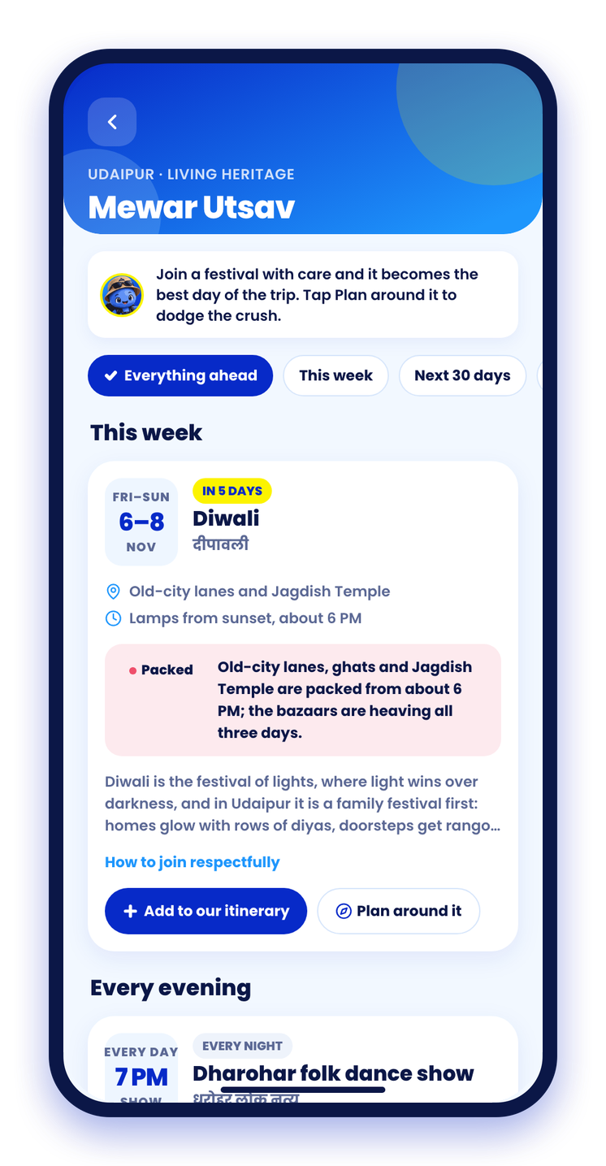
Calmer heritage sites, one squad at a time
1
A crowd-smart plan
2
Hour by hour, at every site
3
Festival-aware
82/100: 8 of 10 heritage stops land off-peak; packed ones get a one-tap move.
City Palace is quietest at 9:30 AM, so that is when the squad goes.
Mewar Utsav dates are verified; crowds rise on festival days. Plan around, or join in.
Notes:
Smart crowd management on the traveller side. The heritage crowd model rates every stop by hour, and the itinerary scores the plan.
Festival days raise the model everywhere: Crowd pulse, the itinerary and the Ops forecast.

Slide 9
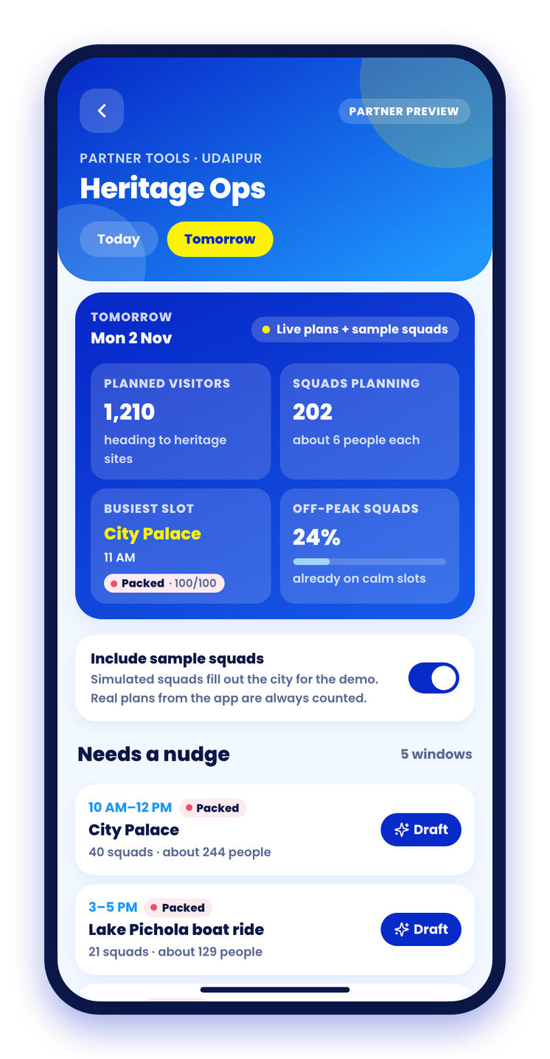
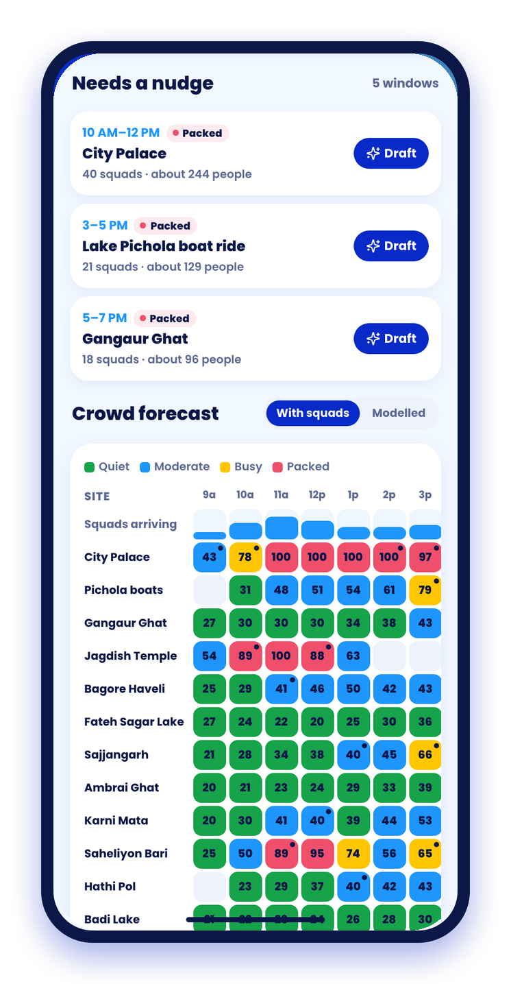



Heritage Ops: see tomorrow’s crowd today
1,210
visitors planned for tomorrow’s heritage sites, read from squads’ itineraries (demo data)
Forecast by site and hour
The modelled crowd curve plus every squad’s planned stops, as a heatmap.
Bilingual advisories in one tap
Gemini drafts English + हिन्दी with a calmer option; squads see “Heads up” and swap.
Private by design
Aggregate only: fewer than 3 squads shows as “<3”.
Notes:
The other side of crowd management: a console for site managers (#/ops). Planned stops from squads are added to the modelled curve.
Demo: draft an advisory for City Palace at 11 AM, publish it, and show the Heads up banner on the squad’s stop page.

Slide 10
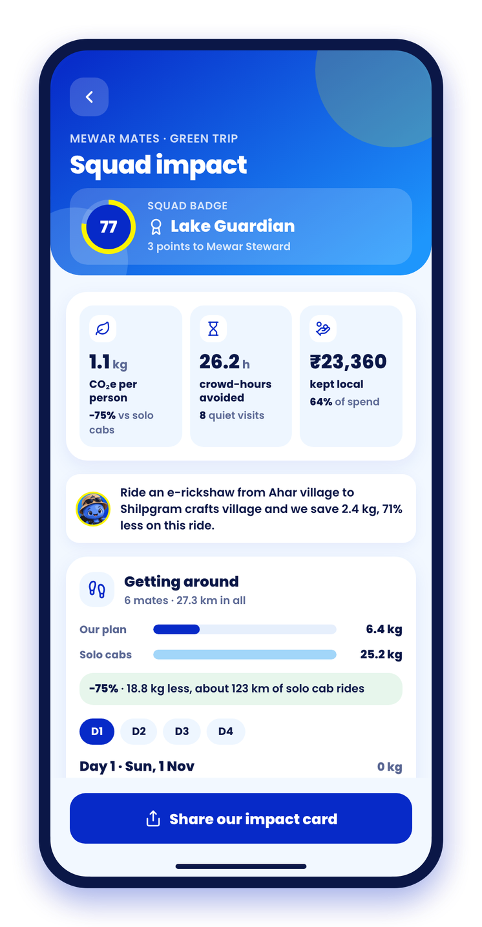
Green Trip: every squad sees its impact
1.1 kg
26.2 h
CO₂e per person
crowd-hours avoided
75% under solo cabs
8 of 10 visits planned at quiet hours
64%
77/100
of spend kept local
Lake Guardian badge
₹23,360 with local people
8 pledges, ticked per mate
Numbers from the live demo trip, Mewar Mates · Udaipur. A live mode switcher (walk, e-rickshaw, auto, cab, boat); emission factors cited from the India GHG Program and CEA.
Notes:
Sustainable tourism, made visible and shareable. CO2e per leg between itinerary stops, crowd-hours avoided by quiet-hour visits, and money kept local from the shared expenses.
Demo moment: swap the Ahar to Shilpgram ride to an e-rickshaw and watch the squad tip over into Mewar Steward.

Slide 11
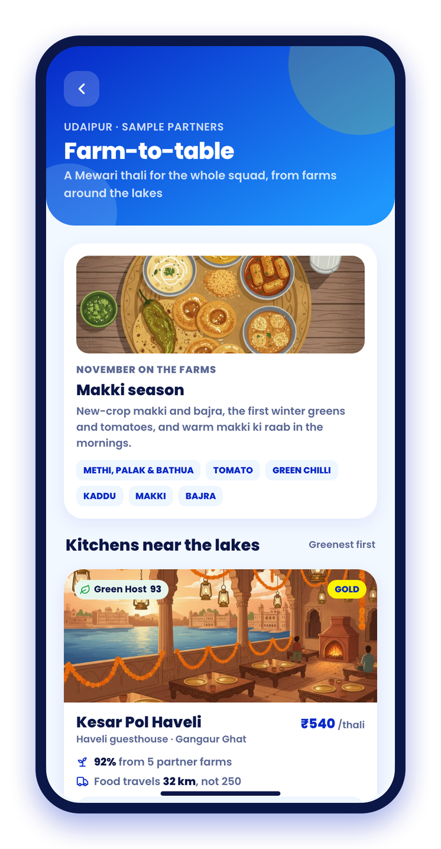
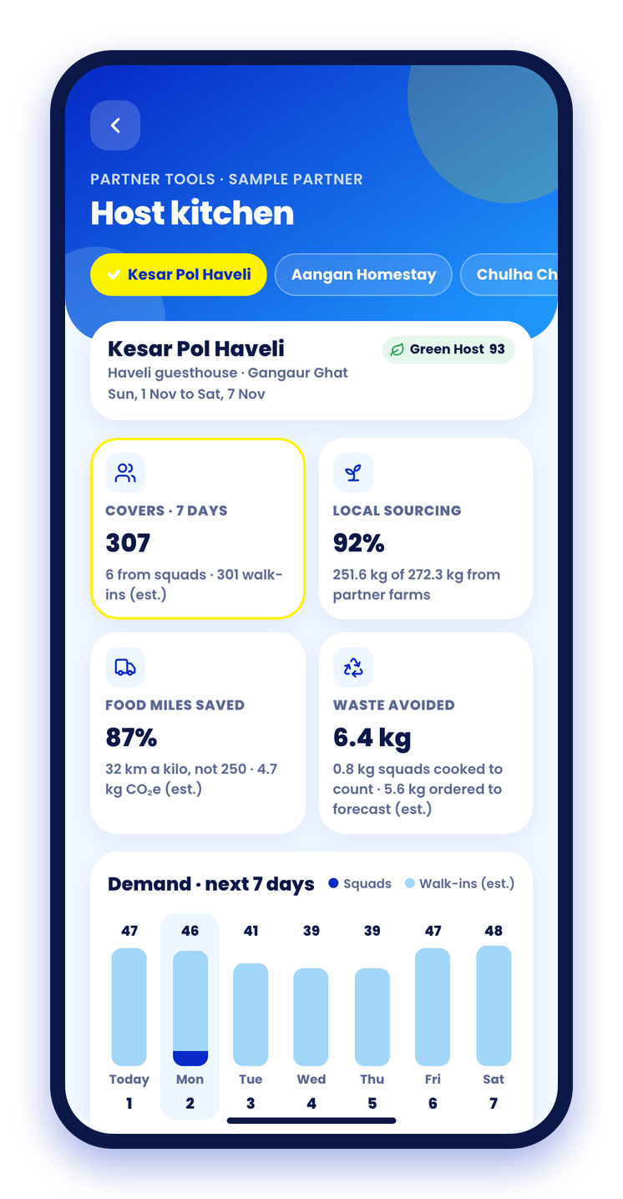


Farm-to-table, for squads and their hosts
FOR THE SQUAD
Reserve a squad thali
Headcount and diets (Jain, vegan) come from mates’ profiles; it lands in the plan.
Green Host score and food miles
Today’s seasonal Mewari special, from partner farms in villages around Udaipur.
FOR THE HOST KITCHEN
Seven-day demand, squads counted
A procurement list per farm, sent as a WhatsApp order; Gemini drafts the menu.
A waste log with a trend
Demo kitchen: 92% sourced locally, 87% fewer food miles, 6.4 kg waste avoided (est.).
Notes:
Farm-to-table sourcing and eco-conscious hospitality operations. Travellers reserve; hosts (#/host) see covers for the next 7 days including squads, order from farms and log waste.
Hosts and farms are sample partners in real villages; numbers are labelled estimates.

Slide 12
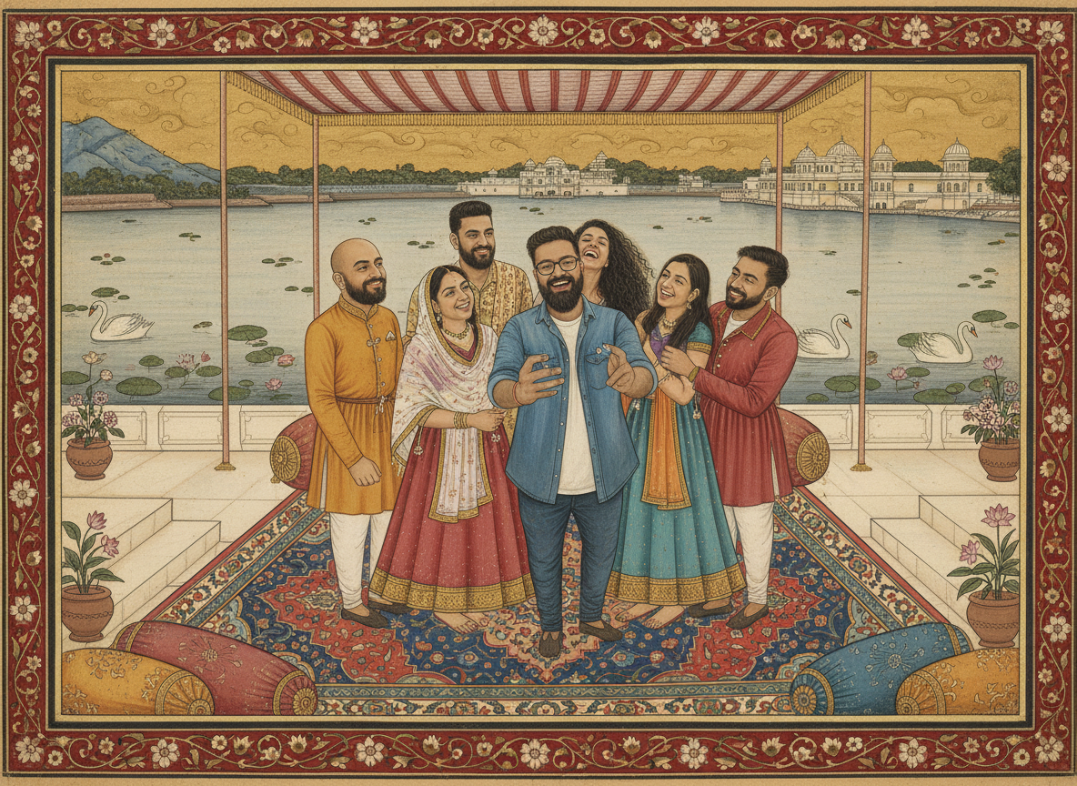



Your squad, painted as a Mewar miniature
Pick a photo, pick a tradition
Mewar miniature, royal procession, jharokha portrait or Phad scroll, by Gemini 2.5 Flash Image on Vertex AI.
Everyone stays in the picture
Gemini checks the head count, so no mate is left out.
Want the real thing?
Every painting links to Udaipur’s miniature painters on the Maker Trail.
An AI keepsake that sends squads to real artists
Painted in the app from one of the demo squad’s photos.
Notes:
Photos tab, Paint us as a Mewar miniature. About 15 seconds per painting; if image generation is unavailable the original photo is shown in a painted frame.
The point for the track: the keepsake drives discovery of real miniature painters.

Slide 13
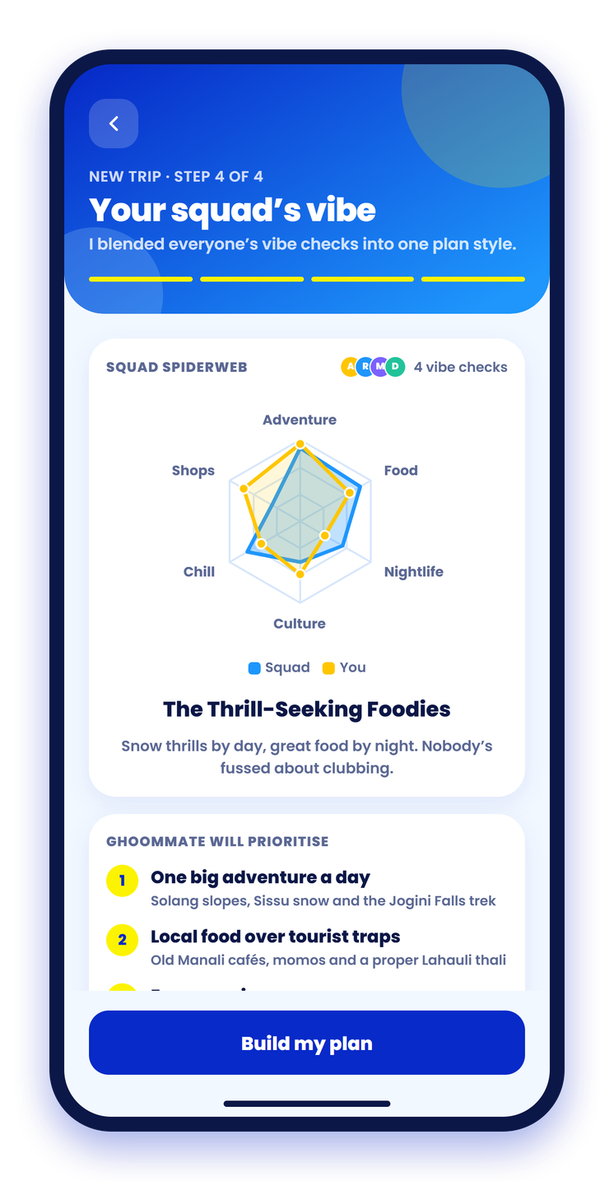
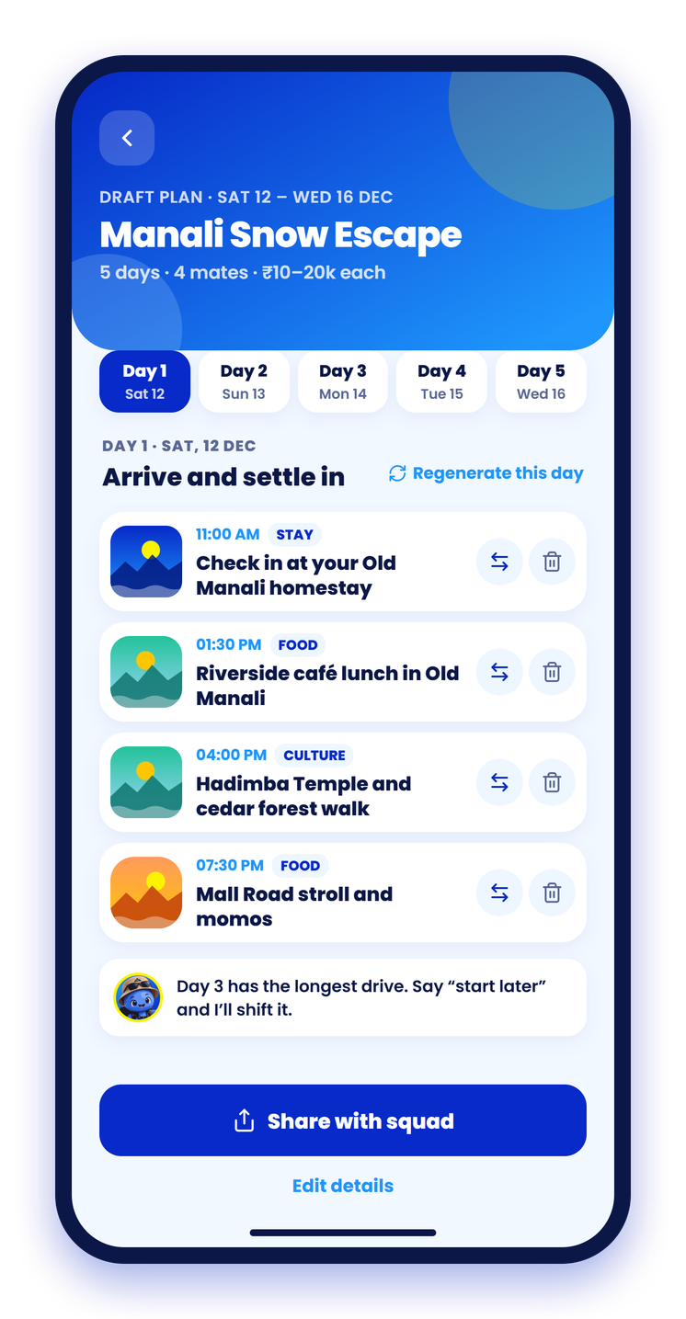
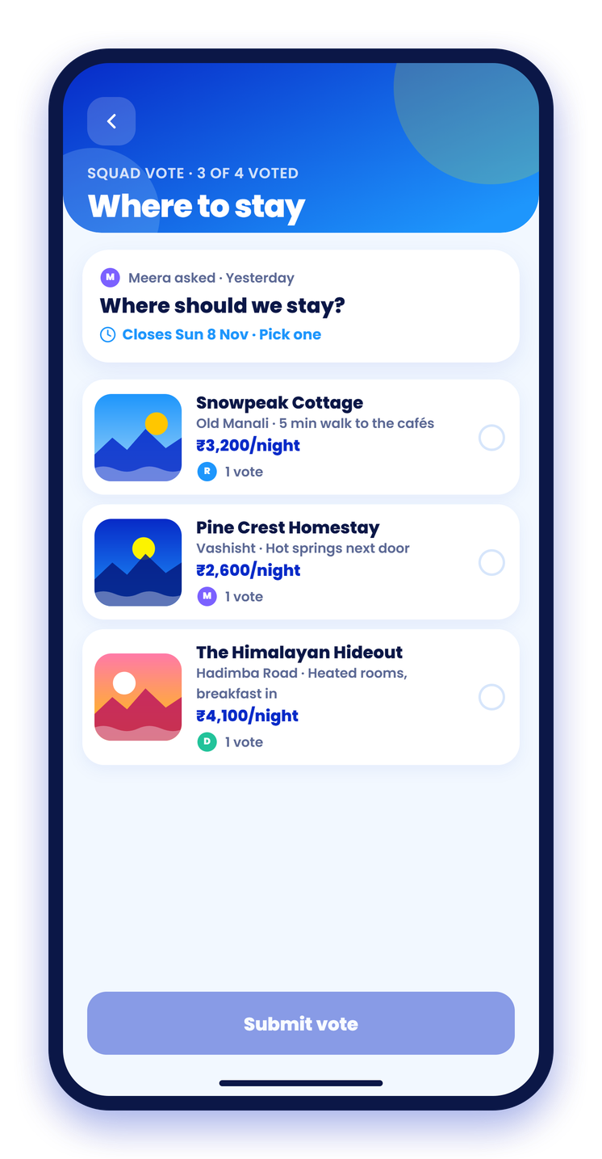
Plan together, without the endless chat
1
A 1-min vibe quiz each
2
GhoomMate drafts it
3
The squad votes, done
Everyone’s answers blend into a squad spiderweb, so the plan fits the whole group.
A day-by-day itinerary tuned to the squad’s vibe, editable stop by stop.
Stays, days and plans decided in a tap instead of a 100-message thread.
Notes:
Demo flow: create trip, squad vibe, draft plan, vote.

Slide 14
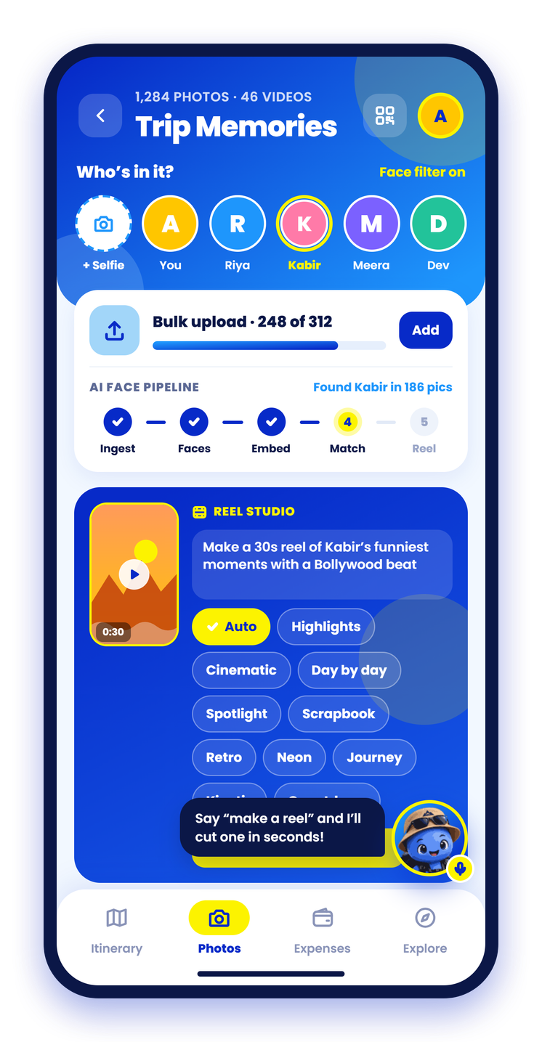
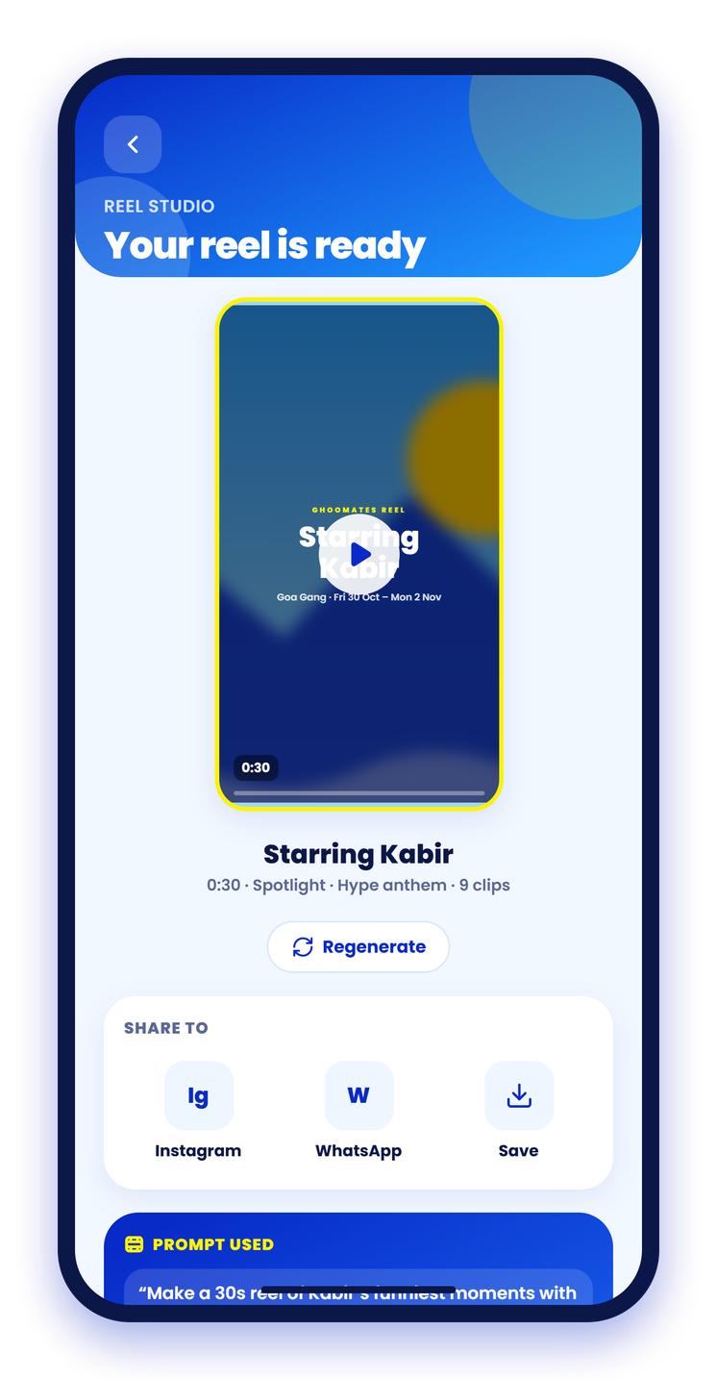


Every pic of you, and a reel in seconds
Find yourself in the album
Upload a selfie once. The album filters to the photos each friend is in.
Ingest
→
Faces
→
Embed
→
Match
Reel studio, powered by AI
Type a prompt. Gemini picks the shots, timing, captions and transitions; Remotion plays the reel in the app.
“Make a 30s reel of Kabir’s funniest moments with a Bollywood beat”
Highlights
Cinematic
Diary
Spotlight
Scrapbook
Retro
Neon
Journey
Notes:
Ten reel styles. Without a Gemini key the frontend plans reels on-device instead.

Slide 15
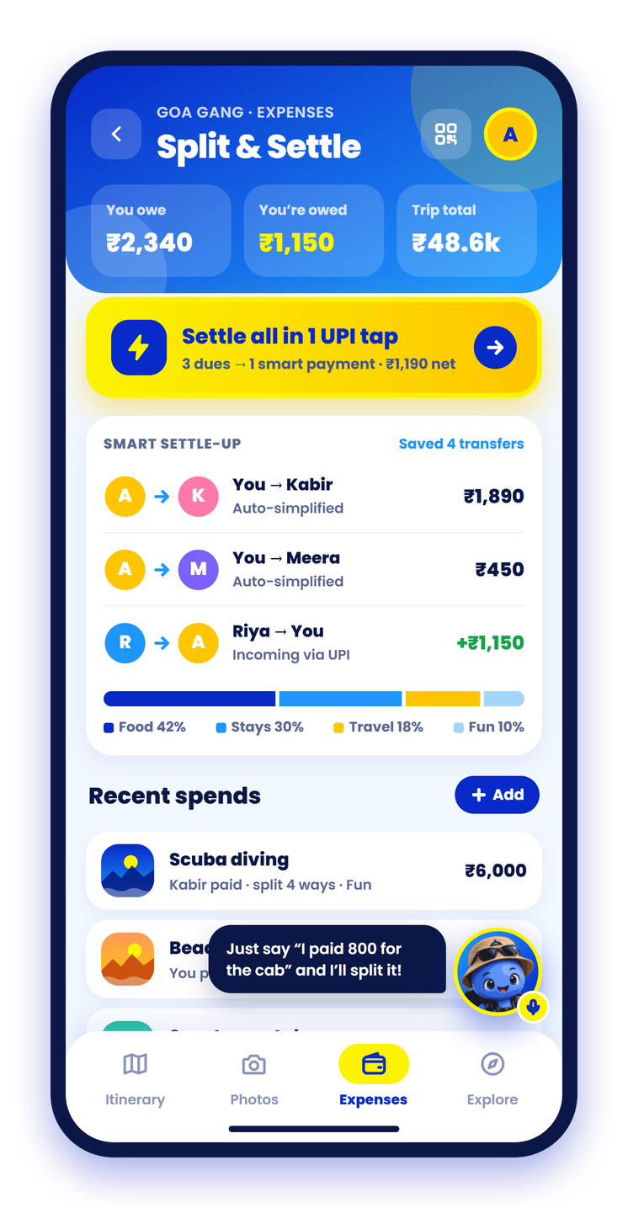
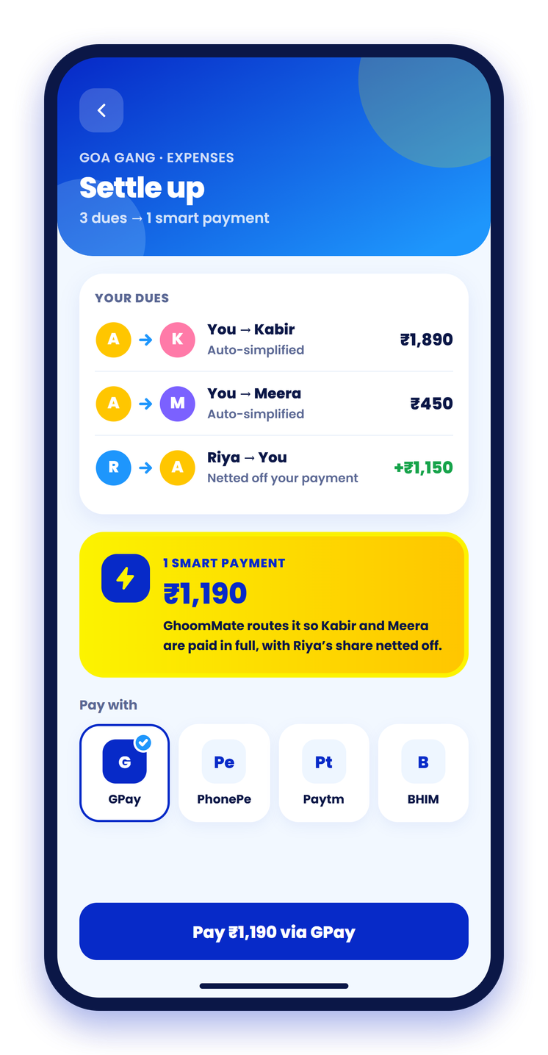



Split every rupee. Settle in one UPI tap
3 dues → 1 payment
Smart settle-up nets out everyone’s balances into the fewest transfers.
Log it by voice
“I paid 800 for the cab” becomes an expense, split the right way.
Every split, every person
Equal or custom shares, and each friend keeps one colour everywhere.
Pay with any UPI app
GPay, PhonePe, Paytm or BHIM, straight from the settle screen.
Notes:
Expenses are backed by our expense API: groups, splits, balances and suggested transfers.

Slide 16
Google AI and Cloud under every feature
Gemini 3.5 Flash
Gemini TTS
Gemini Image
Gemini Live
Story retellings, advisories, menus, maker and festival Q&A, expense sorting
Kaavad Tales narration in English and हिन्दी, on Vertex AI
Gemini 2.5 Flash Image on Vertex AI: craft covers, story panels, miniatures
GhoomMate, the voice buddy, with a “what’s on” festival skill
Cloud SQL + pgvector
Cloud Storage
Cloud Run
Google Maps
Trips, plans, stamps, bookings and face embeddings in one database
Photos, narration and artworks; Eventarc triggers face indexing
API, voice agent, face search and indexer
Directions, plus the Routes API for real leg distances
Built to demo, built to last: every feature falls back to hand-written content when AI, the database or storage is unavailable. 608 backend tests pass.
Notes:
Google tech mapped to features. Narration and images go through Vertex AI with Application Default Credentials.
Feasibility: fallbacks everywhere, 608 backend tests, Cloud Run deploy kit.

Slide 17
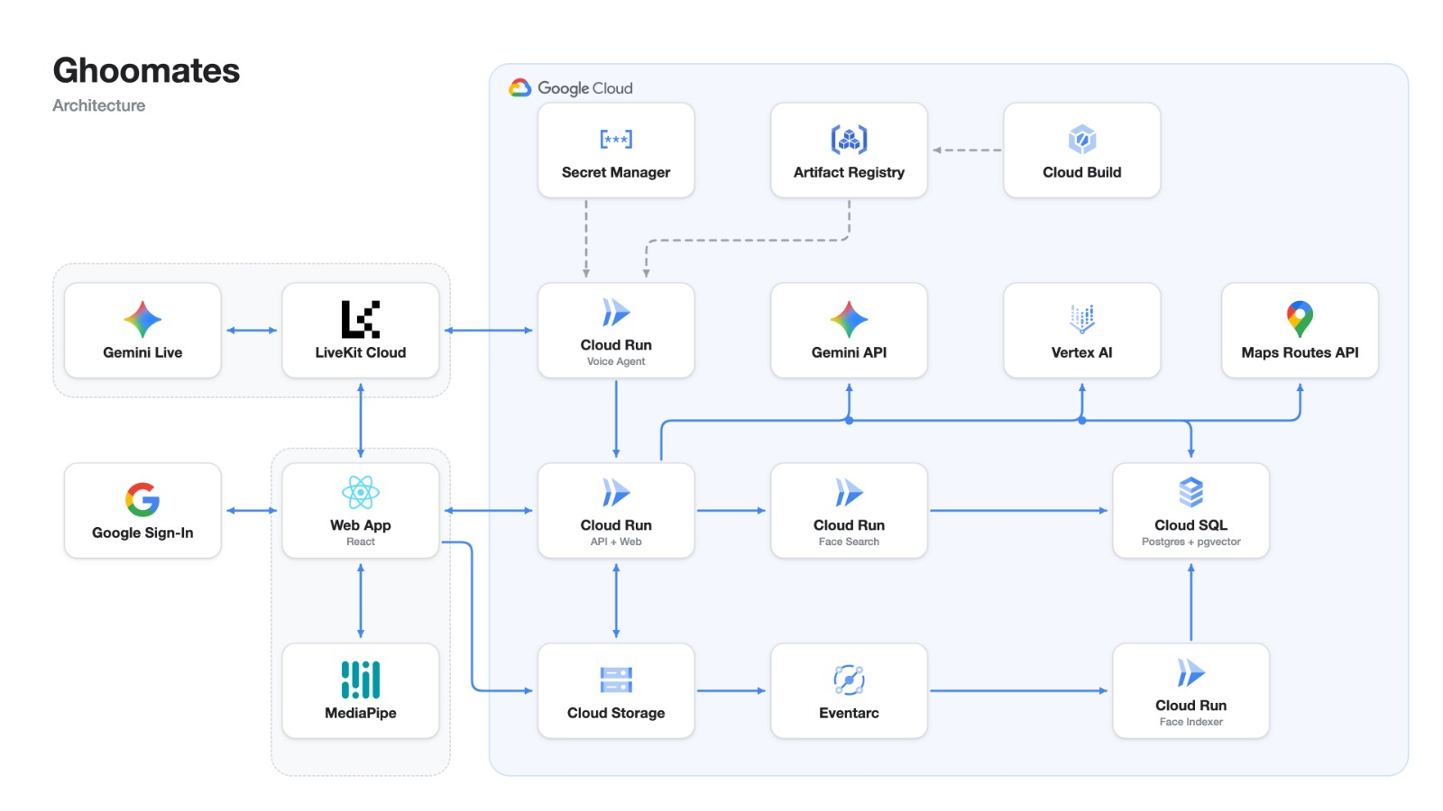

Slide 18



What’s next
Let’s plan your next squad trip together!
Bookings through the app
Booking for tours, hotels and adventures made easy
Discover Travel Buddies
Finding travel buddies on solo trip
Full voice control
Ask GhoomMate about stories, makers and crowds.
Real partners, then more cities
Verified makers, kitchens and site managers first.
Thank you! Questions?
Notes:
Close with the roadmap: real Udaipur partners first, then more heritage cities. Invite questions.

