Slide 1
SlOMO
Sourabh Daptardar

Slide 2
METHOD 1 (Warping triangulations)
For every successive pair of frames A and B:
Choose points for triangulation
Uniformly spaced
Edges (Canny) edges
Good features to track (corners)
Deluanay triangulation
For corners of every triangle in B
find the corresponding points in A by adding optical flow
Corresponding points in the interpolated frame are obtained by adding flow scaled by 1/n, 2/n, … , (n-1)/n respectively where n is video slowdown factor
find the affine transformation that maps triangle in A to B
invert the transformation and add to hashmap for that frame

Slide 3
METHOD 1
For every point in B
Find the triangle it is contained in
Find the corresponding inverse mapping
Apply the inverse warp to get the point in A and the intermediate frames
Linear interpolation using ‘remap’ (equaivalent of interp2)
“Cross-dissolve” between A and B

Slide 4
METHOD 2 (No Triangulation)
No triangulation
Map every point using dense optical flow field
Interpolation procedure: same as method1
Remap procedure : same as method 1

Slide 5
Interpolations
From opencv docs:
The function finds an optical flow for each prev pixel using the [Farneback2003] algorithm so that
prev(y,x) ~ next(y + flow(y,x)[1], x + flow(y,x)[0])
So, for 3 interpolated frames, we have:
prev(y,x) ~ next(y + alpha * flow(y,x)[1] + alpha * flow(y,x)[0])
Where alpha = { 0.75, 0.5, 0.25}

Slide 6
NOT ALL FLOWS ARE EQUAL !
OpenCV default dense flow : Farneback (2003)
DeepFlow : algorithm from INRIA LEAR (2012)
EPIC Flow : Edge preserving interpolation of correspondences
best according to evaluation by MPI SINTEL (relaistic videos generated by graphics + vision and hence has ground truth to quantitatively evaluate flow algorithms)

Slide 7
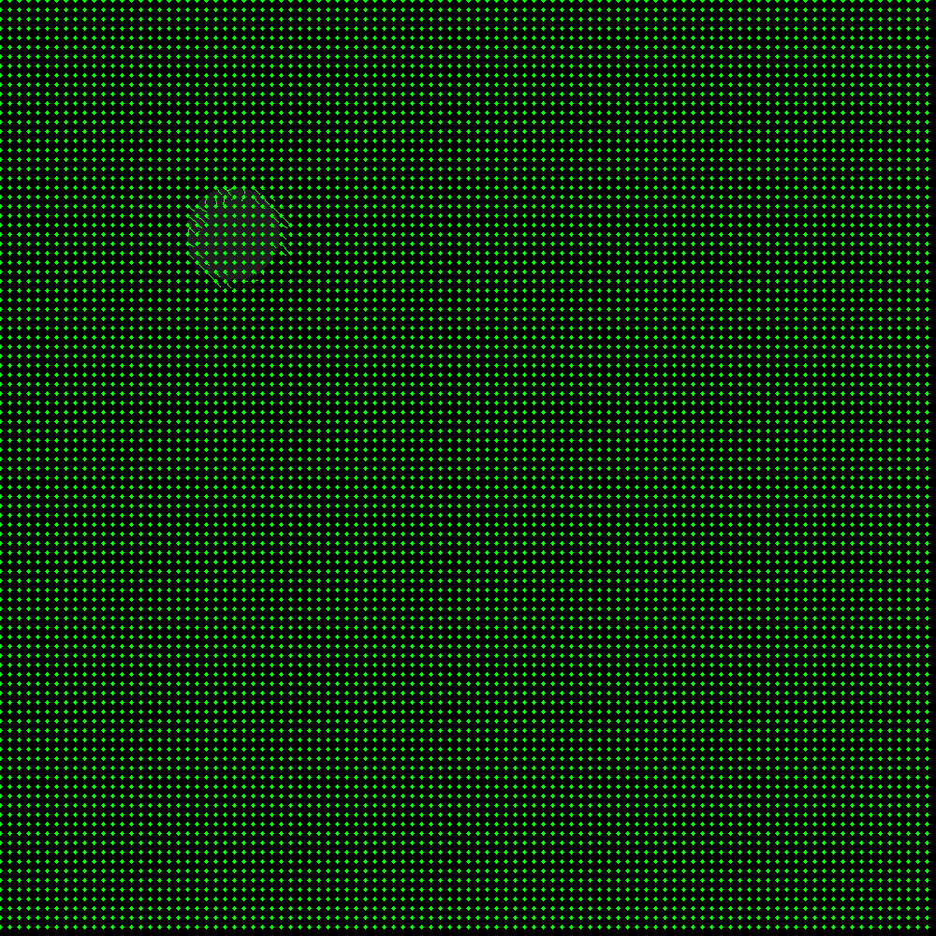
FARENBACK FLOW

Slide 8

DEEP FLOW

Slide 9
Demo videos
Farenback : test video
DeepFlow : test video
Farenback : jump video
Deep Flow : jump video

Slide 10
THEORY
Farneback :
Approximate each neighbourhood by a quadratic:
If such a quadratic undergoes displacement d,
The resultant is also quadratic and we can solve for d

Slide 11
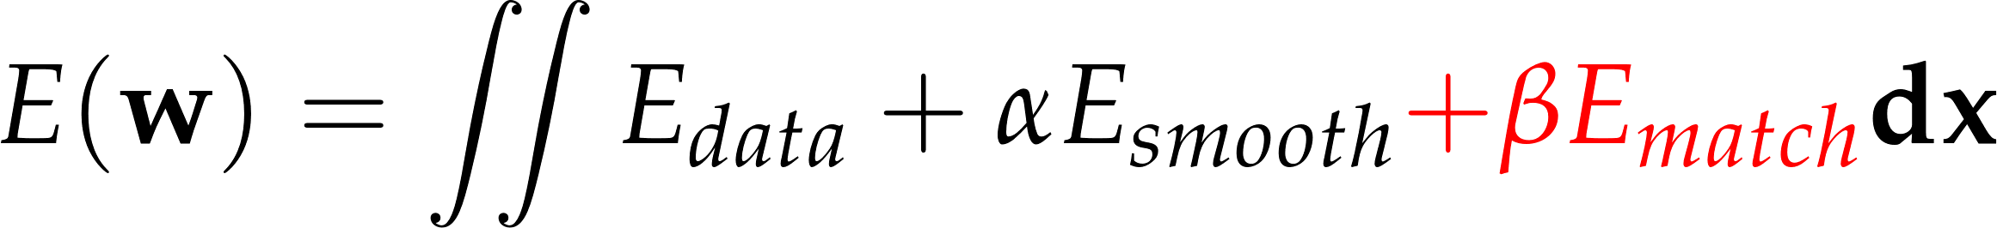
THEORY
Variational Framework

Slide 12
BETTER OPTICAL FLOW
Large displacements (multiple scales )
Descriptor based matching (matching should guide flow)
Non rigid matching
Preserving edges
Edges are superset of motion boundaries
Addressed by EPIC flow ( currently state of the art )

Slide 13
Deep Flow [Weinzaepfel et al ] Non-rigid matching

Slide 14
Deep Flow [Weinzaepfel et al ] Pipeline

Slide 15
THANK YOU

