Slide 1
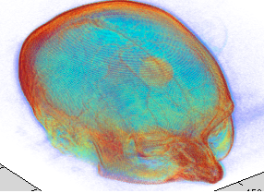
Chan-Vese Segmentation in 2D and 3D Medical Image Data
Presented by:
Sourabh Daptardar
Ahsanul Karim

Slide 2
Outline
Segmentation
Chan-Vese Model
Level Set Formulation
Numerical Approximation
Implementation
Demo & Experiment Results

Slide 3
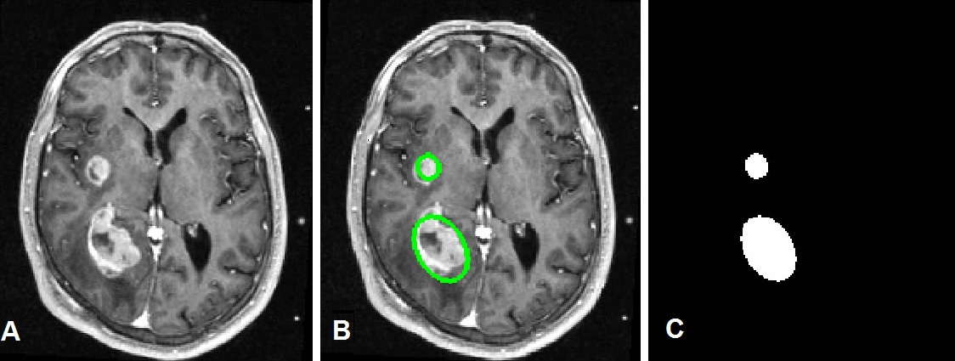
Segmentation
- Segmentation is the task of diving an image into meaningful sub-regions
- Not the same as edge detection
- Many applications in medical imaging
- Tumor detection
- Tissue volume measurement
- Anatomical features (Organs, blood vessel etc.)

Slide 4
Segmentation
Methods
Thresholding
Clustering
Region Growing
Graph Partitions
Machine Learning based approaches
PDE and Contour based methods
We’ll discuss an Active Contour based method named Chan-Vese method.

Slide 5
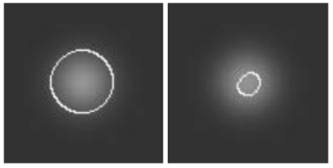
Chan Vese Method
Introduction…
Powerful and flexible method
Able to segment many types of images including some that are difficult to segment using classical thresholding or gradient based methods
The model is based on Mumford-Shah functional
Widely used in medical imaging field
(especially for the segmentation of brain, hear and trachea)
Chan Vese versus Gradient based method

Slide 6
Chan Vese Method
Introduction…
An Active Contour model
Begins with a contour in the image plane defining some initial segmentation
The initial contour is evolved according to some evolution equation
Goal is to evolve the contour such that it stops on the boundaries of the foreground region
Various approaches:
- Level Set method
- Graph-cut based method
We’ll present the Level Set based implementation

Slide 7
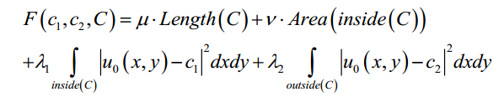

Chan Vese Method
Chan-Vese Model
The objective is to minimize the energy functional F(c₁, c₂, C):
Where, µ ≥0, v≥0, λ₁, λ₂ >0 are fixed parameters.
Therefore, the minimization problem is:

Slide 8
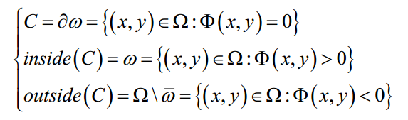
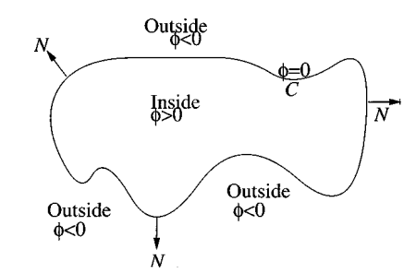
Chan Vese Method
Level Set Formulation
Redefining the problem in level set formalism:
C is represented by zero level set of some Lipschitz function,
Φ : Ω ⟶ R such that:

Slide 9

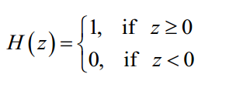

Chan Vese Method
Level Set Formulation
Functional F(c₁, c₂, C) in terms of Φ(x, y):
[1] Length(C) calculated as length of the zero level set Φ(x, y) = 0:
Where, H(z) is the Heaviside function:
and, Dirac measure:

Slide 10


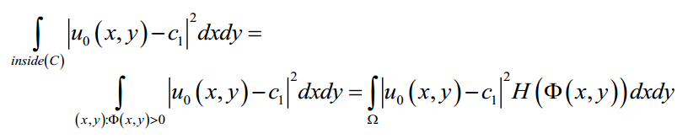
Chan Vese Method
Level Set Formulation
Functional F(c₁, c₂, C) in terms of Φ(x, y):
[2] Area(inside(C)) calculated as the area of the region where
Φ(x, y) ≥ 0:
[3] in terms of Φ(x, y) > 0, considering
only the region in which Φ(x, y) > 0:

Slide 11
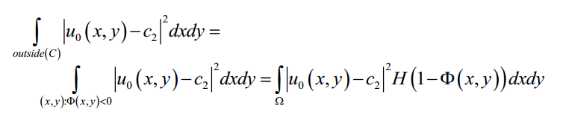
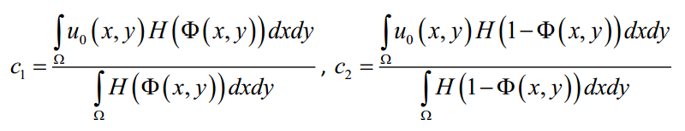
Chan Vese Method
Level Set Formulation
Functional F(c₁, c₂, C) in terms of Φ(x, y):
[4] Similarly:
[5] The average intensities:

Slide 12
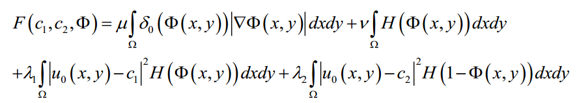
Chan Vese Method
Level Set Formulation
Functional F(c₁, c₂, C) in terms of Φ(x, y):
The Energy functional becomes:

Slide 13


Chan Vese Method
Level Set Formulation
Functional F(c₁, c₂, C) in terms of Φ(x, y):
The Energy functional becomes:
Parameters:
Region term:
affects the motion of the curve
Term
is the penalty on the total length of C

Slide 14
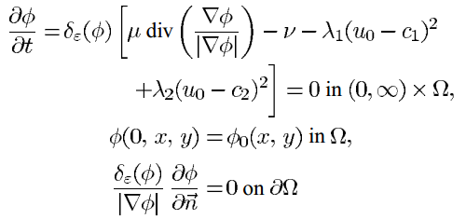
Chan Vese Method
Level Set Formulation
Variational PDE
The Euler-Lagrange equation and the gradient-descent method are used to derive equation for the level set function Φ that minimizes fitting energy F(Φ):
Here, κ (Φ) is the curvature of evolving curve.
For 3D case, we have used curvature of surface.

Slide 15
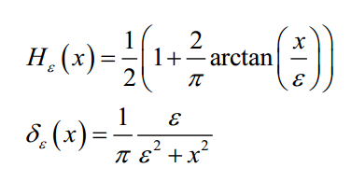
Chan Vese Method
Numerical Approximation
Analytic approximations of Heaviside and Dirac delta function

Slide 16
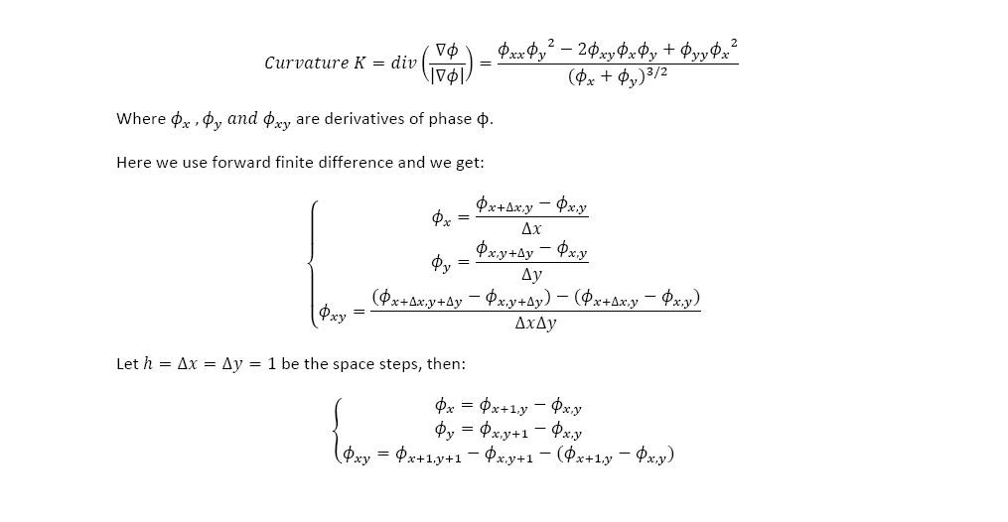
Chan Vese Method
Numerical Approximation
Analytic approximations image curvature

Slide 17
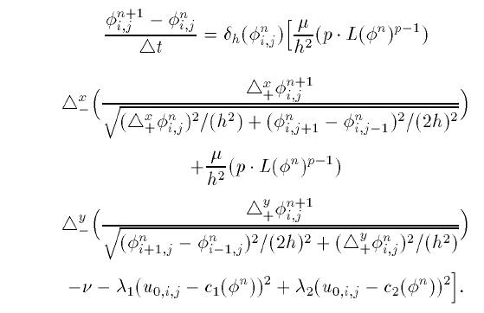
Chan Vese Method
Numerical Approximation
Approximation of Φ

Slide 18


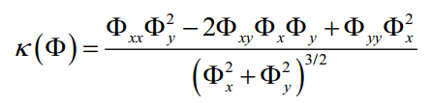
Chan Vese Method
Numerical Simpler Form
We have used the following form of the equation:
With: λ₁ = λ₂ = 0.1 and ε = 0.1
Here, curvature:
For 3D Slicer data, we have calculated Gaussian Curvature of surface:
κ( x,y,z) = {[Φ_{z}(Φ_{xx} Φ_{z}-2 Φ_{x} Φ_{xz})+ Φ_{x}² Φ_{zz}][Φ_{z}(Φ_{yy} Φ_{z}-2 Φ_{y} Φ_{yz})+ Φ_{y}² Φ_{zz}]-
(Φ_{z}(- Φ_{x} Φ_{yz}+ Φ_{xy} Φ_{z} - Φ_{xz} Φ_{y})+ Φ _{x} Φ _{y} Φ _{zz})²} [Φ_{z}²(Φ_{x}²+ Φ_{y}²+ Φ_{z}²)²]⁻¹
http://mathworld.wolfram.com/GaussianCurvature.html

Slide 19
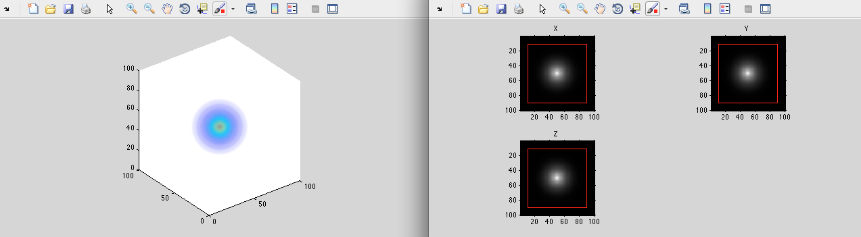
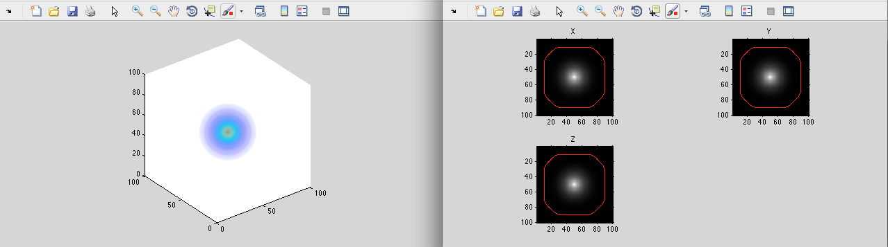
Chan Vese Method
Demo & Experiment Results
Sphere with Gaussian blur: [1]

Slide 20
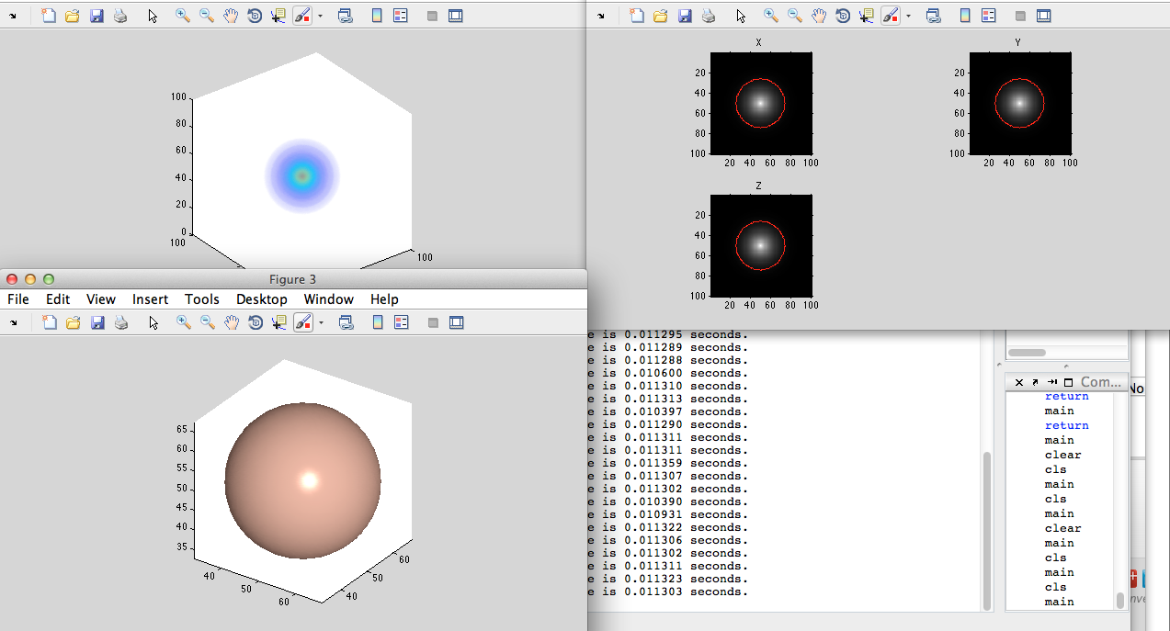
Chan Vese Method
Demo & Experiment Results
Sphere with Gaussian blur: [2]

Slide 21
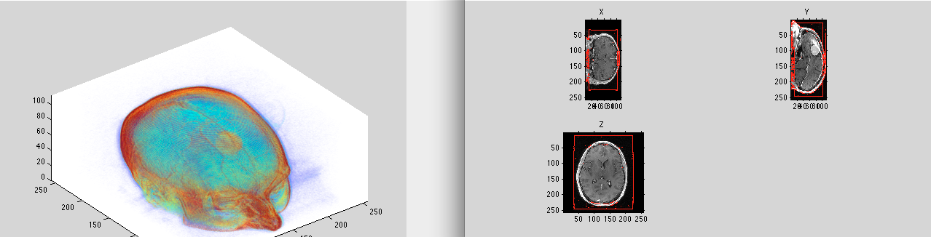
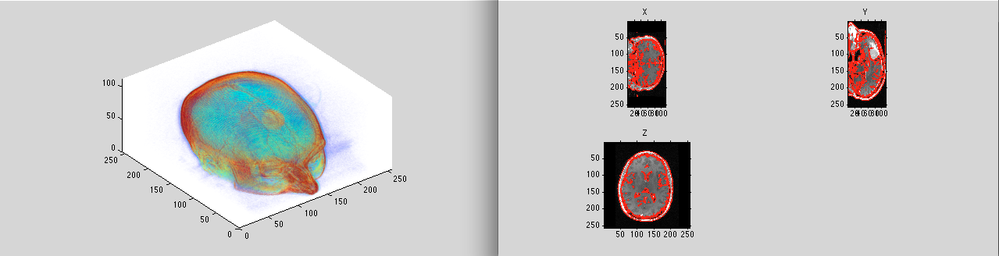
Chan Vese Method
Demo & Experiment Results
MRI Head Tumor: 1

Slide 22
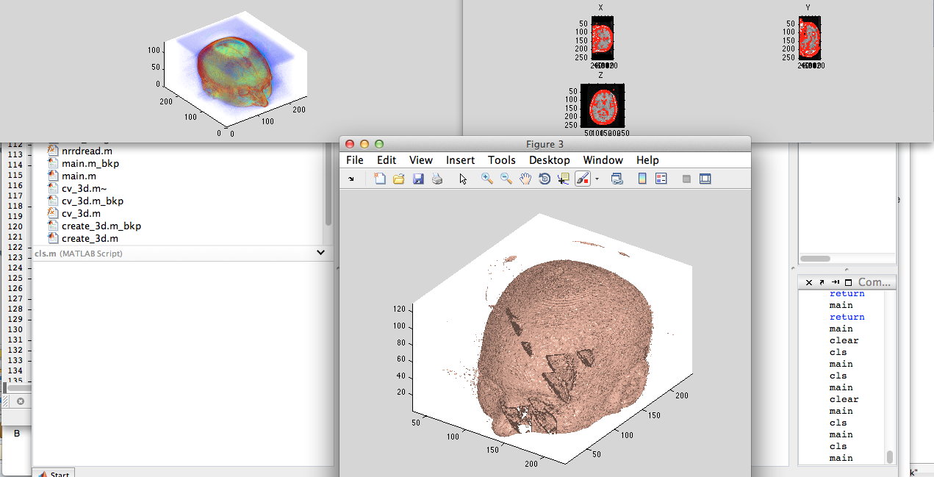
Chan Vese Method
Demo & Experiment Results
MRI Head Tumor : 2

Slide 23
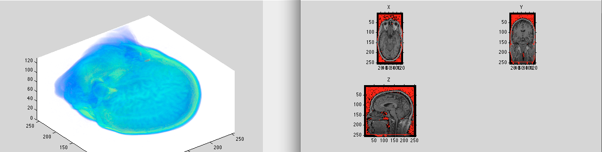
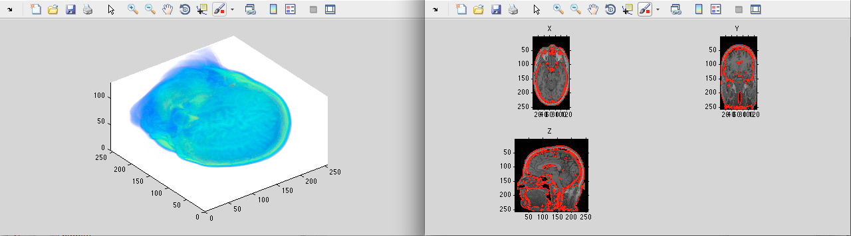
Chan Vese Method
Demo & Experiment Results
MRI Head: 2

Slide 24
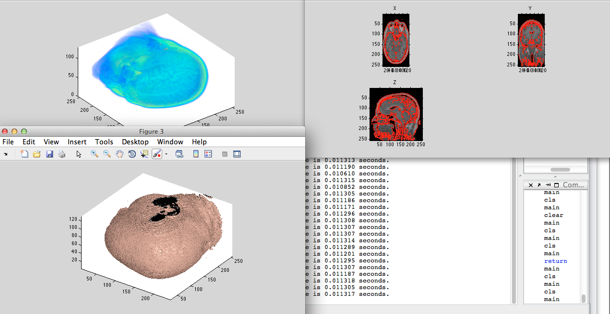
Chan Vese Method
Demo & Experiment Results
MRI Head: 2

Slide 25
Chan Vese Method
References
[1] Active Contours without Edges. Tony F. Chan & Luminita A. Vese.
[2] Image Processing Course by Todd Wittman http://www.math.ucla.edu/~wittman/Fields/
[3] Level Set and PDE Methods for Computer Graphics. Notes for SIGGRAPH 2004. [http://www.museth.org/Ken/Publications_files/Breen-etal_SIG04.pdf]

