Slide 1
Twitter Sentiment Analysis
Professor Dr. Alex,Sumarsono
Sourabh (W1648445) & Sarthak (W1650954)

Slide 2
Overview
Problem Statement -
Predict and extract the Sentiments (Positive or Negative) from the real time tweets.
Agenda -
Overview
Model Generating Workflow
Model Selection
Project Application Workflow
Demo
Q&A
Dataset Used -
Sentiment140 dataset with 1.6 Million Tweets.
https://www.kaggle.com/datasets/kazanova/sentiment140
Modules used in Project -
Pickle, Seaborn, Numpy, Pandas, Tweepy, Wordcloud, Matplotlib, nltk, sklearn.

Slide 3
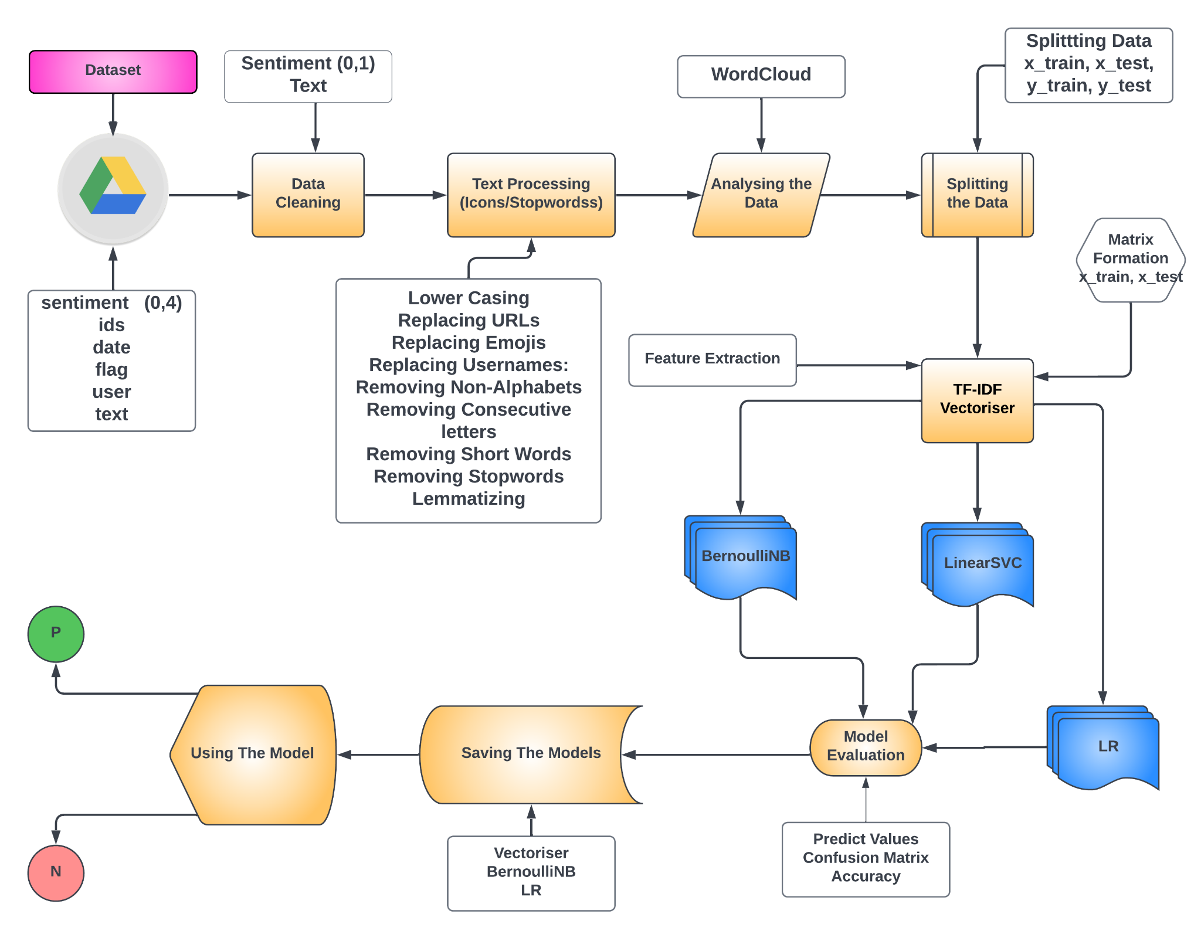
Model Generation Workflow

Slide 4
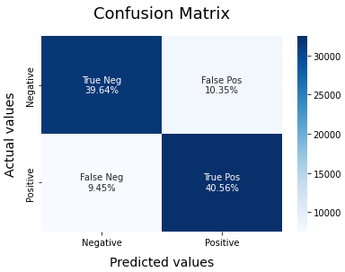
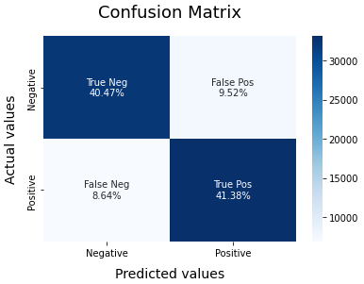
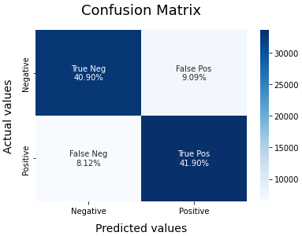
Model Selection
BernoulliNB
LinearSVC
Logistic Regression
F1 Score (Pos) | 0.80
F1 Score (Neg) | 0.80
Accuracy | 0.80
Weighted Avg | 0.80
F1 Score (Pos) | 0.82
F1 Score (Neg) | 0.82
Accuracy | 0.82
Weighted Avg | 0.82
F1 Score (Pos) | 0.83
F1 Score (Neg) | 0.83
Accuracy | 0.83
Weighted Avg | 0.83

Slide 5
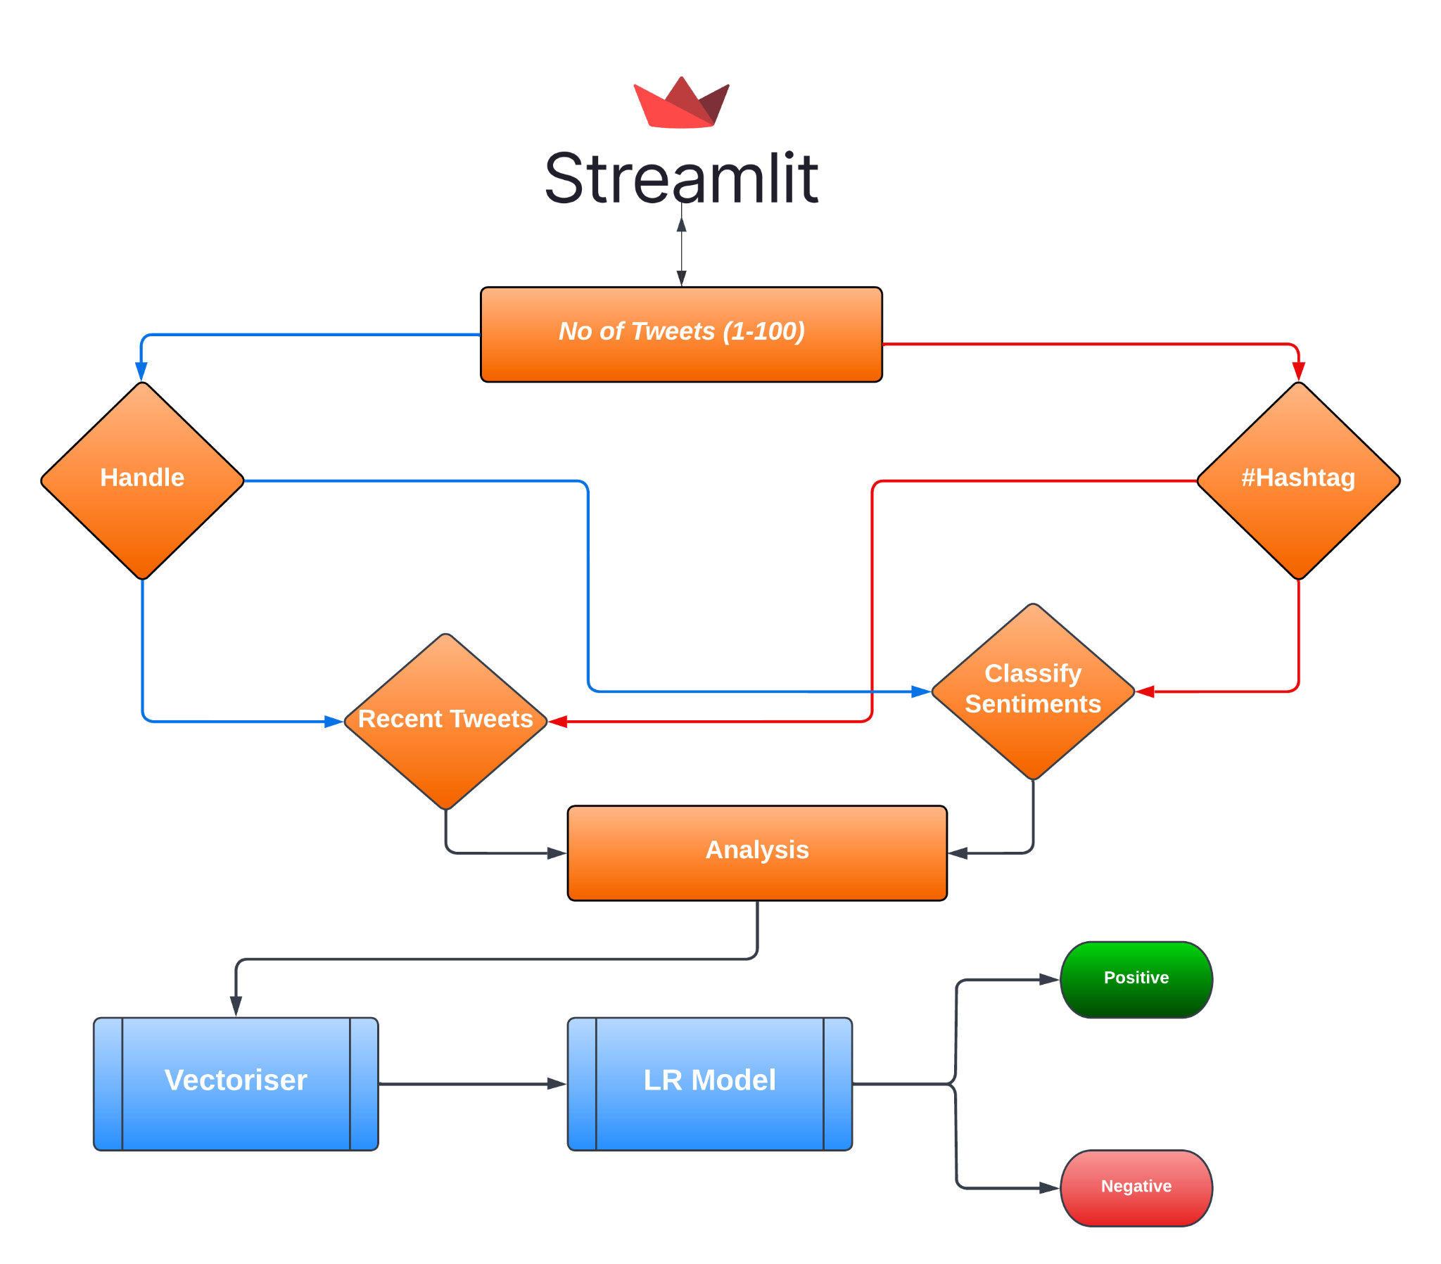
Project Application Workflow

Slide 6
Demo
Link to Project: Twitter Sentiment Analysis
Link to Notebook: twitter_sentiment_analysis.ipynb
Q & A

