Slide 1
LTTS OPENHACK 2026 · TEAM MCP MAVERICKS · SCORING-ALIGNED DECK
EI-Nexus
Autonomous Engineering Intelligence Twin
This deck is organized around the official evaluation rubric — every one of the 10 scoring parameters gets its own slide, with the specific evidence a judge can point to.
1. Problem Definition
2. Solution Architecture
3. Engineering Quality
4. AI Appropriateness
5. AI Implementation
6. AI Impact
7. Business Relevance
8. Benefits & Viability
9. Working Demo
10. Differentiation
EI-NEXUS · MCP MAVERICKS
1
Notes:
HOW TO WIN THIS OPENING: say explicitly that this deck is structured around their rubric before you say anything else - 'we mapped our build to all 10 of your scoring criteria, one slide each.' That single sentence signals you read the brief carefully, which itself is worth points on Problem Definition and Business Relevance. Don't linger - 15 seconds, then move to the scorecard.

Slide 2
READ THIS SLIDE FIRST
Scorecard at a glance — where to find the evidence
#
Criterion
Primary Evidence
Slide
1
Problem Definition
Quantified: 2-3 weeks manual RCA, 6 named consequences, real industry pattern
3
2
Solution Architecture
6 UML diagrams (class/sequence/state/component/deployment/ER), documented ADRs
4
3
Engineering Quality
16 automated tests, CI pipeline, Docker, 2 real bugs found+fixed+documented
5
4
AI Appropriateness
AI used exactly where reasoning is needed; rules stay deterministic elsewhere
6
5
AI Implementation
4-tool MCP agent, RAG, hybrid detection, 3-tier LLM fallback, ARIA chatbot
7
6
AI Impact
100% RAG precision, self-tightening thresholds, live before/after metrics
8
7
Business Relevance
GOH-UC-034 primary + 3 secondary use cases, 2 Big Bets, named industry pain
9
8
Benefits & Viability
Live ROI ($/hr saved), 3-stage deployment plan, cloud-ready today
10
9
Working Demo
Fully running app — not mockups. Screenshots + live walkthrough available now
11
10
Differentiation
Fleet concurrency, self-optimization, dual-LLM fallback, found-a-real-bug story
12
EI-NEXUS · MCP MAVERICKS
2
Notes:
HOW TO WIN: this slide is a gift to time-pressured judges - point at it and say 'you can score us directly off this table, and every row has a slide behind it if you want to dig in.' If a judge is filling out a rubric live during your pitch, this is the slide they'll screenshot. Don't read every row out loud - just orient them to the structure, then move fast into slide 3.

Slide 3
CRITERION 1 · PROBLEM DEFINITION
A specific, quantified, industry-real problem
Modern industrial plants generate enormous volumes of telemetry, engineering drawings, maintenance records, BOMs, historical service tickets, and operational documents — but this information sits in disconnected systems. Engineers can't diagnose failures quickly or accurately.
QUANTIFIED
2–3 WEEKS
Named, specific consequences (not vague pain points):
per field failure — manually tracing tickets, BOM specs, and design docs by hand
Unplanned production downtime
High maintenance cost
Delayed troubleshooting
Increased mean-time-to-repair
WHO FEELS THIS
Reduced equipment reliability
Lost operational efficiency
Plant maintenance engineers — chase root cause across 4+ disconnected systems
Reliability teams — repeat failures because design feedback never closes the loop
Plant managers — unplanned downtime directly hits production targets
EI-NEXUS · MCP MAVERICKS
3
Notes:
HOW TO WIN 'PROBLEM DEFINITION': judges scoring this criterion are checking for specificity, not drama. Say the two numbers plainly - '2 to 3 weeks becomes under 90 seconds' - and name ONE of the 'who feels this' bullets that matches whoever is in the room (plant engineers if it's an industrial audience, reliability teams if it's more technical). Do not skip the 'who feels this' box - a problem statement with no named stakeholder reads as generic, and generic loses points here specifically.

Slide 4






CRITERION 2 · SOLUTION ARCHITECTURE
Documented at every level — not just a slide diagram
Class Diagram
2 Sequence Diagrams
State Diagram
Every backend module, every relationship
Manual RCA flow + autonomous closed loop
Agent's 6-state machine, MONITORING to OPTIMIZING
Component Diagram
Deployment Diagram
ER Diagram
Full system by tier — client, API, domain, data
Physical runtime nodes, local and cloud
SQLite schema — 6 tables, indexed relationships
Plus: 6 documented Architecture Decision Records (ADRs) explaining WHY each key choice was made —
TF-IDF over embeddings, rule+statistics over ML, SQLite over managed DB, in-process MCP over full SDK, the concurrency bug fix, and ARIA's read-only design. Full technical design document: 14 sections, API contract (OpenAPI), requirements traceability matrix.
EI-NEXUS · MCP MAVERICKS
4
Notes:
HOW TO WIN 'SOLUTION ARCHITECTURE': the failure mode here is a single fuzzy box diagram. You have the opposite problem - almost too much documentation - so the move is to NAME the artifact types out loud fast ('class diagram, two sequence diagrams, a state diagram, component diagram, deployment diagram, ER diagram - all in the design doc') rather than explain each one. If a judge asks a follow-up about a specific piece, that's when you go deep on that one diagram, not before. The ADR mention at the bottom is your answer to 'why did you build it this way' - point at it if asked.

Slide 5
CRITERION 3 · ENGINEERING / BUILD QUALITY
Real SDLC discipline, not vibes-based coding
16
21
6
2
Automated Tests
API Endpoints
ADRs Written
Real Bugs Found
python -m unittest — all passing
every one documented in OpenAPI
key decisions, reasoned and dated
via deliberate stress testing
SDLC ARTIFACT TRAIL
A REAL BUG WE FOUND — AND DOCUMENTED
Sprint 0-4 tracked on a live Kanban board (27 tasks, 17 done)
During concurrency stress testing, the statistical anomaly detector occasionally false-triggered on pure noise for an untouched asset — and because no real fault was active, the agent would “resolve” it in ~1 second, silently padding our own ROI ledger.
Requirements Traceability Matrix — every use case to code to test
Formal Test Plan with a 22-item test case matrix
Root-caused to a z-score divide-by-near-zero-variance edge case. Fixed two ways (variance floor + a structural guard: autonomous fixes only ever trigger on a genuine rule threshold breach, never statistics alone). Re-ran a 75-second stress test clean.
CI pipeline (GitHub Actions) — tests + Docker build on every push
CHANGELOG documenting every version, what changed and why
EI-NEXUS · MCP MAVERICKS
5
Notes:
HOW TO WIN 'ENGINEERING/BUILD QUALITY': this is the criterion most teams will only have vibes for - you have receipts. Lead with the red box, told as a story not a confession: 'we stress-tested our own system on purpose, found a real concurrency bug, and fixed it two ways.' Judges with an engineering background will specifically probe for whether a team tests anything - having a *found and fixed* bug story is worth more than claiming zero bugs, which nobody believes anyway. If asked to prove the 16 tests are real, you can run `python -m unittest discover tests -v` live in a terminal in under 3 minutes.

Slide 6
CRITERION 4 · AI APPROPRIATENESS
AI exactly where reasoning is needed — nowhere else
Every component was deliberately assigned to AI or to deterministic rules based on whether the task genuinely requires language understanding and evidence synthesis, or just needs to be fast, explainable, and predictable.
USES AI — genuine reasoning tasks
STAYS DETERMINISTIC — precision-critical tasks
Interpreting free-text symptoms
Anomaly detection thresholds
"motor running hot and shut down" leads to inferred failure mode — needs language understanding, not keyword matching
hard rule + rolling z-score — explainable in one sentence, no training data needed, no model drift risk
Synthesizing a root-cause narrative
Fix application & recovery validation
combining 4 sources of retrieved evidence into a coherent, cited explanation
deterministic state machine — an autonomous fix must never depend on a probabilistic guess
Conversational Q&A (ARIA)
Citation grounding
answering open-ended natural-language questions about live system state
every claim traced to a real ticket/spec/fix ID by structured lookup, not left to the LLM's discretion
This is why the system works fully offline: AI enriches the output, it is never a single point of failure for correctness.
EI-NEXUS · MCP MAVERICKS
6
Notes:
HOW TO WIN 'AI APPROPRIATENESS': this criterion punishes AI-washing - bolting an LLM onto something that didn't need one. Your strongest line is the closing one: 'AI enriches the output, it's never a single point of failure for correctness.' Say that sentence deliberately, it directly answers what a judge is listening for. If asked 'couldn't you have just used rules for everything', point at the left column - free-text symptom interpretation and evidence synthesis are genuinely language tasks, not something a regex or lookup table can do.

Slide 7






CRITERION 5 · AI IMPLEMENTATION
Depth, not a single API call
4-Tool MCP Agent
RAG Retrieval
Hybrid Detection
Ticket search, BOM lookup, design-doc RAG, past-fix retrieval — live reasoning trace, cited evidence
Hand-rolled TF-IDF + cosine similarity — transparent, zero vector-DB dependency
Rule thresholds + rolling z-score statistics, with a variance floor for stability
3-Tier LLM Fallback
ARIA Chatbot
Real MCP Protocol Path
Gemini to GPT (Azure AI Foundry or public OpenAI) to offline rule-based — never breaks
Conversational Q&A grounded in live fleet + incident history, same fallback reliability
mcp_stdio_server.py — same 4 tools over the actual MCP SDK for Claude Desktop
EI-NEXUS · MCP MAVERICKS
7
Notes:
HOW TO WIN 'AI IMPLEMENTATION': judges scoring depth are counting distinct AI components, not just checking a box for 'uses an LLM.' You have six genuinely different pieces here - say that number out loud: 'six separate AI/ML components, not one API call wearing a UI.' The 3-tier LLM fallback is your best answer if someone asks about reliability - most teams have a single point of failure if their API key runs out mid-demo; you don't. Mention the real MCP protocol path only if someone asks a protocol-compliance question - it's a depth signal, not a headline.

Slide 8
CRITERION 6 · AI IMPACT
Measured, not asserted
100%
<90s
2.94
0
RAG Precision@1
Detect to Fix to Validate
Threshold after 2nd incident
False Positives
vs. 83% naive keyword baseline
vs. 2-3 weeks manual RCA
tightened itself from 3.0 mm/s
post-fix, 75s concurrent stress test
THE SELF-OPTIMIZATION STORY — AI IMPACT COMPOUNDS OVER TIME
Most AI-in-industrial-monitoring demos show a static model scoring a static dataset. EI-Nexus's impact is dynamic and observable in real time: when the same failure mode recurs, the autonomous agent tightens its own detection threshold — fleet-wide, not just on the asset that failed. One incident makes every asset in the fleet catch that failure mode earlier next time.
This is the literal, measurable difference between “we used AI” and “this system is measurably smarter this session than it was five minutes ago” — and it's visible live in the demo, not a claim you have to trust.
EI-NEXUS · MCP MAVERICKS
8
Notes:
HOW TO WIN 'AI IMPACT': this is the criterion where 'impact' gets confused with 'used a lot of AI' - don't make that mistake. Impact means measurable before/after, and you have a genuine one: the threshold number itself changes (3.0 to 2.94) after a real repeat incident. If you can, trigger this live during Q&A - inject the same fault twice and let the judges watch the number move. That single live moment is worth more than every stat on this slide combined. If live isn't possible, say explicitly 'this isn't a simulated number for the slide, it's the actual threshold value from backend/anomaly.py.'

Slide 9
CRITERION 7 · BUSINESS RELEVANCE
Built for the Big Bet strategy — not retrofitted onto it
PRIMARY USE CASE
GOH-UC-034 — AI Agent for Root Cause Analysis and Process Optimization
The autonomous closed loop IS this use case — detect, diagnose, fix, validate, optimize, no human step required.
GOH-UC-010
GOH-UC-046
GOH-UC-065
Predictive Maintenance
Fault Detection
Agentic Asset Management
Self-tightening thresholds move detection earlier over time
Hybrid rule + statistical engine, explainable per-signal
The twin doesn't just report — it acts, across a fleet
BIG BETS
Energy & Automation · Digital Manufacturing
Industrial systems monitoring at scale, preventing downtime, closing the design feedback loop fleet-wide.
EI-NEXUS · MCP MAVERICKS
9
Notes:
HOW TO WIN 'BUSINESS RELEVANCE': the trap here is treating use-case alignment as a checkbox exercise - listing four codes without explaining why. Instead say the sentence that's already in your README: 'GOH-UC-034 is an AGENT use case, not a monitoring one - that's deliberate, and it's why the closed loop matters more than a dashboard would.' That one line shows judges you understood the difference between what they asked for and what most teams will build anyway.

Slide 10
CRITERION 8 · BENEFITS & VIABILITY
Live ROI today, a real path to production tomorrow
$807K+
336 hrs
16.8s
Est. Savings / Session
Downtime Avoided
Avg Resolution Time
computed live, not a slide estimate
vs. 2-week traditional RCA baseline
detect to diagnose to fix to validate
VIABILITY — THREE STAGES, EACH INDEPENDENTLY USEFUL
STAGE 1 - TODAY
Local / offline-first — pip install + run, zero cloud account needed. Runs on any judge's laptop right now.
STAGE 2 - NEAR-TERM
Dockerized cloud pilot — GCP Cloud Run / Azure Container Apps / AWS App Runner, all deployment-ready with exact commands written
STAGE 3 - PRODUCTION
Fleet-scale platform — Kubernetes, managed DB (Cloud SQL/Azure SQL/RDS), SAP/CMMS integration, SSO
EI-NEXUS · MCP MAVERICKS
10
Notes:
HOW TO WIN 'BENEFITS & VIABILITY': judges here are checking whether you understand the difference between a demo and a product. Be honest about Stage 1 vs 2 vs 3 - say 'Stage 1 is real and running now, Stages 2 and 3 are scoped with exact deployment commands but not yet executed against a live cloud account.' That honesty is itself a viability signal - overclaiming production-readiness for a hackathon project is a bigger red flag to experienced judges than admitting what's not done yet. The ROI number: always caveat 'computed from this session, assumptions stated openly in the code.'

Slide 11
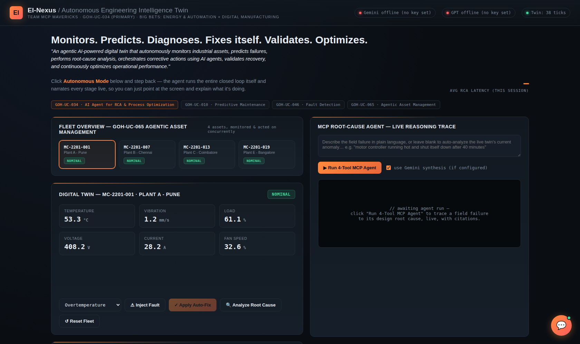
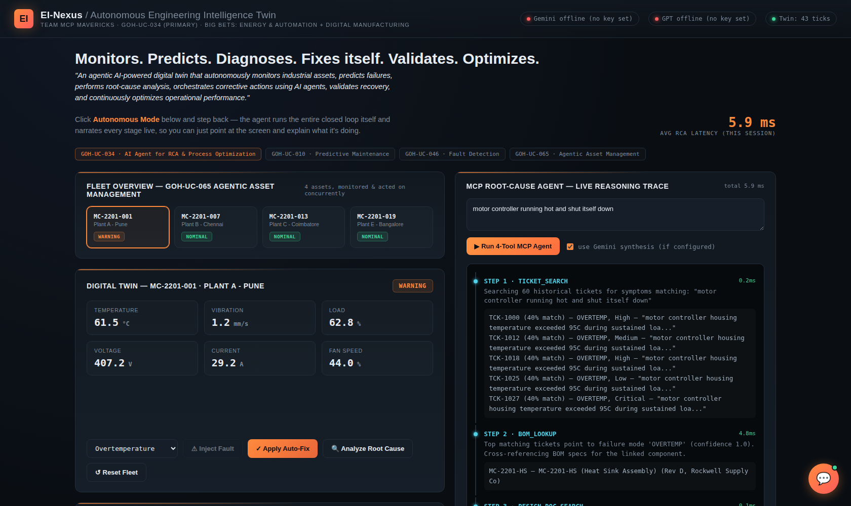
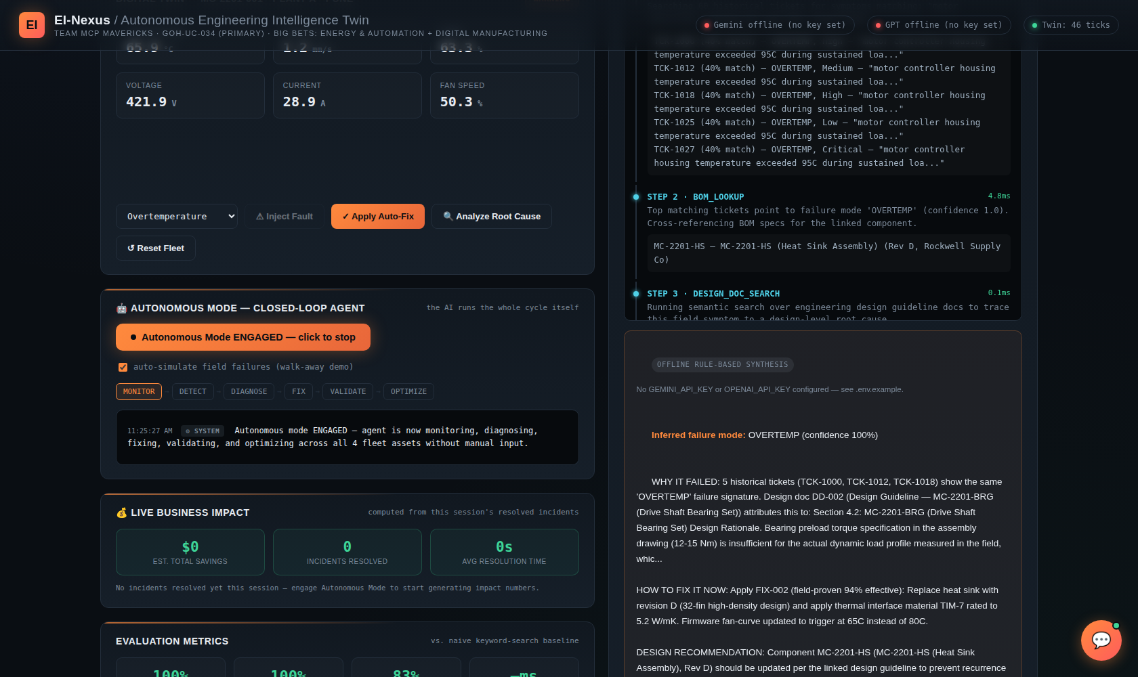
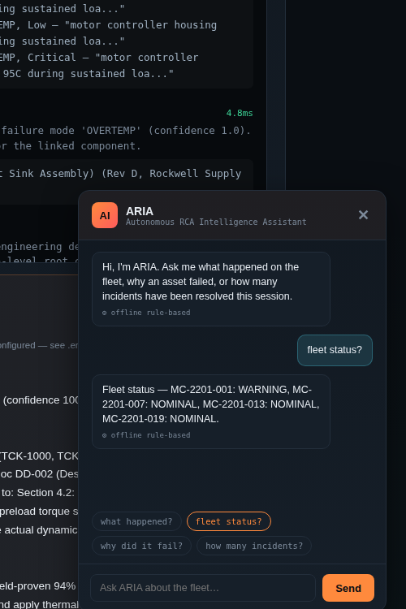
CRITERION 9 · WORKING DEMO
Real screenshots of a running app — not mockups
Live fleet dashboard — 4 assets, real telemetry
4-tool MCP agent — live cited reasoning trace
Autonomous mode engaged — closed loop running
ARIA answering live
EI-NEXUS · MCP MAVERICKS
11
Notes:
HOW TO WIN 'WORKING DEMO': this is the single highest-leverage criterion in the whole rubric because it's the one you can prove in real time instead of arguing about. If there's ANY way to have the laptop open and the app running live, do it here instead of clicking through this slide - say 'let me just show you' and switch to the browser. These screenshots exist only as the fallback if live demo isn't possible in this particular judging round (e.g. a spot-judging walk-by with no setup time). Either way, say explicitly: 'this is the actual running app, not a mockup - you're welcome to drive it yourselves.'

Slide 12





CRITERION 10 · DIFFERENTIATION
What other teams won't have on stage
It fixes itself
It gets smarter live
It manages a fleet
Not a dashboard that alerts a human — an agent that detects, diagnoses, fixes, and validates with nobody touching the keyboard.
Self-tightening detection thresholds, fleet-wide, triggered by a real repeat incident in front of the judges.
Two incidents on two different assets, handled concurrently, at the same time, on screen.
Dual-LLM fallback
It has a memory
We found our own bug
Gemini to GPT (Azure AI Foundry) to offline rule-based — the demo survives an exhausted API quota mid-pitch.
SQLite-backed audit trail — resolved incidents and ARIA's chat history survive a full server restart.
Documented, root-caused, and fixed a real concurrency defect via deliberate stress testing — not hidden, shown.
EI-NEXUS · MCP MAVERICKS
12
Notes:
HOW TO WIN 'DIFFERENTIATION': don't read all six cards - a judge who's seen 20 pitches today will tune out a recitation. Pick the TWO that are hardest for another team to casually claim: 'it manages a fleet' (most teams demo one machine) and 'we found our own bug' (most teams won't volunteer this at all). Gesture at the rest as 'and a few more reasons on the screen.' This slide should feel confident and slightly amused, not defensive - you're not arguing you're different, you're just listing facts.

Slide 13
TEAM MCP MAVERICKS · LTTS OPENHACK 2026
10 for 10.
Every scoring criterion answered with working code, not slideware.
1-2
Problem + Architecture
Quantified pain, 6 UML diagrams, 6 ADRs
3
Engineering Quality
16 tests, CI, Docker, 2 documented real bugs
4-5
AI Appropriateness + Implementation
AI where reasoning matters, rules where precision matters
6
AI Impact
100% precision, self-optimizing thresholds, live
7-8
Business + Viability
4 use cases, live ROI, 3-stage cloud deployment
9-10
Working Demo + Differentiation
Running now — screenshots don't lie
Thank you — ask us to show you anything on this list, live.
EI-NEXUS · MCP MAVERICKS
13
Notes:
HOW TO WIN THE CLOSE: read 'every scoring criterion answered with working code, not slideware' slowly - it's the thesis of the entire pitch in one sentence. Then stop talking. The recap table is there for judges taking notes, not for you to narrate. If there's time for one final beat, offer: 'pick any row on this table and we'll show you the code or the live feature right now' - that's an invitation a judge scoring you seriously will often actually take you up on, and it's the strongest possible way to end, because it hands control of the remaining time to the people doing the scoring.

