Slide 1
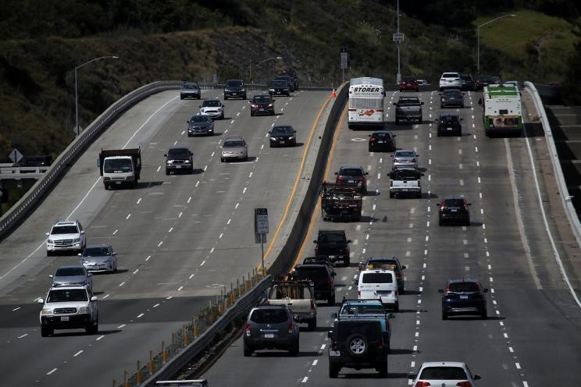
PREDICTING ACCIDENT SEVERITY - Seattle Car Accident Data Predictive Analysis | Sourabh Dixit IBM DATA SCIENCE CAPSTONE – October 2020

Slide 2
Predicting Car Accident Severity in Seattle
INTRODUCTION / BUSINESS PROBLEM
Road traffic injuries are currently estimated to be the eighth leading cause of death across all age groups globally, and are predicted to become the seventh leading cause of death by 2030.
Analysing a significant range of factors, including weather conditions, special events, roadworks, traffic jams among others, an accurate prediction of the severity of the accidents can be performed.
These insights, could allow law enforcement bodies to allocate their resources more effectively in advance of potential accidents, preventing when and where a severe accidents can occur as well as saving both, time and money. In addition, this knowledge of a severe accident situation can be warned to drivers so that they would drive more carefully or even change their route if it is possible or to hospital which could have set everything ready for a severe intervention in advance.
Governments should be highly interested in accurate predictions of the severity of an accident, in order to reduce the time of arrival and thus save a significant amount of people each year. Others interested could be private companies investing in technologies aiming to improve road safeness.
The Seattle government is going to prevent avoidable car accidents by employing methods that alert drivers through alert display system and police to be more careful in critical situations. In most cases, not paying enough attention during driving, drugs and alcohol or driving at very high speed for fun/competition are the main causes of occurring accidents that can be prevented by deploying harsher regulations. Besides the aforementioned causes, weather, visibility, or road conditions are the major uncontrollable factors that can be prevented by revealing hidden patterns in the data and announcing warning to the local government, police and drivers on the targeted roads.
The target audience of the project is local Seattle government, police, rescue groups and insurance organisation as well. This model results will provide them to make insightful decisions for reducing the number of accidents for the city.

Slide 3
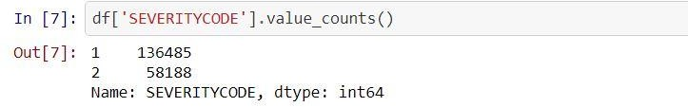
DATASET
The data was collected by the Seattle Police Department and Accident Traffic Records Department from 2004 to present. The data consists of 37 independent variables and 194,673 rows. The dependent variable, “SEVERITYCODE”, contains numbers that correspond to different levels of severity caused by an accident from 1 and 2.
Furthermore, because of the existence of null values in some records, the data needs to be preprocessed before any further processing. Among all the features, I believe the following features have the most influence in the accuracy of the predictions:
“WEATHER”, “ROADCOND”, “LIGHTCOND” The target variable is “SEVERITYCODE”.
The models aim was to predict the severity of an accident, considering that, the variable of Severity Code was in the form of 1 (Property Damage Only) and 2 (Injury Collision) which were encoded to the form of 0 (Property Damage Only) and 1 (Injury Collision). Furthermore, the Y was given value of 1 whereas N and no value was given 0 for the variables Inattention, Speeding and Under the influence. For lighting condition, Light was given 0 along with Medium as 1 and Dark as 2. For Road Condition, Dry was assigned 0, Mushy was assigned 1 and Wet was given 2. As for Weather Condition, 0 is Clear, Overcast is 1, Windy is 2 and Rain and Snow was given 3. 0 was assigned to the element of each variable which can be the least probable cause of severe accident whereas a high number represented adverse condition which can lead to a higher accident severity.
The Target Variable – ‘SEVERITYCODE’
Find the value distribution below from the notebook:

Slide 4
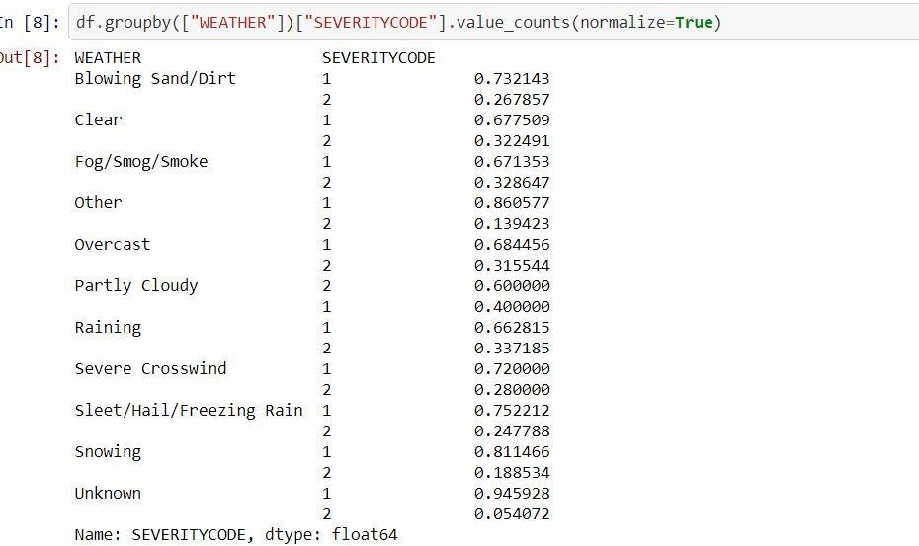
Weather vs Severity code value counts :

Slide 5
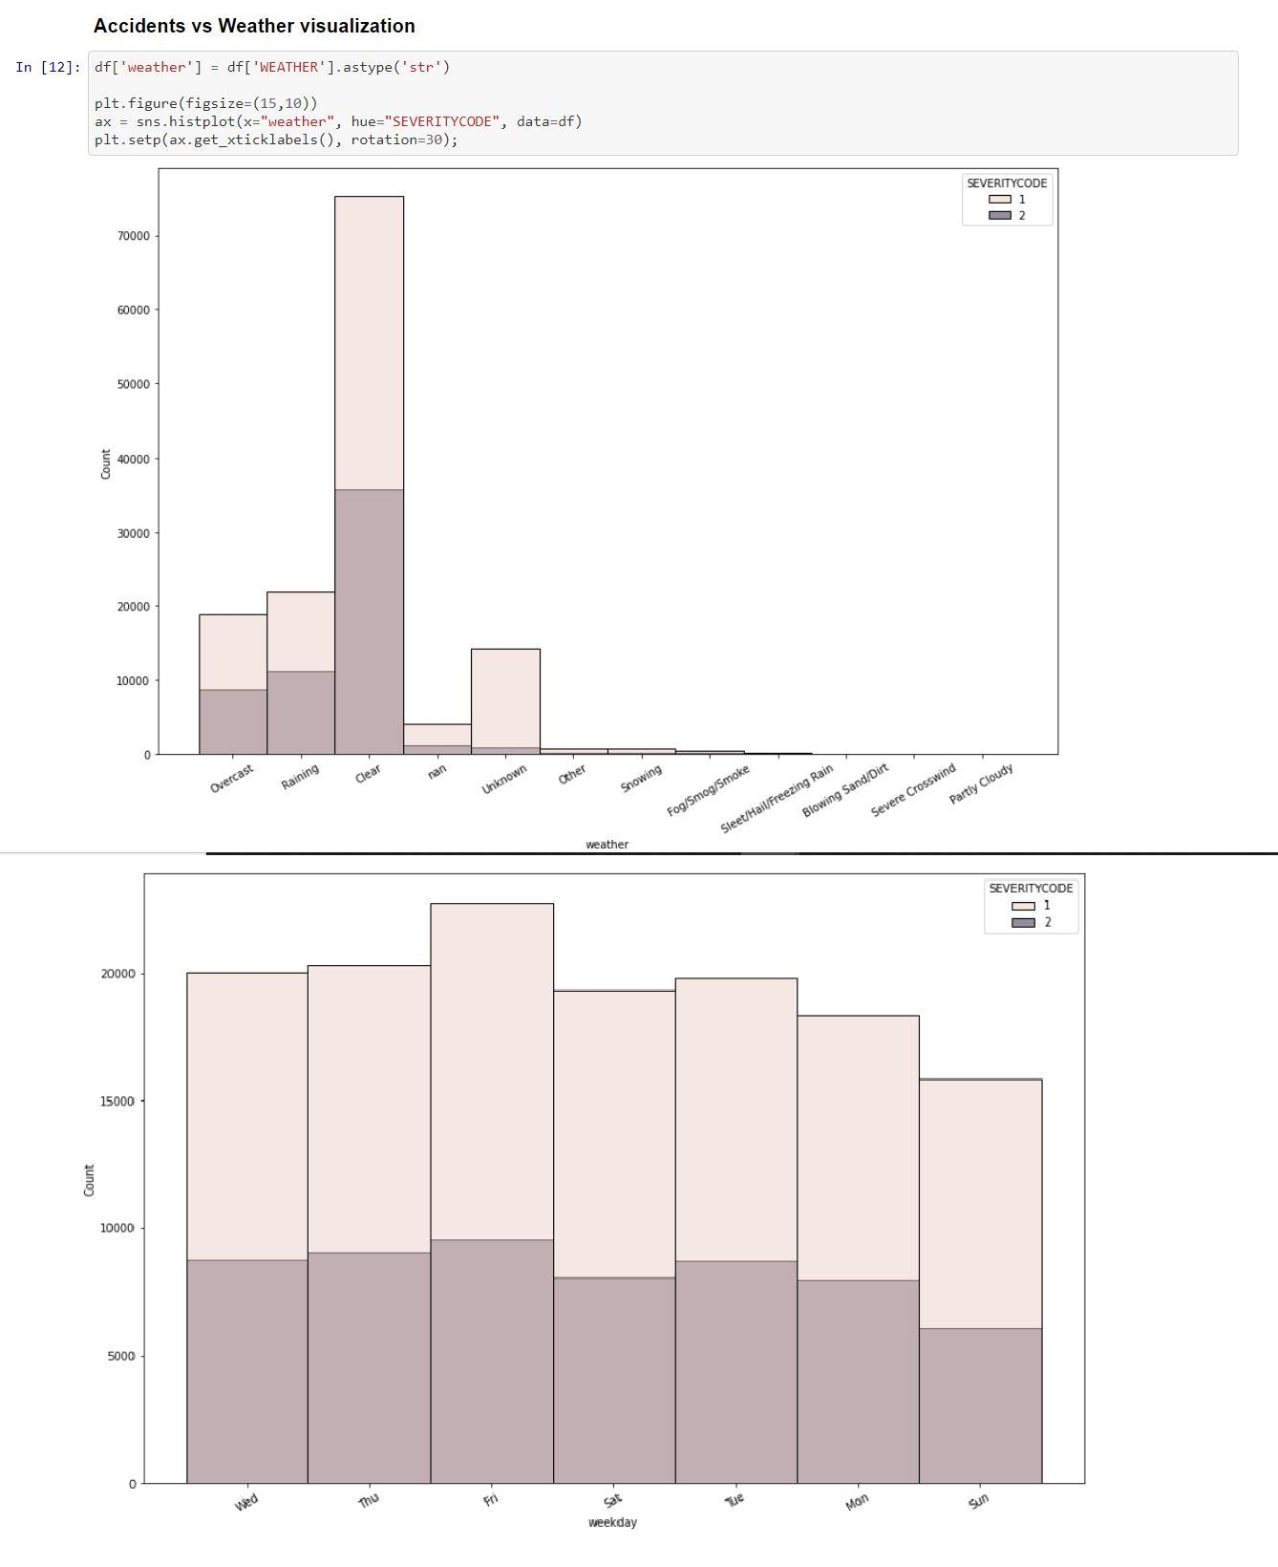
DATA VISUALIZATION

Slide 6
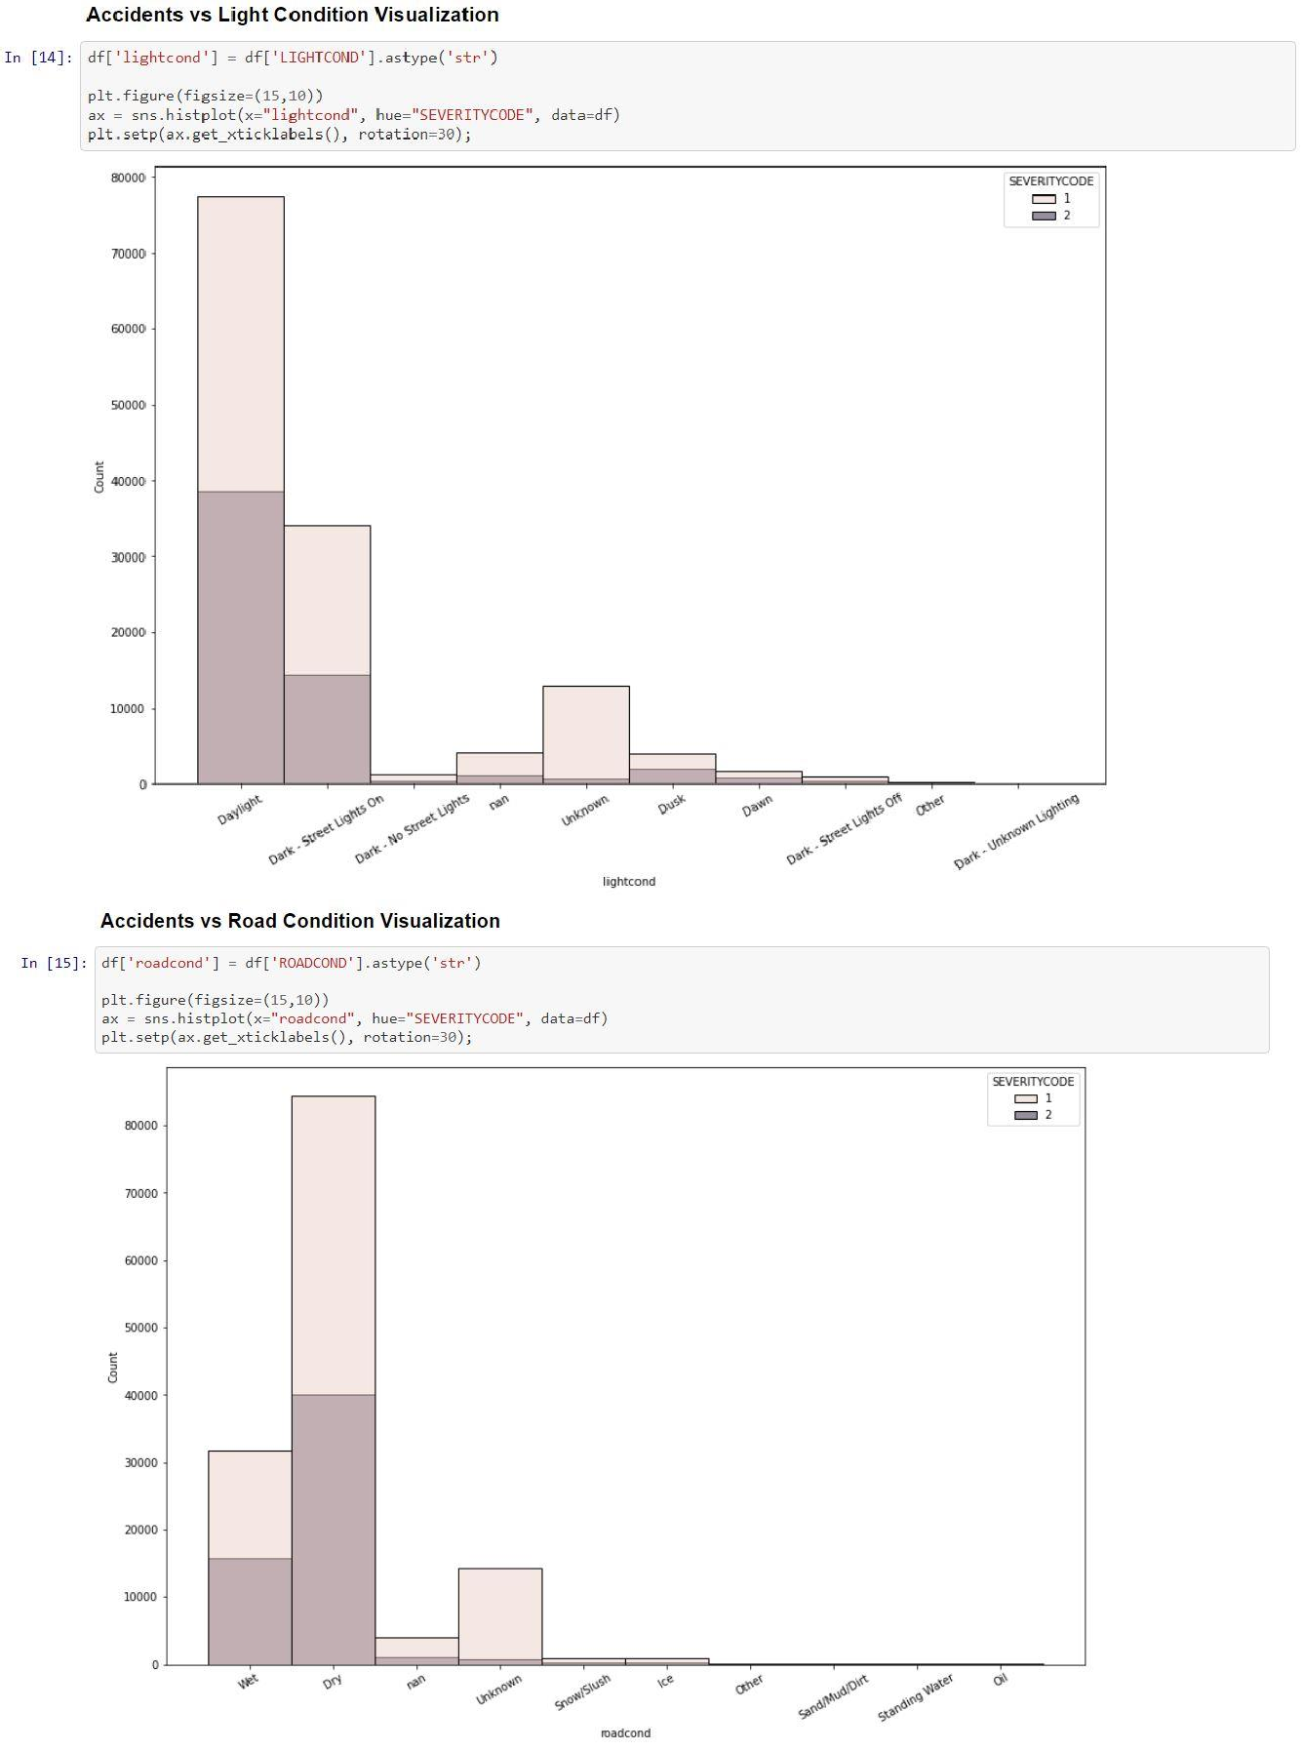

Slide 7
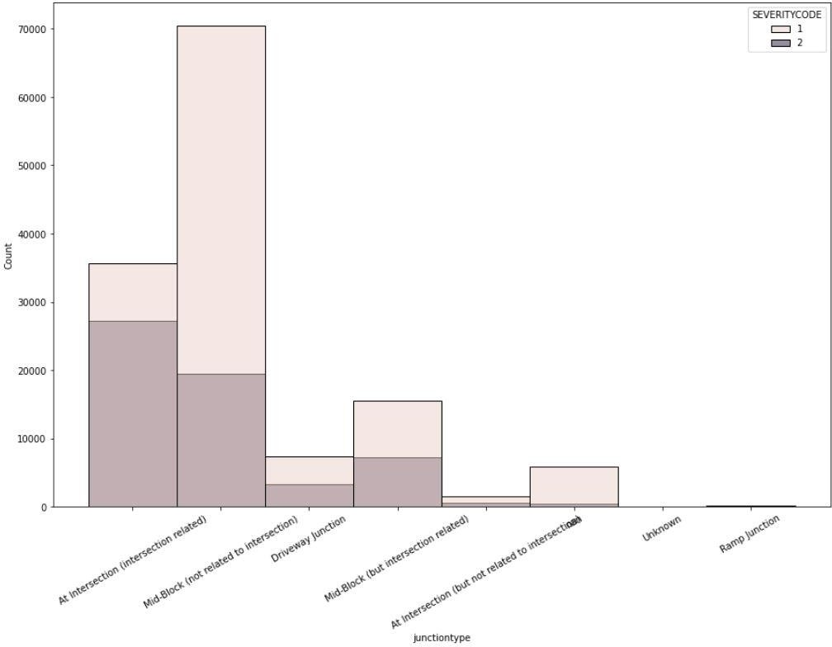
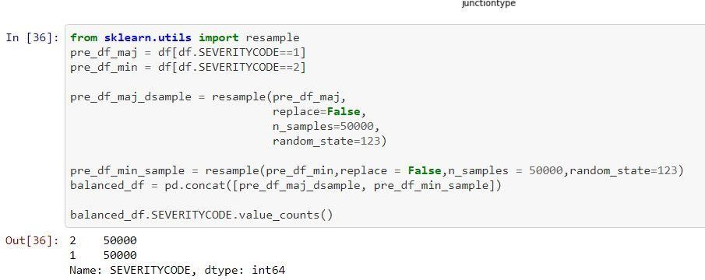
DATA PREPROCESSING
The dataset is analysed and majority of the variables being categorical are converted into Booleans using pandas get_dummies functionality. Once converted, I chose ‘Weather’, ‘Road Conditions’ and ‘Light Conditions’ as the most descriptive independent variables to predict our target variable.
To balance the class imbalance , Downsampling to the lower majority class group was applied.

Slide 8
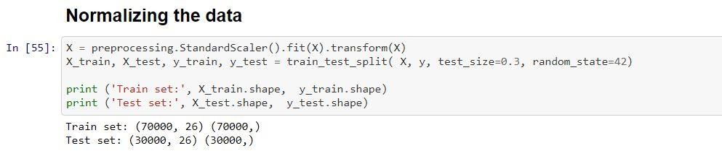
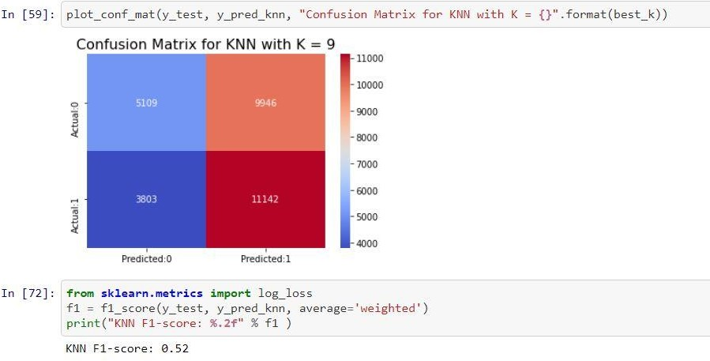
MACHINE LEARNING MODELS (CLASSIFICATION)
After successfully applying pre-processing techniques, balancing the class imbalance and downsampling, our data is ready to be fed to machine learning algorithms to predict our target class.
K Nearest Neighbor
Hyper-parameter tuning was applied to find the best value of K, resulting in best accuracies for k=9. The results were as follows:

Slide 9
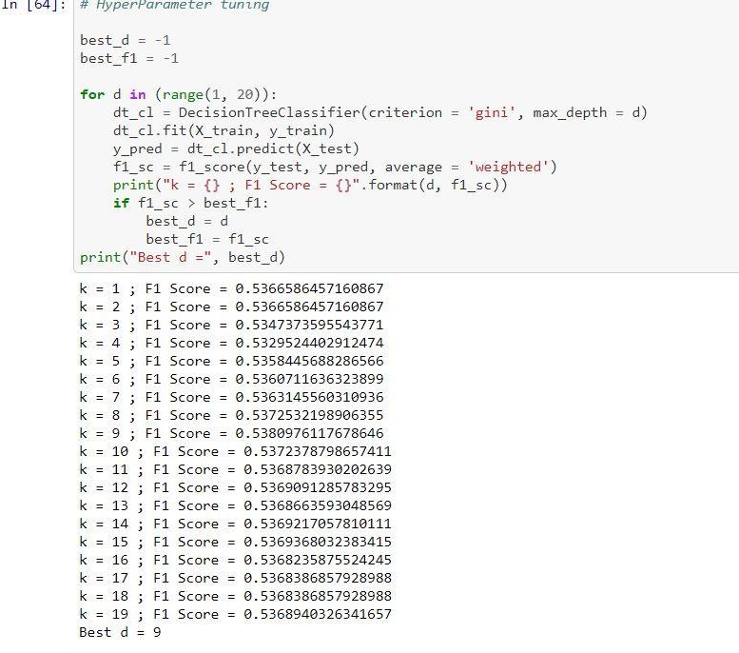
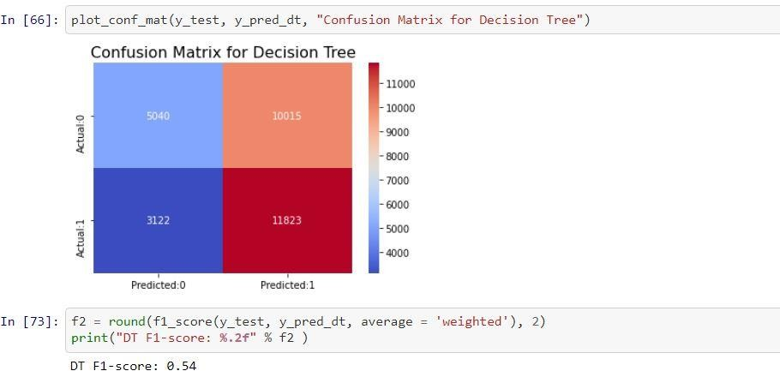
Decision Tree Classifier
Hyper-parameter tuning was applied to find the best value of D (depth), resulting in best accuracies for d=9.
Results were as follows:

Slide 10
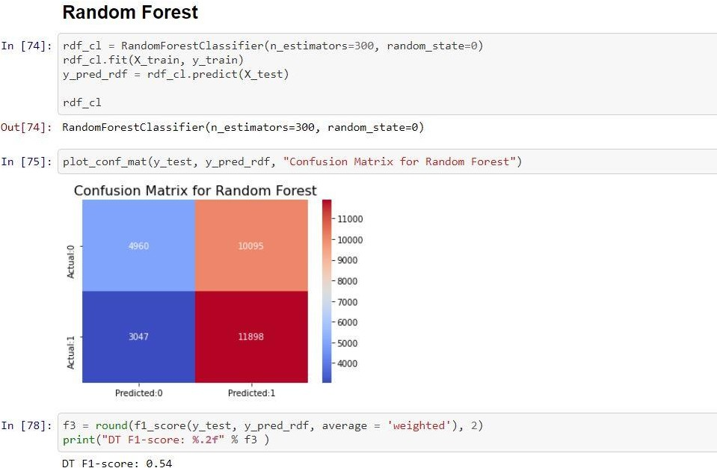
Random Forests
The prediction results were as follows:

Slide 11
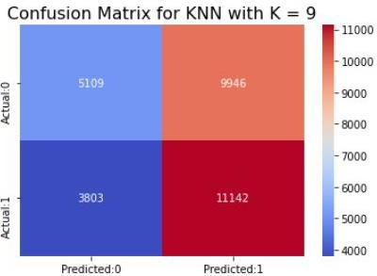
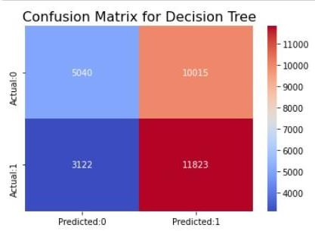
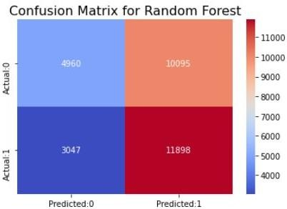
RESULTS & EVALUATION
Based on the results above, the summary is as follows:
ML Model | F1 Score | Confusion Matrix
KNN | 0.52
Decision Tree | 0.54
Random Forest | 0.54
Based on the above summary, Decision Tree and Random Forest classifiers perform the best on the Seattle Car Accident Dataset.

Slide 12
FURTHER DISCUSSION / SCOPE OF IMPROVEMENT
My analysis demonstrates the highest F1-score is achieved using DT and Random Forest Classifiers. Particular attention to be paid towards better feature engineering and data sampling techniques to improve on this base analysis in the future.
CONCLUSION
The achieved accuracies using the ML models can be further improved upon by using better features and will contribute to the future scope of this problem.
Explore similar algorithms like Weighted XGBoost and Naïve Bayes instead of resampling the dataset.
Study the features in a bit more detail and derive correlation metrics for each in relation to the target variable.

