Slide 1

Data Mining And Analysis Course Project
Earlier known as
B. V. B. College of Engineering & Technology
Team D3 :
Shrenik H, 01FE17BCS194
Sourabh J, 01FE17BCS214
Sushant M, 01FE17BCS222
Sweekar B, 01FE17BCS227
KLETech/SoCSE(2018-19)/18ECSC301/DM&A/Course Project

Slide 2
Challenge : Dynamic Profile Forecasting Challenge Host : Enedis Start date : Jan. 1, 2019 End date : Jan. 1, 2020 Link : https://challengedata.ens.fr/challenges/6/
Earlier known as
B. V. B. College of Engineering & Technology
KLETech/SoCSE(2018-19)/18ECSC301/DM&A/Course Project

Slide 3
Problem Statement
Earlier known as
B. V. B. College of Engineering & Technology
Forecast 7 dynamic profile time-series, modelling the electricity consumption shape of several mass-market customer groups. The challenge is about forecasting dynamic profiles values from their past values.
KLETech/SoCSE(2018-19)/18ECSC301/DM&A/Course Project

Slide 4
Data Description
Earlier known as
B. V. B. College of Engineering & Technology
Dataset consists of only numerical data, No Categorical Data
Training Input Data
No. of Tuples – 70128
No. of Attributes – 26
Training Output Data
No. of Tuples – 70128
No. of Attributes – 11
Test Input Data
No. of Tuples – 17520
No. of Attributes – 26
KLETech/SoCSE(2018-19)/18ECSC301/DM&A/Course Project

Slide 5
Output Attributes of Training Data
Earlier known as
B. V. B. College of Engineering & Technology
RES1_BASE : Residential customer profile, subscribed power up to 6kVA, with no tariff option
RES11_BASE : Residential customer profile, subscribed power over 6kVA, with no tariff option
RES2_HP : Residential customer profile, with Peak Hours/Off Peak Hours tariff option, during Peak hours.
RES2_HC : Residential customer profile, with Peak Hours/Off Peak Hours tariff option, during Off Peak hours.
PRO1_BASE : Commercial customer profile, with no tariff option
PRO2_HP : Commercial customer profile, with Peak Hours/Off Peak Hours tariff option, during Peak hours
PRO2_HC : Commercial customer profile, with Peak Hours/Off Peak Hours tariff option, during Off Peak hours.
KLETech/SoCSE(2018-19)/18ECSC301/DM&A/Course Project

Slide 6
Understanding the data
Earlier known as
B. V. B. College of Engineering & Technology
Data in the dataset represents all the past information about electricity consumption of several customer groups.
Dataset consists of Timestamps, Weather data, Measured Data, Modelled data and Sums(From Models and Measurements).
Data in the time series are hour beginning: for example, a value at 08:00h is the integrated value from 08:00h to 08:30h for the said tuple.
Data for residential profiles starts from Oct 13th, 2013 and data for commercial profiles starts from Nov 1st, 2016.
Training files include data for the period [13/10/2013 - 12/10/2018] excluding the [01/07/2017 - 30/06/2018] period.
Testing files include data for the [01/07/2017 - 30/06/2018] period.
KLETech/SoCSE(2018-19)/18ECSC301/DM&A/Course Project

Slide 7
Earlier known as
B. V. B. College of Engineering & Technology
Pre-Processing
Merging Both Input and Output Data
Both the Data have common attributes as IDS,Month,TimeStamp,TimeStamp_UTC.
Therefore, after merging both the dataset total attributes for training data are 33.
Fixing TimeStamp Format
All the values in TimeStamp columns are converted to proper datetime format using pd.to_datetime().
Dividing data into Residential and Commercial Customer
Data for Residential Customer is from 13/10/2013. Data for Commercial Customer is from 01/11/2016. Hence, we divided the data into two groups one for Residential Customers and one for Commercial Customers.
KLETech/SoCSE(2018-19)/18ECSC301/DM&A/Course Project

Slide 8
Earlier known as
B. V. B. College of Engineering & Technology
Checking for NULL Values
The following attributes in residential dataset have most of the values as null hence,we dropped them
Pseudo radiation : 92.489560
PRO1_BASE : 82.095922
PRO2_HC : 82.095922
PRO2_HP : 82.095922
KLETech/SoCSE(2018-19)/18ECSC301/DM&A/Course Project

Slide 9
Attribute selection(Using Correlation Feature Selection)
Earlier known as
B. V. B. College of Engineering & Technology
RES1_BASE
Modelled Losses (W)
Profit Professional Consumption(W)
Residential Consumption(W)
RES11_BASE
Total Power Consumption(W)
SME-PMI consumption profiled (W)
Profit Professional Consumption(W)
Standard Temperature ( ° Celcius)
Regular Temperature ( ° Celcius)
KLETech/SoCSE(2018-19)/18ECSC301/DM&A/Course Project

Slide 10
Earlier known as
B. V. B. College of Engineering & Technology
RES2_HP
Modelled losses (W)
SME-PMI consumption profiled(W)
Profit Professional Consumption(W)
Standard Temperature(° Celcius )
RES2_HC
Total photovoltaic production (W)
SME-PMI consumption profiled (W)
Standard Temperature (° Celcius)
KLETech/SoCSE(2018-19)/18ECSC301/DM&A/Course Project

Slide 11
Earlier known as
B. V. B. College of Engineering & Technology
PRO1_BASE
Total consumption (W)
Peak power consumption (W)
SME-PMI consumption profiled (W)
Profit Professional Consumption (W)
Residential residential consumption (W)
Temperature achieved smoothed (° Celcius)
Regular temperature (° Celcius)
Total HTA consumption (W)
Net withdrawal to other GRD (W)
KLETech/SoCSE(2018-19)/18ECSC301/DM&A/Course Project

Slide 12
Earlier known as
B. V. B. College of Engineering & Technology
PRO2_HP
Total consumption(W)
SME-PMI consumption profiled (W)
Profit Professional Consumption (W)
Total HTA consumption(W)
PRO2_HC
Total photovoltaic production(W)
KLETech/SoCSE(2018-19)/18ECSC301/DM&A/Course Project

Slide 13
Using Time Series approach
Earlier known as
B. V. B. College of Engineering & Technology
KLETech/SoCSE(2018-19)/18ECSC301/DM&A/Course Project

Slide 14
Earlier known as
B. V. B. College of Engineering & Technology
Check for Stationarity
Stationary data should have Constant mean, the variance of series should not be function of time, the covariance of i and i+m term should be same.
If changes are not constant then model will fail to predict. Hence we need to make data Stationary
Ways to check stationarity
Look at plots
Summary statistic
Statistical test
ADF(Augmented Dickey- Fuller test)
We use Dickey Fuller Test to find Stationarity
Select TimeStamp as Index of the dataset (Analysis becomes easy)
Check for stationarity of all the output attributes (Dickey - Fuller Test)
KLETech/SoCSE(2018-19)/18ECSC301/DM&A/Course Project

Slide 15
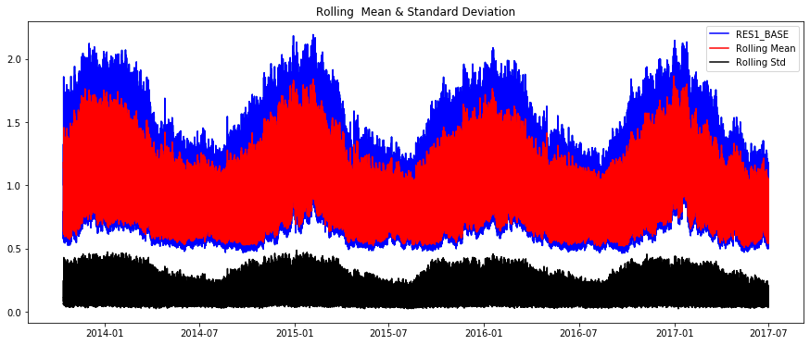
Earlier known as
B. V. B. College of Engineering & Technology
Results for the stationary test for RES1_BASE
Results of Dickey-Fuller Test:
Test Statistic -5.505498
p-value 0.000002
Critical Value (1%) -3.430450
Critical Value (5%) -2.861584
Critical Value (10%) -2.566794
RES1_BASE is Stationary
KLETech/SoCSE(2018-19)/18ECSC301/DM&A/Course Project

Slide 16
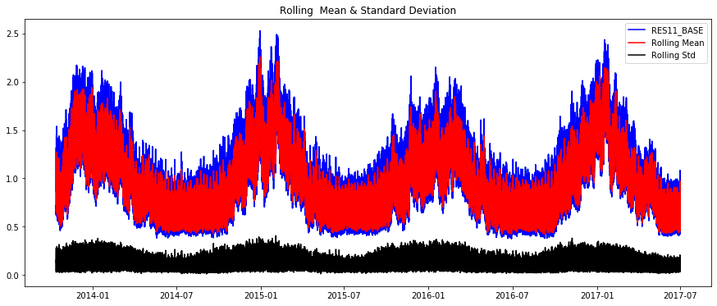
Results for the stationary test for RES11_BASE
Earlier known as
B. V. B. College of Engineering & Technology
Results of Dickey-Fuller Test:
Test Statistic -3.653446
p-value 0.004818
Critical Value (1%) -3.430450
Critical Value (5%) -2.861584
Critical Value (10%) -2.566794
RES11_BASE is Stationary
KLETech/SoCSE(2018-19)/18ECSC301/DM&A/Course Project

Slide 17
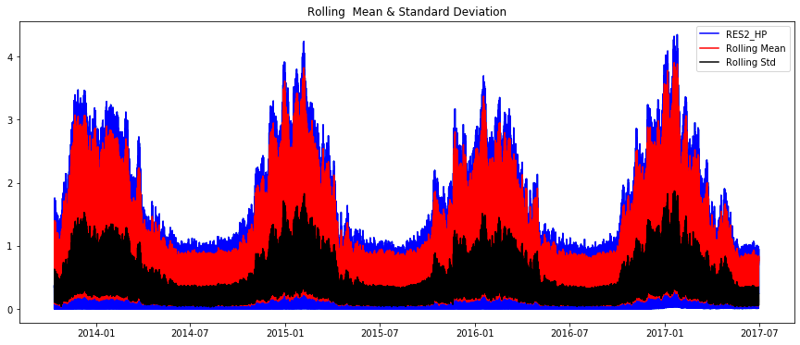
Earlier known as
B. V. B. College of Engineering & Technology
Results for the stationary test for RES2_HP
Results of Dickey-Fuller Test:
Test Statistic -2.979163
p-value 0.036887
Critical Value (1%) -3.430450
Critical Value (5%) -2.861584
Critical Value (10%) -2.566794
RES2_HP is not Stationary
KLETech/SoCSE(2018-19)/18ECSC301/DM&A/Course Project

Slide 18
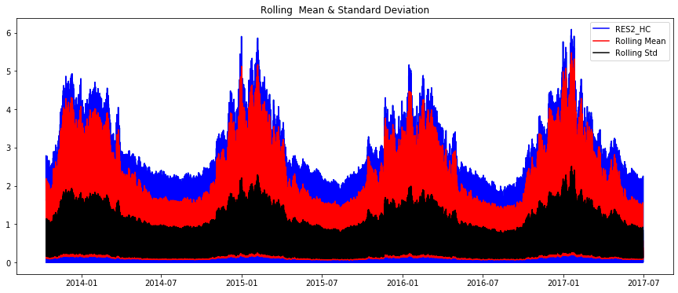
Results for the stationary test for RES2_HC
Earlier known as
B. V. B. College of Engineering & Technology
Results of Dickey-Fuller Test:
Test Statistic -2.516659
p-value 0.111473
Critical Value (1%) -3.430450
Critical Value (5%) -2.861584
Critical Value (10%) -2.566794
RES2_HC is not Stationary
KLETech/SoCSE(2018-19)/18ECSC301/DM&A/Course Project

Slide 19
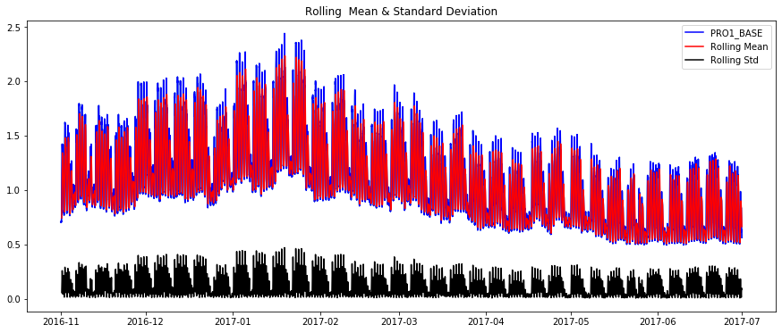
Results for the stationary test for PRO1_BASE
Earlier known as
B. V. B. College of Engineering & Technology
Results of Dickey-Fuller Test:
Test Statistic -2.985764
p-value 0.036245
Critical Value (1%) -3.430915
Critical Value (5%) -2.861790
Critical Value (10%) -2.566903
PRO1_BASE is not Stationary
KLETech/SoCSE(2018-19)/18ECSC301/DM&A/Course Project

Slide 20
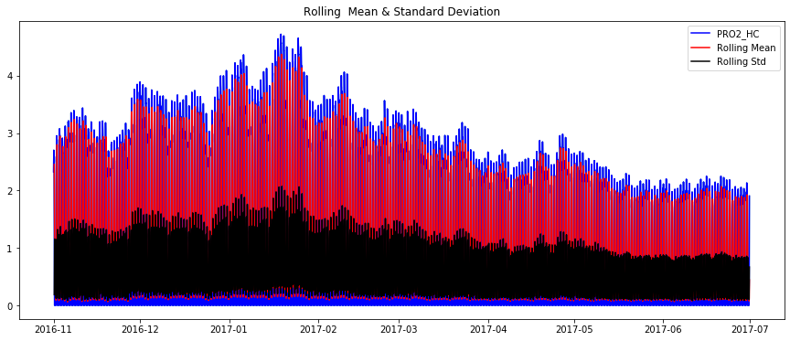
Results for the stationary test for PRO2_HC
Earlier known as
B. V. B. College of Engineering & Technology
Results of Dickey-Fuller Test:
Test Statistic 9.654546e+00
p-value 1.405525e-16
Critical Value (1%) -3.430915e+00
Critical Value (5%) -2.861790e+00
Critical Value (10%) -2.566903e+00
PRO2_HC is Stationary
KLETech/SoCSE(2018-19)/18ECSC301/DM&A/Course Project

Slide 21
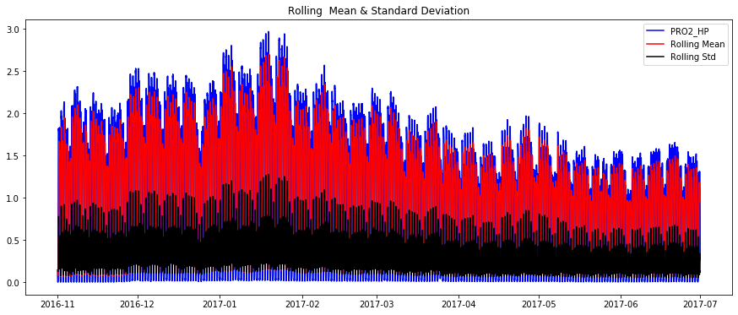
Results for the stationary test for Pro2_HP
Earlier known as
B. V. B. College of Engineering & Technology
Results of Dickey-Fuller Test:
Test Statistic -4.855867
p-value 0.000042
Critical Value (1%) -3.430915
Critical Value (5%) -2.861790
Critical Value (10%) -2.566903
PRO2_HP is Stationary
KLETech/SoCSE(2018-19)/18ECSC301/DM&A/Course Project

Slide 22
Making Data Stationary
Earlier known as
B. V. B. College of Engineering & Technology
From above test , we get
Stationary attributes as RES1_BASE , RES11_BASE , PRO2_HC , PRO2_HP
Non-Stationary attributes as RES2_HC , RES2_HP , PRO1_BASE
Ways to stationarize data
Moving Average
E-Trend
Differencing
Log Transform and Square root Transform
KLETech/SoCSE(2018-19)/18ECSC301/DM&A/Course Project

Slide 23
Stationarizing PRO1_BASE by applying
Log Transform,
Moving Avg
Earlier known as
B. V. B. College of Engineering & Technology
KLETech/SoCSE(2018-19)/18ECSC301/DM&A/Course Project

Slide 24
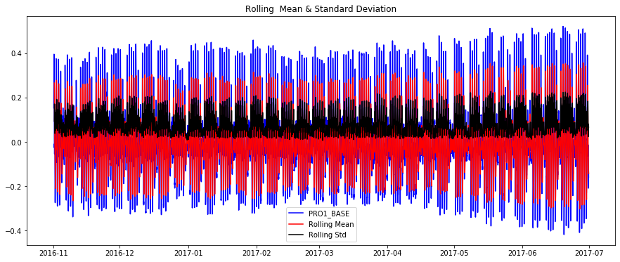
PRO1-BASE
Earlier known as
B. V. B. College of Engineering & Technology
Results of Dickey-Fuller Test:
Test Statistic -21.800438
p-value 0.000000
Critical Value (1%) -3.430916
Critical Value (5%) -2.861790
Critical Value (10%) -2.566903
RES2_HP is Stationarized
KLETech/SoCSE(2018-19)/18ECSC301/DM&A/Course Project

Slide 25
Stationarizing RES2_HP and RES2_HC profiles using
Square root Transform
Moving Avg
Earlier known as
B. V. B. College of Engineering & Technology
KLETech/SoCSE(2018-19)/18ECSC301/DM&A/Course Project

Slide 26
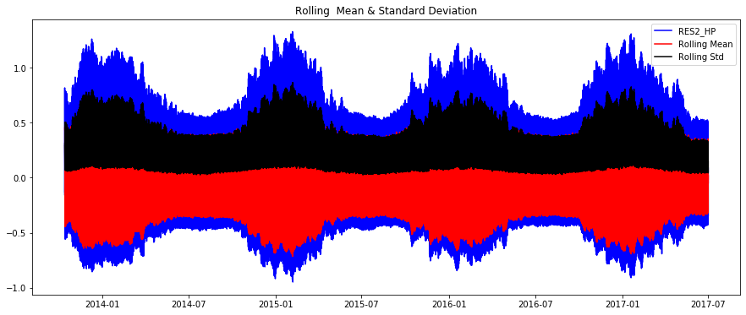
RES2_HP
Earlier known as
B. V. B. College of Engineering & Technology
Results of Dickey-Fuller Test:
Test Statistic -32.597768
p-value 0.000000
Critical Value (1%) -3.430451
Critical Value (5%) -2.861584
Critical Value (10%) -2.566794
RES2_HP is Stationarized
KLETech/SoCSE(2018-19)/18ECSC301/DM&A/Course Project

Slide 27
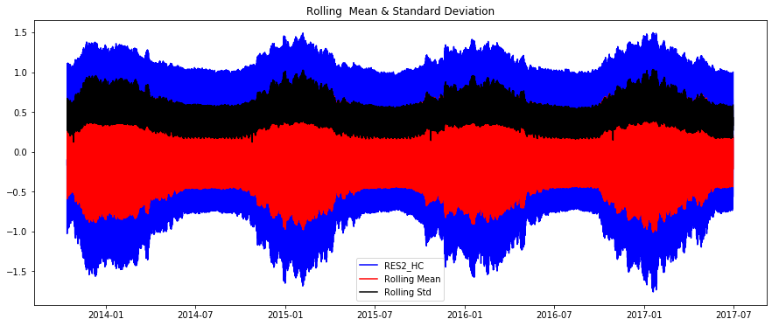
RES2_HC
Earlier known as
B. V. B. College of Engineering & Technology
Results of Dickey-Fuller Test:
Test Statistic -43.550822
p-value 0.000000
Critical Value (1%) -3.430451
Critical Value (5%) -2.861584
Critical Value (10%) -2.566794
RES2_HC is Stationarized
KLETech/SoCSE(2018-19)/18ECSC301/DM&A/Course Project

Slide 28
Model Building
Earlier known as
B. V. B. College of Engineering & Technology
KLETech/SoCSE(2018-19)/18ECSC301/DM&A/Course Project

Slide 29
Time Series Models

Slide 30
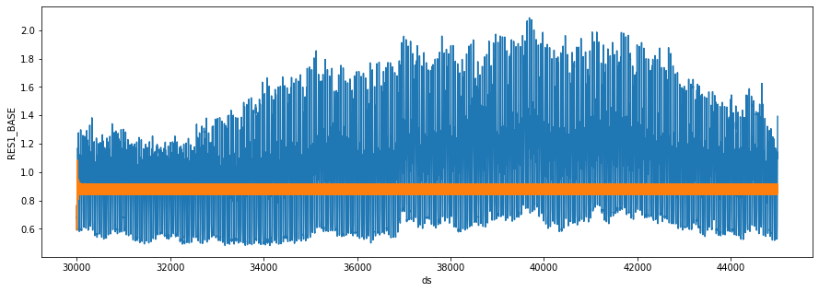
SARIMA
Earlier known as
B. V. B. College of Engineering & Technology
RES1_BASE
KLETech/SoCSE(2018-19)/18ECSC301/DM&A/Course Project

Slide 31
SARIMA
Earlier known as
B. V. B. College of Engineering & Technology
Conclusion :
The model considers seasonality in data but doesn’t suits our data since our data is not continuous..
The RMSE obtained for this model is 0.34.
KLETech/SoCSE(2018-19)/18ECSC301/DM&A/Course Project

Slide 32
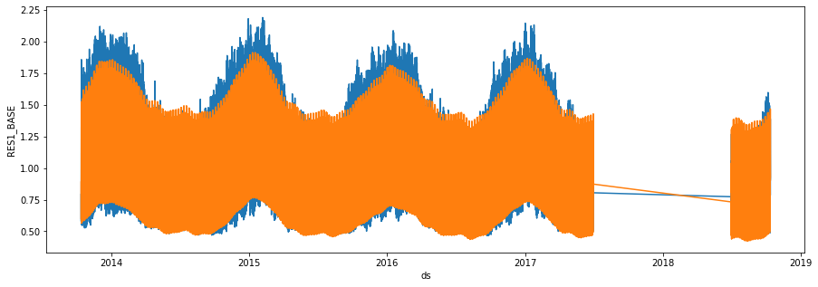
FBProphet
Earlier known as
B. V. B. College of Engineering & Technology
--- line indicates actual data
--- line indicates predicted data
KLETech/SoCSE(2018-19)/18ECSC301/DM&A/Course Project

Slide 33
FBProphet
Earlier known as
B. V. B. College of Engineering & Technology
Conclusion :
The model shows a close relationship with actual data and considers parameters like seasonality,holidays.
The RMSE obtained for this model is 0.11.
KLETech/SoCSE(2018-19)/18ECSC301/DM&A/Course Project

Slide 34
Regression Models

Slide 35
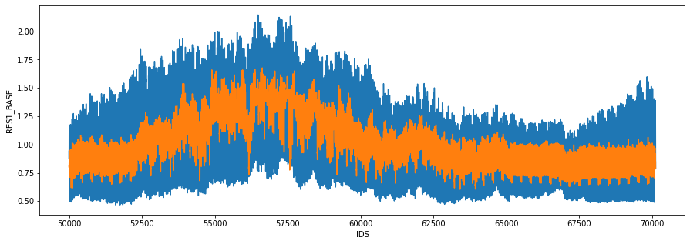
Linear Regression(Degree 2)
Earlier known as
B. V. B. College of Engineering & Technology
RES1_BASE
--- line indicates actual data
--- line indicates predicted data
KLETech/SoCSE(2018-19)/18ECSC301/DM&A/Course Project

Slide 36
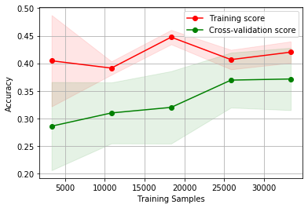
Linear Regression(Degree 2)
Earlier known as
B. V. B. College of Engineering & Technology
Conclusion :
It has low variance and high bias
Has a very low accuracy
KLETech/SoCSE(2018-19)/18ECSC301/DM&A/Course Project

Slide 37
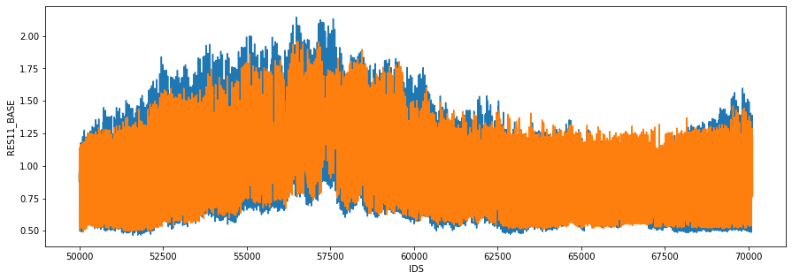
XGBRegressor
Earlier known as
B. V. B. College of Engineering & Technology
--- line indicates actual data
--- line indicates predicted data
KLETech/SoCSE(2018-19)/18ECSC301/DM&A/Course Project

Slide 38
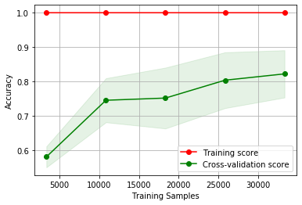
XGBRegressor
Earlier known as
B. V. B. College of Engineering & Technology
Conclusion :
It overfits the data
It has a comparatively high accuracy
KLETech/SoCSE(2018-19)/18ECSC301/DM&A/Course Project

Slide 39
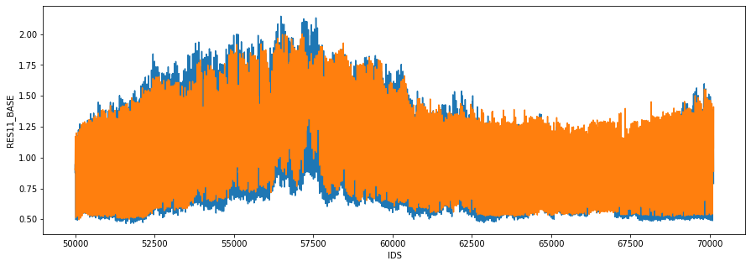
Random Forest Regressor
Earlier known as
B. V. B. College of Engineering & Technology
--- line indicates actual data
--- line indicates predicted data
KLETech/SoCSE(2018-19)/18ECSC301/DM&A/Course Project

Slide 40
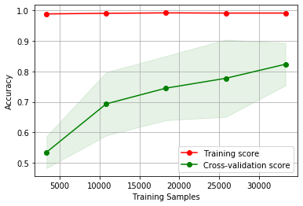
Random Forest Regressor
Earlier known as
B. V. B. College of Engineering & Technology
Conclusion :
Has a accuracy higher
KLETech/SoCSE(2018-19)/18ECSC301/DM&A/Course Project

Slide 41
Model Selection
Model | RMSE( w.r.t. ‘RES1_BASE’ )
Linear Regression | 0.234
Random Forest Regressor(Default Parameters) | 0.136
XGBRegressor | 0.133
SARIMA | 0.3575
FBprophet | 0.1143

Slide 42
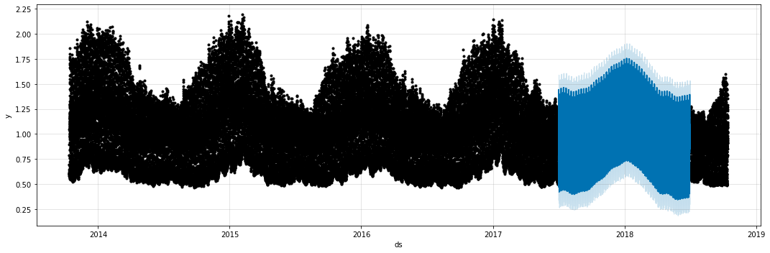
FBprophet
Earlier known as
B. V. B. College of Engineering & Technology
The section of the graph represented with blue color represents the data predicted for testing part .
KLETech/SoCSE(2018-19)/18ECSC301/DM&A/Course Project

Slide 43
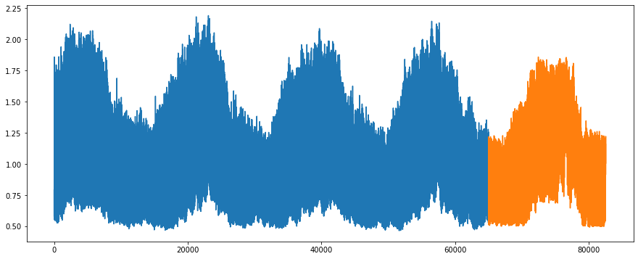
Random Forest (All attributes)
Earlier known as
B. V. B. College of Engineering & Technology
--- line indicates actual data
--- line indicates predicted data
RES1_BASE
KLETech/SoCSE(2018-19)/18ECSC301/DM&A/Course Project

Slide 44
Average of Both the Models
Earlier known as
B. V. B. College of Engineering & Technology
KLETech/SoCSE(2018-19)/18ECSC301/DM&A/Course Project

Slide 45
Conclusion
Earlier known as
B. V. B. College of Engineering & Technology
We selected FBprophet among Time Series models as it suits non continuous and seasonal data and selected XGBRegressor to extract other features as it had no overfitting and gave better accuracy.
XGBRegressor predicted the values for each output separately, hence we used a multi-Output meta regressor along with XGBRegressor which predicts the output for different dependent variables simultaneously.
Hence we calculated the average result obtained from both the models and found that it gives best accuracy with error score of 14.26.
KLETech/SoCSE(2018-19)/18ECSC301/DM&A/Course Project

Slide 46
Earlier known as
B. V. B. College of Engineering & Technology
THANK YOU
KLETech/SoCSE(2018-19)/18ECSC301/DM&A/Course Project

