Slide 1

Model Thinking Term Paper Presentation
Paper Title
Educational Model: A new approach for Indian Education System
Name: Sourabh Jain
SRN: 01FE17BCS214

Slide 2
Introduction
Education systems play an important role in shaping one’s life and the way one perceives the world
The present Indian Education System has a variety of holes in its strategy
The education provided to students is usually academic and lacks practicality.
Most of the parents now a day look for a private school and prefer not to send their child to a government school due to lack of facilities.
Hence, Education has to have a better model to minimize the gaps in the present education system by improvising the current model

Slide 3
Methodology
Correctly divide the curriculum based on both online and offline mode of learning – Colonel Blotto
Overcrowding in Schools and colleges – Tipping Point
Selection of Domains(or Streams) from 8th and proper counseling is required – Standing Ovation Model
Introduction to Indian classics (like Adventure of tom sawyer) – Social Model
Negative Marking in all competitive exams – Random walk and Luck

Slide 4
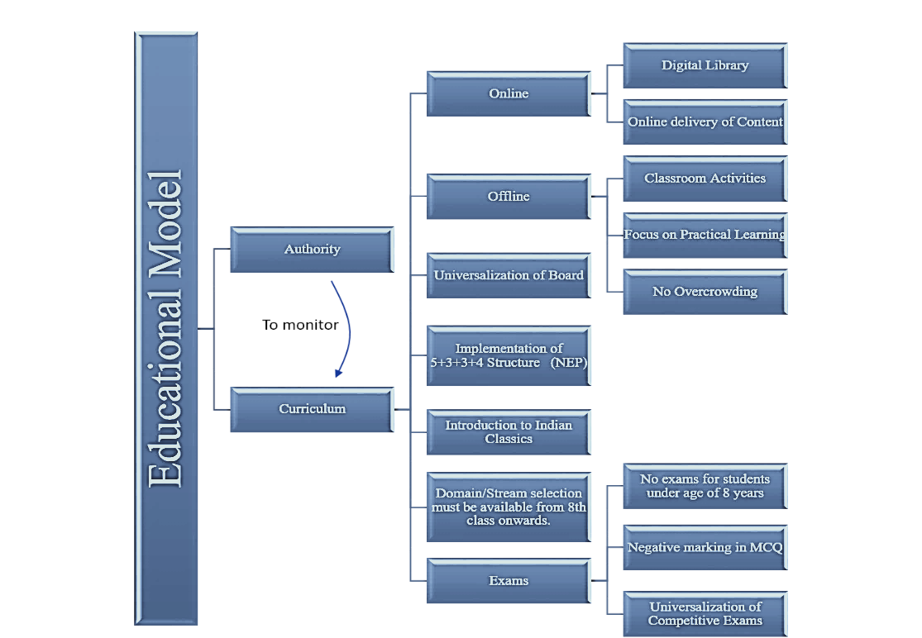
Methodology(Contd.,)

Slide 5
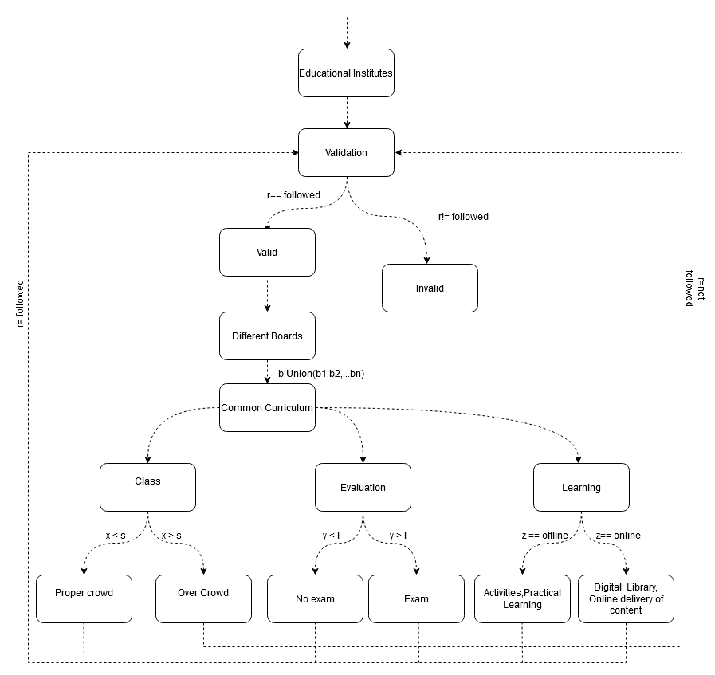
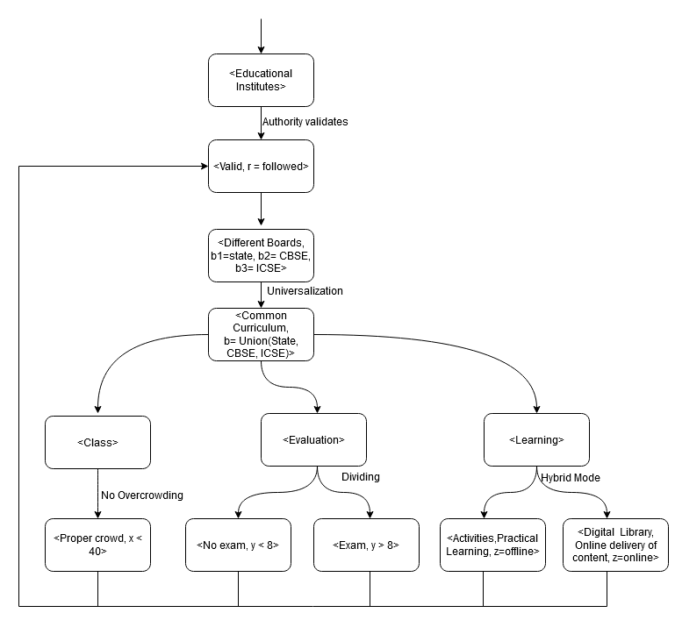
Formal Models
Fig 1. PG
Fig 2. TS

Slide 6
Fertility
The present model is build based on the type of people living in India and includes most of the aspects of Indian culture.
The model is designed for the Indian education systems by considers various gaps present in Current Indian Education and provides solutions to the problems faced by the Indian Education System.
Therefore, the model is specific for Indian education and hence, it is not applicable for any other domains.

Slide 7
Conclusion
The model tries to fill the gaps in the current Indian education system.
It suggests various new policies that can be implemented in the present education system.
The proposed model aims at universalization of the current system to remove confusion and making the system transparent irrespective of the state education.
It also makes use of online and offline hybrid teaching in school and college education.
Hybrid teaching might not only be beneficial to improve the standard of curricula teaching but also has an essential functional significance for enhancing students' self-learning skills.
Thank you.

