Slide 1

Geotechnical Characterization of Lightweight Cellular Cemented Clay for Environmental Application
Dual Degree Project Second review meeting
Presented by
Sourabh Kalgunde
ce11b093

Slide 2
Overview
Objective and Scope
Introduction
Experimental methodology
Results and discussion
Summary and concluding remarks
Proposed Schedule of the Work
References

Slide 3
Objective and Scope
The objective of the study is to evaluate the performance of lightweight cellular cemented clay as permeable reactive barrier.
The scope of the work involves the following:
To develop digital image processing technique for determining the pore size distribution characteristics of soils, using the images obtained from digital single lens reflex camera and X-ray computed tomography and scanning electron microscope
To develop a predictive model for obtaining geotechnical properties of light weight cellular cemented clays using their pore size distribution characteristics

Slide 4
Introduction
Air permeability of soil (and other porous materials) is the coefficient, K_{a} governing convective transmission of air through soil under an applied total pressure gradient. It is also called as intrinsic permeability
The unit of intrinsic permeability is m²
Intrinsic permeability related to the nature of porous medium hence is constant for different fluid properties i.e K_{air} = K_{water}
k = (K×ρ×g)/ μ (1)
k = hydraulic conductivity (m/s)
K = intrinsic permeability (m²)
ρ = density of the fluid, kg/m³
μ = dynamic viscosity (Pa.s)
So, if we calculate intrinsic permeability of air, we know the intrinsic permeability of water and then we can calculate hydraulic conductivity of soil using above relation (Eq. 1).

Slide 5
Introduction
Darcy's law can be used to describe the flow of air through a porous medium.
Assumptions of Darcy’s equation about isothermal, non turbulent flow of a viscous gas
Darcy’s equation
Q = [K × A × (P₀-P₁)] / (L × μ) (2)
Q = flow rate (m³ /sec)
K = intrinsic permeability (m² )
A = effective cross sectional area of sample
P₀ = inlet pressure (Pa)
P₁ = outlet pressure ( Pa)
Notes:
But since Fick’s law is not useful in 0% saturated soil.

Slide 6
Introduction
Air flow plays an important role in geotechnical engineering because it has various application such as:
To remove hazardous volatile soil contaminants, aeration and gas exchange in soil and for removal of methane in landfills (USEPA, 2012)
1. Air Sparging: Positive air pressure is used to force air through the soil
2. Soil vapour extraction/ Soil venting: Negative air pressure is used to force air through the soil
Hence, soil pore size properties such as permeability play an important role in affecting the movement of soil contaminants through it.

Slide 7
Experimental methodology
To find air permeability of different range of glass beads
Particle size properties of glass beads
Classification
Specific gravity of solids (G_{s} )
Unit weight (γ_{d} )
Theoretical porosity
Size of glass bead
3.6 mm
3.075 mm
2.36 mm
1.29 mm
0.46 mm

Slide 8
Classification of soil
Table : Indian Standard of Classification of soils
Coarse soils | Gravel size (G) | Coarse | 20 - 80 mm
 |  | Fine | 4.75 - 20 mm
 | Sand size (S) | Coarse | 2 - 4.75 mm
 |  | Medium | 0.425 - 2 mm
 |  | Fine | 0.075 - 0.425 mm
Fine soils | Silt size (M) |  | 0.002 - 0.075 mm
 | Clay size (C) |  | < 0.002 mm
Particle Size - All the glass beads for each size are single-sized particle
0.460 mm, 1.29 mm glass beads are medium sand
2.36 mm, 3.075 mm, 3.6 mm glass beads are coarse sand

Slide 9
Glass beads properties
Specific Gravity (G_{s} )
Calculated using helium gas pycnometer (ASTM D5550-14)
Size of glass bead | G_{s} (gm/cc) | γ_{d} (gm/cc)
3.6 mm | 2.5020 | 1.519
3.075 mm | 2.5087 | 1.520
2.36 mm | 2.4904 | 1.520
1.29 mm | 2.5087 | 1.528
0.46 mm | 2.6106 | 1.565

Slide 10
Glass beads properties
Theoretical porosity
e = [(G_{s} × γ_{w} )/ γ_{d} - 1] (3)
η = e / (1+e) (4)
Size of glass bead | Void ratio | Porosity
3.6 mm | 0.61 | 0.38
3.075 mm | 0.62 | 0.38
2.36 mm | 0.61 | 0.38
1.29 mm | 0.61 | 0.38
0.46 mm | 0.64 | 0.39

Slide 11
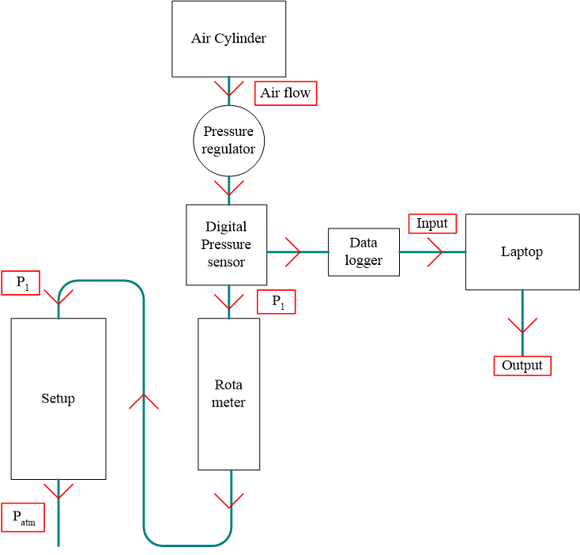
Experimental methodology
Fig : Flow chart of experimental setup for air permeability

Slide 12
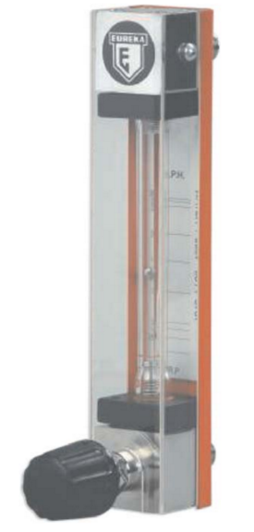
Experimental methodology
Eureka made variable area flow meters (Eureka Industrial Equipments Pvt. Ltd, Pune, India) were used in the experiment to measure the air flow rate in liters per hour which works on the principle of variable area.
It is equipped with a float moves freely up and down in the tapered borosilicate glass tube with fluid flow from bottom to top.
The float takes up a position where buoyancy forces and the float weight are balanced in proportion to flow rate.
The vertical position of the float as indicated by scale is the measure of the instantaneous flow rate.
Fig : View of rotameter

Slide 13
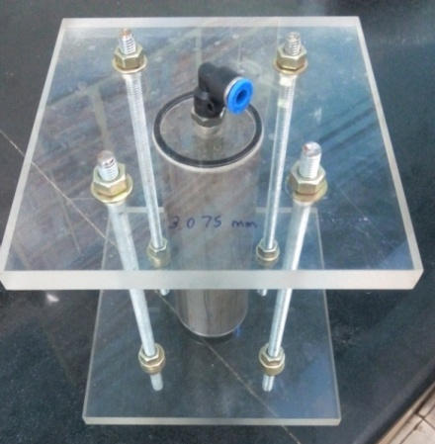
Experimental methodology
Air permeability setup
5 setups for glass beads were fabricated
Each setup has one size of glass bead
Pressure sensor
Keller made pressure sensors with the help of National Instruments data logger with National Instruments Lab view 2012
Fig : Isometric view of permeability apparatus

Slide 14
Experimental methodology
Once the entire system is arranged properly, air is allowed to flow through rotameter and sample at constant flow rate.
At the same time, pressure along the system was data logged.
The voltage values corresponding to pressure in the system were then converted to pressure using the calibration equation
Thus, we can get pressure difference across the sample.
The data logger gives 1000 readings of voltage in 10 sec.
For all five different glass bead, air flow rate at 200 lph, 300 lph and 500 lph were performed.
For each air flow rate 3 trials were performed and K values is calculated by taking average of trials and average of flow rate.

Slide 15
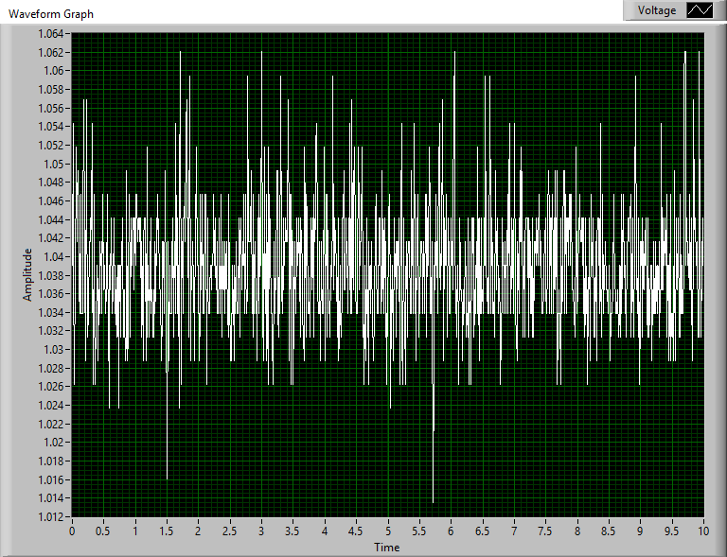
Calculations
The Keller made pressure sensor were calibrated with National Instruments data logger with Lab view 2012 using:
P (bar) = (1.5405) × V (volts) - 1.5698
Intrinsic permeability (K) -
where
Length of specimen (L)= 8.8 cm
Diameter of specimen = 4.7 cm
Area of specimen (A) = 17.35 cm²
μ of air = 1.79 E-05 Pa.s
Q = 200 lph, 300 lph and 500 lph
K = (Q × μ × L)/ ∆p × A
Fig : Voltage amplitude versus time (Lab view)

Slide 16
Results and discussion
Results obtained are shown in the following tables
460 um | Trial 1 | Trial 2 | Trial 3 | Average
200 lph | 1.996E-11 | 1.882E-11 | 1.943E-11 | 1.940E-11
300 lph | 2.136E-11 | 2.085E-11 | 2.085E-11 | 2.102E-11
500 lph | 2.082E-11 | 2.085E-11 | 2.186E-11 | 2.118E-11
 |  |  | Average K | 2.053E-11 | m²
Table : Average of K for different size of glass beads
Air permeability values obtained were consistent for various trials and flow rates for any given size of glass bead

Slide 17
Results and discussion
1.29 mm | Trial 1 | Trial 2 | Trial 3 | Average
200 lph | 2.597E-11 | 2.596E-11 | 2.546E-11 | 2.580E-11
300 lph | 2.762E-11 | 2.851E-11 | 2.824E-11 | 2.813E-11
500 lph | 2.566E-11 | 2.600E-11 | 2.488E-11 | 2.551E-11
 |  |  | Average K | 2.648E-11 | m²
2.36 mm | Trial 1 | Trial 2 | Trial 3 | Average
200 lph | 2.774E-11 | 2.748E-11 | 2.921E-11 | 2.814E-11
300 lph | 3.069E-11 | 3.008E-11 | 3.043E-11 | 3.040E-11
500 lph | 2.735E-11 | 2.680E-11 | 2.750E-11 | 2.722E-11
 |  |  | Average K | 2.859E-11 | m²
Table : Average of K for different size of glass beads

Slide 18
Results and discussion
3.6 mm | Trial 1 | Trial 2 | Trial 3 | Average
200 lph | 2.8670E-11 | 2.8780E-11 | 2.9250E-11 | 2.8900E-11
300 lph | 3.0920E-11 | 3.2240E-11 | 3.1000E-11 | 3.1387E-11
500 lph | 2.8620E-11 | 2.9210E-11 | 2.9450E-11 | 2.9093E-11
 |  |  | Average K | 2.979E-11 | m²
3.075 mm | Trial 1 | Trial 2 | Trial 3 | Average
200 lph | 3.094E-11 | 3.039E-11 | 2.850E-11 | 2.994E-11
300 lph | 2.811E-11 | 2.897E-11 | 3.009E-11 | 2.906E-11
500 lph | 3.030E-11 | 3.036E-11 | 2.779E-11 | 2.948E-11
 |  |  | Average K | 2.949E-11 | m²
Table : Average of K for different size of glass beads

Slide 19
Results and discussion
Table : Size of glass bead versus Intrinsic permeability K (×10⁻¹¹ m² )
Size of glass bead (mm) | K (×10⁻¹¹ m² )
3.6 | 2.979
3.075 | 2.949
2.36 | 2.859
1.29 | 2.648
0.46 | 2.053
It can be seen that the air permeability decreases as size of glass beads decreases.

Slide 20
Results and discussion
Fig : Size of glass beads (mm) versus Intrinsic permeability K (×10⁻¹¹ m² )

Slide 21
Table : Intrinsic permeability of different type of soil (Bear, 1972)
Results and discussion
Permeability | Pervious |  |  |  |  | Semi-Pervious |  |  |  | Impervious
Sand & Gravel | Well Sorted Gravel |  |  | Well Sorted Sand or Sand & Gravel |  |  | Very Fine Sand, Silt,
Clay |  |  |  |  |  | Peat |  | Layered Clay |  |  | Unweathered Clay
K (m²) | 10⁻⁷ | 10⁻⁸ | 10⁻⁹ |  | 10⁻¹⁰ | 10⁻¹¹ | 10⁻¹² | 10⁻¹³ | 10⁻¹⁴ | 10⁻¹⁵ | 10⁻¹⁶ | 10⁻¹⁷ | 10⁻¹⁸ | 10⁻¹⁹
It can be observed that air permeability values are similar to common permeability values as shown in the above table by Bear, 1972.

Slide 22
Summary and Concluding Remarks
Air permeability values obtained are consistent for various trials and flow rates for any given size of glass bead.
Error is negligible as readings are taken using software.
Accurate results are obtained as readings up to five decimal places
Air permeability method using rotameter gave good results and hence can be used in wide range of soils from coarse sands, fine sand to silt and clays.
Now that air permeability of glass beads is obtained, the next step is to find the pore size distribution using resin impregnation and digital image processing on the same apparatus.

Slide 23
Proposed Schedule of the Work
 | June-Sept 2015 | Oct –Dec 2015 | Jan-Feb 2016 | March-May 2016
Literature Review
Digital Image Processing
Evaluation of Properties of Light Weight Cellular Cemented Clay using pore size distribution
Thesis Writing

Slide 24
References
United States Environmental Protection Agency (2012). "A Citizen’s Guide to Soil Vapor Extraction and Air Sparging", Office of Solid Waste and Emergency Response, EPA-542-F-12-018.
IS 1498-1970. "Classification and Identification of soils for general engineering purposes", First revision, Reaffirmed 2007, Bureau of Indian Standards, New Delhi.
Bear, J. (1972). "Dynamics of Fluids in Porous Media", American Elsevier, New York.
ASTM D5550-14 (2014). "Standard Test Method for Specific Gravity of Soil Solids by Gas Pycnometer", ASTM International, West Conshohocken, PA.

Slide 25
Thank You

