Slide 1
Digital Books

Slide 2
Abstract
The Goal of this Use Case is to design and develop an online digital book web application
User can access the website content and search books based on Title, Price and Category.
Reader can search books, read books and buy books
There are 2 Roles supported by application-
Reader
Author
An Author can Update/Add a new book, create a new account

Slide 3
Tools,Design and Methodology
In this Project, several technical approaches are used:
SSMS/Azure Sql Database for relational database system.
.Net Web Api Core 6.0 is used to design a backend of application and serves as an API
Ocelot Api Gateway is used to connect with multiple microservices with the help of global base URL
Angular is used for designing the frontend part of application.
Azure Functions used for Payment gateway.

Slide 4
Database OverView
The Digital book database has 3 tables
Book Table
Author Table
Payment Table
Book table is used to store and manipulate data related to books
User Detail table is used to store/ manipulate User data based on roles i.e., Author/Reader.
Payment Table is used to keep track of all purchase history by a particular user.

Slide 5
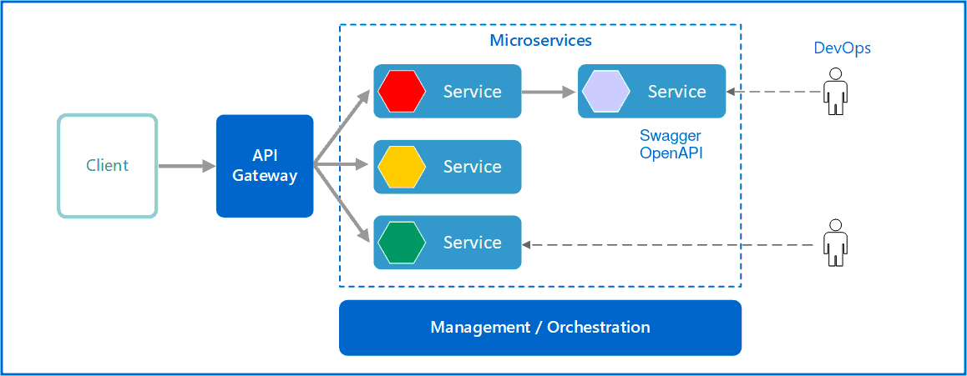
Application architecture

Slide 6
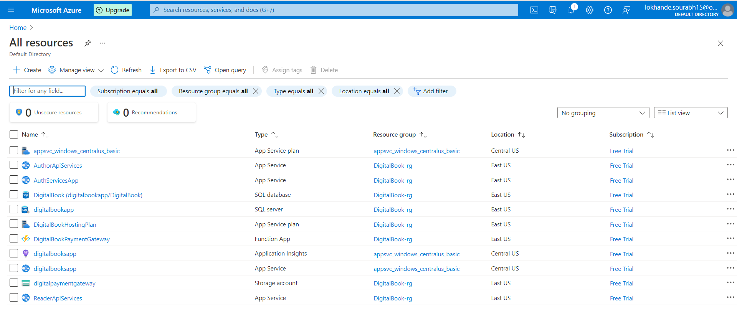
All Resources deployed On Azure

Slide 7
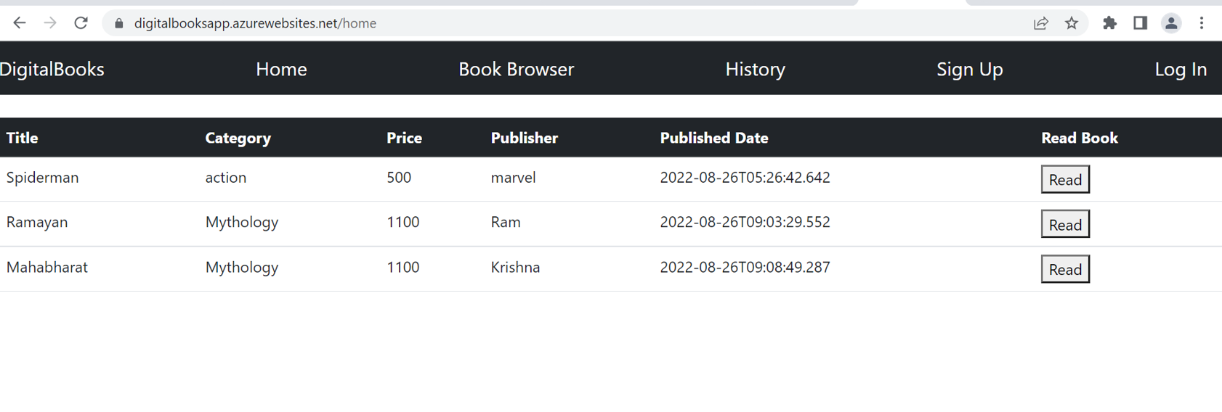
HomePage Screenshot

Slide 8
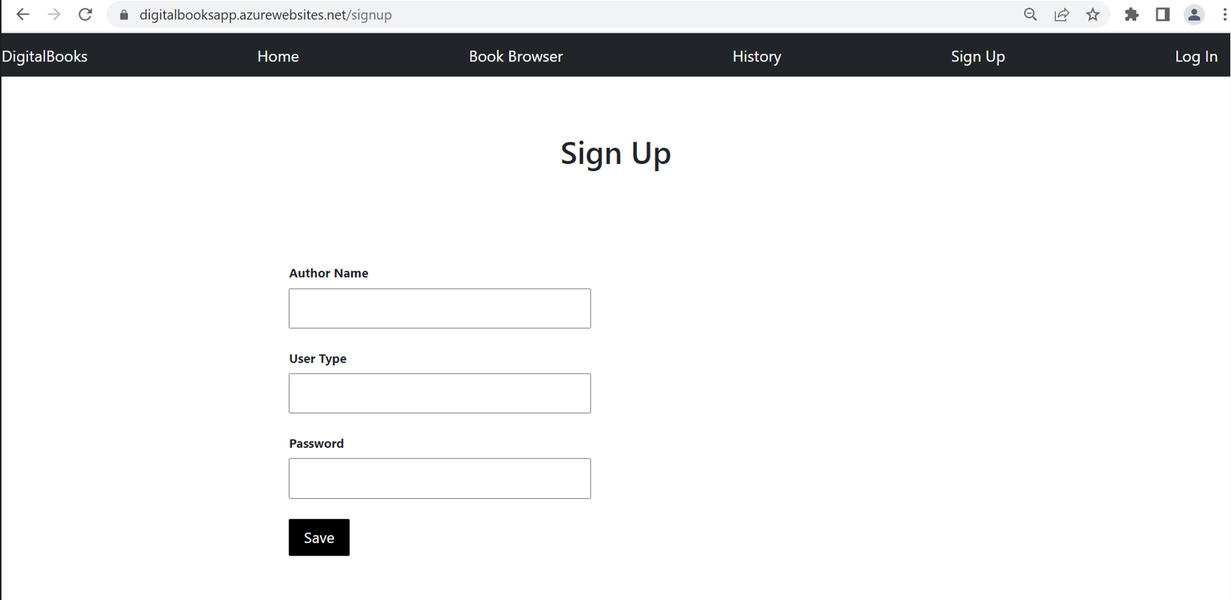
Signup Screenshot

Slide 9
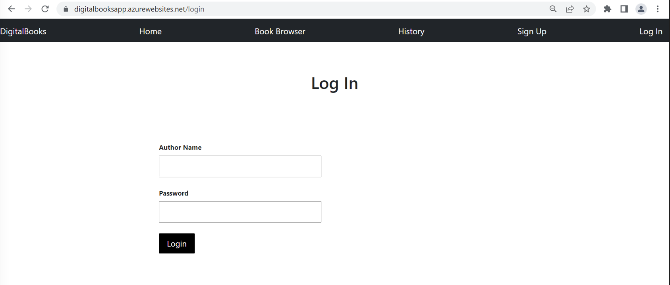
Login Screenshot

Slide 10
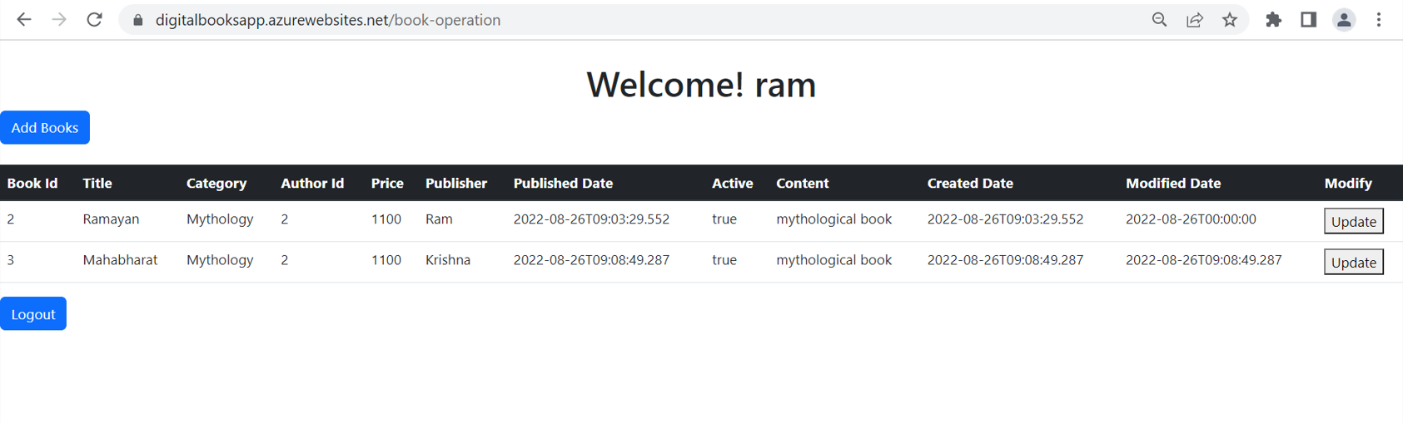
Author Login Homepage Screenshot

Slide 11
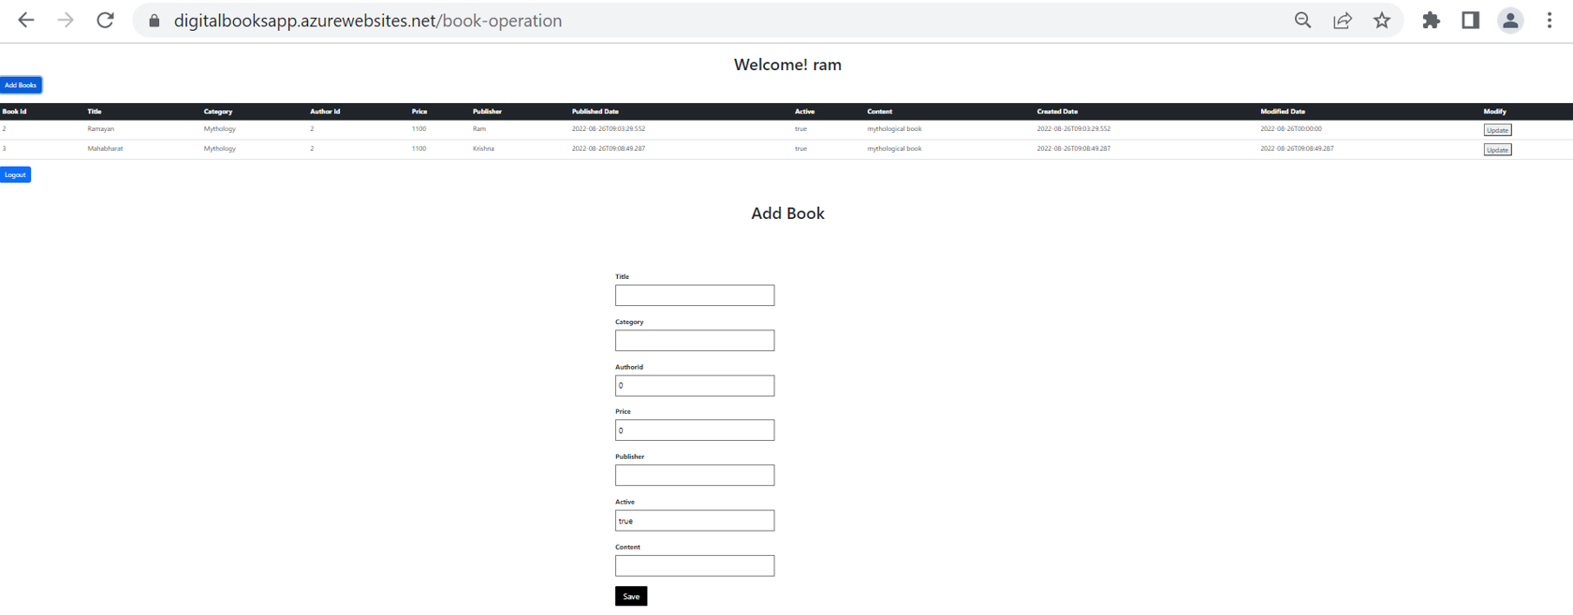
Author Add New Book Screenshot

Slide 12
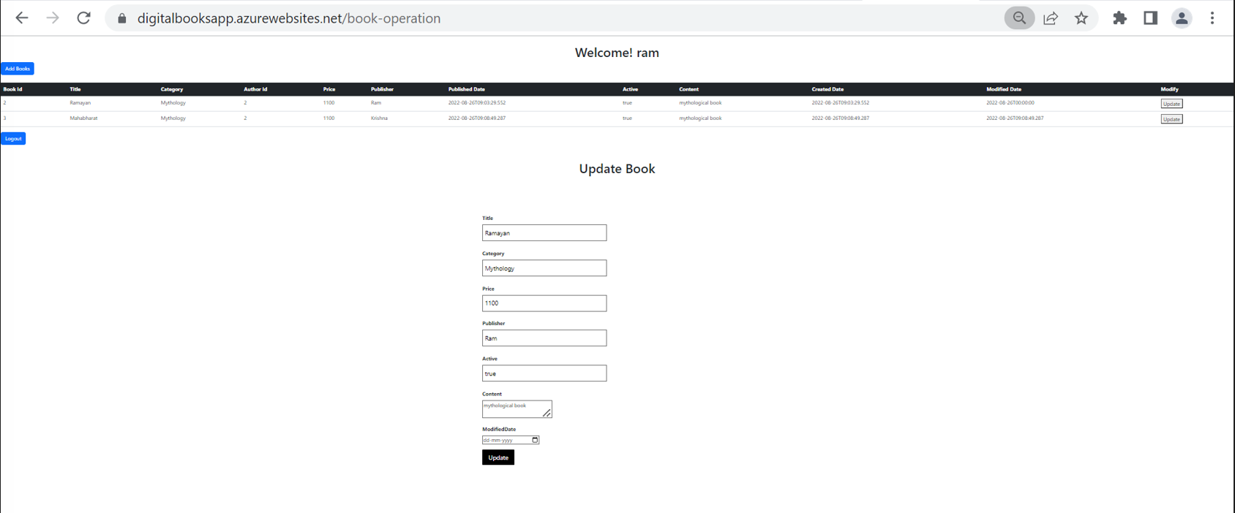
Author Update Book Screenshot

Slide 13
Thank You

