Slide 1

ClassifyCloud
Image classification as a service
Gurupad Hegde,
Sourabh Parvatikar

Slide 2
Architecture
Worker pool
User requests
Web
Server
Request Queue
EC2
Response Queue
AWS
S3
EC2
Load
Balancer
Terminate Queue
EC2
Create instances based on auto scaling criteria
Self terminating instances

Slide 3
Components
Web Server
  Spring boot application which receives requests from the user and sends it to the request queue.
  Spawns a thread for each user request.
  Starts response service which waits for the response on the response queue.
  Response service times out after 120 seconds.

Slide 4
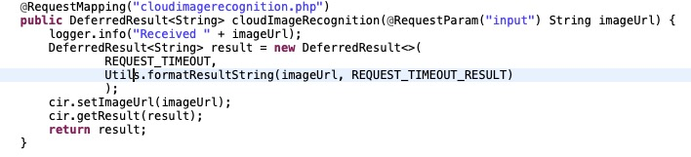
Deferred Result
DefferedResult in Spring assists in offloading a long-running computation from an http-worker thread to a separate thread.

Slide 5
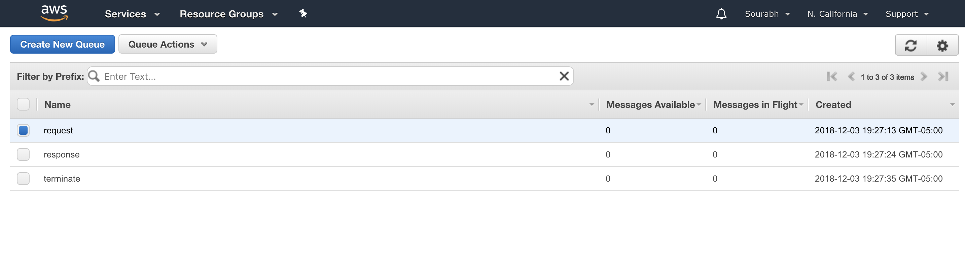
AWS SQS
AWS SQS queues:
Request queue
Response queue
Terminate queue

Slide 6
Components
Request Queue
  AWS SQS (simple queue service) which stores the JSON request having UUID and image URL.
Response Queue
  AWS SQS queue which stores the JSON consisting of UUID, image URL and result of the image classifier model.

Slide 7
Components
Worker pool
  Consists of worker instances which take in requests from Request Queue, classify images received using the trained CNN model and send out results to the Response Queue.
  Results are also stored in S3 bucket as [key, value] pairs.
  Each worker listens on terminate queue when it is idle and self terminates if the terminate message hasn’t expired.

Slide 8
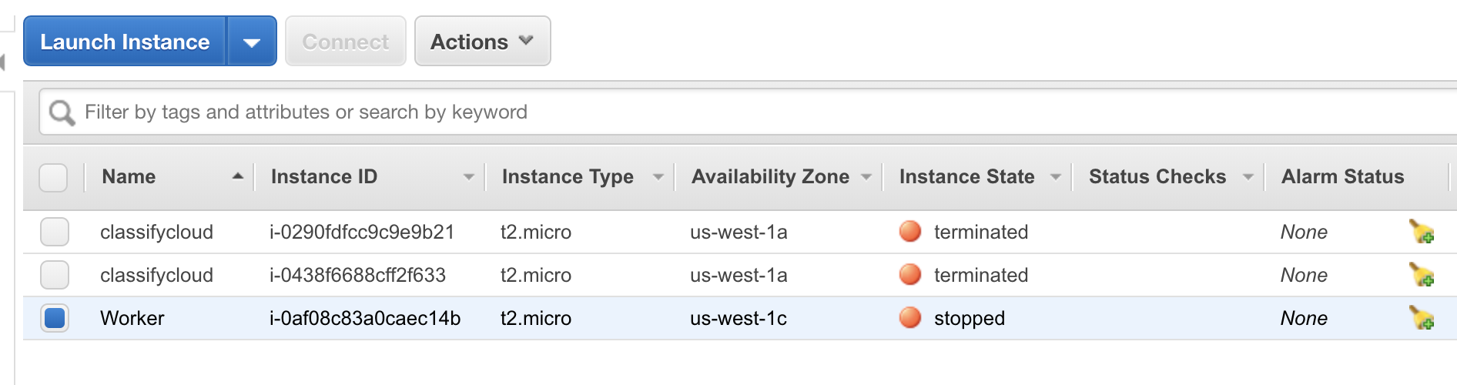
Worker pool
An EC2 instance named classifycloud is created for every request.
Instance is killed after it sends the response back to response SQS.
At least 1 worker will always be alive at any point of time.

Slide 9
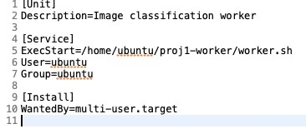
Worker pool
When a worker is created, the below code executes on boot.
worker.sh is called which takes in a request from request SQS and starts processes it.

Slide 10
Components
Terminate queue
  An AWS SQS queue required to terminate worker instances during scaling process.
  Its consists of batch messages and the size of the batch is determined by the scaling logic.
  The workers listen to terminate queue and self terminate only if the message is not older than time to live (5 seconds).

Slide 11
Components
Load Balancer
  An independent module in the web application responsible for creating and terminating worker instances as required.
  Instances are created using Java API’s provided.
  To terminate instances, a batch message is sent out to the terminate queue

Slide 12
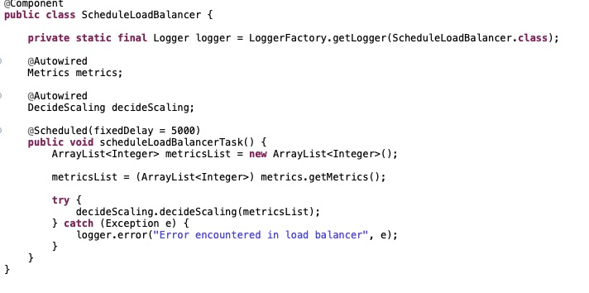
Load Balancer
Method scheduleLoadBalancer() runs every 5 seconds (the refresh time provided for load balancer between consecutively calibrating the scaling requirements)

Slide 13
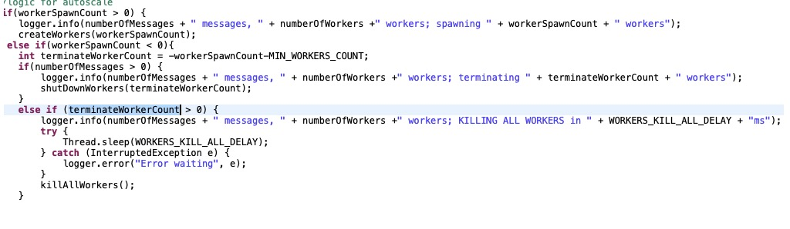
Load Balancer
Decides whether to create or terminate workers based on the scaling criteria logic.

Slide 14
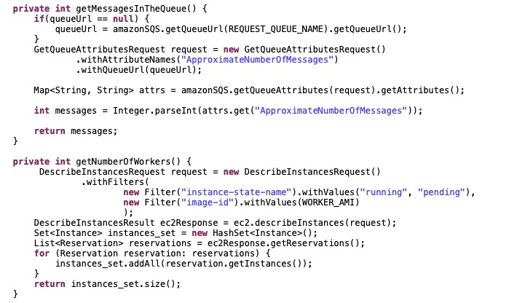
Load Balancer
Metrics class is used to obtain the current state of queue(total number of messages in the queue) and the total number of instances running.

Slide 15
Auto scaling logic
F_{wc} = min (W_{max} , D_{wc}), where
  F_{wc} - Feasible Worker count
  W_{max} - max worker count, constant 19
  D_{wc} - Desired worker count
D_{wc} = N_{q}/QOS, where
  N_{q} - Number of messages in request queue
  QOS - Quality Of Service (constant 1)
S = F_{wc} - N_{w}, where
  S - Scaling criteria
  N_{w} - number of worker already running

Slide 16
Load Balancer Flow
Metrics
No of worker running
No of messages in the request queue
Decide scaling
Scaling Criteria
Scaling criteria>0
Create requested no of instances
Scaling criteria<0
Send requested no of terminate messages
Scaling criteria=0
Kill all running instances
sleep (5000)

Slide 17
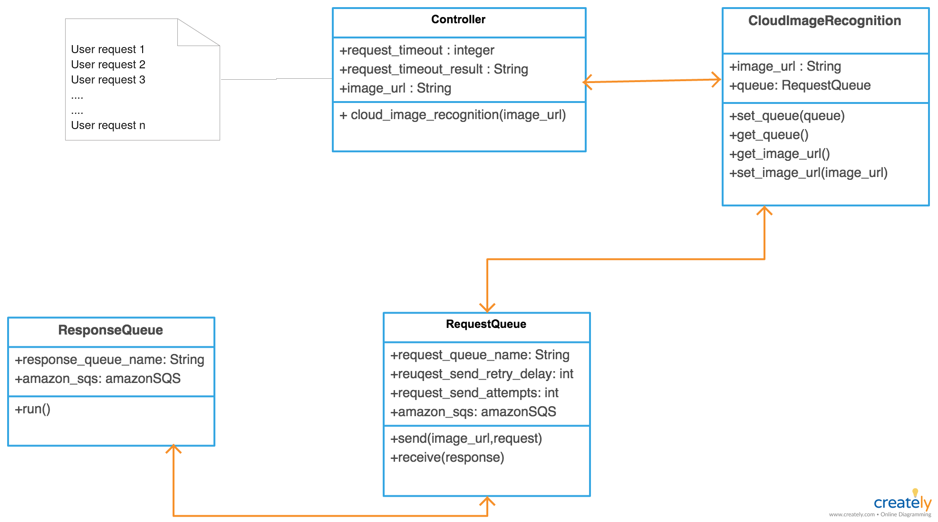
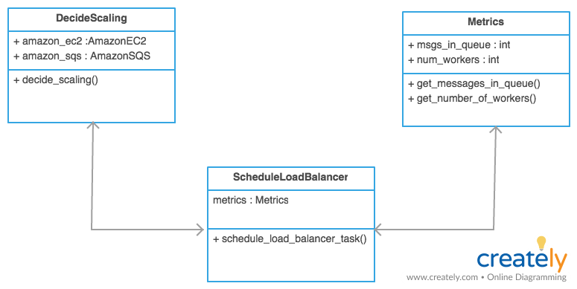
Class Diagrams
Web Server
Load Balancer

Slide 18
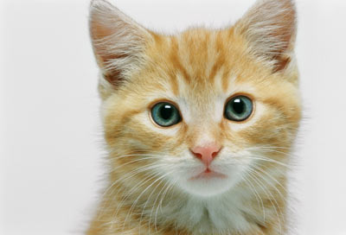
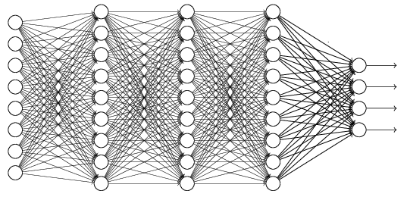
Convolutional Neural Network
cat dog ……
Fully Connected Feedforward network
Convolution
Multiple times
Max Pooling
Flattened
A new image

Slide 19
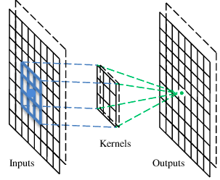
Convolutional layer
A CNN is a neural network with some convolutional layers
(and some other layers).
A convolutional layer has a number of filters that does convolutional operation.
Feature detector
A filter

Slide 20
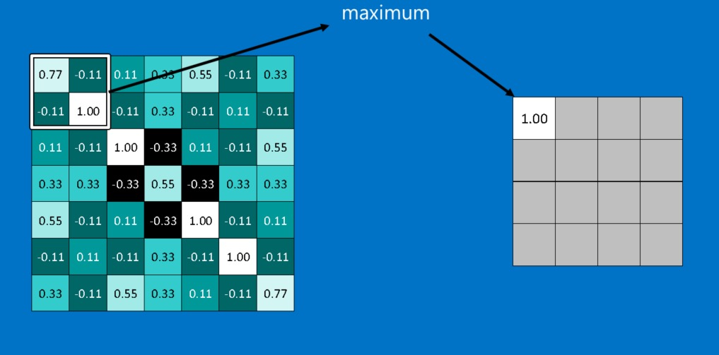
Max Pooling
Pooling involves shrinking large images down preserving the most important information in them.
Consists of stepping a small window across an image taking the maximum value from the window at each step.

Slide 21
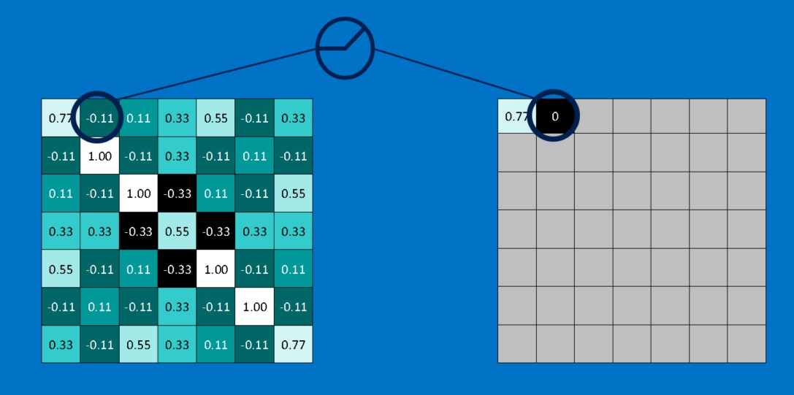
Rectified Linear Units (ReLu)
ReLu swaps the negative numbers in feature matrix with 0.

Slide 22

Image Classification
ImageNet:
Biggest dataset available for Image Classification.
It has close to close 1M images.
Inception:
One of best models for classifying images using CNN.
Used pre-trained Inception model on ImageNet for our experiments.

Slide 23
Experiments and Deliverables
Fine tuned the formula for calculating scaling criteria.
Optimized the load balancer design and specifications such as time to live (TTL) and frequency of terminate requests.
Built a cloud service using Spring Boot, Java API’s for AWS.

Slide 24
Future Experiments
Make the cloud service generic so that it can be used with any trained image classification model.
Use only 1 queue instead of using 3 separate SQS queues.

Slide 25
Limitations
Maximum of 19 parallel workers can at any time.
ClassifyCloud runs on a fixed CNN model (Inception).

Slide 26




Tech Stack

Slide 27
Demo

Slide 28
Thank You

