Slide 1

Comprehensive Analysis of YouTube Songs Data Using Power BI
Internship Project Overview
Name:- Sourabh Patil
Batch Name: MIP-DA-10
Date:- 5/7/2024

Slide 2
Problem Statement
Overview: This project aims to analyze YouTube songs data to understand performance, popularity, and user engagement using Power BI.
Goal: Create insightful visualizations and reports to uncover trends, preferences, and patterns.
Objective: Aid content creators and stakeholders in optimizing their YouTube song content.

Slide 3
Dataset Description
Attributes:
Video_id: Unique identifier for each video.
Title: Title of the channel.
Description: Description of the video.
Tags: Tags associated with the video.
Date & Time: Publishing date and time.
Views: Number of views.
Likes: Number of likes.
Comments: Number of comments.
Duration: Duration of the video.
Quality: Video quality (e.g., HD, SD).

Slide 4
Project Objectives
Data Cleaning and Preparation:
Handle missing values and outliers.
Convert columns to appropriate data types.
Exploratory Data Analysis (EDA):
Patterns in views, likes, and comments.
Trends in popularity and engagement.
Content and Channel Analysis:
Distribution across channels.
Correlation of tags with view counts.

Slide 5
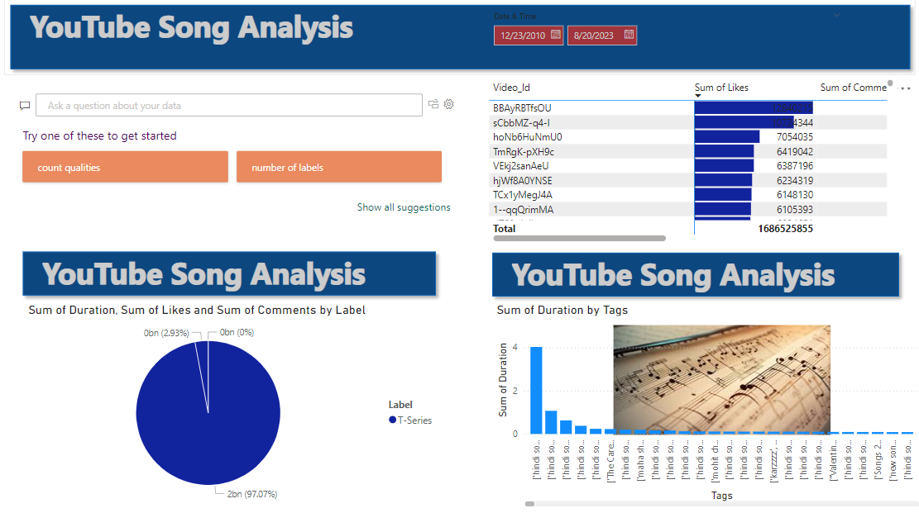
Dashboard

Slide 6
Recommendations to Uplift Business
Optimize Content Strategy:
Focus on popular tags and high-engagement periods.
Produce more content in high-demand genres or styles.
Enhance User Engagement:
Encourage comments and likes through call-to-action in videos.
Use captions to increase accessibility and reach a wider audience.
Leverage Data Insights:
Regularly analyze performance metrics to adjust strategies.
Identify and collaborate with successful channels for cross-promotion.
Improve Video Quality:
Ensure videos are available in HD or higher quality.
Provide detailed and engaging descriptions and tags.
Publish Consistently:
Identify peak times and maintain a consistent publishing schedule.
Monitor trends to adapt quickly to changes in user preferences.

Slide 7
THANK YOU!

