Slide 1

Hotel Reservation Analysis with SQL
Data Analyst Intern
Presented by:- Sourabh Anil Patil
Batch Name: MIP-DA-10

Slide 2

Objective Overview
The hotel industry relies on data to make informed decisions and provide a better guest experience. In this internship, we are working with a hotel reservation dataset to gain insights into guest preferences, booking trends, and other key factors that impact the hotel's operations. we will be using SQL to query and analyze the data, as well as answer specific questions about the dataset.
Tool used :-

Slide 3
Dataset Overview
The dataset includes the following columns:
Booking_id
No_of_adults
No_of_children
No_of_weekend_nights
No_of_week_nights
Type_of_meal_plan
Room_type_reserved
Lead_time
Arrival_date
Market_segment_type
Avg_price_per_room
Booking_status

Slide 4

IMPORT DATASET

Slide 5
The Task!
We will write SQL queries to get insights related to the given task..

Slide 6


1)What is the total number of reservations in the dataset?
SELECT count(Booking_ID) FROM hotel_r;
2)Which meal plan is the most popular among guests?
SELECT type_of_meal_plan, COUNT(*) AS total FROM hotel_r
GROUP BY type_of_meal_plan
ORDER BY total DESC
LIMIT 1;

Slide 7
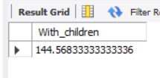
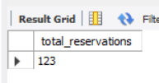
3)What is the average price per room for reservations involving children?
SELECT AVG(avg_price_per_room) AS With_children FROM hotel_r
WHERE no_of_children > 0;
4)How many reservations were made for the year 20XX (replace XX with the desired year)?
SELECT COUNT(*) AS total_reservations FROM hotel_r
WHERE YEAR(STR_TO_DATE(arrival_date, '%d-%m-%Y')) = 2017;

Slide 8
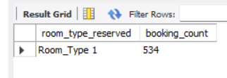
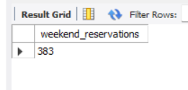
5)What is the most commonly booked room type?
SELECT room_type_reserved, COUNT(*) AS booking_count FROM hotel_r
GROUP BY room_type_reserved
ORDER BY booking_count DESC
LIMIT 1;
6)How many reservations fall on a weekend (no_of_weekend_nights >0)?
SELECT COUNT(*) AS weekend_reservations FROM hotel_r
WHERE no_of_weekend_nights > 0;

Slide 9

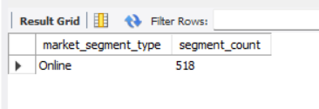
7)What is the highest and lowest lead time for reservations?
SELECT
MAX(lead_time) AS highest_lead_time,
MIN(lead_time) AS lowest_lead_time
FROM hotel_r;
8)What is the most common market segment type for reservations?
SELECT market_segment_type, COUNT(*) AS segment_count FROM hotel_r
GROUP BY market_segment_type
ORDER BY segment_count DESC
LIMIT 1;

Slide 10
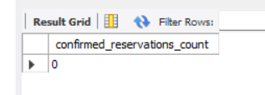
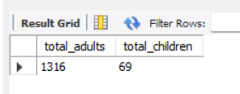
9)How many reservations have a booking status of "Confirmed"?
SELECT COUNT(*) AS confirmed_reservations_count FROM hotel_r
WHERE booking_status = 'Confirmed';
10)What is the total number of adults and children across all reservations?
SELECT
SUM(no_of_adults) AS total_adults,
SUM(no_of_children) AS total_children
FROM hotel_r;

Slide 11

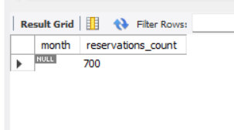
11)What is the average number of weekend nights for reservations involving children?
SELECT avg(no_of_weekend_nights) FROM hotel_r
WHERE no_of_children >0;
12)How many reservations were made in each month of the year?
SELECT
EXTRACT(MONTH FROM arrival_date) AS month,
COUNT(*) AS reservations_count
FROM hotel_r
GROUP BY EXTRACT(MONTH FROM arrival_date)
ORDER BY month;

Slide 12
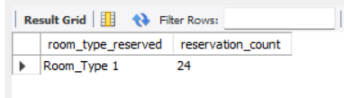
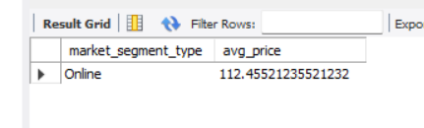
13)For reservations involving children, what is the most common room type, and what is the average price for that room type?
SELECT room_type_reserved, COUNT(*) AS reservation_count FROM hotel_r
WHERE no_of_children > 0
GROUP BY room_type_reserved
ORDER BY reservation_count DESC
LIMIT 1;
14)Find the market segment type that generates the highest average price per room.
SELECT market_segment_type, AVG(avg_price_per_room) AS avg_price FROM hotel_r
GROUP BY market_segment_type
ORDER BY avg_price DESC
LIMIT 1;

Slide 13
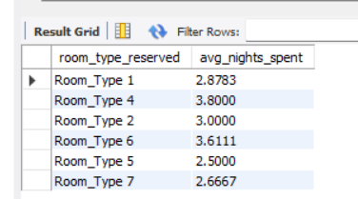
15)What is the average number of nights (both weekend and weekday) spent by guests for each room type?
SELECT room_type_reserved, AVG(no_of_weekend_nights + no_of_week_nights) AS avg_nights_spent
FROM hotel_r
GROUP BY room_type_reserved;

Slide 14
Recommendations
Adjust Pricing Based on Room Type Popularity:
Dynamic Pricing: Implement a dynamic pricing strategy that adjusts rates based on demand, room type popularity, and booking lead times.
Seasonal Adjustments: Adjust pricing based on seasonal demand fluctuations to ensure maximum occupancy and revenue
Enhance Guest Experience:
Personalized Services: Offer personalized services such as welcome drinks, room preferences, and tailored recommendations for activities.
Guest Communication: Maintain regular communication with guests before, during, and after their stay to ensure satisfaction and gather feedback.
Sustainability Initiatives:
Eco-Friendly Practices: Adopt eco-friendly practices such as energy-efficient lighting, water conservation measures, and waste reduction programs.
Promote Sustainability: Highlight your hotel's sustainability efforts in your marketing materials to attract eco-conscious guests.
Implement Strategies to Reduce Cancellations:
Flexible Booking Policies: Offer flexible booking and cancellation policies to give guests confidence when making reservations. Non-Refundable Rates: Provide a non-refundable booking option at a discounted rate to secure commitments.

Slide 15
Thank you for attention!

