Slide 1




Blockchain in Python
By : Sourabh Somani
Sourabh_somani2010@hotmail.com
sourabh_somani
https://facebook.com/hackersourabh
https://www.pythonbabu.com

Slide 2


You directly talk to your friends via Mobile Phone
Notes:
There is no third party or mediator

Slide 3
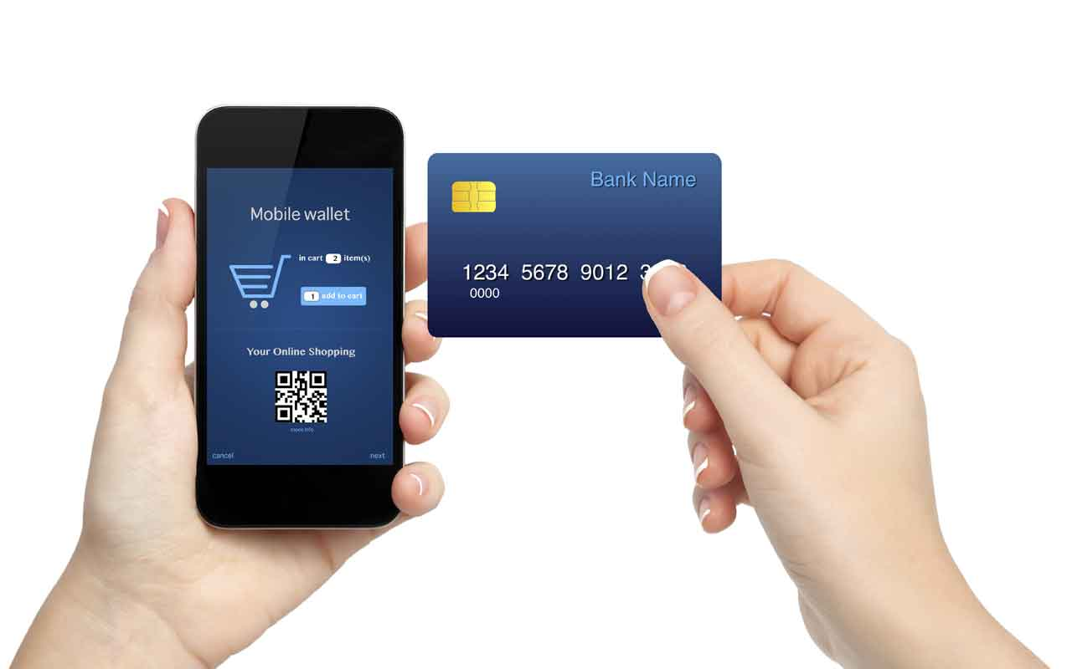

What about when you do any payment via Phone
Of course, You need third party
Notes:
Because third party gives guarantees to the seller that you have done your payment
Is this possible directly without any third party…???

Slide 4
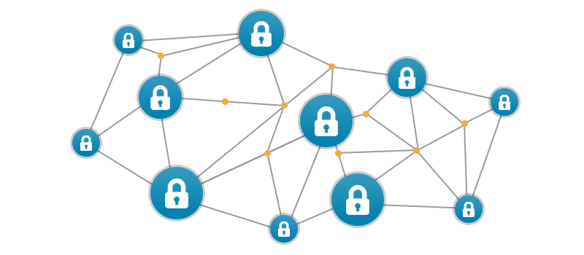
Blockchain is here…

Slide 5
Distributed Database
DB
DB
DB
DB
DB
DB
DB
Notes:
You can say blockchain is the distributed database
The data is not only copied on one or two computers
Thousands of computer are there where data is copied
And complete data is encrypted at every node

Slide 6
Blockchain is Fault Tolerant
DB
DB
DB
DB
DB
DB
DB
Notes:
This is also Fault Tolerant. Means any defect happen on any node then still there will not be any issue

Slide 7
Blockchain is Public Ledger
It is "an open, distributed ledger that can record transactions between two parties efficiently and in a verifiable and permanent way".

Slide 8
More Secure
Notes:
A hacker can hack one system easily but, if he will try to hack blockchain system he have to hack thousands of computer at the same time.

Slide 9
Blockchain History
Invented by Satoshi Nakamoto in 2008 for use in the cryptocurrency bitcoin, as its public transaction ledger.
Bitcoin is not a currency of any a country or a government or a bank.
Bitcoin is digital currency

Slide 10
Where we can use Blockchain
We can use blockchain anywhere, where for Believe, Trust and Guarantee we need third-party.
For Home Registry
Government funding to the poor
In Hospital
In Exam marksheet

Slide 11
Lets Start Coding
For
Blockchain in Python

