Slide 1

WebAssembly

Slide 2
What is WebAssembly
According to webassembly.org, WebAssembly (abbreviated Wasm) is a binary instruction format for a stack-based virtual machine. Wasm is designed as a portable target for compilation of high-level languages like C/C++/Rust, enabling deployment on the web for client and server applications.
According to MDN, It’s a new type of code that can be run on modern browser and provide new features and major gains in performance.
Notes:
Let's learn about WebAssembly. We'll start by exploring where it came from. And before we do that, let's look at the definition just to get a feeling of what we are talking about. Here it is. WebAssembly is a new type of code that can be run in modern web browsers and provides new features and major gains in performance. This is a definition from developer. mozilla. org, which has a lot of WebAssembly documentation. So it says that WebAssembly is a type of code. It is actually a binary code format that you can run in a web browser and in other places. This new type of code is useful because it is very performant, and you can compile languages, like C++ and C#, into WebAssembly. We'll dive into what it is and why it is useful later on. Now let's take a look at where WebAssembly came from.

Slide 3
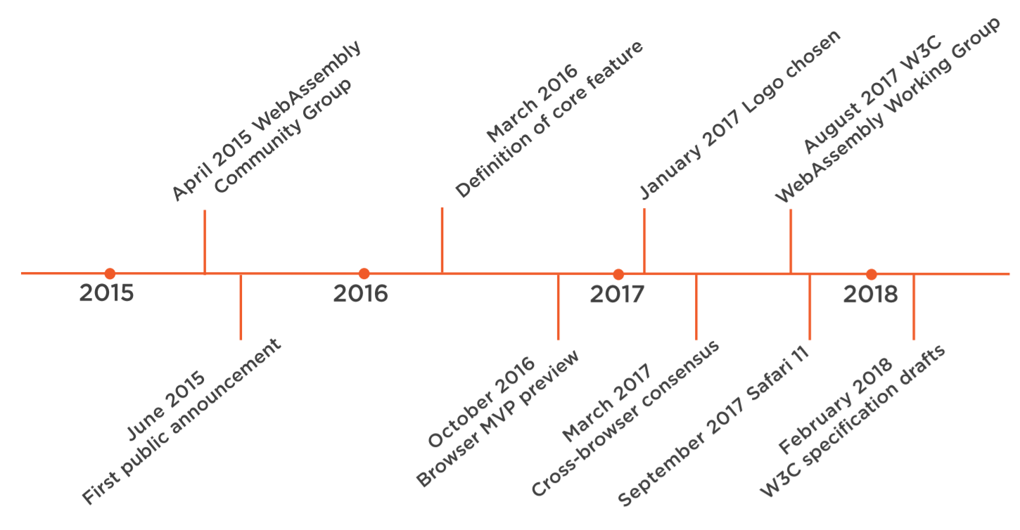
History of WebAssembly
Notes:
MVP: minimum viable product
The history of WebAssembly is relatively short so far as this is a new technology that is just beginning to gain traction in the industry. It all starts in 2015. In April of 2015, a group called the WebAssembly Community Group is started. This is a community group of the World Wide Web Consortium, or W3C. This community group initially consisted out of people from some major browser vendors that wanted to create a new code format for the web that was faster and more portable than JavaScript. This effort started after other efforts, like asm.js, which performed a similar role, but had very specific implementations. In June of 2015, the group announced publically that they were working on this new standard called WebAssembly. And in March of 2016, the community group created their first definition of the core features that would be in the WebAssembly standard. And from that date, some of the major browsers implemented some of these core features as experiments. In October of 2016, a minimal viable product was announced as a preview for the community to try out and build applications for. This MVP was also supported by all the major browsers. This was pretty big news because now all of the major browsers had actually implemented this first preview version of WebAssembly. In January of 2017, the community chose a logo, which is this logo. I should note that so far all of the work that is being done, including the creation and choosing of the logo, is done by the community, all of it in the open on GitHub. And later in 2017 in March, the major browser vendors, which included Chrome, Edge, Firefox, and WebKit reached consensus about the minimum viable product, which meant that it was complete to the extent that no further design work is possible without implementation experience and significant usage. This also ended the browser preview period. In August of 2017, a new group was created to officially start work on the standard of WebAssembly. This was the W3C WebAssembly working group. They were tasked to create official standards for WebAssembly that could be used by all the browsers to implement WebAssembly, just like the standards for HTML, CSS, and JavaScript. And although WebKit was in the community group, it wasn't until Safari 11 that Safari supported WebAssembly. Safari 11 was released in September of 2017. And the final point in the WebAssembly history so far is in February of 2018 when the first draft specifications were delivered by the new WebAssembly Working Group. These specifications contained standards for WebAssembly and various components of it.

Slide 4
Who is Developing WASM
2015 : WASM Community Group
900+ members joined this group and representatives from browsers
Promotion of WASM before collaboration in browser
2017 : W3C WASM working group
Google, Facebook, Mozilla, Apple,W3C etc.
Standardize WASM
Notes:
Now let's take a brief look at who is developing WebAssembly. We've seen two groups in the history of WebAssembly so far. The first was the WebAssembly Community Group. This group contains people from all the major browsers, and they started WebAssembly. They really pushed the evolution of it by already implementing early versions of it in the major browsers, even before there was an official standard. This group now consists out of more than 900 people, and it is open for anyone to join. And in 2017, the W3C WebAssembly Working Group started. This group contains people from lots of major companies, like Facebook, Apple, Google, Tencent, W3C itself, Mozilla, and LG Electronics. This shows that the industry is investing in this new technology. The mission of this group is to create standards for WebAssembly that can be used by browsers and other platforms to implement WebAssembly and interpret it. This already resulted in draft standards for WebAssembly in February of 2018.

Slide 5
Which browser Support WASM
We can use caniuse.com to check WASM browser support

Slide 6
JS in Nutshell
Web Browser
JS APIs : Web Socket, WEB RTC, Canvas, WebGL,
File API, Web Storage, Audio, Media, DOM etc.
JS Runtime
HTML
CSS
JS

Slide 7
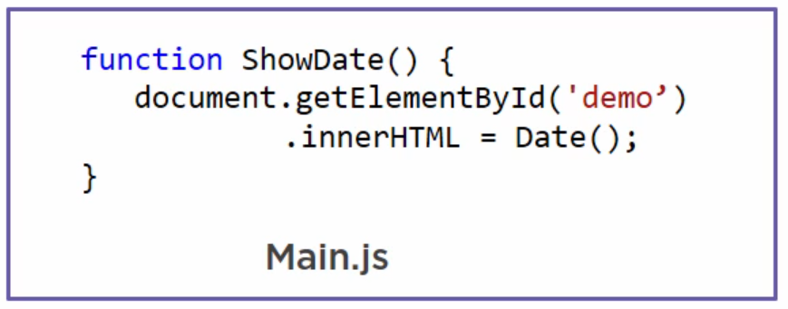
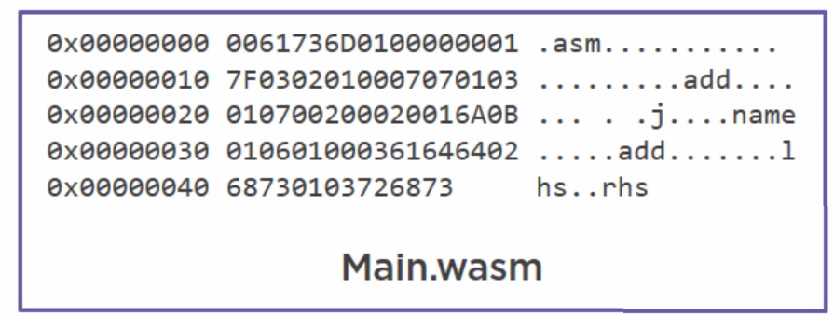
WASM
JS Runtime
JS

Slide 8
WASM
WebAssembly not only can run on web browser it can also run on server side like we can use with node.js Here is the example of that : http://thecodebarbarian.com/getting-started-with-webassembly-in-node.js.html
WASM can also run on device means outside the browser, like in Android devices for that there will be WASM runtime. And can access android apis.

Slide 9
WASM VM
https://github.com/perlin-network/life
https://github.com/WAVM/WAVM

Slide 10
Why WASM?
Run code near native speed
Other languages can compiled to WASM
No plugin needed, it is natively supported by Web Browsers
Secure by design, It runs in the JS sendbox
JS code can run WebAssembly Module

Slide 11






Where should we use?
Audio/Video Editing
Audio/Video Streaming
Gaming
Conferencing and WEB RTC
AR and VR
AI and ML

Slide 12
Example
https://www.funkykarts.rocks/demo.html
https://webassembly.org/demo/Tanks/

Slide 13
Working with WebAssembly
There are several ways to use WebAssembly to make applications
Write WebAssembly yourself
Compile code from other programming languages

Slide 14
Write WASM Yourself
We can write .wasm file from .wat format https://developer.mozilla.org/en-US/docs/WebAssembly/Text_format_to_wasm
Using WebAssembly Binary Toolkit we can use to convert into Runtime
Tool :
https://webassembly.studio/

Slide 15
Compile Code into WASM
For C++, we can use Emscripten toolchain which can compile and make WASM file for the runtime
https://kripken.github.io/emscripten-site/docs/tools_reference/emcc.html
We can also use C#, and Blazor do the same thing https://www.hanselman.com/blog/CompilingCToWASMWithMonoAndBlazorThenDebuggingNETSourceWithRemoteDebuggingInChromeDevTools.aspx

Slide 16
Thank You

