Slide 1
What is VCS?

Slide 2
Version Control System
Software Tools that helps managing the changes that are done in the source code over time.
Keeps track of all modification.
Helps working in a team more flexible.

Slide 3
Version control system
In case of mistake,we can revert back and use a earlier version of the code.
Prevent human error and unintended consequences
Each person can work on different features

Slide 4
Version control system
Bug-fixing and development at the same time.
Without disrupting others you can test features

Slide 5
Why VCS and Why Git?
Backups
Code-efficiency and testing
Release versions

Slide 6
DVCS and CVCS
Complete history of all modification(changes)
done to file
like create,delete,edits etc.
Branching and Merging

Slide 7
Version control systems
Git
Subversion
Perforce
mercurial

Slide 8
GIT
Git is DVCS
Git focuses on content of file
Offline
SHA1 hasing
Extreme tracing of all changes
IDE support,open source

Slide 9
GIT COMMANDS

Slide 10
Creation
git init
      To create new repository
      Or convert existing directory into git repo
      Usage: git init
git init <directory>

Slide 11
Creation
git clone
      Copies an existing git repo.
      It creates a remote connection with the orginal repo.
      Usage: git clone <repo-link>
git clone<repo> <directory>

Slide 12
Creation
git config
      Configures installation
      Usage:
      git config –global user.name <name>
      git config –global user.email <email>

Slide 13
Saving Changes
git add
      Add files to the staging area to be tracked by git
      Usage: git add <file-name>
git add <directory>

Slide 14
Saving changes
git commit
      Commit means you are done changing the files.
      You can explicitly changes your committed changes.
      Usage: git commit -m “<message>”
      git commit -a

Slide 15
Inspecting
git status
      Displays the state of the working directory and staging area.
      Usage: git status

Slide 16
Inspecting
git log
      Shows all the changes(commits),history
      Usage: git log
      git log -n <limit>
      git log –oneline

Slide 17
Inspecting
git checkout
      Lets you checkout files,commit,branch
      Usage: git checkout <branch-name>
      git checkout <commit> <file> git checkout <commit>

Slide 18
Inspecting
git revert
      Undoes the commit BUT..
      instead of deleting the commit,
      it creates a new one with changes
      of the older commit.
      Usage: git revert <commit>

Slide 19
Inspecting
git reset
      Dangerous brother of revert.
      It undoes whatever changes you have made.
      Usage: git reset <file>
      git reset
      git reset <commit>
      git reset --hard

Slide 20
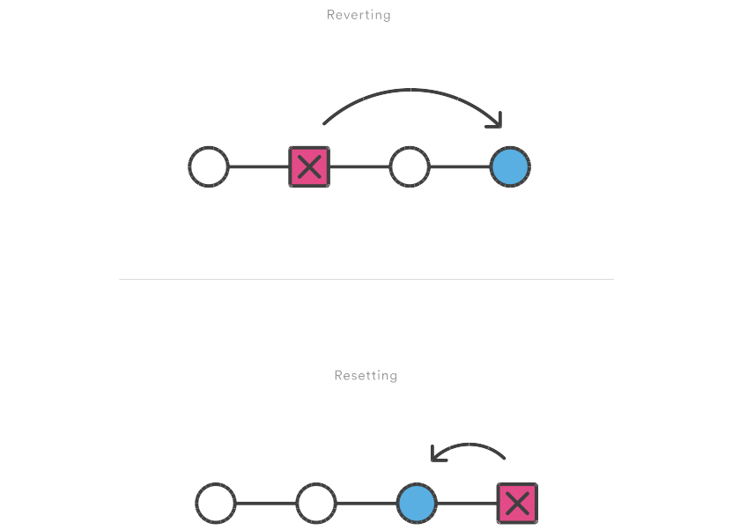

Slide 21
Inspecting
git clean
      Little safer than reset
      Removes untracked files too.
      Usage: git clean -n (details file which is to be removed)
      git clean -f

Slide 22
Collaborating

Slide 23
Syncing
git remote
      Lets you create,view,delete connection to different repository
      Usage: git remote
      git remote add <commit> <url>
      git remote rm <name>

Slide 24
Syncing
git fetch
      Imports commits(changes) as a local branch
      Usage: git fetch <remote>
      git fetch <remote> <branch>
      git merge

Slide 25
Syncing
git pull
      Merges upstream changes into local repo
      Combines git fetch and git merge
      Usage: git pull <remote>
      git pull --rebase <remote>
      (makes your branch top-priority)

Slide 26
Syncing
git push
      Transfer commits(changes) from local repo to remote repo.
      Usage: git push <remote> <branch>
      git push <remote> --force

Slide 27
Making a Pull Request

Slide 28
Branching
git branch
      New line for new features,bug-fixes,testing area etc.
      Usage: git branch
      git branch <branch-name>
      git branch -d <branch>
      git checkout -b <new-branch>
      git checkout<branch>

Slide 29
Branching
git merge
      Integreate changes done in a branch into current branch.
      Usage: git merge <branch>

