Slide 1
Home Automation
Using Machine Learning

Slide 2
Why Automation ?
Electrical Energy is wasted in hostels and departments due to carelessness.
All the lights in the corridor are simultaneously turned on.
For daily work an uniform intensity distribution of 800-900 W/m² is enough.

Slide 3
Need for Automation
Bhabha Bhavan – 8 Floor(Including Ground) , each floor has 100 lights .
Total lights = 800 , assuming that with the help of automation 200 lights can be turned off .
Power consumed by 1 light is 25 W , and in a day it consumes 0.3 Units of electricity(KW/Hr) . There are 800 lights therefore it consumes 240 units in a year. Assuming that 200 lights can be turned off , 60 Units can be saved . The total power consumption would be 180 Units.
Total Units saved in a month are 1800 Units .
A normal household consumes 250 units of power in a month, by saving 60 units in a day , about 7 households can be powered in a month

Slide 4
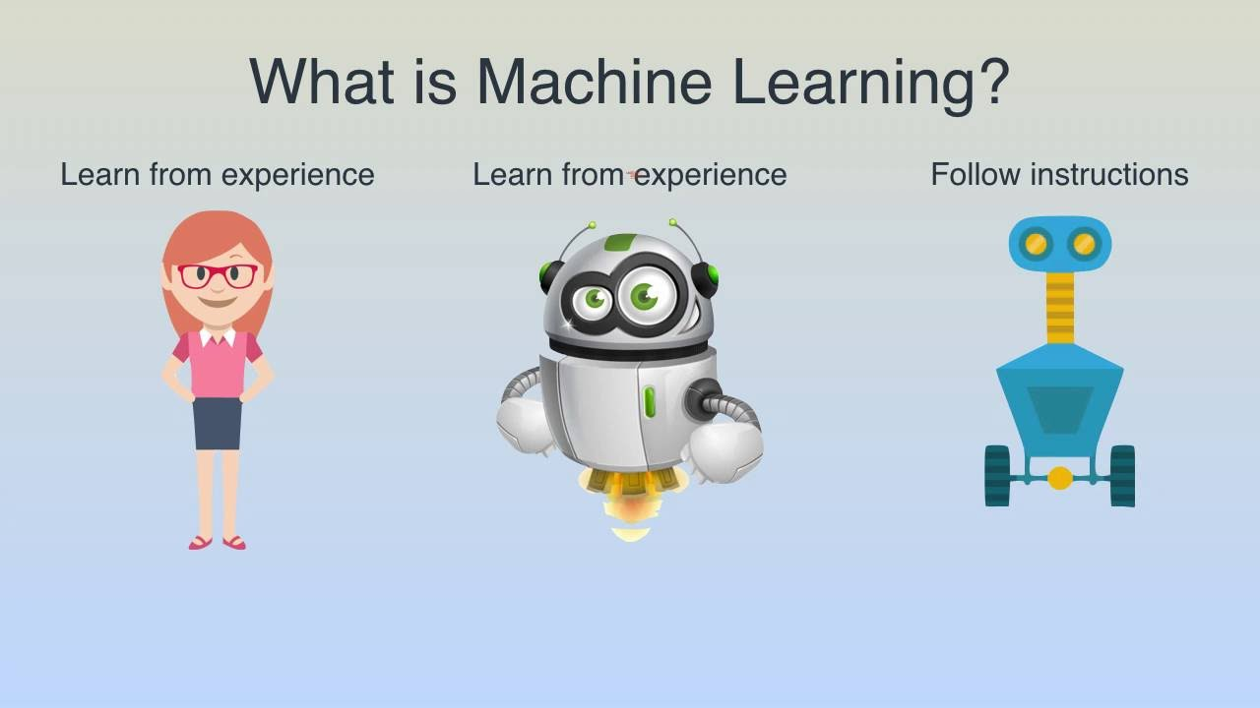

Slide 5
Why Machine Learning ?
After collection of the data most of the sensors are not needed.
Many times sensors can show wrong readings.

Slide 6
Task was divided into two parts:
Automating a miniature lobby by Neural Networks.
Creating an automation model by speech commands.

Slide 7
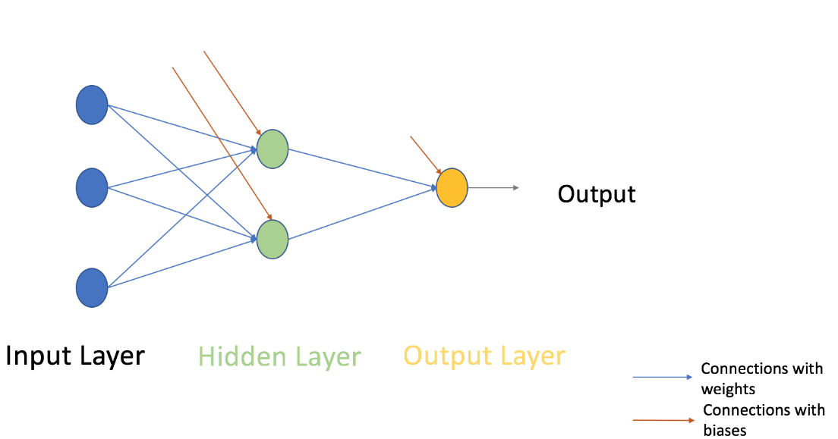
Neural Networks

Slide 8

Neural Networks
Activation Function
Activation Function takes the sum of weighted input (b*1+w1*x1 + w2*x2 + w3*x3 ) as an argument and return the output of the neuron.
In above equation, we have represented 1 as x0 and b as w0.
The activation function is mostly used to make a non-linear transformation which allows us to fit nonlinear hypotheses or to estimate the complex functions. An example of an activation function is the ‘Sigmoid’ function.

Slide 9
Model 1
Input: The graph for intensity at every point as shown earlier.
Neural Network 1: The intensity at each point is the training set for the same. Its output is the status of each bulb whether on or off.
The same can be done using a circuitry which detects if the bulb is on or off using X rated capacitor which converts 220V to 5V.
Neural Network 2: The output of the 1st neural network is fed as input to 2nd neural network. By adjusting weights of different layers, the output is obtained such that intensity at each point is just above threshold intensity.
Flaw: It needed high amount of computation to train according to dataset. It also had the vulnerability of not being very efficient in the approach.

Slide 10
Model 2
Input: Intensity array of all sensors at different time, time at different instances and state of window i.e. open or close (0 or 1)
Output: Binary array depicting status of lights (0 or 1) such that intensity at each point is above and nearest to threshold.
Training: Each combination of output on or off states of lights will be set for a day. The intensity at each point will be obtained by sensors. This will be the training set for the four-layer neural network.
Flaw: Training is needed for 365 days because of seasonal change and random environment changes. Training this large data is not feasible hence this model was discarded or needed future changes.

Slide 11
Neural Network
Code
(In python using library NUMPY)
Creation of Dataset
Training of Neural Network
Testing
Deciding the model

Slide 12
Neural Network
Creating training dataset:
Input: Intensity Values at different points in the lobby obtained by ldr sensors.
Output: 5 Bit in depicting in which pattern of led’s glowing.
Intensity:
1. Time interval of 15 mins
2. every possible combination of led

Slide 13
Neural Network
Creating training dataset:
Since LDR sensors could not be interfaced with bulbs in an actual lobby, a miniature version was made
Miniature version had:
5 set of led’s, each having 2 led’s in series
2 windows at the end of the lobby
Ldr sensors between each led and at the outside the windows.
Data was taken for all 32 combinations of led (2^5) and saved in excel file.
Collected data is further divided into training and testing data

Slide 14
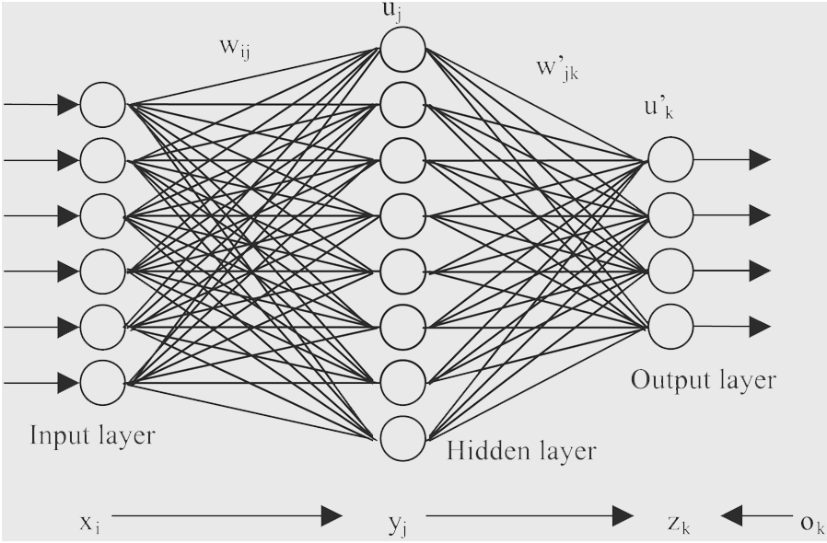
Neural Network
Neural network design:
Input layer : 6 neurons (for each ldr sensor)
Output layer: 5 neurons (representing each led)
Hidden layer: To be varied during training according to data available

Slide 15
Neural Network
Training the network:
What does the network learn?
According to the values of intensity by ldr sensors, it learns the pattern of led’s (indicating status of all led’s)
While using the network, input will be intensities, the extreme ones being the intensity values outside the windows (indicating time of day) and the middle 4 equal to the threshold value.

Slide 16
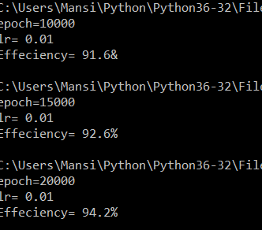
Neural Network
Testing the network:
Changing the learning rate
Changing the epoch
Changing number of hidden layer neuron

Slide 17
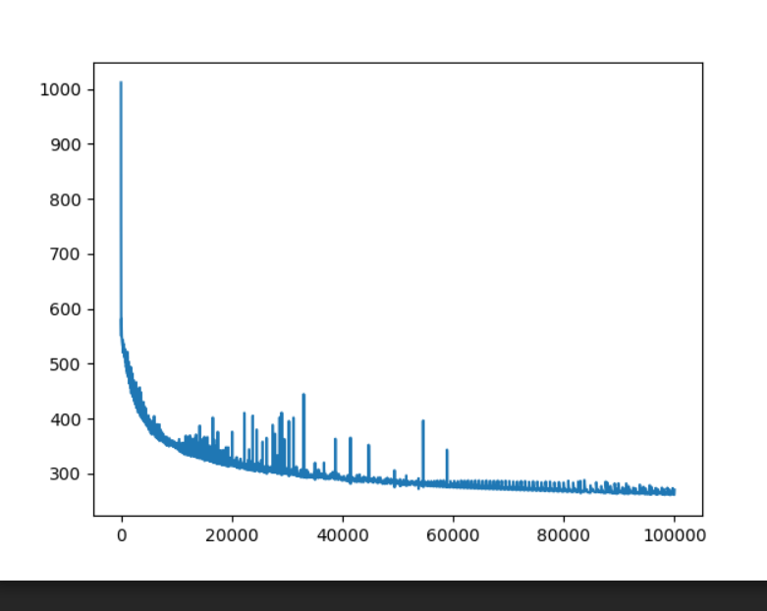
Error Vs Epoch

Slide 18
Implementation
Problems faced
Timeline
Future Aspects

Slide 19
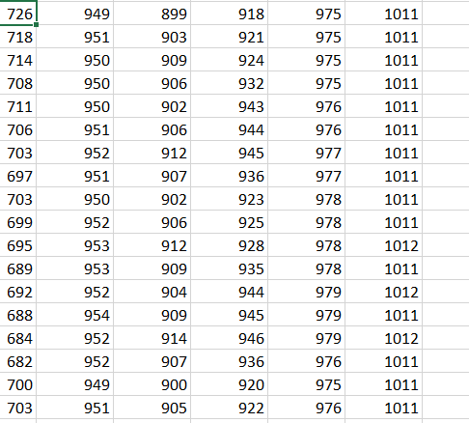
Implementation- Problems faced
Problems in dataset:
Data for the middle 4 sensors in the range >900 and threshold being 800 in real life.
Intensity values are taken at point values.

Slide 20
Implementation- Problems faced
Since there is no generalised approach for determining the parameters, it is just random changes in design of network used for training of network, it was difficult to train the network.
There was overshooting in the network even after reducing the learning rate to 0.00003
Saturation: After a certain point the error in the network was getting saturated (remained constant despite further iterations)
No. of hidden layers : The data was insufficient for more than one hidden layer.
In case of training the network for every single input, the output in case of testing was found to be same as the last trained data.

Slide 21
Optimisation
Learning rate, epoch and no. of hidden layer neurons were changed form 0.3 to 0.0003 , 800 to 100000 and 2 to 30 which changes the efficiency from 40% to 66%
For saturated error, the learning rate was changed after every few thousand iterations.
Batch, Mini-Batch and Stochastic learning was used
Weights were saved after few iterations and were used for further training.
Data was taken once again ensuring the flaws were solved.
The above procedure was repeated and the error efficiency was increased upto 94%

Slide 22
HOME AUTOMATION BASED ANDROID APPLICATION

Slide 23
INTRODUCTION:-
This android application was built keeping in mind the idea of home automation. ie controlling the lights and fans of the room via an android application. This application first accepts speech from the user then converts it into text ,connects it to the microcontroller via Bluetooth and then the corresponding command is sent to the controller using Bluetooth HC-05.Thus this application is divided into three modules:
Speech To text Conversion
Connecting the application to the microcontroller
Sending corresponding command to the controller

Slide 24
Speech To Text Conversion:-
In this module the voice command was recorded and converted into corresponding english text command with the help of Speech Recognizer Intent present in Android Studio for API greater than 15. This intent is very flexible and can be used to convert voice command to different languages using the VOCALE LIBRARY.

Slide 25
Natural Language Processing
What is Natural Language Processing ?
Natural Language Processing is a branch of computer science and to be specific it is a sub-branch of Artificial Intelligence. Through its programming a computer would be able to understand the vocabulary of a language , its syntax , its grammar and the meaning behind a sentence .
When a string is passed through a computer , it would be able to identify the nouns, verbs , compound nouns, adjectives and so forth .

Slide 26
For the problem of automating the lights and fan , the vocabulary is limited therefore the necessary verbs , nouns , compound nouns were explicitly defined. After the sentence is passed , it is tokenized where the sentence is broken up into its words.
Once the command has been tokenized , the tokenized list is then intersected with the defined verbs , nouns and compound nouns , based on the number of intersections , there are few numerical comparisons that happen after which a deciding command is made such as the Light :On and Fan:Off.

Slide 27
Interface Between the two
As the app used Java and we processed text in Python. So we need to provide an interface between them.
We used Jython. What is that?? Why we left that?
We tried Kivy. Kivy?? Why we didn't try that?
Then finally came to solution: Conversion of code

Slide 28
Connection Between Devices:-
The second task was to connect the application to the microcontroller. Controller used in our project is Arduino UNO. The data transmission could be done using either Bluetooth or USB. Bluetooth having more advantages was preffered.
Bluetooth connection between the devices was made possible by using Android Sockets for the Connection .
Setting up Bluetooth ,sending request for pairing and then establishing the connection with the Bluetooth HC-05 was achieved through the application.

Slide 29
Sending Command to controller:-
After the connection was established the next process was to send command to the controller. The text that was obtained was first deciphered by using NLP(Natural language Processing) and then accordingly the corresponding commands were sent via HC-05 to the Arduino uno using sockets as a medium for transmission of data to controller to control the lights and fans present in the room.

