Slide 1




Analysis of Testing Methods for Pre-Trained Models in Open-Source Software
ECE 59500ASE - Final Project Presentation
Mohammed Metwaly
Mohit Pandiya
Souradip Pal

Slide 2
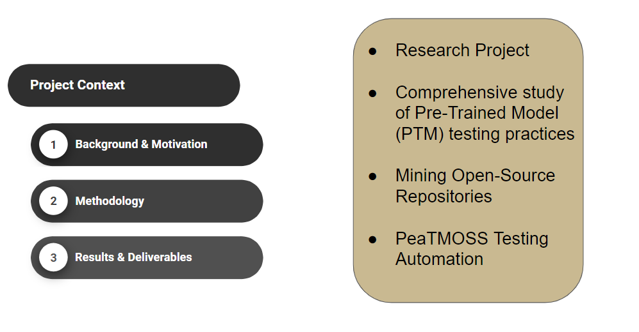
Overview

Slide 3
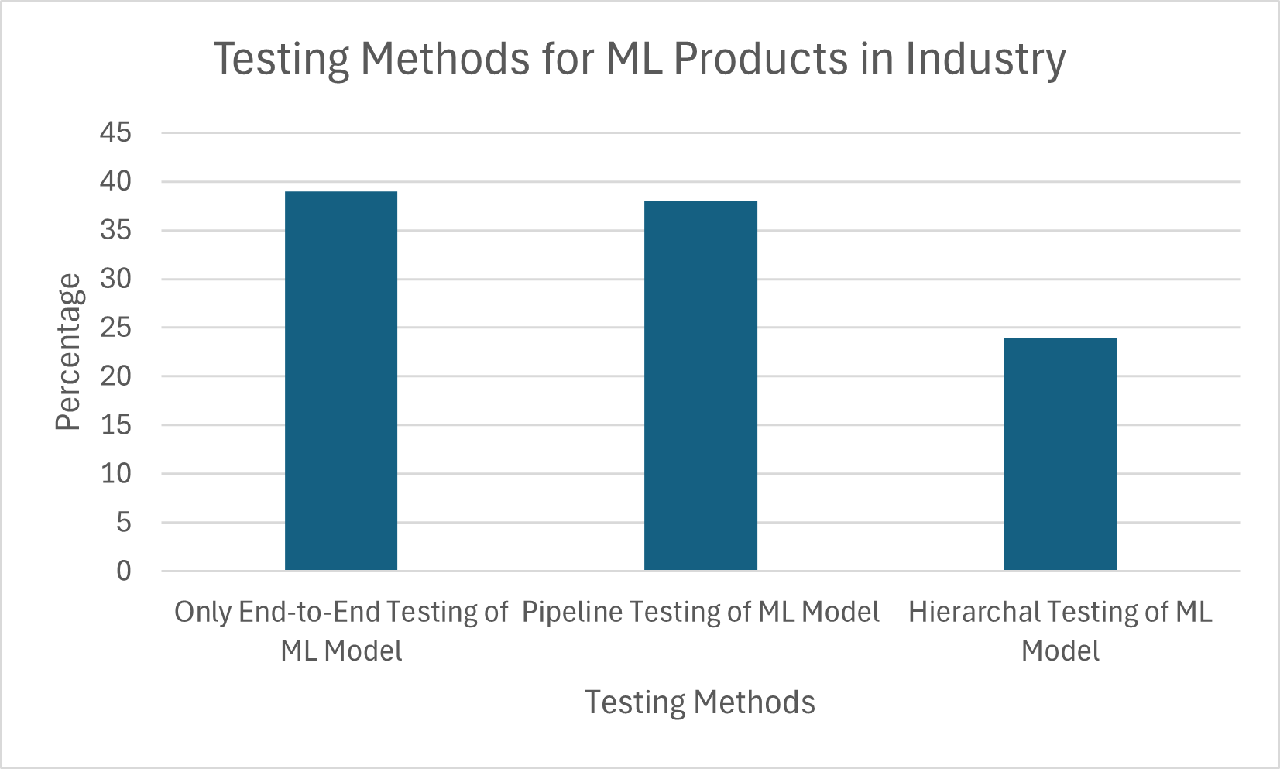
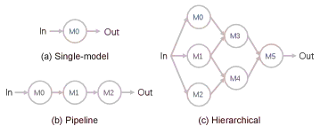
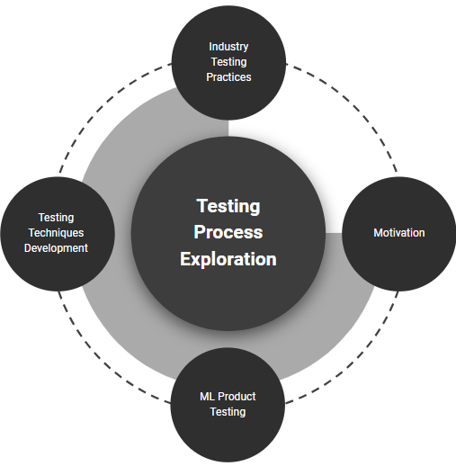
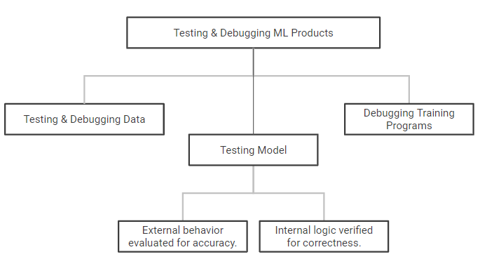
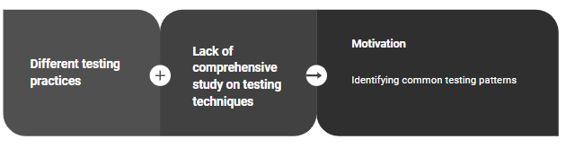
Background & Motivation
Image Credit: Shuyue Li, et. al. Testing machine learning systems in industry: an empirical study

Slide 4

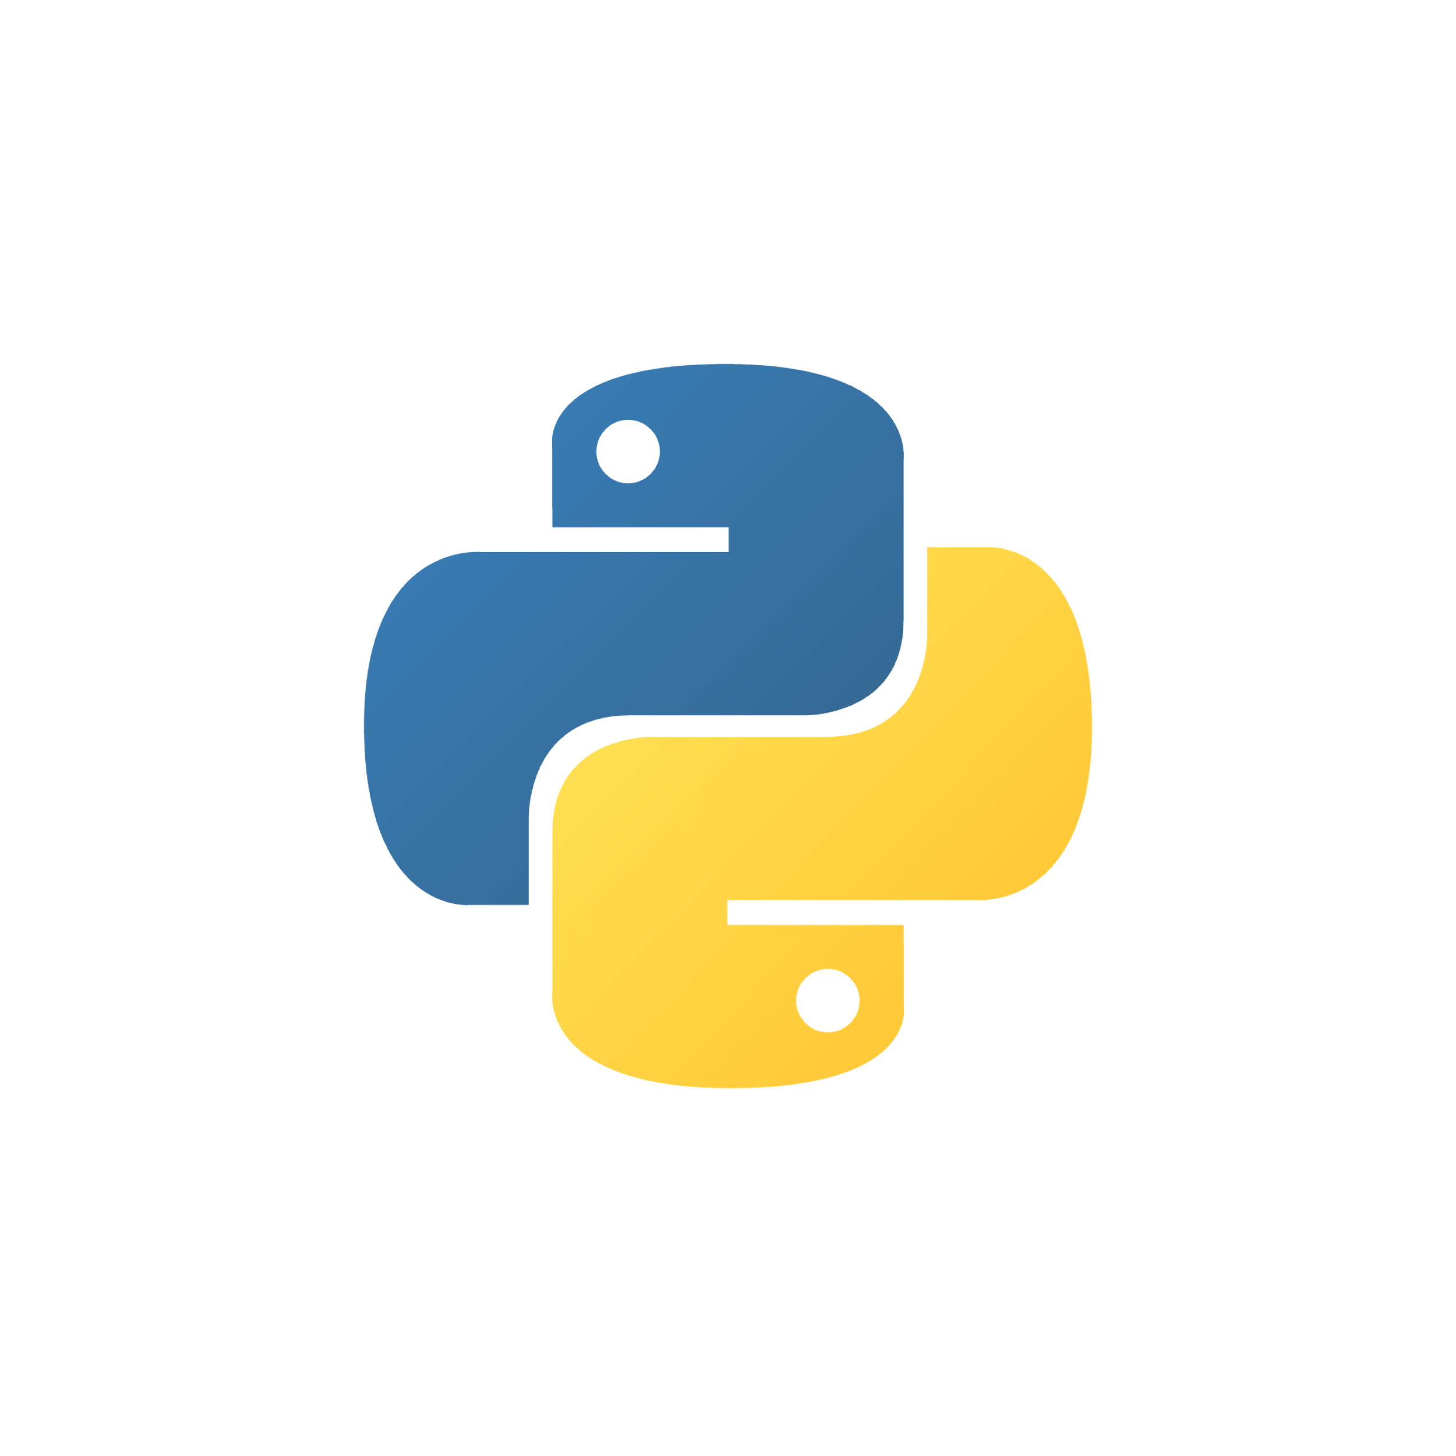





Methodology - Manual & Automated Testing Approach
README
Test Pattern
Analysis
Run Tests
Manual Study
Setup Files
Manual Setup
UT/IT/E2E
PeaTMOSS
reuse_repository
table
PTM/Test Files
Dataset
Filter GitHub Repos
Coverage Reports
PeaTMOSS reuse_file
table
pytest.ini tox.ini
Test Env Setup
Tests
Unit
reuse_test_file
Automated
Analysis
Setup Files
Integration
Workflow
Setup
Makefile pyproject.toml requirements.txt
PTM-Test
File Mapping
E2E

Slide 5
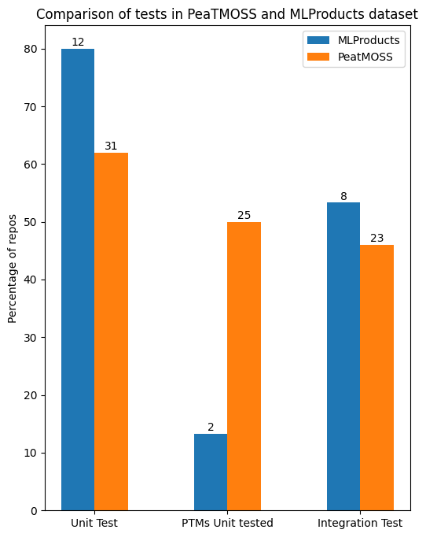
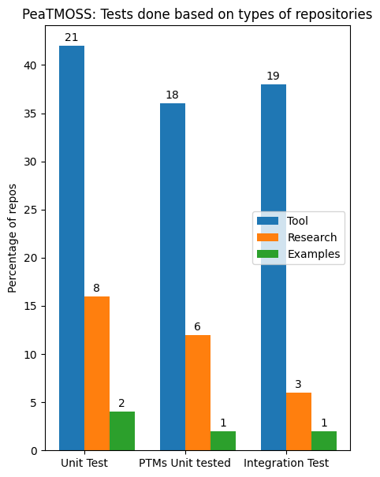
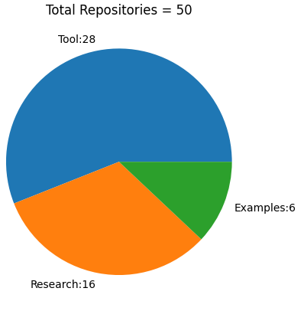
Results - Manual Analysis of Datasets
PeaTMOSS Dataset
Research repositories give less importance in maintaining a proper test suite.

Slide 6
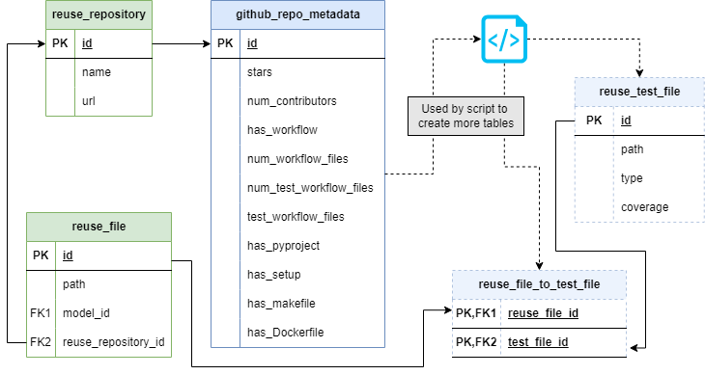
Results: Extension to PeaTMOSS
Existing
Done
Planned

Slide 7
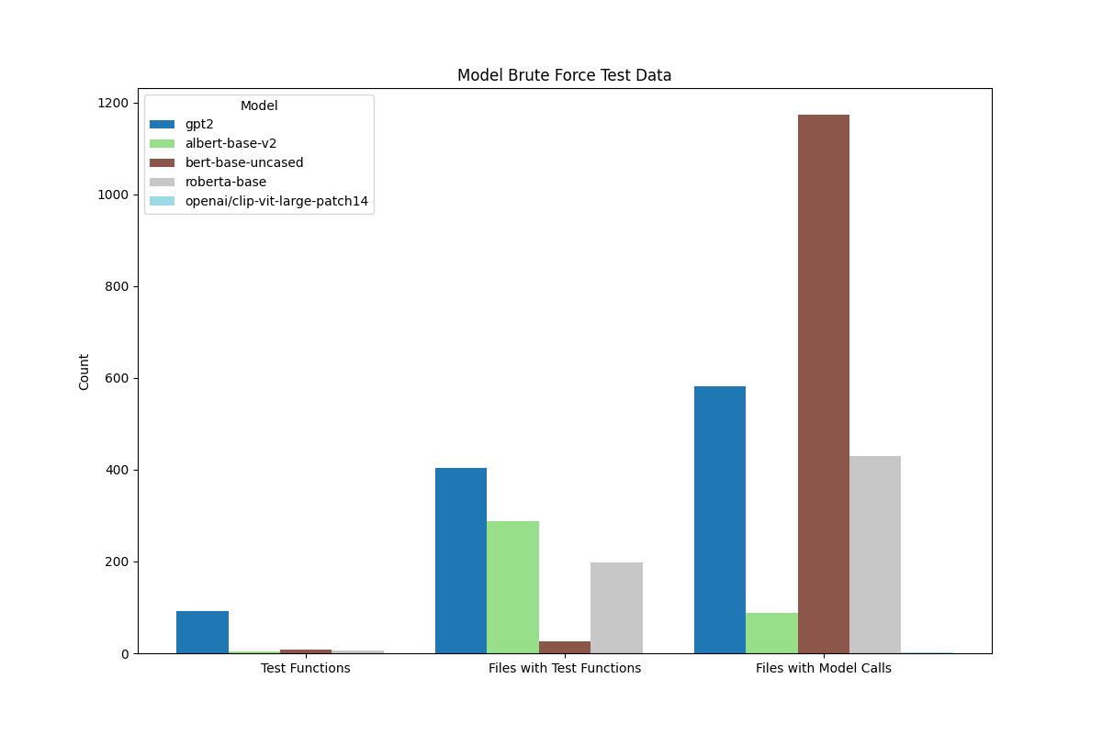
Results: Brute-Force Analysis
50 Repositories
5 Pre-Trained Models
Pre-Trained Models called in test functions or called directly without a function.
Frequency of files that call test functions and files that call PTM without a test function.
Developers often call models directly, bypassing the use of specific test functions.

Slide 8
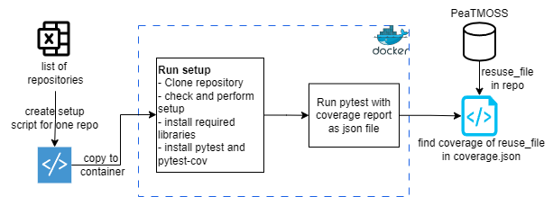
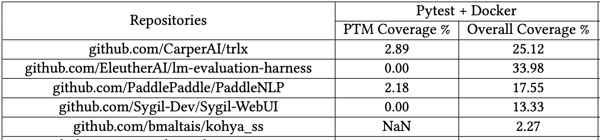
Results: Running Tests using Pytest in Docker
Result stats
Total repositories =50
Successfully setup = 34
28 repositories generated a test coverage report
13 out of 28 did not cover files using PTMs
There was a drastic difference between total coverage and coverage for PTM-files

Slide 9
Results: Running Tests using CI/CD Workflow Commands
Result Stats
Total repositories = 50
8 repositories generated test coverage report
5 out of 8 repositories did not cover files using PTMs
Advantages:
Has exact setup commands
Partially runnable, effective in small projects (1 or 2 workflows)
Can use 'act' tool, uses Docker
Limitations
Requires external API keys, environment variables or secrets
Compatibility issues, dependency version mismatches
Repositories | CI/CD Workflows
 | PTM Coverage % | Overall Coverage %
github.com/CarperAI/trlx | 3.02 | 13.25
github.com/hpcaitech/ColossalAI | 48.64 | 13.253
github.com/EleutherAI/gpt-neox | 10.46 | 2.79
github.com/huggingface/text-generation-inference | 0.0 | 43.74
github.com/microsoft/guidance | 0.0 | 23.82

Slide 10
Conclusion
OSS projects contain tests (more unit than integration/E2E tests)
Does not really test PTM features, low coverage
More tests in tool/product repositories than research/tutorial
Most tests on specific models
Text - 'gpt2', 'bert'
Vision - 'sdxl', 'openai/clip-vit-large-patch14'
Key Takeaways
Automating test pattern analysis is hard, requires complex setup
Can be improved using PeaTMOSS extension
PeaTMOSS
reuse_test_file

Slide 11
Thank you

