Slide 1

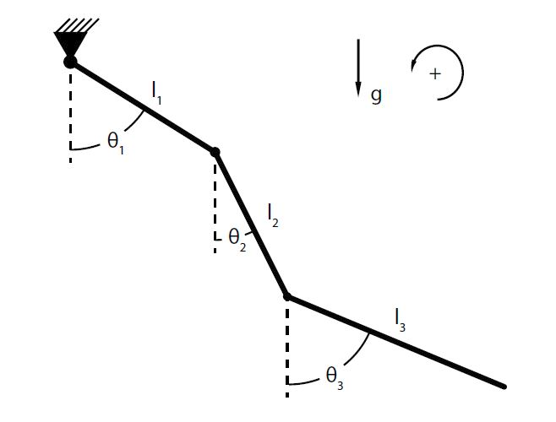
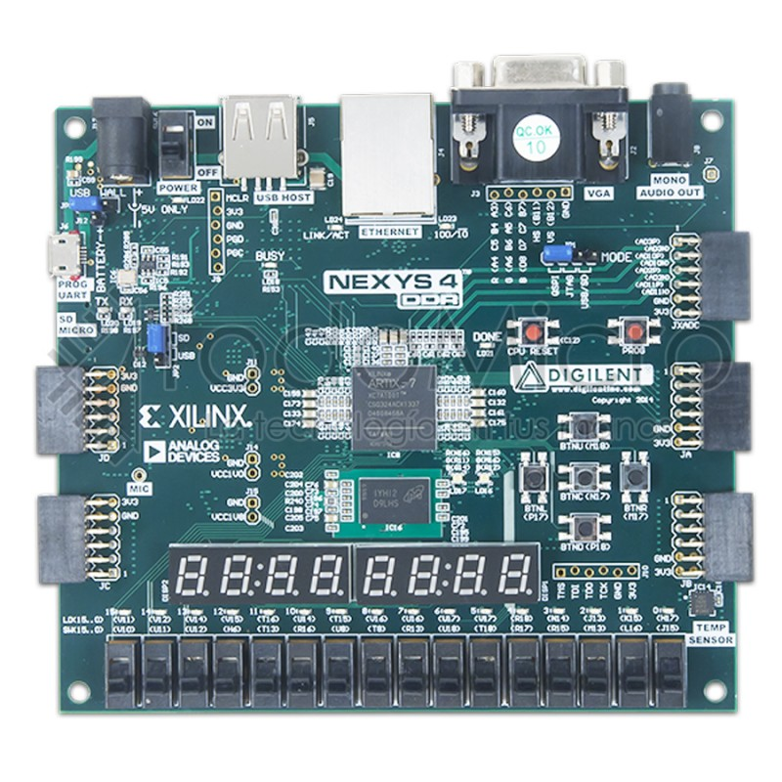
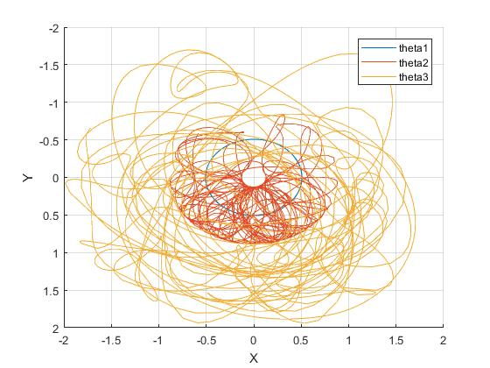
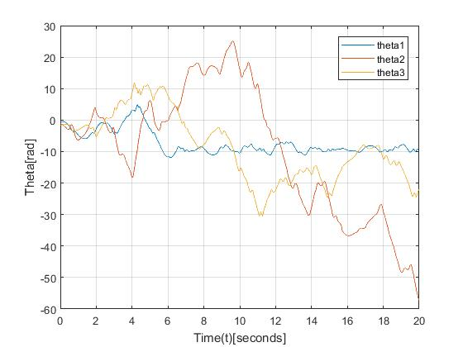
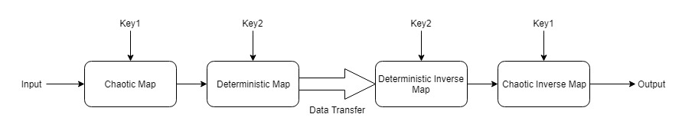
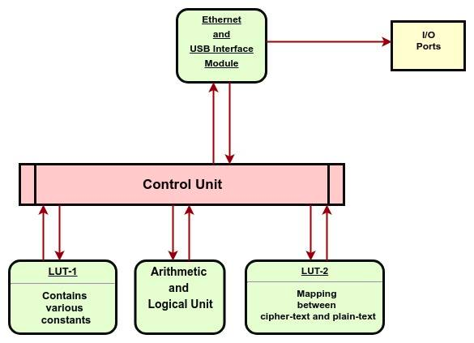
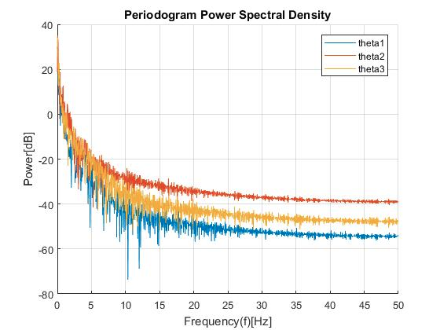
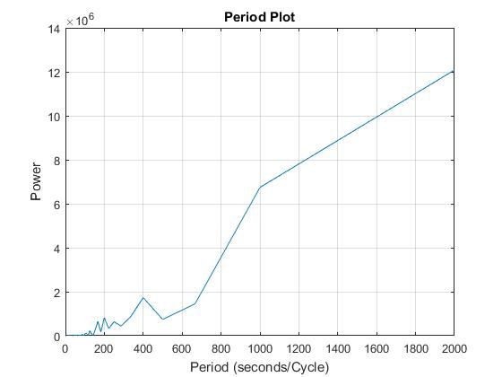
Design & Implementation of Quantum Computing
Immune Cryptography Processor
Abhishek Agrawal (150102002) Souradip Pal (150102076)
Department of Electronics and Electrical Engineering, Indian Institute of Technology Guwahati
Abstract: This project aims at designing a chaos-based cryptographic system that is immune against attacks by both quantum and classical computers. The encryption-decryption scheme proposed here is based on chaotic map generated from model of a non-linear dynamic system. Further, we present the FPGA implementation of the proposed method.
1. INTRODUCTION
4. WORK PROGRESS
Most of the present-day encryption algorithms are largely designed around a 'trap-door functions' which are problems with sufficient computational hardness.
Popular symmetric and asymmetric cryptosystems including RSA, ECC, DES, DiffieHellman etc. are based on the integer factorization problem and discrete logarithm problem.
These problems can be efficient solved using Quantum computer running Shor’s algorithm within reasonable time.
The proposed approach attempts to create a chaos-based cryptosystem which is resistant against such brute-force quantum computing attacks.
The aim is to design and implement the cryptosystem in dedicated hardware like FPGA and analyse its performance and security.
The simulation of multi-pendulum system is based on characteristics such as mass of the bars, moment of inertia, length and damping factors.
Basic hardware implementation was carried on the target device, Digilent Nexys4 board, having Xilinx Artix-7 FPGA.
Simulation of the system yields the chaotic map shown below. The periodogram plot of the motion shows the highly aperiodic nature of the system.
2. DESIGN
Necessary statistical analysis is performed for generation of valid keys.
The keys and the mapped values are stored in Loop Up Tables in the FPGA for fast encryption and decryption.
3. PROPOSED APPROACH
A multi-pendulum system is simulated in order to create a chaotic map for encryption and decryption.
A set of valid keys are to be generated for mapping the plain-text to cipher-text and revert back to clear-text.
The entire algorithm is implemented on FPGA and necessary optimizations are to be performed at hardware level to achieve computational efficiency.
Implement ALU with variable precision to enable the study of variation in the level of security based on precision.
USB and Ethernet modules are also to be implemented for interfacing with external devices.
5. CONCLUSION & FUTURE WORK
Through a number of simulations, we can conclude that this cryptosystem can provide the desired level of chaos and security.
Moreover, this cryptosystem also fulfils the basic requirements defined by Shannon including diffusion and confusion.
We plan to optimize the hardware implementation of the cryptosystem and measure the performance of the algorithm under various precision constraints and estimate the error rate.

