Slide 1

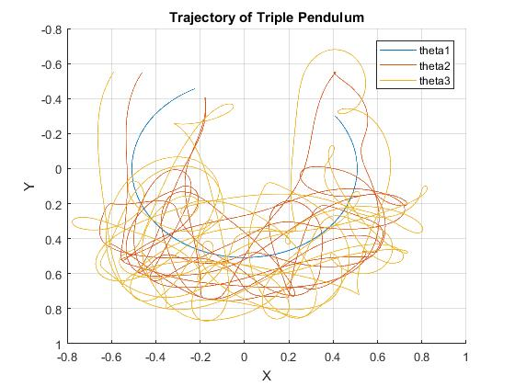
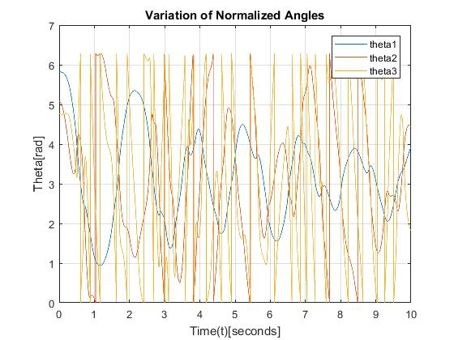
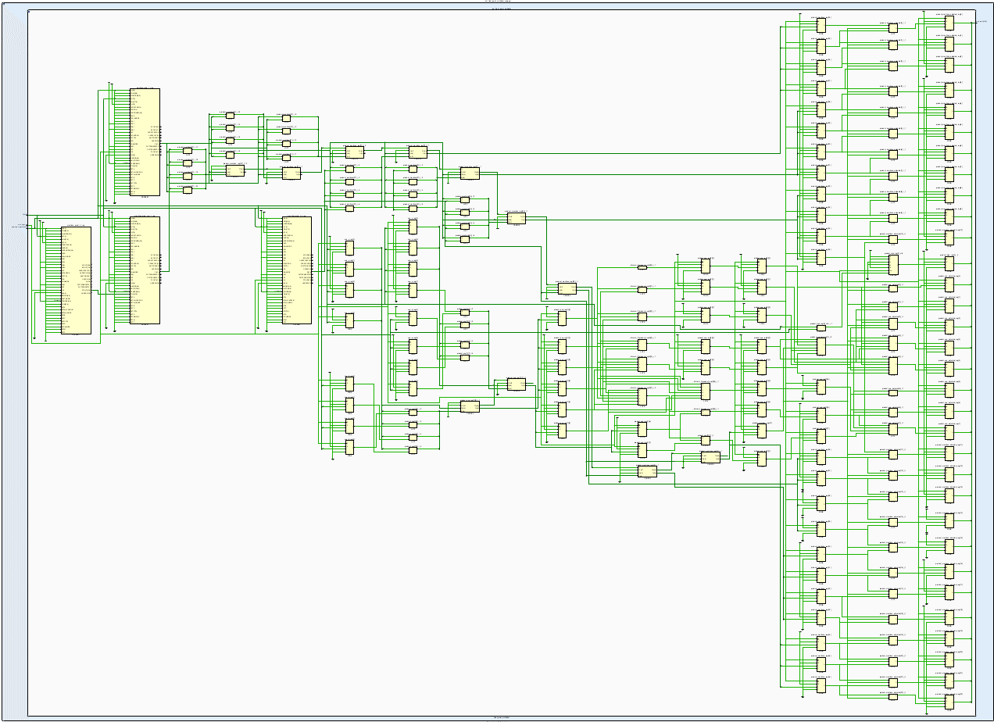
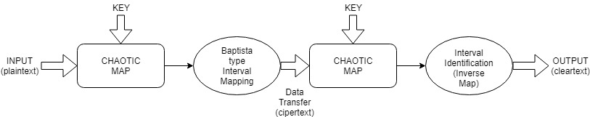
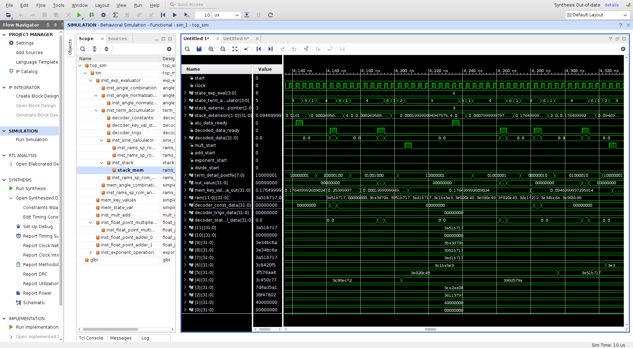
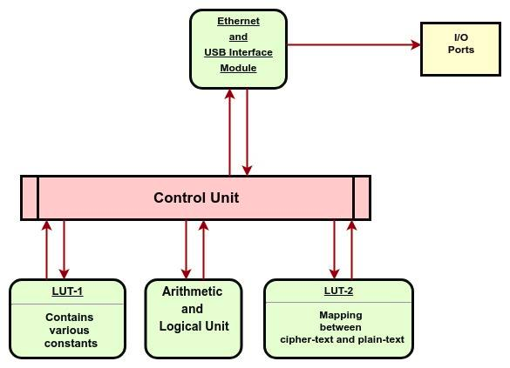
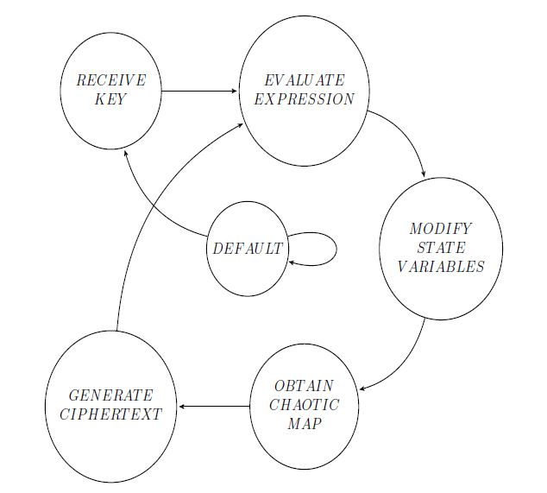
Design & Implementation of Quantum Computing
Immune Cryptography Processor
Abhishek Agrawal (150102002) Souradip Pal (150102076)
Department of Electronics and Electrical Engineering, Indian Institute of Technology Guwahati
Abstract: This project aims at designing a chaos-based cryptographic system that is immune against attacks by both quantum and classical computers. The encryption-decryption scheme proposed here is based on chaotic map generated from model of nonlinear dynamic system. Further, we present the hardware implementation of the proposed method on Artix FPGA platform.
1. INTRODUCTION
4. WORK PROGRESS
Most of the present-day encryption algorithms are largely designed around 'trap-door functions' which are problems with sufficient computational hardness like integer factorization, discrete logarithm problem etc.
These problems can be efficiently solved using a quantum computer running Shor's algorithm within reasonable time.
The proposed approach attempts to create a chaos-based cryptosystem which is resistant against such brute-force quantum computing attacks.
The aim is to design and implement the cryptosystem in dedicated hardware like FPGA and analyse its performance and security.
The simulation of multi-pendulum system was verified in MATLAB and a set of valid keys for generation of chaotic maps from the model were generated.
2. PROPOSED APPROACH
Necessary statistical analysis were performed for testing randomness of the chaotic map.
Hardware implementation was carried on the target device Digilent Nexys4 board having Xilinx Artix-7 FPGA.
Simulate a multi-pendulum system using state space method in order to generate a chaotic map.
Use Baptista-type interval partitioning of the map for encrypting plaintext into ciphertext and vice-versa.
Implement the encryption-decryption algorithm on FPGA and perform necessary optimizations at hardware level to achieve computational efficiency.
Implement ALU with variable precision to enable the study of variation in the level of security based on precision.
Generate and maintain a set of valid keys for the mapping.
Implemented USB and Ethernet modules for interfacing with external devices.
The keys and the mapped values were stored in LUTs in the FPGA for fast encryption and decryption.
Encryption & decryption modules were implemented and tested against the software simulations.
3. DESIGN
5. RESULTS & CONCLUSION
The data from the hardware simulation in Xilinx Vivado matched with that of the software simulations.
The algorithm can be extended for asymmetric key cryptosystems for usage in secure communication.
The hardware implementation can be further optimized by efficient caching of the values generated.
Through a number of analysis, we conclude that this cryptosystem can provide the desired level of chaos and security against quantum crypto-attacks.
ALU : It consists of addition, multiplication, division & exponentiation modules.
Control Unit : It consists of FSMs like postfix expression evaluator, state space value calculator, top-level FSM etc.
LUT : Stores state variable values and other constants.

