Slide 1

SURVEY ON REINFORCEMENT LEARNING VIA. SEQUENCE MODELING USING DECISION TRANSFORMER
ECE 59500RL FINAL PROJECT
SOURADIP PAL
NEELESH GOPALAKRISHNAN

Slide 2
Introduction
Background
Traditional RL maximizes discounted cumulative rewards; recent methods directly predict actions based on trajectory distribution
Offline RL problems can be viewed as sequence modeling problems and solved by supervised learning methods
Transformers are applied in RL due to their ability to predict actions and model sequences, leveraging self-attention for effective long-term credit assignment
Offline RL focuses on learning from static datasets without direct environment interaction
Offline RL with Online Finetuning enhances policy performance by fine-tuning pre-trained models via online interactions

Slide 3
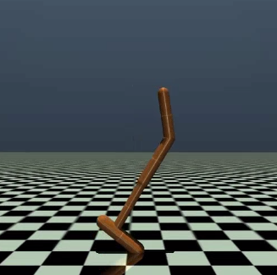
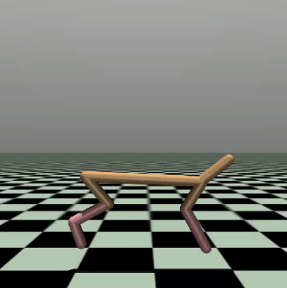
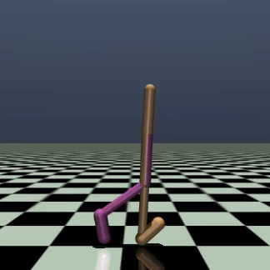
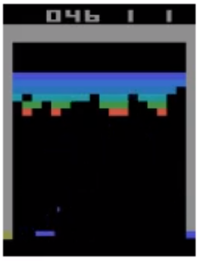
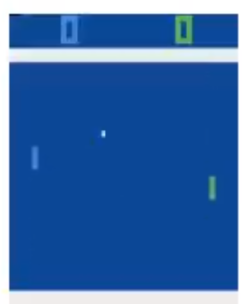
Problem Statement
Study and Compare RL methods using Decision Transformer
Understand the use of Transformer architecture in sequence modeling-based RL formulation
Compare the return variance observed in the online and offline settings for locomotion tasks like Hopper, HalfCheetah, Walker2D
Determine the effect of context length on the return variance for different environments
Extend Online Decision Transformer to Atari games for comparison
Hopper
Half Cheetah
Walker2D
Breakout
Pong
Image: Credit to Open AI

Slide 4
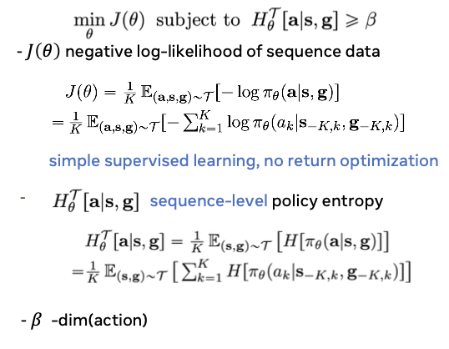
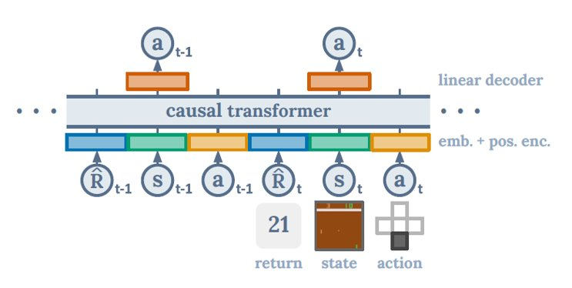
Algorithms
Decision Transformer
Online Decision Transformer
Model free approach, employs deterministic policy
Generates return-conditioned policies
Learns from a fixed dataset without environment interactions
Leverages Transformer to predict the next best action autoregressively
Employs stochastic policy
Efficient log-likelihood maximization via. Max-Entropy sequence modeling
Combines offline pretraining with online finetuning for stable learning
Uses observed return instead of target return - hindsight return relabeling
Image: Credit to Chen et al. and Zheng et al.

Slide 5
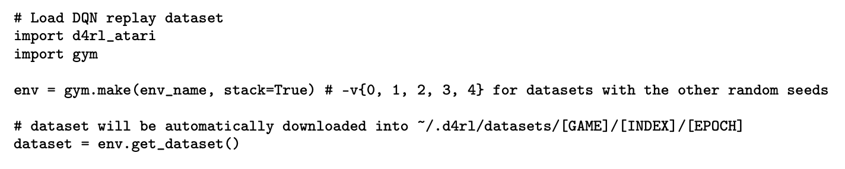
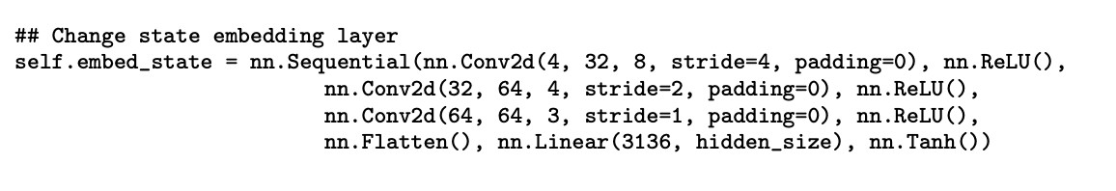
Experiments
Experimented with pre-trained models, varied context length & compared between offline and online approach
Used HuggingFace pretrained models for evaluation
Experimented on D4RL dataset for OpenAI Gym environments and DQN Replay dataset for Atari games
Trained models by varying context length and observed variance
Evaluated GPT2 model using ODT on Gym environments
Modified architecture to run ODT on Atari games
Compared return variance based on DT and ODT results

Slide 6
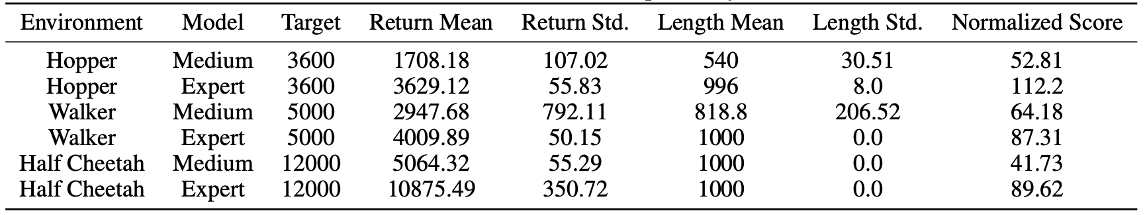
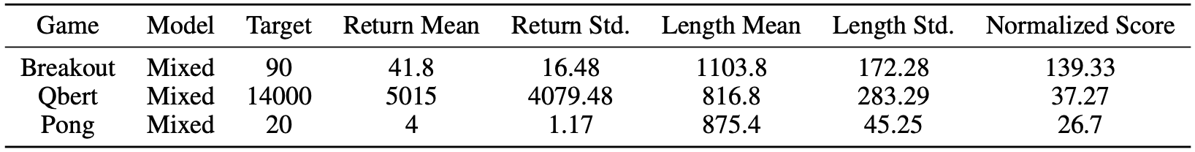
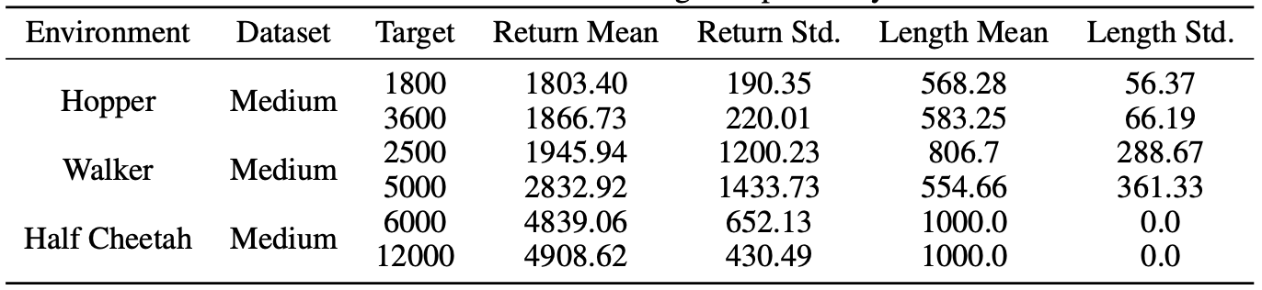
Results - DT
Experiments done with Offline Decision Transformer
Pretrained Model evaluation on Gym environments
Pretrained Model evaluation on Atari games
DT model training and evaluation on Gym environments

Slide 7
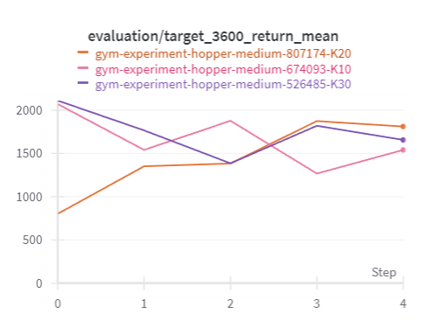
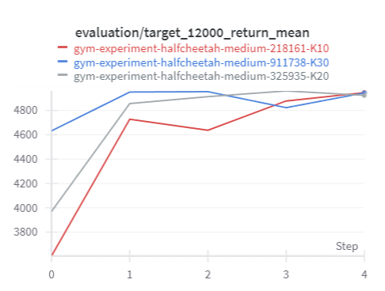
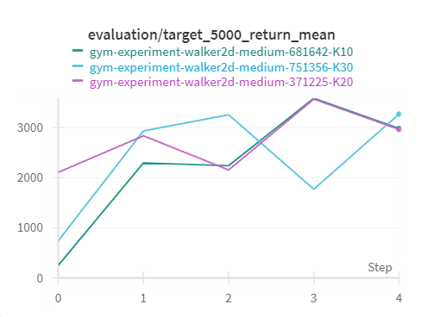
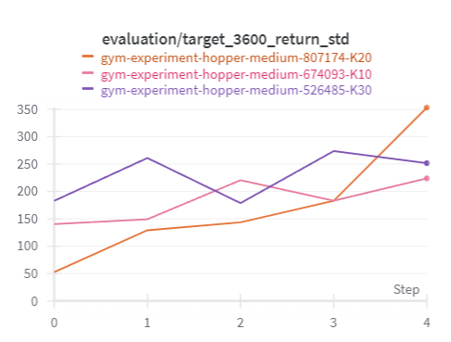
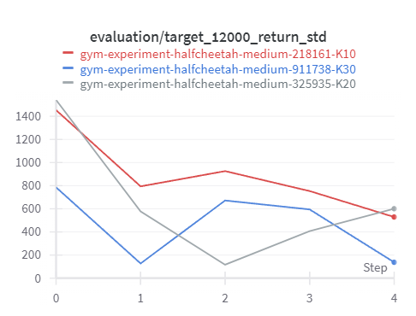
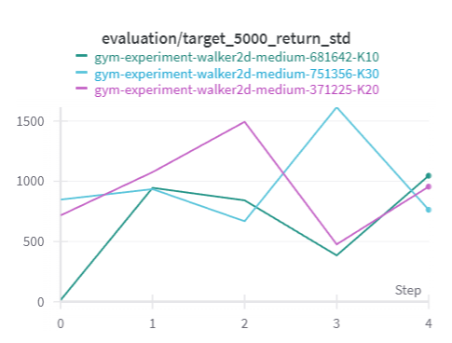
DT - Variation of Return Mean and Std. With Context Length K (10, 20, 30)
Return Mean
Return Std.
Hopper
Half Cheetah
Walker2D

Slide 8
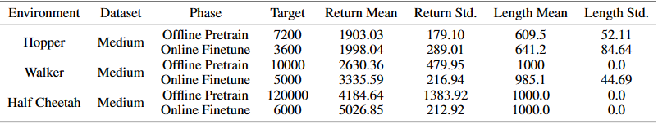
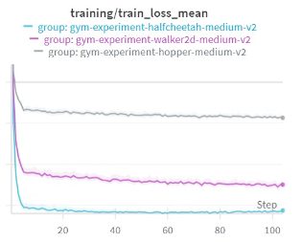
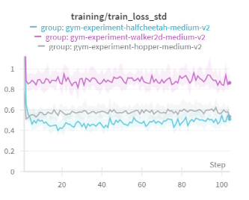
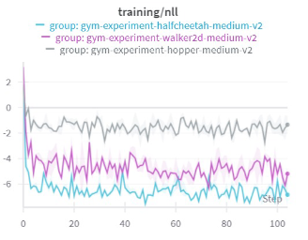
Results - ODT
Experiments done with Online Decision Transformer
Online Decision Transformer Training on OpenAI Gym Environments

Slide 9
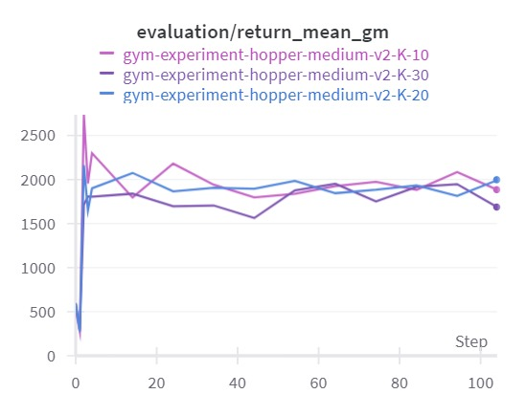
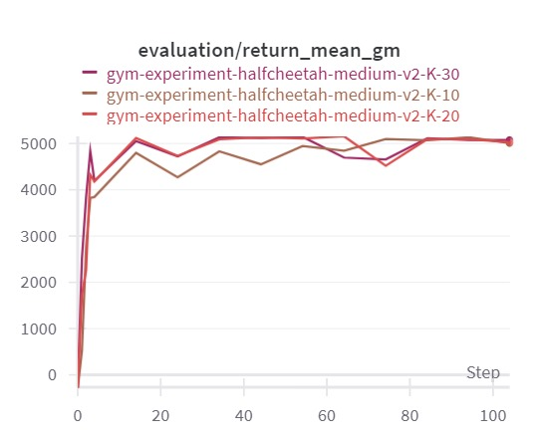
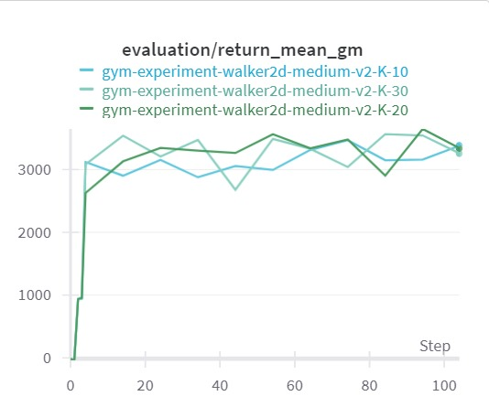
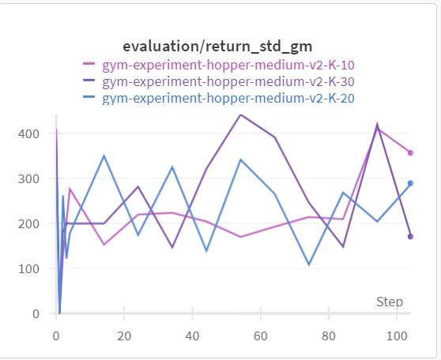
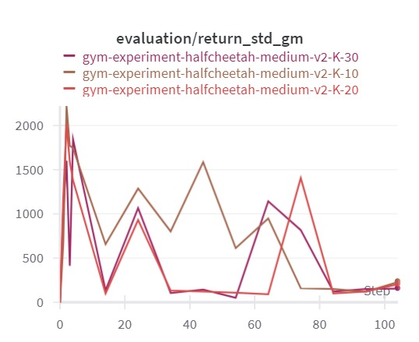
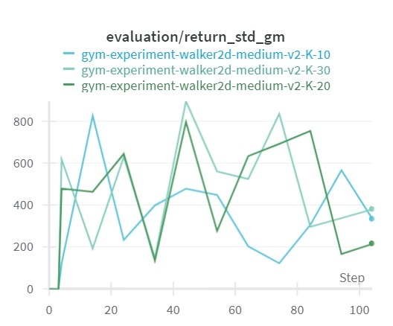
ODT - Variation of Return Mean and Std. With Context Length K (10, 20, 30)
Return Mean
Return Std.
Hopper
Half Cheetah
Walker2D

Slide 10
Conclusion
RL via. Sequence Modeling is effective
Transformers can become highly useful in modeling RL problems
No need for value function or policy gradient, directly predict actions
Returns-to-Go conditioning helps in guiding the agent
Online fine-tuning with policy constraint improves stability

Slide 11
Future Work
Improvements on top of the current work
Can be tested using other transformer architectures like BERT
Vary context length for Atari games and observe the return variance
Change embedding dimension and non-linear activation function used
Modifications may be included into original codebase for Atari games
Can be trained using more GPU resources using multiple random seeds

Slide 12
Thank You
References
https://sites.google.com/berkeley.edu/decision-transformer
https://github.com/kzl/decision-transformer
https://github.com/facebookresearch/online-dt
https://huggingface.co/docs/transformers/model_doc/decision_transformer
https://huggingface.co/blog/decision-transformers

