Slide 1

HR Data - Analysis Dashboard
Talend Data Analyst Team

Slide 2

Agenda of Dashboard Analysis
Understand, Assess and help the management team have the overall insight of the company’s employees.
Providing corrective measures to overcome challenges faced by the HR department.

Slide 3
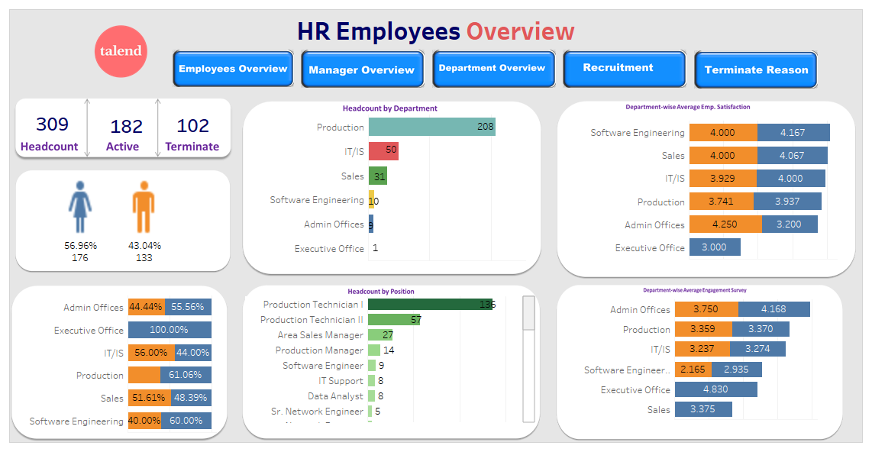

COMPANY OUTLOOK
196

Slide 4
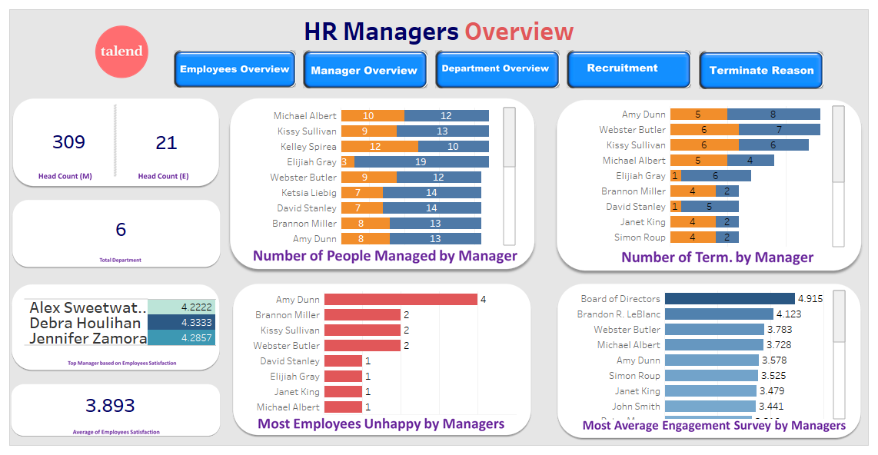
COMPANY OUTLOOK
196

Slide 5
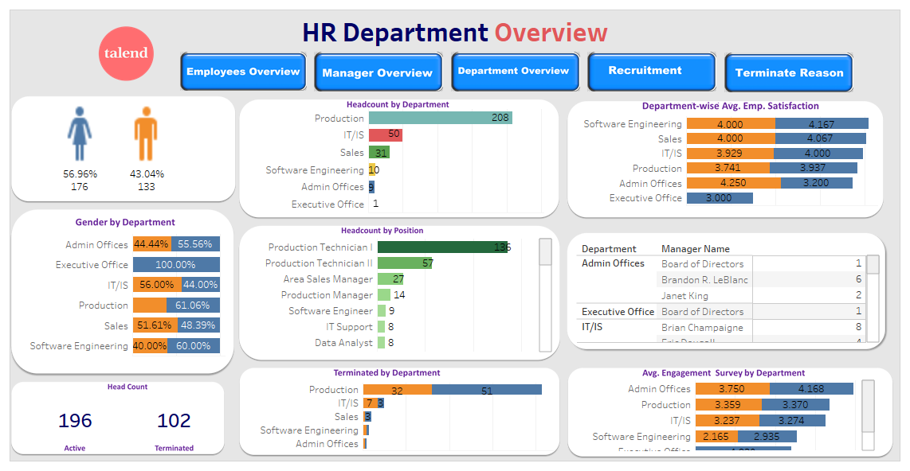
COMPANY OUTLOOK

Slide 6
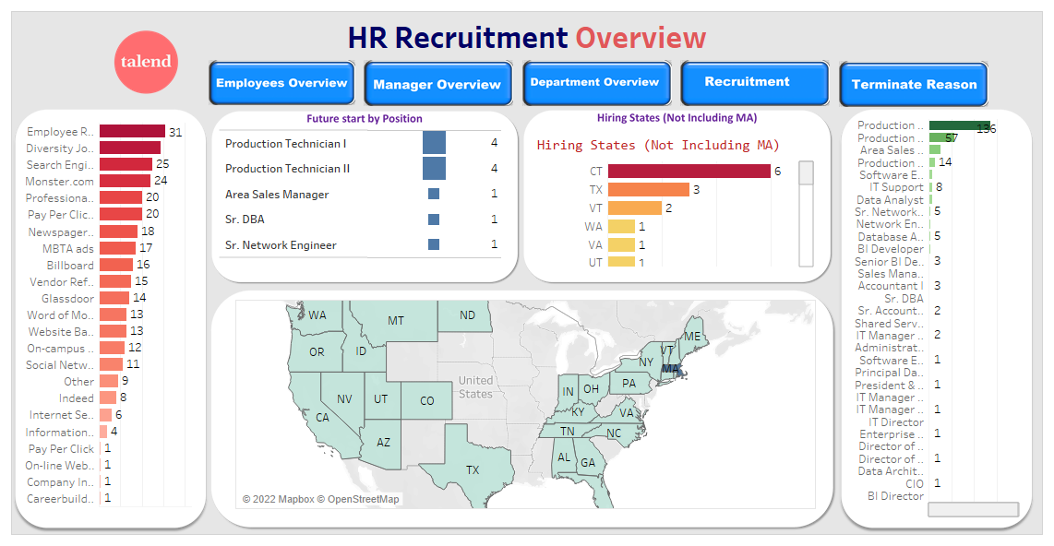
COMPANY OUTLOOK

Slide 7
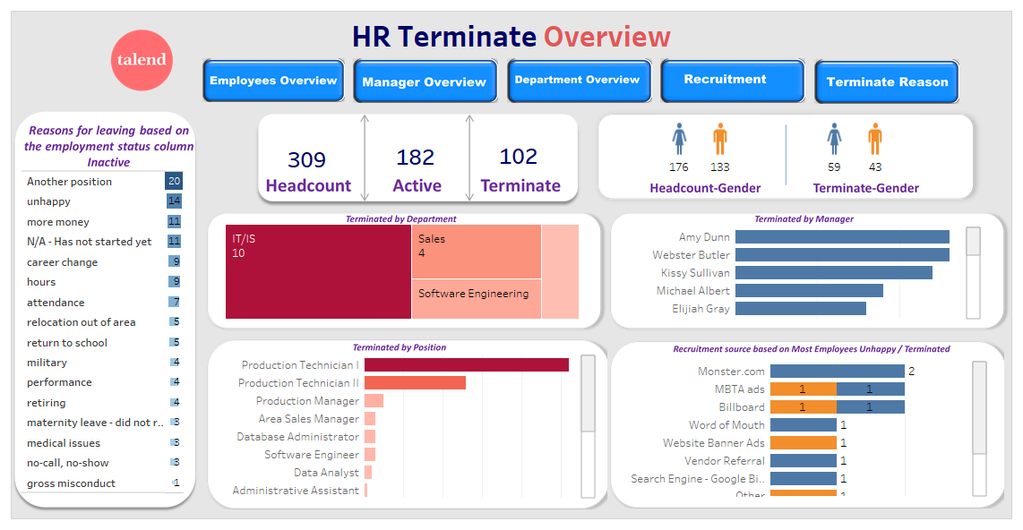
COMPANY OUTLOOK

Slide 8
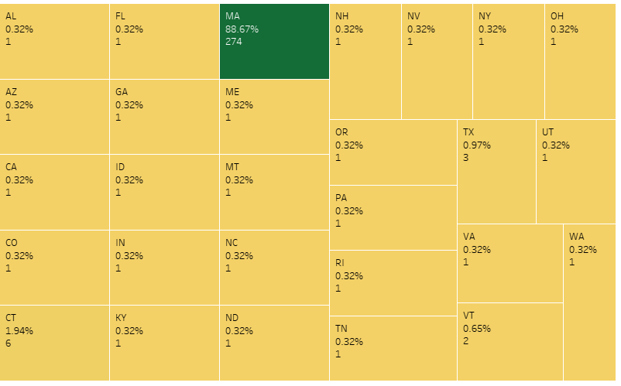
Insight of the company’s employees.
What states do most of our employees reside?
As we can see in the analysis that most of the employees comes from city MA. It’s 88.67% of overall.
1.94% of employees comes from CT. which is second highest.

Slide 9
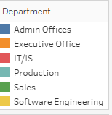
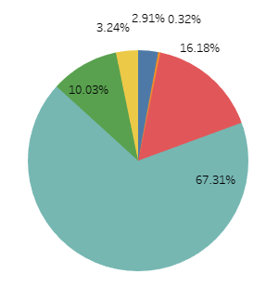
Insight of the company’s employees.
What is the organizational structure by position?
65.31% of company’s staffed by 'Production’.
16.18% of company’s staffed by IT/IS.
10% of company’s staffed by Sales.
3.24% of company’s staffed by Software Engineering.
3% of company’s staffed by ‘Admin office & Executive Office’.

Slide 10
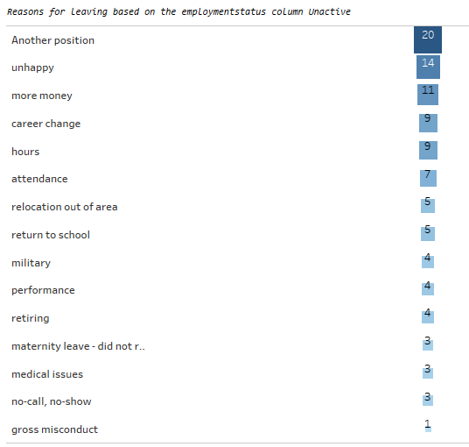
Insight of the company’s employees.
What are the top reasons employees leave?
The top reasons employees leave are for another position, unhappiness, and for more money.
There is also a high churn rate under the Production department.

Slide 11

THANK YOU!

