Slide 1
Supervised Machine Learning:
Classification
Dr. Sourasekhar Banerjee (Ph.D.)

Slide 2
Intended Learning Outcomes
Understand the meaning of classification
Understand and use two types of classifiers to predict the class of previously unseen records (instance-based and model-based classifiers)
  We mostly focus on how to use them in your research and work
Explain the role of training and test data
Understand and apply the main classifier evaluation measures

Slide 3
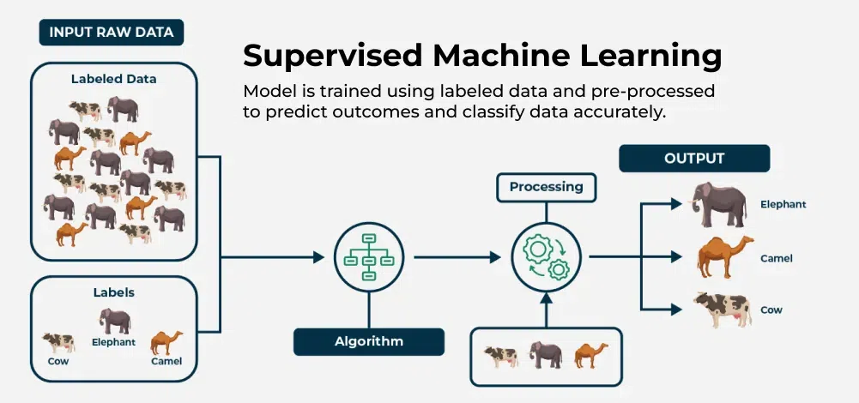
Introduction

Slide 4
Classification Methods
Instance-Based
  Often used when you want a simple method, have moderate-size data, and can handle slower prediction.
  Example: K-NN
Model-Based
  Preferred for larger-scale or more complex tasks where you want faster predictions and a generalized pattern learned from the data.
  Example Decision Tree

Slide 5
Instance based Classification
ID Sepal.L Sepal.W Petal.L Petal.W Species
2 4.9 3.0 1.4 0.2 setosa
6 5.4 3.9 1.7 0.4 setosa
12 4.8 3.4 1.6 0.2 setosa
22 5.1 3.7 1.5 0.4 virginica
32 5.4 3.4 1.5 0.4 setosa
50 5.0 3.3 1.4 0.2 setosa
51 7.0 3.2 4.7 1.4 versicolor
52 6.4 3.2 4.5 1.5 versicolor
71 5.9 3.2 4.8 1.8 versicolor
97 5.7 2.9 4.2 1.3 versicolor
Comparison
Class
152 6.0 2.3 5.0 1.6 ?
Notes:
Instance-Based Classifiers
Key Idea: They typically store (or remember) all or most of the training data.
No Explicit Model Training: Instead of creating a condensed “model” in a separate training phase, they defer most of the work until prediction time (hence “lazy learning”).
Prediction Mechanism:
When a new instance (test example) arrives, these algorithms compute similarity (e.g., distance) between the new instance and the stored training examples.
They then use the closest or most relevant instances (neighbors) to determine the class label or value.
Examples:
k-Nearest Neighbors (k-NN): Finds the k closest points (neighbors) in the training set and uses majority vote (classification) or average (regression).
Kernel Methods (in some contexts) that keep the data points around for local comparisons.
Pros & Cons:
Pros: Simple to implement, can adapt quickly to changes in data.
Cons: Requires storing much (or all) of the dataset, can be slow at prediction time, sensitive to noise and irrelevant features.

Slide 6
Model based Classification
ID Sepal.L Sepal.W Petal.L Petal.W Species
2 4.9 3.0 1.4 0.2 setosa
6 5.4 3.9 1.7 0.4 setosa
12 4.8 3.4 1.6 0.2 setosa
22 5.1 3.7 1.5 0.4 virginica
32 5.4 3.4 1.5 0.4 setosa
50 5.0 3.3 1.4 0.2 setosa
51 7.0 3.2 4.7 1.4 versicolor
52 6.4 3.2 4.5 1.5 versicolor
71 5.9 3.2 4.8 1.8 versicolor
97 5.7 2.9 4.2 1.3 versicolor
Model
Learn
Class
152 6.0 2.3 5.0 1.6 ?
Notes:
Key Idea: They create a generalized model (set of parameters or rules) from the training data.
Training Phase: Also called “eager learning” because they spend time up front learning a function or structure that represents the data.
Prediction Mechanism:
Once trained, they apply the learned model parameters (or decision rules) to new instances without needing the entire training set.
Prediction is usually faster than in instance-based methods, because the model is a compressed representation of patterns learned from the data.
Examples:
Logistic Regression or Linear Regression (weights learned).
Decision Trees / Random Forests (splitting rules, tree structures).
Support Vector Machines (support vectors and learned hyperplane).
Neural Networks (learned weights across layers).
Pros & Cons:
Pros: Generally more efficient at prediction time, can handle large data, captures data patterns in a more compact form.
Cons: Requires a (sometimes expensive) training process, can be prone to model misspecification, might not adapt instantly to new data unless retrained.

Slide 7
K-Nearest Neighbours (K-NN)
A non-parametric, instance-based (or “lazy”) learning algorithm
Used for both classification and regression tasks
Key Concept
  No explicit model training;
  the algorithm makes predictions based on the proximity of training examples

Slide 8
Algorithm
Step 1: Data Preparation
  Normalize or scale features to ensure fair distance calculations
  Handle missing data appropriately
Step 2: Add a query point
Step 3: Compute Distance
  Calculate distances between the query point and all training points
Step 4: Identify Neighbors
  Sort distances and select the top K closest points
Step 5: Make a Prediction
  Classification: Use majority vote among neighbors
  Regression: Compute the average (or weighted average) of neighbors’ values

Slide 9
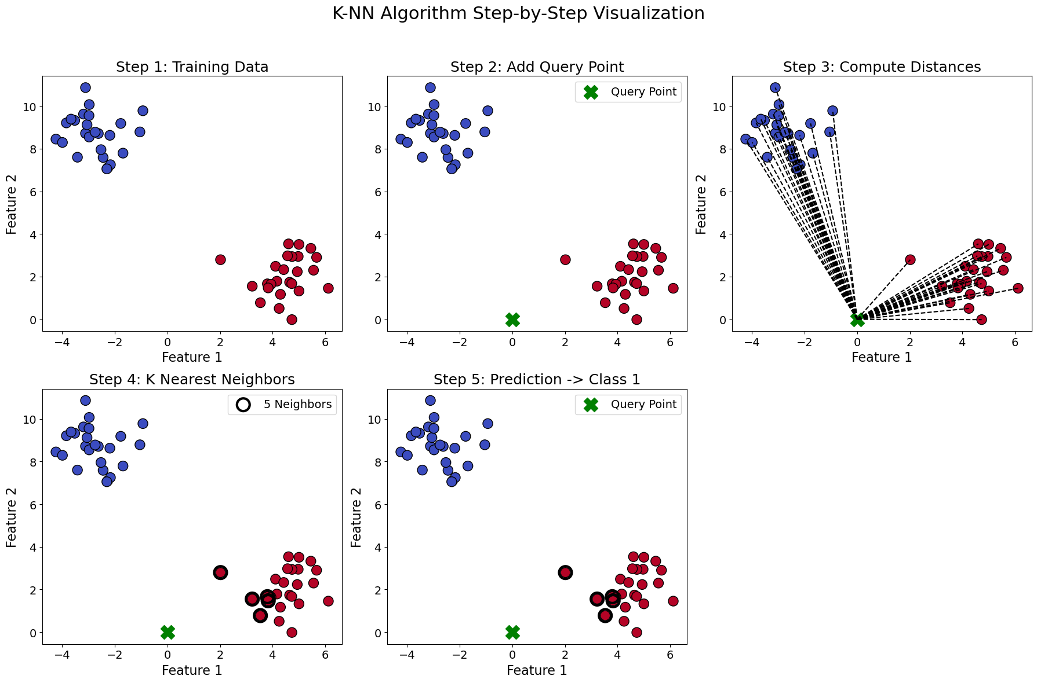
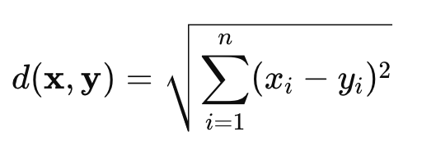
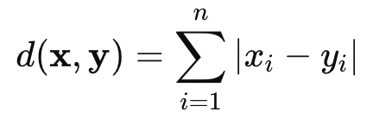
K-Nearest Neighbours (K-NN)
Distance Computation
Euclidean:
Manhattan:
The choice of metric affects the outcome, especially in high-dimensional data.

Slide 10
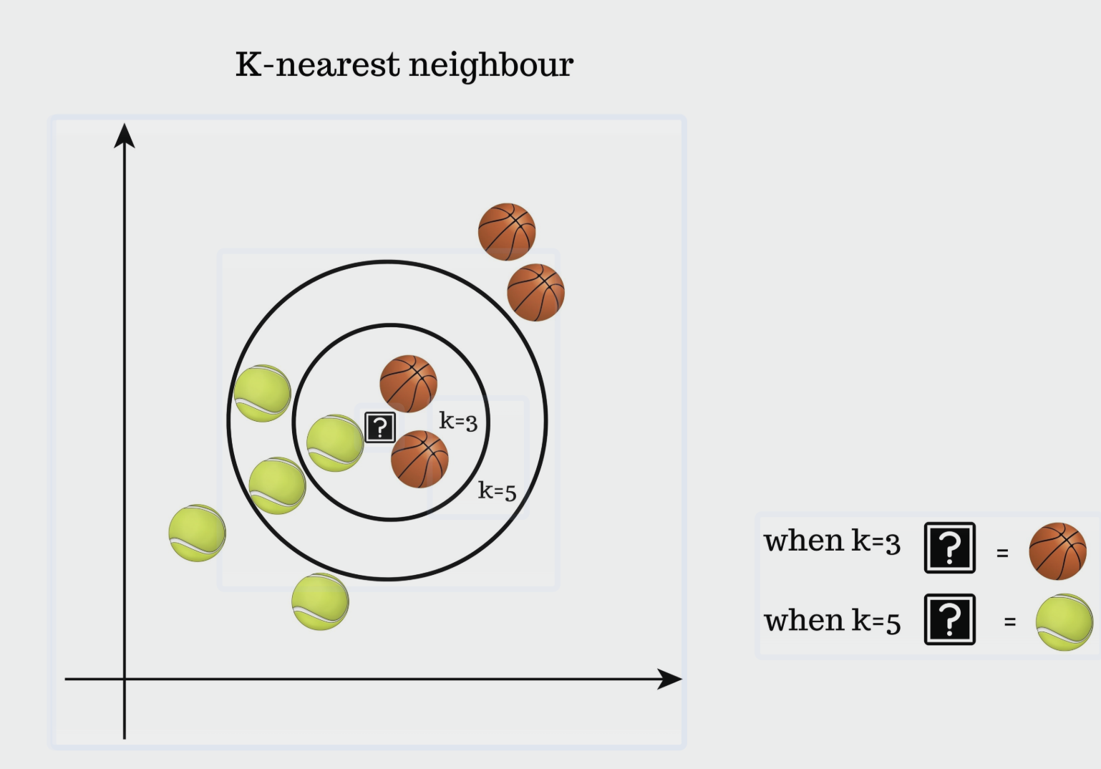
Problem (Value of k ?)?
Choosing the Right K
  Small K Values: Can capture local structure but may be sensitive to noise (high variance)
  Large K Values: Provide smoother decision boundaries but risk ignoring local detail (high bias)

Slide 11
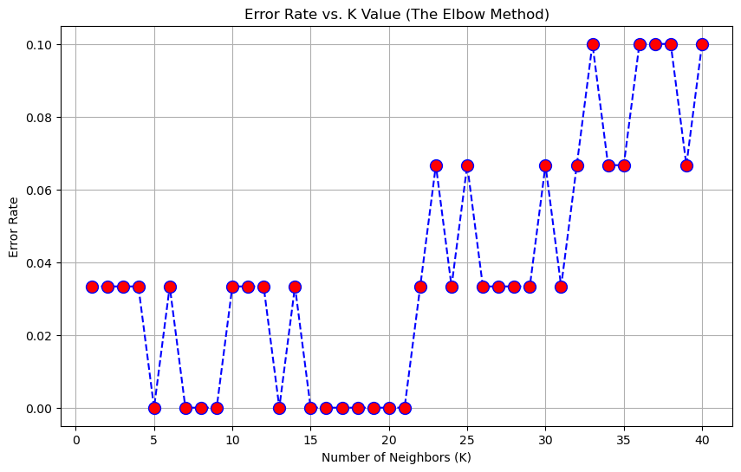
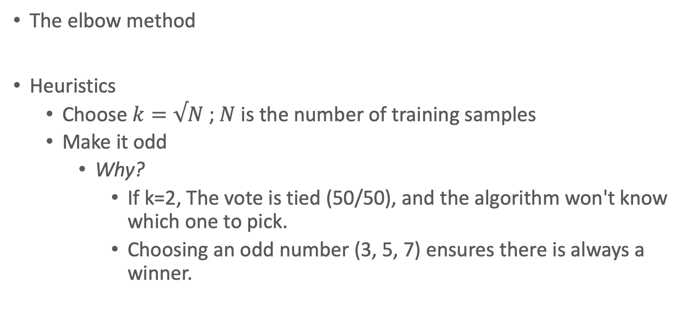
Value of K?
The elbow method
Heuristics
  Choose $k=√N$ ; $N$ is the number of training samples
  Make it odd
    Why?
      If k=2, The vote is tied (50/50), and the algorithm won't know which one to pick.
      Choosing an odd number (3, 5, 7) ensures there is always a winner.

Slide 12
K-Nearest Neighbours (K-NN)
Making Predictions
  Majority vote among K nearest neighbors determines the class of the query point
  Neighbors closer to the query point have higher influence on the prediction (Weighted K-NN)

Slide 13
Quiz 1
Scenario: You are classifying batteries using two features:
  Cycle Count: Ranges from 0 to 5,000.
  Voltage Difference: Ranges from 0.01 to 0.05 Volts.
You use the standard Euclidean distance without modifying the data.

Slide 14
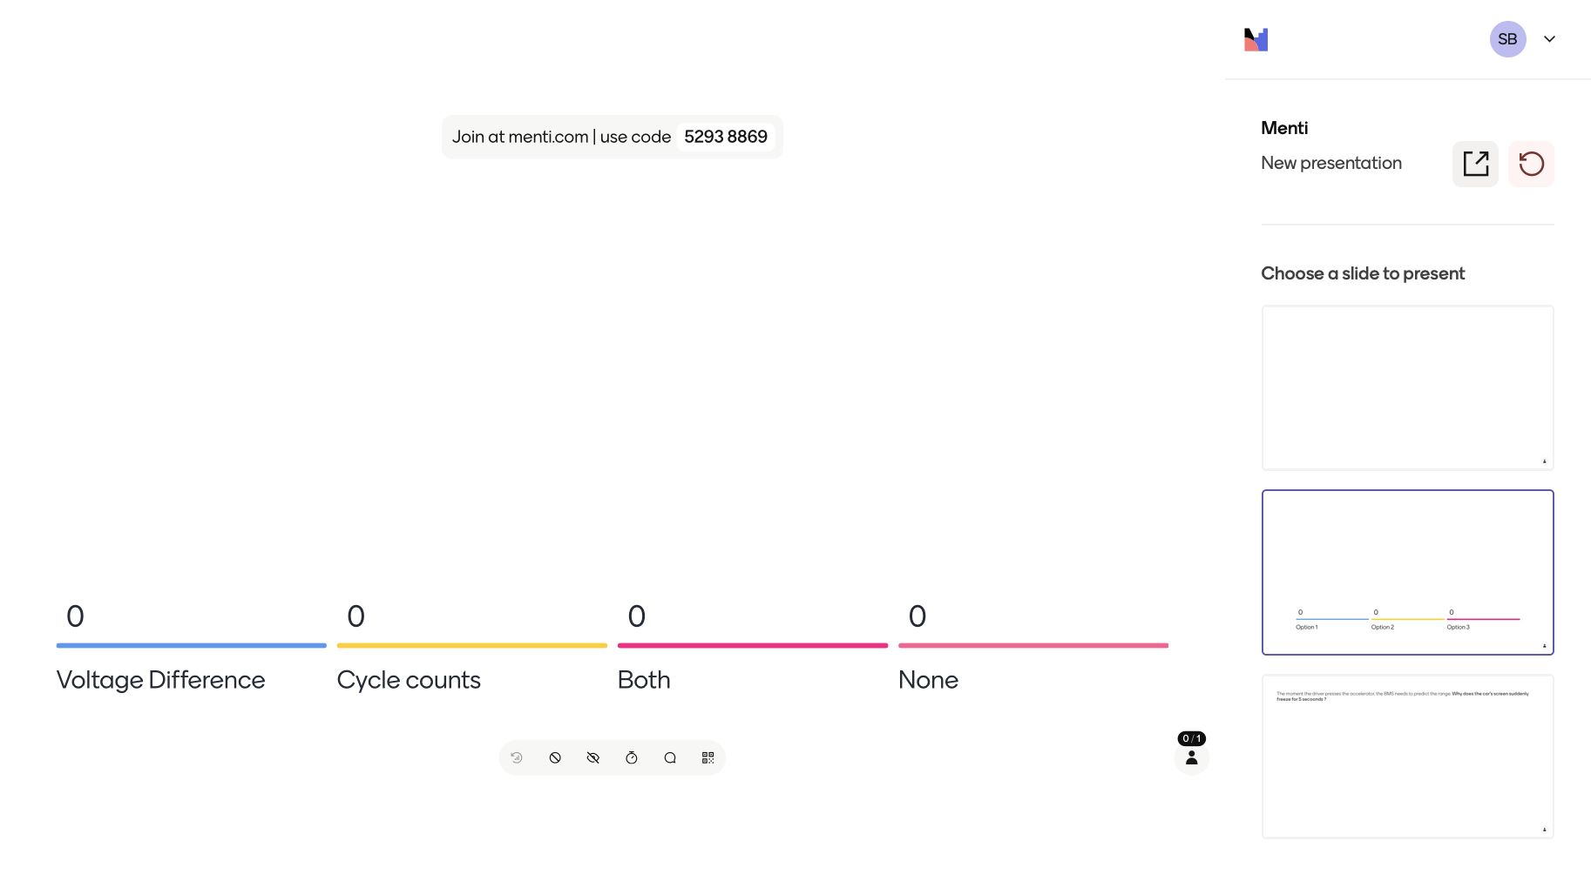
Quiz 1
Scenario
  You have deployed a k-NN system for a self-driving car to detect obstacles. The system works fine in the lab with 1,000 training examples. Before launch, your boss says, "Accuracy is good, but let's make it perfect. I've collected 10 million more training examples. Add them all to the system.”
The Question
  Does adding this massive amount of data make the prediction speed (inference time) faster, slower, or stay the same?

Slide 15
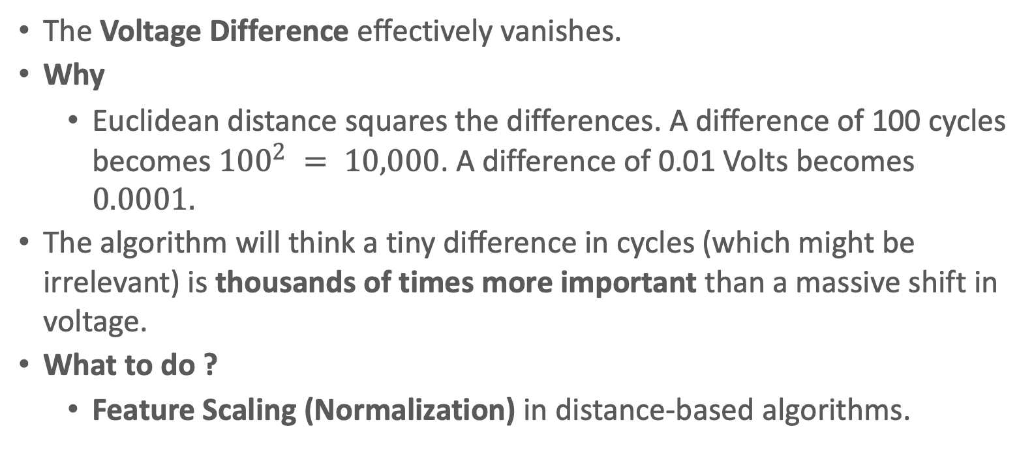
Answer
The Voltage Difference effectively vanishes.
Why
  Euclidean distance squares the differences. A difference of 100 cycles becomes ${100}^{2} = 10,000$. A difference of 0.01 Volts becomes $0.0001.$
The algorithm will think a tiny difference in cycles (which might be irrelevant) is thousands of times more important than a massive shift in voltage.
What to do ?
  Feature Scaling (Normalization) in distance-based algorithms.

Slide 16
Quiz 2
Scenario: You write a k-NN code for an Electric Vehicle's Battery Management System (BMS). It runs on a small, low-power chip.
  Version 1: Uses 1,000 past driving logs to predict range. It works instantly but is less accurate.
  Version 2: You upload 10 million driving logs to "improve accuracy."
* Range: The remaining distance the vehicle can travel before the high-voltage battery is completely empty.

Slide 17
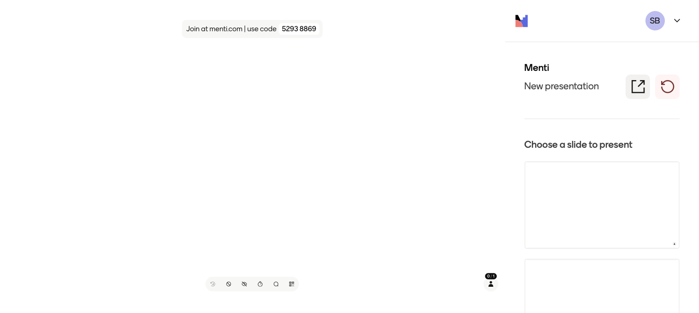

Slide 18
Hands-on

Slide 19
Advantage and disadvantage
Advantage | Disadvantage
1. Simplicity: Easy to understand and implement | 1. Computational Cost: Requires calculating the distance to every training point, which is expensive for large datasets.
2. No Training Phase: Makes it adaptive; new data can be added without retraining. | 2. Memory Intensive: Stores all training data, leading to high memory usage.
3. Versatility: Applicable to both classification and regression problems. | 3. Curse of Dimensionality: Performance degrades as the number of features increases; distances become less meaningful.
4. Naturally Handles Multi-class Problems: Works out-of-the-box for problems with more than two classes. | 4. Sensitivity to Noise and Irrelevant Features: Noisy data or features with different scales can negatively impact performance.
5. Flexible with Distance Metrics: Can be tailored to the problem by choosing different distance functions. | 5. Parameter Tuning: The choice of K (number of neighbors) significantly affects the outcome and requires careful tuning, often via cross-validation

Slide 20
Decision Trees
A Decision Tree is a supervised learning method that splits data recursively based on feature values to predict a target variable (either categorical for classification or numerical for regression).
Structure
  Root Node: The top of the tree containing all training instances.
  Decision/Internal Nodes: Each node splits the data into subsets based on a condition (e.g., “Temperature > 30°C?”).
  Leaf Nodes: Terminal nodes that give the final outcome/class (e.g., “Good” battery vs. “Needs Replacement”) or a predicted value.
Types of Decision Trees
  Classification Trees: The target is categorical (e.g., “Yes/No”, “Good/Needs Replacement”).
  Regression Trees: The target is numerical (e.g., battery lifetime in hours).

Slide 21
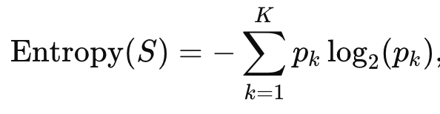
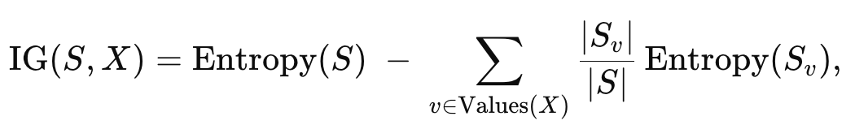
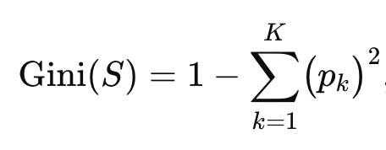
Decision Trees
ID3 (Iterative Dichotomiser 3): is a greedy algorithm for constructing classification decision trees using Information Gain (based on Entropy) as its splitting criterion.
CART (Classification and Regression Tree): Use Gini impurity as a splitting criteria
Notes:
The ID3 (Iterative Dichotomiser 3) algorithm is the "grandfather" of modern decision tree algorithms. Developed by Ross Quinlan in 1986, it’s a greedy approach used to create a decision tree by training on a dataset and finding the most efficient way to classify data points.
1. Entropy (The Messiness Factor)
Entropy measures the amount of uncertainty or "randomness" in your data.
If a group is pure (all members are the same class), Entropy is 0.
If a group is a 50/50 mix, Entropy is at its maximum (1).
The Probability Problem
In the formula, p_i represents the probability of a class, which is always a fraction between 0 and 1 (e.g., 0.5 or 0.25).
When you take the logarithm of a fraction, the result is always negative.
log_2(0.5) = -1
log_2(0.25) = -2
If we didn't have that negative sign at the front of the formula, our final Entropy calculation would be a negative number (e.g., -0.94).
In mathematics and information theory, we want "uncertainty" to be represented as a positive amount of "bits."
Entropy is the "messiness" of your data, you can think of Information Gain (IG) as the "Cleanliness Score."
Information Gain tells you how much a specific feature (like "Outlook" or "Windy") reduces the messiness in your dataset. The more it reduces entropy, the better that feature is at organizing your data

Slide 22
Algorithm
Start with all training instances at the root node.
Compute the current dataset’s entropy. If it’s pure (all instances share the same label) or if no features remain, stop and make a leaf node.
For each feature, calculate how much it reduces entropy (Information Gain).Pick the feature with the highest Information Gain to split on.
Create branches for each distinct value of that feature.
Recurse: Move down to each child node, apply the same logic until the dataset is perfectly classified or no features remain.

Slide 23
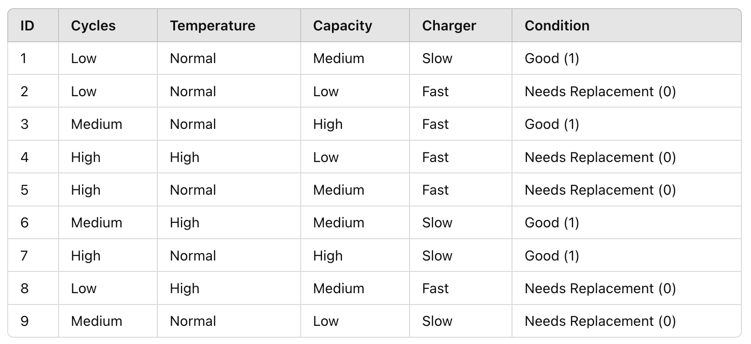
Example
Labels
  Good = 1
  Needs Replacement = 0
Condition Totals
  Good: IDs 1, 3, 6, 7 → 4 batteries
  Needs Replacement: IDs 2, 4, 5, 8, 9 → 5 batteries
Total: 9 batteries

Slide 24
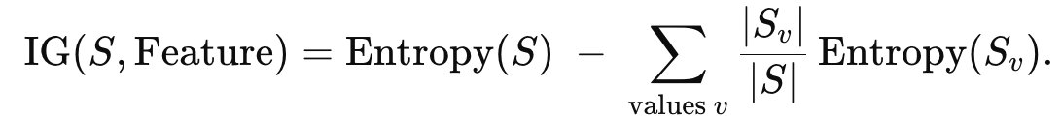
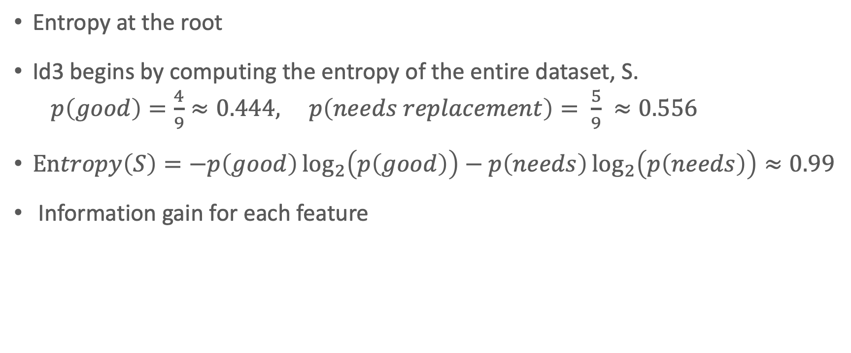
Example
Entropy at the root
Id3 begins by computing the entropy of the entire dataset, S.
  $p\left(good\right)=\frac{4}{9}≈0.444, p\left(needs replacement\right)= \frac{5}{9} ≈0.556$
$Entropy\left(S\right)=−p\left(good\right)\log_{2}\left(p\left(good\right)\right)−p\left(needs\right)\log_{2}\left(p\left(needs\right)\right)≈0.99$
Information gain for each feature

Slide 25
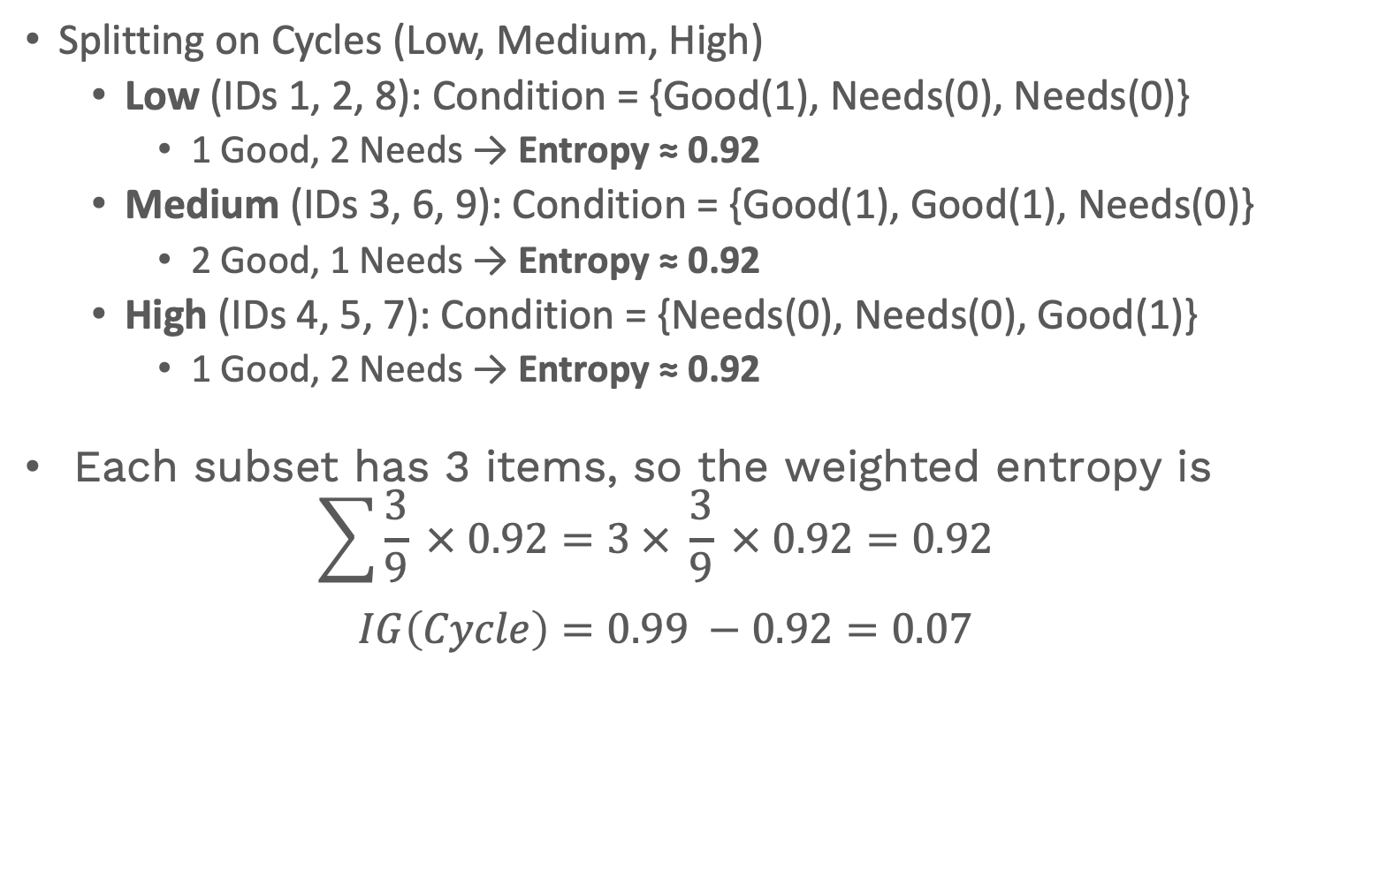
Example
Splitting on Cycles (Low, Medium, High)
  Low (IDs 1, 2, 8): Condition = {Good(1), Needs(0), Needs(0)}
    1 Good, 2 Needs → Entropy ≈ 0.92
  Medium (IDs 3, 6, 9): Condition = {Good(1), Good(1), Needs(0)}
    2 Good, 1 Needs → Entropy ≈ 0.92
  High (IDs 4, 5, 7): Condition = {Needs(0), Needs(0), Good(1)}
    1 Good, 2 Needs → Entropy ≈ 0.92
Each subset has 3 items, so the weighted entropy is
  $$\sum{\frac{3}{9} × 0.92=3 × \frac{3}{9} × 0.92=0.92 }$$
  $$IG\left(Cycle\right)=0.99 −0.92=0.07$$

Slide 26
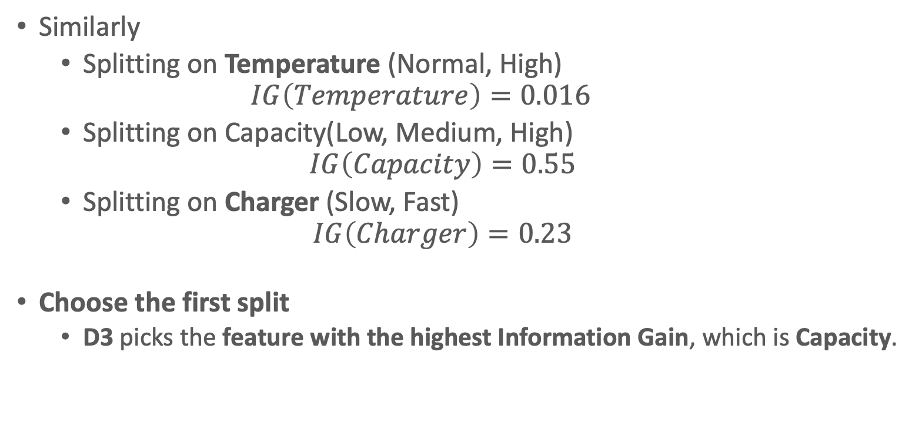
Example
Similarly
  Splitting on Temperature (Normal, High)
    $$IG\left(Temperature\right)=0.016$$
  Splitting on Capacity(Low, Medium, High)
  $$IG\left(Capacity\right)=0.55$$
  Splitting on Charger (Slow, Fast)
  $$IG\left(Charger\right)=0.23$$
Choose the first split
  D3 picks the feature with the highest Information Gain, which is Capacity.

Slide 27
Example
Splitting on “Capacity”
  We now form three child branches from the root:
    Capacity = Low → IDs {2, 4, 9}
      Condition = {0, 0, 0} (all Needs Replacement) → Pure → Leaf labeled “Needs Replacement.”
    Capacity = High → IDs {3, 7}
      Condition = {1, 1} (all Good) → Pure → Leaf labeled “Good.”
    Capacity = Medium → IDs {1, 5, 6, 8}
      Condition = {1 (Good), 0 (Needs), 1 (Good), 0 (Needs)} → 2 Good, 2 Needs → Not pure. We must continue splitting

Slide 28
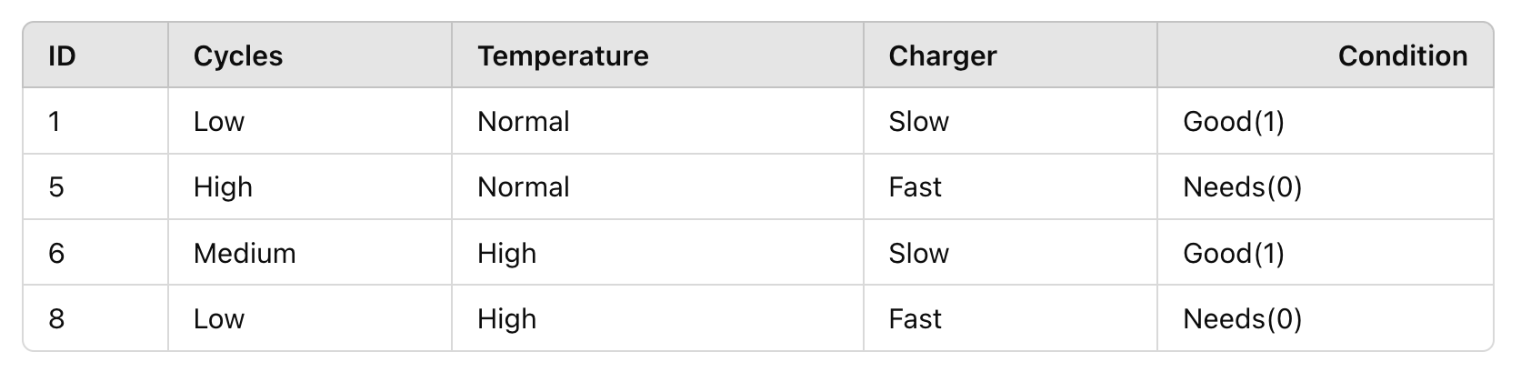
Example
Next split for “Medium” subset
Condition:
  2 Good (#1,6),
  2 Needs (#5,8)
  Subset entropy = 1.0
  (perfect 50/50).
Similarly calculate IG for
  Cycles = 0.5
  Temperature = 0.0
  Charger = 1.0 (Perfect separation)
Charger yields Information Gain of 1.0 in this subset, so that’s the next split.

Slide 29
Example
Capacity
ID3 uses Entropy and Information Gain to choose the next splitting feature.
Capacity had the highest IG (0.55) at the root.Within the “Capacity = Medium” subset, Charger gave a perfect separation (IG = 1.0).
Cycles and Temperature were less informative for these particular data distributions.
The final tree is pure after at most two decisions
Low
Medium
(Charger)
High
Needs
Good
Slow
Fast
Good
Needs

Slide 30
Random Forest
Single Decision Tree Limitations
  A single Decision Tree can easily overfit the training data, especially if the tree grows very deep.
  Small changes in the training data can cause significant changes in the tree structure (high variance).
  While easy to interpret, a single tree might not always provide the best generalization performance.

Slide 31
Random Forest Overview
Ensemble of Trees: A Random Forest builds many decision trees and aggregates (averages) their predictions to produce one final output
Reduce Variance: By combining multiple trees, the model’s overall variance decreases, mitigating the risk of overfitting
Randomness: Introduces two main forms of randomness to create diverse (uncorrelated) trees:
  Bootstrap Sampling (Bagging): Each tree is trained on a random subset of the data (sampled with replacement)
  Random Feature Selection: At each split, the algorithm considers a random subset of features instead of all features.

Slide 32
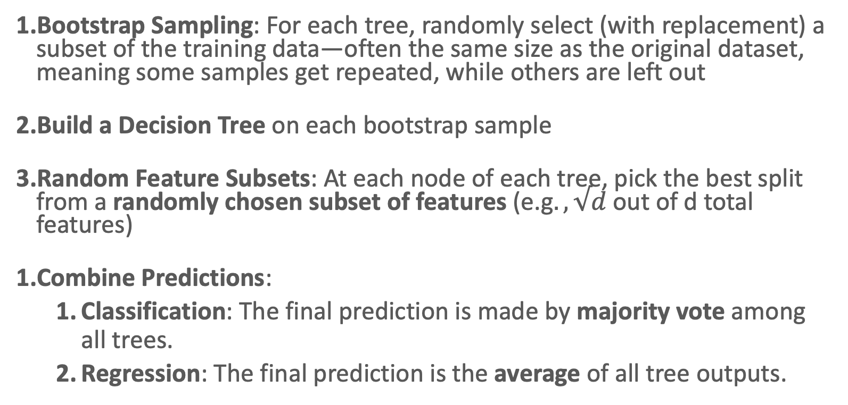
Algorithm
Bootstrap Sampling: For each tree, randomly select (with replacement) a subset of the training data—often the same size as the original dataset, meaning some samples get repeated, while others are left out
Build a Decision Tree on each bootstrap sample
Random Feature Subsets: At each node of each tree, pick the best split from a randomly chosen subset of features (e.g$., √d$out of d total features)
Combine Predictions:
  Classification: The final prediction is made by majority vote among all trees.
  Regression: The final prediction is the average of all tree outputs.
Notes:
Random feature subsets:
This prevents one highly dominant feature from making every tree look identical.
It forces the forest to discover patterns in "weaker" features that a single tree might ignore.

Slide 33
Example
ID | f1 | f2 | f3 | f4 | f5 | Class
1 | 4.3 | 4.9 | 4.1 | 4.7 | 5.5 | Healthy
2 | 3.9 | 6.1 | 5.9 | 5.5 | 5.9 | Healthy
3 | 2.7 | 4.8 | 4.1 | 5 | 5.6 | Healthy
4 | 6.6 | 4.4 | 4.5 | 3.9 | 5.9 | Sick
5 | 6.5 | 2.9 | 4.7 | 4.6 | 6.1 | Sick
6 | 2.7 | 6.7 | 4.2 | 5.3 | 4.8 | Sick
7 | 6.5 | 4.1 | 5.9 | 5.5 | 5.9 | Healthy
Training
Testing

Slide 34
Example
ID
1
2
3
4
5
6
7
ID
3
1
6
4
4
4
ID
1
2
2
5
6
6
ID
6
2
2
1
1
4
Split data into training and testing sets
Generate multiple new dataset by randomly sampling the original training set with replacement (bootstrapping) Every dataset contains the same number of rows as the original data

Slide 35
Example
Split data into training and testing sets
Generate multiple new dataset by randomly sampling the original training set with replacement (bootstrapping) Every dataset contains the same number of rows as the original data
We will randomly select a subset of features for each new dataset
ID
1
2
3
4
5
6
7
ID
3
1
6
4
4
4
ID
1
2
2
5
6
6
ID
6
2
2
1
1
4
f1, f4
f2, f3
f1, f2
Notes:
The Setup
To keep it simple, we will use:
Original Features: Water, Fertilizer, Sunlight, Soil.
Original Samples: 9 (denoted as S1 through S9).
Tree 1: The "Fertilizer & Soil" Expert
Bootstrap Sample: Randomly picks 9 samples with replacement. Let's say it gets: {S1, S1, S2, S3, S5, S6, S8, S8, S9}. (Note: S4 and S7 were left out).
Feature Subset: It is only allowed to look at Fertilizer and Soil.
The Result: This tree finds that Fertilizer is the biggest driver for these specific samples.
Prediction: If we give it a new test case, Tree 1 predicts: 28 kg.
Tree 2: The "Sunlight & Water" Expert
Bootstrap Sample: Randomly picks: {S2, S3, S4, S4, S5, S7, S7, S8, S9}.
Feature Subset: It is only allowed to look at Sunlight and Water.
The Result: Since it can't see Fertilizer, it relies heavily on Sunlight. It notices that high sunlight usually means higher yield.
Prediction: For that same test case, Tree 2 predicts: 22 kg.
Tree 3: The "Soil & Sunlight" Expert
Bootstrap Sample: Randomly picks: {S1, S2, S3, S4, S5, S6, S7, S8, S9} (The original set, by chance).
Feature Subset: It is only allowed to look at Soil and Sunlight.
The Result: This tree focuses on the fact that "Loamy" soil (Soil Type 2) produces better results.
Prediction: For that same test case, Tree 3 predicts: 25 kg.
The Final Step: Aggregation (The "Forest" Prediction)
Now, we take the individual predictions from all three trees for our new test case:
TreeExpert FocusPredictionTree 1Fertilizer / Soil28 kgTree 2Sunlight / Water22 kgTree 3Soil / Sunlight25 kg
Final Random Forest Prediction (Average):
$$\frac{28 + 22 + 25}{3} = \mathbf{25.0 \text{ kg}}$$

Slide 36
Take away from Random Forest
Diversity of Trees: By changing the training subset (via bootstrapping) and the feature subset (at each split), each tree captures somewhat different patterns. This diversity reduces the chance that all trees overfit to the same noisy pattern.
Lower Variance: Averaging many uncorrelated trees significantly reduces variance compared to a single tree
Better Generalization: Random Forests typically outperform a single decision tree on unseen data because the ensemble is more robust and less prone to overfitting
Notes:
In machine learning (and statistics), variance refers to how sensitive a model is to the particularities of the training data. A model with high variance will significantly change its predictions if you alter the training data slightly (e.g., by removing or adding a few data points). A lower-variance model is more stable, meaning small changes in the training data will not drastically change the learned model or its predictions.

Slide 37
Evaluation
Precision
Recall
F1-Score
Accuracy
The best way to explain these measures is by using “confusion matrix”

Slide 38
Confusion Matrix
A confusion matrix for the battery classification example, summarizing the true vs. predicted labels for faulty cells
True Positives (TP) = 15
(cells that were actually faulty and predicted faulty)
  TP is about catching the problem correctly (finding the faulty cells).
False Negatives (FN) = 5
(cells that were actually faulty but predicted healthy)
False Positives (FP) = 10
(cells that were actually healthy but predicted faulty)
True Negatives (TN) = 70
(cells that were actually healthy and predicted healthy)
  TN is about correctly recognizing when there is no problem (confirming the healthy cells).
You can derive metrics like precision, recall, accuracy, and the F1 score directly from these four values
There are 100 cells total.
20 of them are actually faulty (ground truth).
80 of them are actually healthy.
Your model predicts 25 as faulty and 75 as healthy.
 | Predicted
Actual |  | Faulty | Healthy
 | Faulty | 15 (TP) | 05 (FN) | 20
 | Healthy | 10 (FP) | 70 (TN) | 80
 |  | 25 | 75

Slide 39
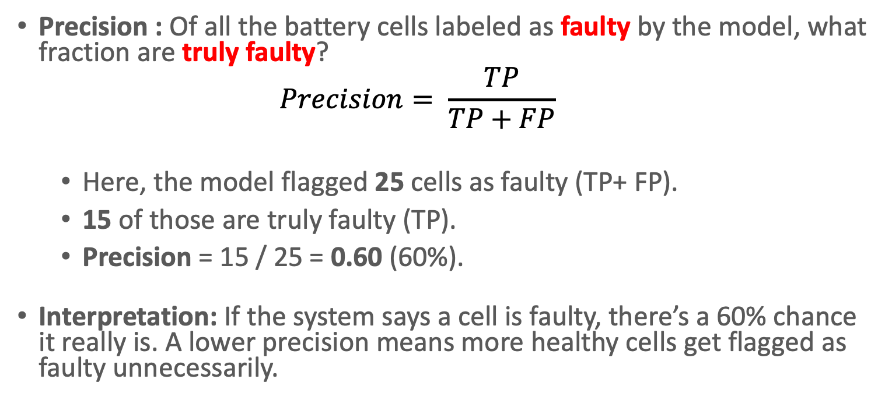
Metrics
Precision : Of all the battery cells labeled as faulty by the model, what fraction are truly faulty?
            $$Precision= \frac{TP}{TP+FP}$$
  Here, the model flagged 25 cells as faulty (TP+ FP).
  15 of those are truly faulty (TP).
  Precision = 15 / 25 = 0.60 (60%).
Interpretation: If the system says a cell is faulty, there’s a 60% chance it really is. A lower precision means more healthy cells get flagged as faulty unnecessarily.
 | Predicted
Actual |  | Faulty | Healthy
 | Faulty | 15 (TP) | 05 (FN) | 20
 | Healthy | 10 (FP) | 70 (TN) | 80
 |  | 25 | 75

Slide 40
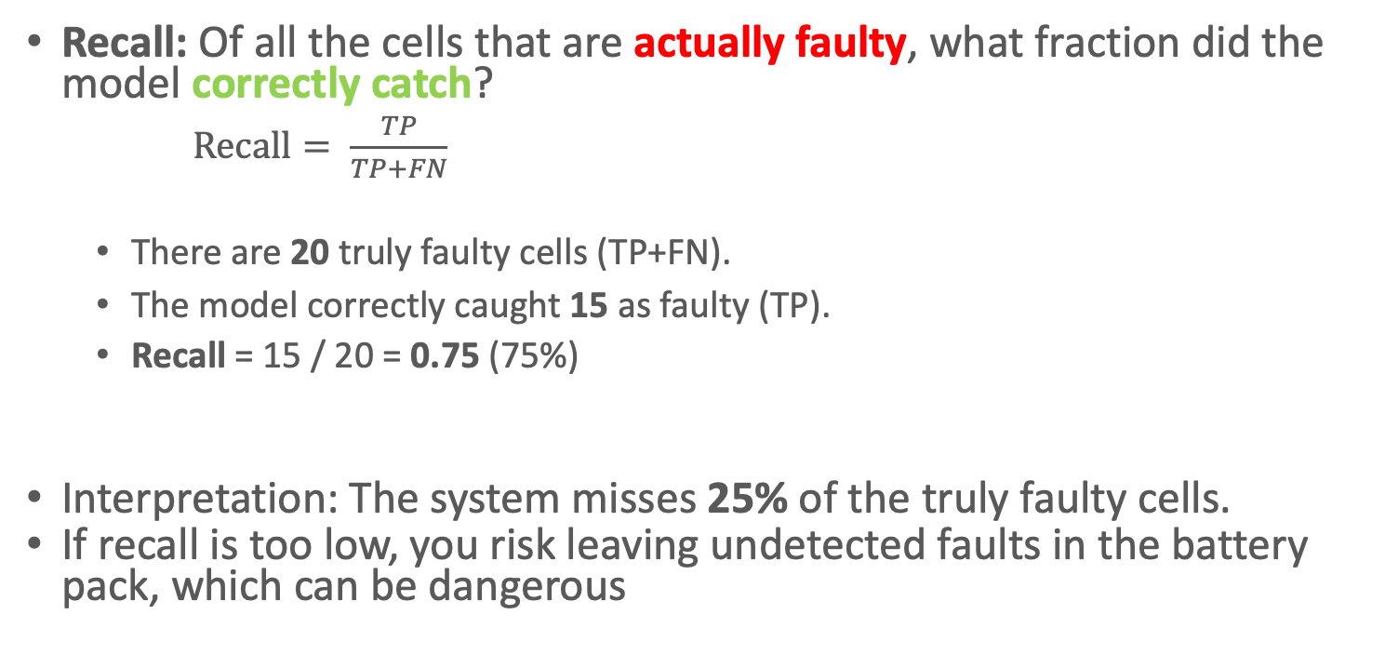
Metrics
Recall: Of all the cells that are actually faulty, what fraction did the model correctly catch?
  $Recall= \frac{TP}{TP+FN}$
  There are 20 truly faulty cells (TP+FN).
  The model correctly caught 15 as faulty (TP).
  Recall = 15 / 20 = 0.75 (75%)
Interpretation: The system misses 25% of the truly faulty cells.
If recall is too low, you risk leaving undetected faults in the battery pack, which can be dangerous
 | Predicted
Actual |  | Faulty | Healthy
 | Faulty | 15 (TP) | 05 (FN) | 20
 | Healthy | 10 (FP) | 70 (TN) | 80
 |  | 25 | 75

Slide 41
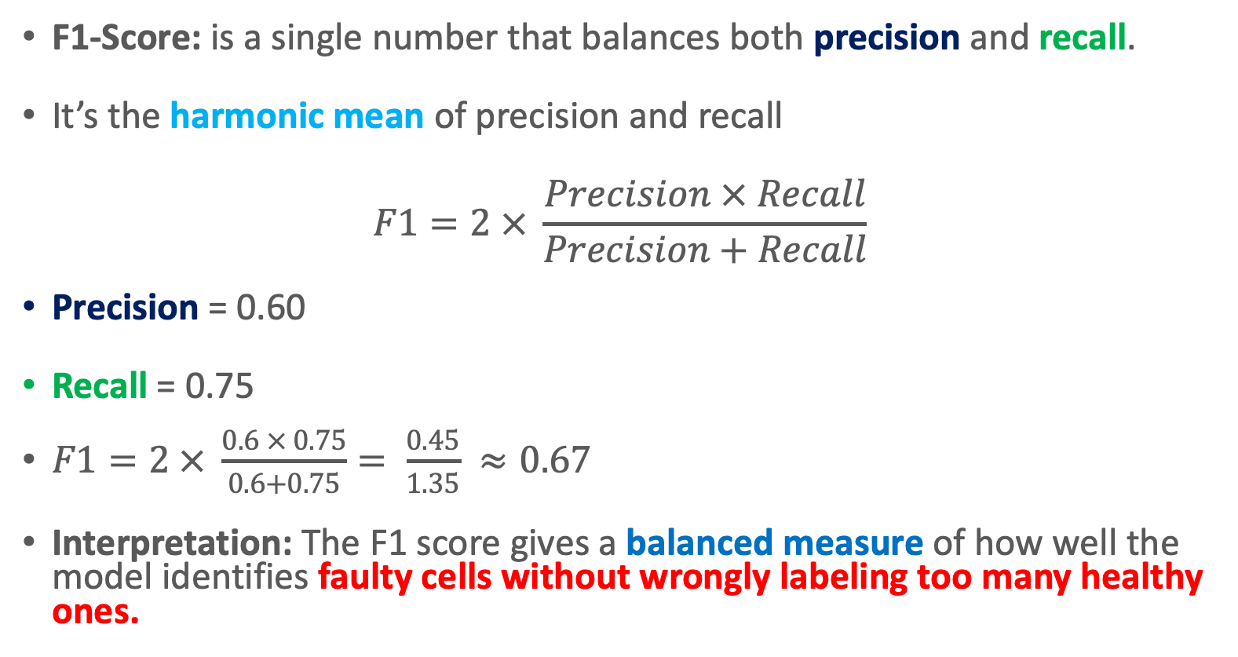
Metrics
F1-Score: is a single number that balances both precision and recall.
It’s the harmonic mean of precision and recall
$$F1=2 × \frac{Precision × Recall}{Precision+Recall}$$
Precision = 0.60
Recall = 0.75
$F1=2 × \frac{0.6 × 0.75}{0.6+0.75}= \frac{0.45}{1.35} ≈0.67$
Interpretation: The F1 score gives a balanced measure of how well the model identifies faulty cells without wrongly labeling too many healthy ones.

Slide 42
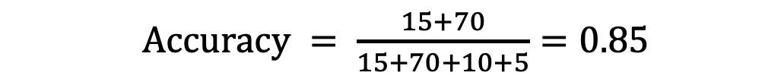
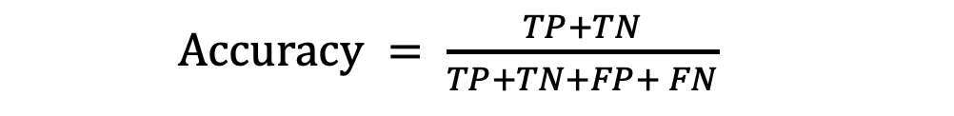
Metrics
Accuracy: is the measure of the overall correctness of a classification model.
  It tells you what proportion of the total predictions (both positive and negative) were correct.
 | Predicted
Actual |  | Faulty | Healthy
 | Faulty | 15 (TP) | 05 (FN) | 20
 | Healthy | 10 (FP) | 70 (TN) | 80
 |  | 25 | 75
  $Accuracy = \frac{TP+TN}{TP+TN+FP+ FN}$
TP = 15
TN = 70
FP = 10
FN = 5
This means that 85% of the time, the model correctly classifies a battery cell as either faulty or healthy.
  $Accuracy = \frac{15+70}{15+70+10+5}=0.85$

Slide 43
Why different metrics are needed ?
Precision: Use when you want to ensure that a cell flagged as faulty is indeed faulty, avoiding unnecessary replacements or investigations of healthy cells.
Recall: Use when it’s critical not to miss any truly faulty cells to prevent potential safety hazards or performance issues.
F1 Score: Ideal when you need a balanced view of the model’s performance—ensuring that you’re both catching as many faulty cells as possible and not over-flagging healthy ones.
Accuracy: Provides an overall view of the system’s performance; however, if the vast majority of cells are healthy, high accuracy might not reveal the model’s shortcomings in identifying faulty cells.

Slide 44
Hands-on

