Slide 1
Tutorial: Must-Know Basics for Machine Learning
Dr. Sourasekhar Banerjee (Ph.D.)

Slide 2
Objective and Learning Outcome
Objective
  Installation of the Python and Jupyter notebook framework
  Introduce key concepts, terminologies, and tools to prepare participants for advanced topics like regression, feature engineering, classification, and artificial neural networks
Learning Outcome
  Participants will understand the basic workflow of machine learning.
  Key tools in the Python ecosystem, and foundational concepts to build upon in subsequent lectures.

Slide 3
Jupyter notebook Installation
Click here to find the Jupyter notebook installation tutorial
Install VS-Code for better experience. Click here
Google Colab is an alternative to all those local setup

Slide 4
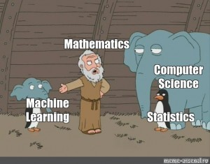
Introduction to Machine Learning
What is Machine Learning (ML) ?
  Branch of artificial intelligence (AI)
  Enables computers to learn from data and make decisions or predictions.
  ML algorithms improve their performance by identifying patterns in data.

Slide 5






Key Components of ML
Test data
Model
Prediction
Raw Data
Features
Training/Learning
Feature Engineering
Evaluation

Slide 6
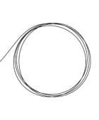
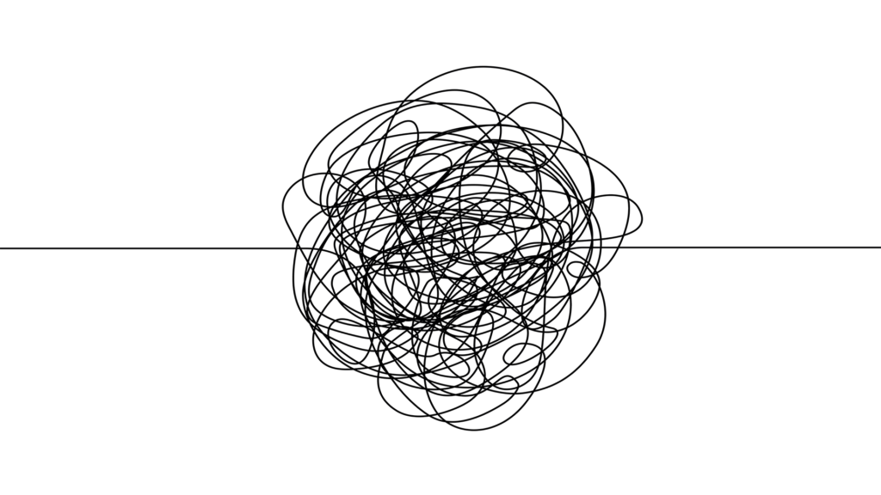
Data
Dirty Data
  Incomplete – Missing/null values
  Inaccurate – Incorrect values or calculations
  Inconsistent – Different unit of measurements
  Duplicate – same data reordered more than once
  Outdated - No longer relevant
  Incorrectly formatted – invalid characters
Cleaning
Feature Engineering

Slide 7
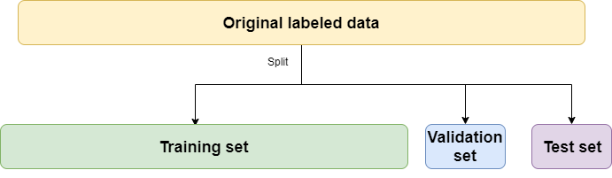
Dataset

Slide 8
Metrics
Performance
  Accuracy : Good for balanced datasets
  F1-Score : Best for imbalanced datasets
  R2 : Used in regression to evaluate model fit
Loss function
  Mean Square Loss (MSE) and Root Mean-Square Loss (RMSE) : Suitable for regression tasks
  Cross-entropy (CE): Suitable for classification tasks
Notes:
Accuracy = TP + TN / total
The F1 Score is the harmonic mean of Precision and Recall. It provides a balance between these two metrics, making it a better measure than accuracy for uneven class distributions.
The Formula
$$F_{1} = 2 × \left\{precesion × recall\right\}/\{precision + Recall\}$$
R² Score is used for Regression. It indicates how well the independent variables explain the variability of the dependent variable.
The Formula. $R^{2}=1 −\frac{residual sum of square}{total sum of square}$

Slide 9
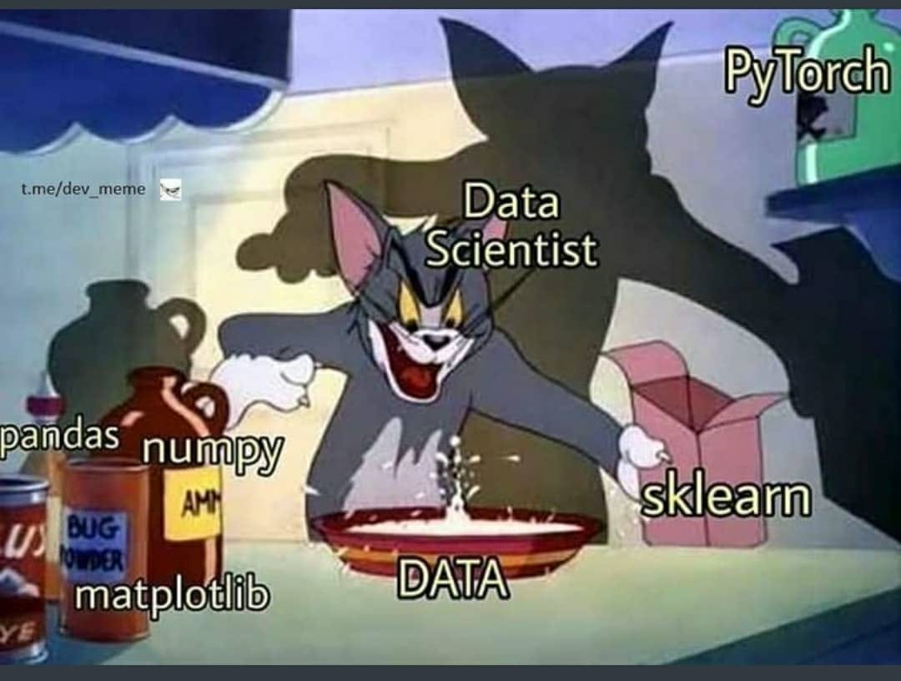
Python Ecosystem for Machine Learning
Notes:
Must-Know Libraries
Numpy: Arrays and Numerical operations
Pandas: Data manipulation and analysis
Matplotlib/Seaborn: Data visualization
Scikit-learn: Preprocessing, algorithm, and evaluation
Pytorch: Deep learning

Slide 10
Hands-on
Numpy tutorial
Pandas tutorial
Go to your Studium page

Slide 11
Thank You!

