Slide 1



Advancing Federated Learning: Algorithms and Use-Cases
Sourasekhar Banerjee
Ph.D. Student
Department of Computing Science
Umeå University, Sweden
September 23, 2024
Notes:
10 seconds

Slide 2
Outline
  Introduction
  Key Challenges
  Research Objectives and Contributions
  Papers I to VI
  Conclusion
  Future Scope
Notes:
60 sec
automatic

Slide 3




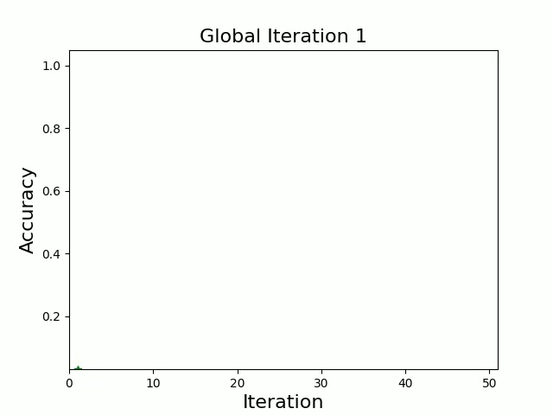
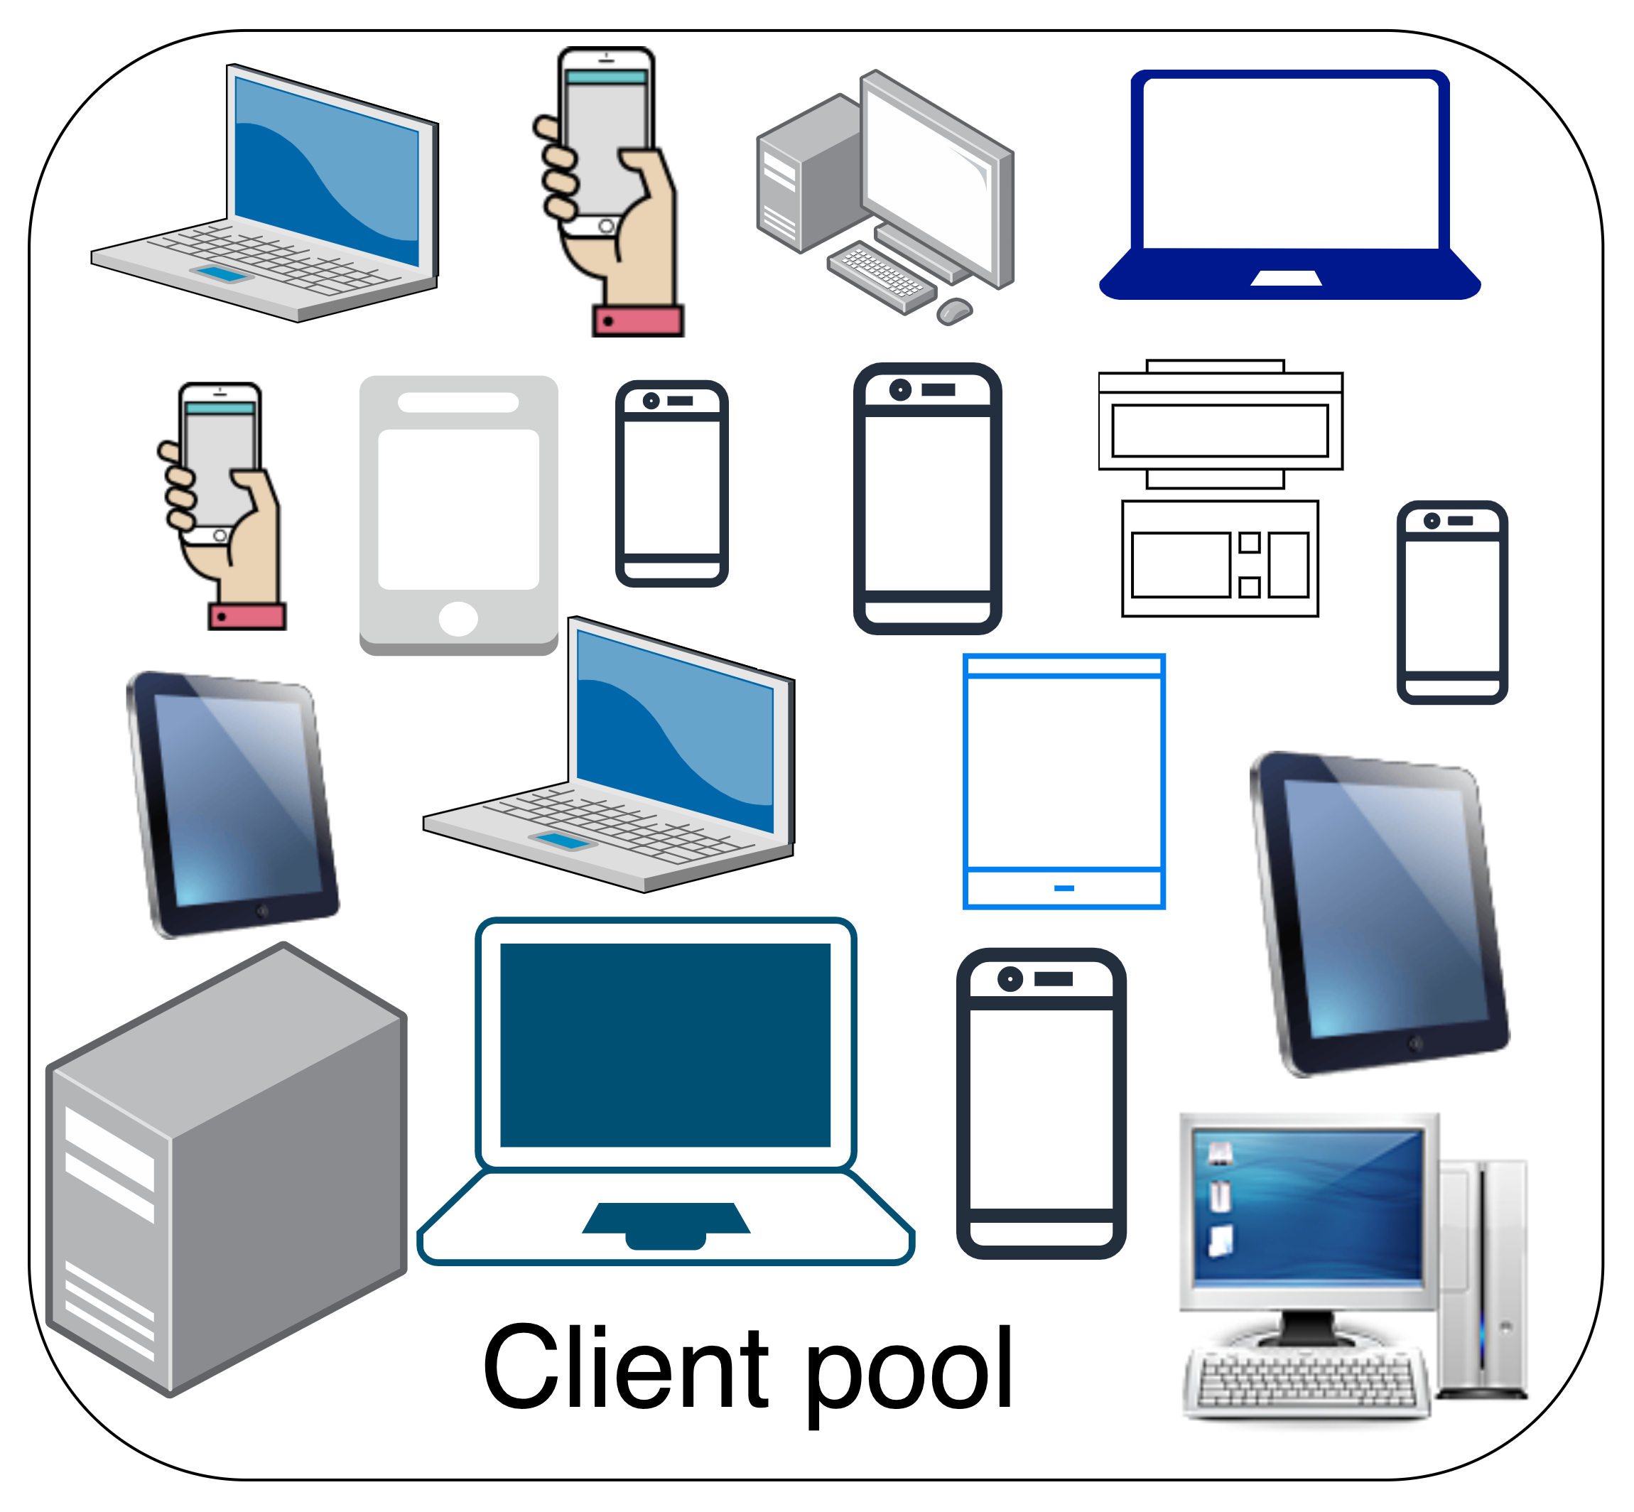






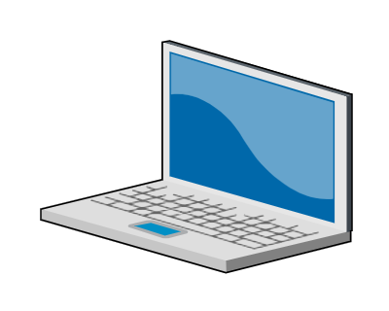


Federated Learning (FL)
Collaborative learning without sharing private data
2
3
1
2
3
Client
selection
2
3
4
Horizontal FL
Train homogeneous model
Notes:
2:30
A. collaborative learning
B. How FL works
C. The aim is to increase the performance of the global model over time.

Slide 4



Why Federated Learning?
𝚺
Data ownership
Data privacy
…
Powerful end devices
Reduced communication
overhead
Notes:
5 min

Slide 5
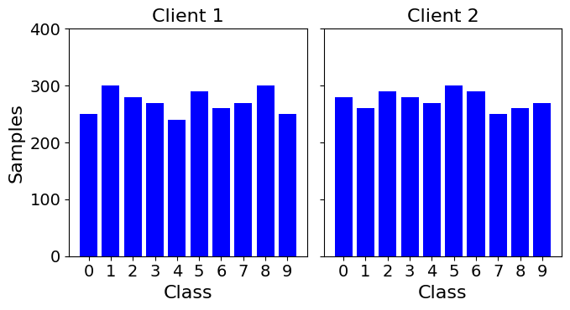
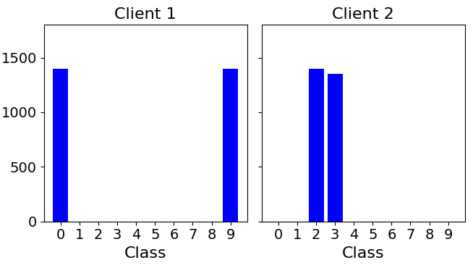


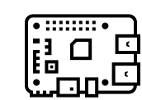





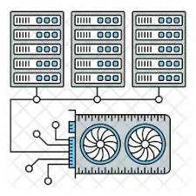
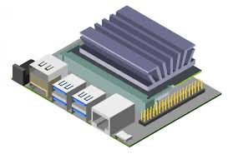
Key Challenges
IID
Non-IID
Data heterogeneity
System heterogeneity
Stragglers
𝜃₁
𝜃₂
Local model
ω
Global model
Client 1
Client 2
Communication
Privacy
Client drift
Notes:
6 min 30 seconds
Independent and Identical

Slide 6


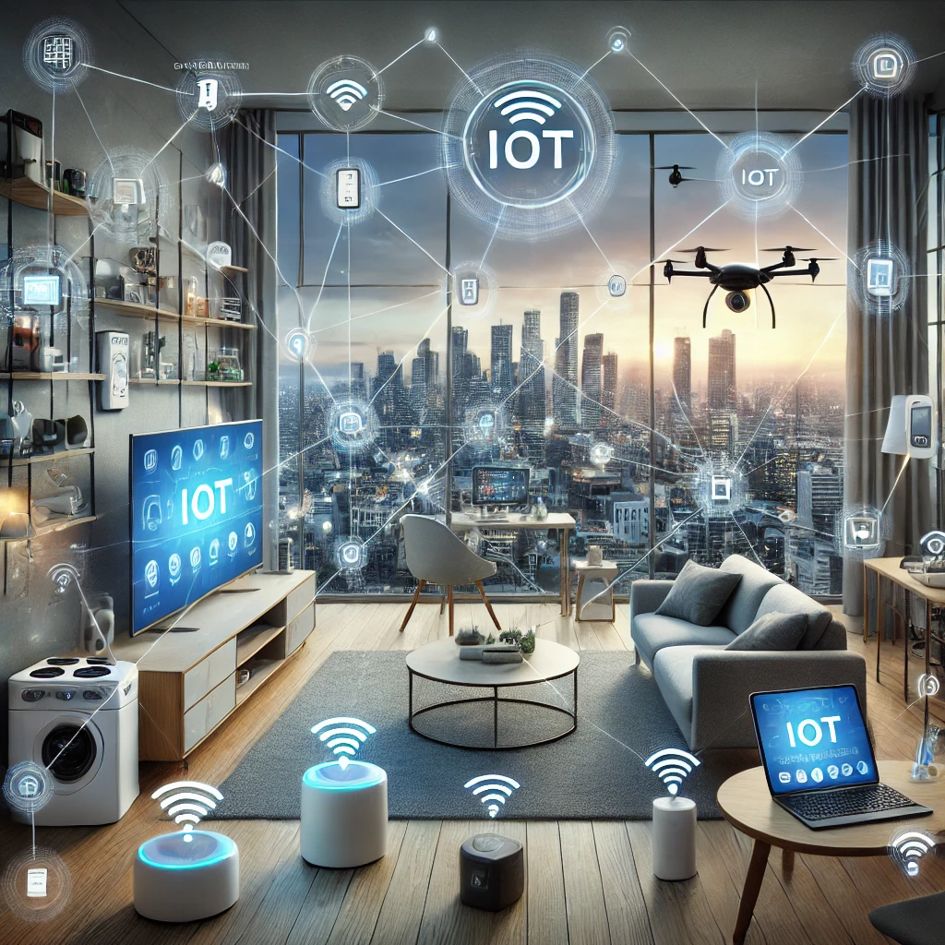



Purpose
*Images are generated using DALL-E
Challenges
Algorithms
Use-cases
Generic
Fed-FiS
Fed-MOFS
PerMFL
FedIoT
Healthcare
Finance
Fed-MOODS
FedHealth
IoT
Memorable
Sharing other
FedMEM
Fed-Rec
FedScore
Clustered-FedDC
Recommender
system
Event
memorability
Privacy
advisor
Use-case specific
Notes:
7 min 30 sec
Event memorability and Privacy advisor
FedMEM and Clustered-FedDC are for he focused use-cases

Slide 7
Scopes and Assumptions
Scopes
Assumptions
Horizontal federated learning
Homogeneous model training
Clients have full (Cross-Silo) and partial participation (Cross-Device)
Data privacy
Secured communication
channel
Model security
Notes:
8 min
automatic

Slide 8


Research Objectives and Contributions
Data heterogeneity
System heterogeneity
RO1: Develop algorithms for feature selection in federated settings
RO2: Develop algorithm for optimal client selection in federated learning
Paper I & III
RO3: Develop personalized FL algorithm for multi-tier settings
Paper II
Paper I: Fed-FiS: A Novel Information-Theoretic Federated Feature Selection for Learning Stability
Paper II: Optimized and Adaptive Federated Learning for Straggler-Resilient Device Selection
Paper IV
Use-cases
Paper III: Cost-Efficient Feature Selection for Horizontal Federated Learning
RO4: Develop FL-enabled solutions for different use-cases
Paper IV: Personalized Multi-tier Federated Learning
Paper V: Predicting Event Memorability using Personalized Federated Learning
Paper V & VI
Paper VI: The Case for Federated Learning in Developing Personalized Image Privacy Advisor
Notes:
10 min
automatic

Slide 9
Fed-FiS: A Novel Information-Theoretic Federated Feature Selection for Learning Stability
Paper I
Cost-Efficient Feature Selection for Horizontal Federated Learning
Paper III
Notes:
10:30

Slide 10





Problem
Effect
Solution
Impact
Data
heterogeneity
Features
Bias in
features
across clients
Learning
Training time
Performance
Feature
selection
Learning
Training time
Performance
Fed-FiS
Fed-MOFS
Paper I and III
Objective RO1
Notes:
11:30
this can be used in any applications for example health care, financical credit scoring, intrusion detection dataset.

Slide 11
Contributions
Local feature subset selection
  FCMI (Relevance)
  FFMI (Redundancy)
  Clustering
Global feature subset selection
  Fed-FiS (Score-function) S( f_{k} )
  Fed-MOFS (Multi-objective optimization)
FCMI: Feature Class Mutual Information
FFMI: Feature Feature Mutual Information
Notes:
12:30

Slide 12
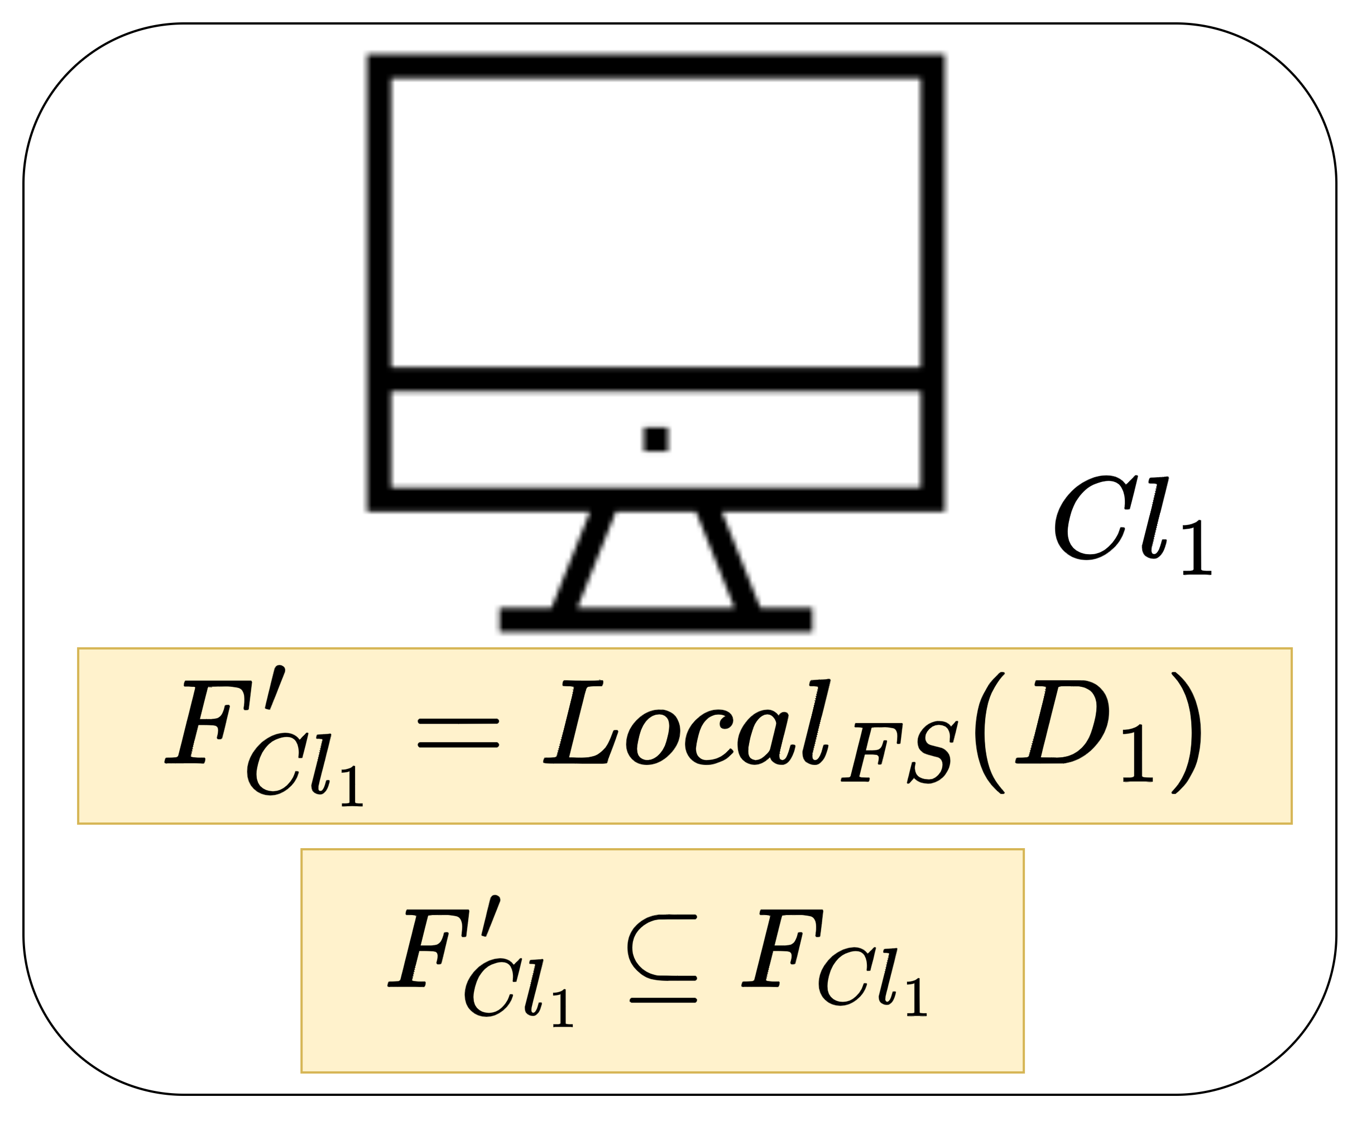

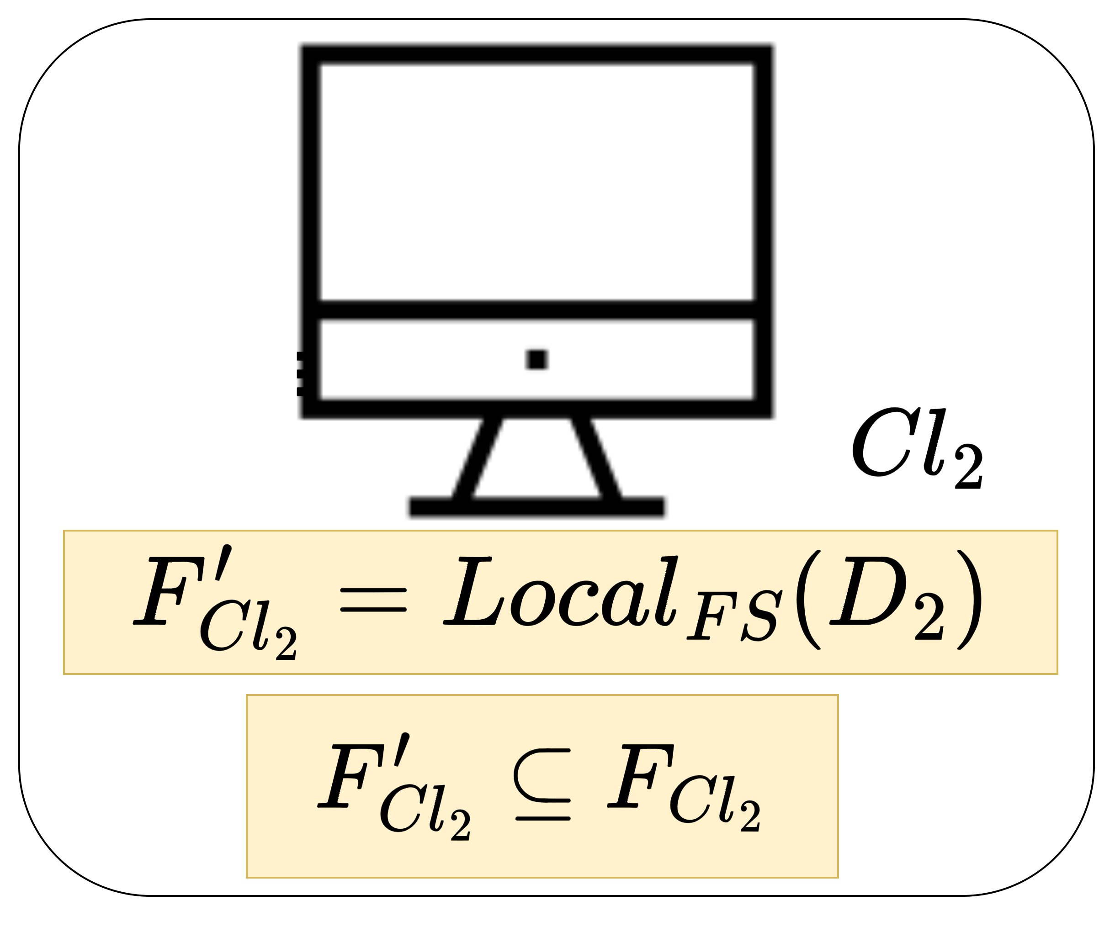
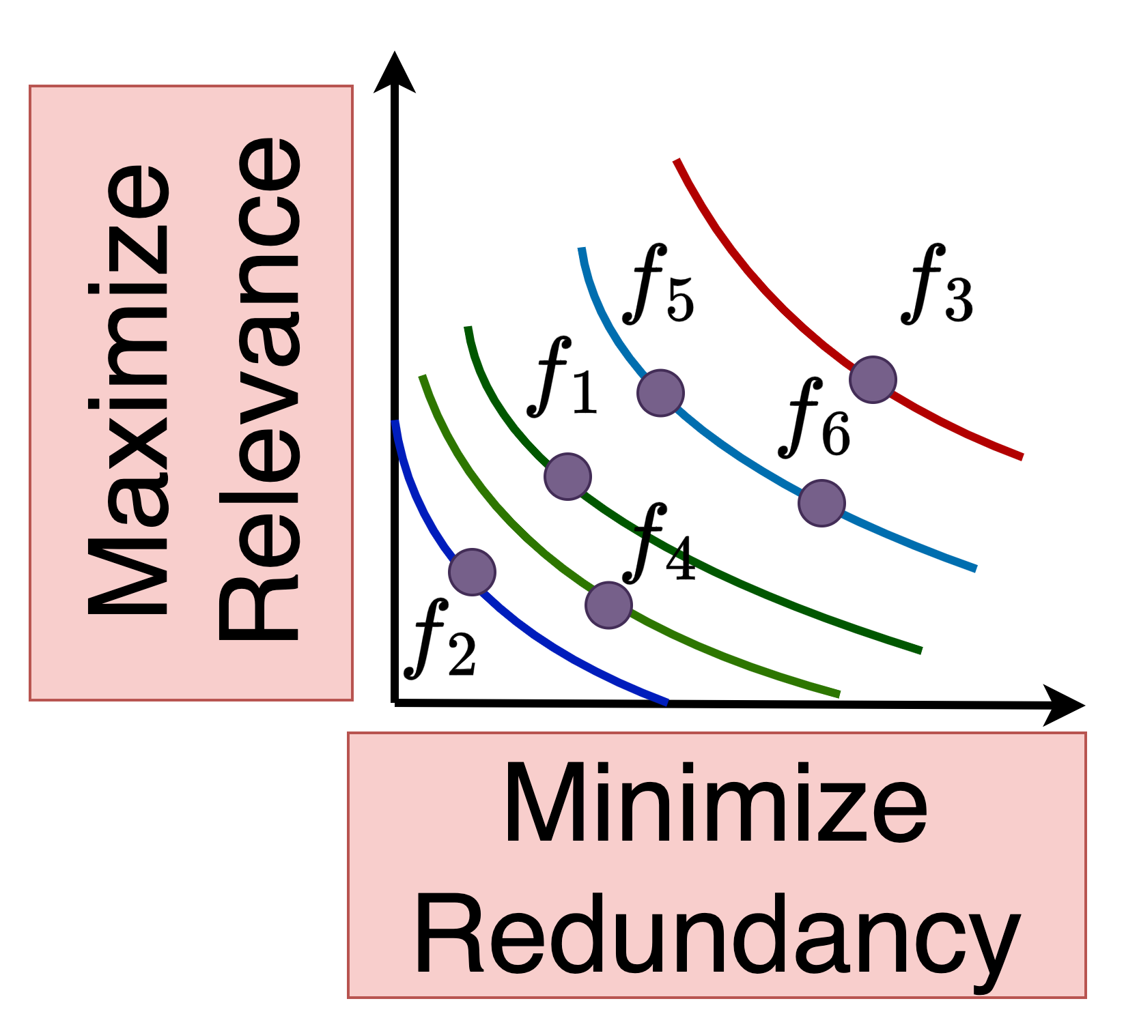


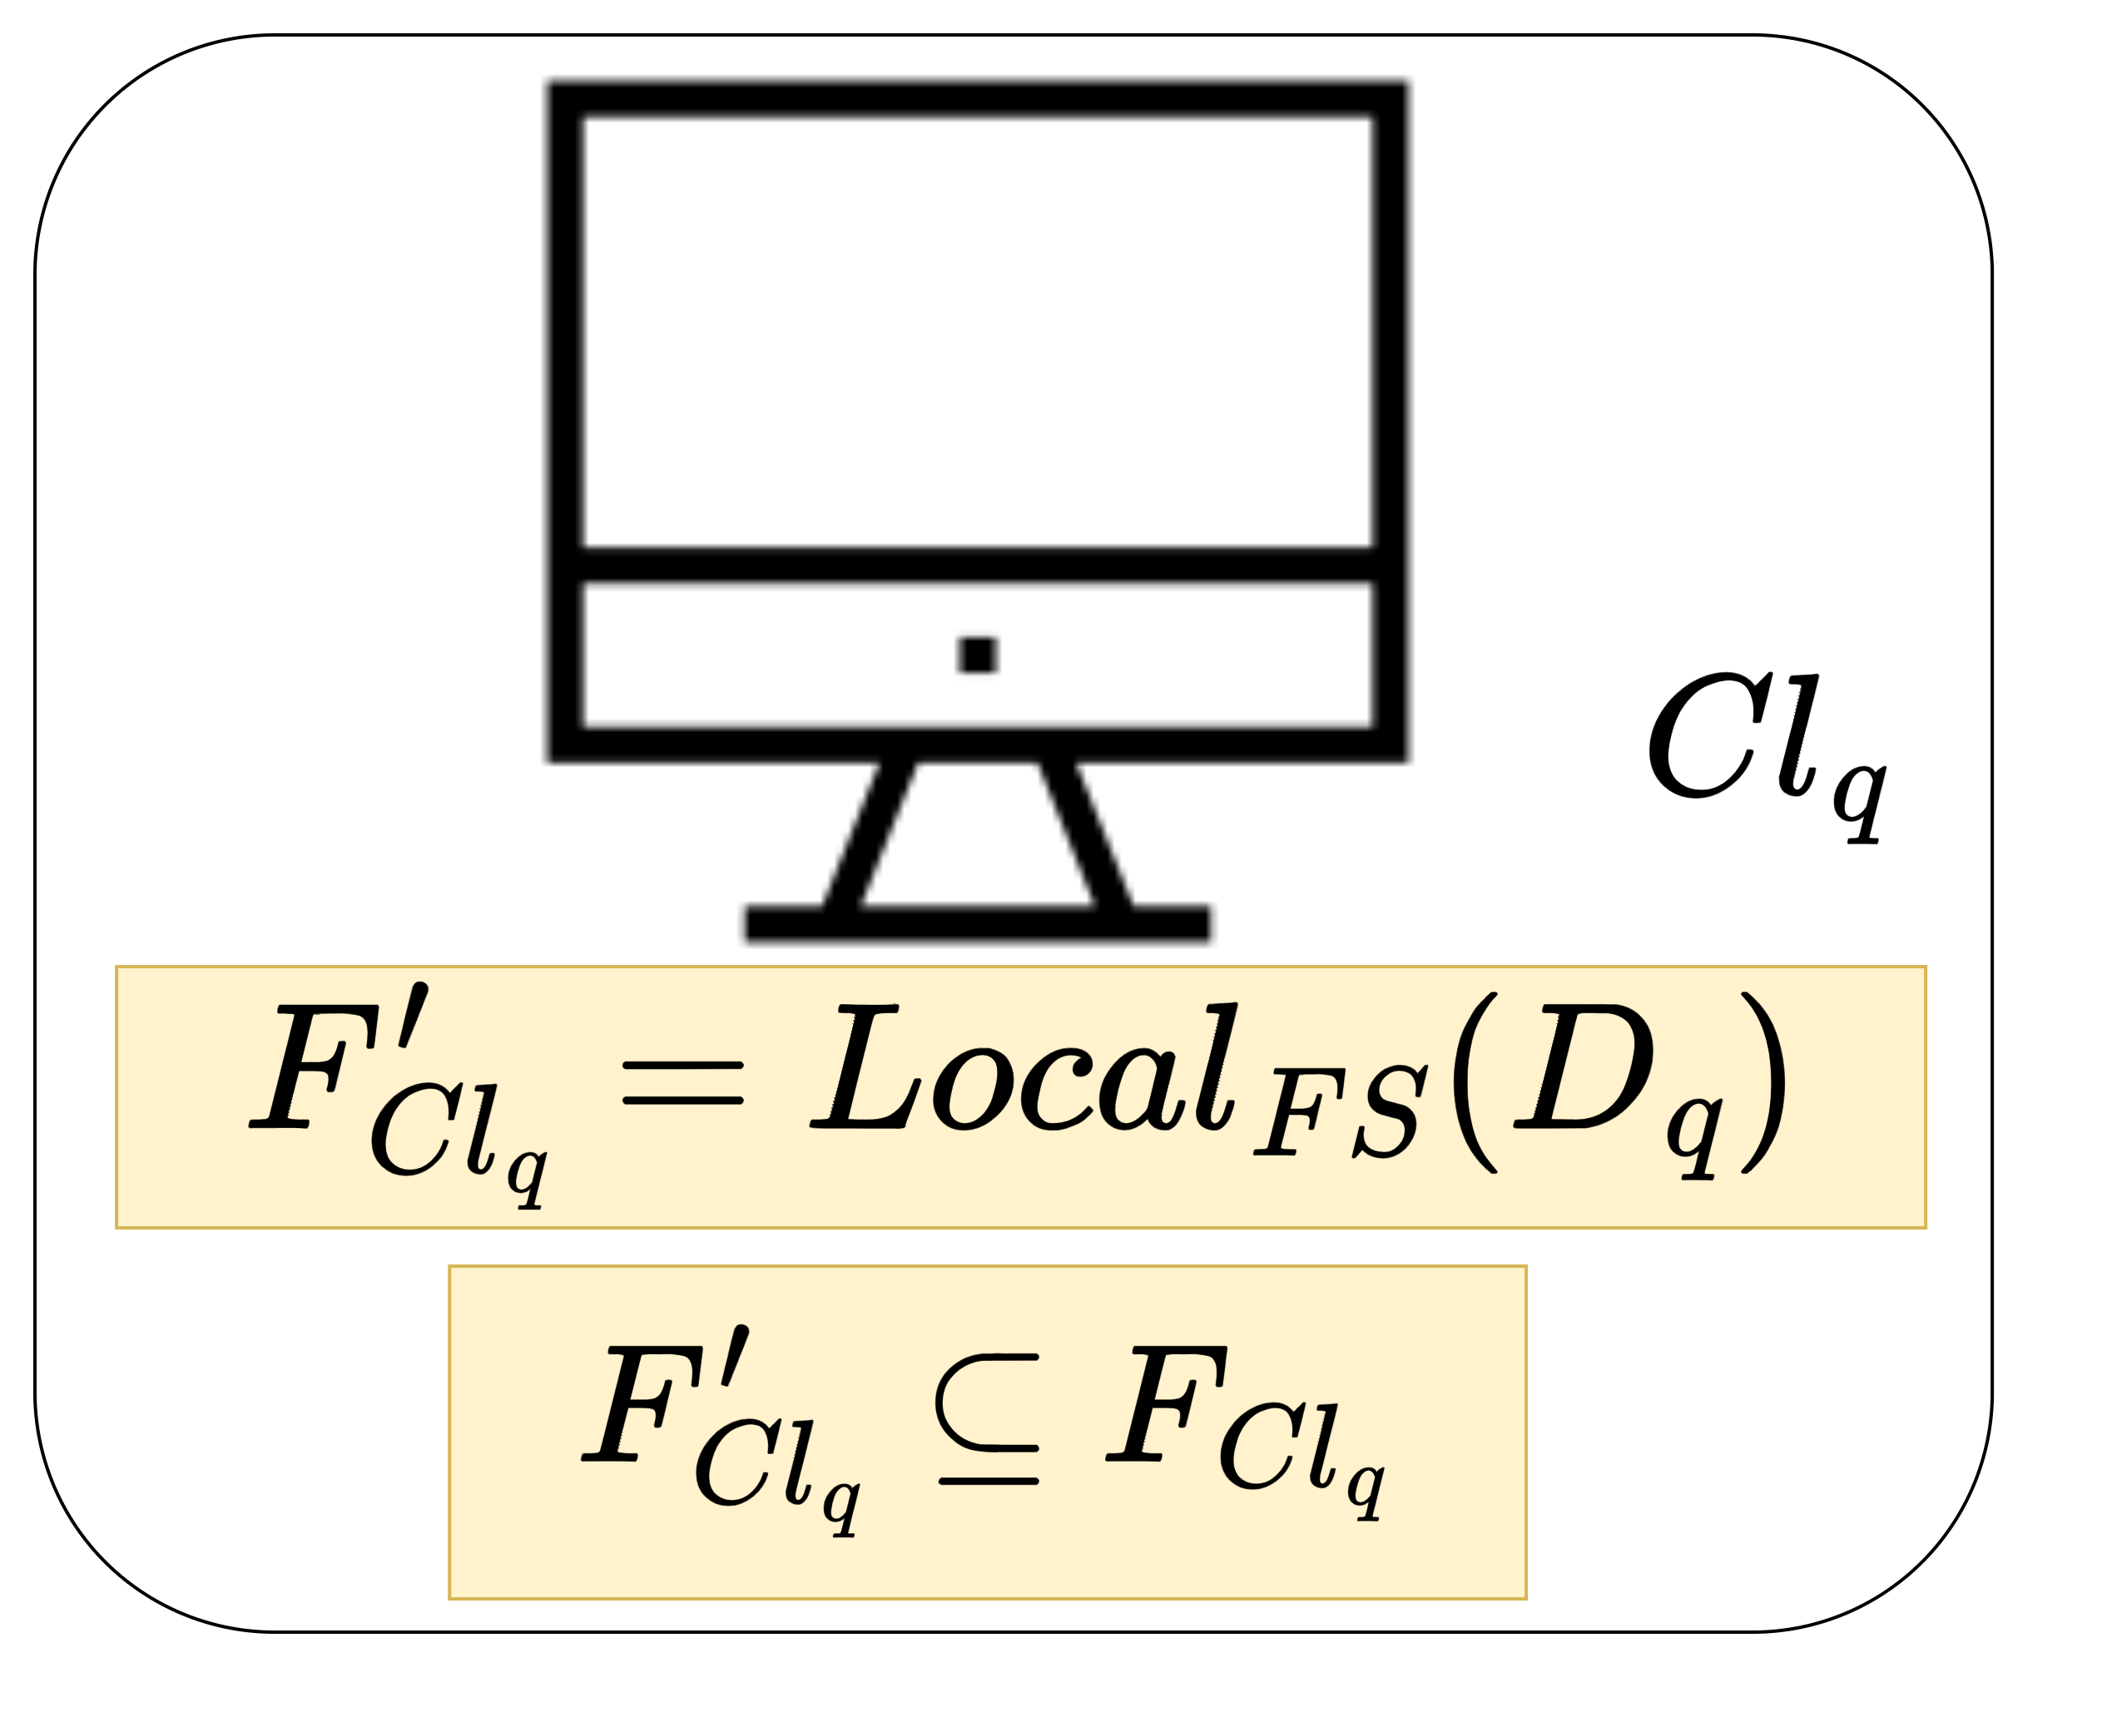

2
3
Fed-FiS
Fed-MOFS
Rank | Feature | S(f_{k})
1 | f₂ | 0.81
2 | f₄ | 0.67
3 | f₁ | 0.53
4 | f₆ | 0.25
5 | f₃ | 0.23
6 | f₅ | 0.21
…
<rank, feature>
1
4
Local feature selection
Global feature selection
Notes:
13:30

Slide 13
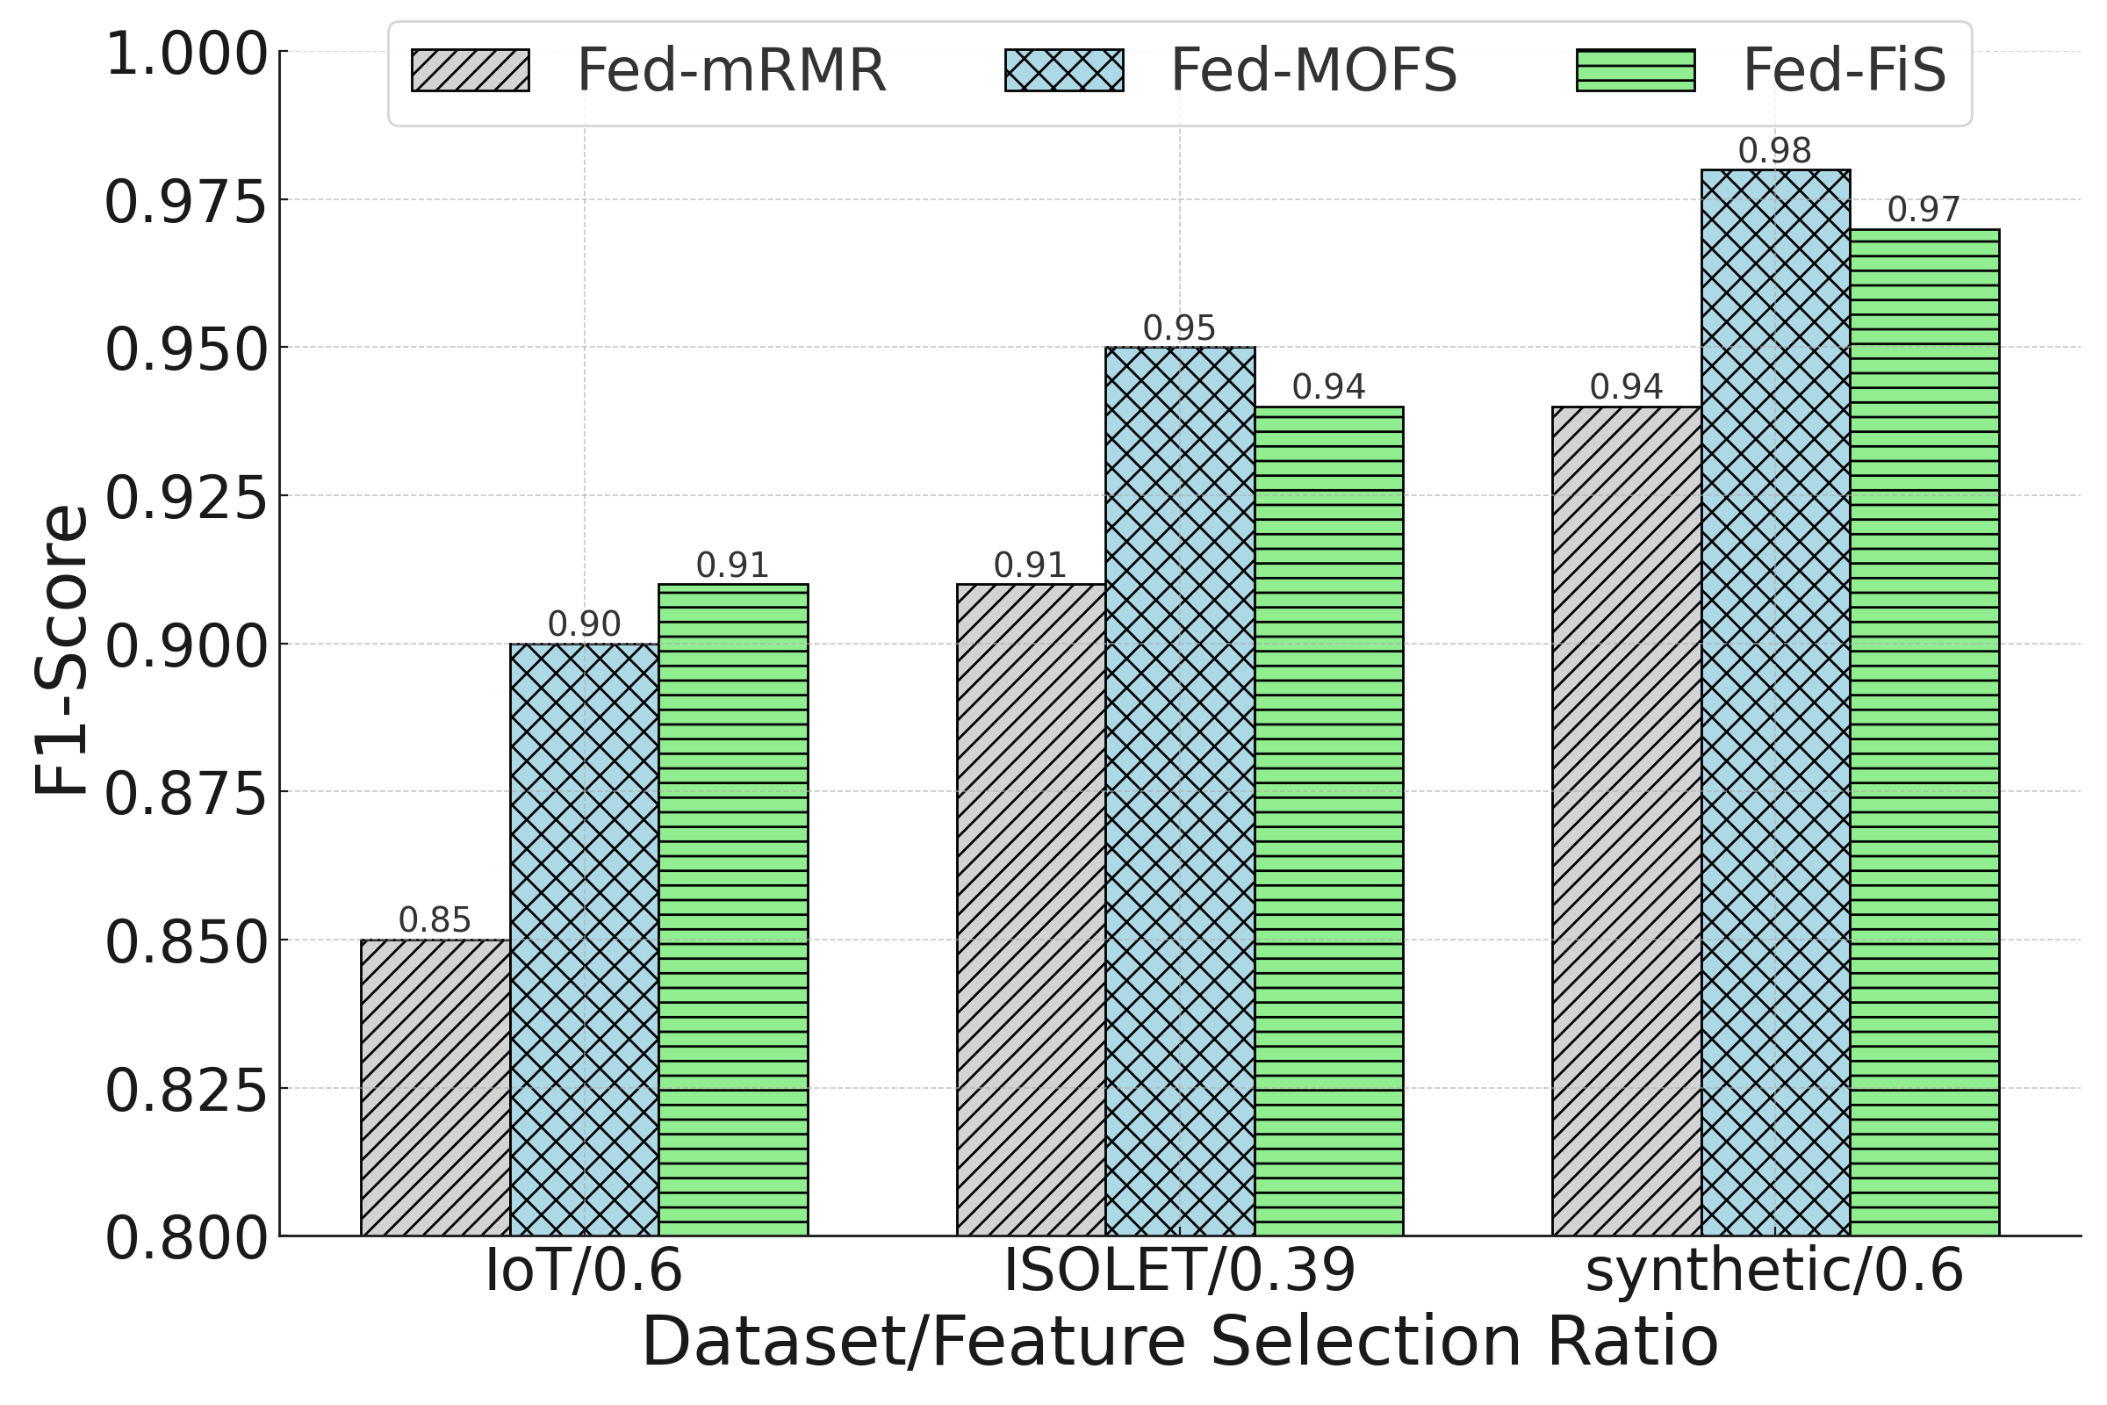
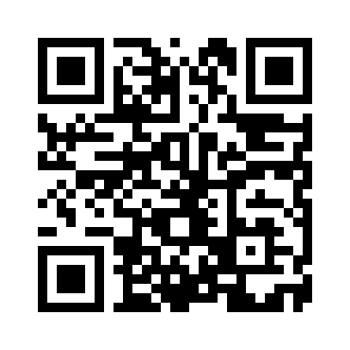
Results and Analysis
Performance across non-IID data setting
Performance
Fed-MOFS vs Fed-mRMR
  4% - 5%
Fed-FiS vs Fed-mRMR
  3% - 6%
Source code
Notes:
14:00

Slide 14
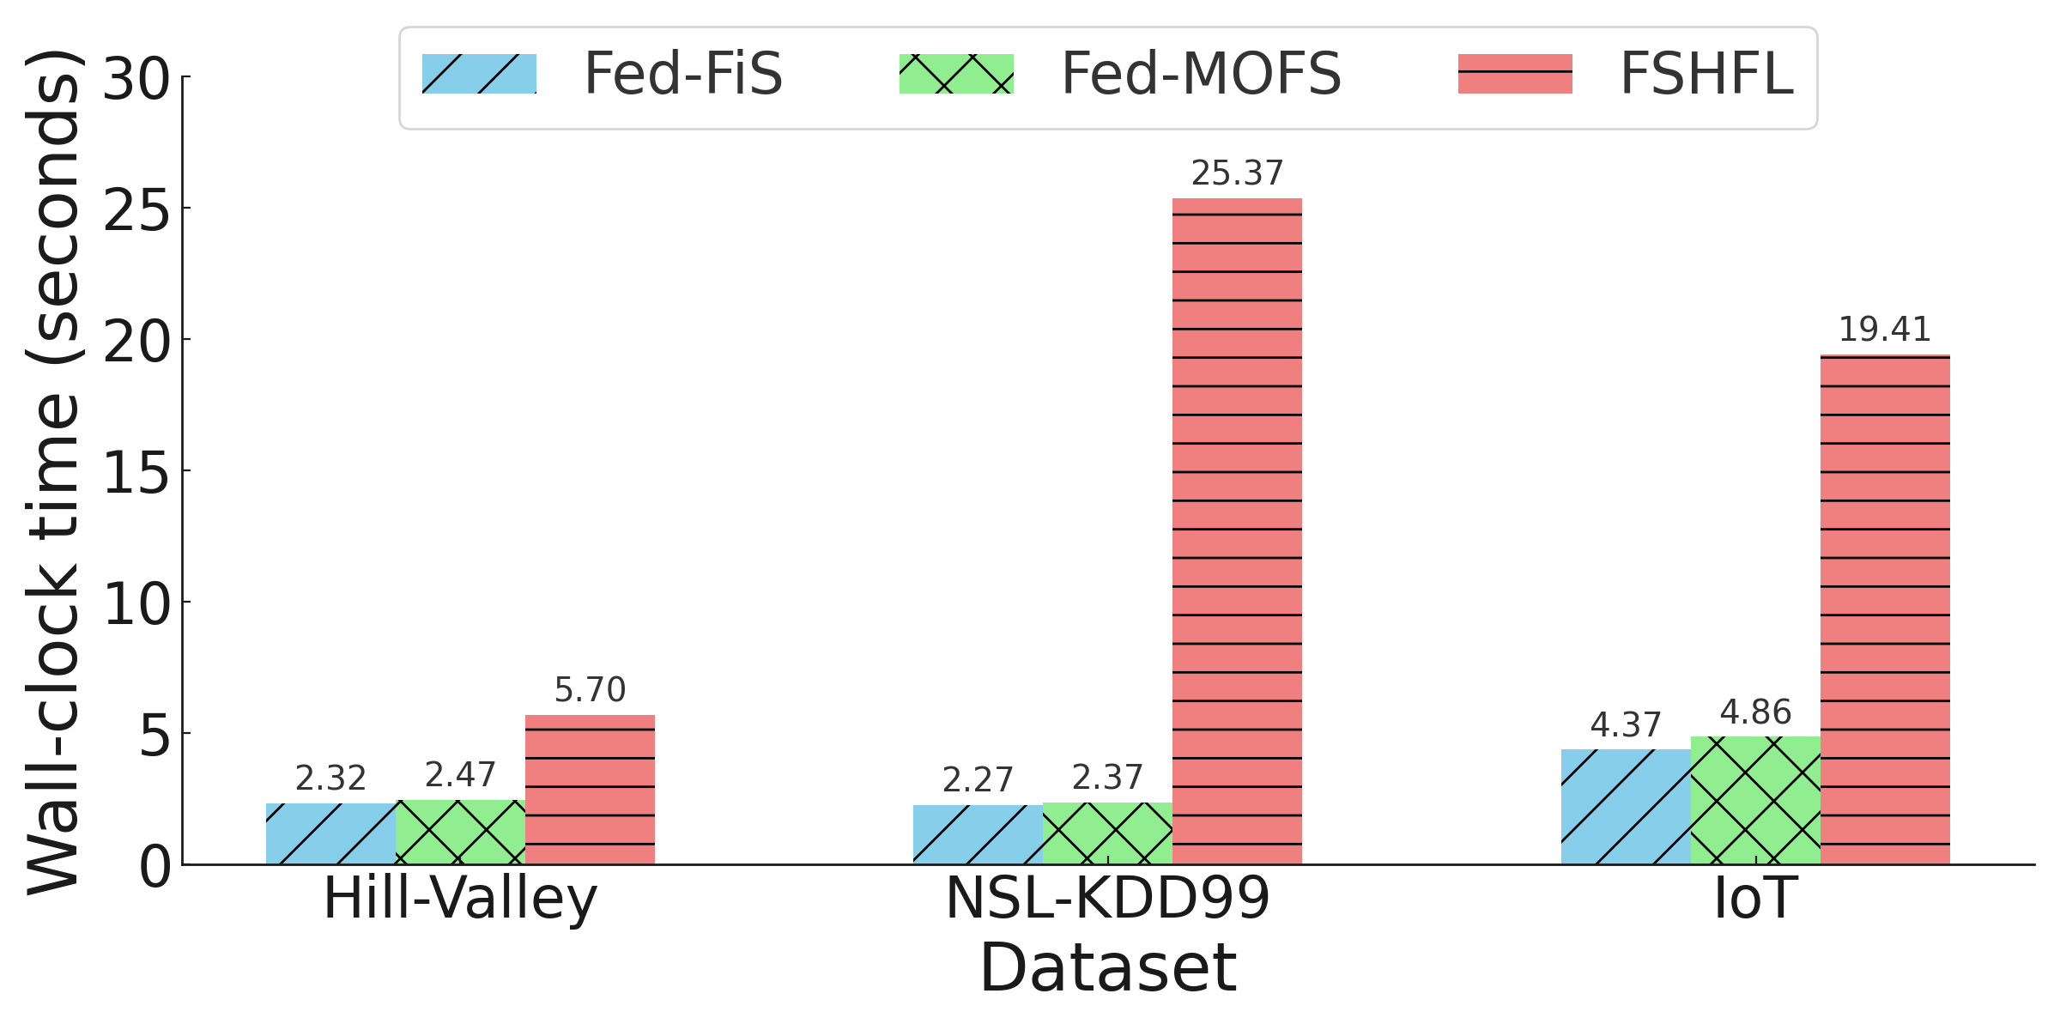
Results and Analysis
Wall-clock running time of federated feature selection algorithms
Efficiency
Fed-FiS vs FSHFL
  at least 2.46x
  at most 11x
Fed-MOFS vs FSHFL
  at least 2.3x
  at most 10.7x
Source code
Notes:
15:00
FSHFL use hierarchical clustering which is costly

Slide 15
Optimized and Adaptive Federated Learning for Straggler-Resilient Device Selection
Paper II
Notes:
15:10

Slide 16
Problem
Effect
Solution
Impact
Performance
Training
time
Strategic Client selection
Device heterogeneity
Convergence
Performance
Training
time
Fed-MOODS
Convergence
Paper II
Objective RO2
Notes:
16

Slide 17
Contributions
Fed-MOODS
  Device ranking based on the availability of
    Processing capacity (AP)
    Memory (AM)
    Bandwidth (AB)
  Adaptive device selection
Notes:
16:30

Slide 18
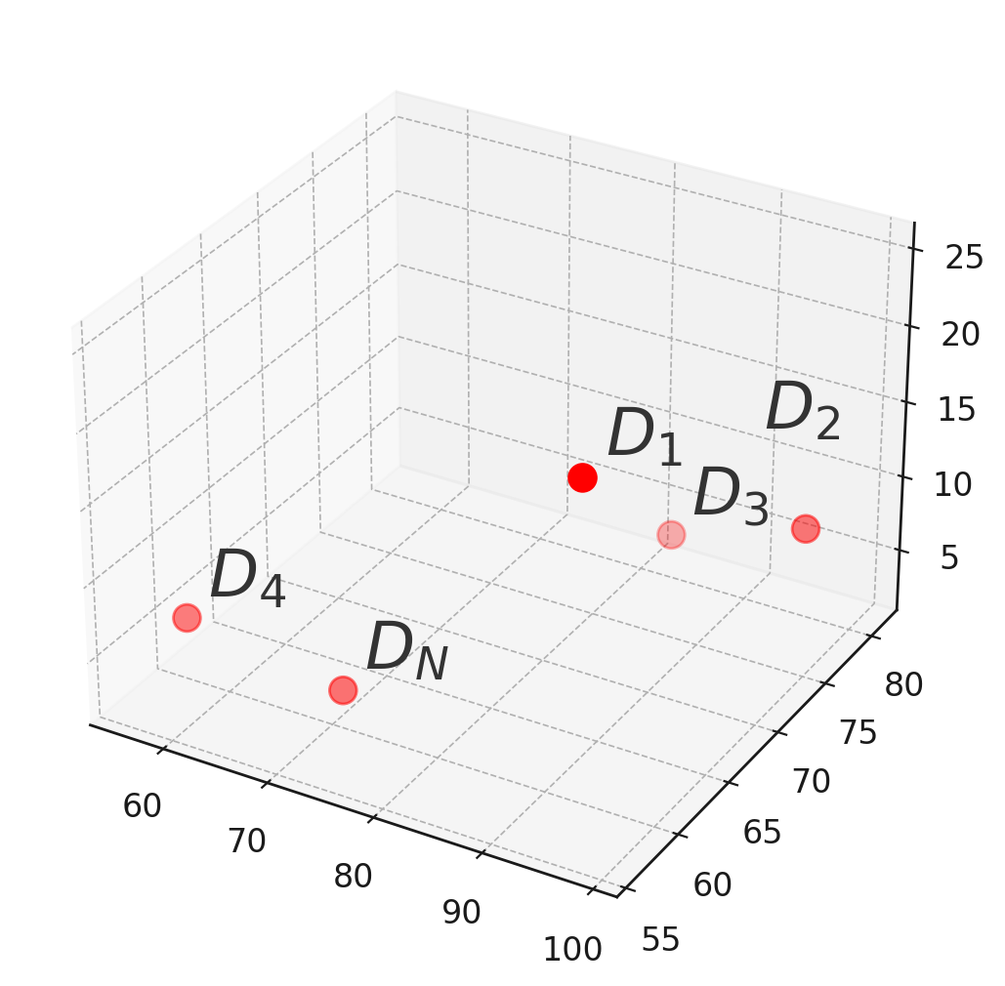

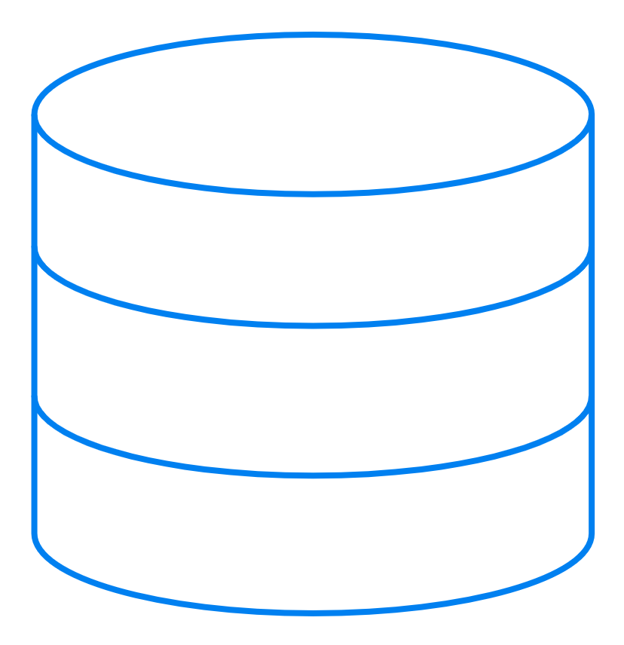


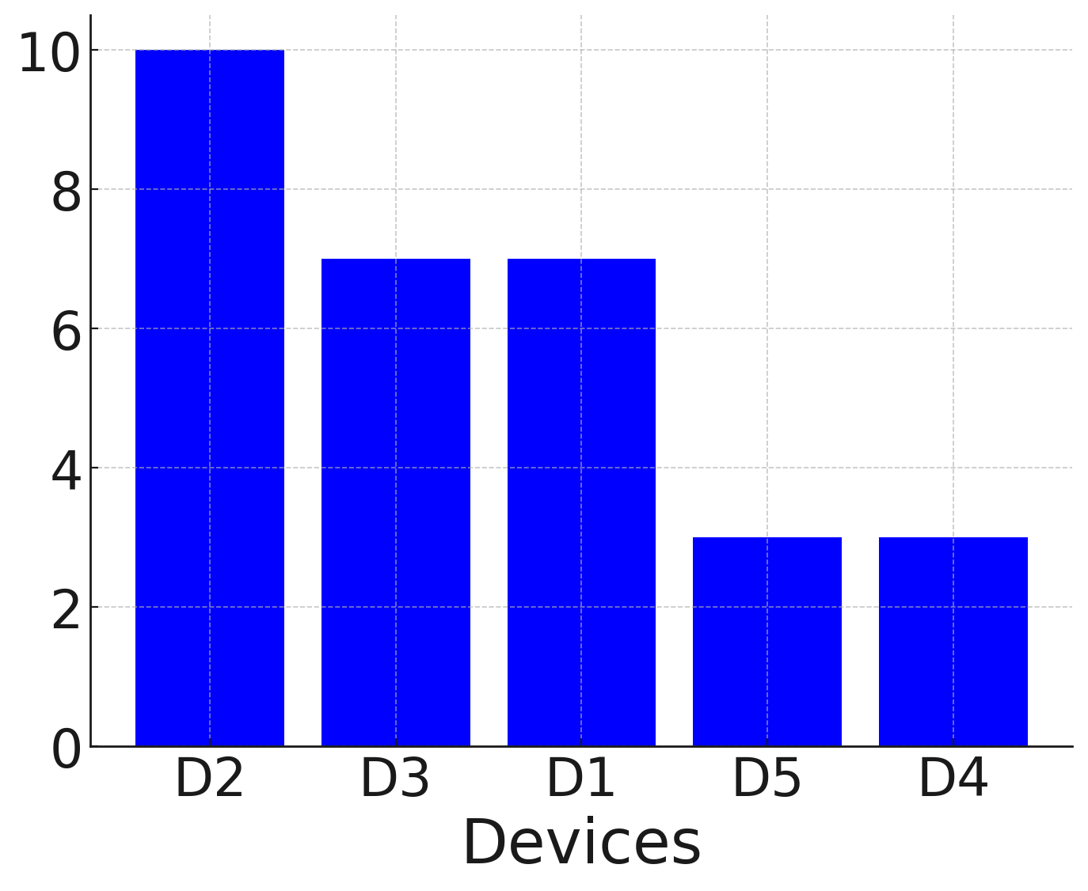

2
Adaptive device selection
3
FL
AB
…
D₁
AP
AM
D₂
1
Device ranking
D₂
D₃
…
D₃
D₁
…
…
…
D_{N}
Notes:
17

Slide 19
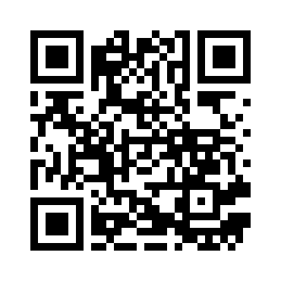
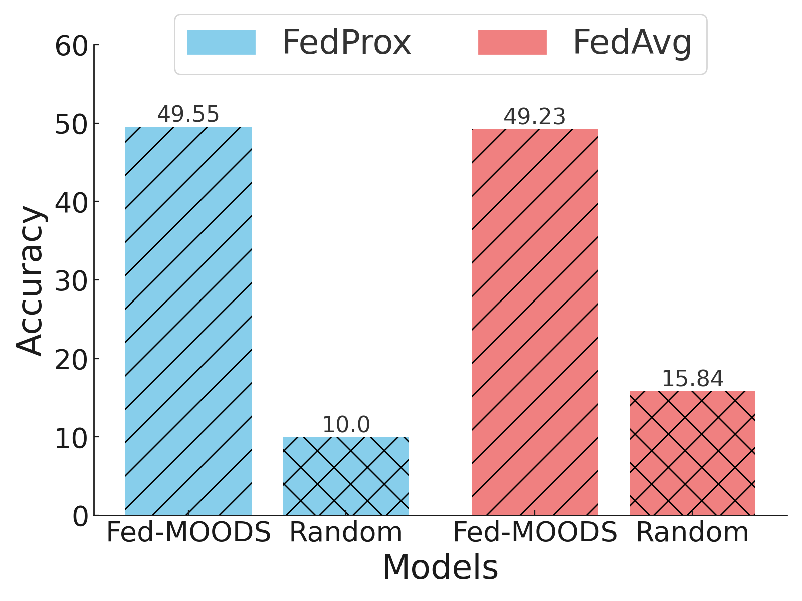
Results and Analysis
Fed-MOODS vs Random selection
Source code
Performance when 90% are stragglers
With Fed-MOODS
FedProx 39.55 %
FedAvg 33.39%
Dataset: CIFAR10
Notes:
18

Slide 20
Personalized Multi-tier Federated Learning
Paper IV
Notes:
19:10

Slide 21
Problem
Effect
Solution
Impact
Generalization
performance
Data
heterogeneity
Performance
Personalized model
Client i
Client j
Client i
Client j
Client drift
PerMFL
Convergence
Convergence
Global
iteration
Global
iteration
Paper III
Objective (RO3)
Notes:
20

Slide 22
Contributions
Personalized
model i
k^{th} Team
model
PerMFL
  A global model
  Personalized team
  models
  Personalized device models
Personalized
model j
Global model
Personalized
model i
m^{th} Team
model
Personalized
model j
Notes:
21

Slide 23
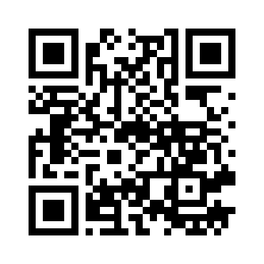
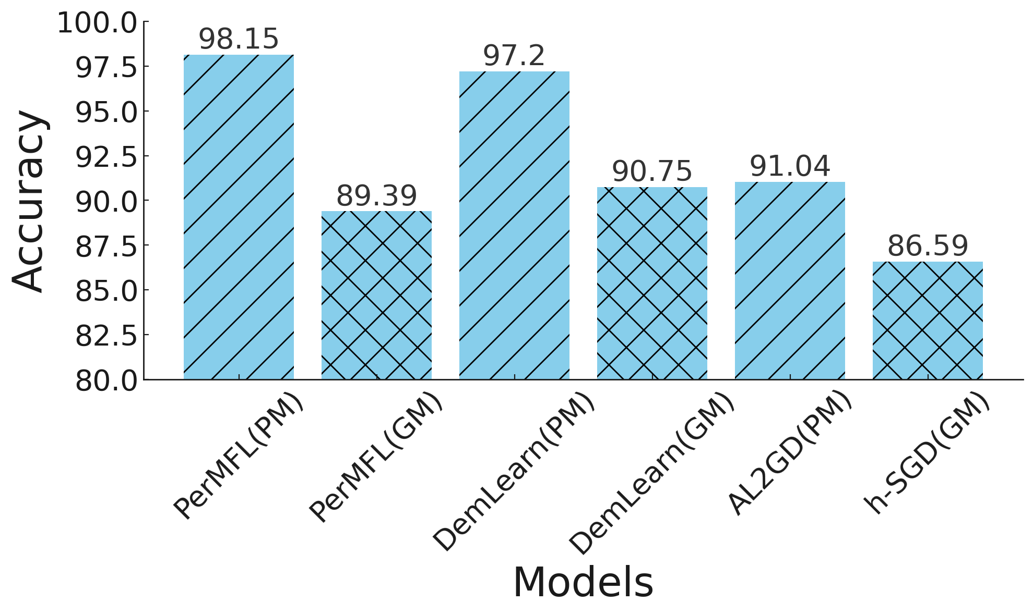
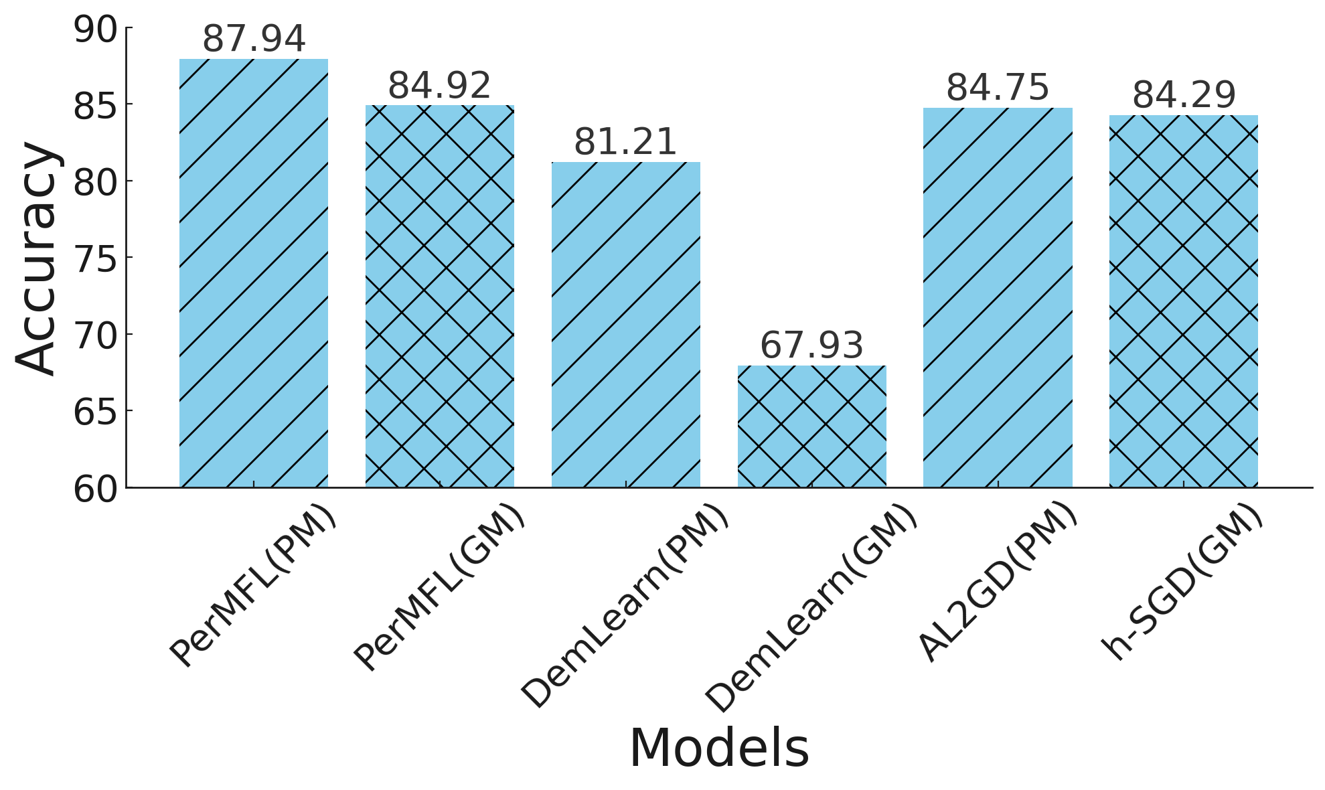
Results and Analysis
Source code
Non-convex
Convex
Dataset:MNIST
Dataset: Synthetic
Performance of PerMFL (PM)
Performance of PerMFL (GM)
≅
Non-convex
Convex
Non-convex
Convex
Notes:
22

Slide 24

Predicting Event Memorability using Personalized Federated Learning
Paper V
Notes:
22:10

Slide 25
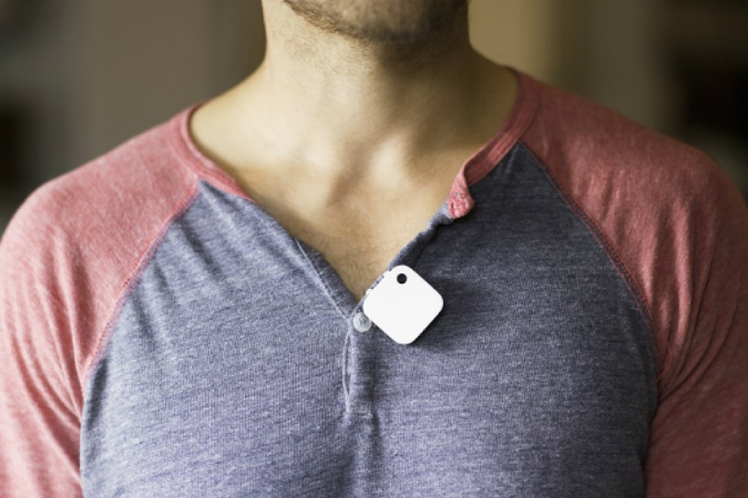
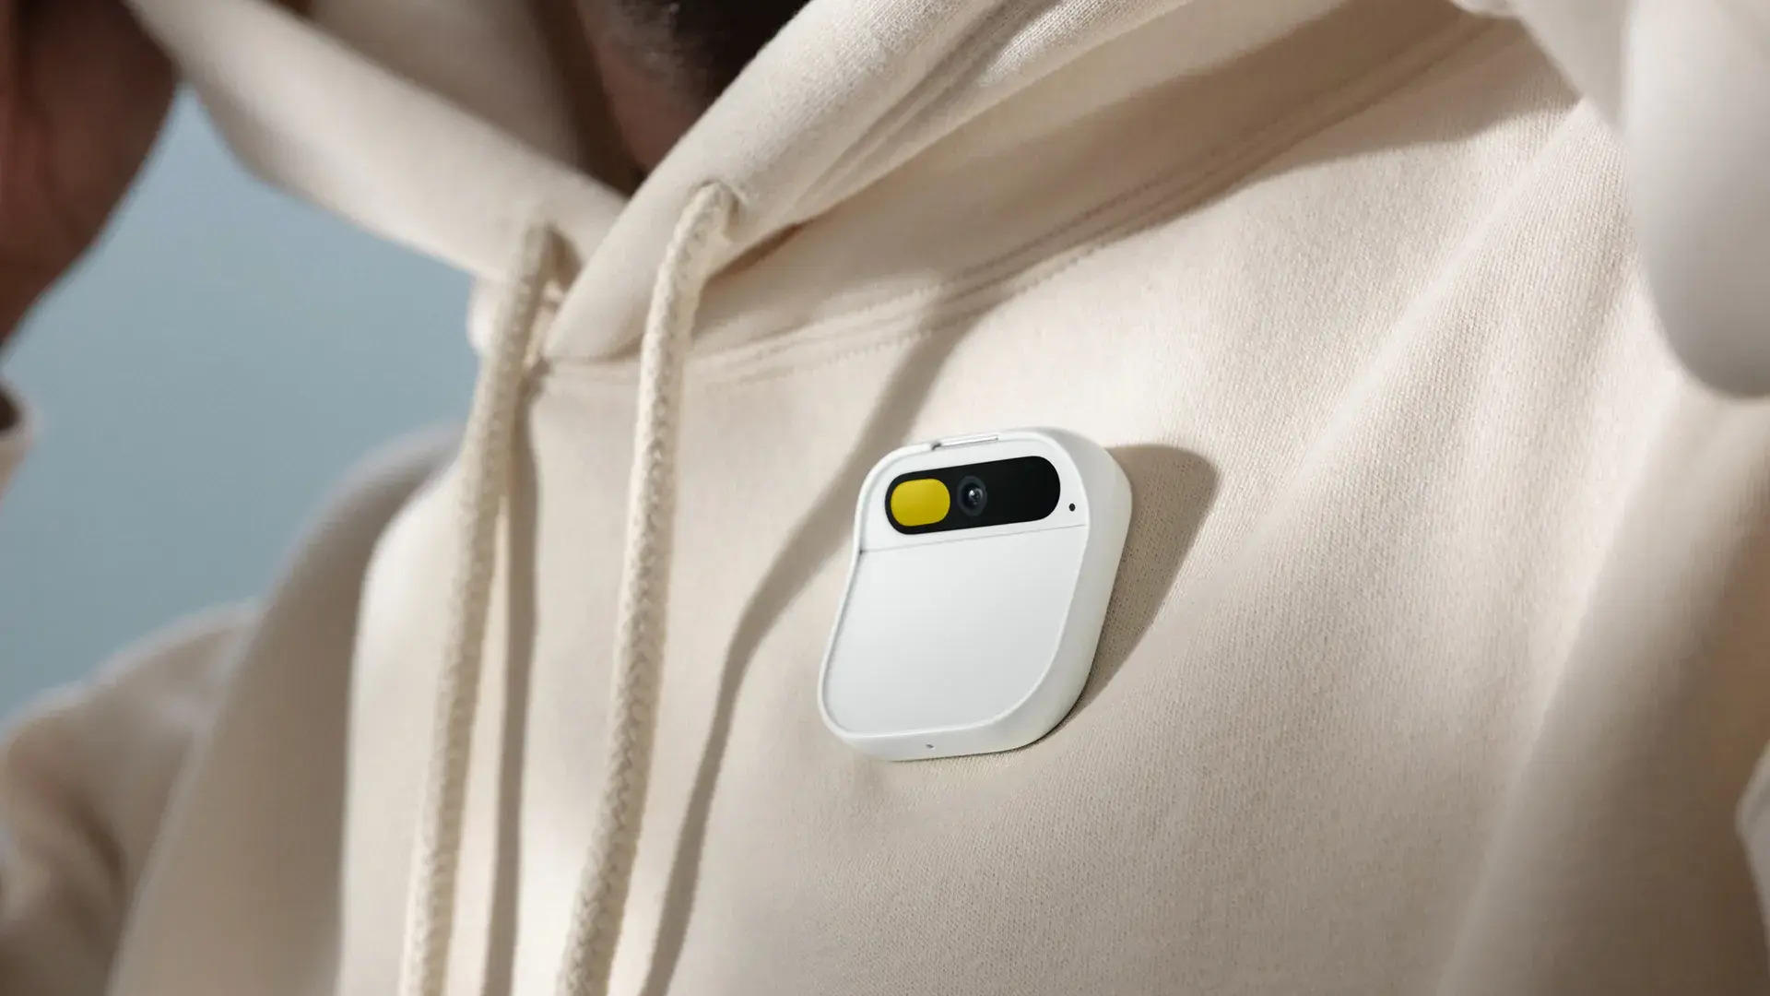
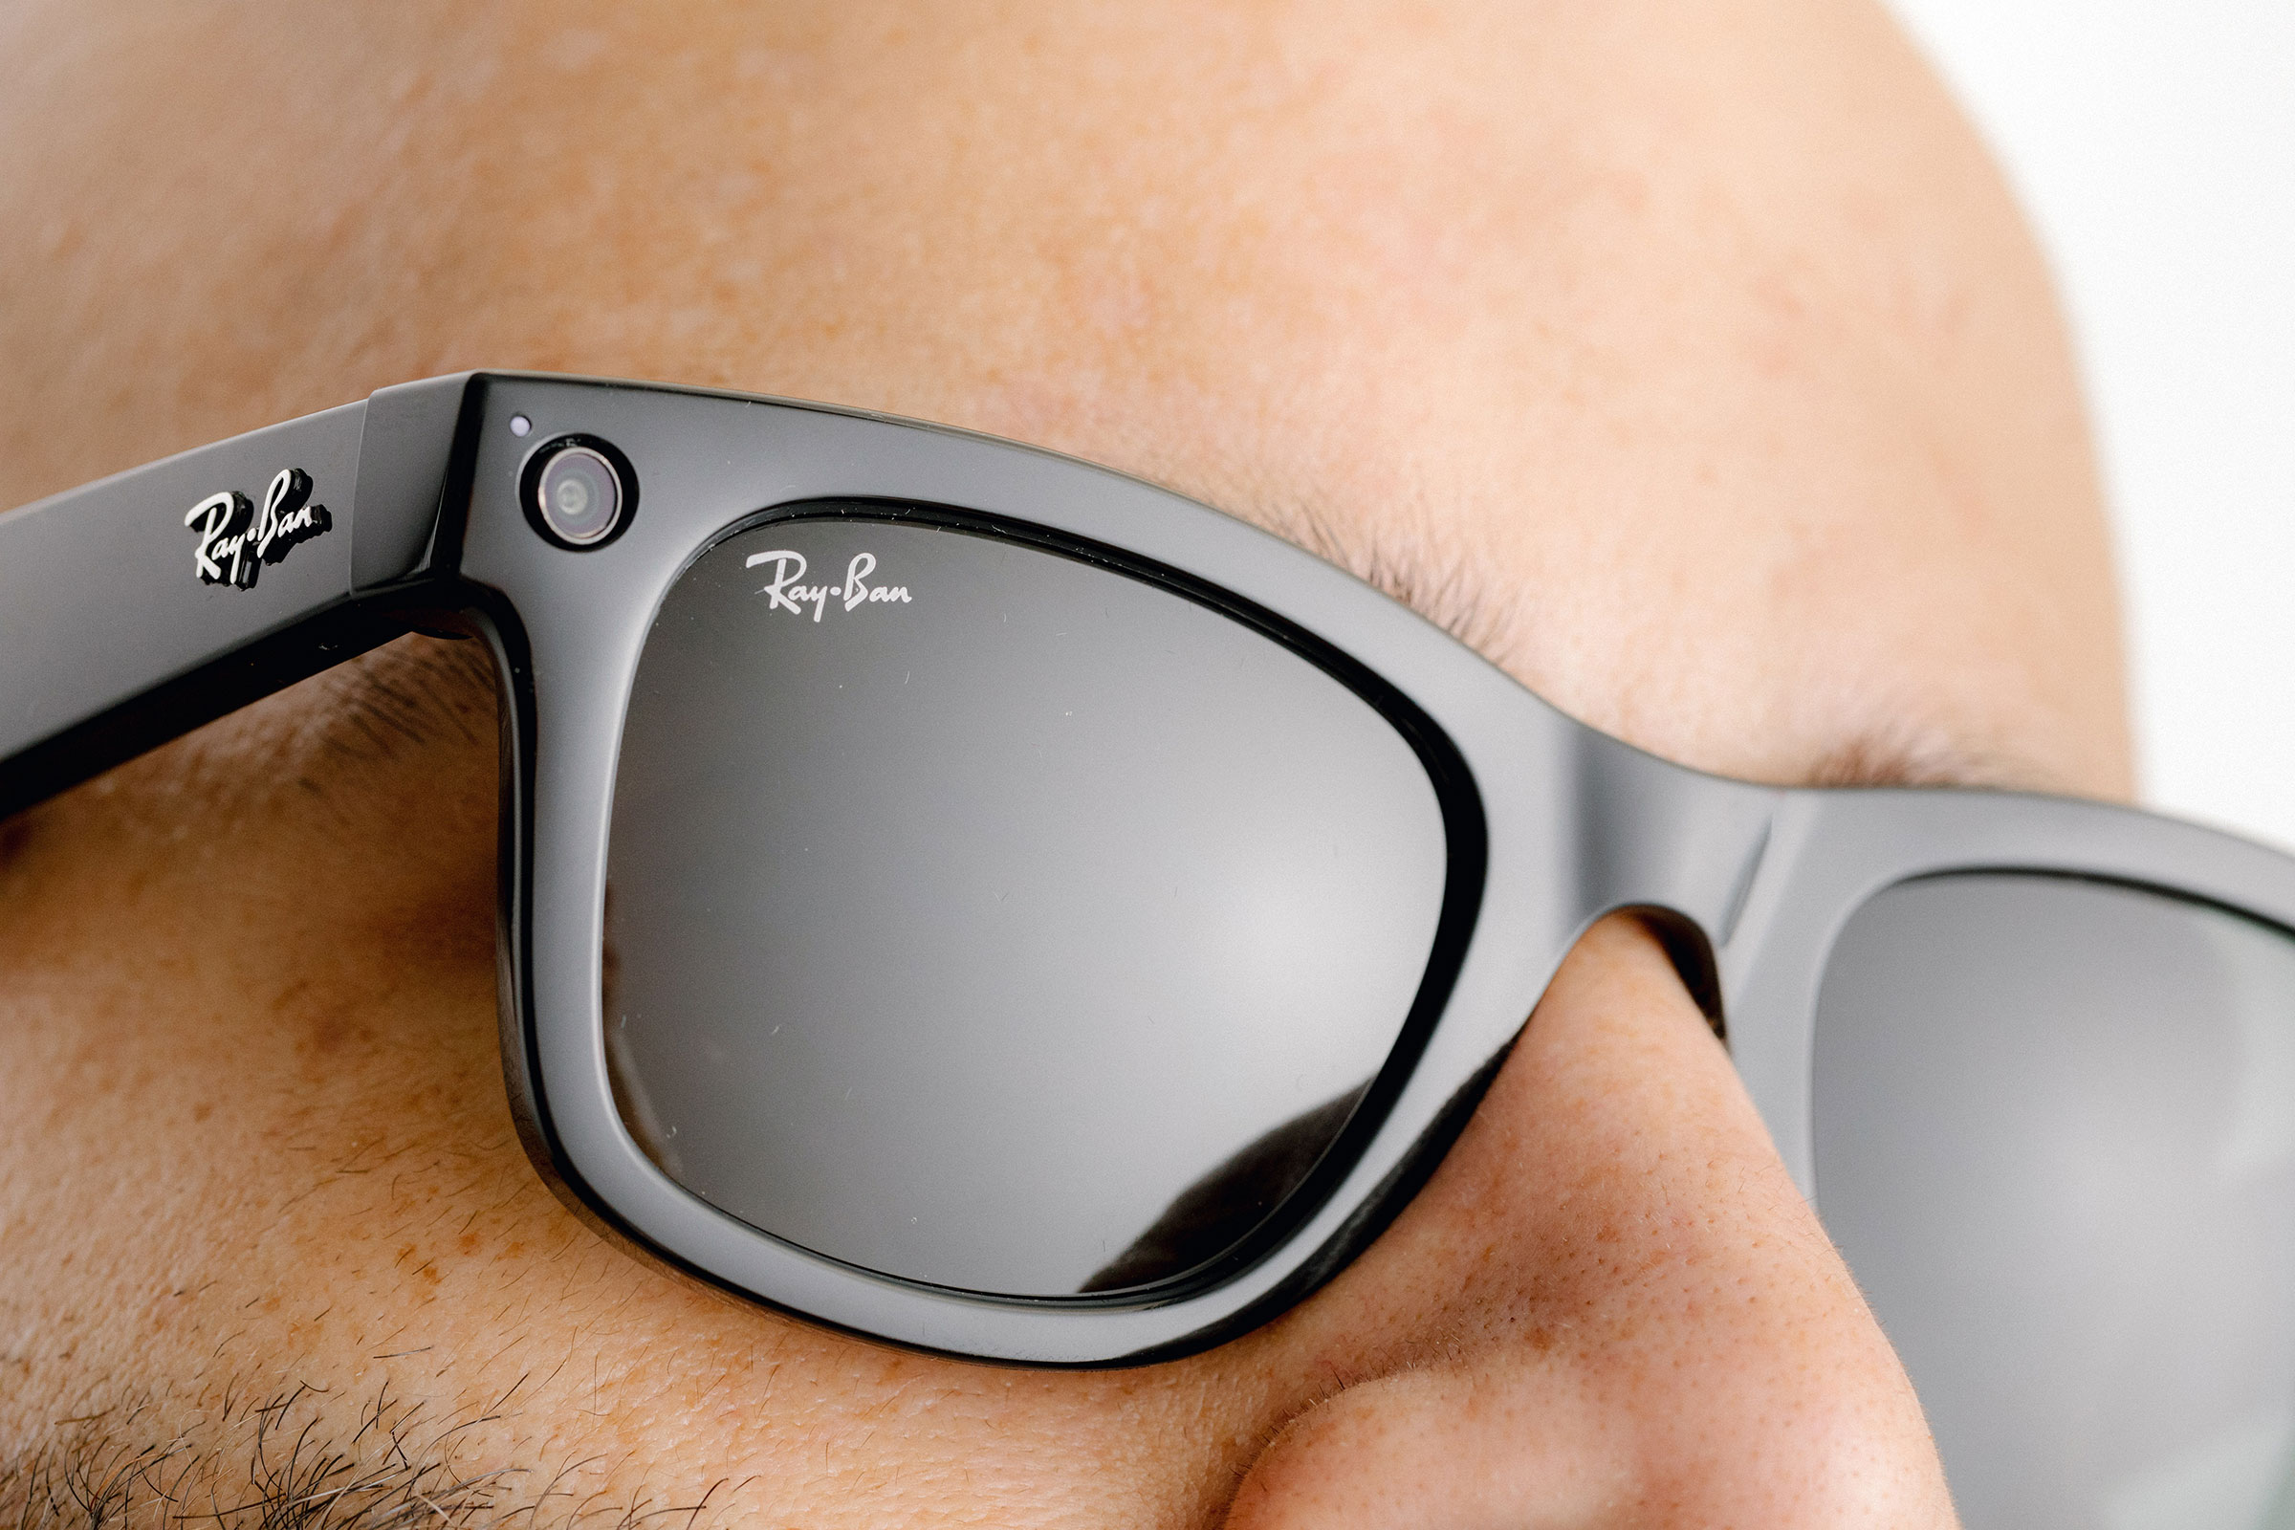
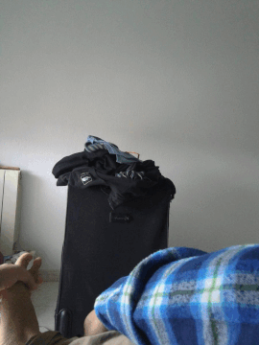
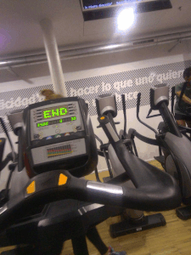
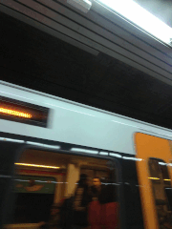
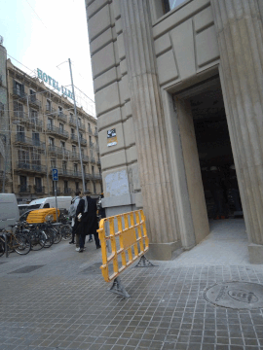
Visual Lifelog
Visual life-log images acquired via wearable cameras
  Automatically record life moments
  2 images per min to 30 FPS
  ~1500 images per day
Memory augmentation - Periodic review of memorable events, interactions, etc.
Home
Gym
Public transport
Outdoor
Notes:
23

Slide 26

Event Memorability
Not memorable
Memorable
Notes:
24
Event memorability refers to the ability of an event, as captured in a lifelog image, to be remembered or recalled by an individual.

Slide 27
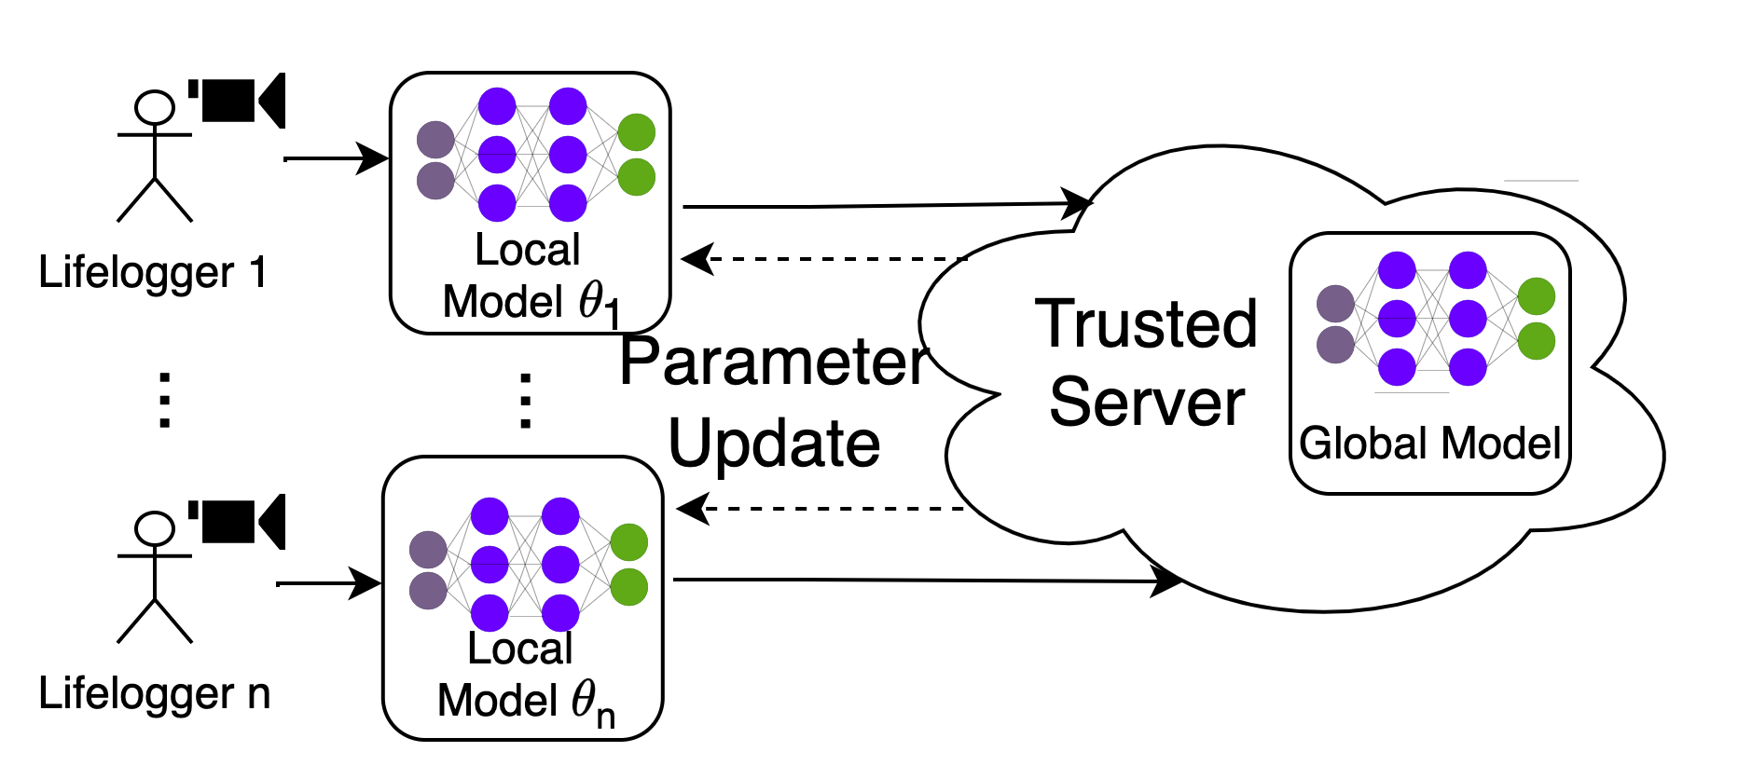
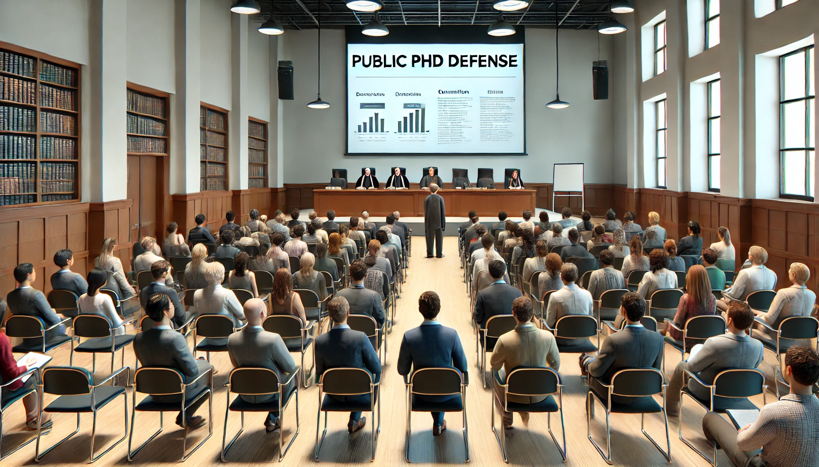
*Image of inter-subject variation is generated using DALL-E
Problem
Effect
Event memorability prediction
Data heterogeneity
Privacy
Accuracy
Privacy
Accuracy
Privacy
Accuracy
Inter-subject variation
Self-rating load
Self-rating load
Self-rating load
My score
Random audience
9
5
Siloed model
Centralized
Global model
Notes:
25

Slide 28
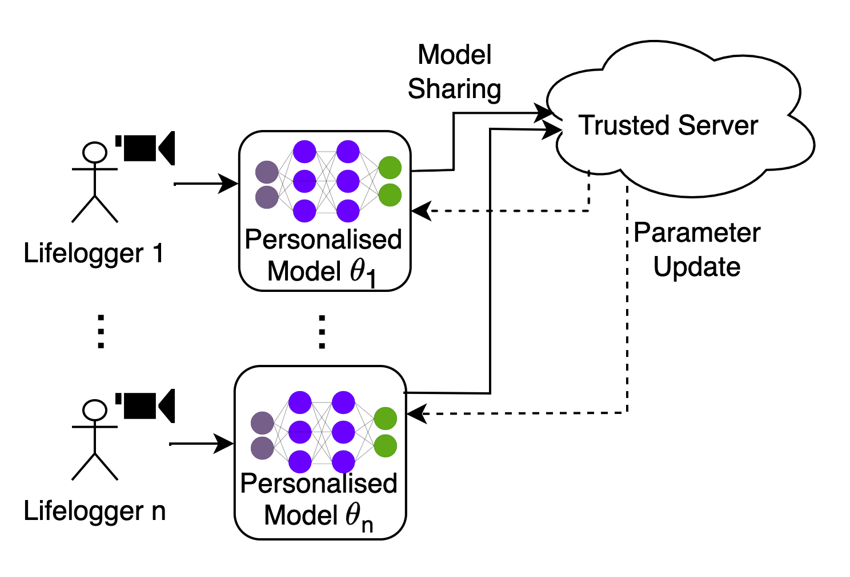
Solution
Effect
Privacy
Accuracy
Self-rating load
Paper V
Objective RO3 and RO4
Notes:
25:50

Slide 29
Contributions
FedMEM
Clustered personalized FL
Memorability Score Distribution - based Clustering (MSDC) of the lifeloggers
Model Similarity Score (MSC) between lifeloggers, cluster model, and global model
MSC based clustering
Notes:
26

Slide 30
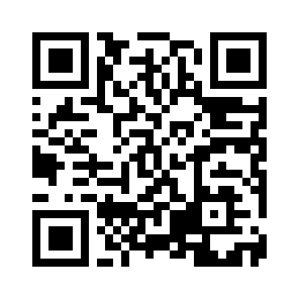
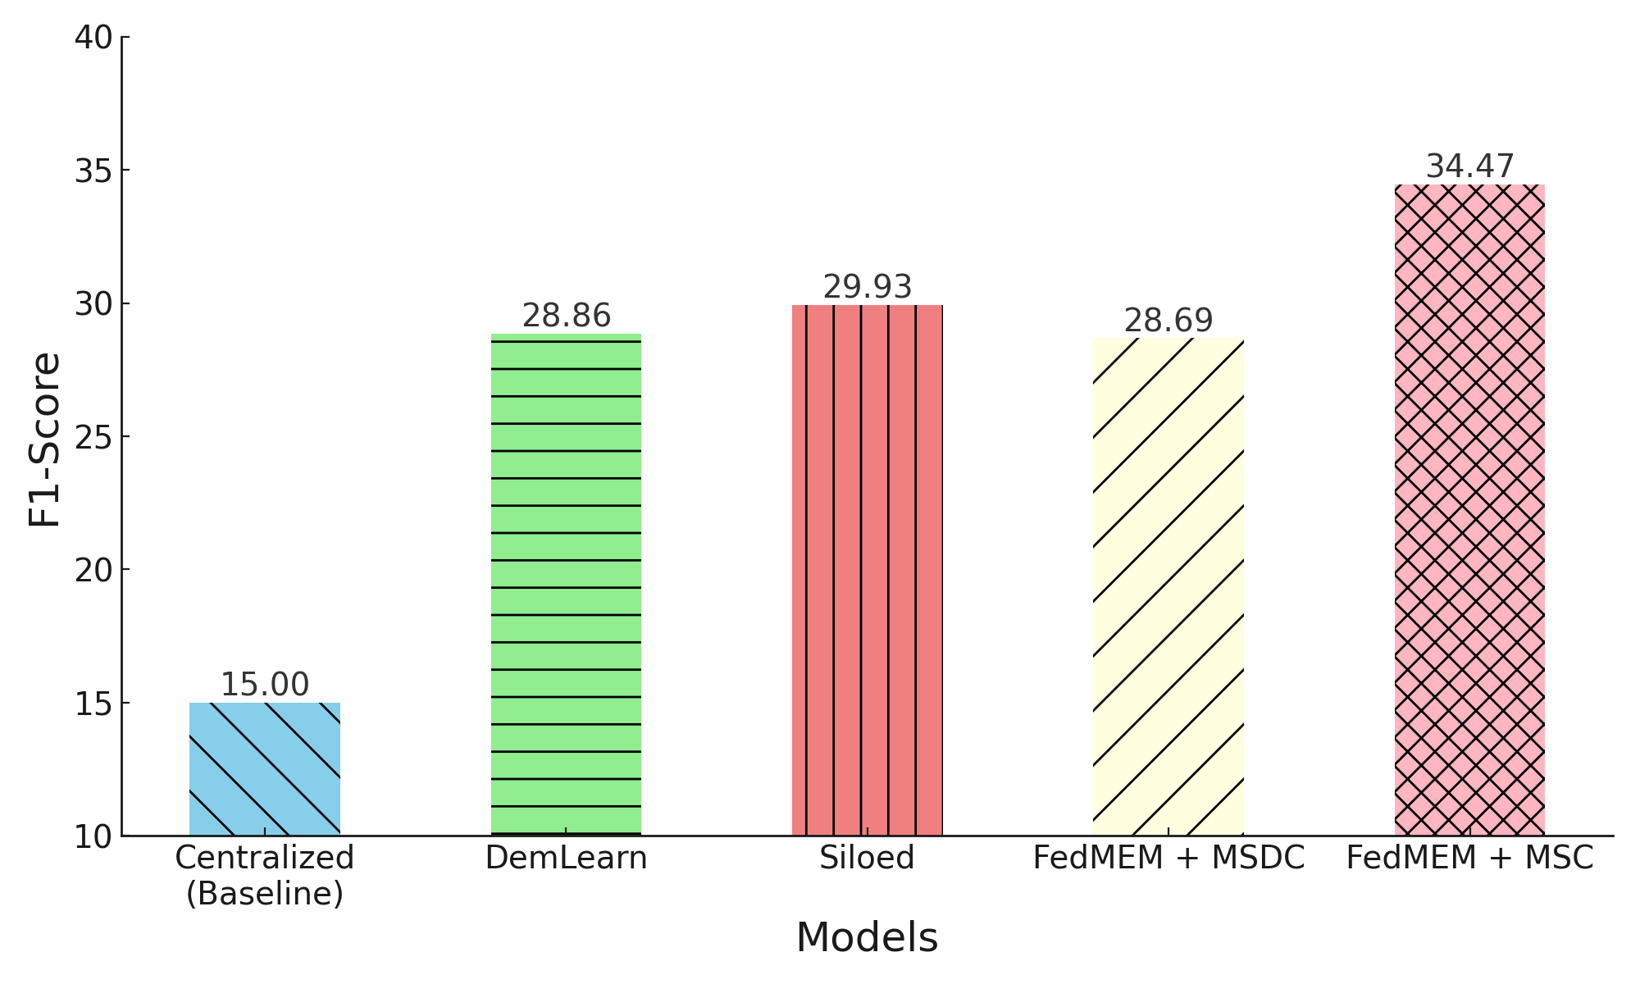
Results and Analysis
Performance
Source code
FedMEM+MSC
Siloed
4.54%
FedMEM+MSDC 5.78%
DemLearn 5.61%
Baseline
19.47%
Notes:
26:30

Slide 31
The Case for Federated Learning in Developing Personalized Image Privacy Advisor
Paper VI
Notes:
27:10

Slide 32
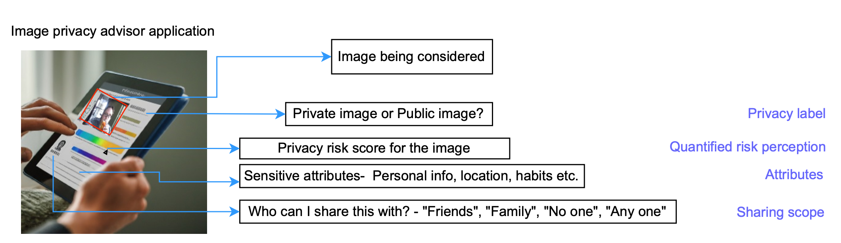
Privacy Advisor
Key functions
  Detect sensitive information
  Personalized risk assessment
Recommendations for users
  Advice on photo sharing
  Suggestions for obfuscation
Notes:
28
Advice on SharingProvides recommendations on whether an image should be shared, modified, or protected.
Suggestions for Obfuscation : Recommends actions such as blurring faces, hiding information, or adjusting the image to reduce risks.
A Privacy Advisor helps users make informed decisions about sharing or protecting personal information, particularly in digital environments.

Slide 33
*Image of cat is generated using DALL-E
Problem
Effect
Solution
Impact
Non-federated
Data heterogeneity
Clustered-personalized FL
Privacy
Accuracy
Privacy
Accuracy
Data scarcity
Inter-subject variation
Data heterogeneity
Federated-global
Daisy
chaining
Data
scarcity
Privacy
Accuracy
Client 1
Client 2
Private
Sharing
other
Paper VI
Objective RO3 and RO4
Notes:
29
Privacy Risks: While training, sharing privacy-sensitive information in images can lead to unintended exposure of personal details.

Slide 34



Contributions
ResourceFul (RF)
Available clients
Data
scarcity
Resource-Limited (RL)
Dynamic-Clustered-FedDC
  RF and RL both performs daisy-chaining
Apriori-Clustered-FedDC
  Clusters based on the personality of the users
  RL performs daisy-chaining
Clustered personalized FL overcomes the data heterogeneity challenge.
Daisy chaining overcomes the data scarcity challenge.
Notes:
30
Appriori clustering based on the big 5 personality of the user
Openness to Experience – Reflects the degree of intellectual curiosity, creativity, and a preference for novelty and variety. People high in this trait tend to be imaginative, open to new experiences, and curious, while those low in openness may be more practical, conventional, and prefer routine.
Conscientiousness – Refers to a person's level of organization, dependability, and self-discipline. High conscientiousness is associated with being responsible, organized, and goal-oriented. Low conscientiousness may indicate a tendency toward carelessness, disorganization, and impulsivity.
Extraversion – Measures the extent to which a person is sociable, outgoing, and enjoys interacting with others. Extraverted individuals tend to be energetic, talkative, and assertive. Introverted individuals (low extraversion) may prefer solitude, be more reserved, and find social situations draining.
Agreeableness – This trait describes a person's tendency to be compassionate, cooperative, and trusting towards others. Highly agreeable individuals are often empathetic, helpful, and value getting along with others, while those low in agreeableness might be more competitive, critical, and less concerned with others' feelings.
Neuroticism – Refers to the degree of emotional stability and the tendency to experience negative emotions like anxiety, anger, or depression. High neuroticism is associated with being more prone to stress, mood swings, and emotional instability. Low neuroticism indicates greater emotional resilience and stability.

Slide 35
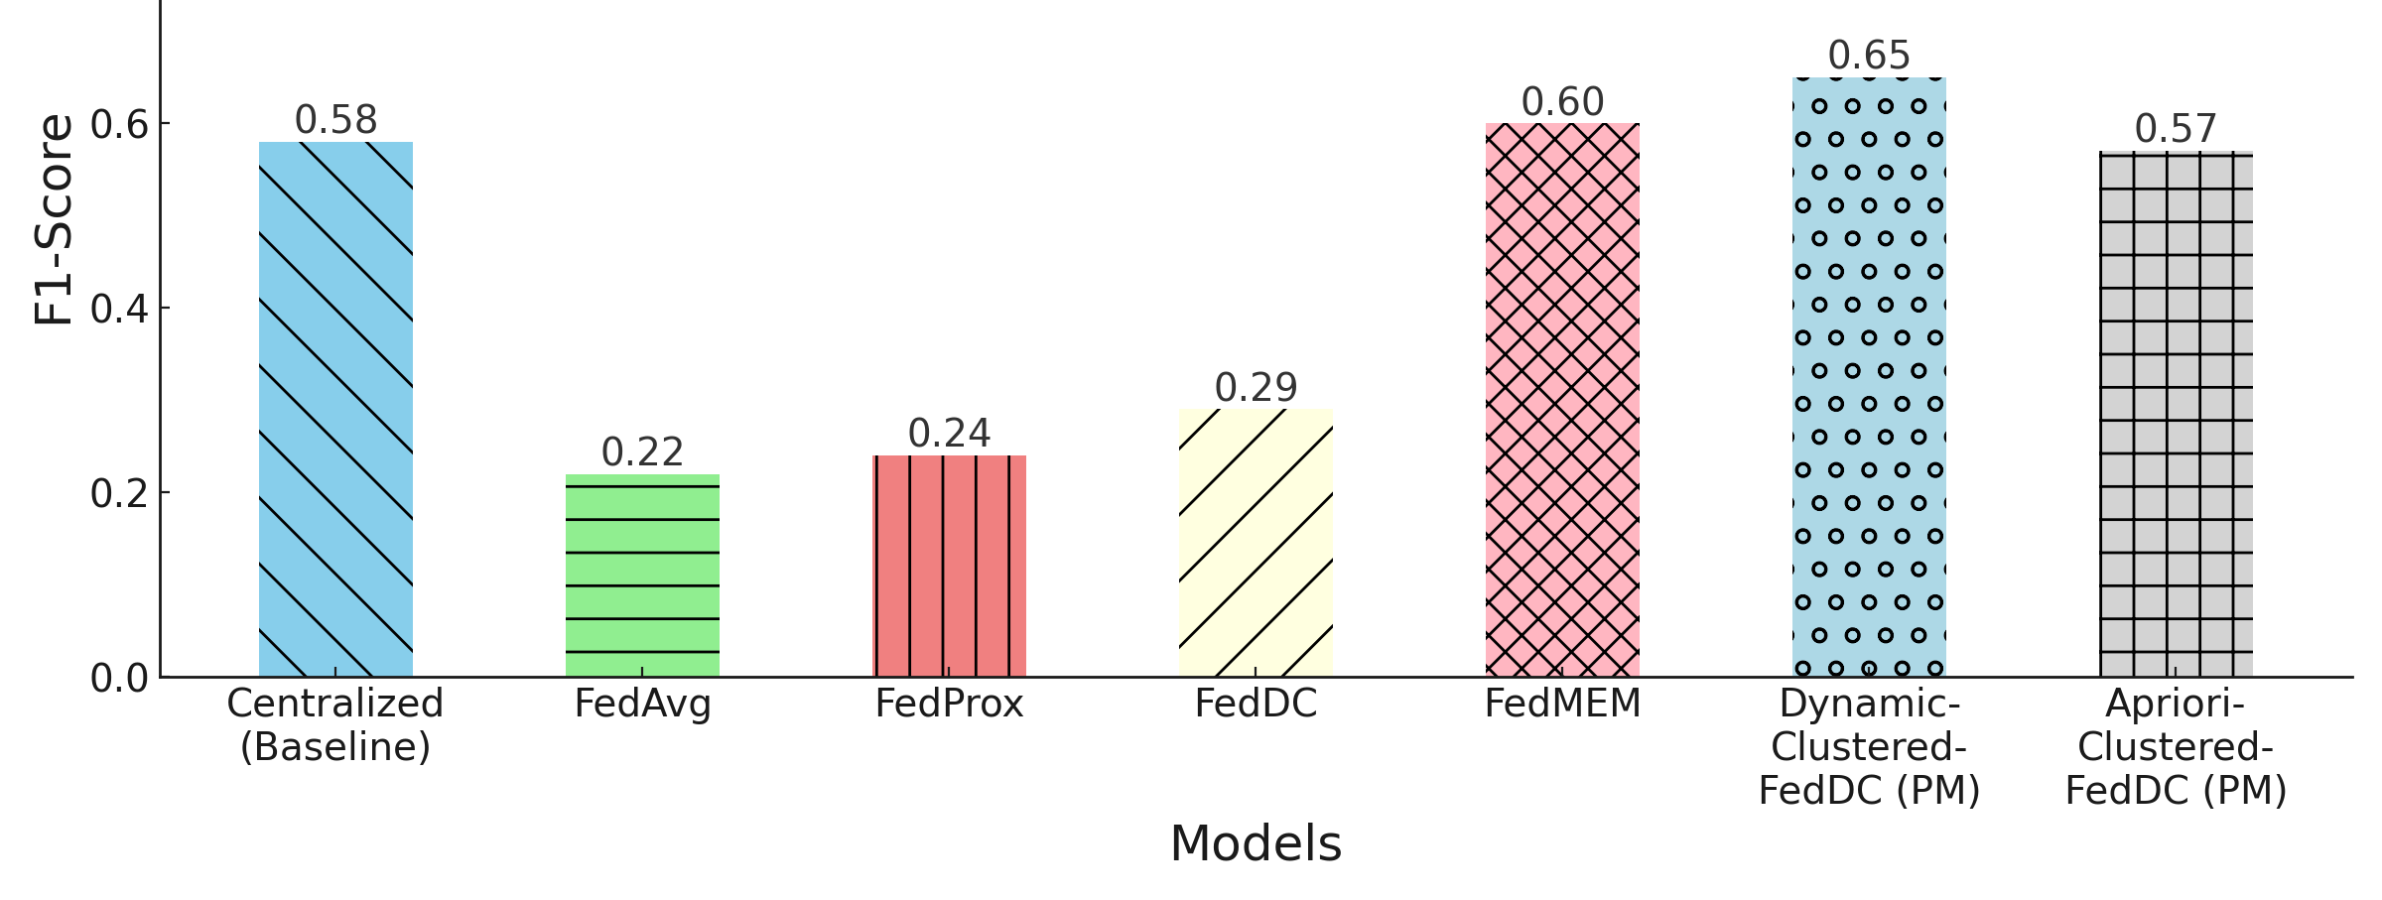
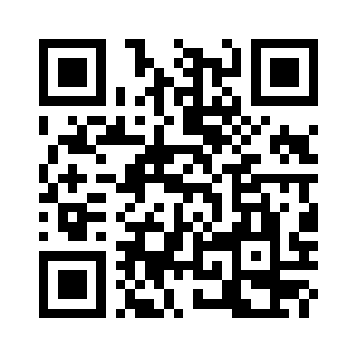
Results and analysis
Performance (Sharing owner)
Dynamic-Clustered-FedDC (PM)
  5% better than FedMEM
  7% better than Baseline
  36% better than FedDC
  41% better than FedProx
  43% better than FedAvg
Sharing owner
Source code
Notes:
31
Sharing owner
1. won't share
2. Share in close relation
3. Regular relationship
4. Acquaintance
5. Public - random public
6. Broadcast - TV
7. Others

Slide 36
Conclusion
Data heterogeneity
System heterogeneity
Focused challenges
Paper I and III
  Feature selection in horizontal FL
Mitigation of stragglers’ effect in FL
Paper II
Paper IV
Personalized FL in multi-tier settings
Event memorability prediction using
personalized FL
Paper V
Paper VI
Personalized image privacy advisor
Notes:
32

Slide 37
Future Scope
Model
heterogeneity
Inconsistency in sharing
  Knowledge-Distillation in FL
Catastrophic
forgetting
+
Data
heterogeneity
Rehearsal/Experience replay
Task-aware FL
Continual
data
Notes:
33
Task-aware Federated Learning (FL) in the context of continual data refers to an approach where the federated learning system is aware of the specific tasks being performed and can adapt to new tasks as they emerge over time. This is particularly important when data is continual, meaning that data streams in over time rather than being available all at once. In this scenario, the system must efficiently manage task switching and continual learning without catastrophic forgetting (where learning new tasks causes degradation in performance on older tasks).

Slide 38
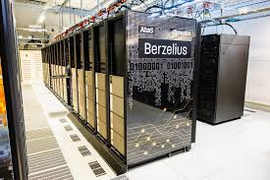

Acknowledgement
Notes:
33:10

Slide 39

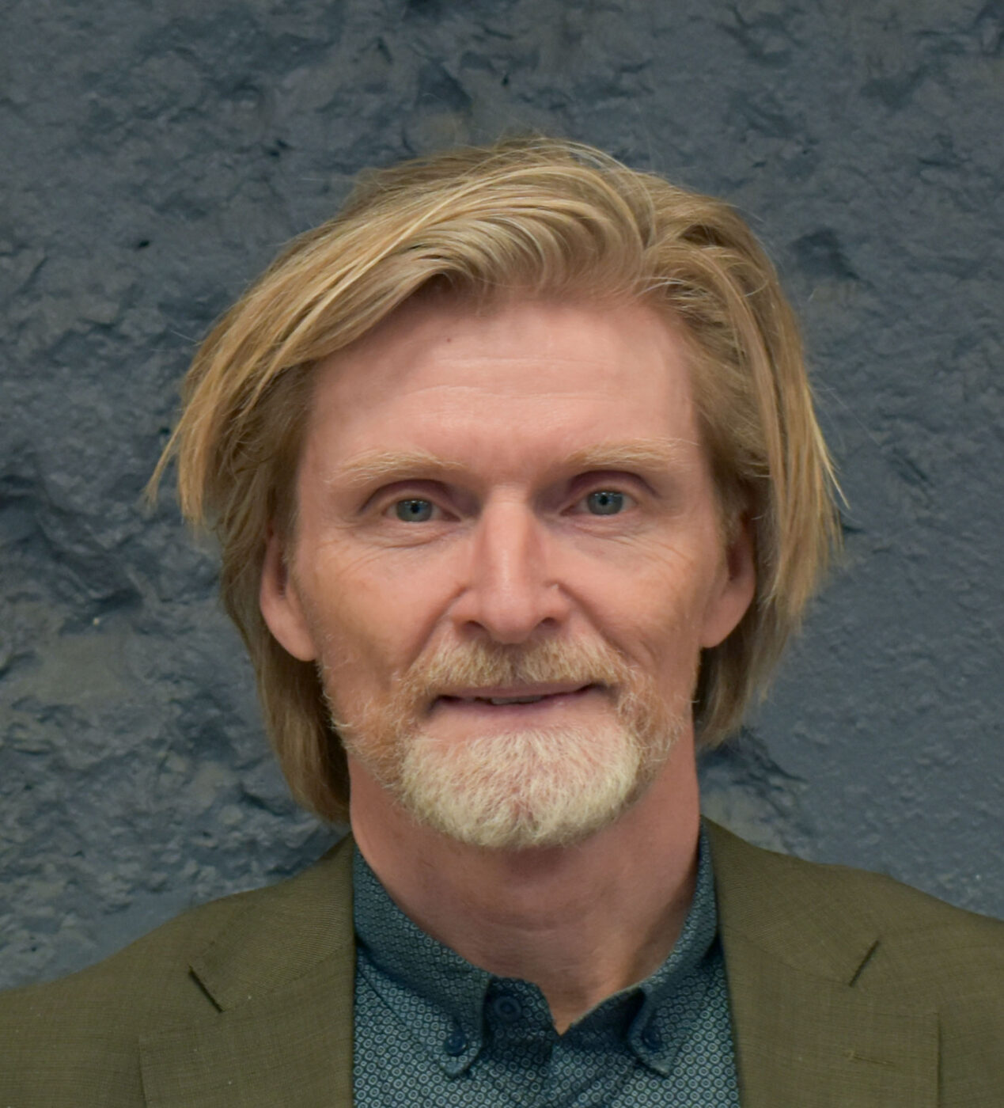
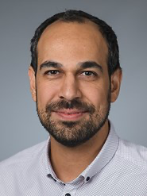
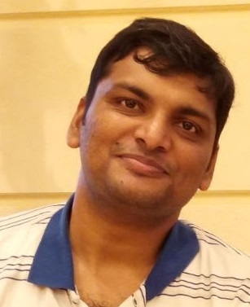

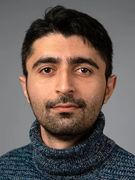


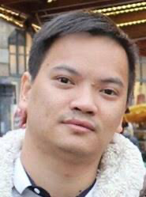
Supervisor
Dr. Monowar Bhuyan
Co-author:
Paper I to VI
Co-supervisor
Prof. Erik Elmroth
Co-author:
Paper I and III
Mentor
Dr. Alp Yurtsever
Co-author:
Paper IV
Mentor
Dr. Vigneshwaran Subbaraju
Co-author:
Paper V and VI
Mentor
Dr. Debaditya Roy
Co-author:
Paper V and VI
Ali Dadras Co-author
Paper IV
Devvjiit Bhuyan Co-author
Paper III
Vengateswaran Subhramanium
Co-author
Paper VI
Dr. Xuan-Son Vu
Co-author
Paper II
Notes:
33:20

Slide 40
Publication list
Paper I : Sourasekhar Banerjee, Erik Elmroth, and Monowar Bhuyan. Fed-FiS: A Novel Information-Theoretic Federated Feature Selection for Learning Stability. Proceedings of the 28th International Conference on Neural Information Processing (ICONIP), Springer, Vol. 1516, pp. 480-487, 2021.
Paper II: Sourasekhar Banerjee, Xuan-Son Vu, and Monowar Bhuyan. Optimized and Adaptive Federated Learning for Straggler-Resilient Device Selection. Proceedings of the International Joint Conference on Neural Networks (IJCNN), IEEE, pp. 1-9, 2022.
Paper III: Sourasekhar Banerjee, Devvjiit Bhuyan, Erik Elmroth, and Monowar Bhuyan. Cost-Efficient Feature Selection for Horizontal Federated Learning. IEEE Transactions on Artificial Intelligence (TAI), IEEE, doi: 10.1109/TAI.2024.3436664, pp. 1-15, 2024.
Paper IV: Sourasekhar Banerjee, Ali Dadras, Alp Yurtsever and Monowar Bhuyan. Personalized Multi-tier Federated Learning. Accepted for publication in the 31st International Conference on Neural Information Processing (ICONIP), pp. 1-16, 2024. (Accepted)
Paper V: Sourasekhar Banerjee, Debaditya Roy, Vigneshwaran Subbaraju, and Monowar Bhuyan. Predicting Event Memorability using Personalized Federated Learning. pp. 1-8, 2024. (Submitted)
Paper VI: Sourasekhar Banerjee, Vengateswaran Subramaniam, Debaditya Roy, Vigneshwaran Subbaraju, and Monowar Bhuyan. The Case for Federated Learning in Developing Personalized Image Privacy Advisor. pp. 1-12, 2024. (Submitted)
Notes:
34

Slide 41
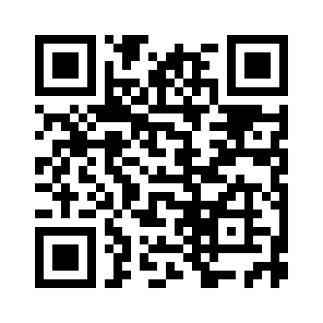
Thank You!
sourasb@cs.umu.se
https://sourasb05.github.io/

Slide 42
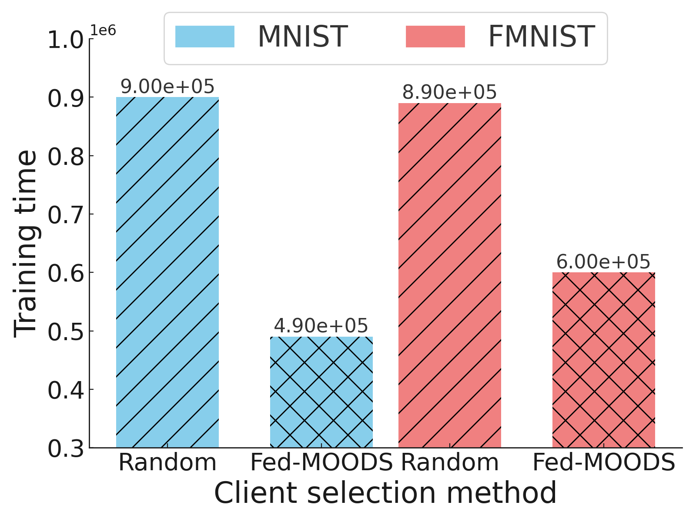

Results and Analysis
Non-IID
Source code
Training time when 90% devices
are straggler
Fed-MOODS
MNIST
FMNIST
1.8 x
1.48 x
Notes:
19

Slide 43
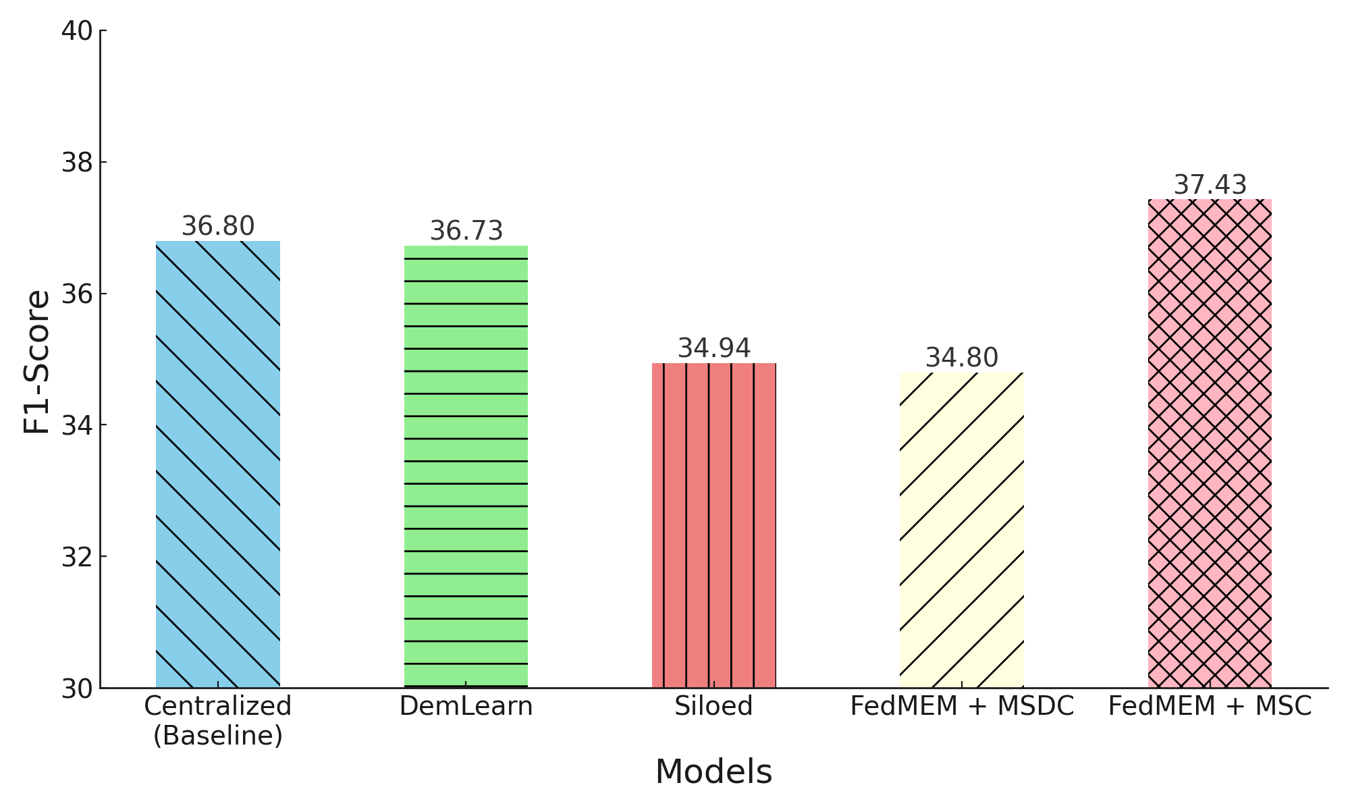
Results and Analysis
Performance
(After fusion)
Source code
FedMEM+MSC
Baseline
0.63%
DemLearn
0.7%
Siloed
2.49%
FedMEM+MSDC 2.63%
Notes:
27

Slide 44
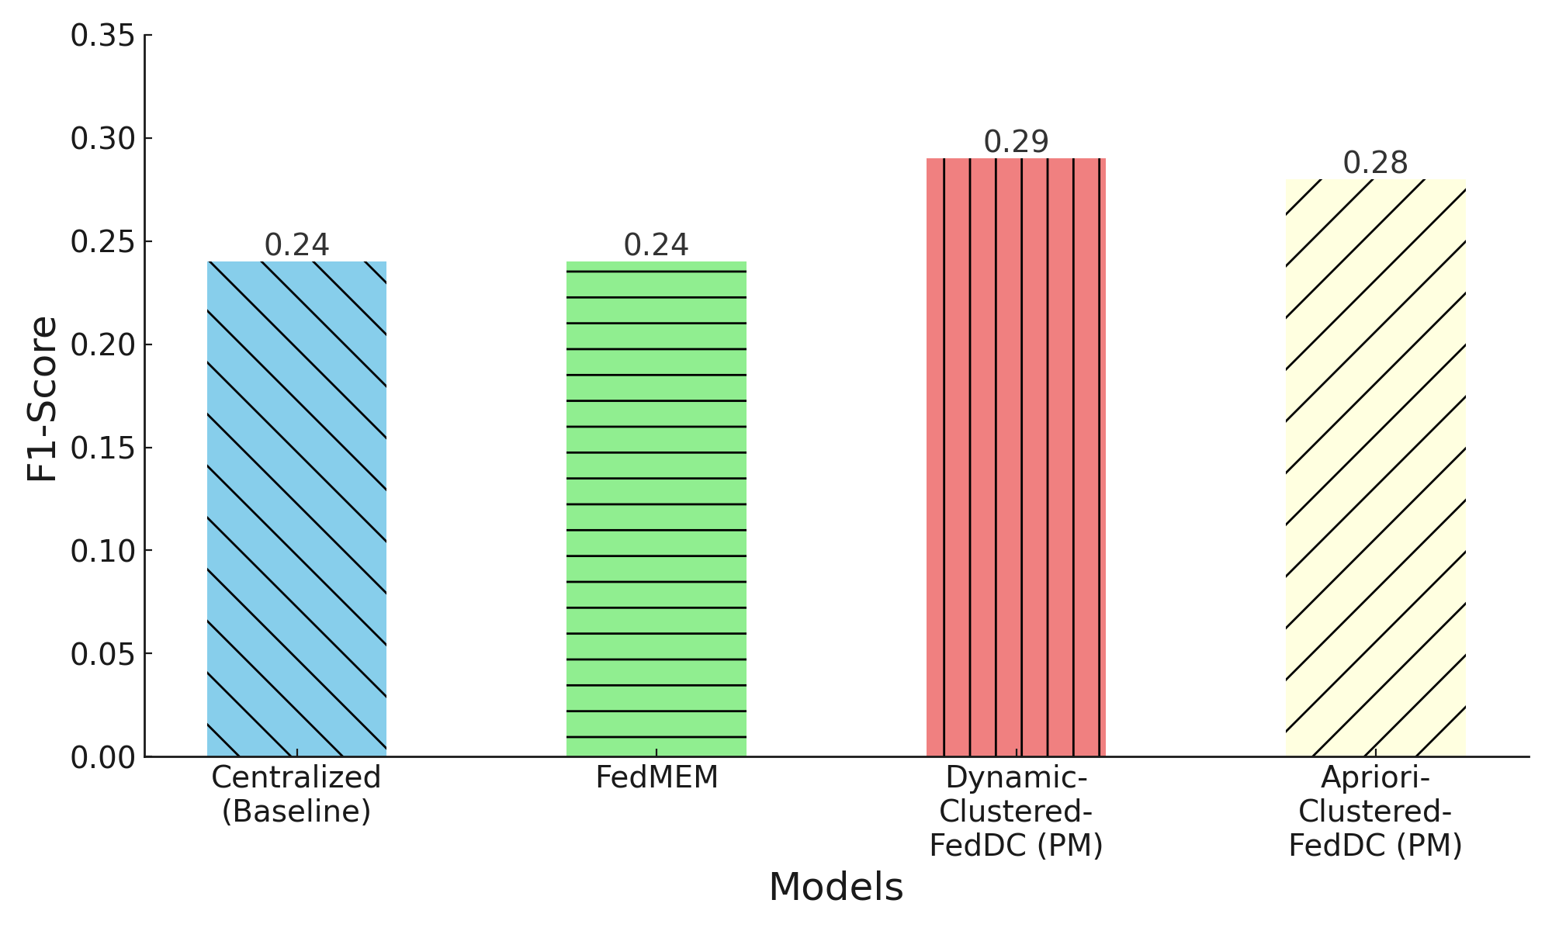
Results and analysis
Informativeness
Performance (Informativeness)
Dynamic-Clustered-FedDC (PM)
  5% better than baseline and FedMEM
Apriori-Clustered-FedDC (PM)
  4% better than baseline and FedMEM

