Slide 1
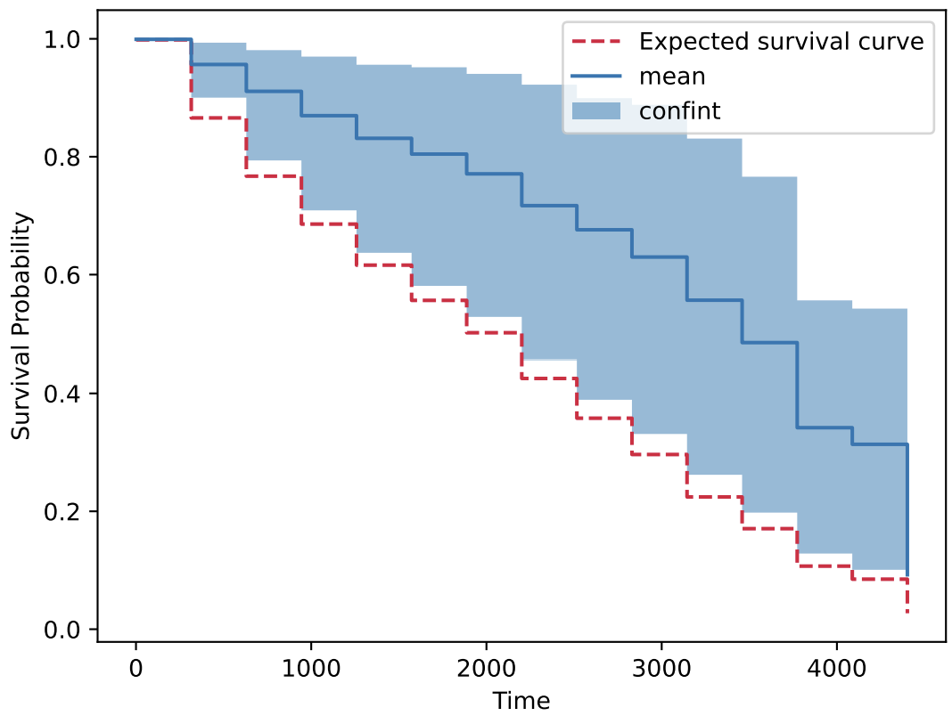
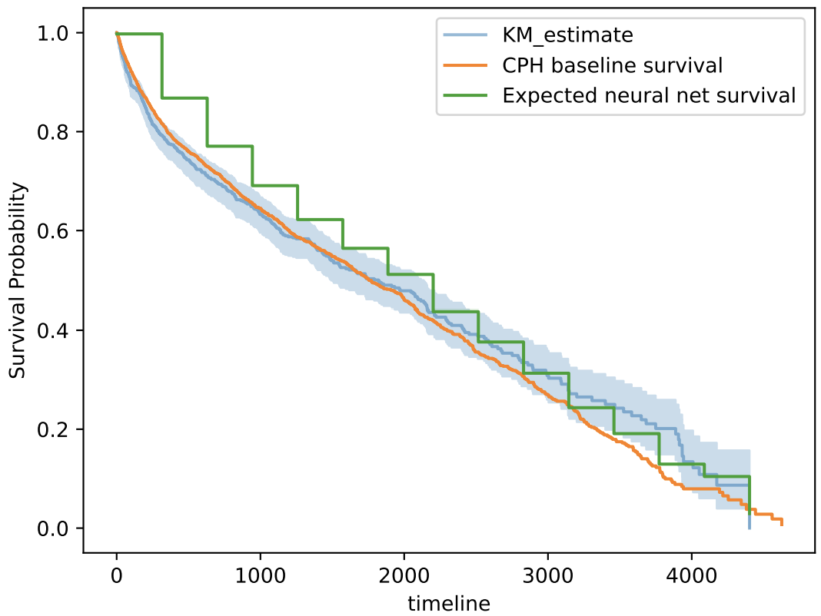




Survival Analysis of Heart Failure Patients
Souradeep Sen | August, 2023
Supervised By
Professor Krasimira Tsaneva
Dr Ayah Helal
$$x_{i}$$
...
...
$$m$$
...
...
$$h$$
$$h$$

Slide 2
Contents
Research Context
Research Question
Aim(s) and Objective(s)
Background
Data
Storage
Processing
Experimental Design
Results
Further Work

Slide 3
Research Context
Heart failure is a syndrome affecting the heart's pumping ability, leading to circulatory issues.
Approximately 64 million individuals affected worldwide (2017) [1].
Accurate risk prediction is crucial for improving patient outcomes.
Medical professionals commonly use traditional semi-parametric models to predict mortality risk.
Various traditional methods are compared against newer deep learning techniques to assess their performance in risk prediction.
Research Question
Aim and Objective
Are deep learning methods better at predicting risk for HF patients when compared to traditional methods?
If so, what are the tradeoffs?
Analyze a suitable dataset and predict survival of patients using traditional as well as deep learning models.
Through rigorous experimentation, ascertain the validity of DL models.
[1] S. L. James, D. Abate, K. H. Abate, S. M. Abay, C. Abbafati, N. Abbasi, and H. Abbastabar, Global, regional, and national incidence, prevalence, and years lived with disability for 354 diseases and injuries for 195 countries and territories, 1990–2017: A systematic analysis for the global burden of disease study 2017., The Lancet https://doi.org/10.1016/S0140-6736(18)32279-7 (2018).

Slide 4
Background – Survival Analysis
Survival analysis differs from regular regression tasks due to unknown event times for some subjects, termed censored observations.
The Cox Proportional Hazards model is a standard in continuous time survival models, maintaining proportional hazards assumption with multiplicative covariate impact.
Extensions explore nonlinear hazards within the Cox model framework.
Recent methods [2] suggest deep neural networks for risk prediction using complex electronic health record (EHR) data, showing promise in congestive heart failure cases.
Real-time risk prediction is explored in [3].
Discrete time survival predictions [4] allow probabilistic estimation of mortality risk.
Clinical settings are adopting deep learning and traditional machine learning for survival analysis [5,6].
Patients With Dementia for Earlier Palliative Care Interventions, JAMA Network Open 2, e196972 (2019).
[2] Z. Che, Y. Cheng, Z. Sun, and Y. Liu, Exploiting convolutional neural network for risk prediction with medical feature embedding, arXiv preprint arXiv:1701.07474 (2017).
[3] L. Brand, A. Patel, I. Singh, and C. Brand, Real time mortality risk prediction: A convolutional neural network approach., in HEALTHINF (2018) pp. 463–470.
[4] C. Lee, J. Yoon, and M. van der Schaar, Dynamicdeephit: A deep learning approach for dynamic survival analysis with competing risks based on longitudinal data, IEEE Transactions on Biomedical Engineering https://doi.org/10.1109/TBME.2019.2909027 (2020).
[5] M. Gjoreski, A. Gradisek, B. Budna, M. Gams, and G. Poglajen, Machine learning and end-to-end deep learning for the detection of chronic heart failure from heart sounds, IEEE Access 8, 20313 (2020).
[6] L. Wang, L. Sha, J. R. Lakin, J. Bynum, D. W. Bates, P. Hong, and L. Zhou, Development and Validation of a Deep Learning Algorithm for Mortality Prediction in Selecting
Notes:
1. Cox PH is fitted by max partial likelihood.
2. DL – data-hungry, advent of EHR great! Longitudinal data

Slide 5
Data Storage and Processing
The study utilizes the open-source MIMIC-IV database [7], encompassing critical care information from hospital and ICU admissions.
The database includes data from nearly 300,000 patients admitted to intensive care units at the Beth Israel Deaconess Medical Center (BIDMC).
For comprehensive data details, see MIMIC-IV website.
In-hospital death (uncensored)
Setup (see: github)
Local postgres server
Python to query
PyTorch for Deep Learning
1 year since discharge
Out-of-hospital death (uncensored)
Patient journeys
1 year since discharge
Patients with Heart Failure ICD-10 codes are chosen for inclusion in the study.
Collected data encompass admission and discharge times, as well as static and time-varying covariates.
Out-of-hospital death (censored)
Timeline
[7] A. E. Johnson, L. Bulgarelli, L. Shen, A. Gayles, A. Shammout, S. Horng, T. J. Pollard, S. Hao, B. Moody, B. Gow, and et al., Mimic-iv, a freely accessible electronic health record dataset, Scientific Data 10, 10.1038/s41597-022-01899-x (2023).
Although the data is freely-available, ethics approval was sought for the project. See: Application ID: 2669275
Date of death (dod) for discharged patients is collected from state records if they died within 1 year of discharge. Otherwise, dod column is left blank (indicating censoring).
For the time-varying approach, patients need records across datasets and at least 10 time steps, reducing patient count compared to the time-invariant version.

Slide 6





Experimental Design - I
Time-Invariant
Time-Variant
Covariates
Discrete outputs
$$x_{i}$$
Time steps
...
...
$$m$$
sigmoid
Conv2d
Conv2d
...
...
$$m$$
...
...
...
...
Patients
$$h$$
$$h$$
Discrete hazards
$$h$$
$$h$$
Patient Image
Survival from cumulative discrete hazards [8]
Composite Loss Function [8]-[9]
$$S\left(τ_{j}\right)=\prod_{k=1}^{j}{\left(1−h\left(τ_{k}\right)\right)}$$
$$ℒ=αℒ_{1}+\left(1−α\right)ℒ_{2}$$
[8] H. Kvamme and Ø. Borgan, Continuous and discrete time survival prediction with neural networks (2019), arXiv:1910.06724
[9] V. C. Raykar, H. Steck, B. Krishnapuram, C. Dehingoberije, and L. Philippe, On ranking in survival analysis: Bounds on the concordance index, Advances in Neural Information Processing Systems (2007).

Slide 7
Experimental Design - II
Traditional Fitters
Deep Learning Fitters
Proposed Fitters
Cox Proportional Hazards[10]
Weibull Accelerated Failure Time[11]
Random Survival Forest[12]
Deep Survival Machines [12]
PyCox with Logistic Hazards*[8]
Time-Invariant Survival
Time-Variant Survival
* Applied architecture is torchtuples.practical.MLPVanilla
[10] D. R. Cox, Regression models and life-tables., Journal of the Royal Statistical Society (1972).
[11] W. R. Swindell, Accelerated failure time models provide a useful statistical framework for aging research, Experimental Gerontology https://doi.org/10.1016/j.exger.2008.10.005 (2009).
[12] H. Ishwaran, U. B. Kogalur, E. H. Blackstone, and M. S. Lauer, Random survival forests, The Annals of Applied Statistics https://doi.org/10.1214/08-AOAS169 (2008).
[13] C. Nagpal, X. R. Li, and A. Dubrawski, Deep survival machines: Fully parametric survival regression and representation learning for censored data with competing risks (2021), arXiv:2003.01176 [cs, stat]

Slide 8
Results are subject to slight change in final submission of report
Results - I
Model | C-index* (0.05 , 0.95) | IBS** (0.05 , 0.95)
Cox Proportional Hazards | 0.6953 | 0.1731
Weibull Accelerated Failure | 0.6953 | 0.1741
Random Survival Forest | 0.6911 (0.6855, 0.6973) | 0.2013 (0.1998, 0.2024)
PyCox Logistic Hazard | 0.5984 (0.5723, 0.6104) | 0.1768 (0.1751, 0.1778)
Deep Survival Machines | 0.6498 (0.6016, 0.6598) | 0.2739 (0.2651, 0.2834)
Time-Invariant Survival | 0.6903 (0.6789, 0.6994) | 0.4030 (0.3937, 0.4090)
Time-Variant Survival | 0.7301 (0.7263 , 0.7352) | 0.4039 (0.3981, 0.4072)
* H. Uno, T. Cai, M. J. Pencina, R. B. D’Agostino, and L. J. Wei, On the c-statistics for evaluating overall adequacy of risk prediction procedures with censored survival data, Statistics in Medicine 30, 1105–1117 (2011).
** E. Graf, C. Schmoor, W. Sauerbrei, and M. Schumacher, Assessment and comparison of prognostic classification schemes for survival data, Statistics in Medicine (1999).

Slide 9
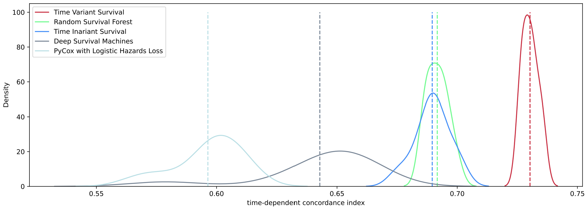
Results are subject to slight change in final submission of report
Results - II
Time Variant Survival
Random Survival Forest
Time Invariant Survival
Deep Survival Machines
PyCox with Logistic Hazards
Cox Proportional Hazards
Distribution of c-index shows high discriminatory power for Time-Invariant and Time-Variant models

Slide 10
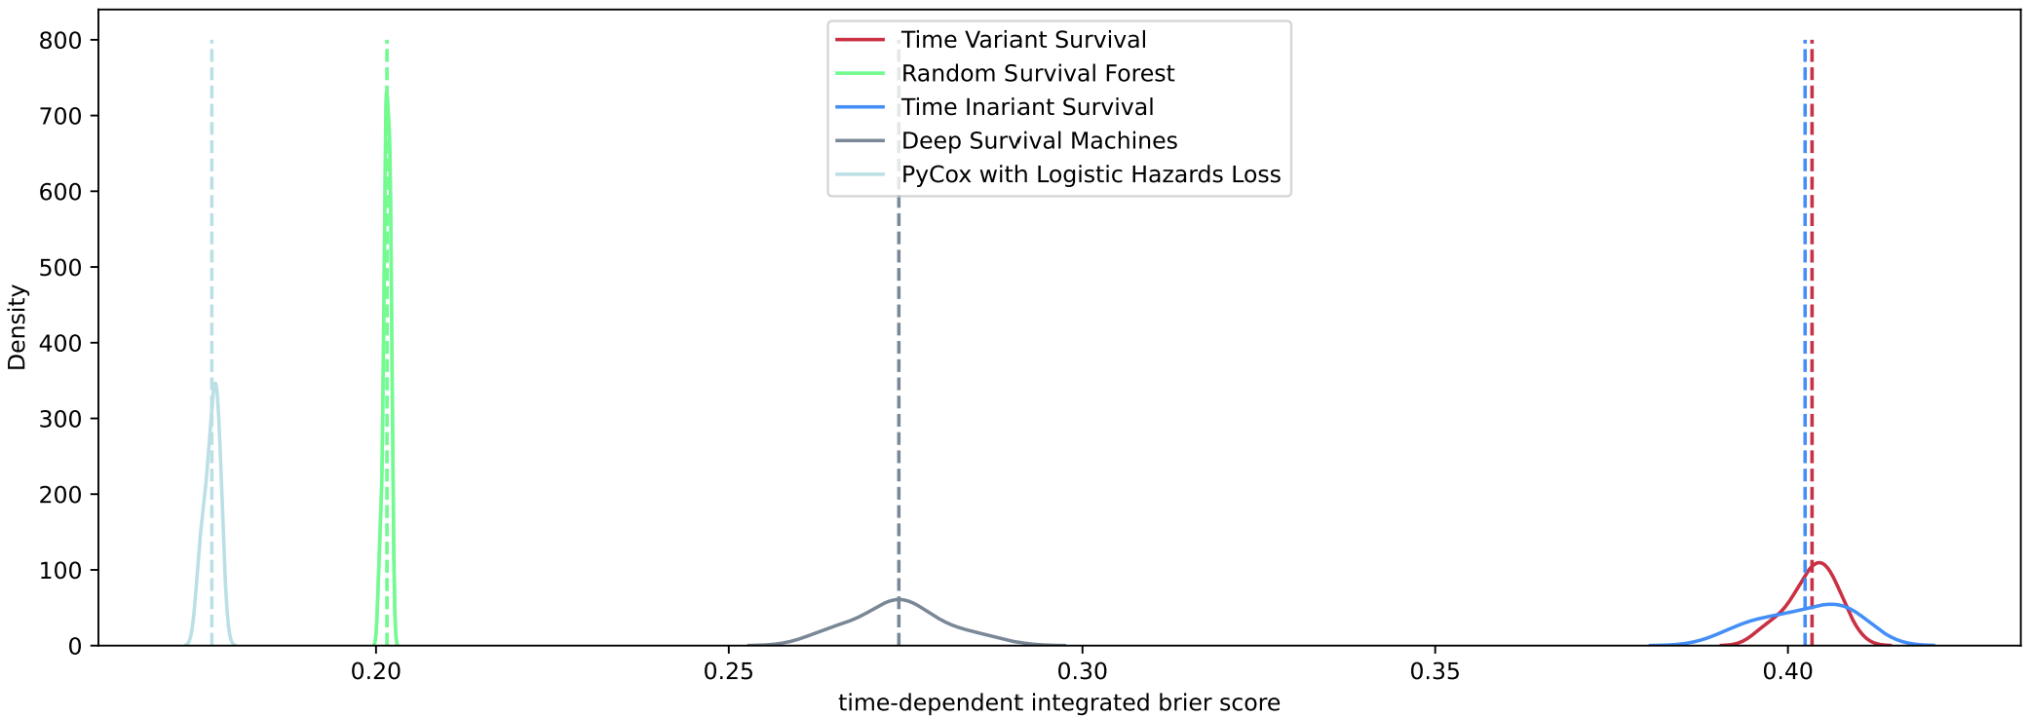
Results are subject to slight change in final submission of report
Results - III
Time Variant Survival
Random Survival Forest
Time Invariant Survival
Deep Survival Machines
PyCox with Logistic Hazards
Cox Proportional Hazards
However, the distribution of IBS shows poor calibration power for both models

Slide 11
Results are subject to slight change in final submission of report
Results - IV
This implementation is equipped with MC dropout [14] (for generating confidence intervals on individual survival curves) and SHAP [15] (for explaining individual survival curves).
What factors drive this change?
SHAP introduces the notion of an ‘expected’ survival curve, which may be comparable to an empirical fit or a baseline survival.
How does the survival curve for an individual subject deviate from the ‘expected’ curve?
[14] Y. Gal and Z. Ghahramani, Dropout as a bayesian approximation: Representing model uncertainty in deep learning, in Proceedings of The 33rd International Conference on Machine Learning, Proceedings of Machine Learning Research, Vol. 48
[15] S. M. Lundberg and S.-I. Lee, A unified approach to interpreting model predictions (2017).

Slide 12
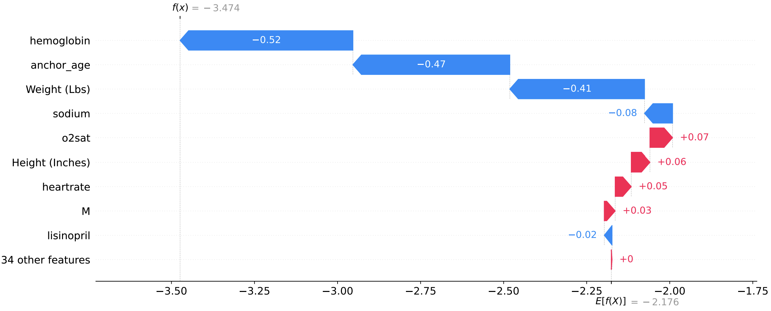
Results are subject to slight change in final submission of report
Results - V
SHAP [15] waterfall charts attempt to allocate credit to covariates as per the final model outputs. E[f(X)] and f(x) are shown on the predictor scale. Once passed through a sigmoid function, they become valid discrete hazards for the concerned subject over the chosen discrete time period.

Slide 13
Further Work
Exploring neural network methods like RNNs that are designed for sequential data could enhance discriminative power.
Future steps might involve advanced optimization like Nesterov momentum and learning rate scheduling.
Deeper architectures can be considered, though they may necessitate longer training times.
Automated hyper-parameter tuning can be an important addition to the implementation.
Improving the efficiency of computing the time-dependent concordance index is an important goal.
For evaluation, alongside current metrics, integrating the cumulative dynamic AUC [16] in future iterations could provide a more comprehensive model assessment.
[16] H. Hung and C.-T. Chiang, Estimation methods for time-dependent auc models with survival data., The Canadian Journal of Statistics / La Revue Canadienne de Statistique 38 (2010).

Slide 14
Discussion
Both the time-invariant and time-varying architectures lead to higher discriminative power in favour of worse calibration. For these to be applied in a clinical setting, the choice of which metric to prioritize needs to be carefully considered.
Additionally, in the realm of neural networks and big data, training time* and selective hyperparameter tuning are important. While deep learning can compete with (and outperform) traditional survival analysis, achieving optimal results requires meticulous hyperparameter tuning and sufficient training duration.
*Nonetheless, the relationship between training time and improved performance is not always linear, highlighting the need for careful evaluation.

Slide 15
Thank you for watching!
Dissertation_Presentation-20230811_183636-Meeting Recording.mp4

