Slide 1


SELF-EVOLVING AI CYBER-RANGE FOR SOC AUTOMATION
GUIDED BY
TEAM MEMBERS
Ms. Angel Varghese
Abhinav Krishnan (MUT23AD005)
Esther Sarah Zachariah (MUT23AD031)
Assistant Professor, Dept. of AI & DS
Rohit Mohan (MUT23AD064)
Sourav Sreekumar (MUT23AD068)
1

Slide 2



BACKGROUND & MOTIVATION
The Modern SOC Dilemma
Core Motivations
•
Security Operations Centers (SOCs) face an overwhelming volume of incoming alerts daily.
Continuous Validation: Transitioning from static manual pen-testing to continuous, autonomous MARL security assessment.
•
This leads to severe alert fatigue among human analysts and delayed reaction times.
Decentralized Automation: Leveraging multi-zone MAPPO defenders and ML featurizers to coordinate mitigation at machine speed (<100ms).
•
Traditional response tools depend entirely on inflexible, static "if-then" rule frameworks.
•
Rigid systems fail against modern, adaptive, and non-linear attack vectors used by sophisticated adversaries.
Self-Evolving Resilience: Co-evolving defensive policies against mutating zero-day threats within an air-gapped digital twin.
SELF-EVOLVING AI CYBER-RANGE FOR SOC AUTOMATION
2

Slide 3

PROBLEM STATEMENT
Modern SOCs face alert fatigue and delayed responses due to high volumes of security events and rigid rule-based systems. Existing approaches struggle to handle complex, evolving attacks and correlate events for effective threat investigation. There is a need for an intelligent cyber-range that enables continuous testing and automated, adaptive threat detection and response.
SELF-EVOLVING AI CYBER-RANGE FOR SOC AUTOMATION
3

Slide 4




NEED & SIGNIFICANCE
The Critical Need
Impact & Significance
Human analysts and brittle rule engines cannot manually parse multi-source logs during fast-moving, multi-step APT campaigns.
Provides an air-gapped, multi-zone sandbox where defensive policies co-evolve against LLM-driven adversarial mutations.
Dramatically reduces MTTR to sub-5 seconds, suppresses benign false alarms, and exports verifiable MITRE ATT&CK audit trails to enterprise SIEM.
Automated systems require cooperative multi-agent reinforcement learning and dynamic reasoning rather than static scripts to adapt to mutating malware.
SELF-EVOLVING AI CYBER-RANGE FOR SOC AUTOMATION
4

Slide 5
LITERATURE REVIEW
Paper title | Methodology | Advantages | Drawbacks
He, L., Yin, Z., & Chen, J. (2024). SecOpsAgent: An LLM-based agent for cybersecurity operations automation. IEEE Trans. Dependable Secure Comput. | Integrates LLMs for autonomous security log triage, dynamic prompt chaining, and automated incident response workflows. | • Automates complex alert triage via LLM reasoning. • Provides explainable incident audit trails. • Drastically reduces Tier-1 SOC analyst workload. | • Lacks autonomous Red Team adversarial feedback. • Does not self-evolve from real-time attack failures.
Chowdhury, M., & Rahman, A. (2023). Automated penetration testing using deep reinforcement learning in dynamic networks. IEEE Access, 11, 45210-45225. | Employs DRL models and scripted vulnerability tools to automate multi-stage network penetration testing. | • Fast and repeatable attack simulation. • High CVE database signature coverage. • Deterministic execution across known target configs. | • Rigid exploit paths fail against runtime defenses. • High sample complexity and poor generalization.
Ahmed, M., & Pathan, A. S. (2022). Unsupervised anomaly detection in high-volume network telemetry using Isolation Forest. Elsevier Computers & Security, 114, 102580. | Applies Isolation Forest and LOF algorithms on raw eBPF/Syslog telemetry streams for anomaly scoring. | • Detects zero-day anomalies without prior signatures. • Scales efficiently to high-throughput log streams. • Low computational training overhead on host CPU. | • High false-positive rate causing SOC alert fatigue. • Lacks autonomous containment or remediation loops.
SELF-EVOLVING AI CYBER-RANGE FOR SOC AUTOMATION
5

Slide 6
LITERATURE REVIEW (PART 2)
LITERATURE REVIEW (PART 2)
Paper title | Methodology | Advantages | Drawbacks
Islam, C., Babar, M. A., & Nepal, S. (2021). Automated cyber incident response using SOAR playbooks. IEEE Transactions on Services Computing, 14(4), 1120-1135. | Implements static SOAR playbooks for standardized incident triage and API-driven firewall containment. | • Drastically cuts manual response latency. • Standardizes enterprise incident management. • Easy integration with existing SIEM tools. | • Static rule-based playbooks cannot adapt. • Breaks during non-linear, multi-stage zero-day attacks.
Wang, Y., & Zhang, H. (2023). Intelligent container honeynet architectures for proactive threat intelligence. ACM Trans. Priv. Secur., 26(2), 1-28. | Deploys containerized decoy environments (honeypots) to capture attacker behavior and extract TTPs. | • Extracts high-fidelity adversarial TTPs. • Safely diverts threats away from production assets. • Low risk to primary network infrastructure. | • Passive defense only; no active containment. • High maintenance overhead for decoy realism.
Nguyen, T. T., & Reddi, V. J. (2021). Deep reinforcement learning for cyber security in coalition networks: A survey. IEEE Comms Surveys & Tutorials, 23(4), 2494-2524. | Surveys multi-agent reinforcement learning (MARL/MAPPO) frameworks for distributed cyber network defense. | • Dynamic policy adaptation against adversaries. • Decentralized execution across partitioned subnets. • Theoretical convergence guarantees in games. | • Black-box decisions lack explainable SOC audit logs. • Severe training instability and compute demands.
SELF-EVOLVING AI CYBER-RANGE FOR SOC AUTOMATION
6

Slide 7

RESEARCH GAP & LIMITATIONS
Existing System Flaws
Our Proposed Advancement
•
Inflexible Rule Logic & Single-Agent Fragility: Current automation relies on rigid heuristic playbooks and single-agent anomaly detectors that fail during non-linear, multi-step attacks and lack decentralized coordination.
We bridge this gap by establishing an adversarial closed-loop ecosystem.
The Red Team agent actively explores and mutates exploits based on target responses, while the Blue Team decentralized MARL cluster (MAPPO) executes sub-second containment actions, evaluated by an LLM reasoning auditor.
•
Fragmented Retraining Loops: Traditional ranges treat attack simulation and defensive logging as decoupled operations, missing closed-loop adversarial retraining to co-evolve defense policies against zero-day variants.
•
High False Positive Burden & Black-Box Decisions: Anomaly engines flood analysts with unstructured alerts without explainable audit trails or verified containment actions aligned to MITRE ATT&CK.
SELF-EVOLVING AI CYBER-RANGE FOR SOC AUTOMATION
7

Slide 8
PROPOSED SOLUTION
The proposed system establishes an autonomous, self-evolving cyber-range combining an LLM-driven Red Team Agent and a decentralized MARL Blue Team SecOps platform within an air-gapped containerized sandbox.
Autonomous Adversarial Probing: An LLM-driven Red Team Agent dynamically probes target applications (OWASP, JuiceShop, DVWA), chains exploits (SQLi, RCE), and mutates payloads on defense block.
Telemetry Featurization & POMDP: eBPF kernel hooks and packet streams are featurized via Isolation Forest into dense state observation vectors per network zone, suppressing benign noise.
Decentralized MARL Defense (MAPPO): Zone-specific defense actors execute sub-second containment (eBPF packet drop, container isolation, token revoke) under bandwidth constraints.
Closed-Loop Policy Co-Evolution: Adversarial retraining updates Blue MAPPO policies against evasive payloads, while an LLM reasoning auditor exports verifiable MITRE ATT&CK audit trails to SIEM.
SELF-EVOLVING AI CYBER-RANGE FOR SOC AUTOMATION
8

Slide 9
OBJECTIVES & DELIVERABLES
Key Objectives
Expected Deliverables
•
To construct an isolated, multi-zone containerized cyber-range with strict network egress controls.
•
Multi-agent Python/Docker cyber-range environment with MAPPO defense policies and Red exploit engine.
•
To develop an LLM-driven Red Team agent for multi-stage exploit chaining and dynamic mutation.
•
Interactive SOC Web Dashboard displaying real-time attack graphs, zone states, and LLM reasoning trails.
•
To implement a decentralized Blue MARL system (MAPPO) for sub-second, cooperative zone containment.
•
Evaluation benchmark report measuring MTTD, MTTR (<5s), false-positive suppression, and MARL co-evolution curves.
•
To establish an adversarial closed-loop retraining pipeline with an LLM reasoning auditor and SIEM export.
SELF-EVOLVING AI CYBER-RANGE FOR SOC AUTOMATION
9

Slide 10
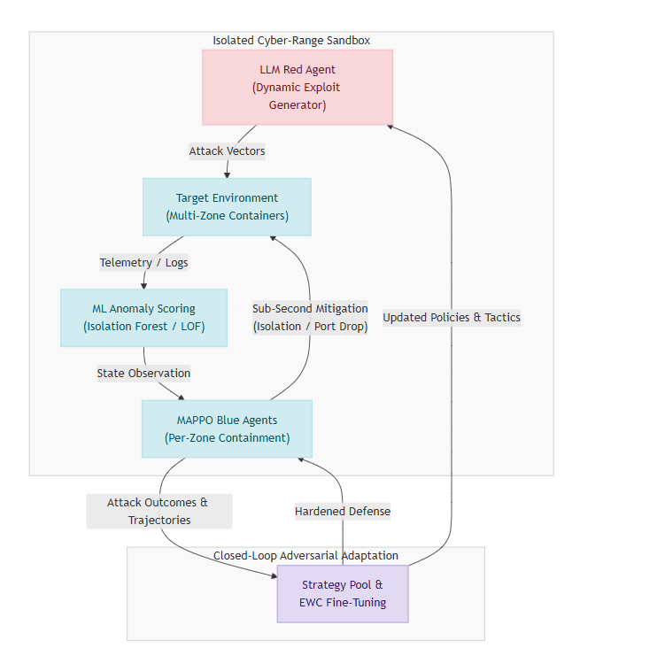
PROPOSED SYSTEM ARCHITECTURE
SELF-EVOLVING AI CYBER-RANGE FOR SOC AUTOMATION
10

Slide 11
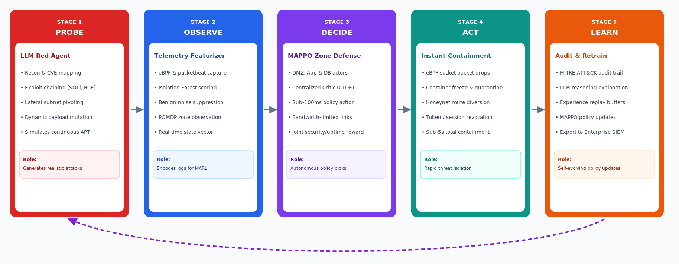
PROPOSED SYSTEM: INCIDENT RESPONSE WORKFLOW
PROPOSED SYSTEM: INCIDENT RESPONSE WORKFLOW
SELF-EVOLVING AI CYBER-RANGE FOR SOC AUTOMATION
11

Slide 12
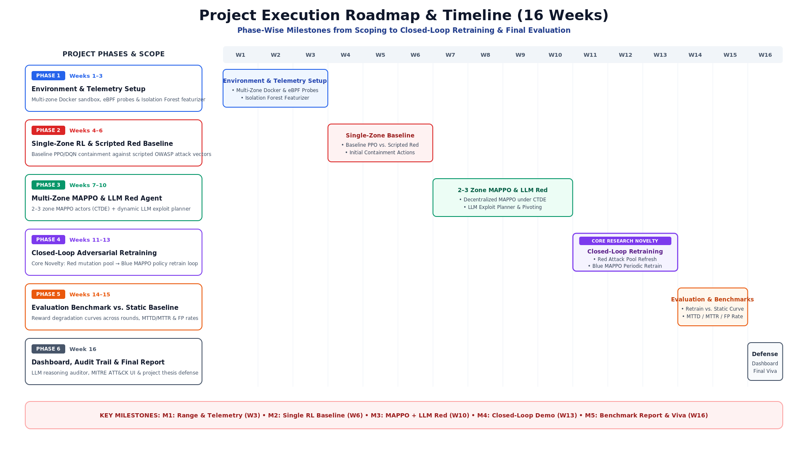
IMPLEMENTATION TIMELINE
SELF-EVOLVING AI CYBER-RANGE FOR SOC AUTOMATION
12

Slide 13




OUTCOMES & FUTURE SCOPE
Expected Outcomes
Future Scope
•
Autonomous, zero-human-intervention threat containment executed in under 5 seconds.
•
Post-deployment continual adaptation pipeline with shadow digital twins and EWC fine-tuning.
•
Over 90% reduction in false-positive alert fatigue with verified MITRE ATT&CK audit trails.
•
Cross-organization federated MARL learning across distributed enterprise SOC enclaves.
•
Decentralized MAPPO defense policies resilient across low-bandwidth, partitioned network zones.
•
Scaling to large-scale multi-cluster Kubernetes service meshes and edge networks.
•
Demonstrated closed-loop co-evolution: Blue defense improves across adversarial retraining rounds.
SELF-EVOLVING AI CYBER-RANGE FOR SOC AUTOMATION
13

Slide 14
BUDGET & RESOURCES
Resource Category | Description / Tooling | Estimated Cost
Compute & Hardware | Local Workstation (NVIDIA GPU, 32GB RAM) / Cloud GPU instances (AWS/GCP). | Existing Lab / Open Source
LLM & API Services | OpenAI GPT-4 / Anthropic Claude API tokens for agent reasoning loops. | Nominal / Research Credits
Software & Frameworks | Docker, Kubernetes, ELK Stack, Python, SecOpsAgent open-source base. | ₹0 (Open Source)
Testing Infrastructure | Virtual SDN tools, OSquery, Packetbeat agents for telemetry capture. | ₹0 (Open Source)
SELF-EVOLVING AI CYBER-RANGE FOR SOC AUTOMATION
14

Slide 15

PROJECT CLASSIFICATION
Domain & Categorization
Primary Domain | Artificial Intelligence & Cybersecurity
Sub-Domains | Multi-Agent Systems, Autonomous SOC Automation, Multi Agent Reinforcement Learning ,Threat Intelligence, Containerized Sandboxing, Machine Learning Anomaly Scoring.
Project Type | Research & Practical Systems Implementation
PO/PSO Core Alignment | PO1 (Engineering Knowledge), PO3 (Design/Dev), PSO1 (AI & Data Science Solutions), PSO2 (Intelligent Systems Engineering)
SELF-EVOLVING AI CYBER-RANGE FOR SOC AUTOMATION
15

Slide 16
SDG ADDRESSED
SDG 9: Industry, Innovation, and Infrastructure
Alignment Justification:
•
Target 9.5 (Enhance Scientific Research): The project drives high-tech innovation by pioneering an autonomous adversarial AI framework to revolutionize traditional SOC automation.
•
Resilient Infrastructure: Directly builds resilient digital infrastructure by constructing containerized, network-restricted cyber-ranges capable of withstanding and autonomously mitigating non-linear cyber threats.
•
Supports secondary goals like SDG 8 (Decent Work) by reducing security operational overhead and SOC burnout.
SELF-EVOLVING AI CYBER-RANGE FOR SOC AUTOMATION
16

Slide 17

THANK YOU
SELF-EVOLVING AI CYBER-RANGE FOR SOC AUTOMATION
17

