Slide 1

Jalpaiguri Government Engineering College
A Project on
“Automatic Gas Cylinder Booking System
With Leakage Alarm”
Guided By
Mrs. Debamita Saha

Slide 2
Submitted By
• Samrat Mitra
Roll-17101106004, Information Technology
• Sourav Sarkar
Roll-17101106017, Information Technology
• Rohan Das
Roll-18101106083, Information Technology
• Samanwita Das
Roll-17101106019, Information Technology

Slide 3
We Will Discuss About
What Is Our Project
Importance
Tools & Technology Used
Flowchart
Basic Working
Advantages
Future Scope
Reference

Slide 4
What is Our Project
Nowadays everyone uses gas cylinder for cooking, but there is no easy way to
Keep track of the remaining gas in a cylinder. Now our idea is to
Simplify the process by informing the owner by an SMS when the cylinder
Reach 20% of it’s full capacity. Also there is a leakage alert
system to inform about any gas leakage for the safety of the house.

Slide 5
Importance
To check how much gas is remaining in a cylinder, we used to lift it and
Check the weight of the cylinder. But it is not possible because we store
The cylinder in a very tight space and not everyone is capable of lifting the
Cylinder and lifting the cylinder may damage the gas pipe which leads to
Gas leakage. So we make a system which can check the weight without
Moving the cylinder, also it can inform you when it is about to empty so
You don’t have to check the cylinder ever. Also it has a LPG gas sensor
Which can detect gas leakage just to keep you safe.

Slide 6
Tools & Technology used
Weight sensor
Arduino UNO
GSM Module
LPG Gas Detector

Slide 7
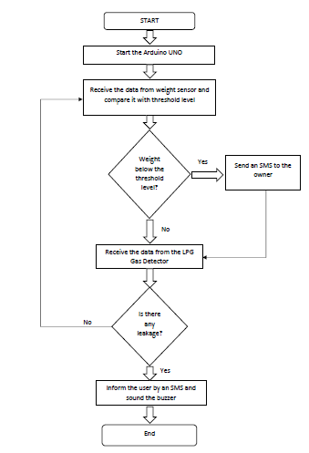
Flowchart

Slide 8
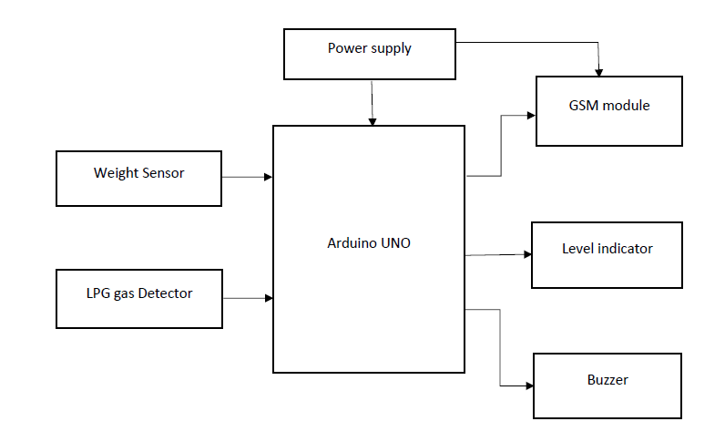
Basic Working

Slide 9
Advantages
It can be Implemented directly to the cylinder stand.
Cost is relatively low compared to other options.
User friendly.
Suited with old traditional system
Can be used in small home as well as big restaurants

Slide 10
Future Scope
Can monitor daily gas uses.
We can add a servo motor to turn off the cylinder nob
Whenever leakage is detected
Can be used to directly book gas cylinder from the
Supplier.

Slide 11
Reference
Wikipedia
www.ijareeie.com/upload/2016/march/8_Comparative.pdf
www.internationaljournalssrg.org/IJECE/2017/Volume4-Issue3/IJECE-V4I3P110.pdf\
Youtube

Slide 12
Thank You

