Slide 1
Code Labeler
Dev Team - 8
TA: Indranil Palit
Harjot Singh
Margin Patel
Sourav Ghai
Aanandi Pankhania
Client Team - 19
TA: Mootez Saad

Slide 2

Summary
This is an application which can aid an admin can share code snippets publicly whereupon interested personals (annotators) can annotate code snippets following the annotations provided by said researcher. An admin can visit the uploaded code snippets later and see the annotations completed till that point.
Goal:
The goal here is to provide the admin with an ability to create surveys, provide the ability to annotator to "mark" or annotate those surveys and then admin can see whatever those annotators have annotated or "mark".

Slide 3

Dashboard
Total number of tasks: 35
Tasks completed by:
Sourav: 11
Margin: 10
Harjot: 7
Aanandi: 7

Slide 4
Demo
Code Labeller

Slide 5
Goals Achieved
Goals | Status
Login/Register | Achieved
Authentication | Achieved
Collective Snippets view | Achieved
Tags of snippets | Achieved
View Highlighted tags | Achieved
Syntax highlighter | Achieved
Upload snippets that needs annotation in bulk | Achieved

Slide 6
Mid-Term Review
Speed up our pace.
Shifted from image to java files
JWT implementation
Syntax and Code highlighter considered as main feature

Slide 7
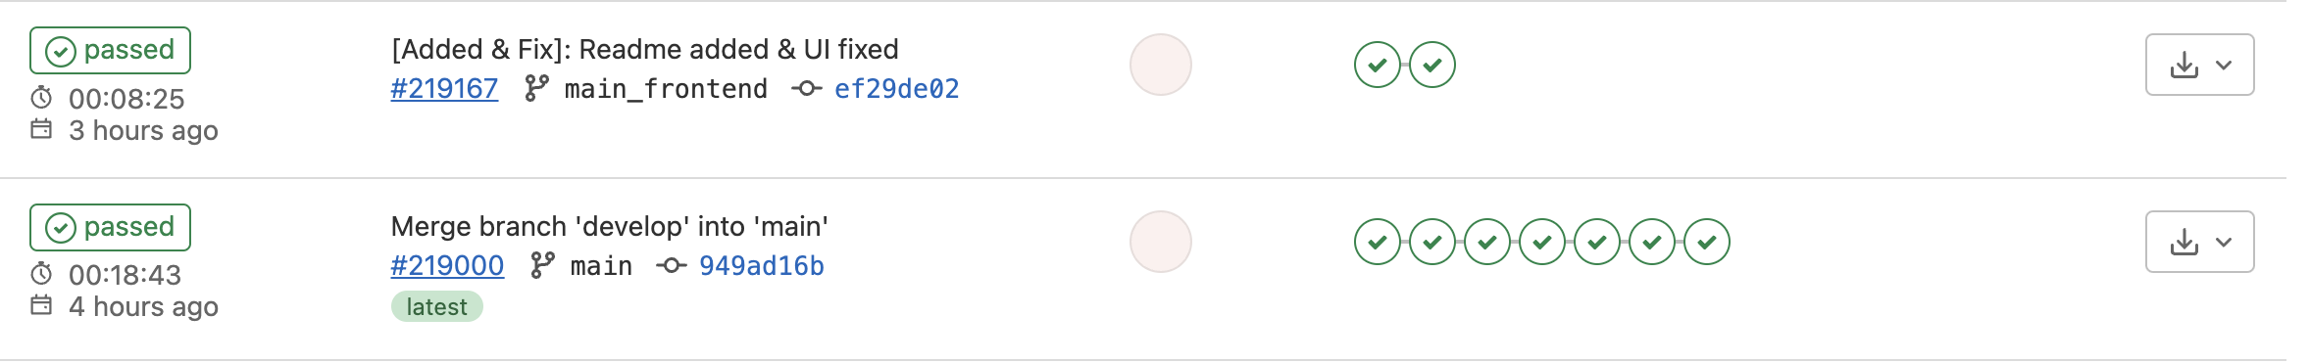
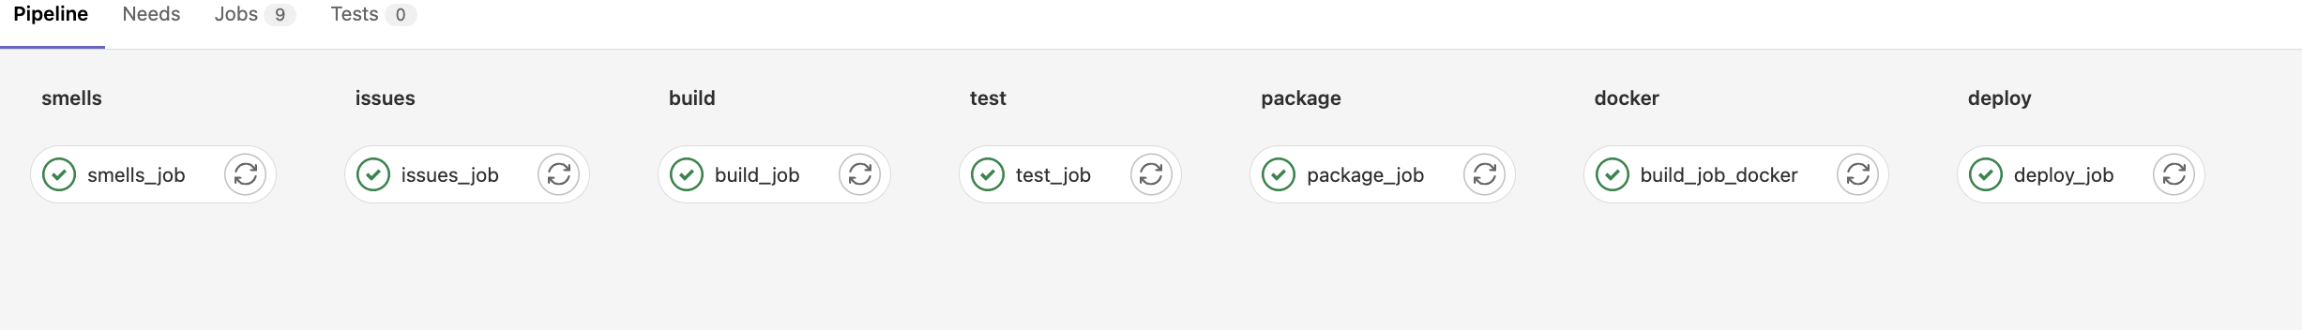
CI/CD

Slide 8
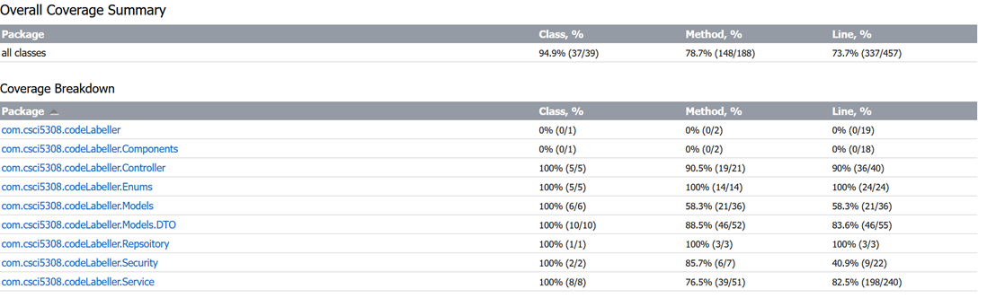
Code Coverage

Slide 9
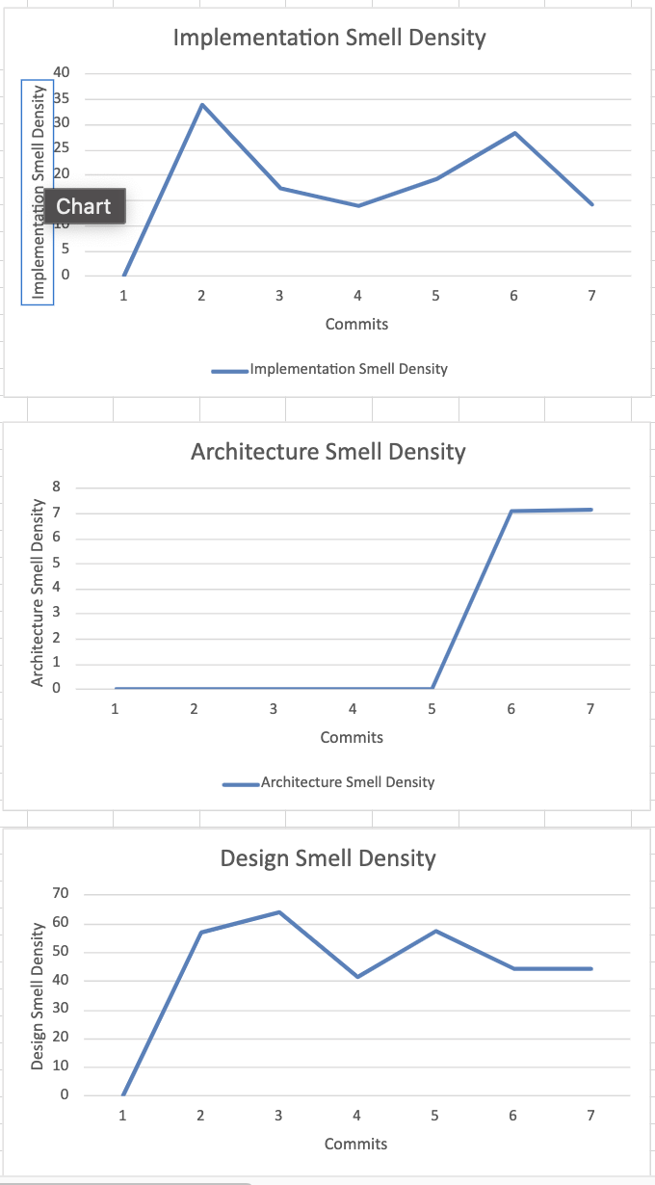
Code Smells

Slide 10
Learnings
Team work
Spring Boot
React
CI/CD
How to do Refactoring
How to remove code smells
How to practice TDD
Design Principles/S.O.L.I.D

Slide 11
Thank you all

