Slide 1
MS EXCEL
Logical Function

Slide 2
What is Logical Function
It is a feature that allows us to introduce decision-making when executing formulas and functions. Functions are used to,
Check if a condition is true or false
Combine multiple conditions together

Slide 3
What is a condition and why does it matter?
A condition is an expression that either evaluates to true or false. The expression could be a function that determines if the value entered in a cell is of numeric or text data type, if a value is greater than, equal to or less than a specified value, etc.

Slide 4
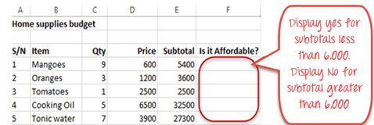
IF Function - It allows you to make logical comparisons between a value and what you expect.
Syntax- IF (logical_test, [value_if_true], [value_if_false])
IF Function example
We work with the home supplies budget. We will use the IF function to determine if an item is expensive or not. We will assume that items with a value greater than 6,000 are expensive. Those that are less than 6,000 are less expensive. The following image shows us the dataset that we will work with.

Slide 5
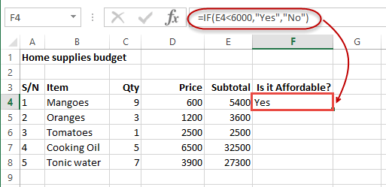
HERE,
“=IF(…)” calls the IF functions
“E4<6000” is the condition that the IF function evaluates. It checks the value of cell address E4 (subtotal) is less than 6,000
“Yes” this is the value that the function will display if the value of E4 is less than 6,000
“No” this is the value that the function will display if the value of E4 is greater than 6,000
When you are done press the enter key
You will get the following results
Put the cursor focus in cell F4 Enter the following formula that uses the IF function =IF(E4<6000,”Yes”,”No”)

Slide 6
Excel COUNTIF Function
The Excel COUNTIF function returns the count of no of cells that meet a single condition. Criteria can be applied to dates, numbers, and text. The COUNTIF function supports logical operators (>,<,<>,=)
Syntax- COUNTIF(range, criteria)

Slide 7
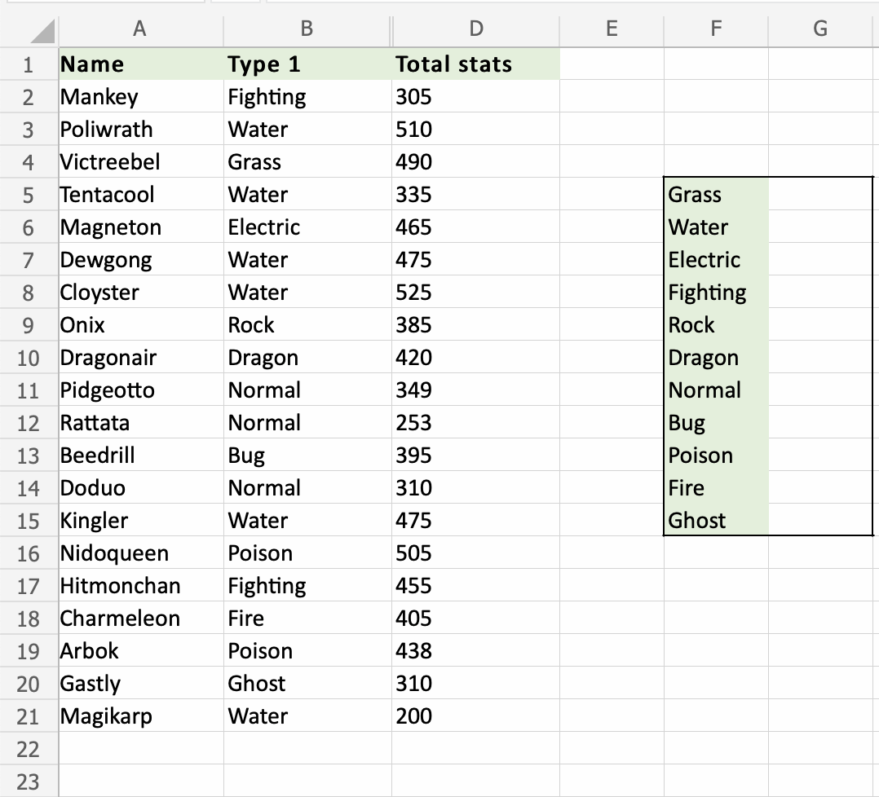
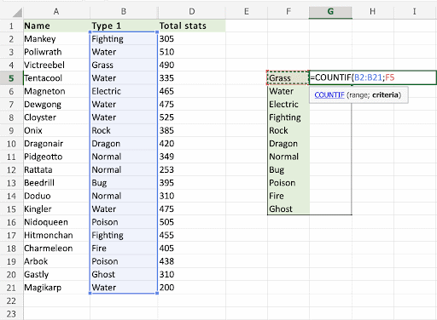
COUNTIF Function example
COUNTIF condition is to determine the count the types of Pokemons.
COUNTIF function, step by step:
Select a cell
Type =COUNTIF
Double click the COUNTIF command
Select a range,
Select a cell (the criteria, the value that you want to count)
Hit enter

Slide 8
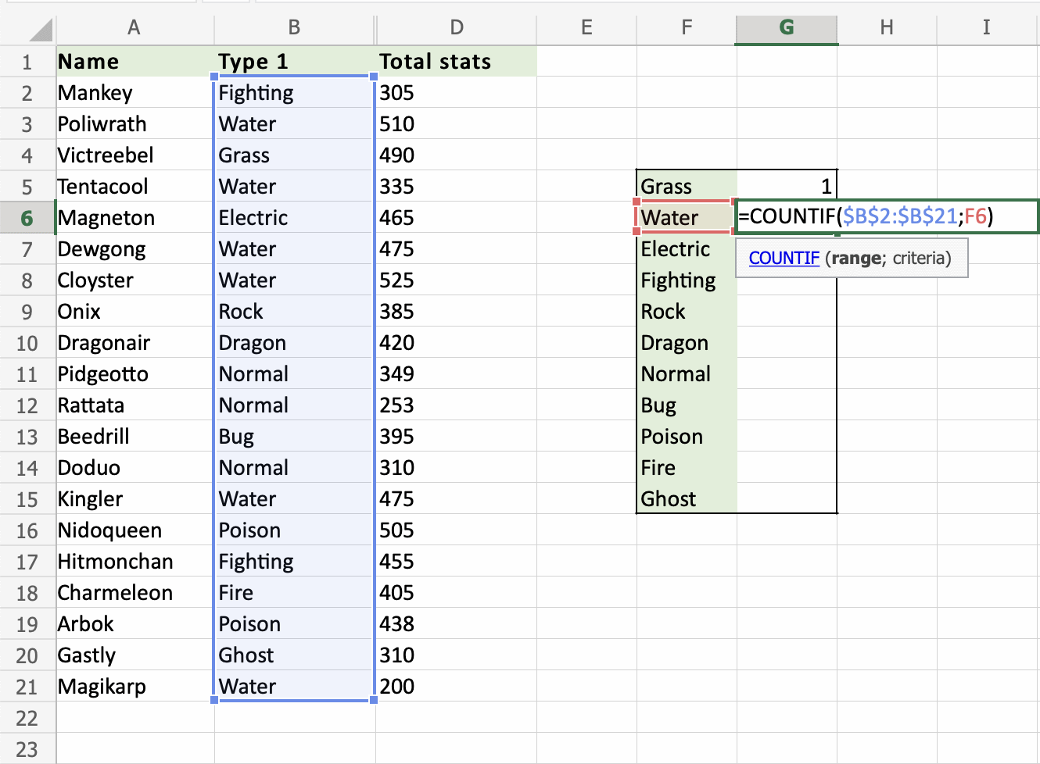
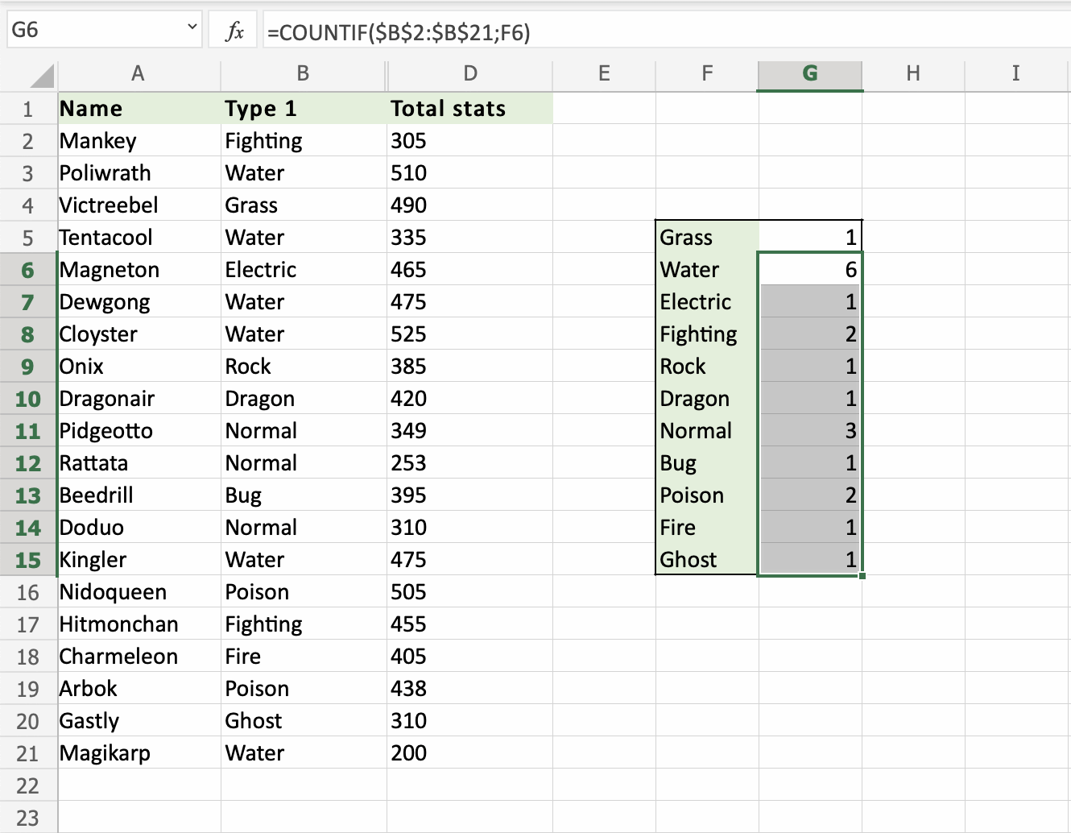
Let's count the rest of the types more effectively. We want to continue the function from G6:G15. Making use of the Filling Function and Absolute References.
Lock the range references absolute (B2:B21). Type dollar signs before the columns and row. Type 4-dollar signs in total. =COUNTIF ($B$2: $B$21, F6).
Note: We want F6 to remain relative. Because we want it to move downwards. Do not add dollar signs ($) to it.

Slide 9
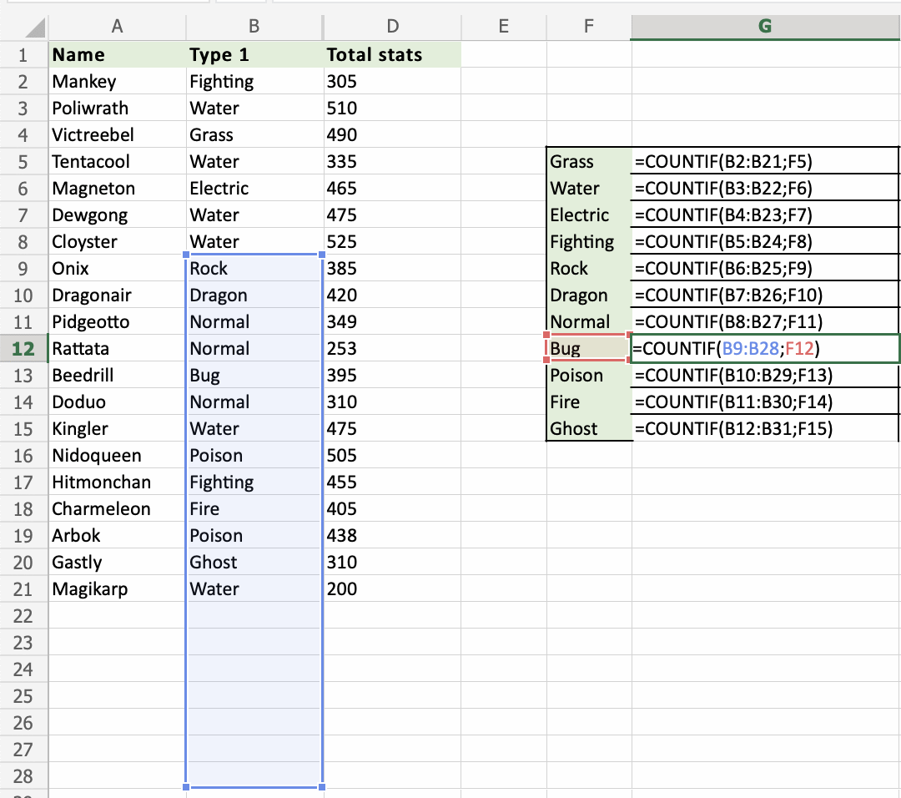
A Non-Working Example (without absolute reference)
Let's try an example that will not work.
Fill G5:G15 without locking the references to see what happens.

Slide 10
Excel SUMIF Function
The Excel SUMIF function returns the sum of cells that meet a single condition. Criteria can be applied to dates, numbers, and text. The SUMIF function supports logical operators (>,<,<>,=)
Syntax- SUMIF(range, criteria, [sum_range])

Slide 11
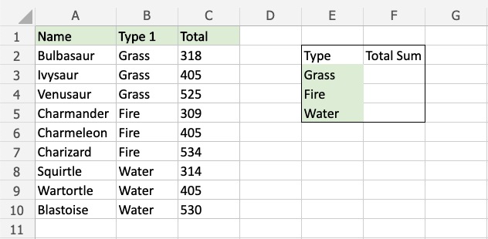
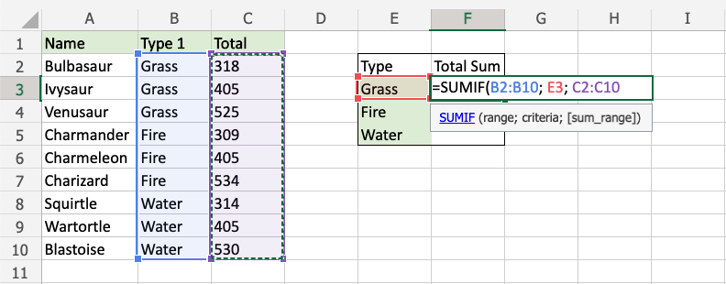
SUMIF Function example
SUMIF condition is to determine the sum of Total stats for Grass, Fire and Water type pokemon.
SUMIF function, step by step:
Select the cell F3
Type =SUMIF
Double click the SUMIF command
Specify the range for the conditionB2:B10 (the Type 1 values),
Specify the criteria (the cell E3, which has the value "Grass"),
Specify the range for the sum C2:C10 (the Total values),
Hit enter

Slide 12
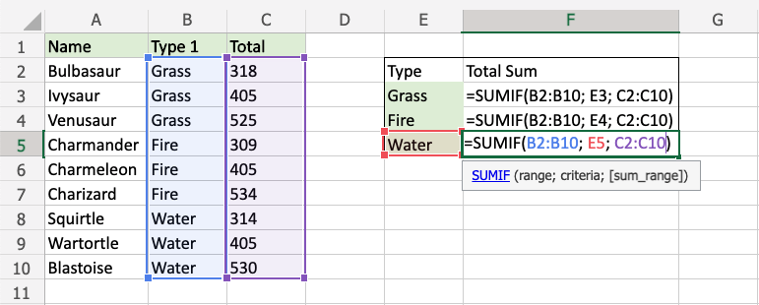
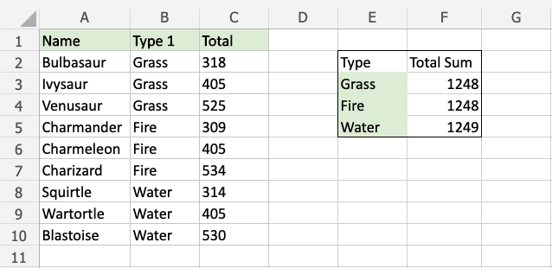
The function now sums the Total stats for Grass, Fire and Water type Pokemon
Now, we can see the sum of total stats for the different types of Pokemon:

Slide 13
Excel AVERAGE Function
Excel AVERAGE - calculate the mean of cells with numbers.
Excel AVERAGEA - find an average of cells with any data (numbers, Boolean and text values).
Excel AVERAGEIF - average cells based on a given criterion.
Excel AVERAGEIFS - average cells that match several criteria, Average cells by multiple criteria

Slide 14
Excel AVERAGEIF Function
The Excel AVERAGEIF function returns the average of cells that meet a single condition. Criteria can be applied to dates, numbers, and text. The Averageif function supports logical operators (>,<,<>,=)
Syntax- =AVERAGEIF(range, criteria, [average_range])

Slide 15
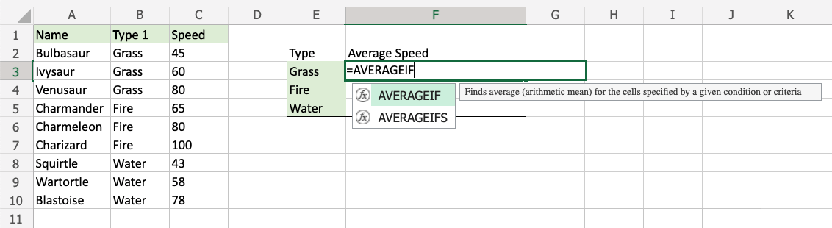
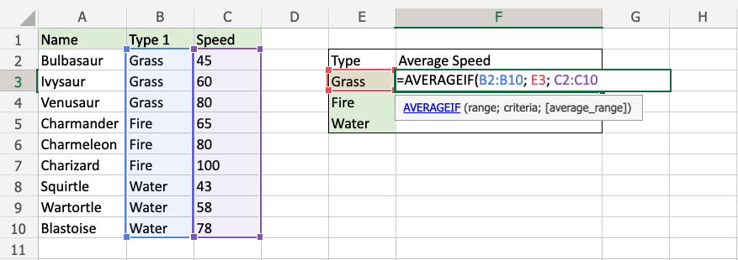
AVERAGEIF Function example The function calculates the average speed value of the Grass type Pokemon: Bulbasaur, Ivysaur and Venusaur.
AVERAGEIF function, step by step:
Select the cell F3
Type =AVERAGEIF
Double click the AVERAGEIF command
Specify the range for the condition B2:B10 (the Type 1 values),
Specify the criteria (the cell E3, which has the value "Grass"),
Specify the range for the average C2:C10 (the Speed values),
Hit enter

Slide 16
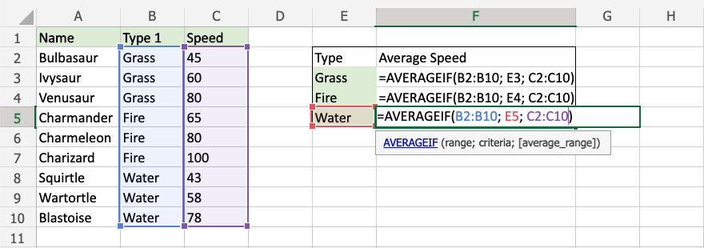
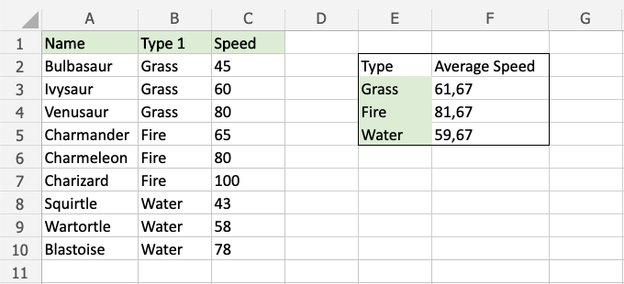
Now, we can see the Average speed values of each type:

Slide 17
IFERROR function
The Excel IFERROR function returns a custom result when a formula generates an error, and a standard result when no error is detected. IFERROR is an elegant way to trap and manage errors without using more complicated nested IF statements
Syntax =IFERROR (value, value_if_error)

Slide 18
Thank You!

