Slide 1

MS Excel Conditional Formatting

Slide 2
What is conditional formatting
Conditional formatting is most often used as color-based formatting to highlight, emphasize, or differentiate among data and information stored in a spreadsheet and make worksheet easier to understand.
It allows the user to automatically apply formatting- such as colors, icons and data bars to one or more cells based on the cell value

Slide 3
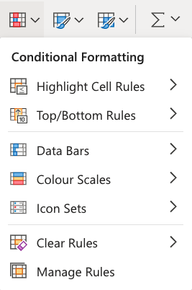
Some feature of conditional formatting
Highlight cell rules
Top/Bottom Rules
Data Bars
Color Scales
Icon Sets
New Rule
Manage Rule

Slide 4
Some advantage of using conditional formatting
A better way to visualize data in a worksheet.
Makes data easier to understand.
Make the work of formatting effortless.
Saves time.

