Slide 1
BORDER SURVEILLANCE
XILINX INNOVATION CHALLENGE
Team Name : SCHWIFTY HORSEMEN

Slide 2
Table of Contents
Project Objective, Dataset, Preprocessing
Motion Tracking and Frame Extraction
Feature Extraction using CNN, VGG Net
Feature Extraction using HOG
Models used
Feature Reduction
Hyperparameter Tuning
Use of Ensemble
Conclusion

Slide 3
Project Objective, Dataset and Pre-processing
Given a video captured using a still camera, the project aims at detecting human trespassing in a forest background.
Dataset obtained from videos downloaded from Youtube of 360p quality, dimension = 360x640x3. 14 such videos with the given specifications were downloaded.
Every frame converted to a single grayscale channel using arithmetic mean of R, G, B.
Frame rate downsampled by 10 : processing speed should be faster than input stream and diverse dataset will be better.
Block average using 3x3 kernels : smoothen out high frequency noise and for background subtraction
Probabilistic model for motion tracking and frame extraction

Slide 4
Motion Tracking and Frame Extraction
01
Need to extract the active region of interest, for easier computation. Background subtraction was done on the smoothed frames to eliminate the effect of noise.
For every pixel p, d = p - 0.7*flop_p - 0.3*flop_flop_p : effect random fluctuations eliminated. Threshold set at d = 16 to create a binary image
Frame divided into 9 overlapping subframes : (180x320x1). Each assigned an initial probability of 1/9.
Pixels counted in each subframe, incremented by 1, normalized and probability updated as : prob = 0.6*prob + 0.4*pixel_prob : Effect of random fluctuations eliminated.
Subframe with maximum probability extracted as positive sample, rest as negative sample. After some manual segregation : 896 +ve and 2092 -ve samples. Split in 4:1 into training and test data
02
03
04
05

Slide 5
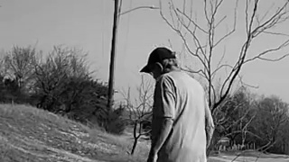
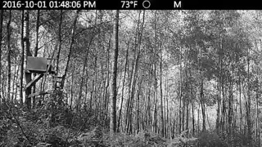
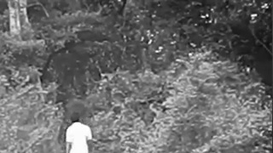

Positive Sample
Negative Sample
Motion Tracking and frame extraction

Slide 6

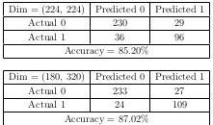
Feature extraction using HOG Descriptor
Scale invariant, rotation invariant feature transform descriptors
Gradient computation in x and y direction using [-1 0 1] and transpose([-1 0 1])
Angles computed using arctan(Gy/Gx) and quantized from 0 to 2π in 8 intervals.
This was implemented by comparing (Gy+Gx, 0) and (Gy-Gx, 0) only, thus requiring lesser computations.
Done in local 16x16 blocks, histogram made for each block after L2 normalization
Flattened into a feature vector of dimension = 512, When input image dimension = (128,128)
Classified using Adaboost on Decision trees
Hyperparameters tuned
Input dimension varied : (128, 256), (224, 224), (180, 320) : Confusion matrix printed, best results on (128, 128)
This selection of input image dimension ensures easy computations.
Kernel size produced best results on 16x16 among the kernels used : 8x8, 16x16, 32x32
83%
Accuracy

Slide 7
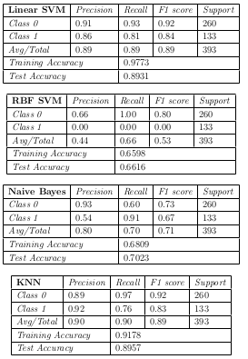
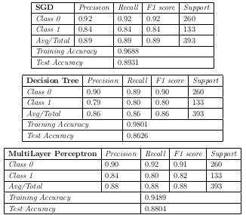
Models used
SVM (Linear and RBF Kernel)
Naive Bayes
KNN
SGD
Decision Tree
MultiLayer Perceptron
89%
Test Accuracy

Slide 8

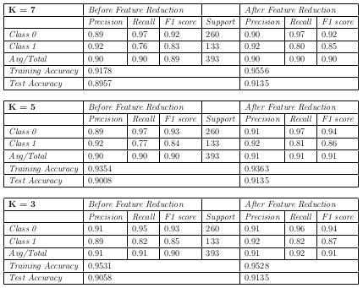
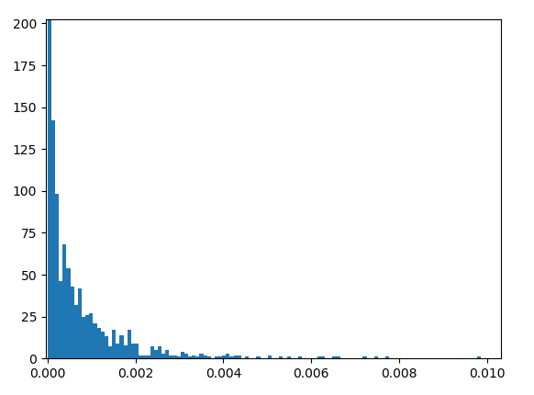
Feature Reduction
KNN used : Curse of dimensionality
Information gain computed for every feature
Threshold varied, best results at 0.005
1299 removed, 461 retained

Slide 9
Hyper-parameter Tuning
04
Weights assigned
Information Gain
Threshold varied for best test accuracy - Problem of overfitting solved
Inverse distance performed better than binary weights by 0.06%, can be compromised for easier hardware implementation
01
03
Value of K
Distance metric
Optimum value found to be equal to 3
Manhattan performed better than Euclidean distance. Easy hardware implementation too.
02

Slide 10
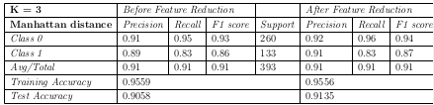
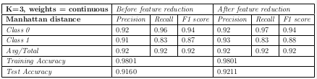
Hyper-parameter Tuning

Slide 11
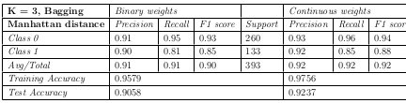
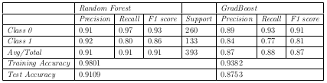
Use of Ensemble : Bagging, Random Forest, Grad-Boost
Bagging : Training data of size N is distributed into multiple training dataset, each of size N.
Sampling uniformly from the original dataset with replacement.
63.2% unique data, rest duplicates.
Majority voting on the different hypotheses
Random Forest and GradBoost : Ensemble of decision trees, all fit differently on the training dataset.
Majority voting among the hypotheses generated.

Slide 12
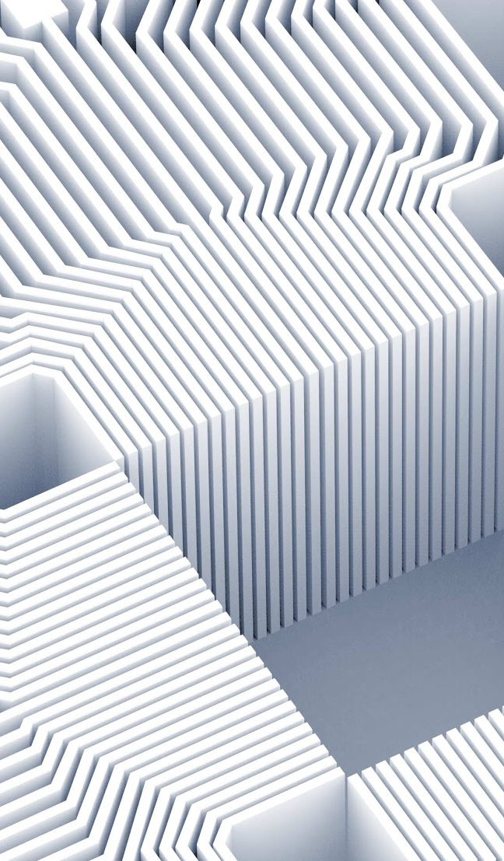
Conclusion and Discussion
Robust motion tracking algorithm based on a probabilistic model.
HOG outperformed DeepNets, very specific conditions, DeepNets overfit on unwanted features.
KNN performed the best, easier to implement on hardware, highly finetuned.
Feature reduction prevented overfitting, feature reduction cannot be applied on CNN, dropout produced poor results.
No need to store weights, no multiplications, does not depend on dataset, can be trained freshly
Ensemble can improve performance

Slide 13
References :
Dalal, N. and Triggs, B. (2005). Histograms of oriented gradients for human detection. In 2005 IEEE Computer Society Conference on Computer Vision and Pattern Recognition (CVPR’05), volume 1, pages 886–893 vol. 1.
Negi, K., Dohi, K., Shibata, Y., and Oguri, K. (2011). Deep pipelined one-chip fpga implementation of a real-time image-based human detection algorithm. In 2011 International Conference on Field-Programmable Technology, pages 1–8.
Pang, Y., Yuan, Y., Li, X., and Pan, J. (2011). Efficient hog human detection. Signal Processing, 91(4):773 – 781
Thank you!

