Slide 1

Real Time Object Detection Using YOLO
by:
Sourav Kumar (231b349)
Garv Gang (231b113)
Tryambkesh Sharma (231b366)
Under the supervision of:
Dr. Animesh Kumar Dubey
Jaypee University of Engineering & Technology, Guna

Slide 2
Introduction:
The main objective of this project is to develop an intelligent real-time object detection using YOLO capable of performing the following tasks:
1. Object Detection :- Detect multiple objects in images and live video streams accurately.
2. Object Counting :- Count the total number of detected objects in each frame.
3. Object Localization :- Identify the exact position of objects using bounding boxes and coordinates.
4. Motion Analysis :- Analyze object movement across consecutive frames in a video.
5. Object Identity Tracking :- Track individual objects over time and assign unique IDs to maintain identity.

Slide 3
Problem Statement :
The following are the key limitations of existing systems:
Real-Time Limitations – Many models are too heavy and cannot run efficiently on CPU systems.
Limited Integration – Existing systems often perform only detection without tracking or analysis.
Lack of Vehicle Counting – No mechanism to automatically count vehicles in traffic scenes.
No Motion Analysis – Speed estimation and movement tracking are generally not included.
Inefficient Traffic Monitoring – Systems do not provide a complete analysis pipeline for real-world use.

Slide 4
Literature Review:
Evolution of Object Detection Techniques :
1. Sliding Window Approach
Scans the image using fixed-size windows
Classifies each region separately
Very slow and computationally expensive
Inefficient for large images
2. R-CNN
Introduced region proposals instead of scanning image
Used CNN for feature extraction
Improved accuracy significantly
Still slow due to multi-stage pipeline
3. Fast R-CNN
Reduced repeated CNN computations
Used ROI Pooling
Faster than R-CNN
4. YOLO
Single-stage detector
Processes entire image in one pass
Real-time performance
Efficient and optimized

Slide 5
Analysis of Existing Work:
Key Findings
Real-Time Detection – Fast inference using YOLO
Accuracy-Speed Trade-off – Balance between speed and precision
Tracking Capability – Maintains object identity
Deep Learning Advantage – Better accuracy than traditional methods
Dataset Importance – Improves model generalization
Limitations
High Computation – Requires powerful hardware
Limited Integration – Detection-only systems
No Complete Pipeline – Missing tracking and analysis
Slow Real-Time Performance – Not suitable for live systems
Deployment Constraints – Difficult real-world implementation

Slide 6
Individual Contribution
Member Name | Enrollment No. | Contribution
Sourav Kumar | 231B349 | Coding ,Dataset, System Design, Implement the system design
Garv Gang | 231B113 | Coding , Dataset, Design the model and it architecture
Tryambkesh Sharma | 231B366 | Coding, design the model

Slide 7
Week Plan:
Week | Work Done | Status
Week 1 | Literature review on real-time object detection and YOLO basics | Completed
Week 2 | Studied YOLO algorithm, object localization, and datasets | Completed
Week 3 | Implemented YOLO on sample video and analyzed FPS issues | Completed
Week 4 | Learned object tracking and object counting from traffic video | Completed
Week 5 | Studied YOLO architecture and research papers in detail | Completed
Week 6 | Studied performance metrics and discussed dataset-related issues | In Progress
Week 7 | Application-specific performance metric analysis and understood difference between YOLO versions | Pending
Week 8 | Reviewed recent research papers related to project | Completed
Week 9 | Dataset exploration and reduction (1 lakh → 10k → 2k → ~700 images finalized) | Completed
Week 10 | Initial implementation and model testing | Completed
Week 11 | Finalized dataset and evaluated performance metrics | Completed
Week 12 | Improved accuracy, analyzed performance, generated graphs, obtained final outputs | Completed
Week 13 | Prepared final report, optimized results, and created PPT | Completed

Slide 8
Dataset Details
Dataset Details
Data Source – BDD100K traffic dataset (custom subset)
Dataset Size – 700 images used for training and testing
Data Split – 490 train, 140 validation, 70 test images
Data Type – Traffic scene images with annotated objects
Annotation Format – YOLO format (bounding box labels)
Dataset Configuration (YAML File)
YAML Structure – Defines dataset paths and classes
Train Path – Path to training images
Validation Path – Path to validation images
Test Path – Path to test images
Classes (names) – List of object categories

Slide 9
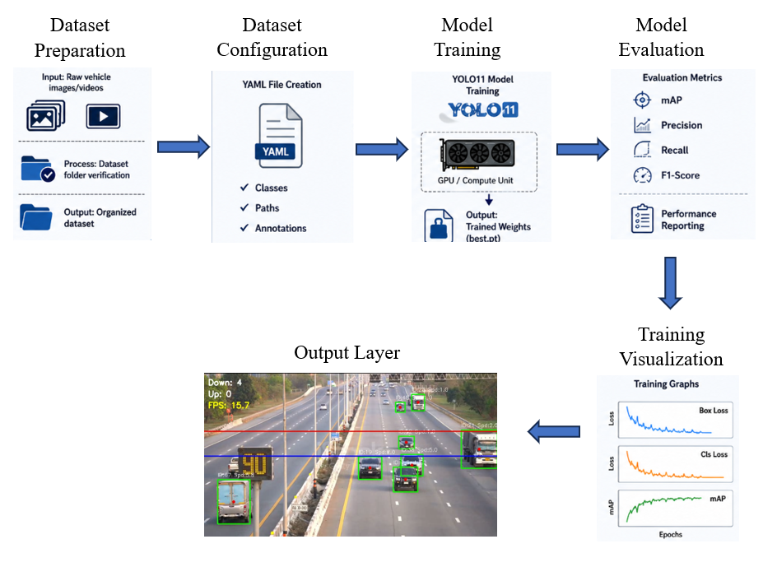
Proposed Methodology

Slide 10
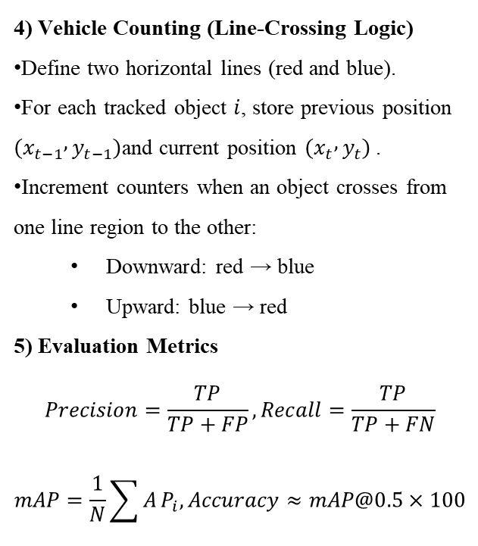
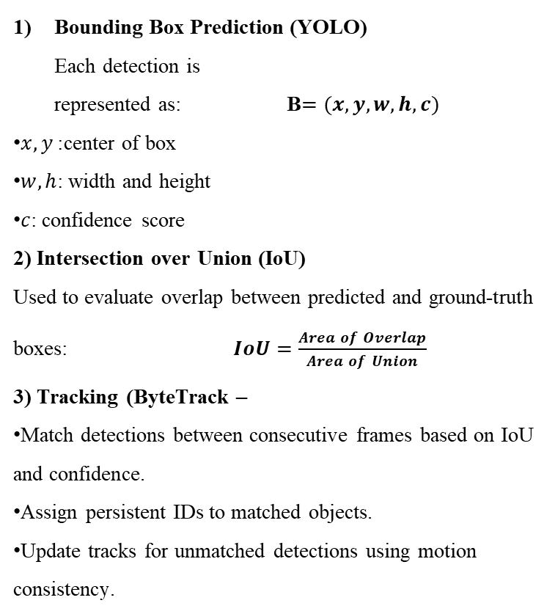
Mathematical Formulation:
Bounding Box Prediction (YOLO) Each detection is represented as: B$=(x,y,w,h,c)$
$x,y$: center of box
$w,h$: width and height
$c$: confidence score
2) Intersection over Union (IoU) Used to evaluate overlap between predicted and ground-truth boxes: $IoU=\frac{Area of Overlap}{Area of Union}$
3) Tracking (ByteTrack –
Match detections between consecutive frames based on IoU and confidence.
Assign persistent IDs to matched objects.
Update tracks for unmatched detections using motion consistency.
4) Vehicle Counting (Line-Crossing Logic)
Define two horizontal lines (red and blue).
For each tracked object $i$, store previous position $\left(x_{t−1} , y_{t−1}\right)$and current position $\left(x_{t} , y_{t}\right)$.
Increment counters when an object crosses from one line region to the other:
Downward: red → blue
Upward: blue → red
5) Evaluation Metrics
$$Precision=\frac{TP}{TP+FP}, Recall=\frac{TP}{TP+FN}$$
$$mAP=\frac{1}{N}\sum{A}P_{i}, Accuracy≈mAP@0.5×100$$

Slide 11
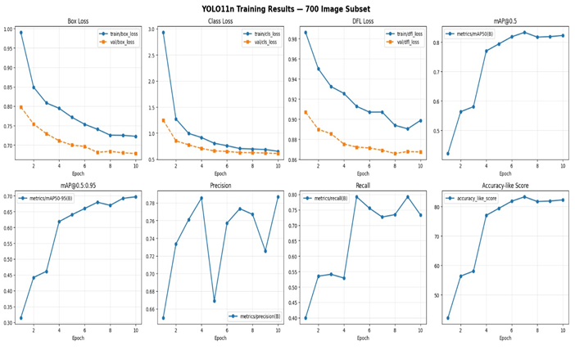
Result Analysis
Performance Metrics
Precision : 78.68%
Recall : 73.36%
mAP@0.5 : 82.27%
mAP@0.5:0.95 : 69.67%
Accuracy : 82.27%

Slide 12
Conclusion
The proposed system successfully demonstrates the application of deep learning for real-time traffic analysis. By integrating object detection, tracking, vehicle counting, and speed estimation, the system provides a complete and efficient solution for traffic monitoring using a YOLO11-based approach.
Accurate Detection – YOLO11 detects vehicles and pedestrians effectively
Efficient Tracking – ByteTrack maintains consistent object IDs
Vehicle Counting – Line-crossing method provides reliable counts
Speed Estimation – Calculates motion using pixel displacement
Real-Time Performance – Runs efficiently on CPU-based systems
Integrated System – Combines detection, tracking, and analysis

Slide 13
References
[1] C.-Y. Wang, I.-H. Yeh and H.-Y. M. Liao, “YOLOv9: Learning What You Want to Learn Using Programmable Gradient Information,” arXiv preprint arXiv:2402.13616, 2024.
[2] A. Wang, H. Chen, L. Liu, K. Chen, Z. Lin, J. Han and G. Ding, “YOLOv10: Real-Time End-to-End Object Detection,” arXiv preprint arXiv:2405.14458, 2024.
[3] R. Khanam and M. Hussain, “YOLOv11: An Overview of the Key Architectural Enhancements,” arXiv preprint arXiv:2410.17725, 2024.
[4] M. Yaseen, “What is YOLOv8: An In-Depth Exploration of the Internal Features of the Next-Generation Object Detector,” arXiv preprint arXiv:2408.15857, 2024.
[5] Y. Zhang, C. Wang, X. Wang, W. Zeng and W. Liu, “FairMOT: On the Fairness of Detection and Re-Identification in Multiple Object Tracking,” International Journal of Computer Vision, 2021.
[6] P. Liao, F. Yang, D. Wu, B. Liu, X. Zhang and S. Zhou, “Enhanced Multi-Object Tracking: Inferring Motion States of Tracked Objects,” ACM Trans. Multimedia Computing, 2022.
[7] M. Kundurthi, T. Gurunathan, M. A. Khan, M. S. Raza and A. Gangopadhyay, “Real-Time Object Tracking on the Edge,” Proc. IEEE Edge Computing Conf., 2022.

Slide 14

Thank You

