Slide 1
Jaypee University of Engineering & Technology Department of Computer Science & Engineering
Minor Project Part - 2
Project Number – AKD1
Real Time Object Detection Using YOLO
Project Guide – Dr. Animesh Kumar Dubey

Slide 2
Objective
The main objective of this project is to develop an intelligent real-time object detection using YOLO capable of performing the following tasks:
1. Object Detection :- Detect multiple objects in images and live video streams accurately.
2. Object Counting :- Count the total number of detected objects in each frame.
3. Object Localization :- Identify the exact position of objects using bounding boxes and coordinates.
4. Motion Analysis :- Analyze object movement across consecutive frames in a video.
5. Object Identity Tracking :- Track individual objects over time and assign unique IDs to maintain identity.

Slide 3
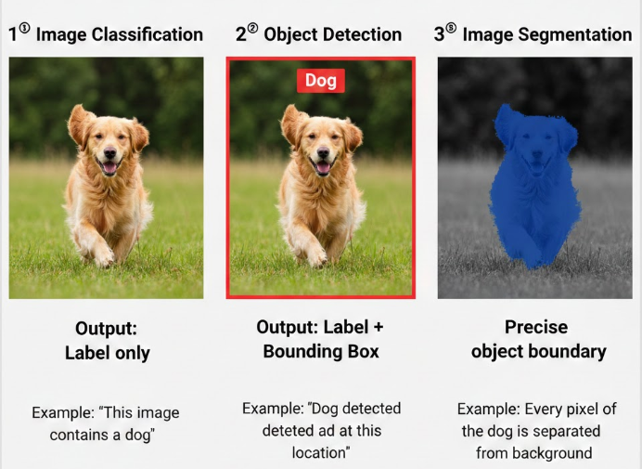
What is Real-Time Object Detection?
Real-Time Object Detection is a computer vision technique that identifies, classifies, and locates objects in images or video streams instantly as the data is captured. It not only detects what the object is, but also determines where it is by drawing bounding boxes around it — all within milliseconds.
Key Features
Detects multiple objects simultaneously
Works on live video or webcam feed
Provides bounding box + class label
Operates with very low delay (high FPS)
Enables instant decision-making

Slide 4
Evolution of Object Detection Techniques
Object detection has evolved significantly over time to improve accuracy and speed.
1. Sliding Window Approach
Scans the image using fixed-size windows
Classifies each region separately
Very slow and computationally expensive
Inefficient for large images
2. R-CNN
Introduced region proposals instead of scanning image
Used CNN for feature extraction
Improved accuracy significantly
Still slow due to multi-stage pipeline
4. YOLO
Single-stage detector
Processes entire image in one pass
Real-time performance
Efficient and optimized
3. Fast R-CNN
Reduced repeated CNN computations
Used ROI Pooling
Faster than R-CNN

Slide 5
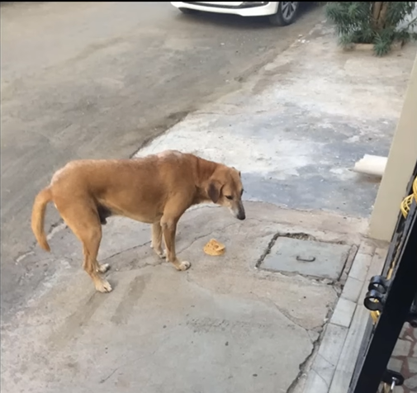
What is YOLO?
YOLO (You Only Look Once) is a deep learning-based real-time object detection algorithm that detects and classifies objects in a single forward pass of a neural network. So let’s see how it does it ?
How Does it work ?
Step 1: Image Classification
Is this a dog or a person ?
Image classification is performed using a Convolutional Neural Network .
The input image is passed through multiple convolutional layers
CNN extracts spatial features (edges, textures, patterns)
Feature maps are generated
Flattening + Fully Connected layers
Softmax layer outputs class probabilities
Highest probability class is selected
Neural Network Output :
Dog=1 Person=0

Slide 6
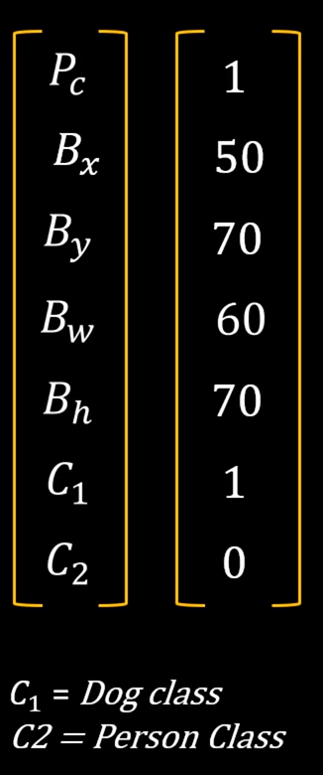
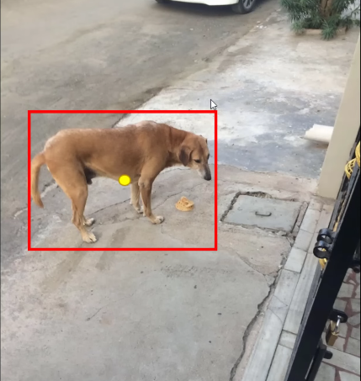
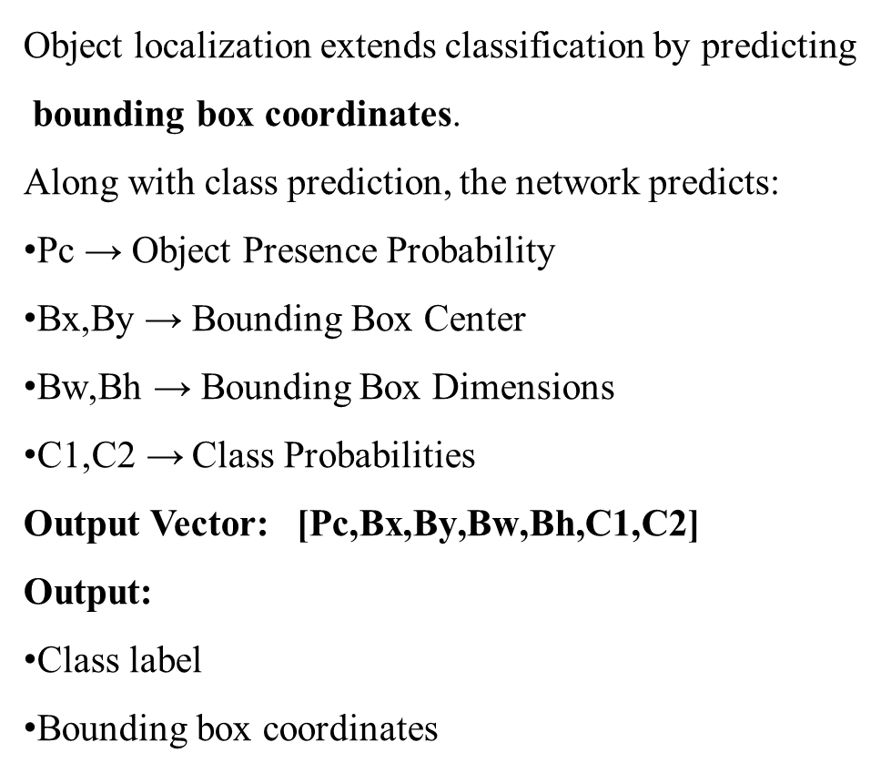
Step 2:Object Localization
Object localization extends classification by predicting
bounding box coordinates.
Along with class prediction, the network predicts:
Pc​ → Object Presence Probability
Bx​,By​ → Bounding Box Center
Bw​,Bh​ → Bounding Box Dimensions
C1​,C2​ → Class Probabilities
Output Vector: $\text{[}\text{Pc}\text{​,}\text{Bx}\text{​,}\text{By}\text{​,}\text{Bw}\text{​,}\text{Bh}\text{​,}\text{C}\text{1​,}\text{C}\text{2​]}$
Output:
Class label
Bounding box coordinates
Where is the dog in this image?
Output
Neural Network : Output
Dog=1 Person=0
+
Bounding Box

Slide 7
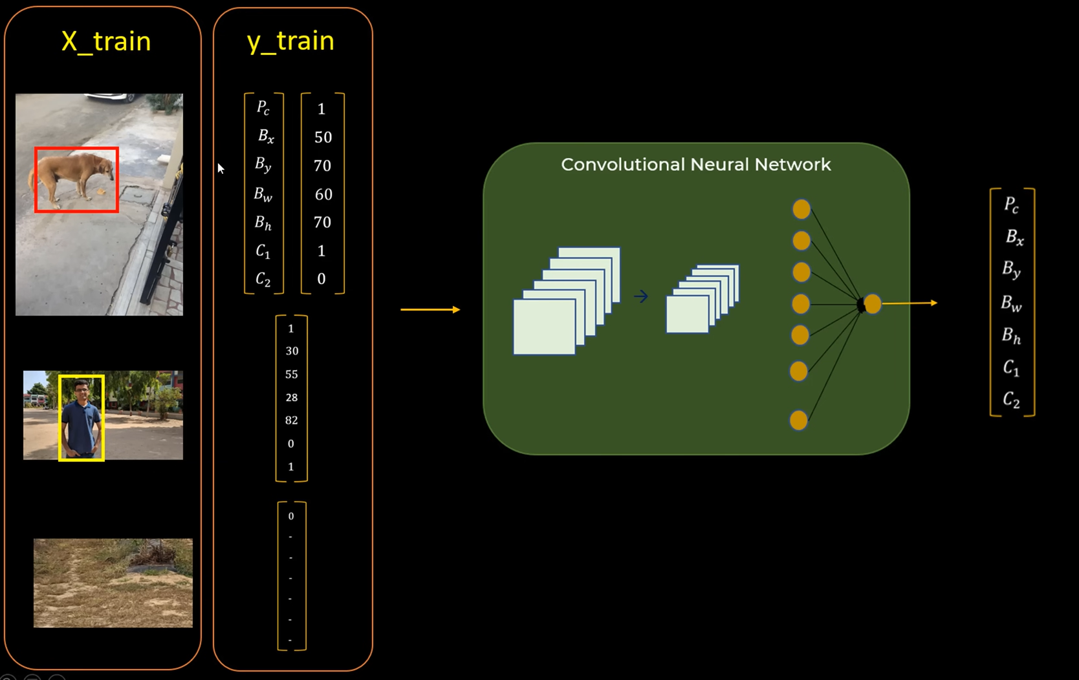
How does YOLO combine them ?
YOLO predicts:
Class probabilities
Bounding box coordinates
Confidence score
All in a single forward pass of the network.
That’s why it performs classification + localization simultaneously.

Slide 8
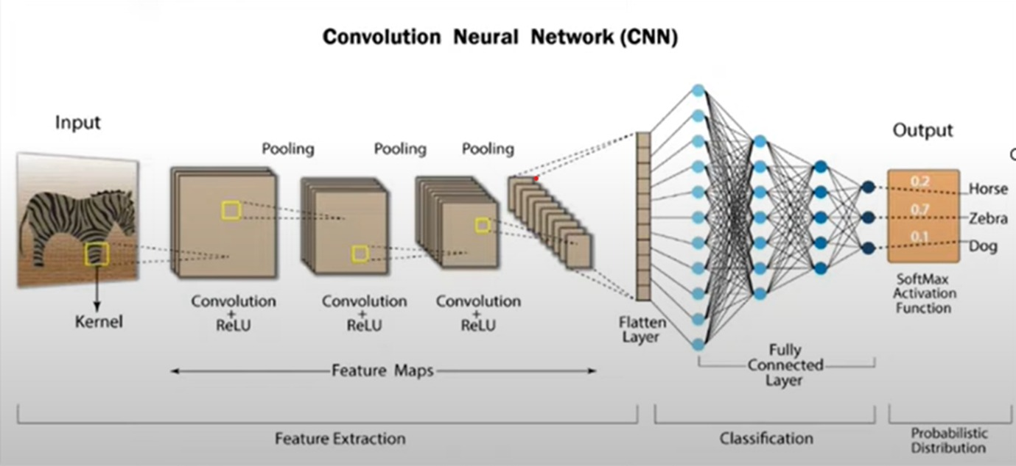
What is CNN (Convolutional Neural Network)?
Convolutional Neural Network (CNN) is an advanced version of artificial neural networks (ANNs), primarily designed to extract features from grid-like matrix datasets.

Slide 9
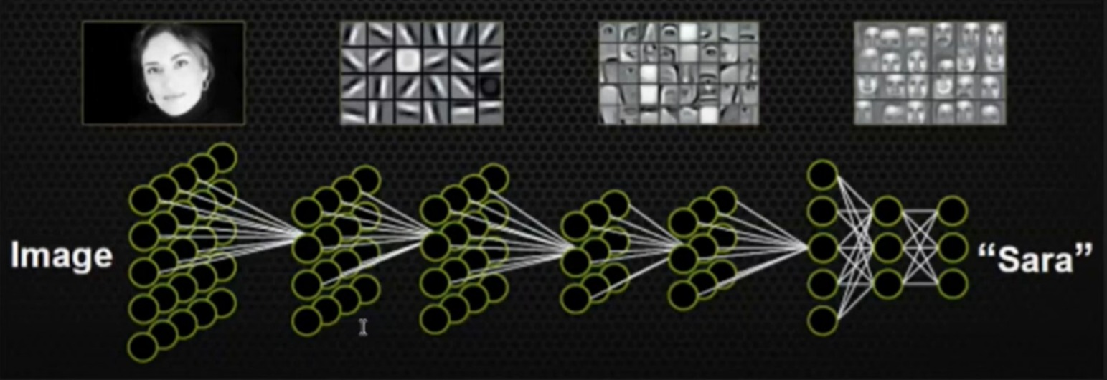
How CNN Works
1. Convolution Layer – Detects local patterns
3. Pooling Layer – Down samples feature maps
4. Fully Connected Layer – Makes final predictions
5. Output – Classification, segmentation, or image correction
Example Use: Detecting and correcting noise in infrared images (e.g military target tracking or medical imaging)

Slide 10
APPLICATIONS OF YOLO
🚗 1. Autonomous Vehicles
Detects pedestrians, vehicles, traffic signs
Enables real-time decision making
Improves road safety
📹 2. Surveillance & Security
CCTV monitoring
Intrusion detection
Suspicious activity tracking
🚦 3. Traffic Monitoring
Vehicle counting
Speed estimation
Congestion analysis
🛍 4. Retail & Inventory Management
Product detection
Customer behaviour analysis
Automated billing systems

Slide 11
THANK YOU

