Slide 1
ShuttleRunner

Slide 2
Tools
Platform : M.S Visual studio 2013 and Microsoft XNA is a set of tools with a managed Runtime Environment provided by Microsoft that facilitates game development and management.
Language : C#

Slide 3
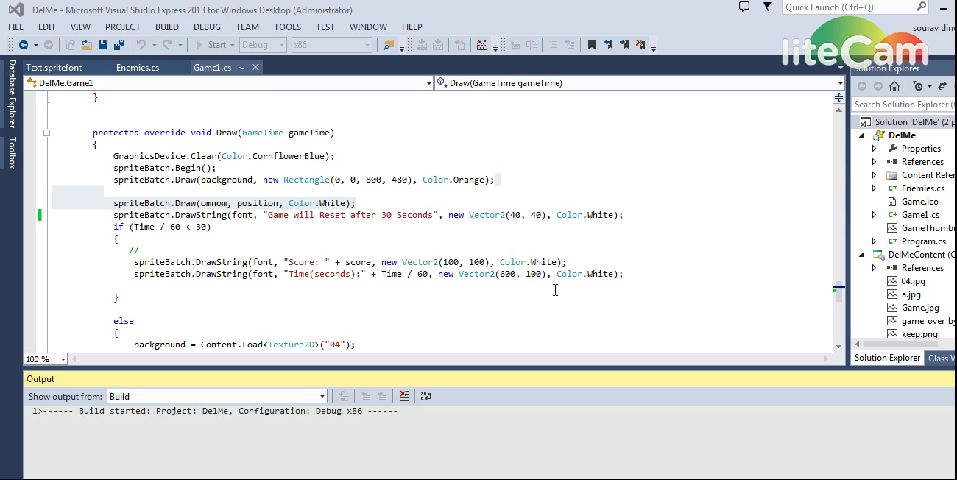

Slide 4
Instructions to Play ShuttleRunner
Control the Shuttle with ArrowKeys
Collide the Shuttle with BlueArrows to Score High
Some Blue Arrows Contains Energy but not All
More the Collision more the score

Slide 5
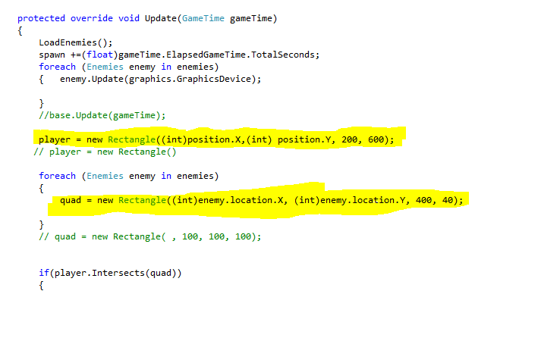
Collision Code
Text box

Slide 6
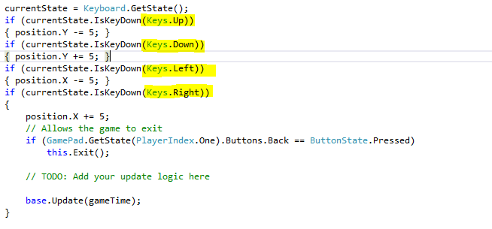
Code to Control Shuttle

Slide 7
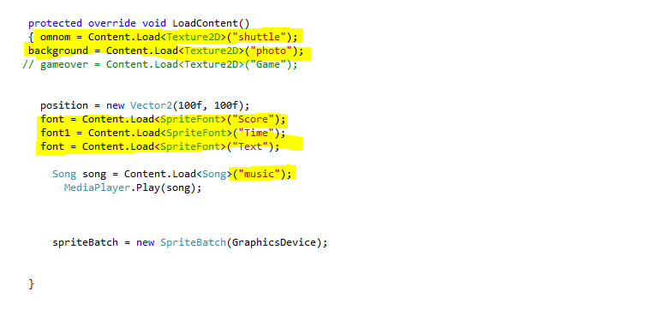
Code to load Background

Slide 8
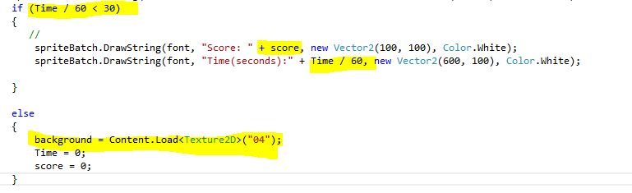
Code To Reset Game

