Slide 1



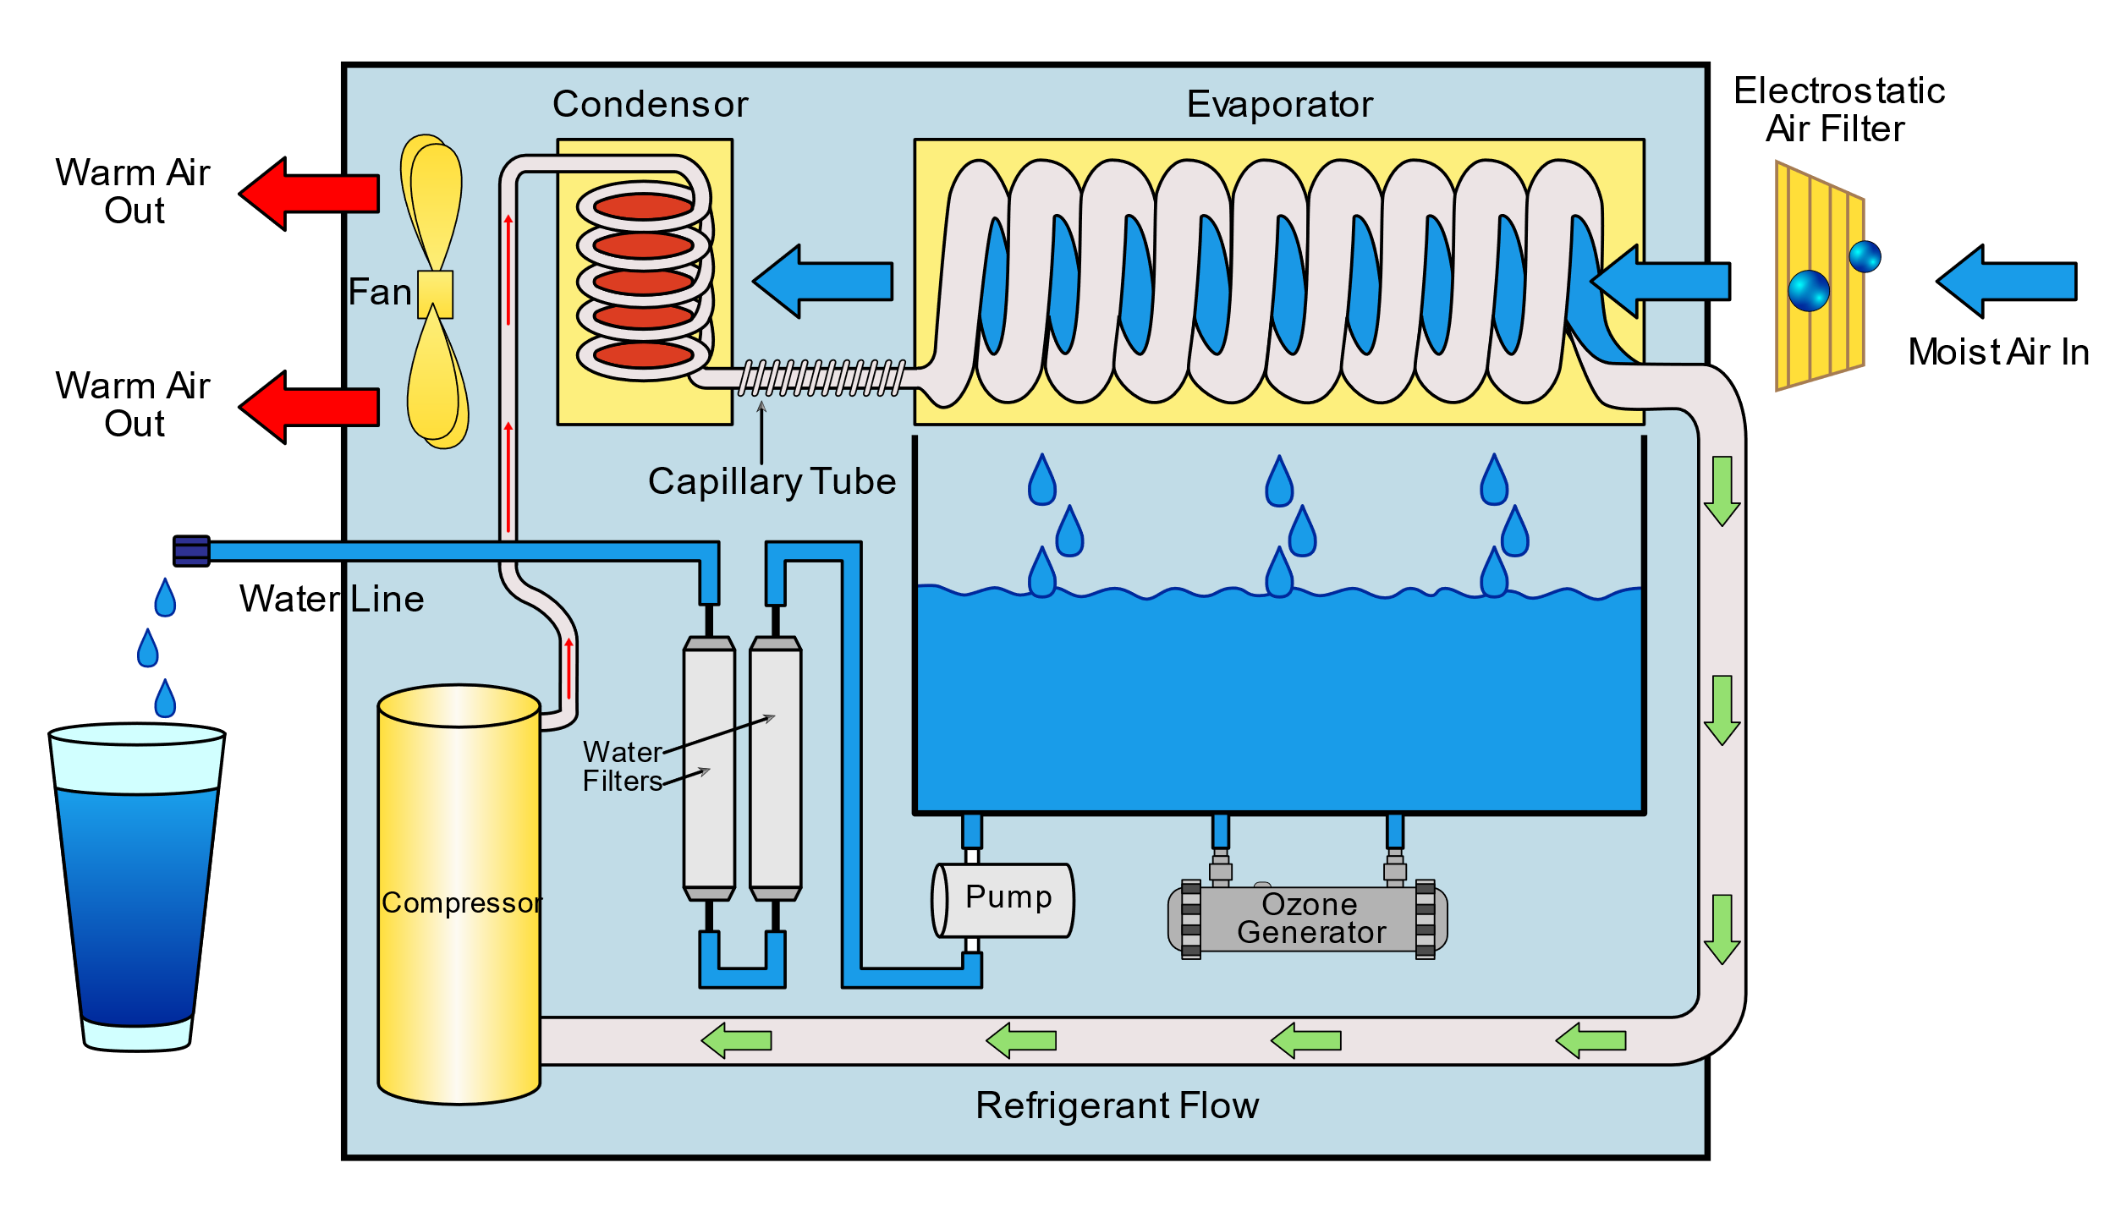
WATER GENERATION FROM AIR USING RENEWABLE ENERGY
Ministry: Ministry of Jal Shakti
PS Code:SIH1328
Problem Statement Title: Call for cost-effective ways of making water source for piped drinking water supply sustainable in Rural areas
Team Name : BLUE EARTHERS
Team Leader Name : RAJDEEP SARKAR
Institute Code (AISHE):U-0584
Institute Name:INDIAN INSTITUTE OF ENGINEERING SCIENCE SND TECHNOLOGY,SHIBPUR
Theme Name: RENEWABLE AND SUSTAINABLE ENERGY

Slide 2
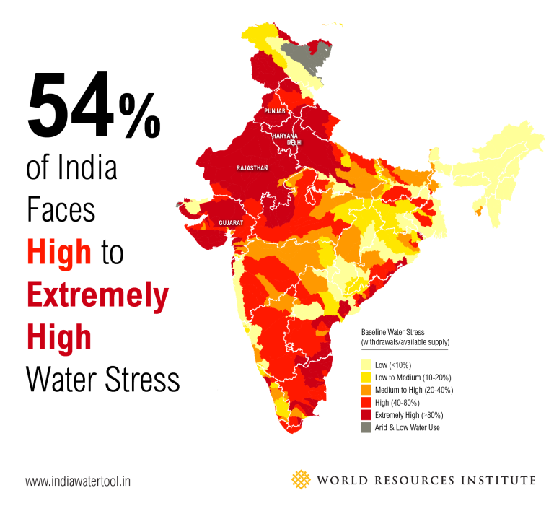
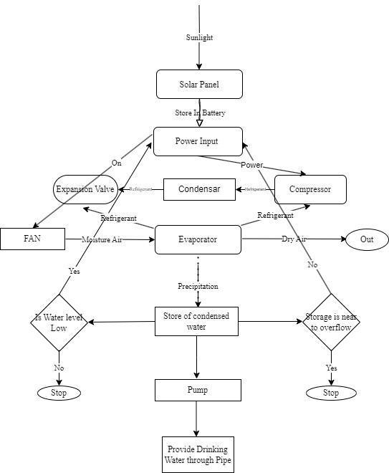
Our aim:-
Flow chart of the process :-
Our aim is to provide drinking water to those areas where the ground water level is very low .
OUR AIR TO WATER GENERATING DEVICE :-
We are building an cost effective air to water generating device
The model consists 3 parts
Power- Solar power with Battery backup.
AWG- moisture gets converted into potable water using numerous electronic components like fan, evaporator,compressor,condenser, expansion valve, UV ray and RO system .
Automation- This part is designed to check the water level with SONAR sensor and make it automated with the help of aurdino and track data into cloud-database.

Slide 3
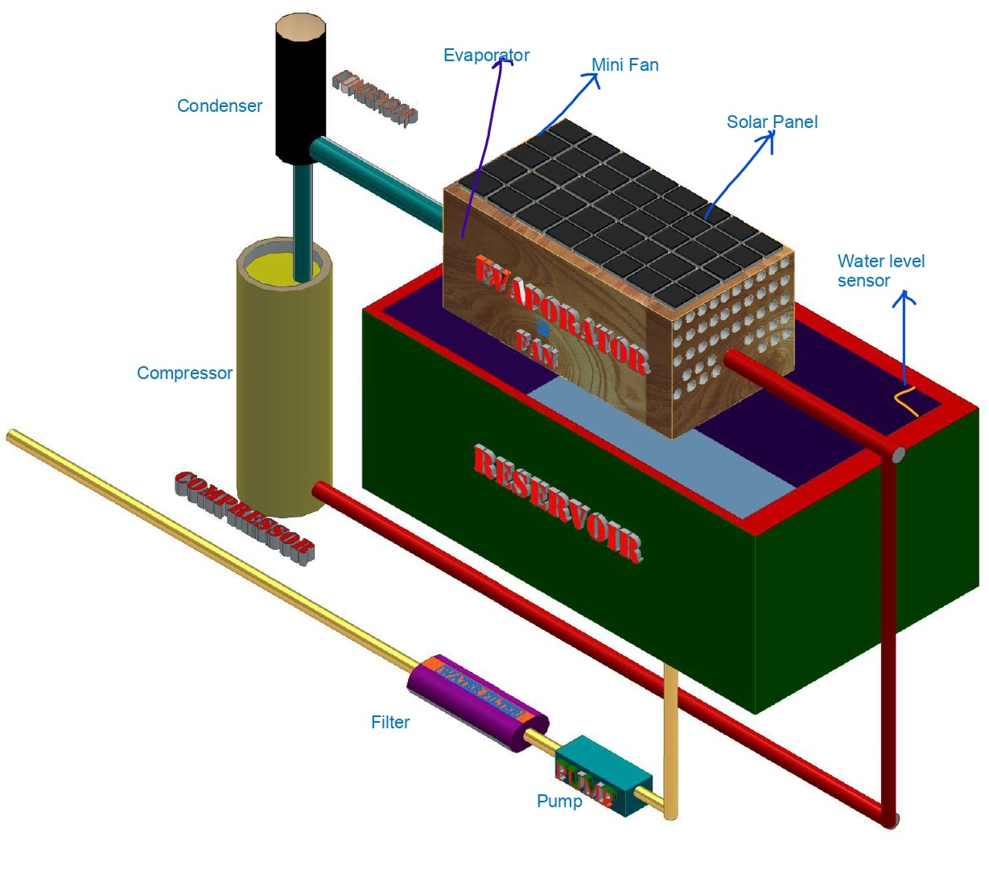

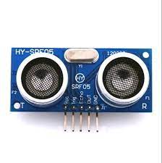


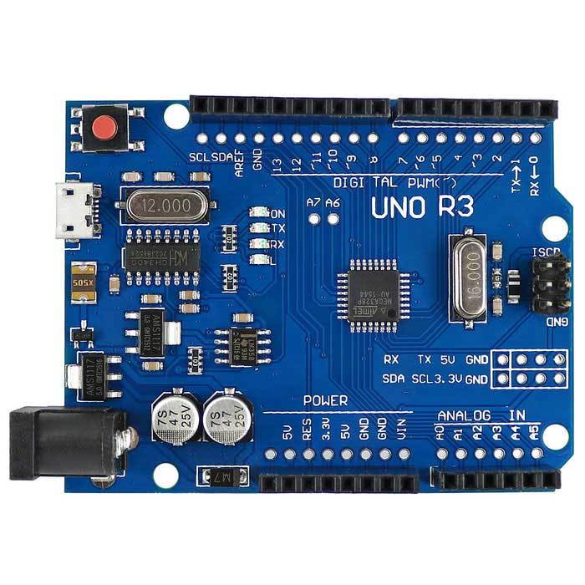
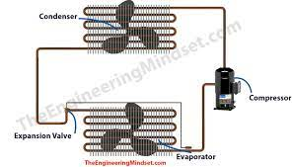
Prototype Basic Design with SolidWorks
Key Features :
Sustainable energy based and Eco-friendly
Maximum wastage water 10%
Zero running cost and maintaining cost
Automation with AI
Track functional data and store in cloud
One time investment continuous
Use Cases :
Sustainable energy based automated cost effective drinking water generation and supply.
Highly effective in the areas with low level of ground water.
Works as alternative source of drinking water in this modern era.
Highly effective in the areas having considerable amount of arsenic.
Commercial Use :
Hardware & Technology stack :
Manufacturing cost is 15000-25000 INR for 10L water generation.
This can be marketed in B2B as well as in B2C form.
Targeted to the companies that deal with lots of amount of ground water such as Coca -Cola; Food companies; Health drink companies; Bisleri.
Also can be marketed in the areas with very low ground water level for domestic purpose.
Wifi Aurdino & SONAR sensor
Solar Panel (Sustainable Energy)
AI, MySQL, SolidWorks
Motor, Compressor, Evaporator, capillary tube,condensor
Battery Backup, Variable Adapter, Dual Power Source

Slide 4
TEAM MEMBER DETAILS:-
Team Leader Name: RAJDEEP SARKAR
Branch : B.TECH Stream : MECHANICAL ENGINEERING Year : II
Team Member 1: ANISH BELEL
Branch : B.TECH Stream : ELECTRONICS AND TELECOMUNICATION ENGINEERING Year : II
Team Member 2 : DIBYA JYOTI DAS
Branch : B.TECH Stream :MECHANICAL ENGINEERING Year: II
Team Member 3 : DEBOLINA DAS
Branch : B.TECH Stream: MECHANICAL ENGINEERING Year : II
Team Member 4 : ANIRUDDHA CHANDRA
Branch : B.TECH Stream : ELECTRONICS AND TELECOMUNICATION ENGINEERING Year : II
Team Member 5 Name: SOURAV DEBNATH
Branch : B.TECH Stream : ELECTRICAL ENGINEERING Year : II
Team Mentor 1 Name: Type Your Name Here
Category (Academic/Industry): Expertise (AI/ML/Blockchain etc): Domain Experience (in years):
Team Mentor 2 Name: Type Your Name Here
Category (Academic/Industry): Expertise (AI/ML/Blockchain etc): Domain Experience (in years):

