Slide 1
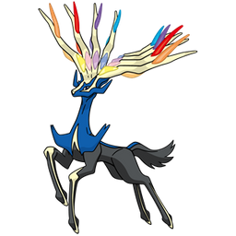
Team Xerneas
Topic:
Jogging with friends
Presenter:
Sourav Das
Members:
Sourav Das
Rahil Dhanwani
Hongjing Bian
Junjie Shao
Special Thanks To Our TA:
Jaber Rad

Slide 2
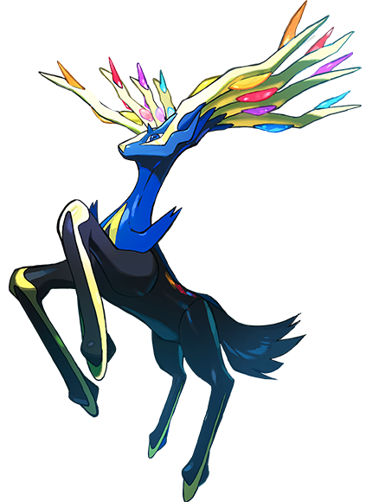
Milestone 1
Activities
User research
Tasks, personas & scenarios
Sketches & Storyboards
Low-fidelity prototype
Walkthrough & feedback
Outcomes
8 unique resources on users
4 tasks, personas & scenarios
8+8 sketches & 4 storyboards
Balsamiq low-fidelity prototype

Slide 3
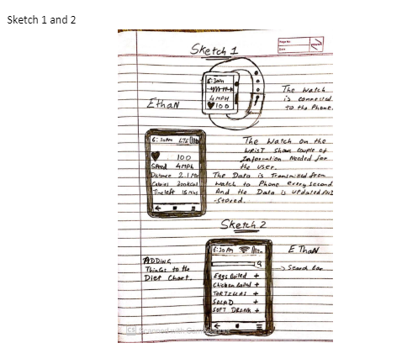
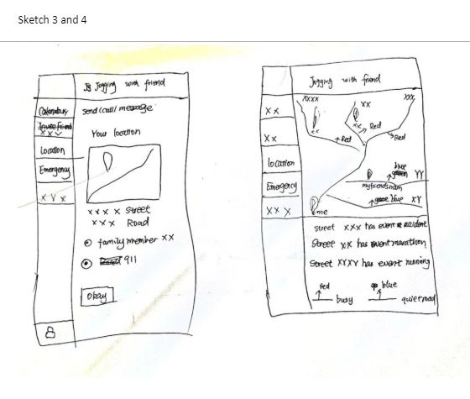
Connecting watch, jogging statistics and diet plan
Calling and texting in emergency, and tracking free or best routes

Slide 4
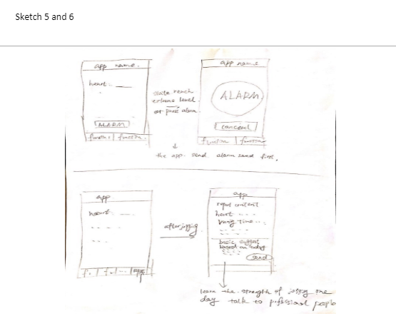
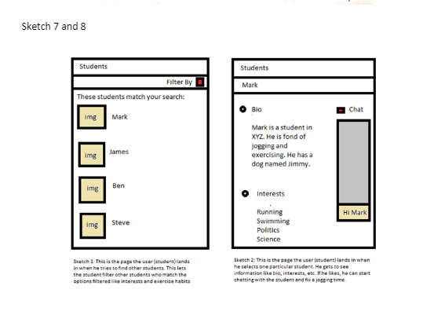
Creating an alarm system to alert the partner and getting the report at the end of jogging session
List of profiles and individual profile

Slide 5
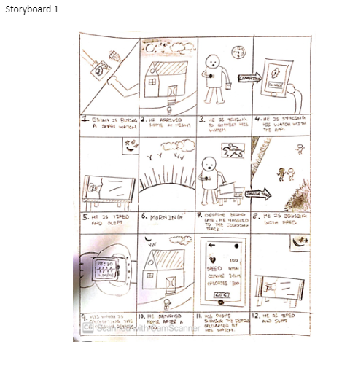
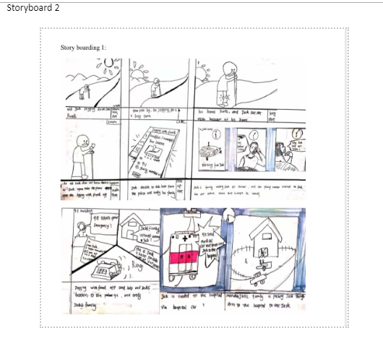
Person with a smart watch
An old person who got lost while jogging

Slide 6
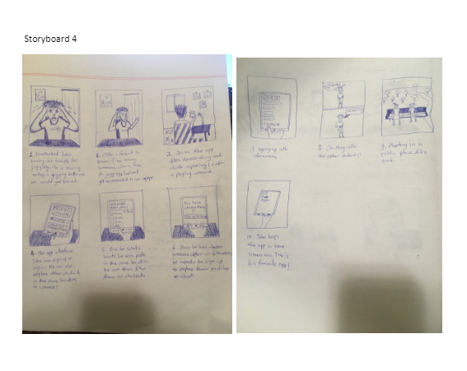
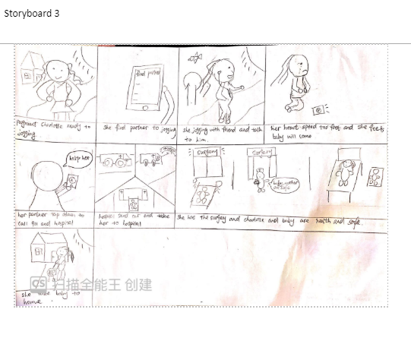
A pregnant woman who is in pain
A frustrated lonely student

Slide 7

Milestone 1
Benefits
Targeting the proper user base
Avoiding mistake in actual prototype
Visualizing ideal situations
Customizing the app design for those
Improving the prototype for milestone 2
Difficulties
- not too many good resources
- not having previous experience of sketching & storyboarding
- sketches were not very good and clear
- lack of enough feedback
Different approach
Ask people in real life
More emphasize on details of scenario
More resources to learn sketching and storyboarding
Simpler and clearer sketches

Slide 8
Milestone 2
Activities
- Analyzing feedback from milestone 1
Revised user researches
Revised the scenarios
Revised sketches
Medium-fidelity prototype
Cognitive walkthrough with peers
Prototype revision
Scenario walkthrough with Prof/TA
Outcomes
More user researches
Better tasks and scenarios that suit more users
Made the app more generalized for emergency uses
Transferred the calling and chatting option to third party app
Better navigation options (like going back)

Slide 9
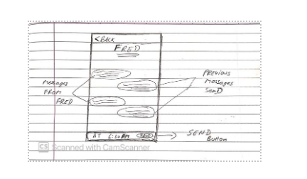
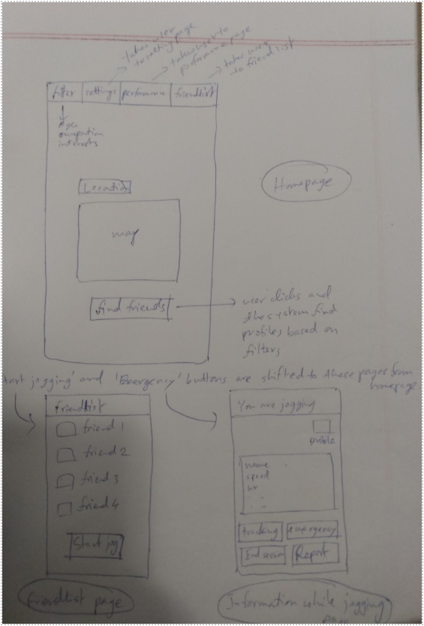
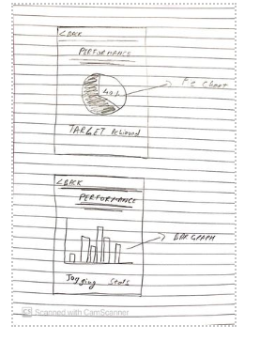
Chat system
Navigation from home, friend list and putting emergency options in the jogging UI
Performance statistics

Slide 10
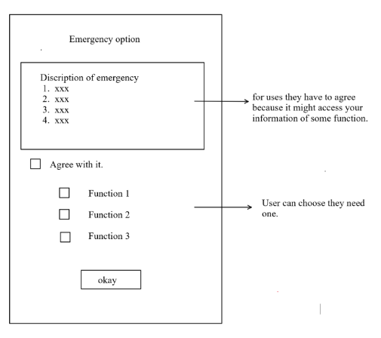
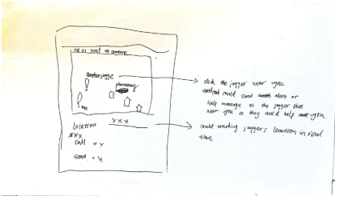
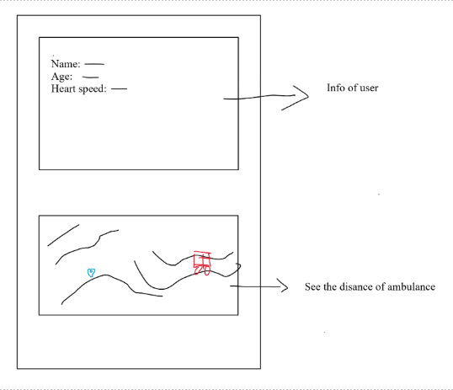
Emergency functions agreement
Calling and messaging transferred to third party app
Sending personal info to hospital and tracking ambulance

Slide 11
Milestone 2
Benefits
Better understanding of the user base
Targeting more types of users
Making the app more usable
Improved and new features
Better UX and UI
Difficulties
Making the app more generalized in emergency scenarios
- lack of good resources for user research
Problem in collaboration
How to connect third party app
-
Different approach
More basic version in the low fidelity and more advanced version in medium fidelity
Using better tool for collaboration and then integrate

Slide 12
Milestone 3
Activities
Analyzing feedback in milestone 2
Final sketching
Revision of the prototype
Graphical screen design
One platform customization
Presentation and demo
Outcomes
Improved sketches
Adding an audio control feature
Added graphical components
Android based app
Better aesthetics
Ready to launch prototype

Slide 13

Milestone 3
Benefits
Better understanding of a launchable prototype
Better understanding of graphics and design elements
Better understanding of basics of android
Difficulties
Lack of feedback
Balsamiq is not good for graphics
Balsamiq is not good for collaboration
Lack of experience in graphics design
Learning android basics
Different approach
More time and emphasize on feedback
Using better platform for collaboration and high-fidelity prototyping
Focusing on ‘one’ platform earlier
Following a methodology (like Agile)

Slide 14
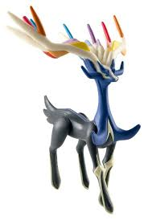
No more sketches!
Let’s jump into the real app…

Slide 15
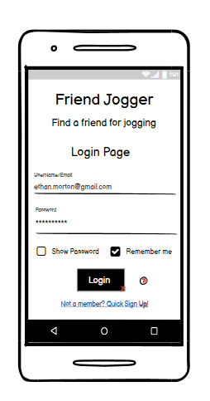
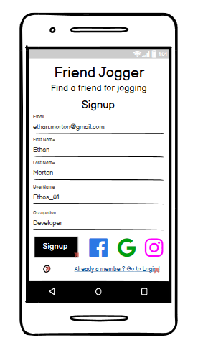

Slide 16
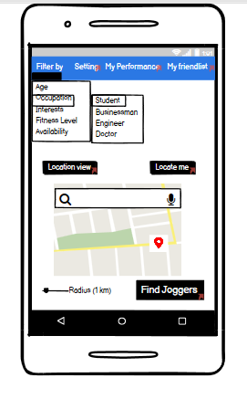

Slide 17
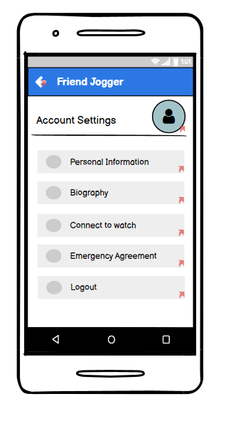
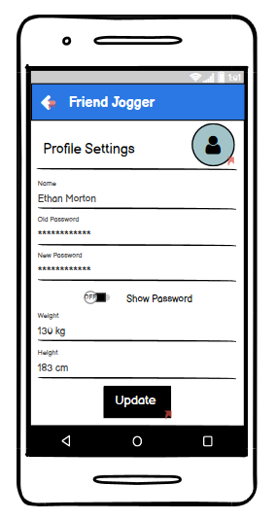
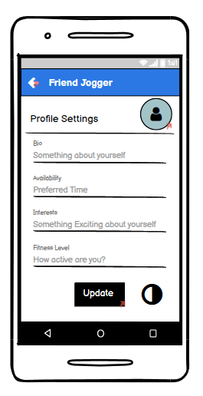
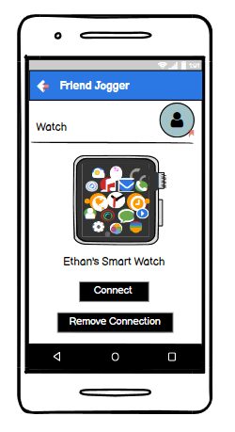

Slide 18
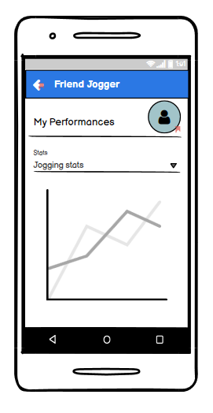
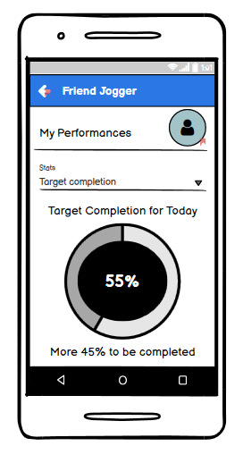
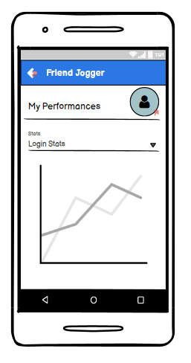

Slide 19
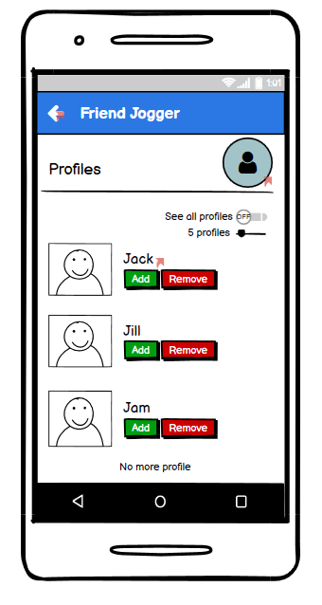
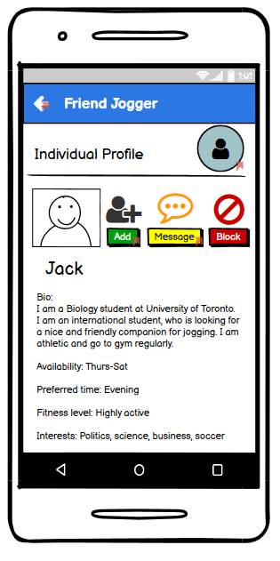
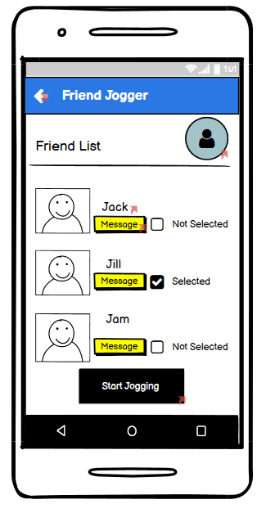
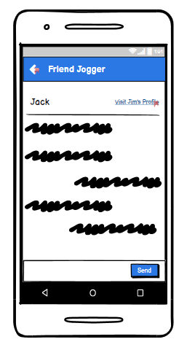

Slide 20
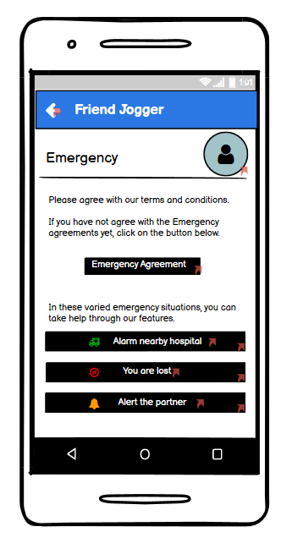
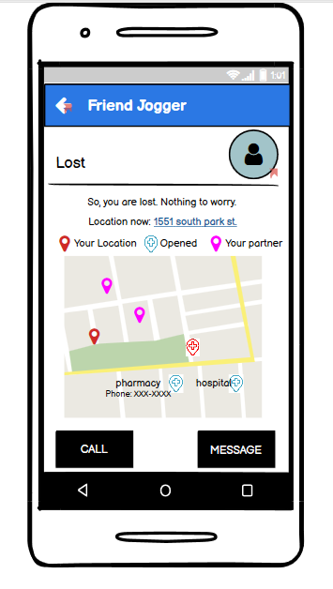
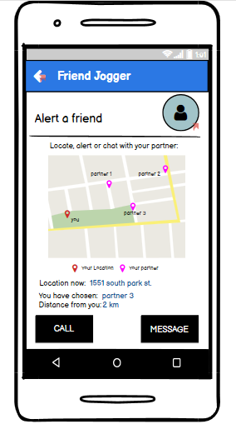

Slide 21
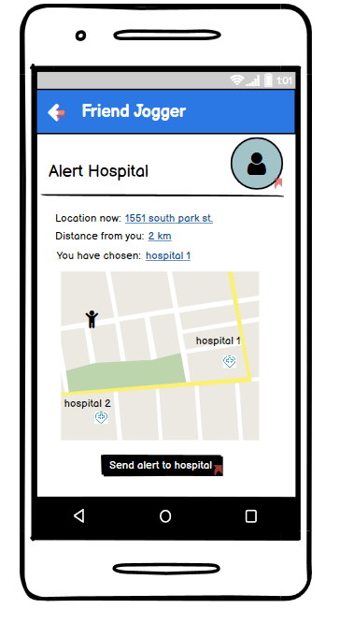
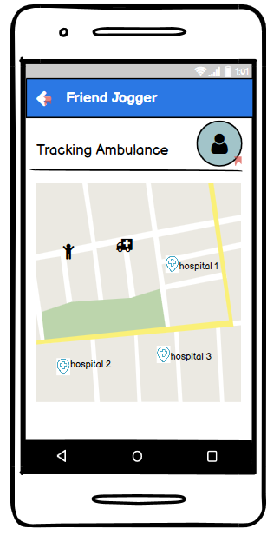

Slide 22
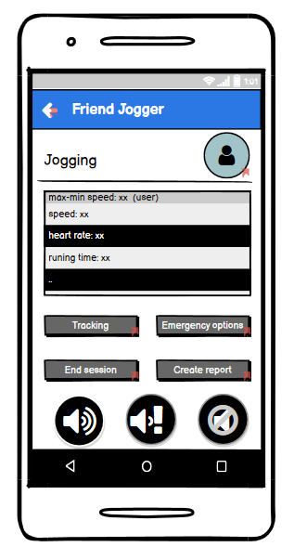
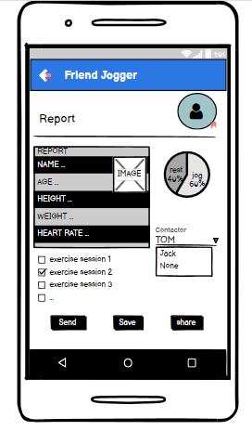

Slide 23
Thank You. Have a wonderful day.

