Slide 1
ANALYSIS OF THE SPREAD OF COVID 19 ACROSS THE WORLD IN 2020:
PREPARED AND DEVELOPED BY –
SOURAV BISWAS
SENIOR DATA ANALYST(JEAN MARTIN SYSTEMS INDIA PVT LTD)

Slide 2
INDEX
Introduction
Problem statement
Source of data
Technical requirements
Data extraction/gathering
Data preparation
Analysis & visualization
Future scope

Slide 3
INTRODUCTION & PROBLEM STATEMENT
Coronavirus disease 2019 (COVID-19) is an infectious disease caused by severe acute respiratory syndrome coronavirus 2 (SARS-CoV-2). The disease was first identified in December 2019 in Wuhan, the capital of China's Hubei province, and has since spread globally, resulting in the ongoing 2019–20 coronavirus pandemic.
To analyze various attributes such as - number of confirmed cases, number of recovered cases, number of deaths in different countries, coming out of a real time data source and represented it through interactive and dynamic data visualization.

Slide 4
SOURCE OF DATA & TECHNICAL REQUIREMENTS
The data has been taken at real time from “The Humanitarian Data Exchange”- https://data.humdata.org/dataset/novel-coronavirus-2019-ncov-cases
Python – 3.7.4
Jupyter Notebook
MS Excel
Sublime Text
Google chrome
Python library used primarily for the visualization – Plotly

Slide 5
DATA EXTRACTION
3 different data have been gathered simultaneously from the main data source –
Data for the recovered cases
Data for the confirmed cases
Data for the death cases
Preprocessing and merging have been done to prepare a single dataframe and make it visualization friendly.

Slide 6
DATA PREPARATION
The most important and critical stage while doing any kind of analysis. 70% -80% of the time is spent on this one. The steps that have been taken care of are as follow –
Importing required libraries
Data gathering and create a single dataframe out of it.
Handling the date and time variable
Preparing the body or the data part of Plotly
Preparing the layout of Plotly
Lastly, visualize the data

Slide 7
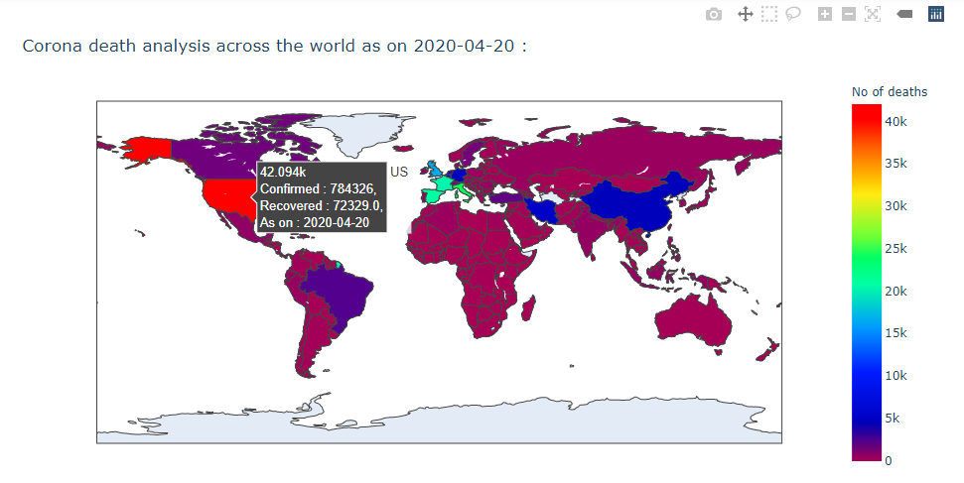
ANALYSIS & VISUALIZATION
This is called Choropleth geo map,- an extension of Plotly. Hovering over the mouse on the countries will portray the data of the corresponding country. The legend shows the number of deaths. The map can be accessed – https://chart-studio.plotly.com/~sourav_jm/22.embed

Slide 8
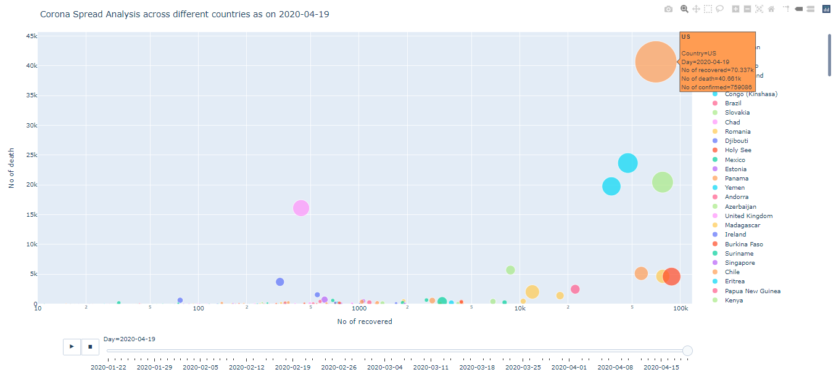
ANALYSIS & VISUALIZATION
This is an animated & dynamic bubble map,- an extension of Plotly. The X axis represents the no of recovered cases and Y axis represents the no of deaths. Size of the bubble denotes the no of confirmed cases. Animation can be paused or resumed based on the 2 buttons below which represent the dates.
Size of the bubble represents the number of confirmed cases.
The X and the Y axis represent the number of recovered and death cases respectively.

Slide 9
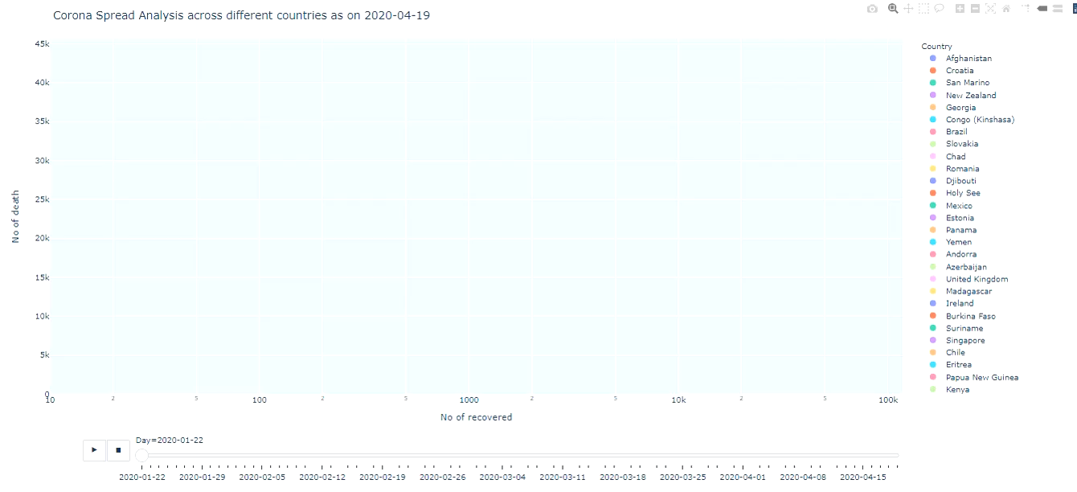
Video – Bubble chart
This is an animated & dynamic bubble map,- an extension of Plotly. The X axis represents the no of recovered cases and Y axis represents the no of deaths. Size of the bubble denotes the no of confirmed cases. Animation can be paused or resumed based on the 2 buttons below which represent the dates.

Slide 10
EMBEDDED OUTPUTS
Double click on the above files to visualize them.

Slide 11
FUTURE SCOPE & CONCLUSION
Data Visualization, Storytelling, Insights generation these are the base of an analysis. This whole process require lot of research in terms of finding a reliable source of data, gathering the data, processing the data and then apply Plotly api onto it.
This is a POC on how to extract data in real time and make interactive and dynamic visualization out of it.
Challenges : Quality of data plays a vital role in any sort of analysis. Hence this project comes out as a successful one. The structure of the recovered data is not correct in few of the cases in comparison with the confirmed and death data. For example, The Lat, Long and the number of rows are same in confirmed and death data but different in the recovered data for Canada as on 20th April,2020. But that is a rare scenario, 95% and above data is coming correct.
Automation : Collecting the data from the source, preprocessing of data such as merging 3 data from 3 sources, handling dates, data labels and axes labels inside the graphs dynamically. Hence no need to modify the internal code to obtain the daily update. One can have it just by running the script.
Conclusion : If the structure and the quality of data is good and includes important information, then meaningful insights and dynamic data visualization can be developed. The domain or business knowledge too plays a significant role.

